Slide 1
CSE 205: Digital Logic Design
Dr. Tanzima Hashem
Associate Professor
CSE, BUET

Slide 2
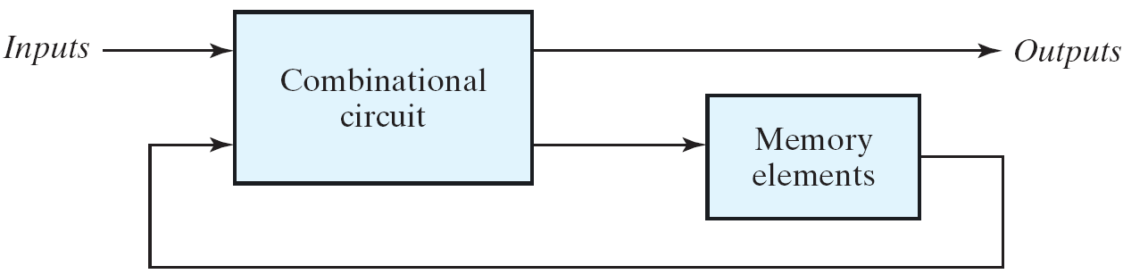
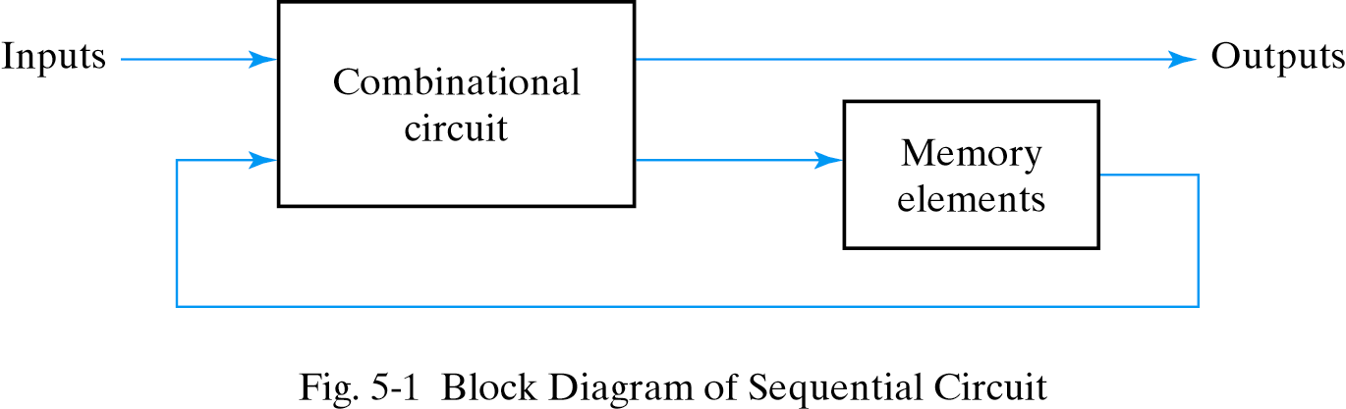
Sequential Circuits
Consist of a combinational circuit to which storage elements are connected to form a feedback path
Specified by a time sequence of inputs, outputs and internal states

Slide 3
Synchronous Sequential Circuit
Synchronous sequential circuits
Synchronized by a periodic train of clock pulses
Much easier to design (preferred design style)

Slide 4
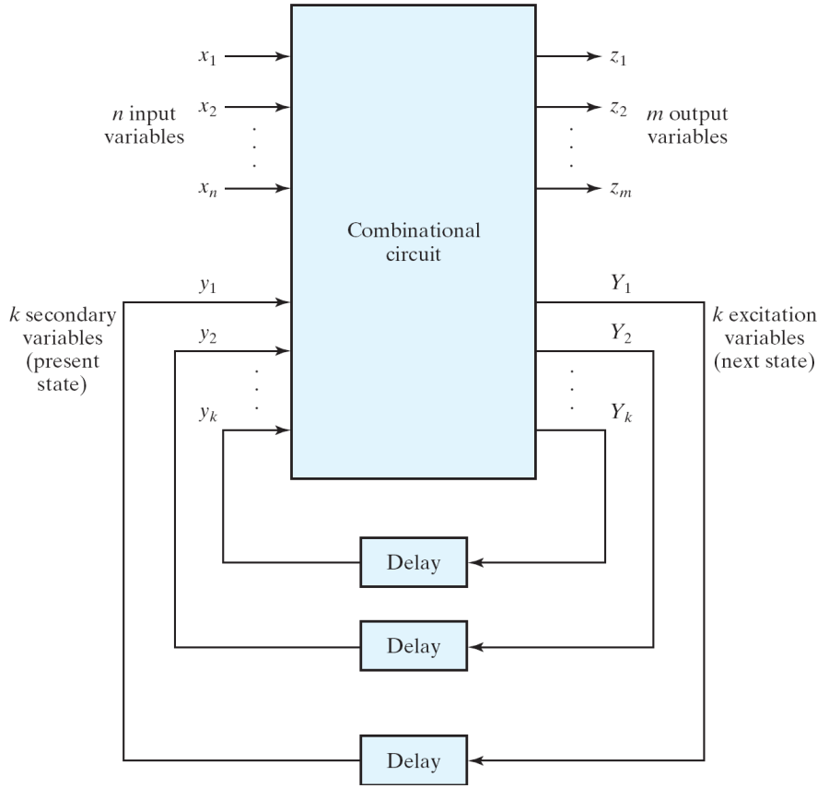
Asynchronous Sequential Circuit
Inputs / Outputs
Delay elements:
Only a short term memory
May not really exist due to original gate delay
Secondary variable:
Current state (small y)
Excitation variable:
Next state (big Y)
Have some delay in response to input changes
Block diagram of an asynchronous sequential circuit

Slide 5
Asynchronous Sequential Circuit
Internal states can change at any instant of time when there is a change in the input variables
No clock signal is required
Have better performance but hard to design due to timing problems
Block diagram of an asynchronous sequential circuit

Slide 6
Why Asynchronous Circuits?
Used when speed of operation is important
Response quickly without waiting for a clock pulse
Used in small independent systems
Only a few components are required
Used when the input signals may change independently of internal clock
Asynchronous in nature
Used in the communication between two units that have their own independent clocks
Must be done in an asynchronous fashion

Slide 7
Operational Mode
Steady-state condition:
Current states and next states are the same
Difference between Y and y will cause a transition
Fundamental mode:
No simultaneous changes of two or more variables
The time between two input changes must be longer than the time it takes the circuit to a stable state
The input signals change one at a time and only when the circuit is in a stable condition

Slide 8
Analysis Procedure Transition Table
Transition table is useful to analyze an asynchronous circuit from the circuit diagram
Procedure to obtain transition table:
1. Determine all feedback loops in the circuits
2. Mark the input (y_{i}) and output (Y_{i}) of each feedback loop
3. Derive the Boolean functions of all Y’s
4. Plot each Y function in a map and combine all maps into one table
5. Circle those values of Y in each square that are equal to the value of y in the same row

Slide 9
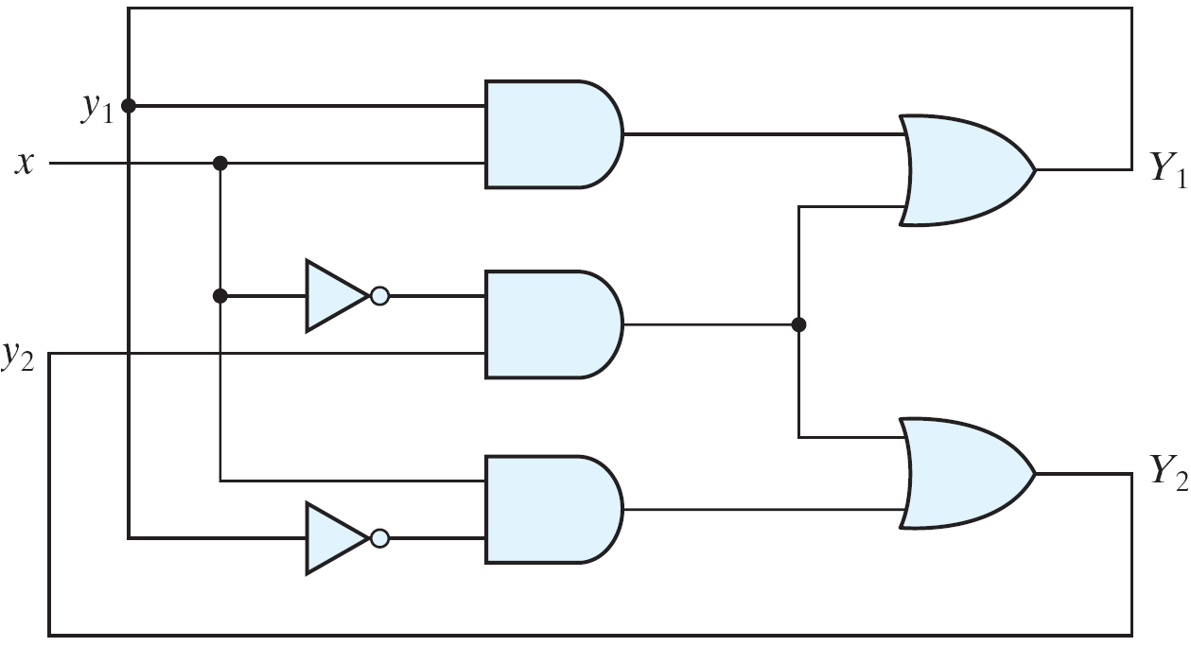
An Example of Transition Table
The excitation variables: Y₁ and Y₂
Y₁ = xy₁+ x'y₂
Y₂ = xy₁' + x'y₂
Fig. 9.2
Example of an asynchronous sequential circuit

Slide 10
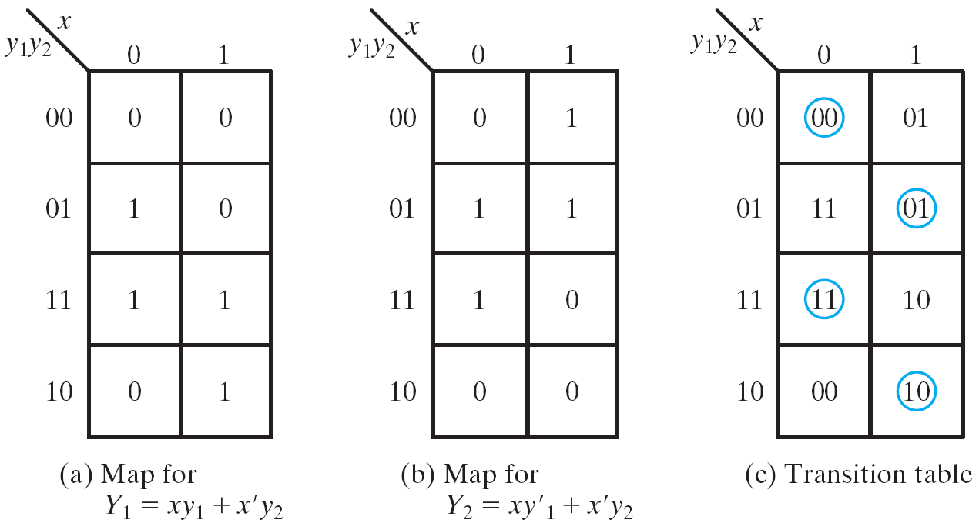
An Example of Transition Table
Maps and transition table
y variables for the rows
External variable for the columns
Circle the stable states
Y = y
Fig. 9.3
Maps and transition table for the circuit of Fig. 9.2

Slide 11
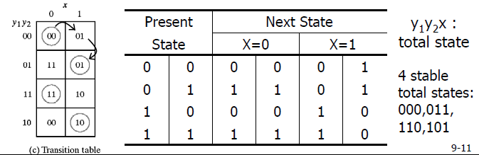
State Table
When input x changes from 0 to 1 while y=00:
Y changes to 01 → unstable
y becomes 01 after a short delay → stable at the second row

Slide 12
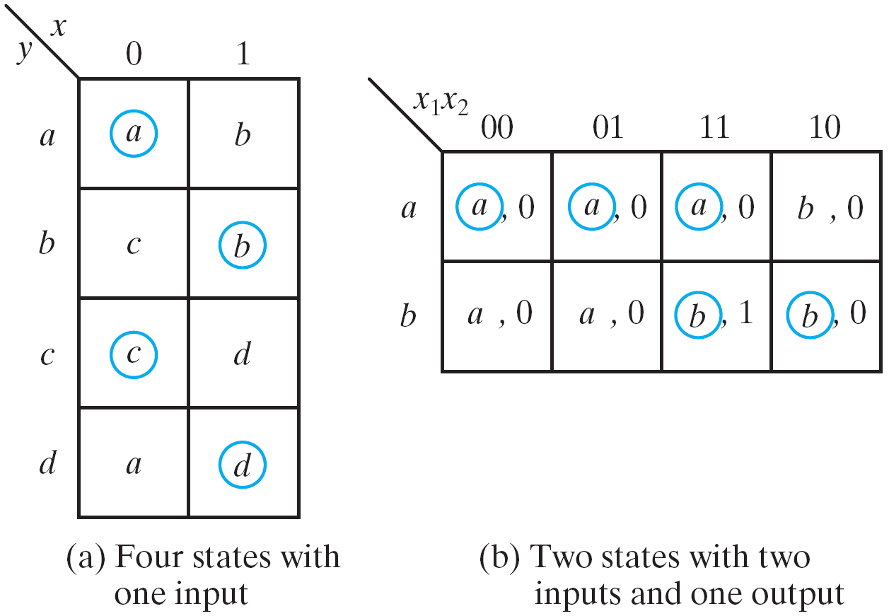
Flow Table
Similar to a transition table except the states are represented by letter symbols
Can also include the output values
Suitable to obtain the logic diagram from it
Primitive flow table:
only one stable state in each row
Equivalent to 9-3(c) if
a=00, b=01, c=11, d=10
Fig. 9.4
Example of flow tables

Slide 13
Flow Table to Circuits
Procedure to obtain circuits from flow table:
Assign to each state a distinct binary value (convert to a transition table)
Obtain circuits from the map
Two difficulties:
The binary state assignment (to avoid race)
The output assigned to the unstable states

Slide 14
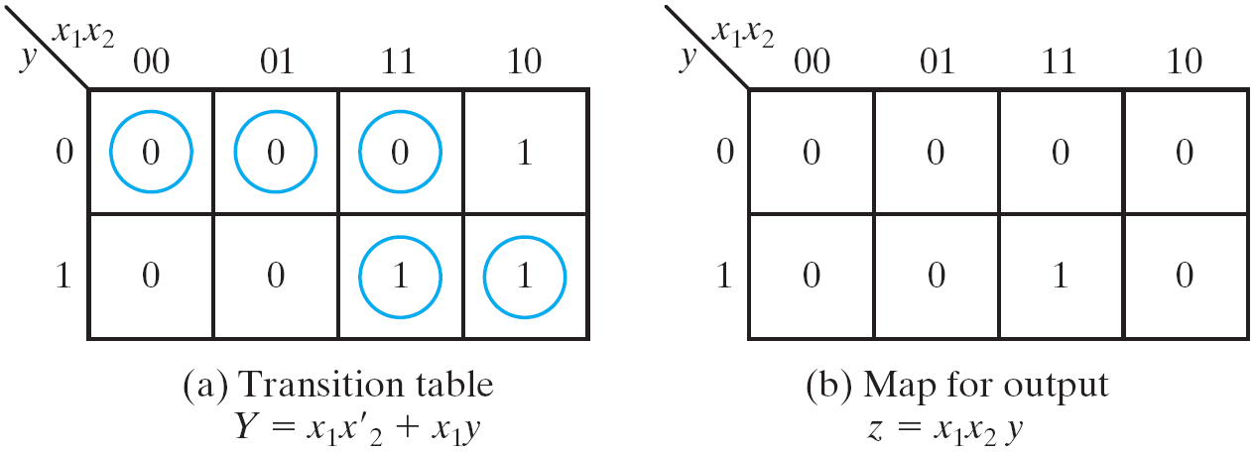
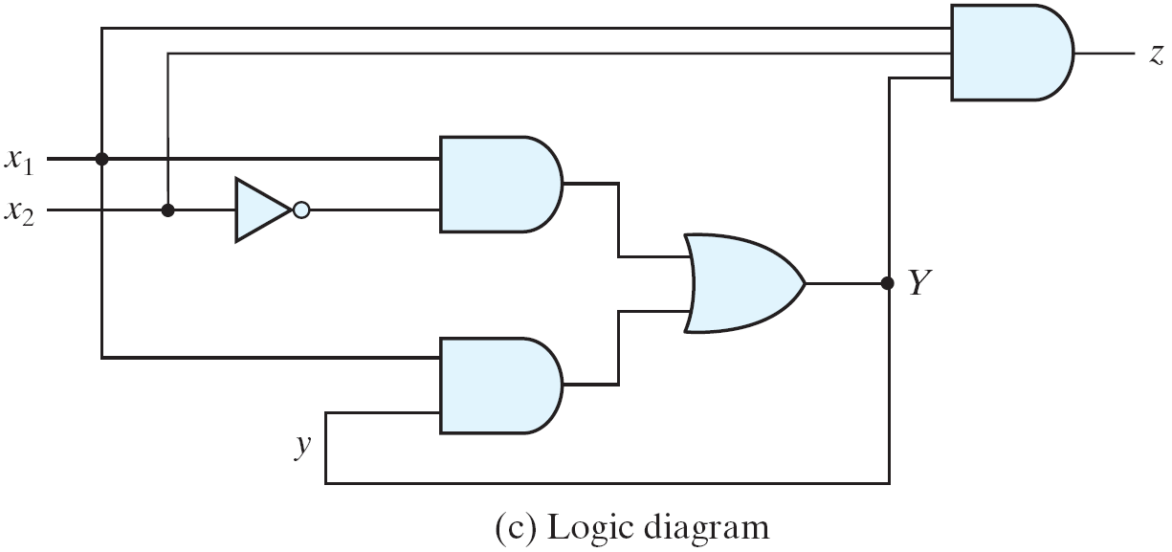
Flow Table to Circuits
Fig. 9.5
Derivation of a circuit specified by the flow table of Fig. 9.4(b)

Slide 15
Race Conditions
Race condition:
two or more binary state variables will change value when one input variable changes
Cannot predict state sequence if unequal delay is encountered
00 → 11
00 → 10 → 11 or 00 → 01 → 11
Non-critical race:
The final stable state does not depend on the change order of state variables
Critical race:
The change order of state variables will result in different stable states
Should be avoided !!

Slide 16
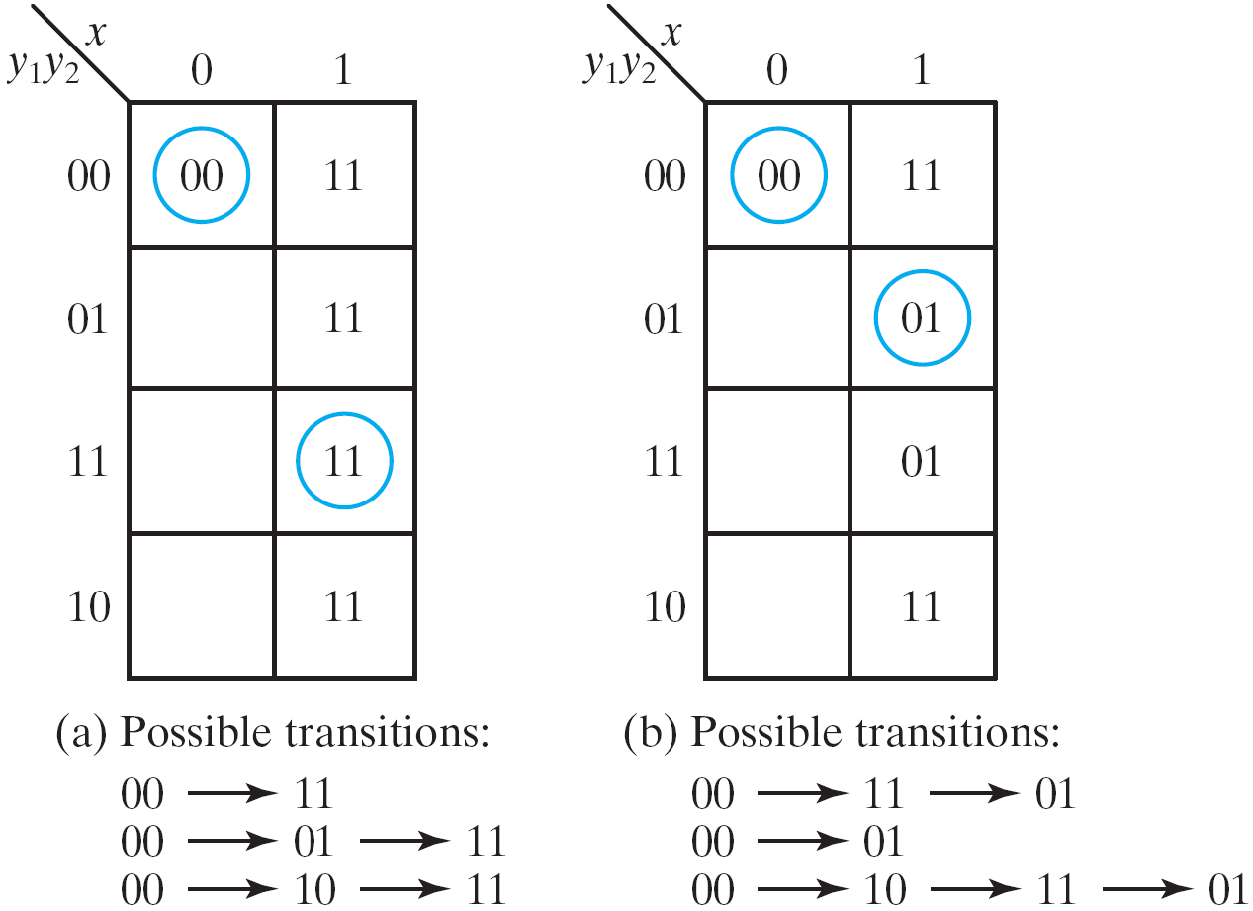
Noncritical Race: Examples

Slide 17
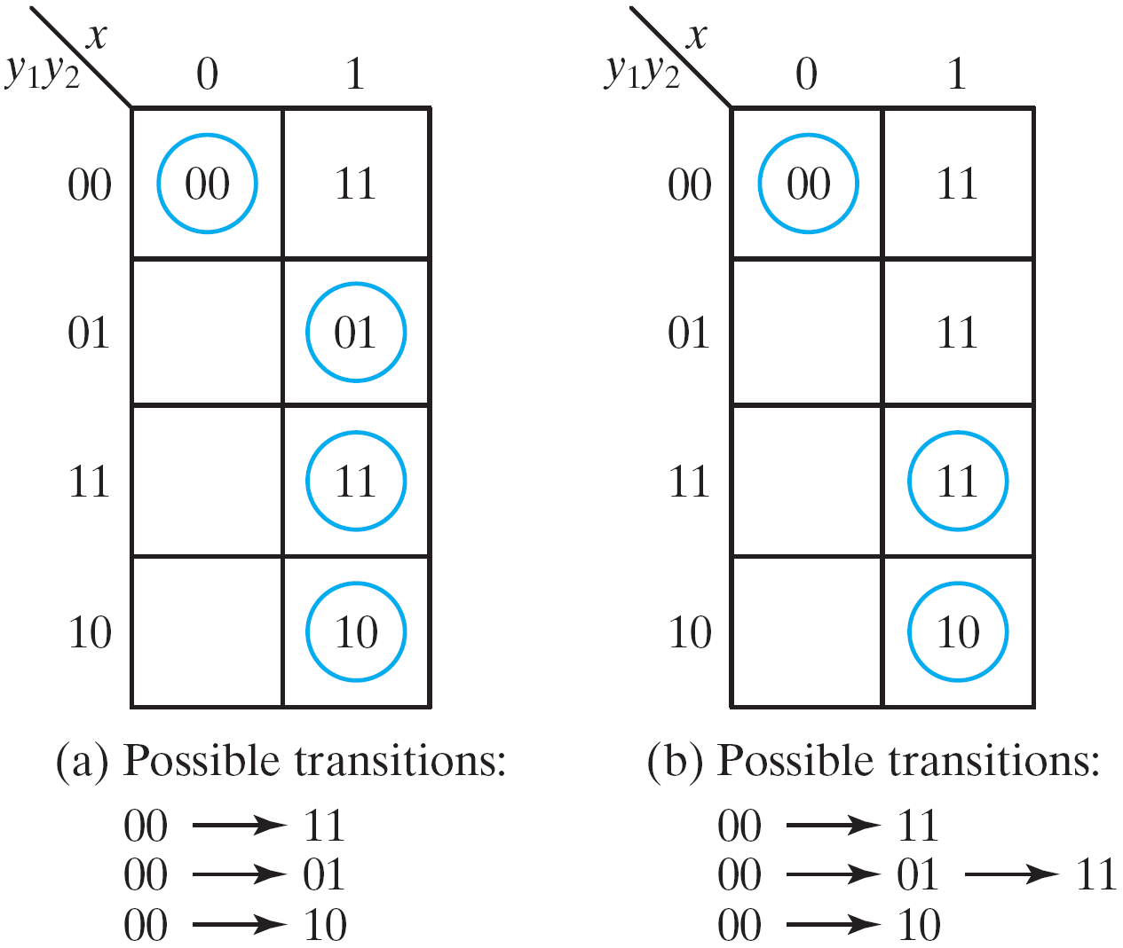
Critical Race: Examples

Slide 18
Race Conditions
Race can be avoided by proper state assignment
Direct the circuit through intermediate unstable states with a unique state-variable change
It is said to have a cycle
Must ensure that a cycle will terminate with a stable state
Otherwise, the circuit will keep going in unstable states

Slide 19
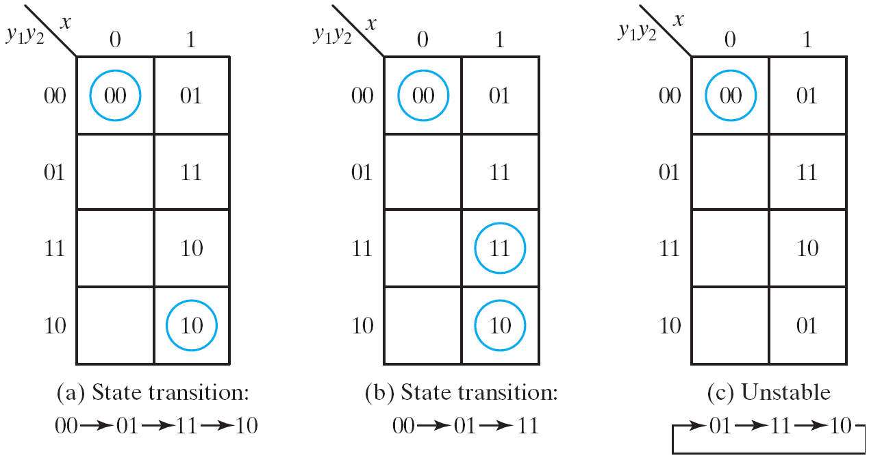
Cycles
A cycle
a unique sequence of unstable states
Fig: Examples of cycles

Slide 20
Stability Check
Asynchronous sequential circuits may oscillate between unstable states due to the feedback
Must check for stability to ensure proper operations
Can be easily checked from the transition table
Any column has no stable states → unstable

Slide 21
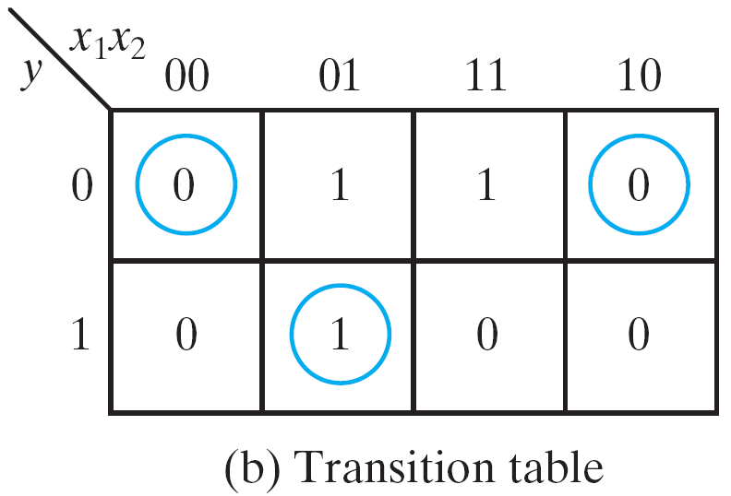
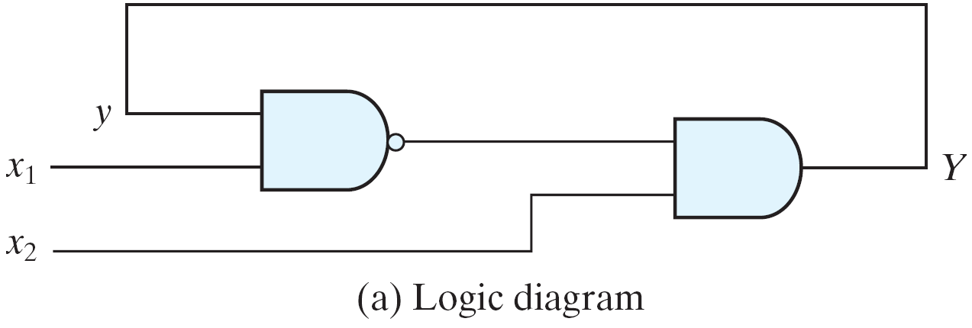
Example of an Unstable Circuit
When x1x2=11 in Fig. 9-9(b), Y and y are never the same
a square waveform generator?
Fig. 9.9: Example of an unstable circuit

Slide 22
Circuits with Latches
The traditional configuration of asynchronous circuits is using one or more feedback loops
No real delay elements
It is more convenient to employ the SR latch as a memory element in asynchronous circuits
Produce an orderly pattern in the logic diagram with the memory elements clearly visible
SR latch is also an asynchronous circuit
Will be analyzed first using the method for asynchronous circuits

Slide 23
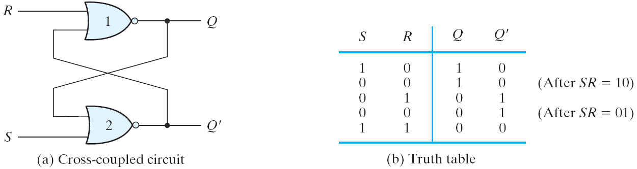
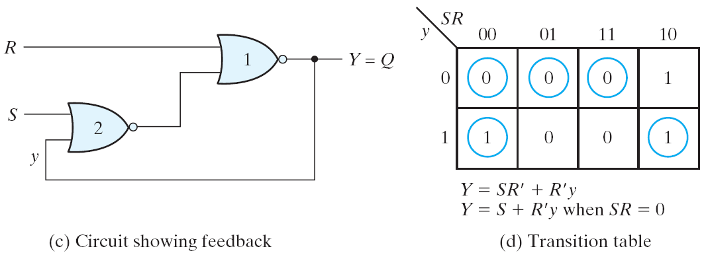
SR Latch with NOR Gates
Fig. 9.10: SR latch with NOR gates

Slide 24
SR Latch with NOR Gates
Y = ((S+y)'+R)' = (S+y)R' = SR'+R'y
An unpredictable result when SR: 11 → 00
SR = 0 in operation
Y = S + R'y when SR = 0

Slide 25
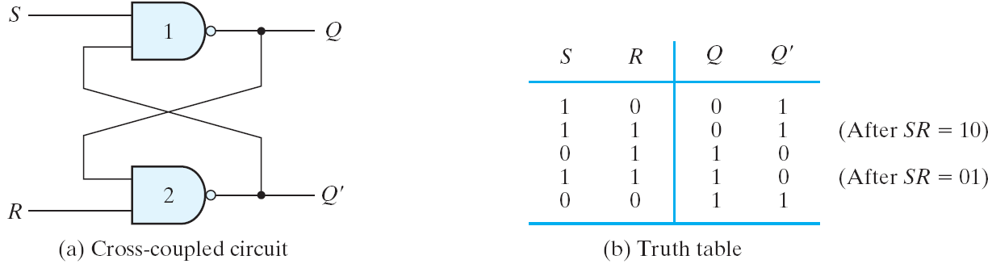
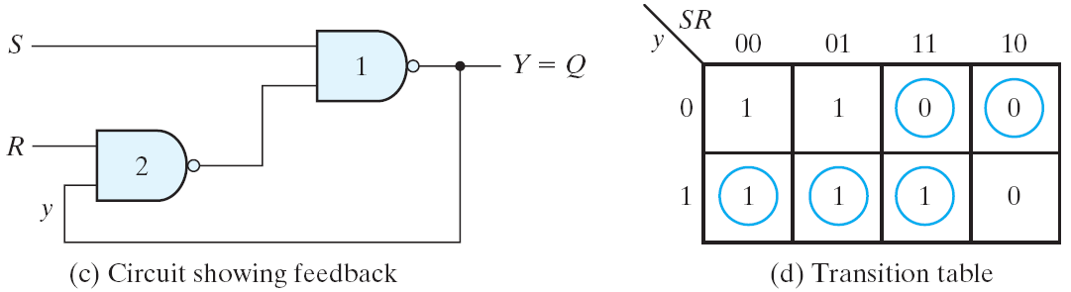
SR Latch with NAND Gates
Fig. 9.11: SR latch with NAND gates

Slide 26
SR Latch with NAND Gates
Two cross-coupled NAND gate
S'R' = 0
Y = (S(Ry)')' = S'+ Ry
S'R' latch

Slide 27
Analysis Procedure
Procedure to analyze an asynchronous sequential circuits with SR latches:
1. Label each latch output with Y_{i} and its external feedback path (if any) with y_{i}
2. Derive the Boolean functions for each S_{i} and R_{i}
3. Check whether SR=0 (NOR latch) or S’R’=0 (NAND latch) is satisfied
4. Evaluate Y=S+R’y (NOR latch) or Y=S’+Ry(NAND latch)
5. Construct the transition table for Y=Y₁Y₂…Y_{k}
6. Circle all stable states where Y=y

Slide 28
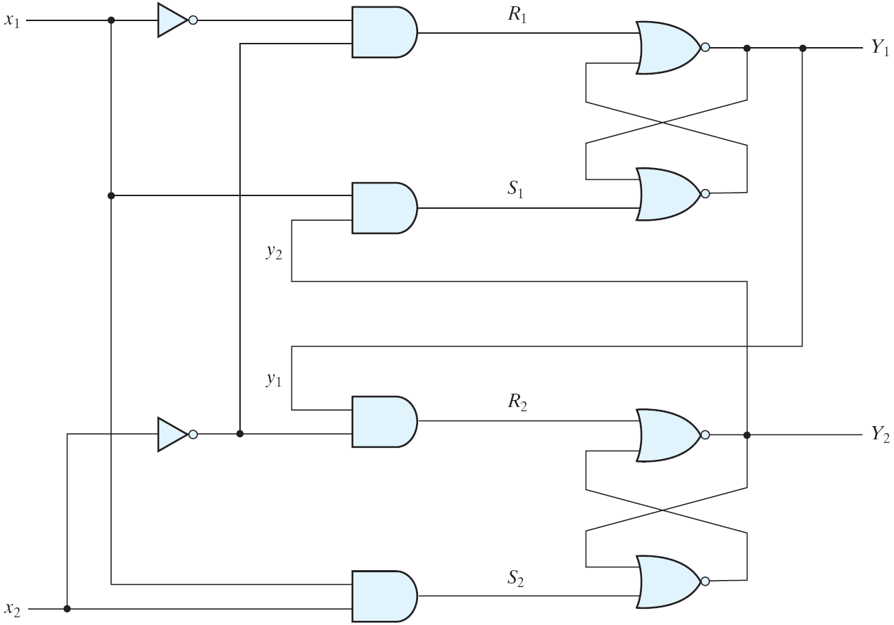
Analysis Example
Fig. 9.12: Examples of a circuit with SR latch

Slide 29
Analysis Example
Label each latch output with Y_{i} and its external feedback path with y_{i}
Derive the Boolean functions for the S_{i} and R_{i}
S₁ = x₁y₂
R₁ = x'₁x'₂
S₂ = x₁x₂
R₂ = x'₂y₁
Check whether SR=0 for each NOR latch or whether S'R'=0 for each NAND latch
S₁R₁ = x₁y₂x'₁x'₂ = 0
S₂R₂ = x₁x₂x'₂y₁ = 0

Slide 30
Analysis Example
Evaluate Y = S +R'y for each NOR latch or Y = S' + Ry for each NAND latch
Y₁ = x₁y₂ + (x₁+x₂)y₁ = x₁y₂+x₁y₁+x₂y₁
Y₂ = x₁x₂ + (x₂+y'₁)y₂ = x₁x₂+x₂y₂+y'₁y₂
Construct the state transition table
Circle all stable states

Slide 31
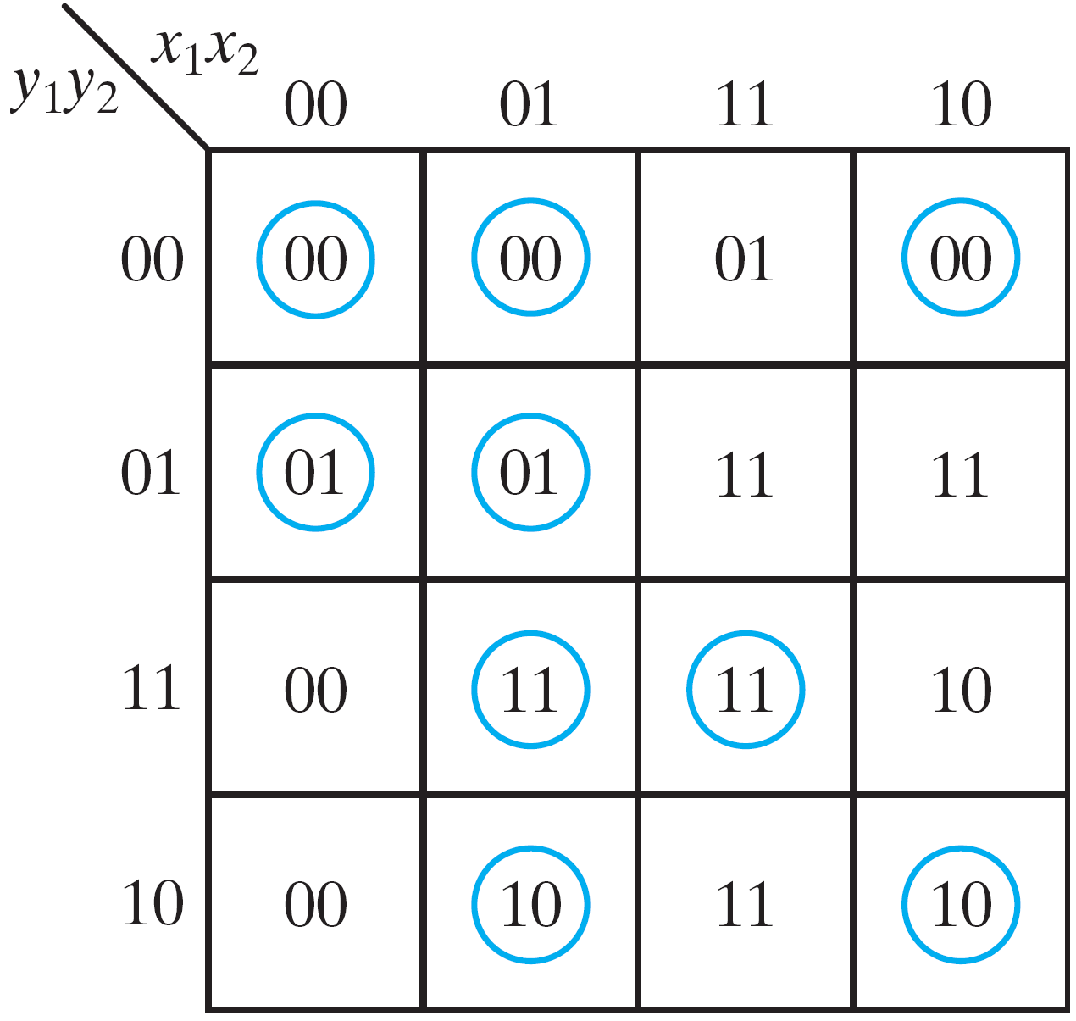
Analysis Example
Race example:
Let initial state is
y₁y₂x₁x₂=1101
input x₂ is changed to 0
if Y₁ change to 0 before Y₂
then y₁y₂x₁x₂=0100
instead of 0000
Fig. 9.13
Transition table for the circuit of Fig. 9.

Slide 32
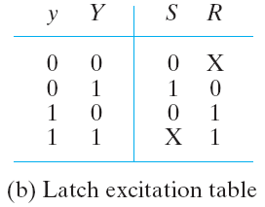
Latch Excitation Table
For SR latch:
0

Slide 33
Implementation Procedure
Procedure to implement an asynchronous sequential circuits with SR latches:
1. Given a transition table that specifies the excitation function Y = Y₁Y₂…Y_{k}, derive a pair of maps for each S_{i} and R_{i} using the latch excitation table
2. Derive the Boolean functions for each S_{i} and R_{i} (do not to make S_{i} and R_{i} equal to 1 in the same minterm square)
3. Draw the logic diagram using k latches together with the gates required to generate the S and R (for NAND latch, use the complemented values in step 2)

Slide 34

Implementation Example
Determine the Boolean functions for the S and R inputs of each latch
Given a transition table
From maps: the simplified Boolean functions are
NOR latch
NAND latch

Slide 35
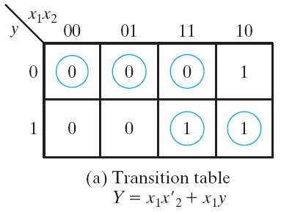
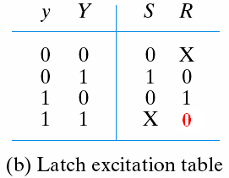
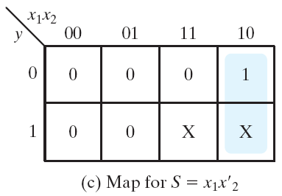
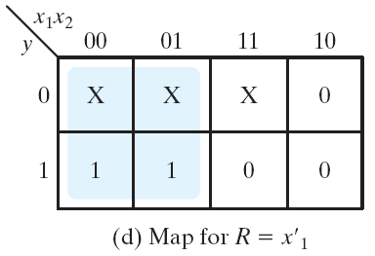
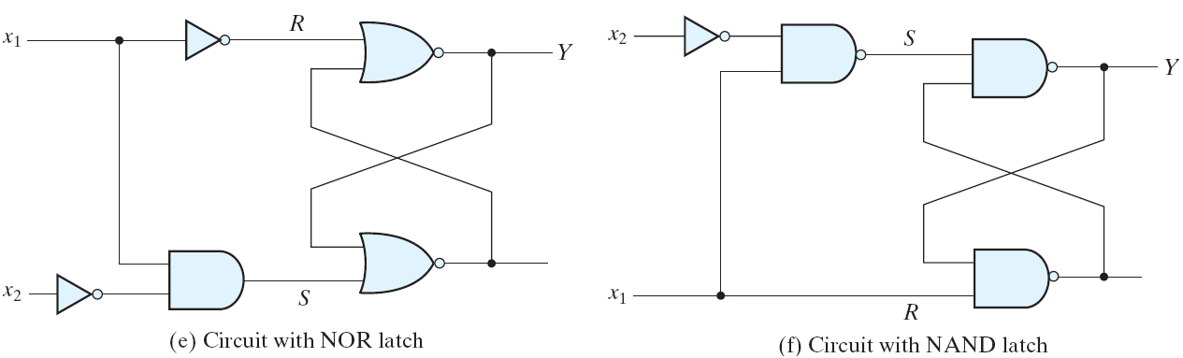
Fig. 9.14
Derivation of a latch circuit from a transition table

Slide 36
Debounce Circuit
Mechanical switches are often used to generate binary signals to a digital circuit
It may vibrate or bounce several times before going to a final rest
Cause the signal to oscillate between 1 and 0

Slide 37
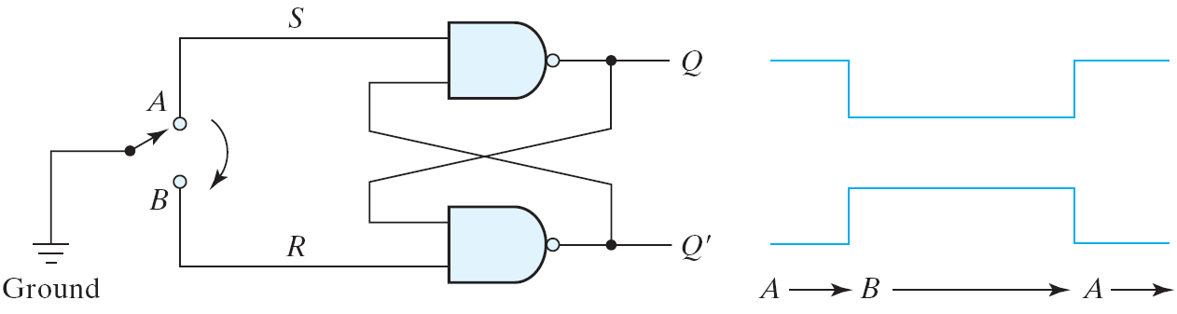
Debounce Circuit
A debounce circuit can remove the series of pulses from a contact bounce and produce a single smooth transition
Position A (SR=01) → bouncing (SR=11)→ Position B (SR=10)
Q = 1 (set) → Q = 1 (no change) → Q = 0 (reset)
Fig. 9.15: Debounce circuit

Slide 38
Design Procedure
Design specifications
(i) Obtain a primitive table from specifications
(ii) Reduce flow table by merging rows in the primitive flow table
(iii) Assign binary state variables to each row of reduced table
(iv) Assign output values to dashes associated with unstable states to obtain the output map
(v) Simplify Boolean functions for excitation and output variables;
(vi) Draw the logic diagram

Slide 39
Design Procedure: Example
Design specifications
a gated latch
two inputs, G (gate) and D (data)
one output, Q
G = 1: Q follows D
G = 0 : Q remains unchanged
Assume fundamental mode operation – only one input changes at a time.

Slide 40
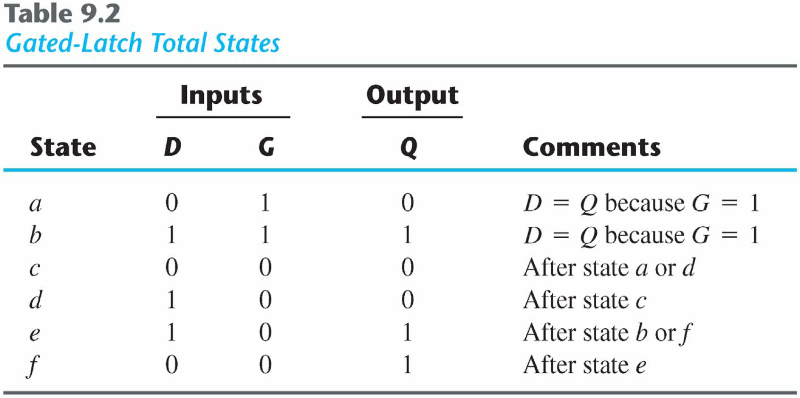
Design Procedure: Example
Form a table with all possible total states

Slide 41
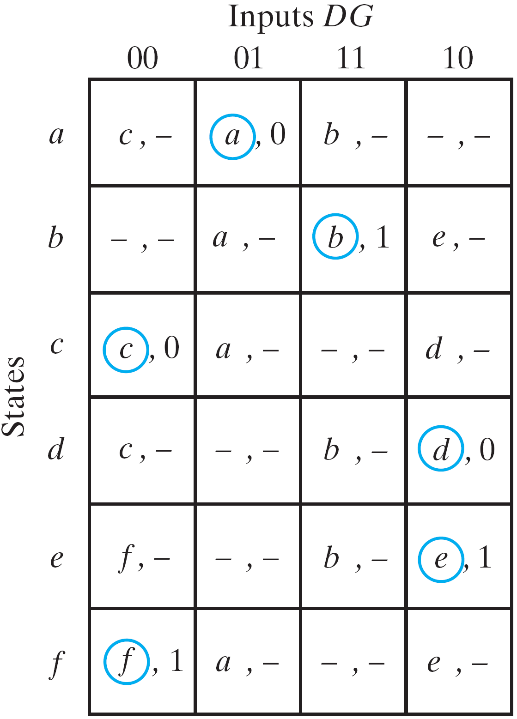
Primitive Flow Table
Obtain the flow table by listing all possible states
Dash marks are given when both inputs change simultaneously
Outputs of unstable states are don’t care
Fig. 9.16
Primitive flow table

Slide 42
Reduce the Flow Table
Reduction of the primitive flow table
two or more rows in the primitive flow table can be merged if there are non-conflicting states and outputs in each of the columns

Slide 43
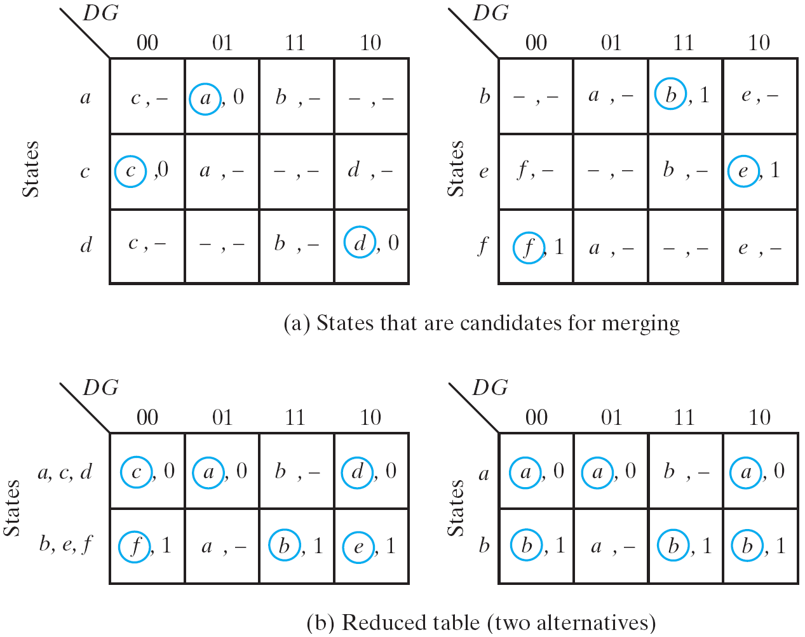
Reduce the Flow Table
Fig. 9.17: Reduction of the primitive flow table

Slide 44
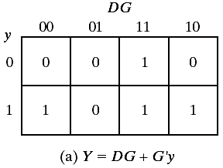
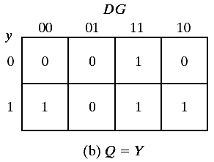
Transition Table and Output Map
Assign a binary value to each state to generate the transition table
a=0, b=1 in this example
Fig. 9.18: Transition table and output map for gated latch

Slide 45
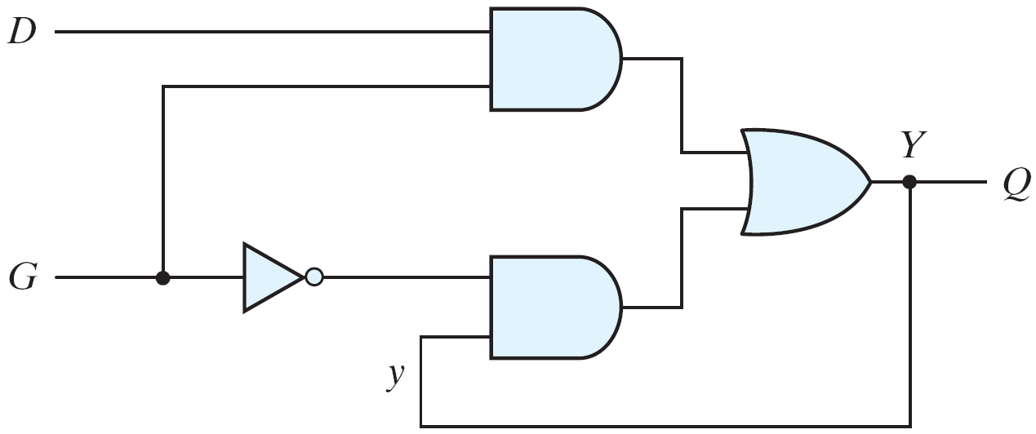
Logic Diagram
Directly use the simplified Boolean function for the excitation variable Y
An asynchronous circuit without latch is produced
Fig. 9.19
Gated-latch logic diagram

Slide 46
Design with SR Latches
We can also implement asynchronous circuits using latches at the outputs.
Given the map for each excitation variable Y, derive necessary equations for S and R of a latch to produce Y.
Derive Boolean equations for S and R.

Slide 47
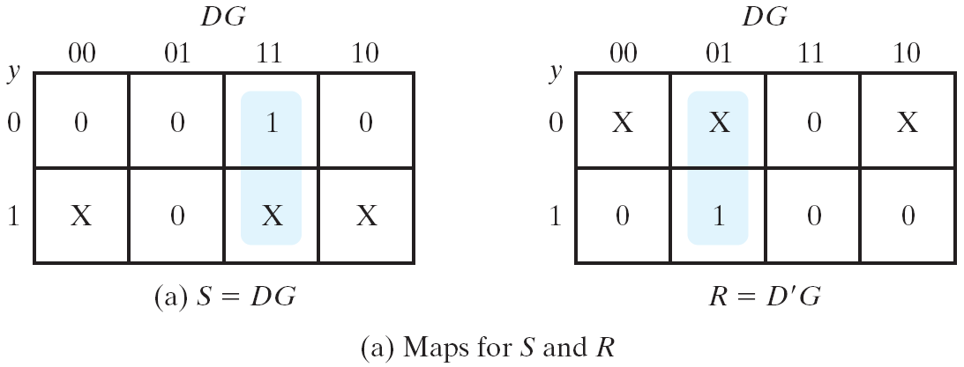
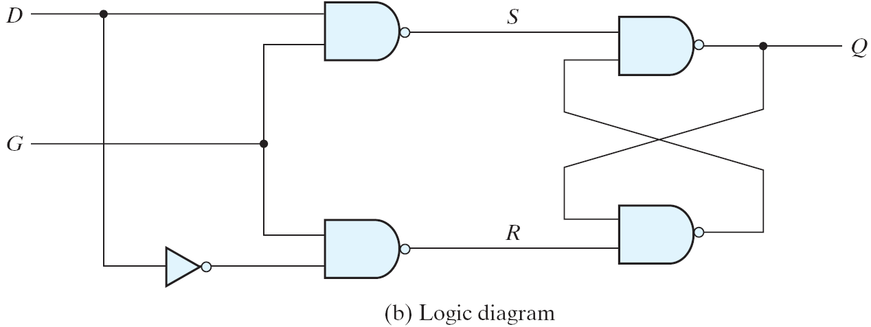
Design with SR Latches
Fig. 9.20
Circuit with SR latch

Slide 48
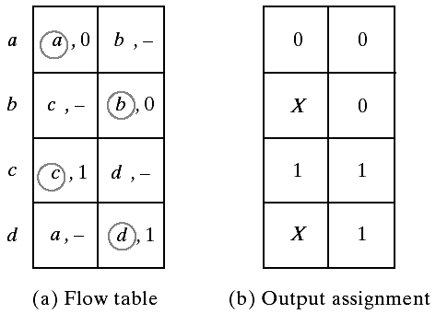
Outputs for Unstable States
Objective: no momentary false outputs occur when the circuit switches between stable states
If the output value is not changed, the intermediate unstable state must have the same output value
0 → 1 (unstable) → 0 (X)
If the output value changed, the intermediate outputs are don’t care
It makes no difference when the output change occurs

Slide 49
Design Procedure
Summary
a primitive flow table
state reduction
state assignment
output assignment
Simplify the Boolean functions of the excitation and output variables and draw the logic diagram

Slide 50
Reduction of State and Flow Table
State reduction procedure is similar in both sync. & async. sequential circuits
For completely specified state tables:
use implication table
For incompletely specified state tables:
use compatible pairs states

Slide 51
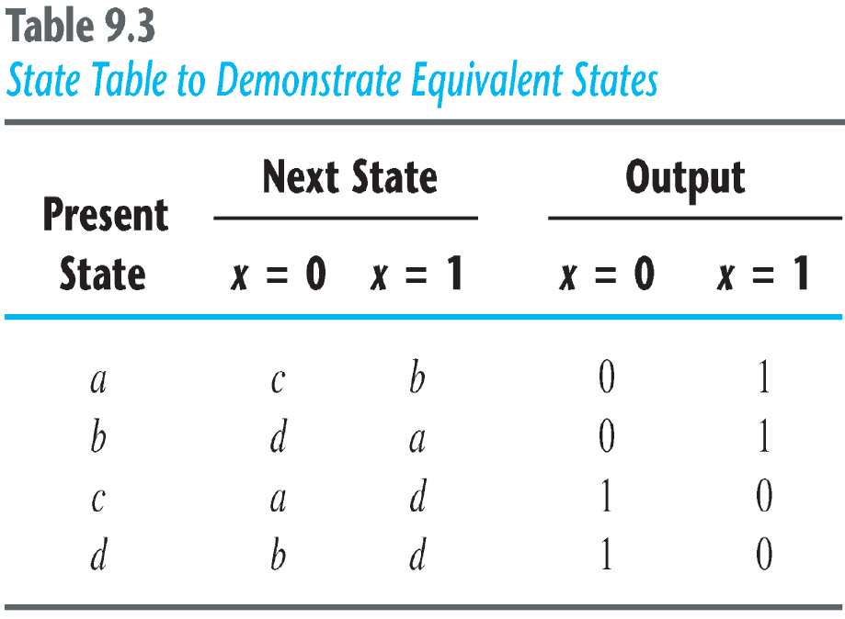
Reduction of State and Flow Table
Two states are equivalent if they have the same output and go to the same (equivalent) next states for each possible input
Example:
(a,b) are equivalent if (c,d) are equivalent
(a,b) imply (c,d)
(c,d) imply (a,b)

Slide 52
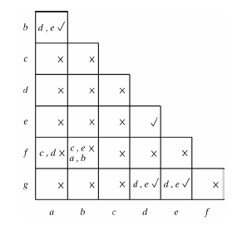
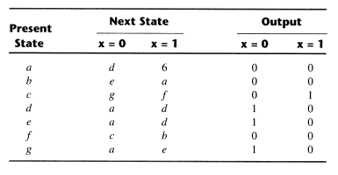
State Reduction:Implication Table

Slide 53
State Reduction: Implication Table
Finally, all the squares that have no crosses are recorded with check marks. The equivalent states are: (a, b), (d, e), (d, g), (e, g).
We now combine pairs of states into larger groups of equivalent states. The last three pairs can be combined into a set of three equivalent states (d, e, g) because each one of the states in the group is equivalent to the other two.

Slide 54
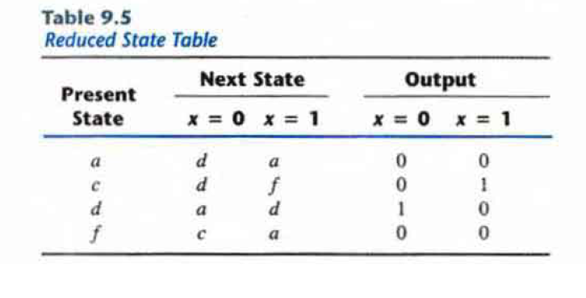
State Reduction: Implication Table
The final partition of these states consists of the equivalent states found from the implication table, together with all the remaining states in the state table that are not equivalent to any other state: (a, b) (c) (d, e, g) (f)

Slide 55
Merging of the Flow Table
The state table may be incompletely specified
Some next states and outputs are don’t care
Primitive flow tables are always incompletely specified
Several synchronous circuits also have this property
Incompletely specified states are not “equivalent”
Instead, we are going to find “compatible” states
Two states are compatible if they have the same output and compatible next states whenever specified
Three procedural steps:
Determine all compatible pairs
Find the maximal compatibles
Find a minimal closed collection of compatibles

Slide 56
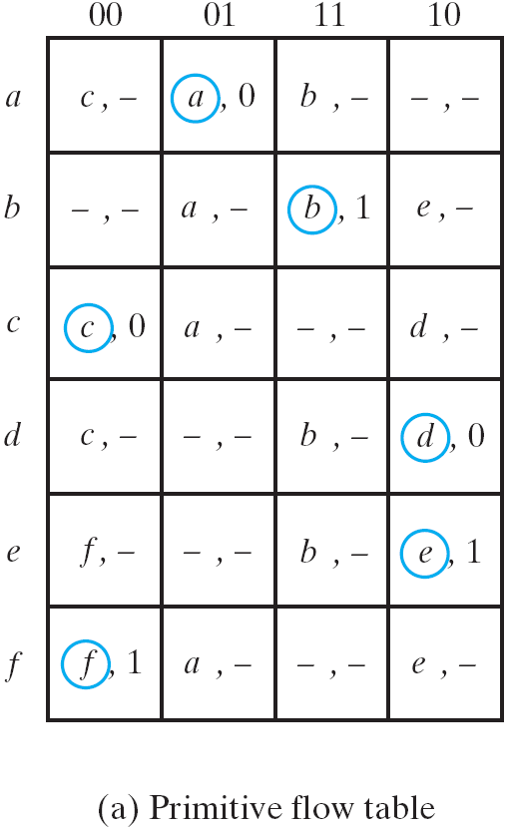
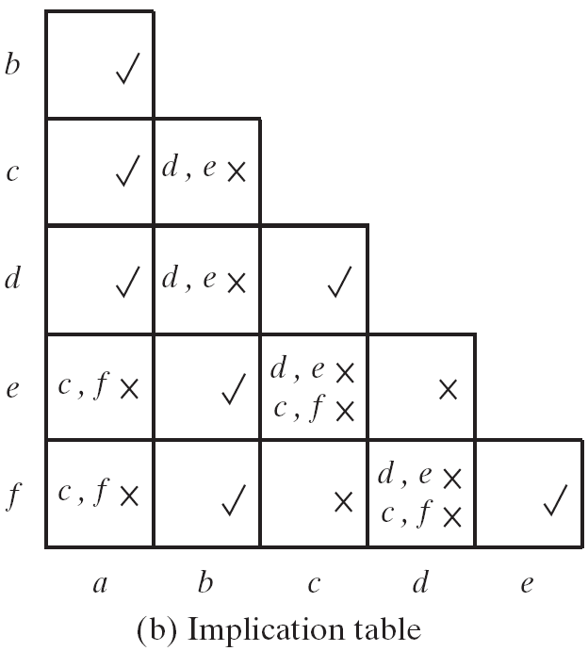
Compatible Pairs
Compatible pairs
(a,b) (a,c) (a,d) (b,e) (b,f) (c,d) (e,f)

Slide 57
Maximal Compatibles
A group of compatibles that contains all the possible combinations of compatible states
Obtained from a merger diagram
A line in the diagram represents that two states are compatible
n-state compatible → n-sided fully connected polygon
All its diagonals connected
Not all maximal compatibles are necessary

Slide 58
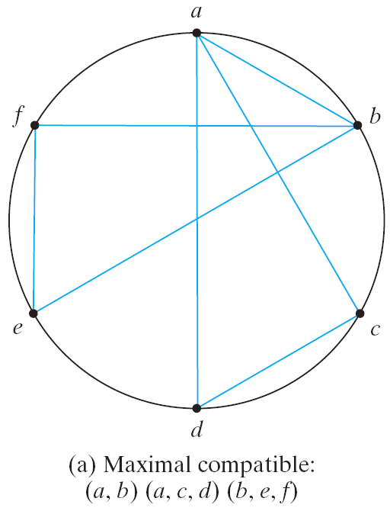
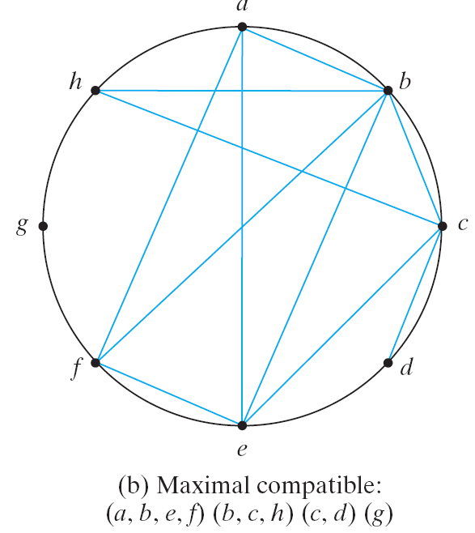
Maximal Compatibles
an isolated dot: a state that is not compatible to any other state
a line: a compatible pair
a triangle: a compatible with three states
an n-state compatible: an n-sided polygon with all its diagonals connected
Fig. 9.24
Merger diagram

Slide 59
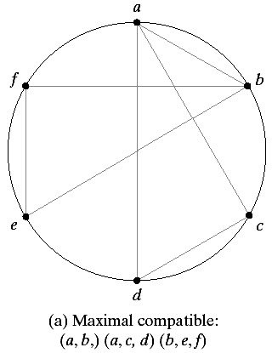
Closed Covering Condition
The set of chosen compatibles must cover all the states and must be closed
The closure condition is satisfied if
no implied states or the implied states are included within the set
Ex: if remove (a,b) in the right
(a,c,d) (b,e,f) are left in the set
All six states are still included
No implied states according to
its implication table

Slide 60
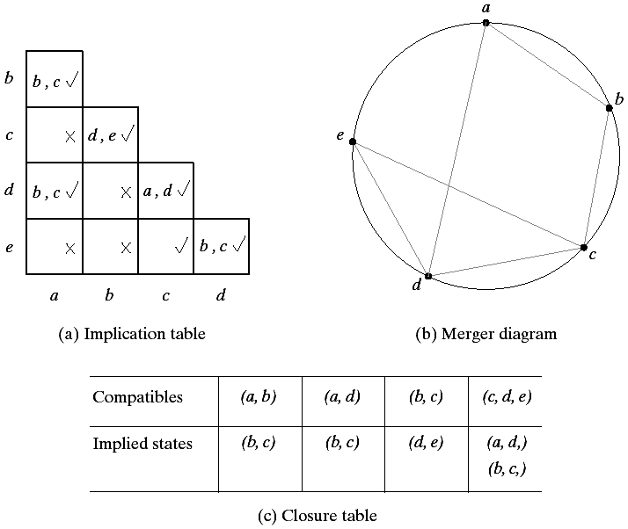
Closed Covering Condition
*(a,b) (c,d,e) → (X)
implied (b,c) is not
included in the set
*better choice:
(a,d) (b,c) (c,d,e)
all implied states
are included

Slide 61
Race-Free State Assignment
Objective: choose a proper binary state assignment to prevent critical races
Only one variable can change at any given time when a state transition occurs
States between which transitions occur will be given adjacent assignments
Two binary values are said to be adjacent if they differ in only one variable
To ensure that a transition table has no critical races, every possible state transition should be checked
A tedious work when the flow table is large
Only 3-row and 4-row examples are demonstrated

Slide 62
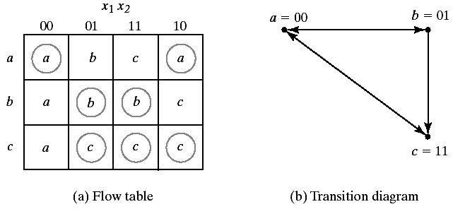
3-Row Flow Table Example
Three states require two binary variables
Outputs are omitted for simplicity
Adjacent info. are represented by a transition diagram
a and c are still not adjacent in such an assignment!!
Impossible to make all states adjacent if only 3 states are used

Slide 63
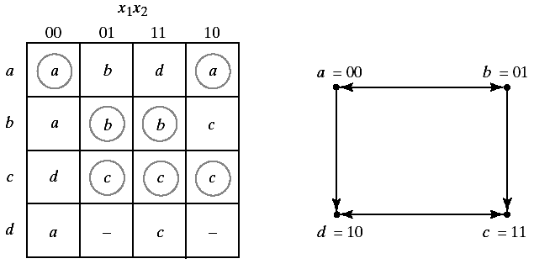
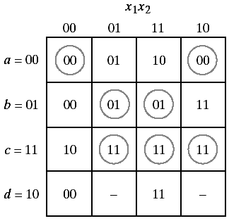
3-Row Flow Table Example
A race-free assignment can be obtained if we add an extra row to the flow table
Only provide a race-free transition between the stable states
The transition from a to c must now go through d
00 → 10 → 11 (no race condition)

Slide 64
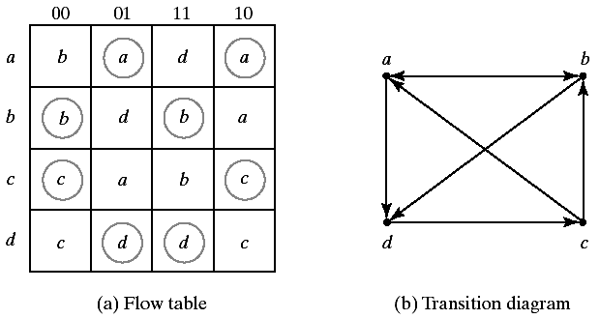
4-Row Flow Table Example
Sometimes, just one extra row may not be sufficient to prevent critical races
More binary state variables may also required
With one or two diagonal transitions, there is no way of using two binary variables that satisfy all adjacency

Slide 65



4-Row Flow Table Example

Slide 66


Multiple-Row Method
Multiple-row method is easier
May not as efficient as in above shared-row method
Each stable state is duplicated with exactly the same output
Behaviours are still the same
While choosing the next states, choose the adjacent one

Slide 67
Hazards
Unwanted switching appears at the output of a circuit
Due to different propagation delay in different paths
May cause the circuit to mal-function
Cause temporary false-output values in combinational circuits
Cause a transition to a wrong state in asynchronous circuits
Not a concern to synchronous sequential circuits

Slide 68

Hazards in Combinational Circuits
Fig. 9.33
Circuits with hazards

Slide 69

Types of Hazards
Three types of hazards:
Fig. 9.34
Types of hazards

Slide 70
Hazard Free Circuit
Static 1-hazard (sum of products)
the removal of static 1-hazard guarantees that no static 0-hazards or dynamic hazards
Static 0-hazard (product of sum)
Y = (x₁+x₂')(x₂+x₃)
The remedy
the circuit moves from one product term to another
additional redundant gate

Slide 71


Hazard Free Circuit

Slide 72


Hazard in a Asynchronous Circuit
In general, no problem for synchronous design
Fig. 9.37
Hazard in a asynchronous sequential circuit

Slide 73

Remove Hazard with Latches
Implement the asynchronous circuit with SR latches can also remove static hazards
A momentary 0 has no effects to the S and R inputs of a NOR latch
A momentary 1 has no effects to the S and R inputs of a NAND latch
Replace
by a latch

Slide 74
Implementation with SR latches
Given:
S = AB + CD
R = A’C
For NAND latch, use complemented inputs
S’ = (AB + CD)’= (AB)’(CD)’
R’ = (A’C)’
Q = (Q’S)’ = [Q’(AB)’(CD)’]’
Two-level circuits (this is the output we want)

Slide 75

Implementation with SR latches

Slide 76
Essential Hazards
Besides static and dynamic hazards, another type of hazard in asynchronous circuits is called essential hazard
Caused by unequal delays along two or more paths that originate from the same input
Cannot be corrected by adding redundant gates
Can only be corrected by adjusting the amount of delay in the affected path
Each feedback path should be examined carefully !!

Slide 77
Summary of Design Procedure
1. State the design specifications
2. Derive a primitive flow table
3. Reduce the flow table by merging the rows
4. Make a race-free binary state assignment
5. Obtain the transition table and output map
6. Obtain the logic diagram using SR latches

Slide 78
Design Specification
Design a negative-edge-triggered T flip-flop
Two inputs: T(toggle) and C(clock)
T=1: toggle, T=0: no change
One output: Q

Slide 79


Primitive Flow Table

Slide 80



Merging of the Flow Table
Compatible pairs:
Maximal compatible set:

Slide 81


State Assignment and Transition Table
No diagonal lines in the transition diagram
No need to add extra states

Slide 82


Logic Diagram

Slide 83
Syllabus
Chapter 9

