Slide 1
CSE 215: Database
Department of CSE
Bangladesh University of Engineering & Technology

Slide 2
ER Model
What is it?
The ER data model employs three basic concepts:
entity sets
relationship sets
attributes
The ER model also has an associated diagrammatic representation, which can express the overall logical structure of a database graphically
ER diagram

Slide 3
ER Model
Entity Sets
An entity is an object that exists and is distinguishable from other objects
Example: specific person, company, plant
An entity set is a set of entities of the same type that share the same properties
Example: set of all persons, companies, trees,
An entity is represented by a set of attributes; i.e., descriptive properties possessed by all members of an entity set
Example:
instructor = (ID, name, salary ) course= (course_id, title, credits)
A subset of the attributes form a primary key of the entity set; i.e., uniquely identifying each member of the set

Slide 4
ER Model
Entity Sets – ER Diagram
Entity sets can be represented graphically as follows:
Rectangles represent entity sets.
Attributes listed inside entity rectangle
Underline indicates primary key attributes

Slide 5
ER Model
Relationship Sets
A relationship is an association among several entities
Example: 44553 (Peltier) advisor 22222 (Einstein) student entity relationship set instructor entity
A relationship set is a mathematical relation among n ≥ 2 entities, each taken from entity sets
{(e₁, e₂, … e_{n}) | e₁ ∈ E₁, e₂ ∈ E₂, …, e_{n} ∈ E_{n}} where (e₁, e₂, …, e_{n}) is a relationship
Example:
(44553,22222) ∈ advisor

Slide 6
ER Model
Relationship Sets
A relationship is an association among several entities
Example: 44553 (Peltier) advisor 22222 (Einstein) student entity relationship set instructor entity
A relationship set is a mathematical relation among n ≥ 2 entities, each taken from entity sets
{(e₁, e₂, … e_{n}) | e₁ ∈ E₁, e₂ ∈ E₂, …, e_{n} ∈ E_{n}} where (e₁, e₂, …, e_{n}) is a relationship
Example:
(44553,22222) ∈ advisor

Slide 7
ER Model
Relationship Sets
Example: we define the relationship set advisor to denote the associations between students and the instructors who act as their advisors
Pictorially, we draw a line between related entities

Slide 8
ER Model
Relationship Sets-ER Diagram
Diamonds represent relationship sets

Slide 9
ER Model
Relationship Sets
An attribute can also be associated with a relationship set.
For instance, the advisor relationship set between entity sets instructor and student may have the attribute date which tracks when the student started being associated with the advisor

Slide 10
ER Model
Relationship Sets-ER Diagram
Diamonds represent relationship sets

Slide 11
ER Model
Roles
Entity sets of a relationship need not be distinct
Each occurrence of an entity set plays a “role” in the relationship
The labels “course_id” and “prereq_id” are called roles.

Slide 12
ER Model
Relationship Degree
Binary relationship
Involve two entity sets (or degree two)
Relationships between more than two entity sets are rare
Example: students work on research projects under the guidance of an instructor.
relationship proj_guide is a ternary relationship between instructor, student, and project

Slide 13
ER Model
Attributes
Attribute types:
Simple and composite attributes
Composite attributes allow us to divided attributes into subparts
Single-valued and multivalued attributes
Example: multivalued attribute: phone_numbers
Derived attributes
Can be computed from other attributes
Example: age, given date_of_birth
Domain – the set of permitted values for each attribute

Slide 14
ER Model
Mapping Cardinalities
Express the number of entities to which another entity can be associated via a relationship set
One to one
An entity in A is associated with at most one entity in B, An entity in B is associated with at most one entity in A
One to many
An entity in A is associated with any number (0 or more) of entities in B, An entity in B is associated with at most one entity in A
Many to one
An entity in A is associated with at most one entity in B, An entity in B is associated with any number (0 or more) of entities in A
Many to many
An entity in A is associated with any number (0 or more) of entities in B, An entity in B is associated with any number (0 or more) of entities in A

Slide 15
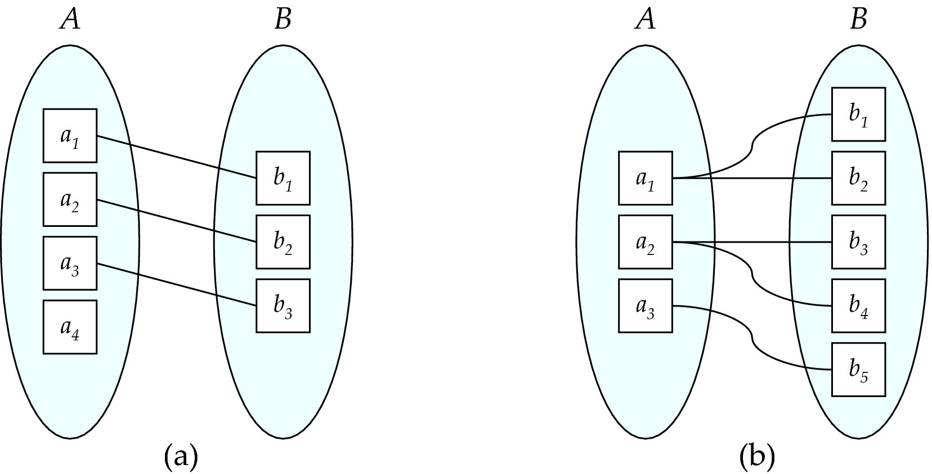
ER Model
Mapping Cardinalities
One to one
One to many

Slide 16
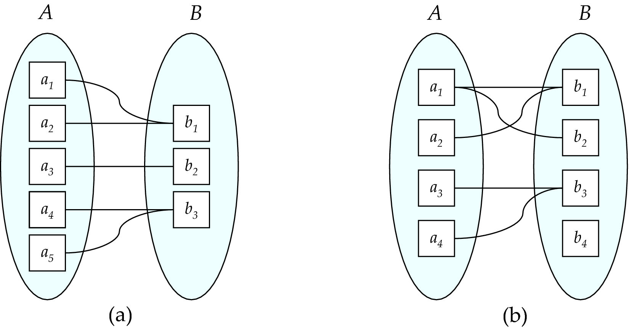
ER Model
Mapping Cardinalities
Many to one
Many to many

Slide 17
ER Model
Cardinality Constraints-ER Diagram
We express cardinality constraints by drawing either a directed line (), signifying “one,” or an undirected line (—), signifying “many,” between the relationship set and the entity set
One to one

Slide 18
ER Model
Cardinality Constraints-ER Diagram
We express cardinality constraints by drawing either a directed line (), signifying “one,” or an undirected line (—), signifying “many,” between the relationship set and the entity set
One to many

Slide 19
ER Model
Cardinality Constraints-ER Diagram
We express cardinality constraints by drawing either a directed line (), signifying “one,” or an undirected line (—), signifying “many,” between the relationship set and the entity set
Many to one

Slide 20
ER Model
Cardinality Constraints-ER Diagram
We express cardinality constraints by drawing either a directed line (), signifying “one,” or an undirected line (—), signifying “many,” between the relationship set and the entity set
Many to many

Slide 21
ER Model
Cardinality Constraints-ER Diagram
Total participation (indicated by double line): every entity in the entity set participates in at least one relationship in the relationship set
Example: participation of student in advisor relation is total, every student must have an associated instructor
Partial participation: some entities may not participate in any relationship in the relationship set
Example: participation of instructor in advisor is partial

Slide 22
ER Model
Cardinality Constraints-ER Diagram
A line may have an associated minimum and maximum cardinality, shown in the form l..h, where l is the minimum and h the maximum cardinality
A minimum value of 1 indicates total participation
A maximum value of 1 indicates that the entity participates in at most one relationship
A maximum value of * indicates no limit
Instructor can advise 0 or more students
A student must have 1 advisor; cannot have multiple advisors

Slide 23
ER Model
Cardinality Constraints-ER Diagram
We allow at most one arrow out of a ternary (or greater degree) relationship to indicate a cardinality constraint
For example, an arrow from proj_guide to instructor indicates each student has at most one guide for a project
If there is more than one arrow, there are two ways of defining the meaning.
For example, a ternary relationship R between A, B and C with arrows to B and C could mean
Each A entity is associated with a unique entity from B and C
Each pair of entities from (A, B) is associated with a unique C entity, and each pair (A, C) is associated with a unique B

Slide 24
ER Model
Primary Key for Entity Sets
By definition, individual entities are distinct.
From database perspective, the differences among them must be expressed in terms of their attributes.
The values of the attribute values of an entity must be such that they can uniquely identify the entity.
No two entities in an entity set are allowed to have exactly the same value for all attributes.
A key for an entity is a set of attributes that suffice to distinguish entities from each other

Slide 25
ER Model
Keys
Let K is a subset of attributes
K is a superkey if values for K are sufficient to identify a unique tuple of each possible relation r(R)
Example: {ID} and {ID,name} are both superkeys of instructor
Superkey K is a candidate key if K is minimal
Example: {ID} is a candidate key for Instructor
One of the candidate keys is selected to be the primary key

Slide 26
ER Model
Primary Key for Relationship Sets
To distinguish among the various relationships of a relationship set we use the individual primary keys of the entities in the relationship set
Let R be a relationship set involving entity sets E1, E2, .. En
The primary key for R is consists of the union of the primary keys of entity sets E1, E2, ..En
If the relationship set R has attributes a1, a2, .., am associated with it, then the primary key of R also includes the attributes a1, a2, .., am
Example: relationship set “advisor”
The primary key consists of instructor.ID and student.ID

Slide 27
ER Model
Primary Key for Relationship Sets
The choice of the primary key for a relationship set depends on the mapping cardinality of the relationship set
Many-to-Many relationships
The preceding union of the primary keys is a minimal superkey and is chosen as the primary key
One-to-Many relationships
The primary key of the “Many” side is a minimal superkey and is used as the primary key
Many-to-one relationships
The primary key of the “Many” side is a minimal superkey and is used as the primary key
One-to-one relationships
The primary key of either one of the participating entity sets forms a minimal superkey, and either one can be chosen as the primary key

Slide 28
ER Model
Weak/Strong Entity Sets
A weak entity set is one whose existence is dependent on another entity, called its identifying entity
Instead of associating a primary key with a weak entity, we use the primary key of identifying entity, along with extra attributes called discriminator to uniquely identify a weak entity
The identifying entity set is said to own the weak entity set that it identifies
The relationship associating the weak entity set with the identifying entity set is called the identifying relationship
An entity set that is not a weak entity set is termed a strong entity set.

Slide 29
ER Model
Weak Entity Sets-ER Diagram
In E-R diagrams, a weak entity set is depicted via a double rectangle.
We underline the discriminator of a weak entity set with a dashed line.
The relationship set connecting the weak entity set to the identifying strong entity set is depicted by a double diamond.
Primary key for section – (course_id, sec_id, semester, year)

Slide 30
ER Model
Redundant Attributes
We model the fact that each student has an associated department using a relationship set stud_dept
The attribute dept_name in student below replicates information present in the relationship and is therefore redundant and needs to be removed.
BUT: when converting back to tables, in some cases the attribute gets reintroduced, as we will see later

Slide 31
ER Model
ER Diagram of University

Slide 32
Database
Acknowledgement
Some slides and figures are collected from
https://www.db-book.com/

