Slide 1
CSE 215: Database
Department of CSE
Bangladesh University of Engineering & Technology

Slide 2
Database
Course Overview
Class Schedule
  Saturday (Sec A: 2 pm, Sec B: 11 am, Sec C: 9 am)
  Sunday (Sec A: 10 am, Sec B: 8 am, Sec C: 9 am)
  Monday (Sec A: 11 am, Sec B: 9 am, Sec C: 12 pm)
Course Teacher (1st part)
  Prof. Tanzima Hashem
  Office: Room# 313
  Email: tanzimahashem AT cse DOT buet DOT ac DOT bd
Course page
  https://cse.buet.ac.bd/moodle/course/view.php?id=179

Slide 3
Database
Course Overview
Text Books
  Database System Concepts by Silberschatz, Korth, and Sudarsan
Other Book
  Database Systems: The Complete Book, by Garcia-Molina, Ullman and Widom

Slide 4
Database
Course Topics (TH)
Concepts of database systems; Data Models: Entity-Relationship model, Relational model; Query Languages: Relational algebra, SQL; Constraints and triggers;

Slide 5
Database
Database and DBMS
Database
  Collection of interrelated data
Database Management System (DBMS)
  Collection of interrelated data
  Set of programs that store, organize, and manage data, and allow users to efficiently add, update, retrieve, and protect information

Slide 6
Database
Key Properties
Massive
Persistent
Reliable
Multi-user
Efficient
Convenient
Safe

Slide 7
Database
Applications
Enterprise Information
  Sales, Accounting, Human Resources
Banking and Finance
Manufacturing
Universities
Web Based Services
  Online retailers, online advertisement
Telecommunication
Document database
Navigation systems
…

Slide 8
Database
File Systems- Limitations
Data redundancy and inconsistency
  Information duplication in different files, inconsistent updates
Difficulty in accessing data
  Need to write a new program to carry out each new task
Data isolation
  Multiple files and formats
Integrity problems
  Integrity constraints (e.g. account balance > 0) become part of program code
  Hard to add new constraints or change existing ones

Slide 9
Database
File Systems- Limitations
Atomicity of updates
  Failures may leave database in an inconsistent state with partial updates carried out
  E.g. transfer of funds from one account to another should either complete or not happen at all
Concurrent access by multiple users
  Concurrent accessed needed for performance
  Uncontrolled concurrent accesses can lead to inconsistencies
    E.g. two people reading a balance and updating it at the same time
Security problems
  Hard to provide user access to some, but not all, data
Notes:
In the early days, database applications were built on top of file systems

Slide 10
Database
Data Models
A collection of tools for describing
  Data
  Data relationships
  Data semantics
  Data constraints
Relational model
Entity-Relationship data model
Object-based data models
Semi-structured data model (XML)
Other older models:
  Network model, Hierarchical model

Slide 11
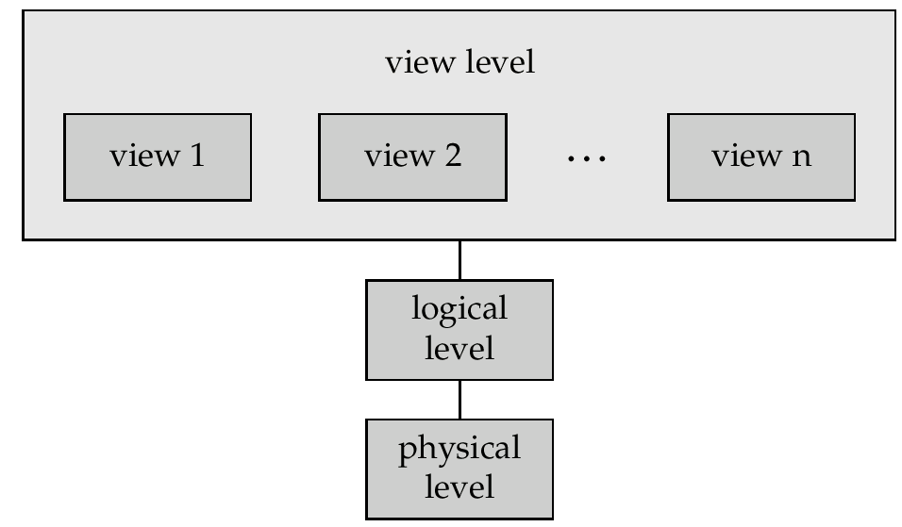
Database
Data Abstraction
Physical level
  Describes how data is stored
Logical level
  Describes data stored in database, and the relationships among the data
View level
  Describes only part of the database
  May provide many views of the same database
Hide the complexity of data structures to represent data in the database from users through several levels of data abstraction

Slide 12
Database
Instances and Schemas
Schema – Overall design of the database
  Analogous to type information of a variable in a program
Instance – the actual content of the database at a particular point in time
  Analogous to the value of a variable

Slide 13
Database
Data Definition Language (DDL)
Specification notation for defining the database schema
  Example: create table instructor (
  ID char(5),
  name varchar(20),
  dept_name varchar(20),
  salary numeric(8,2))
DDL compiler generates a set of table templates stored in a data dictionary

Slide 14
Database
Data Definition Language (DDL)
Data dictionary contains metadata (i.e., data about data)
  Database schema
  Constraints
    Integrity constraints
    Referential constraints
    Domain constraints
    Authorization

Slide 15
Database
Data Manipulation Language (DML)
Language for accessing and updating the data organized by the appropriate data model
There are basically two types of data-manipulation language
  Procedural DML -- require a user to specify what data are needed and how to get those data
  Declarative DML -- require a user to specify what data are needed without specifying how to get those data
Declarative DMLs are usually easier to learn and use than are procedural DMLs
Declarative DMLs are also referred to as non-procedural DMLs
  The portion of a DML that involves information retrieval is called a query language

Slide 16
Database
Database Design
Initial phase -- characterize fully the data needs of the prospective database users
Second phase -- choosing a data model
  Applying the concepts of the chosen data model
  Translating these requirements into a conceptual schema of the database
  A fully developed conceptual schema indicates the functional requirements of the enterprise
    Describe the kinds of operations (or transactions) that will be performed on the data

Slide 17
Database
Database Design
Final Phase -- Moving from an abstract data model to the implementation of the database
  Logical Design – Deciding on the database schema
    Database design requires that we find a “good” collection of relation schemas
    Business decision – What attributes should we record in the database?
    Computer Science decision – What relation schemas should we have and how should the attributes be distributed among the various relation schemas?
  Physical Design – Deciding on the physical layout of the database

Slide 18
Database
Database Design
In designing a database schema, we must ensure that we avoid two major pitfalls:
  Redundancy: a bad design may result in repeat information.
    Redundant representation of information may lead to data inconsistency among the various copies of information
  Incompleteness: a bad design may make certain aspects of the enterprise difficult or impossible to model

Slide 19
Database
Database Engine
A database system is partitioned into modules that deal with each of the responsibilities of the overall system
The functional components of a database system:
  The storage manager
    Provides the interface between the low-level data and the application programs and user queries
  The query processor component
    Interprets, optimizes, and executes user queries by converting them into efficient low-level instructions
  The transaction management component
    Keeps database consistent even after system or transaction failures

Slide 20
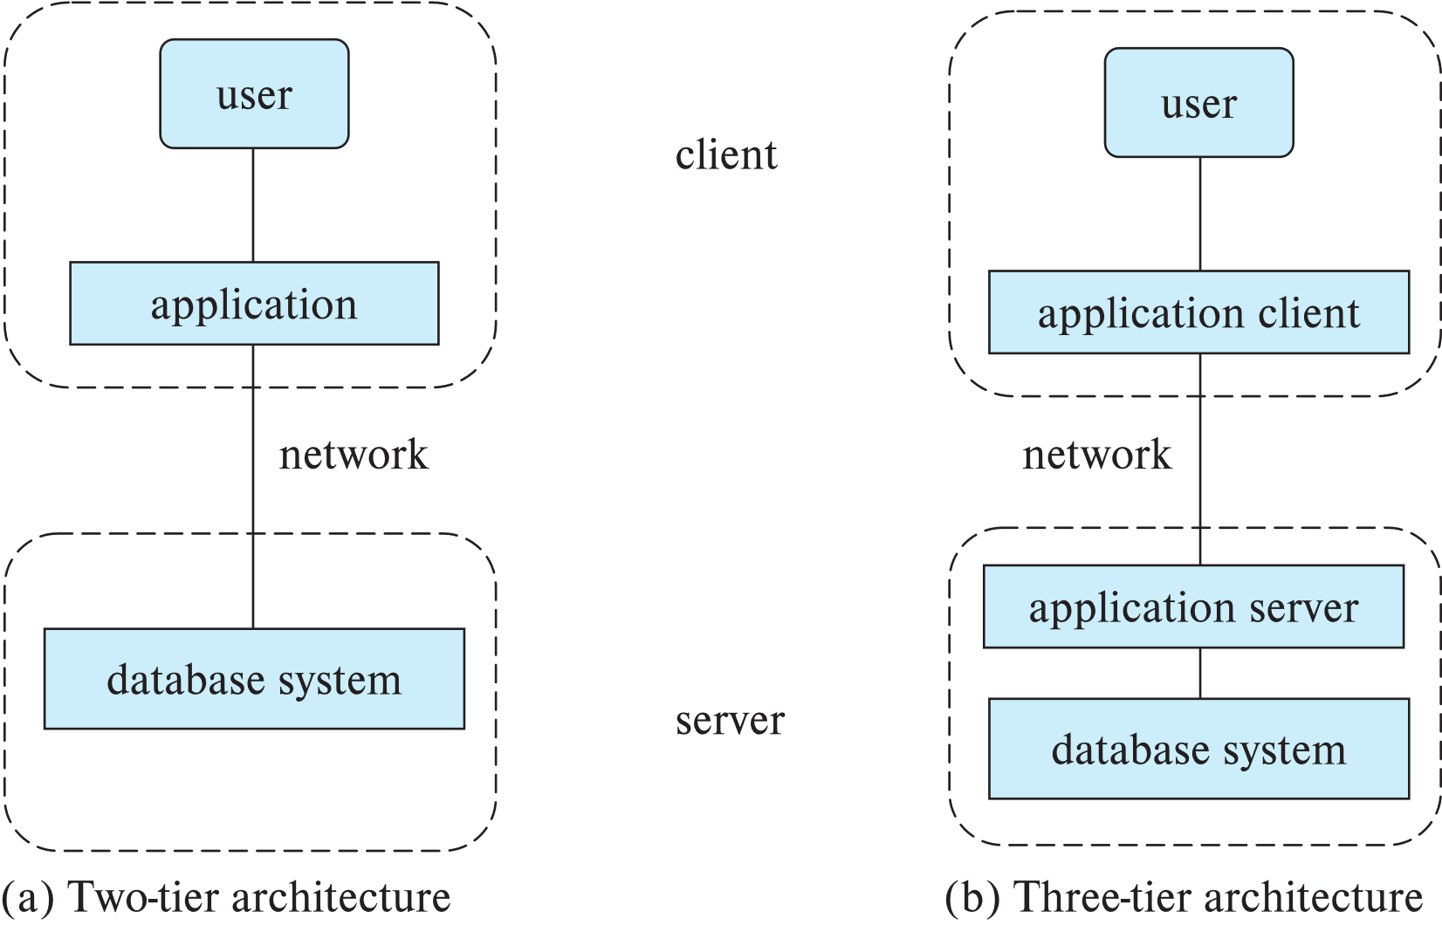
Database
Database Architecture

Slide 21
Database
Key People
Database Users
  Naïve Users: Interact with the system by using the predefined interface
  Application Programmers: Write application programs
  Analysts: Submit query to explore data without writing programs
Database Administrator
  Has central control over the system
    Schema definition
    Storage structure and access-method definition
    Schema and physical organization modification
    Granting authorization for data access
    Routine maintenance

Slide 22
Database
Acknowledgement
Some slides and figures are collected from
  https://www.db-book.com/

