Slide 1
CSE 215: Database
Department of CSE
Bangladesh University of Engineering & Technology

Slide 2
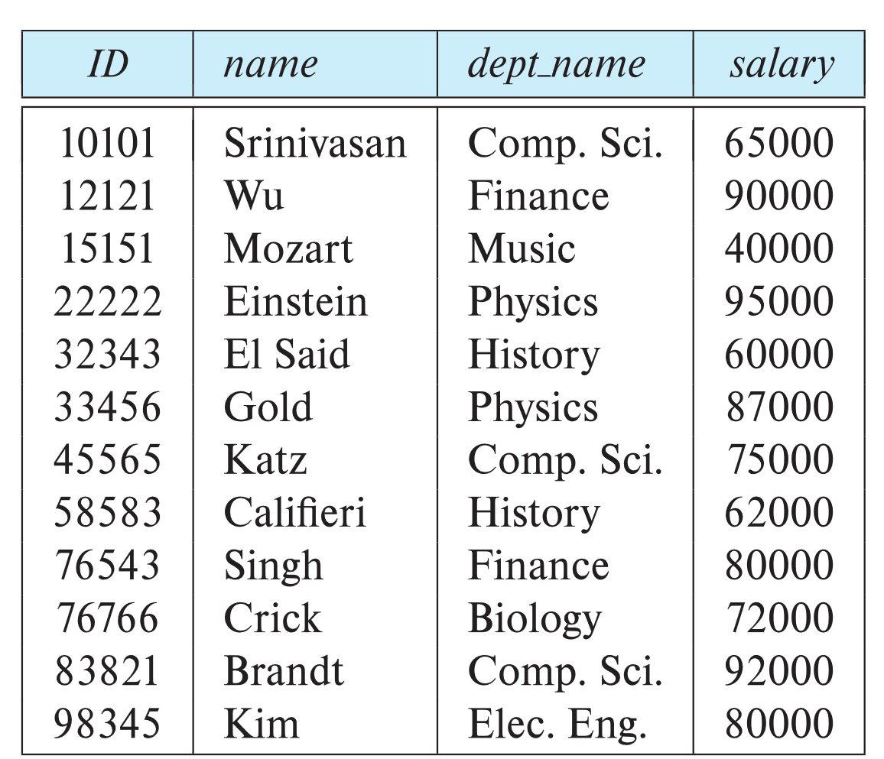
Relational Model
Instructor Relation
attributes
(or columns)
tuples
(or rows)

Slide 3
Relational Model
Relation Schema and Instance
A₁, A₂, …, A_{n} are attributes
R = (A₁, A₂, …, A_{n} ) is a relation schema
Example:
instructor = (ID, name, dept_name, salary)
A relation instance r defined over schema R is denoted by r (R)
The current values a relation are specified by a table
An element t of relation r is called a tuple and is represented by a row in a table

Slide 4
Relational Model
Attributes
The set of allowed values for each attribute is called the domain of the attribute
Attribute values are (normally) required to be atomic; that is, indivisible
The special value null is a member of every domain. Indicated that the value is “unknown”
The null value causes complications in the definition of many operations

Slide 5
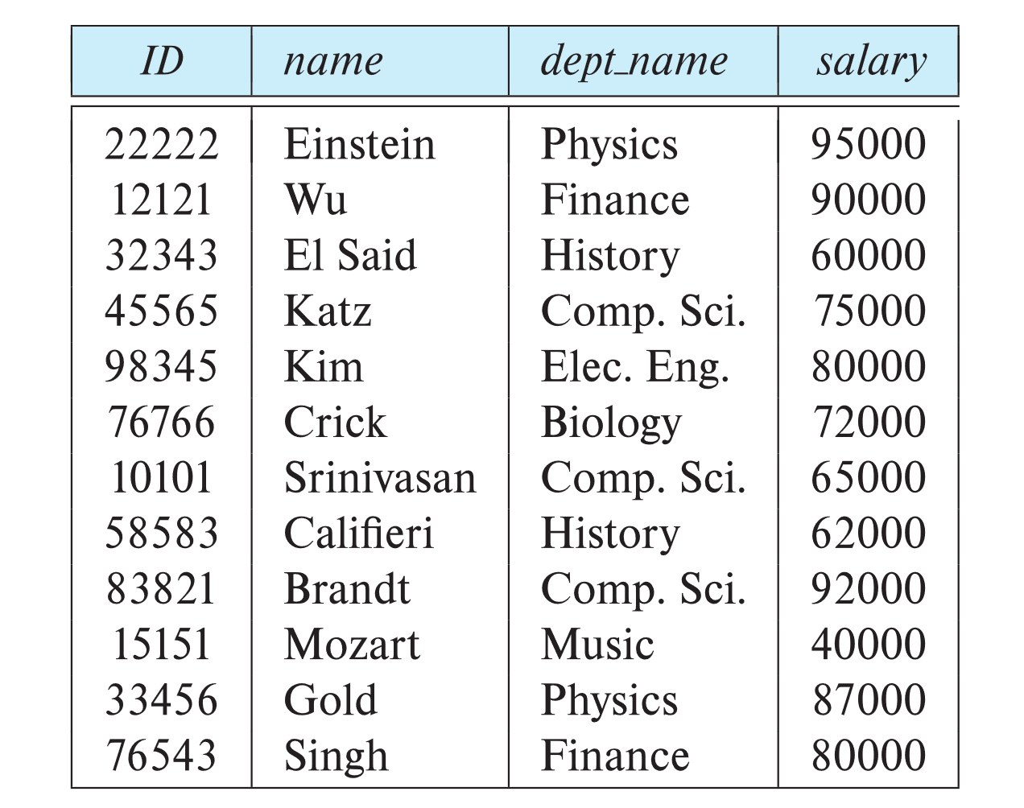
ER Model
Relations are Unordered
Order of tuples is irrelevant (tuples may be stored in an arbitrary order)
Example: instructor relation with unordered tuples

Slide 6
Relational Model
Database Schema
Database schema -- is the logical structure of the database.
Database instance -- is a snapshot of the data in the database at a given instant in time.
schema: instructor (ID, name, dept_name, salary)
Instance:

Slide 7
Relational Model
Keys
Let K ⊆ R
K is a superkey of R if values for K are sufficient to identify a unique tuple of each possible relation r(R)
  Example: {ID} and {ID,name} are both superkeys of instructor
Superkey K is a candidate key if K is minimal
Example: {ID} is a candidate key for Instructor
One of the candidate keys is selected to be the primary key
Foreign key constraint: Value in one relation must appear in another
  Referencing relation, Referenced relation
  Example: dept_name in instructor is a foreign key from instructor referencing department

Slide 8
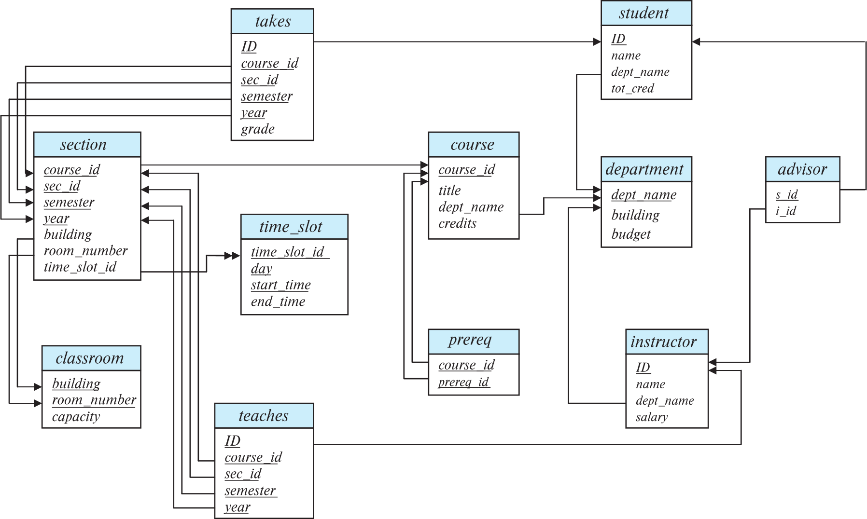
Relational Model
Schema Diagram

Slide 9
Relational Model
Acknowledgement
Some slides and figures are collected from
  https://www.db-book.com/

