Slide 1
Survival Modeling
by Tom Fusillo
6/28/16

Slide 2
What is Survival Modeling?
Modeling the expected time until a given event occurs
Also known as “churn” or “hazard” analysis
Assumptions
There is a relation between time and an event occurring
Some variables effect the timing of the event occurring
Some events occur outside of the window that is being analyzed (censoring)

Slide 3
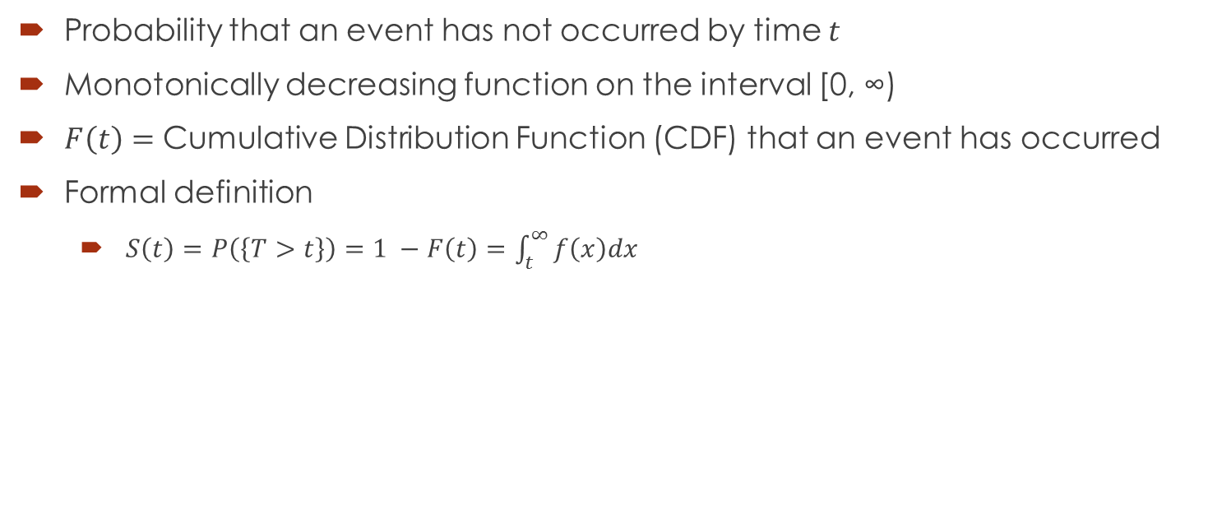
Survival Function
Probability that an event has not occurred by time $t$
Monotonically decreasing function on the interval [0, ∞)
$F\left(t\right)=$ Cumulative Distribution Function (CDF) that an event has occurred
Formal definition
$S\left(t\right)=P\left(\left\{T>t\right\}\right)=1 −F\left(t\right)=\int_{t}^{∞}{f\left(x\right)dx}$

Slide 4
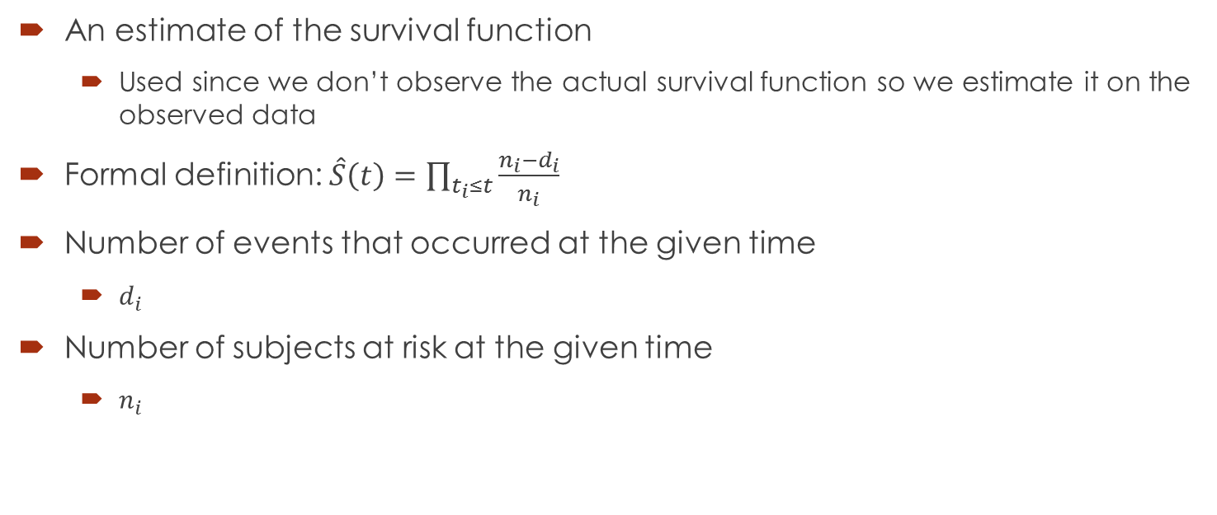
Kaplan-Meier Estimate
An estimate of the survival function
Used since we don’t observe the actual survival function so we estimate it on the observed data
Formal definition: $\hat{S}\left(t\right)=\prod_{t_{i}≤t}{\frac{n_{i}−d_{i}}{n_{i}}}$
Number of events that occurred at the given time
$d_{i}$
Number of subjects at risk at the given time
$n_{i}$

Slide 5

Hazard Function
Instantaneous rate of an event occurring given that an event hasn’t already occurred
Formal definition
$λ\left(t\right)= \frac{f(t)}{S(t)}$

Slide 6
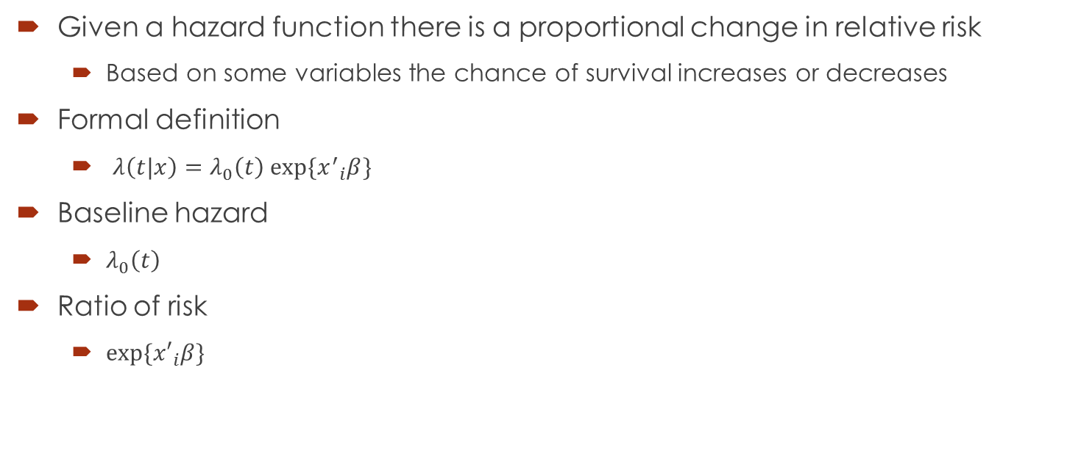
Proportional Hazard Models
Given a hazard function there is a proportional change in relative risk
Based on some variables the chance of survival increases or decreases
Formal definition
$λ\left(t|x\right)=λ_{0}\left(t\right) exp⁡\{{x^{′}}_{i}β\}$
Baseline hazard
$λ_{0}\left(t\right)$
Ratio of risk
$exp⁡\{{x′}_{i}β\}$

Slide 7
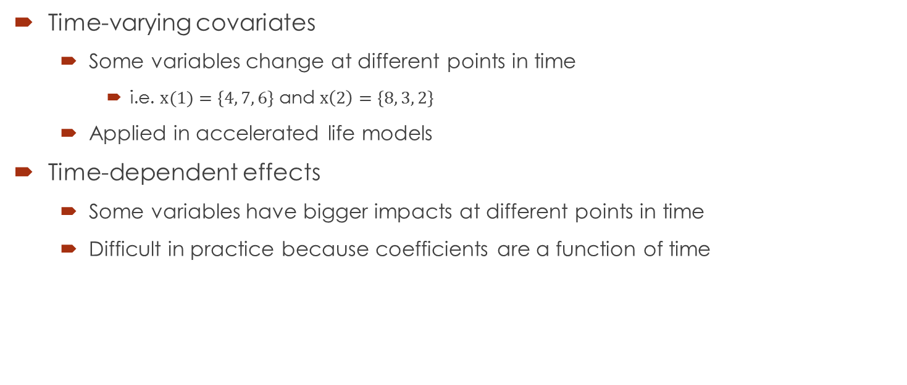
Additional modeling information
Time-varying covariates
Some variables change at different points in time
i.e. $x(1)=\left\{4, 7, 6\right\}$ and $x\left(2\right)=\left\{8, 3, 2\right\}$
Applied in accelerated life models
Time-dependent effects
Some variables have bigger impacts at different points in time
Difficult in practice because coefficients are a function of time

Slide 8
Use case
Dataset on Worchester Heart Attack Study
500 patients
Predict time of death based on sex, age, BMI, etc.
Calculate survival distribution
Calculate hazard rate
Predict probability of event happening

Slide 9
Resources
R
survival
https://cran.r-project.org/web/packages/survival/index.html
Python
lifelines
https://github.com/CamDavidsonPilon/lifelines
Dataset
https://www.umass.edu/statdata/statdata/data/whas500.txt
https://www.umass.edu/statdata/statdata/data/whas500.dat
Lecture Notes on Survival Models by Germán Rodríguez
http://data.princeton.edu/wws509/notes/c7.pdf

