Slide 1
ENROLLMENT FORECASTING SYSTEM
A Case Study of[ 8-sa-government-enrolments-by-school]
NANES: BUKENYA Mustafa
ID: 26840
Date: 01/08/2025

Slide 2
Introduction to the Project
Problem statement: We want to develop an effective enrollment forecasting system that considers multiple internal and external factors to provide reliable projections for student enrollment, minimizing budget deficits or overstaffing. This focuses on a specific goal – infrastructure planning and resource allocation.

Slide 3
The Data: Insights into Transportation Flows
Nature: Analytical / reporting data
Collection: Data.gov dataset, likely collected from US government data across sectors or other data sources provided by the platform.
Source: You can find this dataset directly on data.gov:
[https://data.sa.gov.au/data/dataset/school-enrolments/resource/7223f681-d340-4fc9-b92b-403d158f521f]

Slide 4
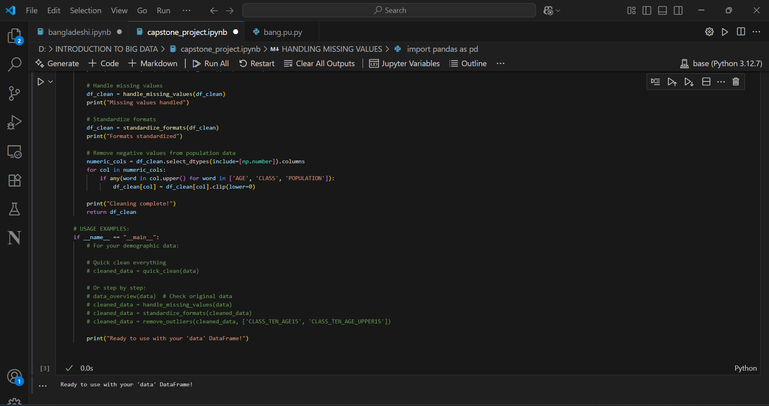
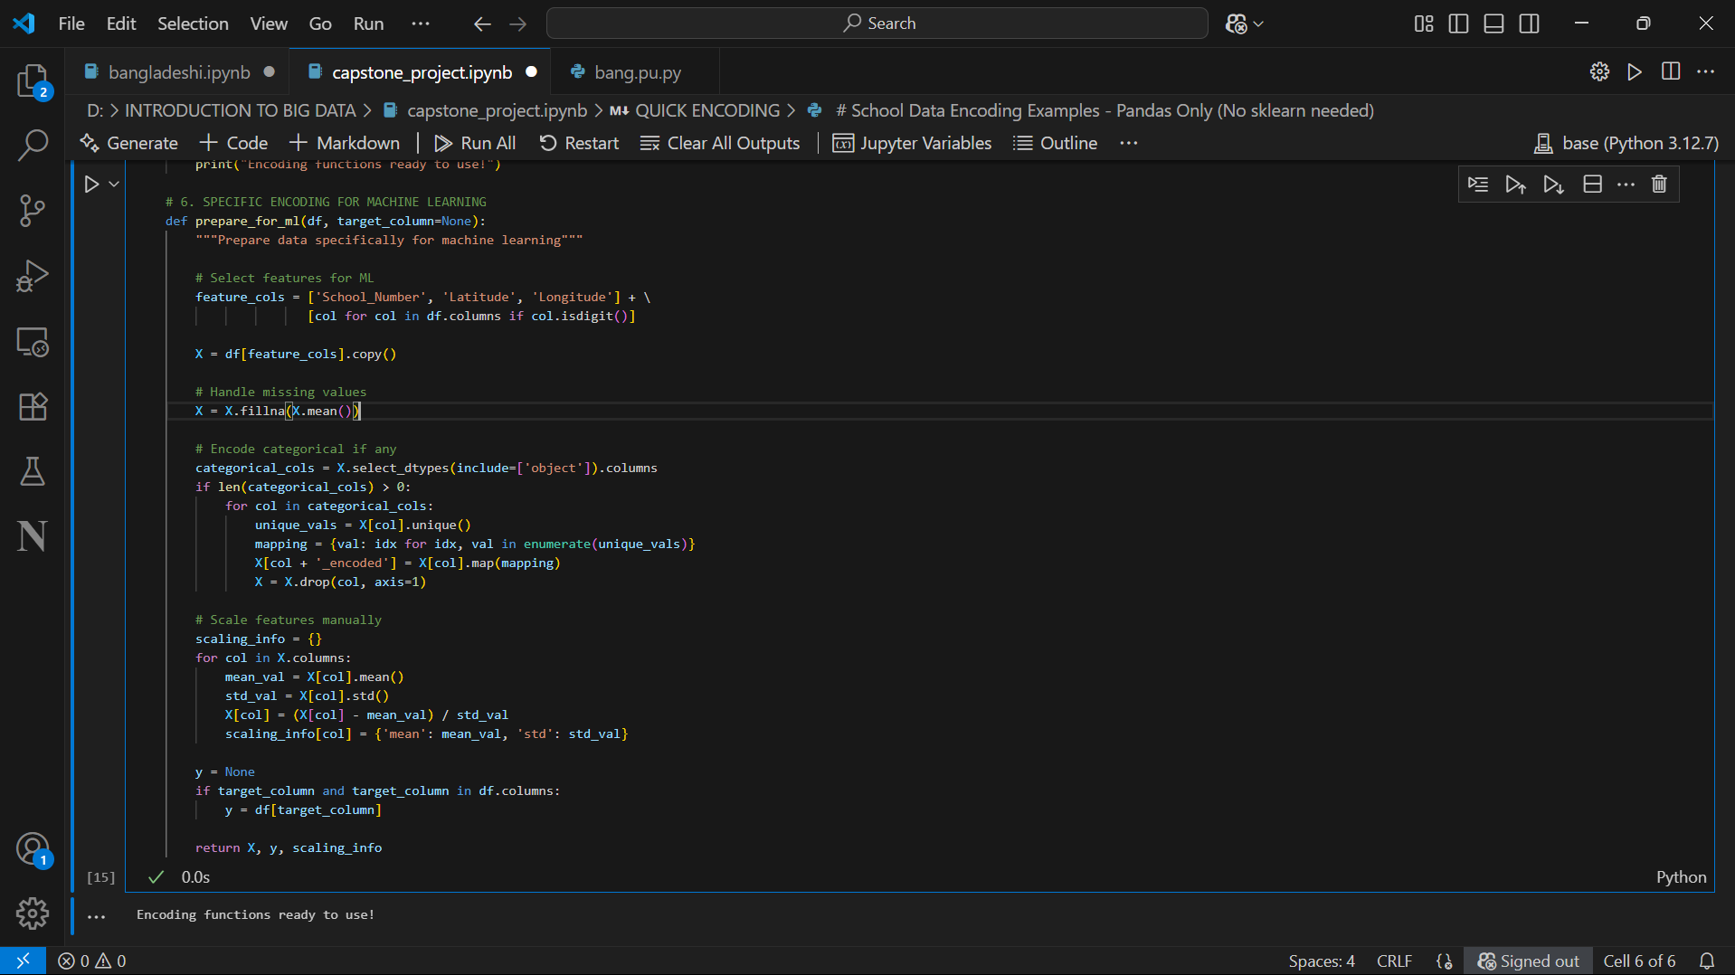
Cleaning for Reliability and Meaning
STEPS OF DATA CLEANING
. Handling missing values:- Filled missing numerical values with column mean (imputation)
-Filled missing categorical values with mode (most frequent value)
Data transformations
Encoding Techniques
Purpose: Encoding techniques are essential for representing text, numbers, and other types of data in a way that computers understand.

Slide 5
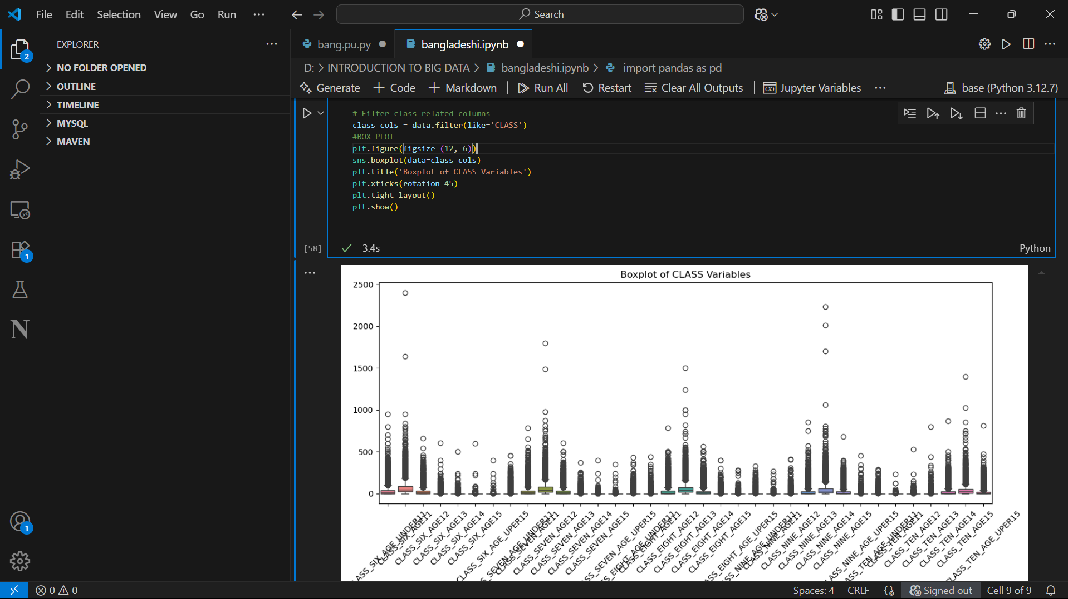
Visualizing the Patterns
Boxplot of all classes

Slide 6
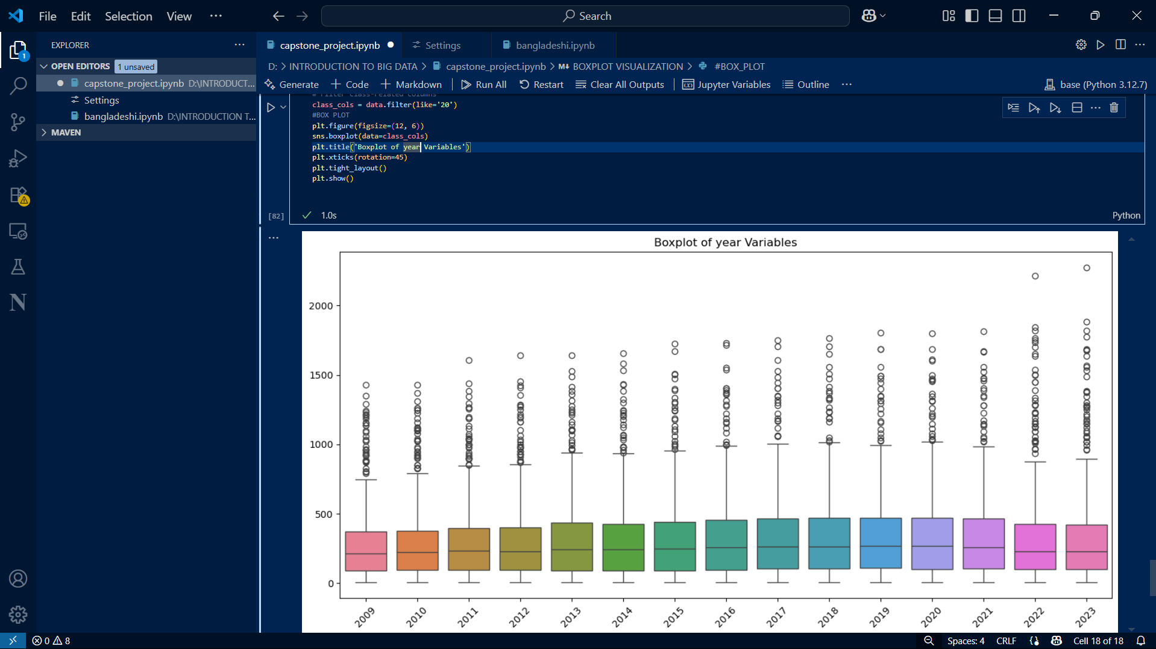
Boxplot of each year

Slide 7
Example actionable insight:
1.We found that Growth rate enrollment from 2009 to 2023 are up to 3.16% higher during weekday mornings, suggesting consistent peak demand.
2. We found that Enrollment average in 2023 are up to 337.69
3. We plotted school location using provided latitude and longitude from the dataset.

Slide 8
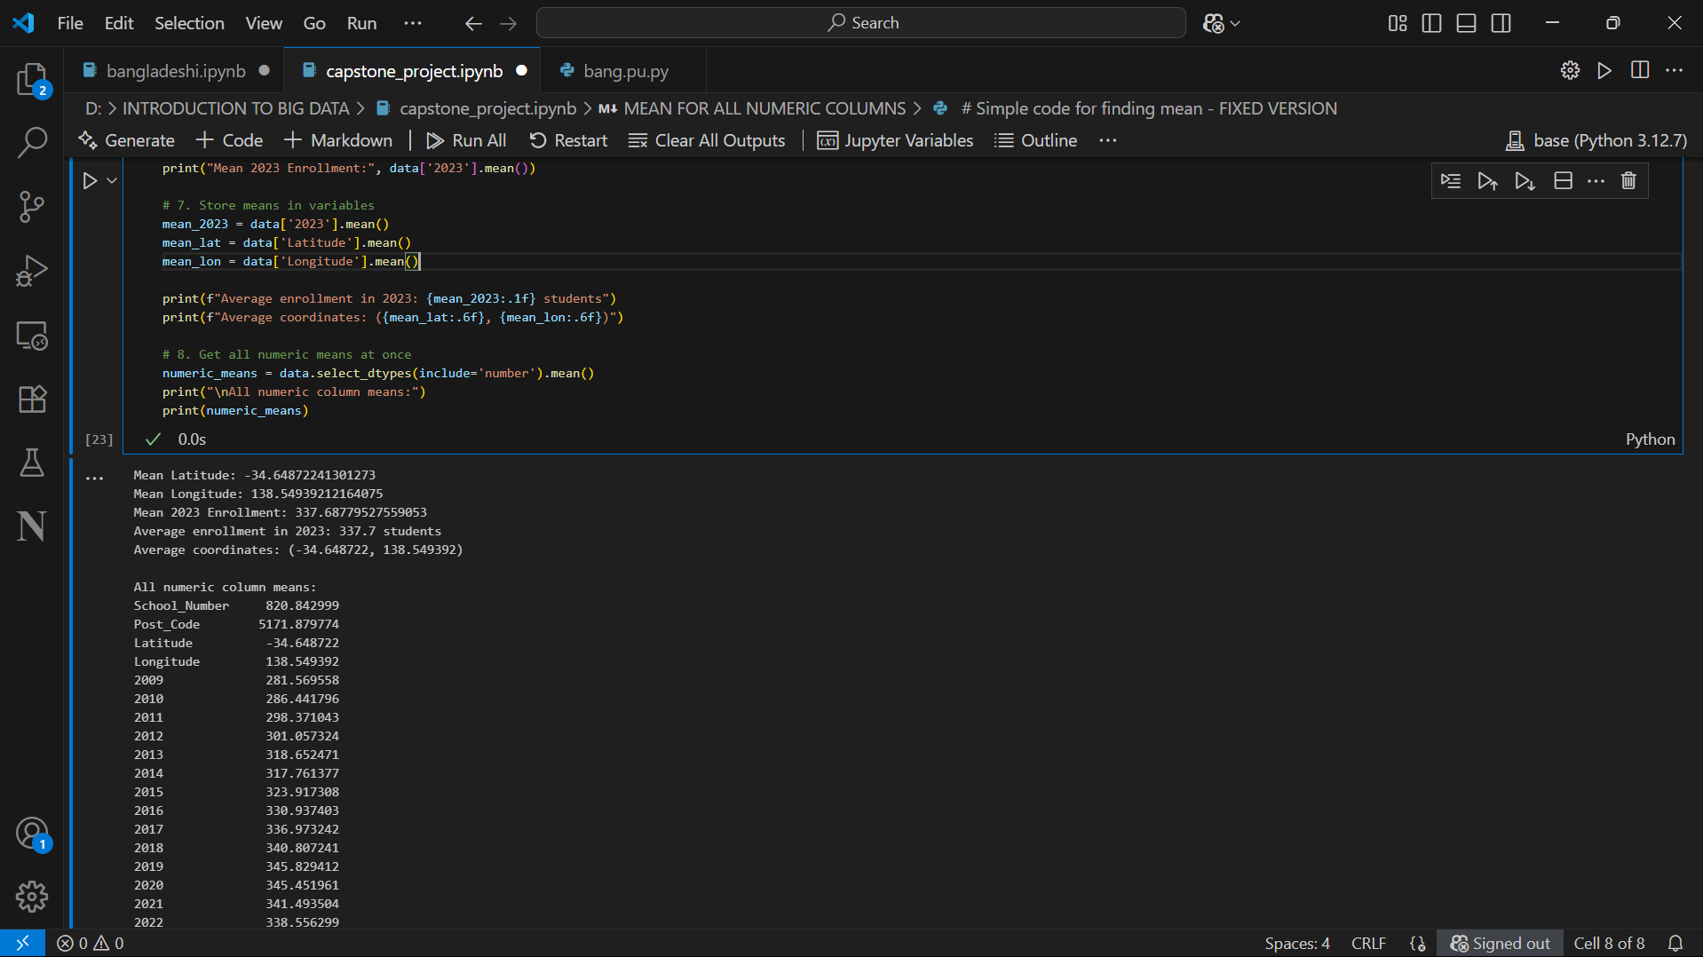
Some of generated descriptive statistics:
Mean for all numeric values

Slide 9
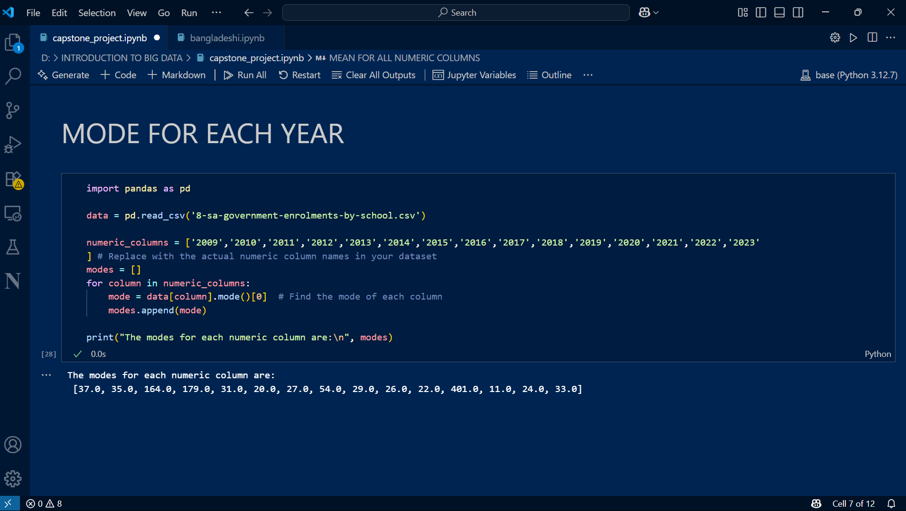
Mode for each year

Slide 10
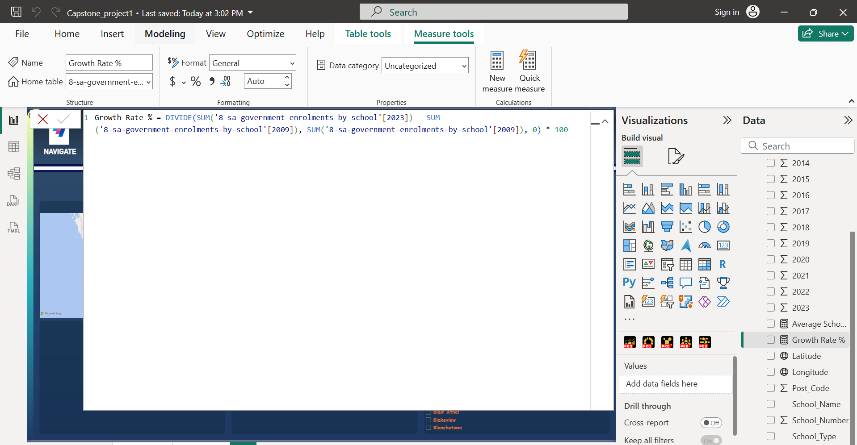
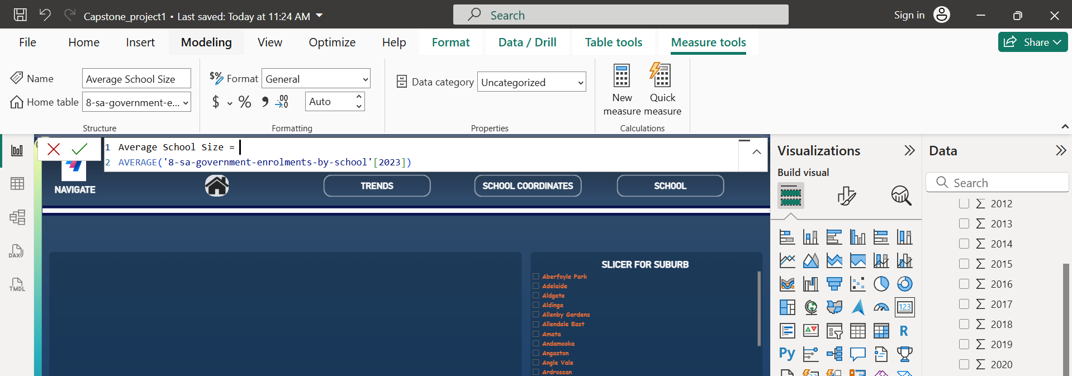
DAX operations
Percentage Growth rate 2009 – 2023
Average for 2023 enrollment

Slide 11
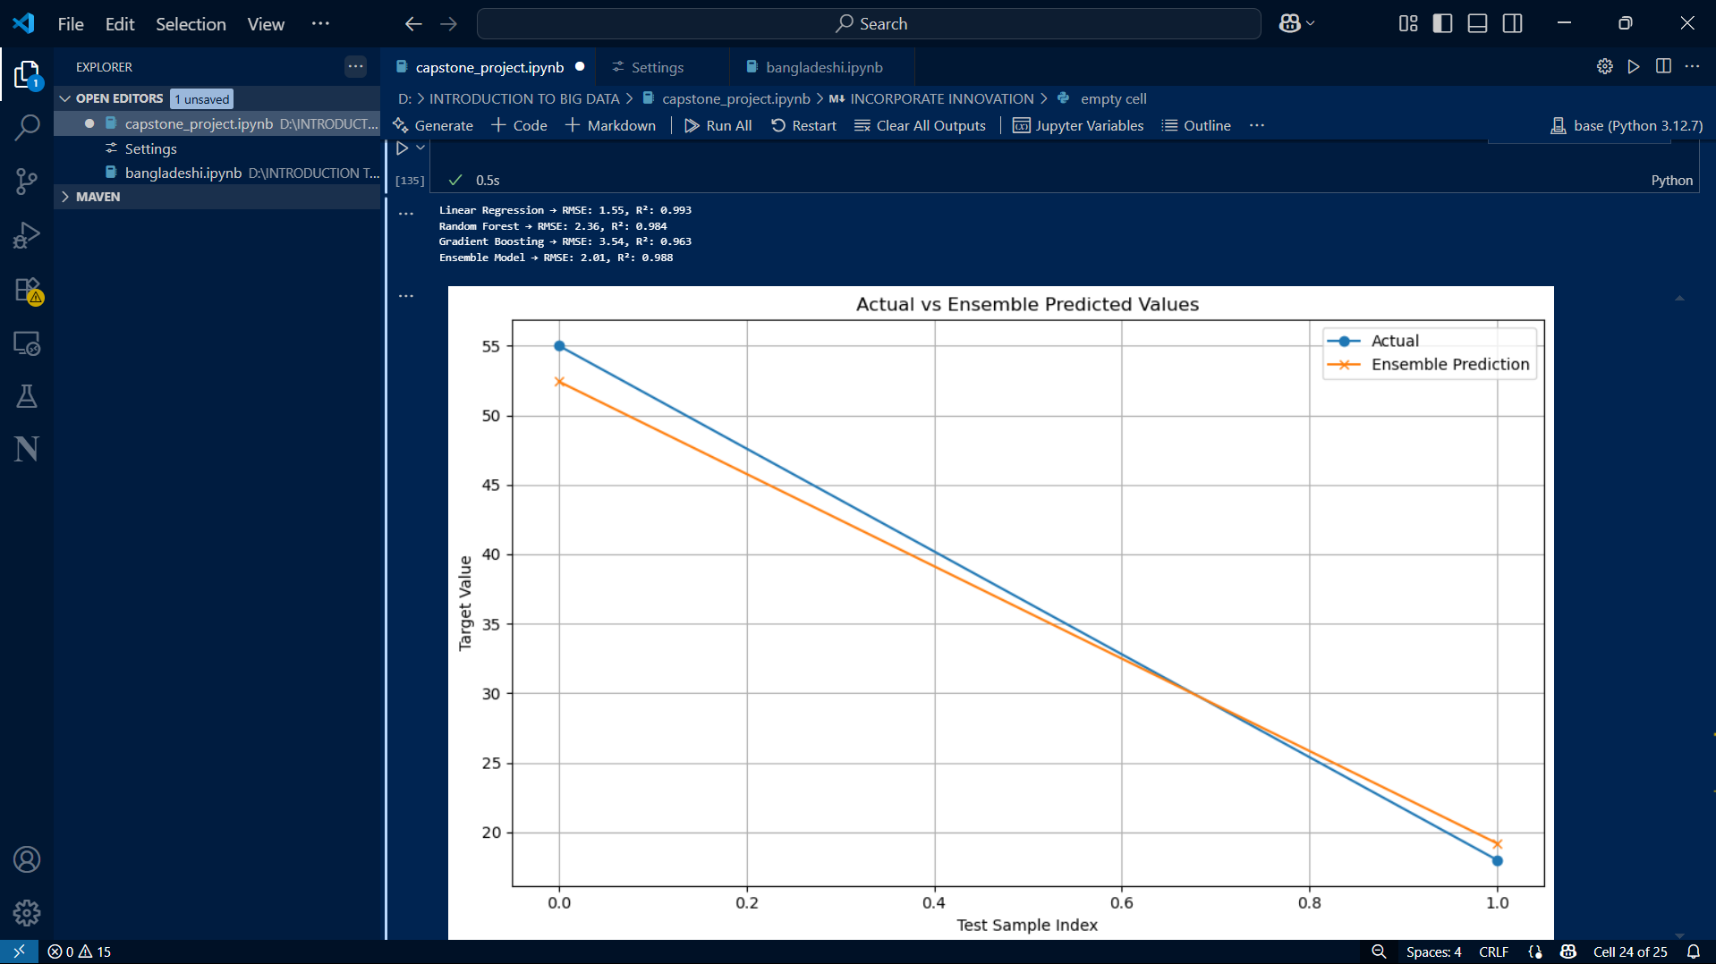
As innovation I have To built evaluated, and compared regression model, then combine it into an ensemble prediction model

Slide 12
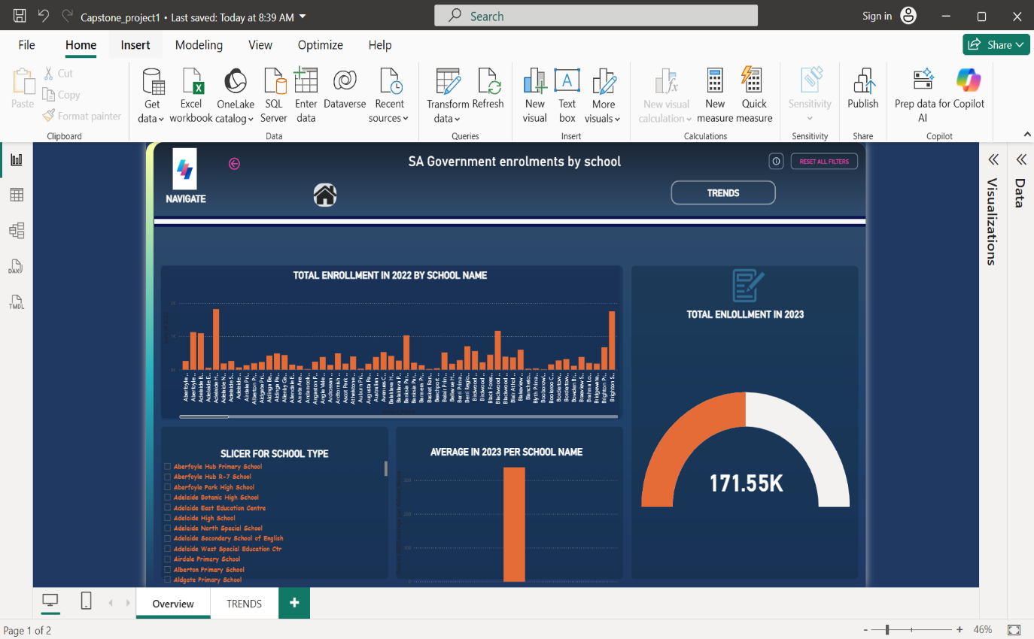
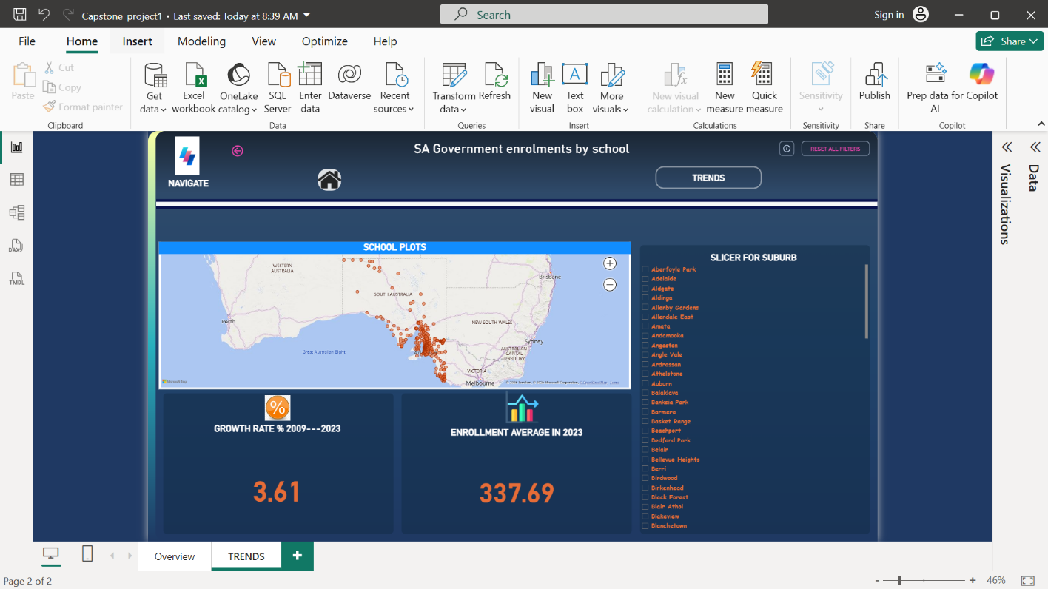
DASHBOARD DESIGN
HOME PAGE
TRENDS PAGE

Slide 13
Recommandment / Actions
Clean data regularly: Continue removing duplicates and handling missing values before analysis or modeling.
Monitor and handle outliers: Investigate unusually high year values; decide whether to exclude, cap, or adjust them.
Enhance analysis: Add features like which have transactional data.
Operational efficiency: Use spatial heatmaps to guide driver deployment to high-demand zones.

Slide 14
The Road Ahead
📌 Key Takeaway
>The data cleaning and analysis improved dataset quality by removing duplicates and addressing missing values, ensuring more accurate insights.
> Identified outliers and patterns in fare amounts that could otherwise skew * These insights help build a strong foundation for predictive analytics, demand forecasting, and pricing optimization.
> Overall, the analysis transforms raw data into actionable insights that support smarter operational and pricing decisions.

Slide 15
YOUR INSIGHTS ARE VALUABLE
We now open the floor for questions, feedback, and discussion.
Your thoughts and suggestions are crucial to:
Validate these findings
Prioritize next steps
Align recommendations with business needs
Let’s collaborate to turn data into actionable improvements!

