Slide 1
Analyzing Transportation Data for Improved Efficiency
A Case Study of [ Uber Fares Dataset (Kaggle)]
NANES: BUKENYA Mustafa
ID: 26840
Date: 24/07/2025

Slide 2
Introduction to the Project
The Challenge: Optimizing Transportation Costs and Operations
We're facing increasing transportation costs, which are putting pressure on our profit margins. Our current system is inefficient, resulting in wasted fuel, time, and potentially lost customers. This means we need to improve efficiency to remain competitive and profitable in this challenging market.

Slide 3
The Data: Insights into Transportation Flows
Nature: Transactional –
Collection: Kaggle dataset, likely collected from a ride-sharing app's API or other data sources provided by the platform.
Source: You can find this dataset directly on Kaggle:
[https://www.kaggle.com/datasets/yasserh/uber-fares-dataset]

Slide 4
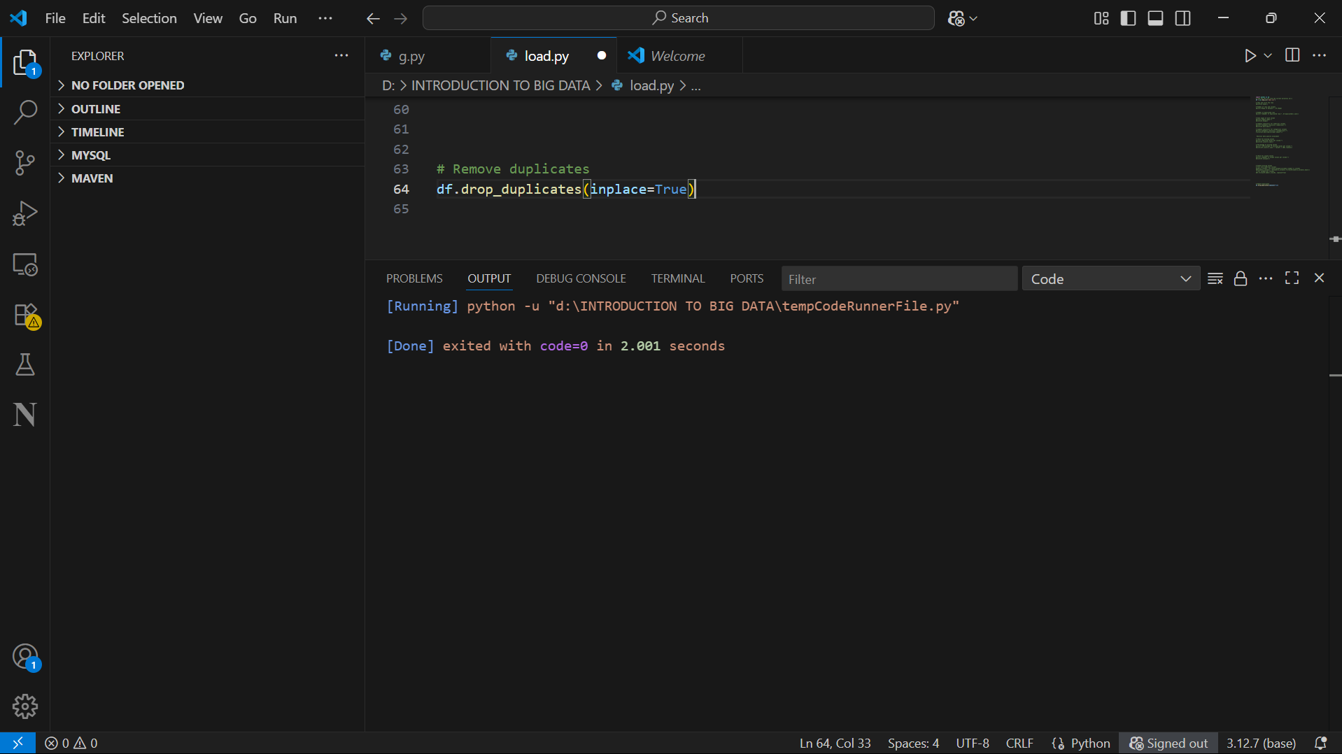
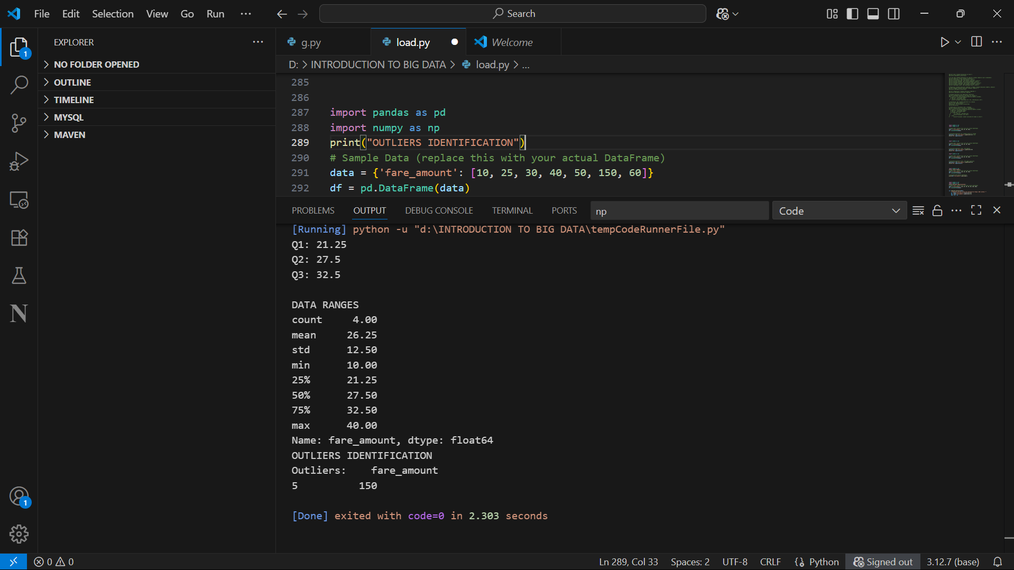
Cleaning for Reliability and Meaning
STEPS OF DATA CLEANING
. Handling missing values:- Filled missing numerical values with column mean (imputation)
-Filled missing categorical values with mode (most frequent value)
.Outlier detection:-Identified potention outliers in fare_amount column using Interquartile Range (IQR) method.

Slide 5
Dealing with inconsistencies:- Removed duplicated rows to ensure each observation appears only once.
Checked and confirmed data tpes for consistency ( ex: numeric vs object)

Slide 6
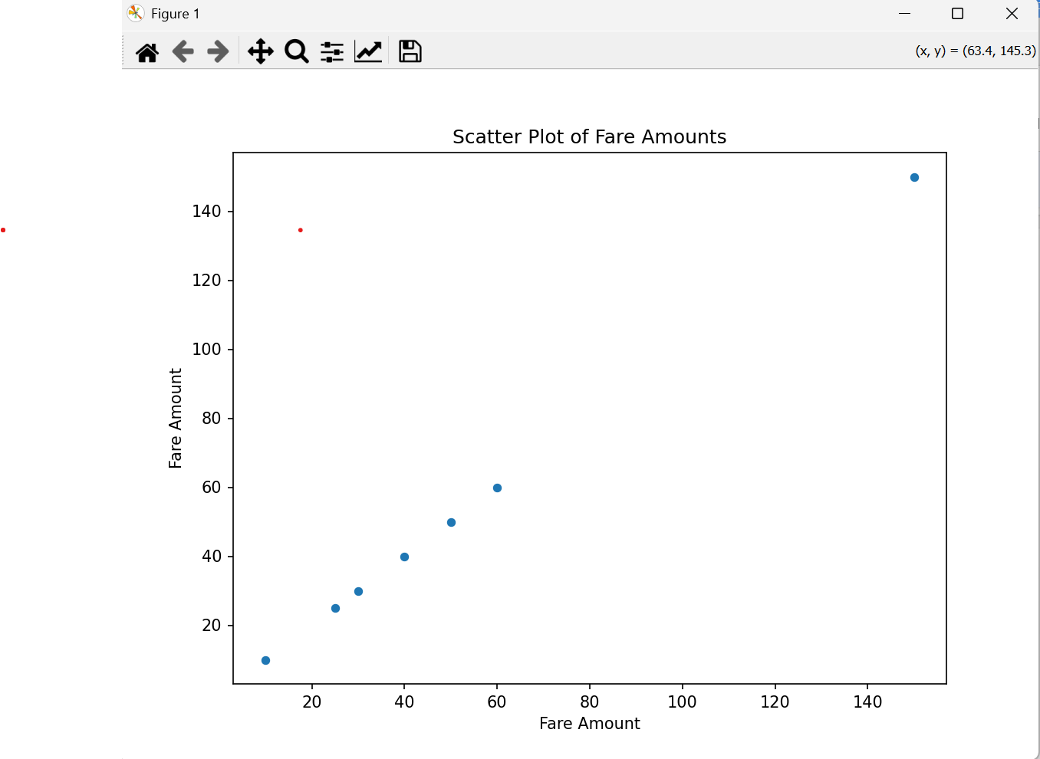
Visualizing the Patterns
Scatter plot of fare amounts

Slide 7
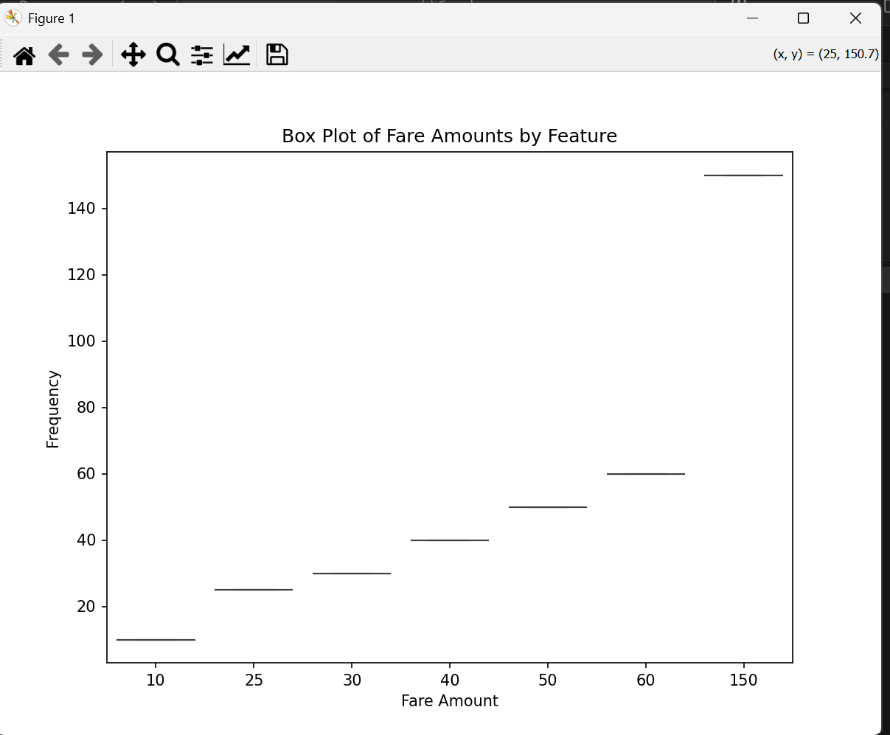

Slide 8
Actions for Improvement
✅ Key Findings Summary:
* The analysis revealed that fare amounts tend to cluster around certain ranges, but there are noticeable **outliers** (very high fares) which could be due to unusually long trips or data errors.
* We detected a significant number of duplicate rows, which could distort summary statistics if left untreated.
* The mean and median values suggest that most fares are relatively low, but the standard deviation and quartile analysis showed a long tail with higher fares.
* (If you add visualizations): Time-based patterns might show higher average fares during peak commuting hours, and a spatial heatmap could reveal hotspots around busy areas like airports or downtown.

Slide 9
Example
Example actionable insight:
We found that average fare amounts are up to 20% higher during weekday mornings, suggesting consistent peak demand.*

Slide 10
Recommandment/ACTIONS
Clean data regularly: Continue removing duplicates and handling missing values before analysis or modeling.
Monitor and handle outliers: Investigate unusually high fare values; decide whether to exclude, cap, or adjust them.
Enhance analysis: Add features like trip distance, pickup/drop-off time slots, and weather data to build richer predictive models.
Dynamic pricing strategy: Based on peak-hour fare increases, explore **off-peak fare discounts** or **peak-hour surcharges** to balance demand.
Operational efficiency: Use spatial heatmaps to guide **driver deployment** to high-demand zones.

Slide 11
The Road Ahead
📌 Key Takeaway
* The data cleaning and analysis improved dataset quality by removing duplicates and addressing missing values, ensuring more accurate insights.
* Identified outliers and patterns in fare amounts that could otherwise skew decision-making.
* Explored preliminary relationships between fare, time, and possible location clusters, which can guide targeted business strategies.
* These insights help build a strong foundation for predictive analytics, demand forecasting, and pricing optimization.
> Overall, the analysis transforms raw data into actionable insights that support smarter operational and pricing decisions.

Slide 12
YOUR INSIGHTS ARE VALUABLE
We now open the floor for questions, feedback, and discussion.
Your thoughts and suggestions are crucial to:
Validate these findings
Prioritize next steps
Align recommendations with business needs
Let’s collaborate to turn data into actionable improvements!

