Slide 1




College of Engineering
Oral Final Defense of Thesis entitled
DEVELOPMENT AND PERFORMANCE EVALUATION OF A REAL-TIME ANOMALY DETECTION SYSTEM FOR HYBRID POWER OPERATION USING RULE-BASED SIGNAL ANALYSIS
BY
ROSIE MAY ANDES
JAYVEE C. BUENAVENTURA
PRINCESS JANELLE M. CALIMUTAN
JHUDIEL F. CORDONATO
JONAS EISEN T. MANGUIAT
IAN MAR D. OCLARINO
KRISTHEL M. OROZCO
JOHN LLOYD P. RAZON
BS Computer Engineering Candidate
ENGR. FLAVIANO L. URERA JR. (Adviser)
ENGR. CHONA MASACUPAN (Co-Adviser)
ENGR. NOIME G. ROBLES (Specialist)
ENGR. RAYMOND R. BALINO (Statistician)
ENGR. WILFREDO G. TUSO III (Panel Chair)
ENGR. LEONARDO A. VENANCIO (Panel Chair)

Slide 2

DEVELOPMENT AND PERFORMANCE EVALUATION OF A REAL-TIME ANOMALY DETECTION SYSTEM FOR HYBRID POWER OPERATION USING RULE-BASED SIGNAL ANALYSIS
ANDES, BUENAVENTURA, CALIMUTAN, CORDONATO, MANGUIAT, OCLARINO, OROZCO, RAZON
OVERVIEW
  Introduction
  Objectives of the Study
  Research Paradigm/ Framework
  General Description and Features, Parts and Relevant Computations and Assumptions
  Special techniques and Procedure
  System Performance, Relevant Graphs and Figures, Analysis
  Findings, Conclusion and Recommendation

Slide 3


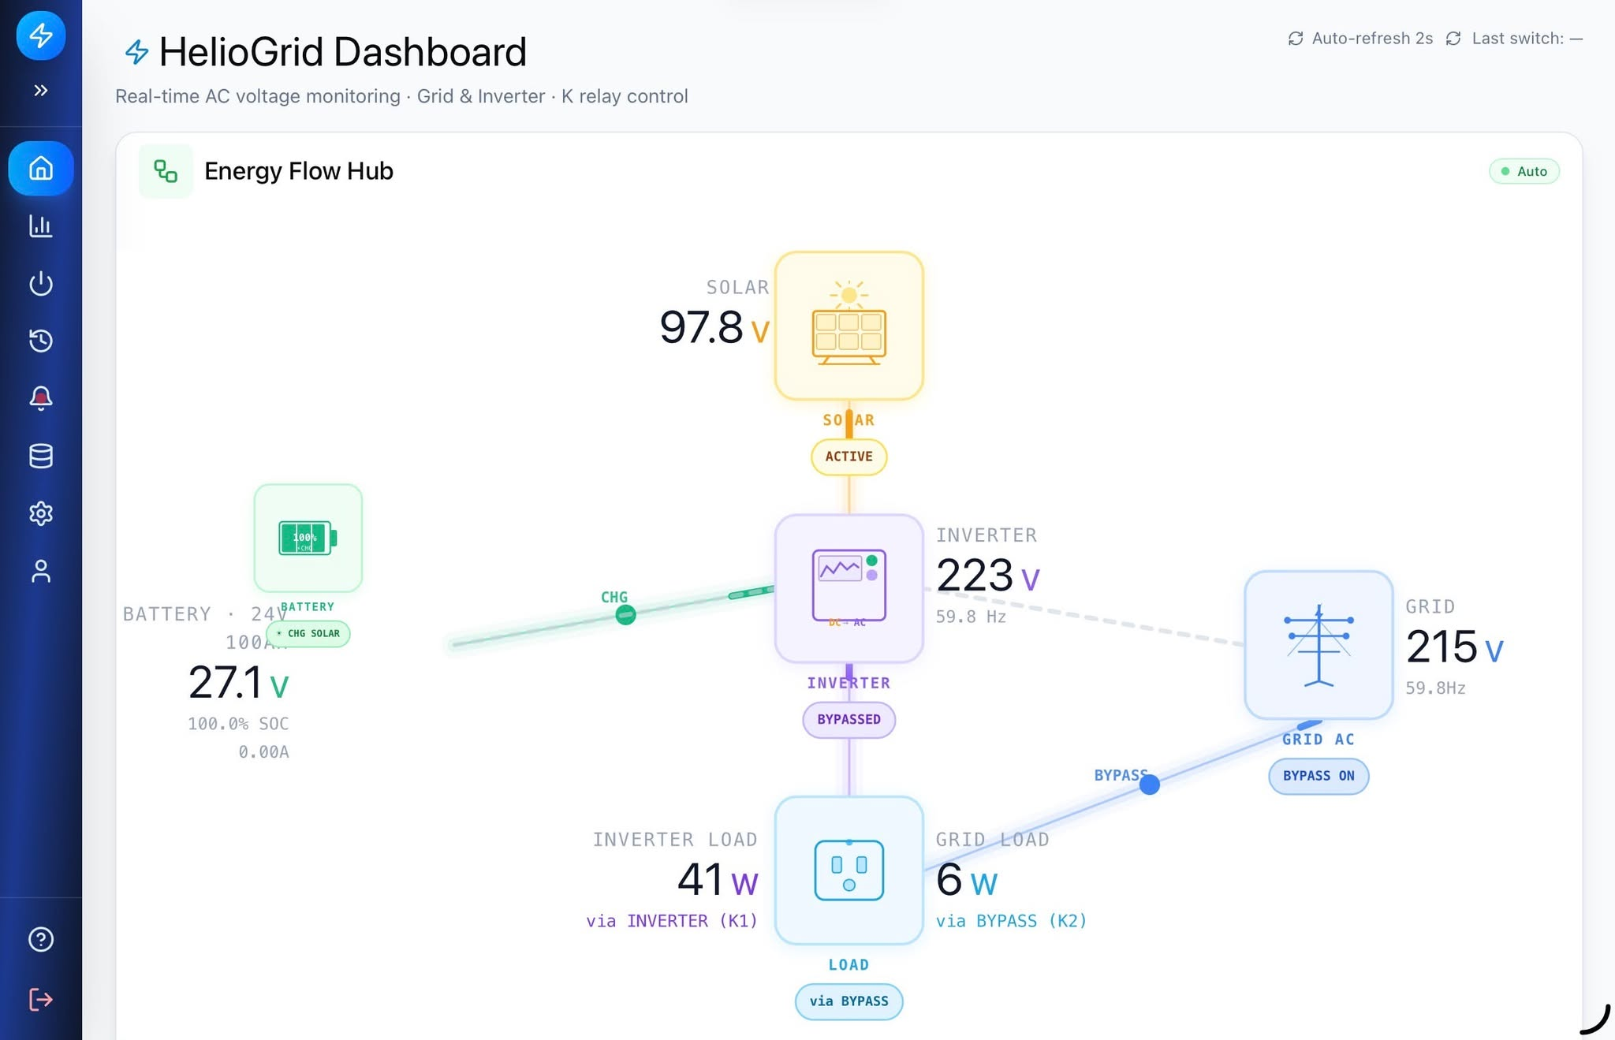
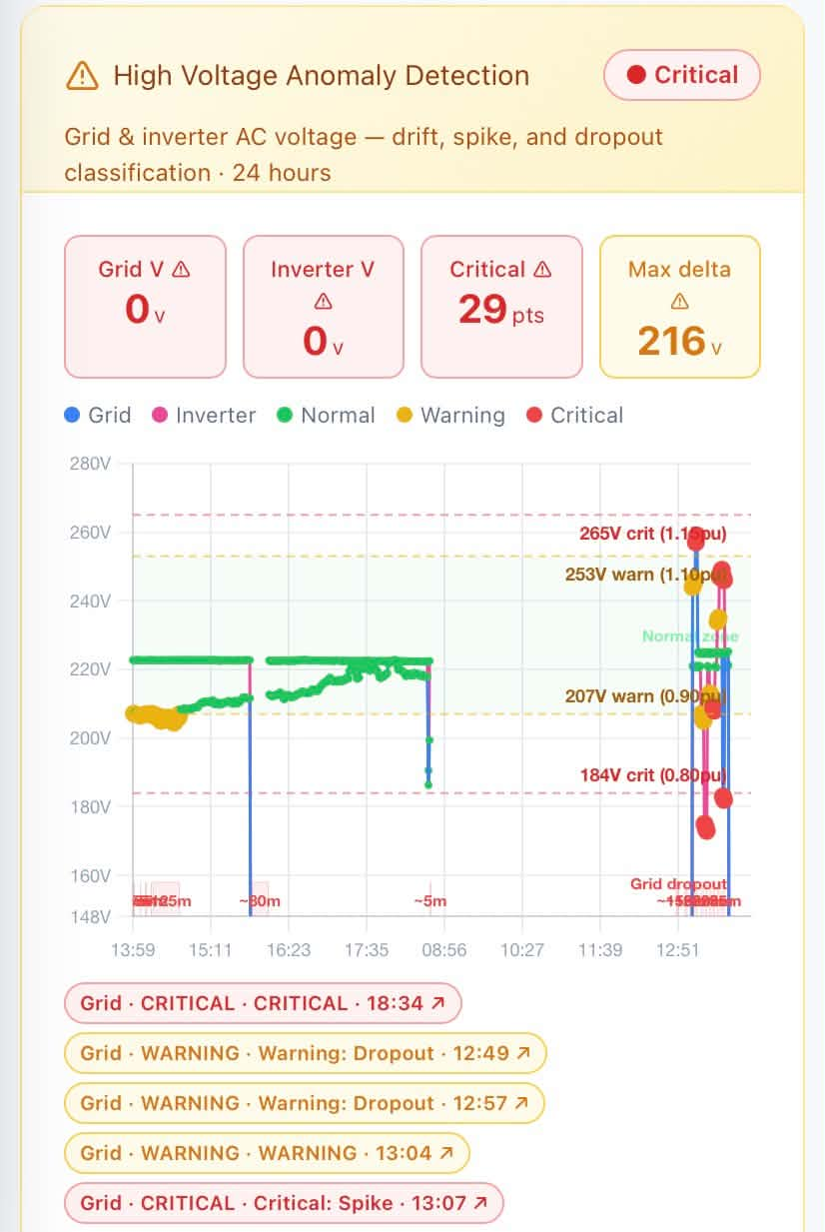
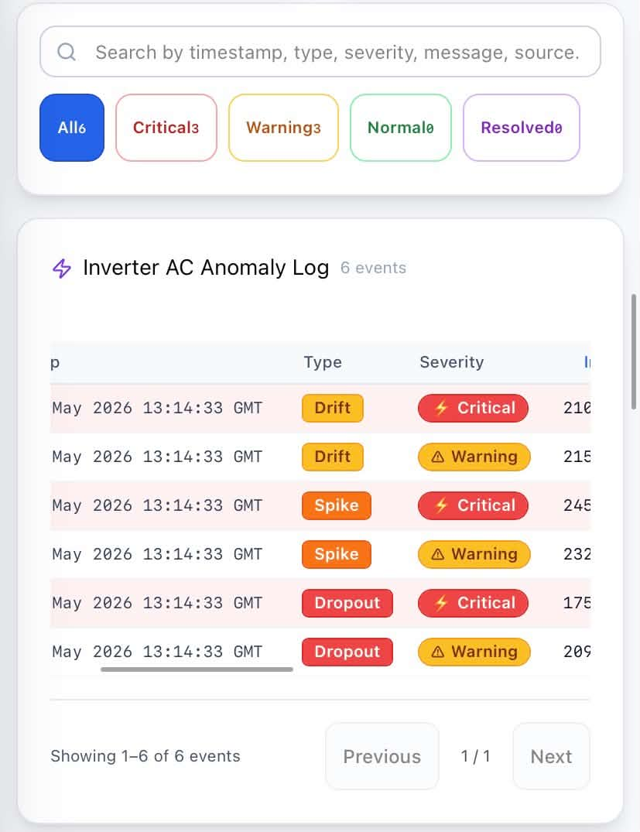
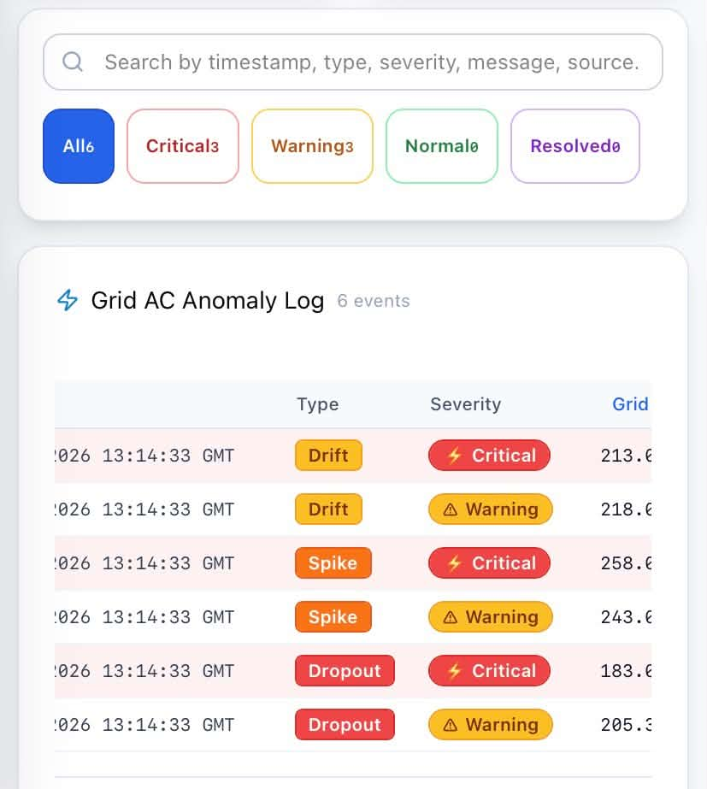
DEVELOPMENT AND PERFORMANCE EVALUATION OF A REAL-TIME ANOMALY DETECTION SYSTEM FOR HYBRID POWER OPERATION USING RULE-BASED SIGNAL ANALYSIS
ANDES, BUENAVENTURA, CALIMUTAN, CORDONATO, MANGUIAT, OCLARINO, OROZCO, RAZON
INTRODUCTION

Slide 4
DEVELOPMENT AND PERFORMANCE EVALUATION OF A REAL-TIME ANOMALY DETECTION SYSTEM FOR HYBRID POWER OPERATION USING RULE-BASED SIGNAL ANALYSIS
ANDES, BUENAVENTURA, CALIMUTAN, CORDONATO, MANGUIAT, OCLARINO, OROZCO, RAZON
OBJECTIVES
The general objective of this study is to develop and evaluate a real-time anomaly detection system for hybrid power operation using rule-based signal analysis.
This study specifically aims to:
Develop a monitoring and alert feature system that presents detected anomalies and notifies users during abnormal voltage conditions.
Design a rule-based mechanism for the real-time detection and classification of voltage anomalies, specifically spike, drift, and dropout.
Evaluate the performance of the developed system in terms of:
3.1 Accuracy
3.2 Precision
3.3 Recall
3.4 F1-Score

Slide 5
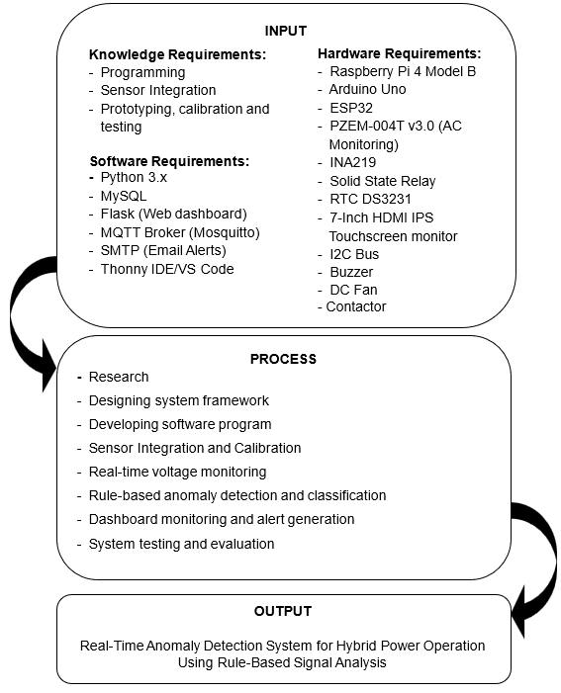
DEVELOPMENT AND PERFORMANCE EVALUATION OF A REAL-TIME ANOMALY DETECTION SYSTEM FOR HYBRID POWER OPERATION USING RULE-BASED SIGNAL ANALYSIS
ANDES, BUENAVENTURA, CALIMUTAN, CORDONATO, MANGUIAT, OCLARINO, OROZCO, RAZON
RESEARCH PARADIGM/ FRAMEWORK

Slide 6
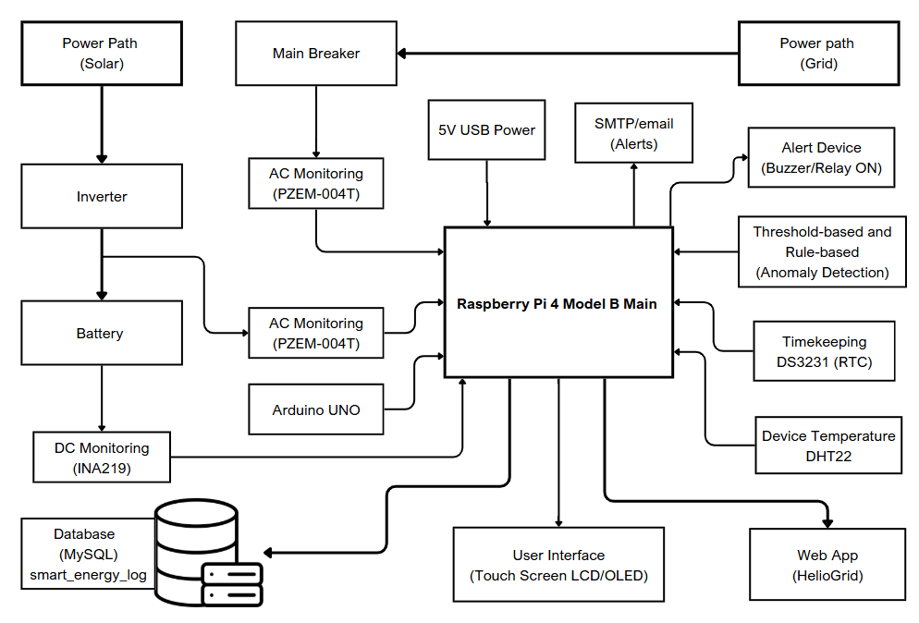
DEVELOPMENT AND PERFORMANCE EVALUATION OF A REAL-TIME ANOMALY DETECTION SYSTEM FOR HYBRID POWER OPERATION USING RULE-BASED SIGNAL ANALYSIS
ANDES, BUENAVENTURA, CALIMUTAN, CORDONATO, MANGUIAT, OCLARINO, OROZCO, RAZON
GENERAL DESCRIPTION AND FEATURES, PARTS AND RELEVANT COMPUTATIONS AND ASSUMPTIONS
Figure 2: Block Diagram of the System

Slide 7
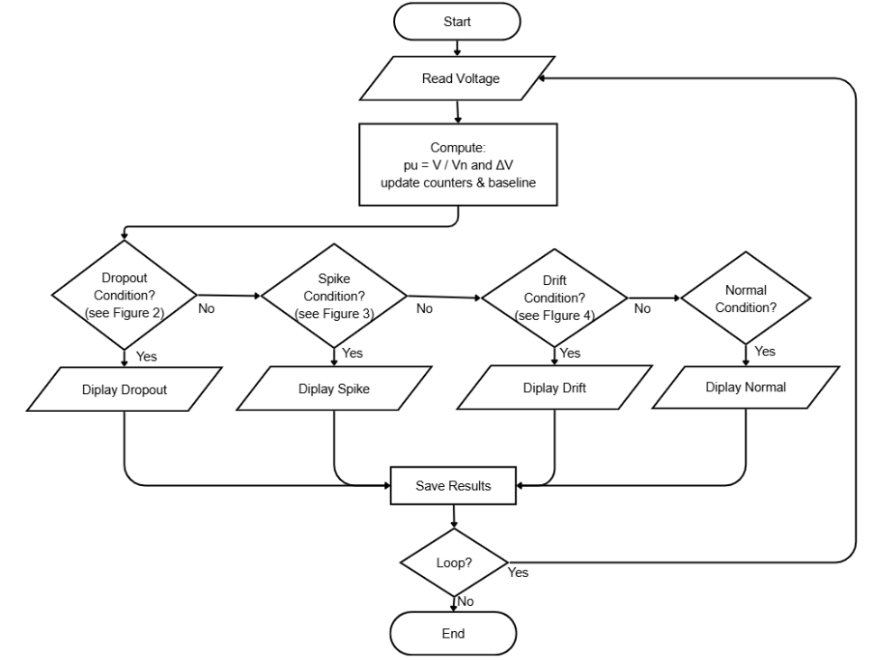
DEVELOPMENT AND PERFORMANCE EVALUATION OF A REAL-TIME ANOMALY DETECTION SYSTEM FOR HYBRID POWER OPERATION USING RULE-BASED SIGNAL ANALYSIS
ANDES, BUENAVENTURA, CALIMUTAN, CORDONATO, MANGUIAT, OCLARINO, OROZCO, RAZON
GENERAL DESCRIPTION AND FEATURES, PARTS AND RELEVANT COMPUTATIONS AND ASSUMPTIONS
Figure 3. Overall Flow of the Anomaly Detection System

Slide 8
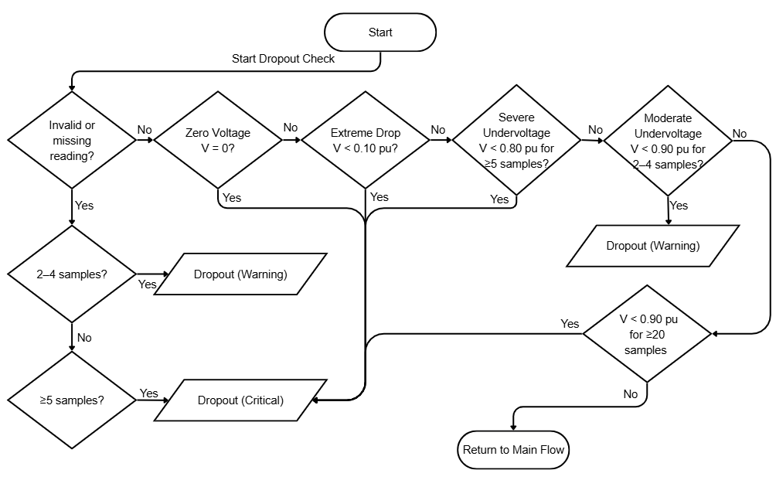
DEVELOPMENT AND PERFORMANCE EVALUATION OF A REAL-TIME ANOMALY DETECTION SYSTEM FOR HYBRID POWER OPERATION USING RULE-BASED SIGNAL ANALYSIS
ANDES, BUENAVENTURA, CALIMUTAN, CORDONATO, MANGUIAT, OCLARINO, OROZCO, RAZON
GENERAL DESCRIPTION AND FEATURES, PARTS AND RELEVANT COMPUTATIONS AND ASSUMPTIONS
Figure 3.1. Dropout Detection Flowchart for AC Grid Power Source

Slide 9
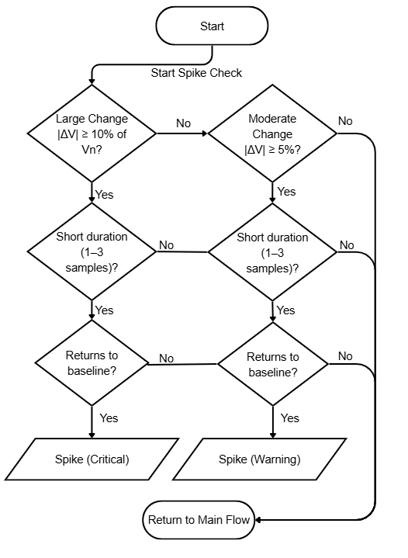
DEVELOPMENT AND PERFORMANCE EVALUATION OF A REAL-TIME ANOMALY DETECTION SYSTEM FOR HYBRID POWER OPERATION USING RULE-BASED SIGNAL ANALYSIS
ANDES, BUENAVENTURA, CALIMUTAN, CORDONATO, MANGUIAT, OCLARINO, OROZCO, RAZON
GENERAL DESCRIPTION AND FEATURES, PARTS AND RELEVANT COMPUTATIONS AND ASSUMPTIONS
Figure 3.2. Spike Detection Flowchart

Slide 10
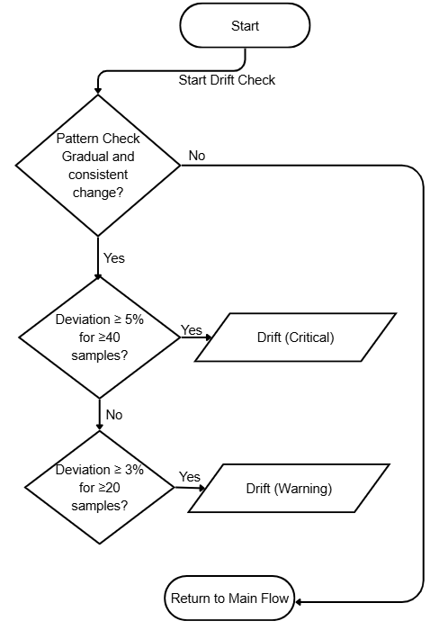
DEVELOPMENT AND PERFORMANCE EVALUATION OF A REAL-TIME ANOMALY DETECTION SYSTEM FOR HYBRID POWER OPERATION USING RULE-BASED SIGNAL ANALYSIS
ANDES, BUENAVENTURA, CALIMUTAN, CORDONATO, MANGUIAT, OCLARINO, OROZCO, RAZON
GENERAL DESCRIPTION AND FEATURES, PARTS AND RELEVANT COMPUTATIONS AND ASSUMPTIONS
Figure 3.3. Drift Detection Flowchart

Slide 11
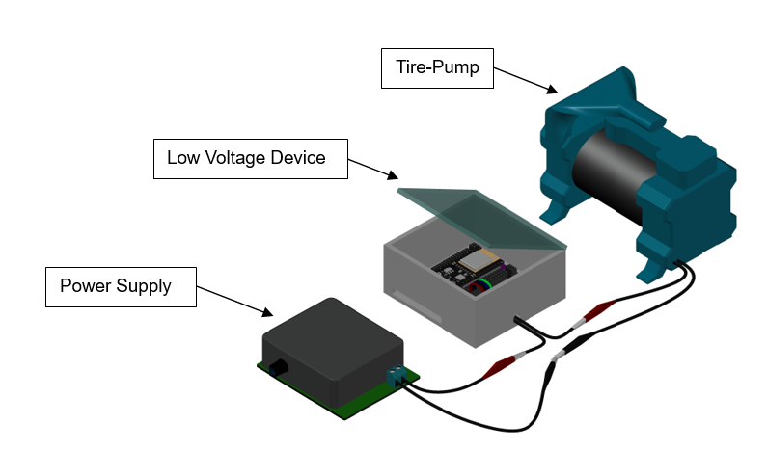
DEVELOPMENT AND PERFORMANCE EVALUATION OF A REAL-TIME ANOMALY DETECTION SYSTEM FOR HYBRID POWER OPERATION USING RULE-BASED SIGNAL ANALYSIS
ANDES, BUENAVENTURA, CALIMUTAN, CORDONATO, MANGUIAT, OCLARINO, OROZCO, RAZON
GENERAL DESCRIPTION AND FEATURES, PARTS AND RELEVANT COMPUTATIONS AND ASSUMPTIONS
Figure 4. Hardware Setup for Low-Voltage Pre-Testing

Slide 12
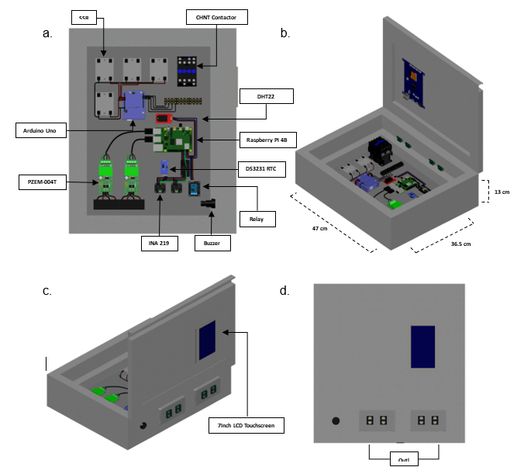
DEVELOPMENT AND PERFORMANCE EVALUATION OF A REAL-TIME ANOMALY DETECTION SYSTEM FOR HYBRID POWER OPERATION USING RULE-BASED SIGNAL ANALYSIS
ANDES, BUENAVENTURA, CALIMUTAN, CORDONATO, MANGUIAT, OCLARINO, OROZCO, RAZON
GENERAL DESCRIPTION AND FEATURES, PARTS AND RELEVANT COMPUTATIONS AND ASSUMPTIONS
Figure 5. Conceptual design of the real-time hybrid power voltage anomaly detection system

Slide 13
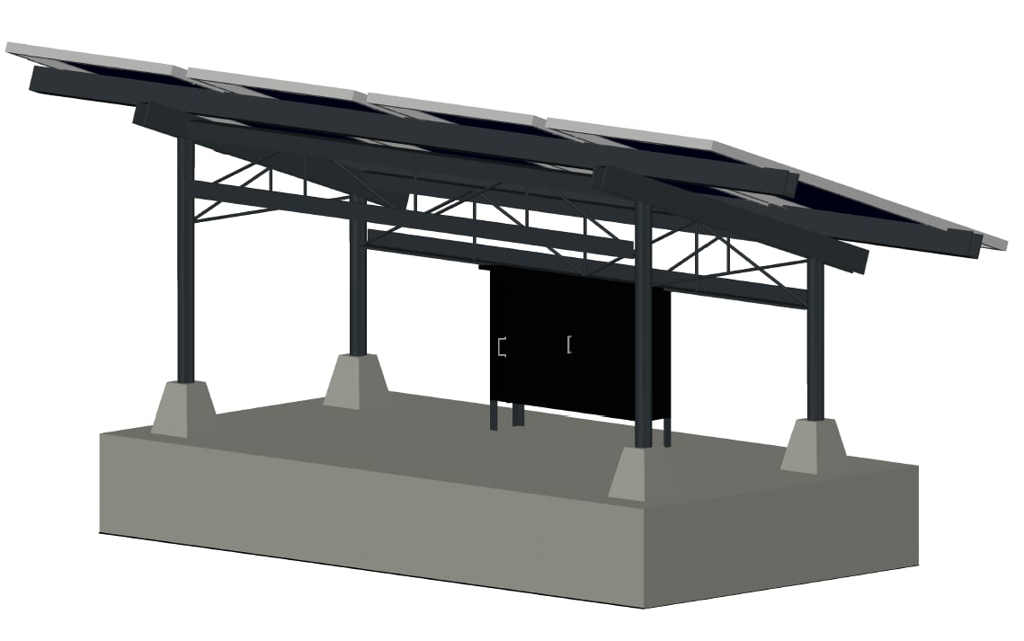
DEVELOPMENT AND PERFORMANCE EVALUATION OF A REAL-TIME ANOMALY DETECTION SYSTEM FOR HYBRID POWER OPERATION USING RULE-BASED SIGNAL ANALYSIS
ANDES, BUENAVENTURA, CALIMUTAN, CORDONATO, MANGUIAT, OCLARINO, OROZCO, RAZON
GENERAL DESCRIPTION AND FEATURES, PARTS AND RELEVANT COMPUTATIONS AND ASSUMPTIONS
Figure 6. Physical setup of the solar panel installation in the hybrid power system

Slide 14
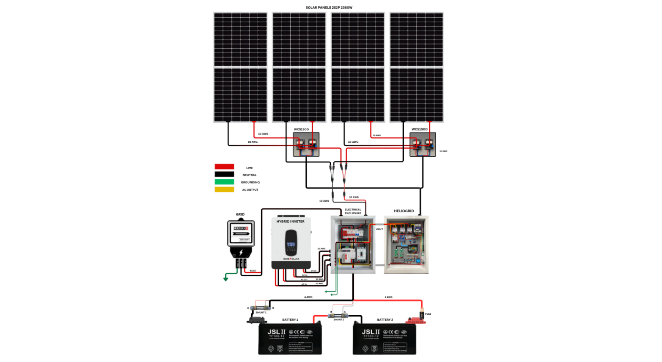
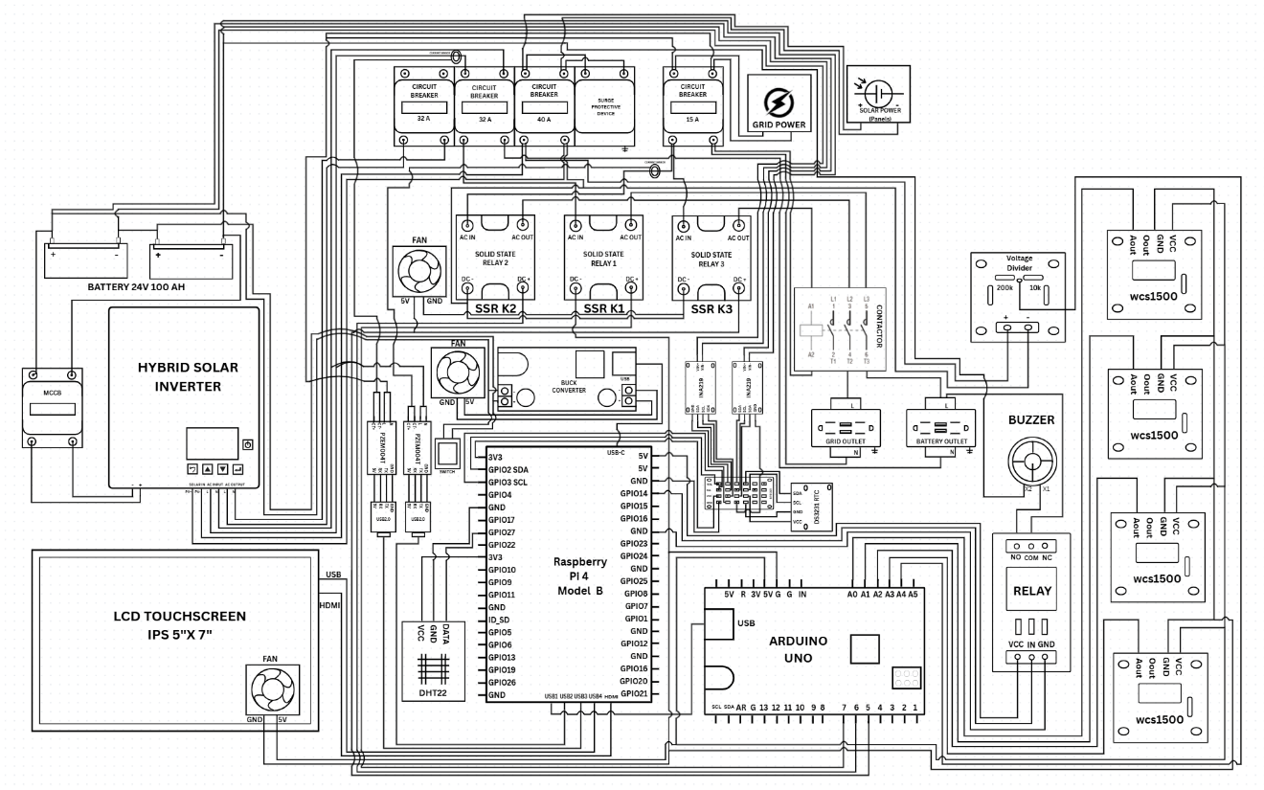
DEVELOPMENT AND PERFORMANCE EVALUATION OF A REAL-TIME ANOMALY DETECTION SYSTEM FOR HYBRID POWER OPERATION USING RULE-BASED SIGNAL ANALYSIS
ANDES, BUENAVENTURA, CALIMUTAN, CORDONATO, MANGUIAT, OCLARINO, OROZCO, RAZON
GENERAL DESCRIPTION AND FEATURES, PARTS AND RELEVANT COMPUTATIONS AND ASSUMPTIONS
Figure 7. Schematic Diagram of the Proposed System
Figure 8. Pictorial Diagram of the Proposed System

Slide 15
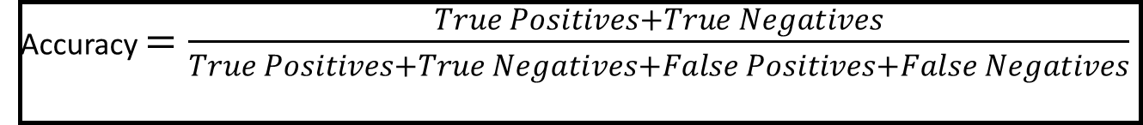
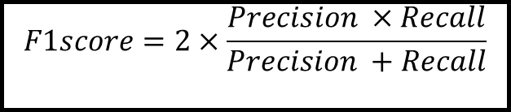
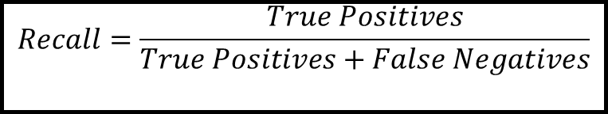
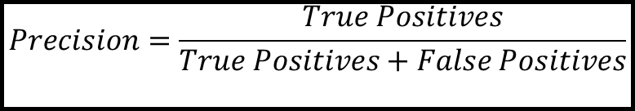
DEVELOPMENT AND PERFORMANCE EVALUATION OF A REAL-TIME ANOMALY DETECTION SYSTEM FOR HYBRID POWER OPERATION USING RULE-BASED SIGNAL ANALYSIS
ANDES, BUENAVENTURA, CALIMUTAN, CORDONATO, MANGUIAT, OCLARINO, OROZCO, RAZON
GENERAL DESCRIPTION AND FEATURES, PARTS AND RELEVANT COMPUTATIONS AND ASSUMPTIONS
Accuracy $=\frac{True Positives+True Negatives}{True Positives+True Negatives+False Positives+False Negatives}$
Equation 1
$$Precision=\frac{True Positives}{True Positives+False Positives}$$
Equation 2
$$Recall=\frac{True Positives}{True Positives+False Negatives}$$
Equation 3
$$F1score=2×\frac{Precision ×Recall}{Precision +Recall}$$
Equation 4

Slide 16
DEVELOPMENT AND PERFORMANCE EVALUATION OF A REAL-TIME ANOMALY DETECTION SYSTEM FOR HYBRID POWER OPERATION USING RULE-BASED SIGNAL ANALYSIS
ANDES, BUENAVENTURA, CALIMUTAN, CORDONATO, MANGUIAT, OCLARINO, OROZCO, RAZON
SPECIAL TECHNIQUES AND PROCEDURE
The study used rule-based signal analysis to detect and classify AC and DC voltage anomalies in a hybrid power system. Voltage readings were evaluated using predefined rules based on voltage magnitude, rate of change, and persistence over time to identify dropout, spike, drift, or normal conditions. A low-voltage pre-testing setup with a nominal voltage of 6.0 V was first used to safely validate and refine the detection logic before applying the calibrated rules to actual AC and DC sources. The system followed a detection sequence of dropout, spike, drift, then normal, and the results were recorded, displayed, and used for alert generation when needed.

Slide 17
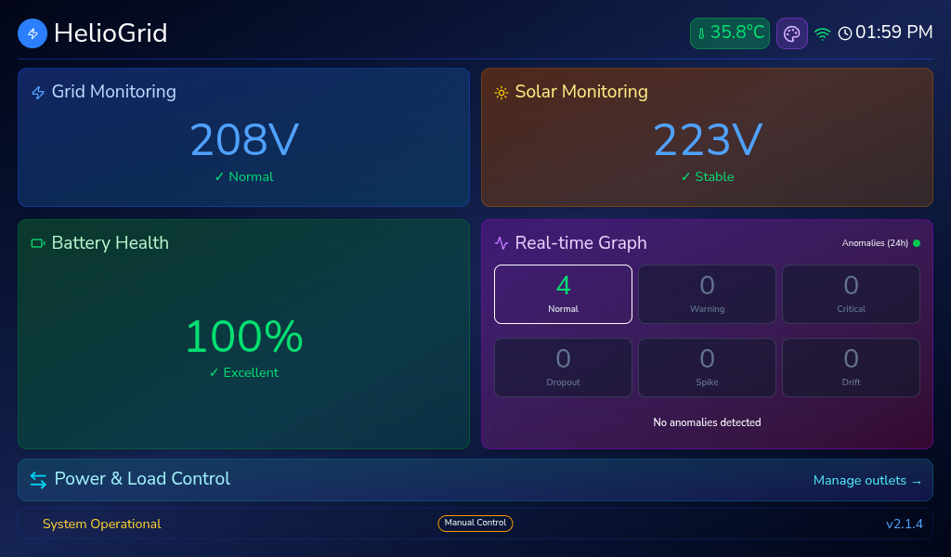
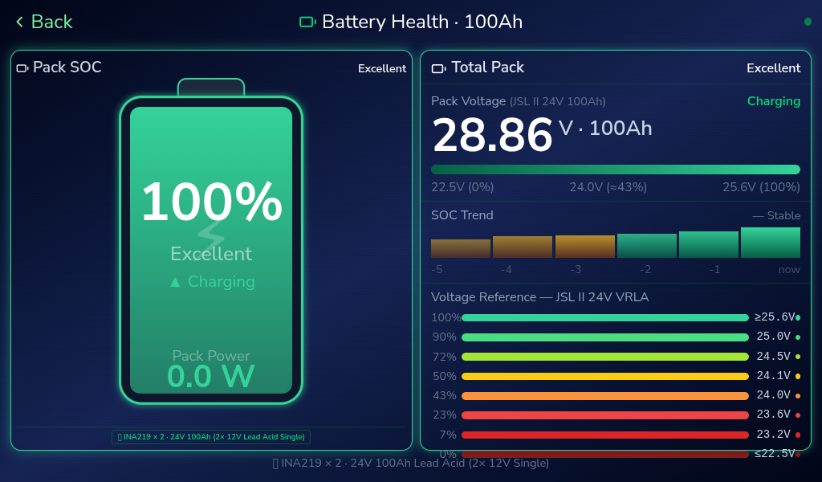
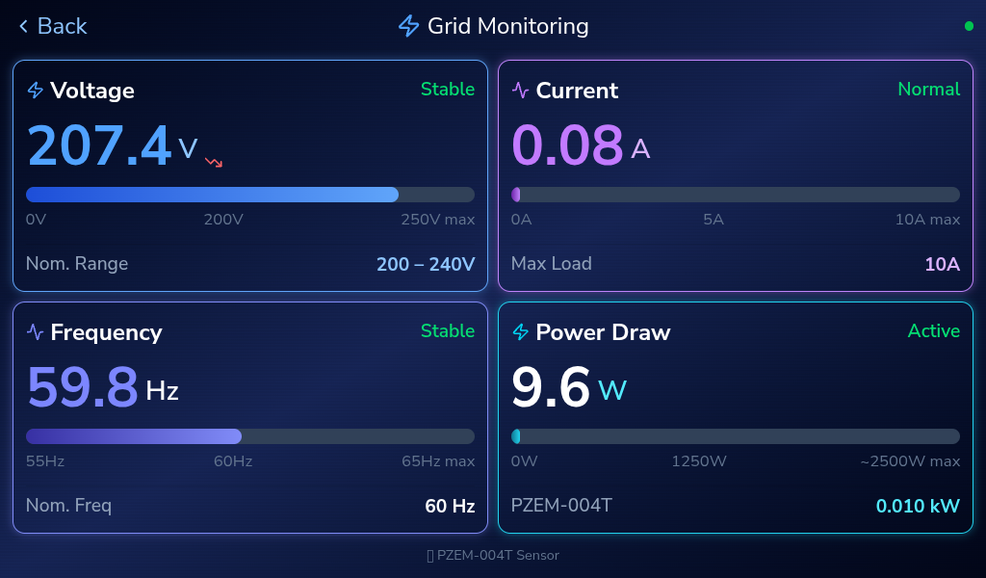
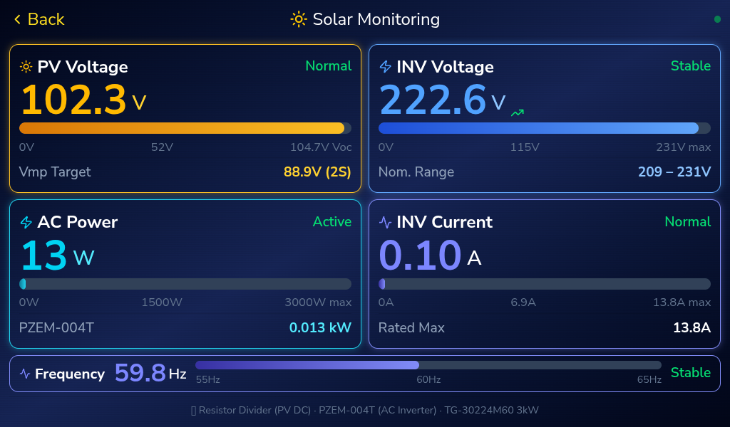
DEVELOPMENT AND PERFORMANCE EVALUATION OF A REAL-TIME ANOMALY DETECTION SYSTEM FOR HYBRID POWER OPERATION USING RULE-BASED SIGNAL ANALYSIS
ANDES, BUENAVENTURA, CALIMUTAN, CORDONATO, MANGUIAT, OCLARINO, OROZCO, RAZON
SPECIAL TECHNIQUES AND PROCEDURE
Figure 9. Interface of the kiosk

Slide 18
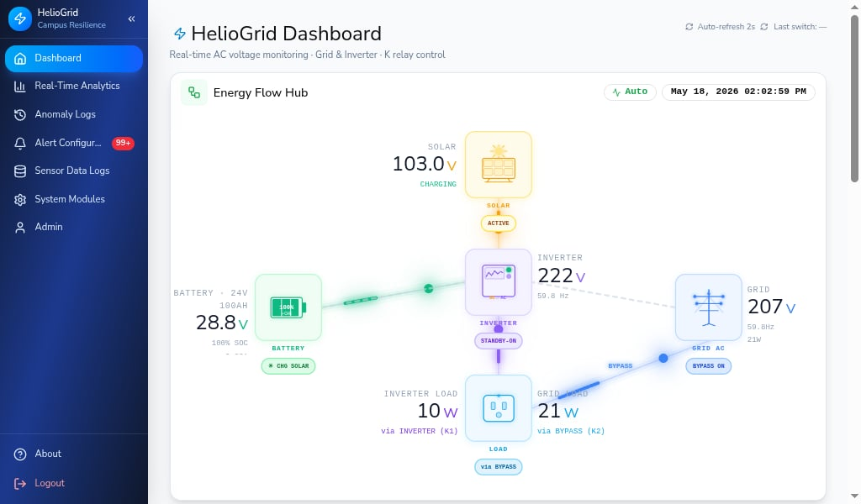
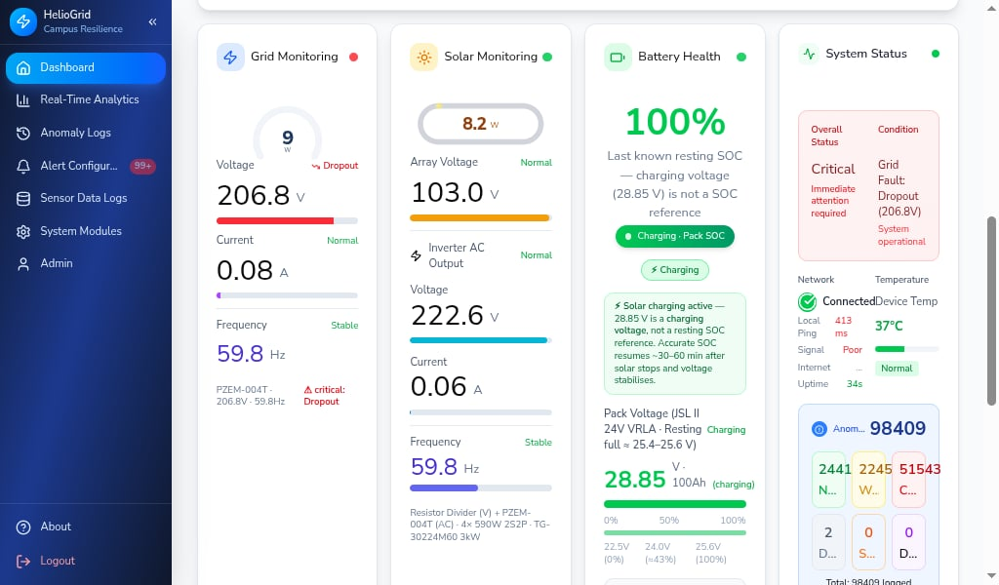
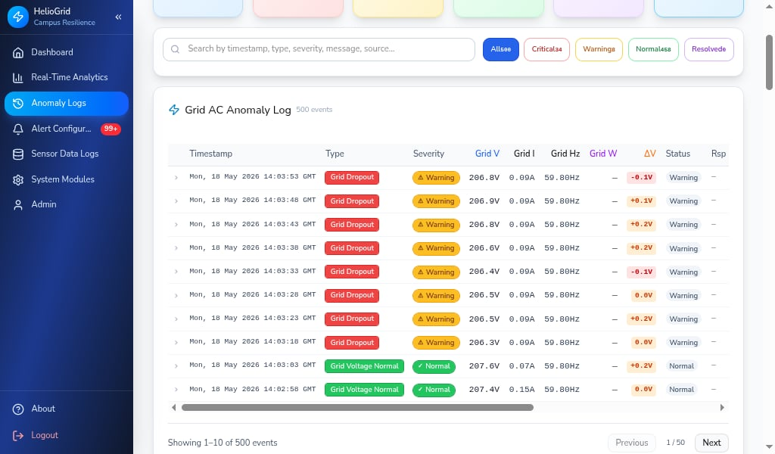
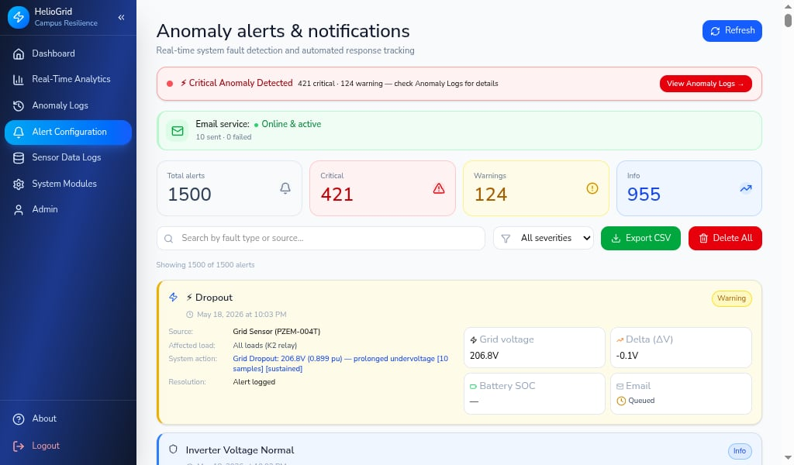
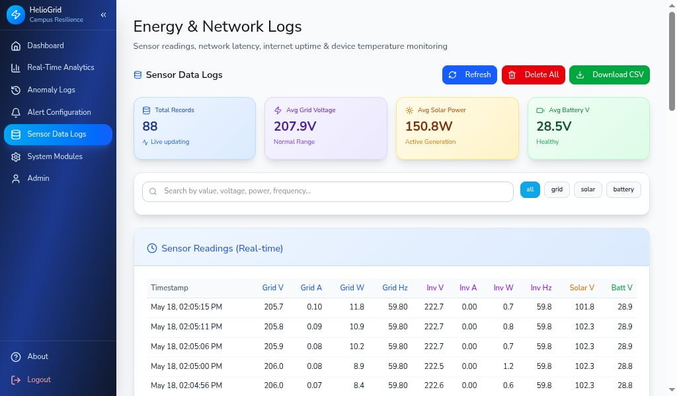
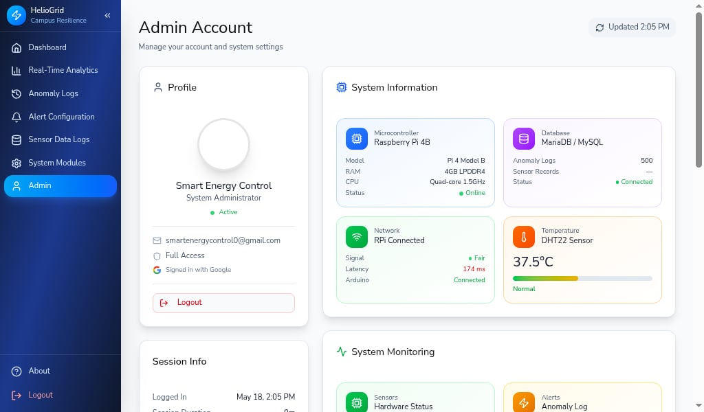
DEVELOPMENT AND PERFORMANCE EVALUATION OF A REAL-TIME ANOMALY DETECTION SYSTEM FOR HYBRID POWER OPERATION USING RULE-BASED SIGNAL ANALYSIS
ANDES, BUENAVENTURA, CALIMUTAN, CORDONATO, MANGUIAT, OCLARINO, OROZCO, RAZON
SPECIAL TECHNIQUES AND PROCEDURE
Figure 10. User Interface Concept Architecture Design

Slide 19
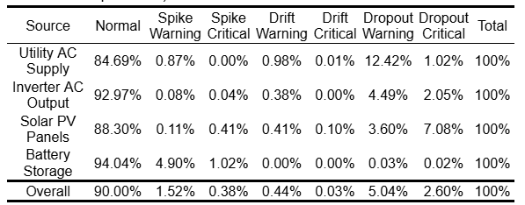
DEVELOPMENT AND PERFORMANCE EVALUATION OF A REAL-TIME ANOMALY DETECTION SYSTEM FOR HYBRID POWER OPERATION USING RULE-BASED SIGNAL ANALYSIS
ANDES, BUENAVENTURA, CALIMUTAN, CORDONATO, MANGUIAT, OCLARINO, OROZCO, RAZON
SYSTEM PERFORMANCE, RELEVANT GRAPHS AND FIGURES, ANALYSIS
Table 6. Percentage Distribution of Detected Voltage Conditions (No Load Phase: April 24–30)

Slide 20
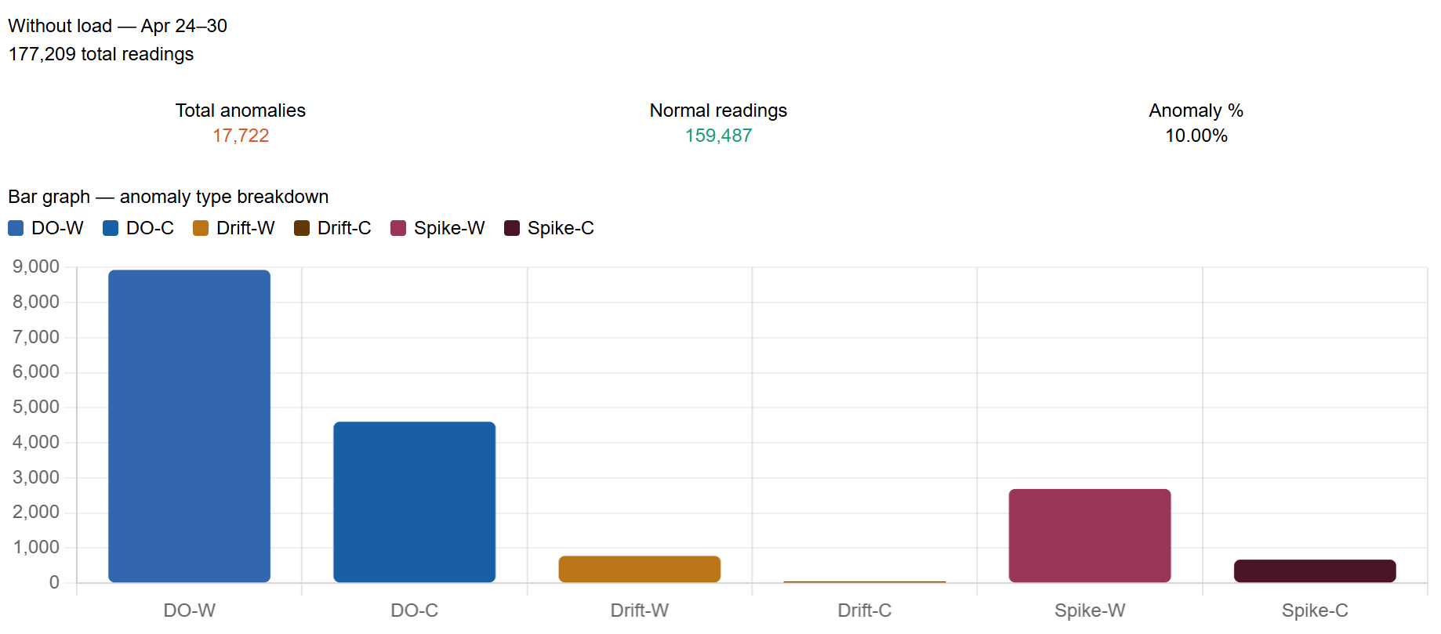
DEVELOPMENT AND PERFORMANCE EVALUATION OF A REAL-TIME ANOMALY DETECTION SYSTEM FOR HYBRID POWER OPERATION USING RULE-BASED SIGNAL ANALYSIS
ANDES, BUENAVENTURA, CALIMUTAN, CORDONATO, MANGUIAT, OCLARINO, OROZCO, RAZON
SYSTEM PERFORMANCE, RELEVANT GRAPHS AND FIGURES, ANALYSIS
Graphical Presentation and Comparative Analysis of Detected Voltage Anomalies
Figure 11. Distribution of Spike, Drift, and Dropout Anomalies During No-Load Operation

Slide 21
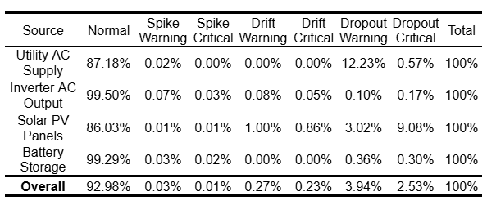
DEVELOPMENT AND PERFORMANCE EVALUATION OF A REAL-TIME ANOMALY DETECTION SYSTEM FOR HYBRID POWER OPERATION USING RULE-BASED SIGNAL ANALYSIS
ANDES, BUENAVENTURA, CALIMUTAN, CORDONATO, MANGUIAT, OCLARINO, OROZCO, RAZON
SYSTEM PERFORMANCE, RELEVANT GRAPHS AND FIGURES, ANALYSIS
Table 7. Percentage Distribution of Detected Voltage Conditions (With Load Phase: May 3–10)

Slide 22
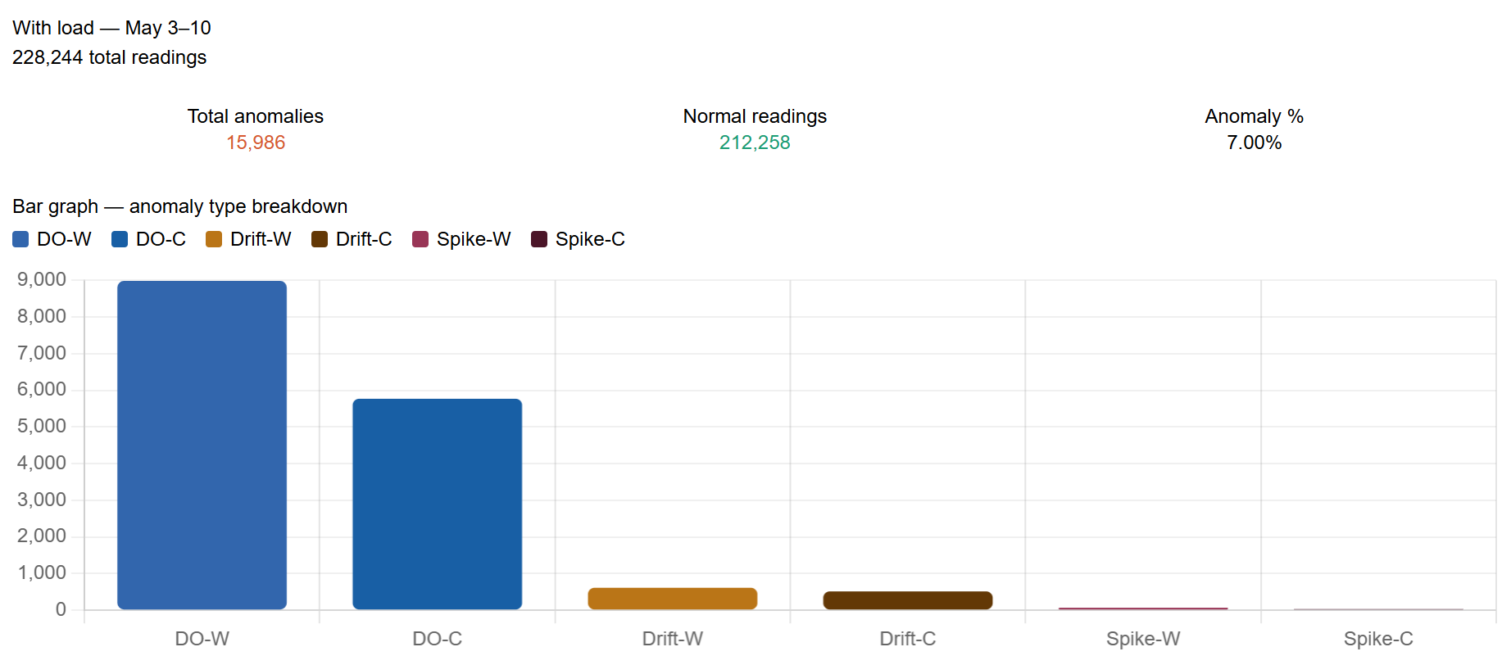
DEVELOPMENT AND PERFORMANCE EVALUATION OF A REAL-TIME ANOMALY DETECTION SYSTEM FOR HYBRID POWER OPERATION USING RULE-BASED SIGNAL ANALYSIS
ANDES, BUENAVENTURA, CALIMUTAN, CORDONATO, MANGUIAT, OCLARINO, OROZCO, RAZON
SYSTEM PERFORMANCE, RELEVANT GRAPHS AND FIGURES, ANALYSIS
Figure 12. Distribution of Spike, Drift, and Dropout Anomalies During With-Load Operation

Slide 23
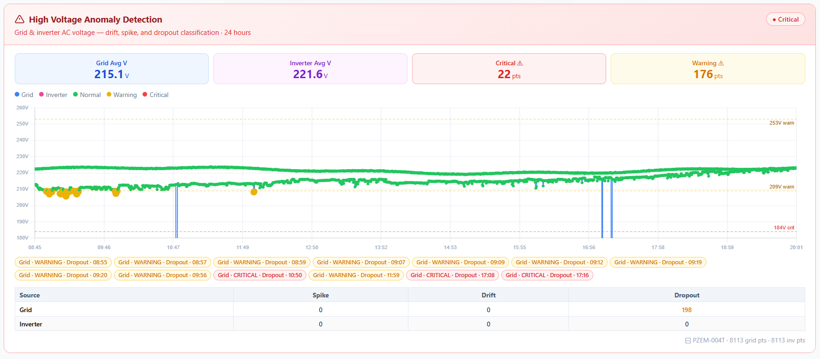
DEVELOPMENT AND PERFORMANCE EVALUATION OF A REAL-TIME ANOMALY DETECTION SYSTEM FOR HYBRID POWER OPERATION USING RULE-BASED SIGNAL ANALYSIS
ANDES, BUENAVENTURA, CALIMUTAN, CORDONATO, MANGUIAT, OCLARINO, OROZCO, RAZON
SYSTEM PERFORMANCE, RELEVANT GRAPHS AND FIGURES, ANALYSIS
Graphical Presentation and Comparative Analysis of Detected Voltage Anomalies
No-Load Phase
April 24, 2026
Figure 13. Grid and Inverter Voltage Trend (April 24)

Slide 24
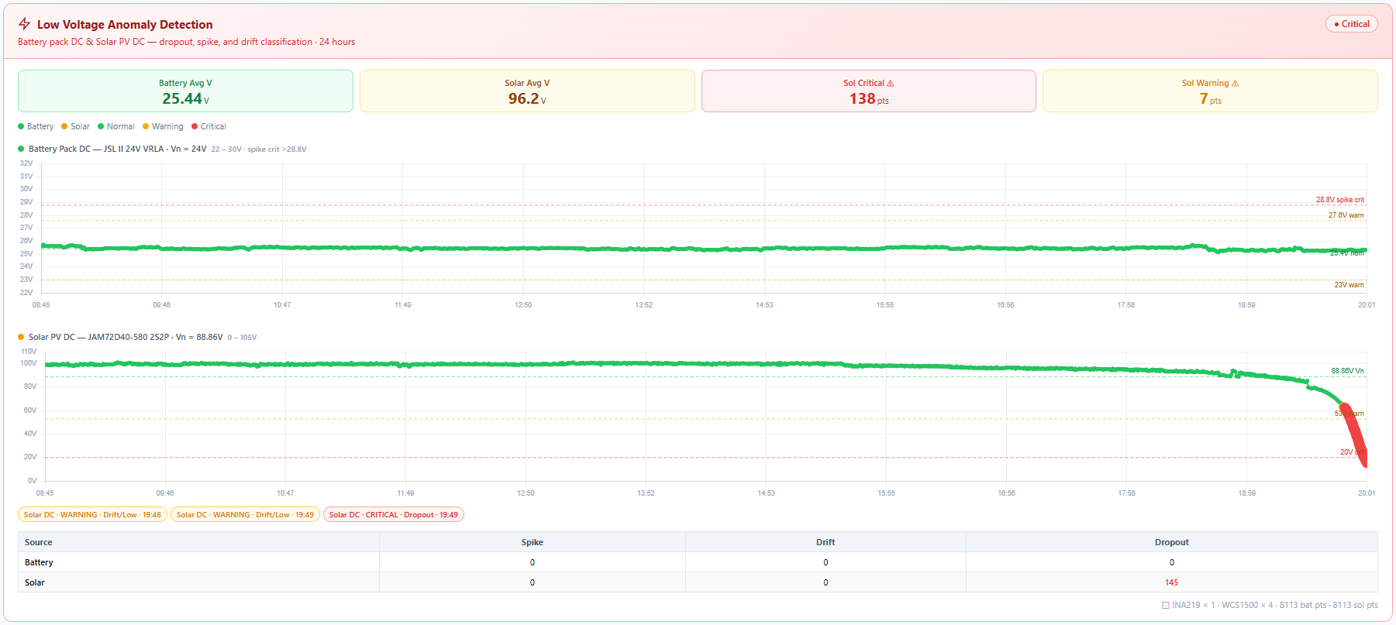
DEVELOPMENT AND PERFORMANCE EVALUATION OF A REAL-TIME ANOMALY DETECTION SYSTEM FOR HYBRID POWER OPERATION USING RULE-BASED SIGNAL ANALYSIS
ANDES, BUENAVENTURA, CALIMUTAN, CORDONATO, MANGUIAT, OCLARINO, OROZCO, RAZON
SYSTEM PERFORMANCE, RELEVANT GRAPHS AND FIGURES, ANALYSIS
Graphical Presentation and Comparative Analysis of Detected Voltage Anomalies
No-Load Phase
April 24, 2026
Figure 14. Solar PV and Battery Voltage Trend (April 24)

Slide 25
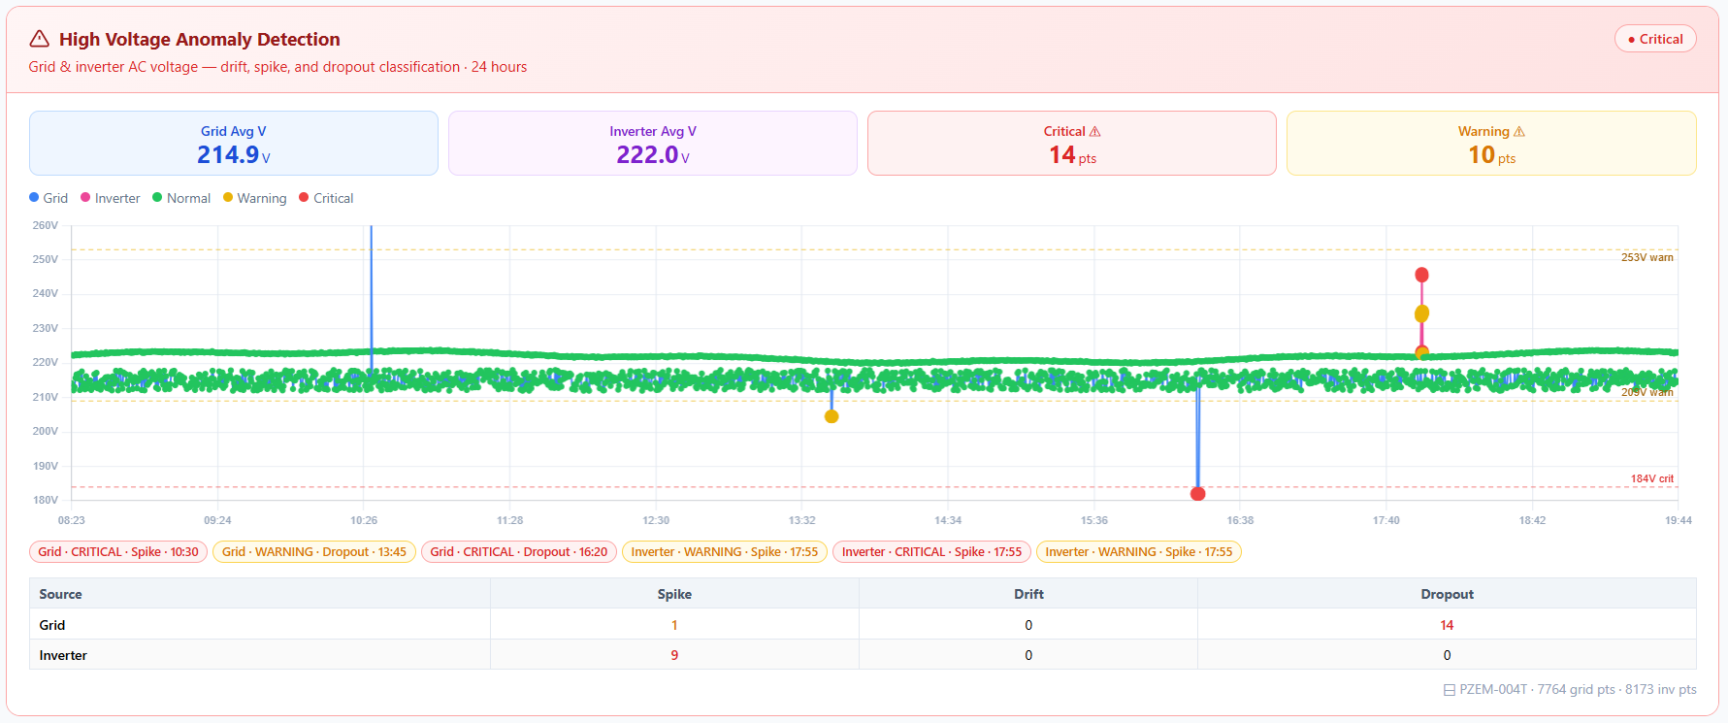
DEVELOPMENT AND PERFORMANCE EVALUATION OF A REAL-TIME ANOMALY DETECTION SYSTEM FOR HYBRID POWER OPERATION USING RULE-BASED SIGNAL ANALYSIS
ANDES, BUENAVENTURA, CALIMUTAN, CORDONATO, MANGUIAT, OCLARINO, OROZCO, RAZON
SYSTEM PERFORMANCE, RELEVANT GRAPHS AND FIGURES, ANALYSIS
April 25, 2026
Figure 15. Grid and Inverter Voltage Trend (April 25)

Slide 26
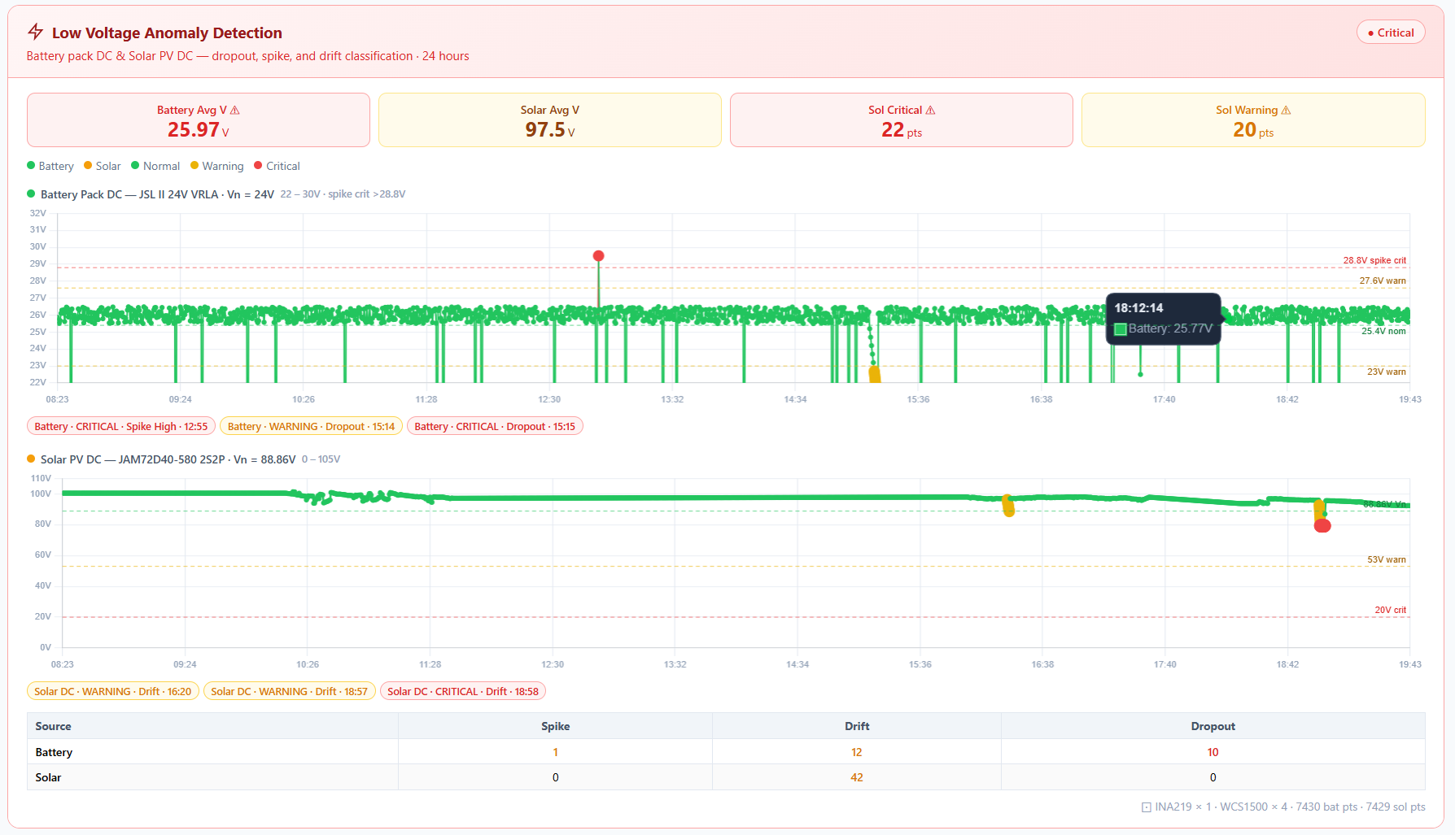
DEVELOPMENT AND PERFORMANCE EVALUATION OF A REAL-TIME ANOMALY DETECTION SYSTEM FOR HYBRID POWER OPERATION USING RULE-BASED SIGNAL ANALYSIS
ANDES, BUENAVENTURA, CALIMUTAN, CORDONATO, MANGUIAT, OCLARINO, OROZCO, RAZON
SYSTEM PERFORMANCE, RELEVANT GRAPHS AND FIGURES, ANALYSIS
April 25, 2026
Figure 16. Solar PV and Battery Voltage Trend (April 25)

Slide 27
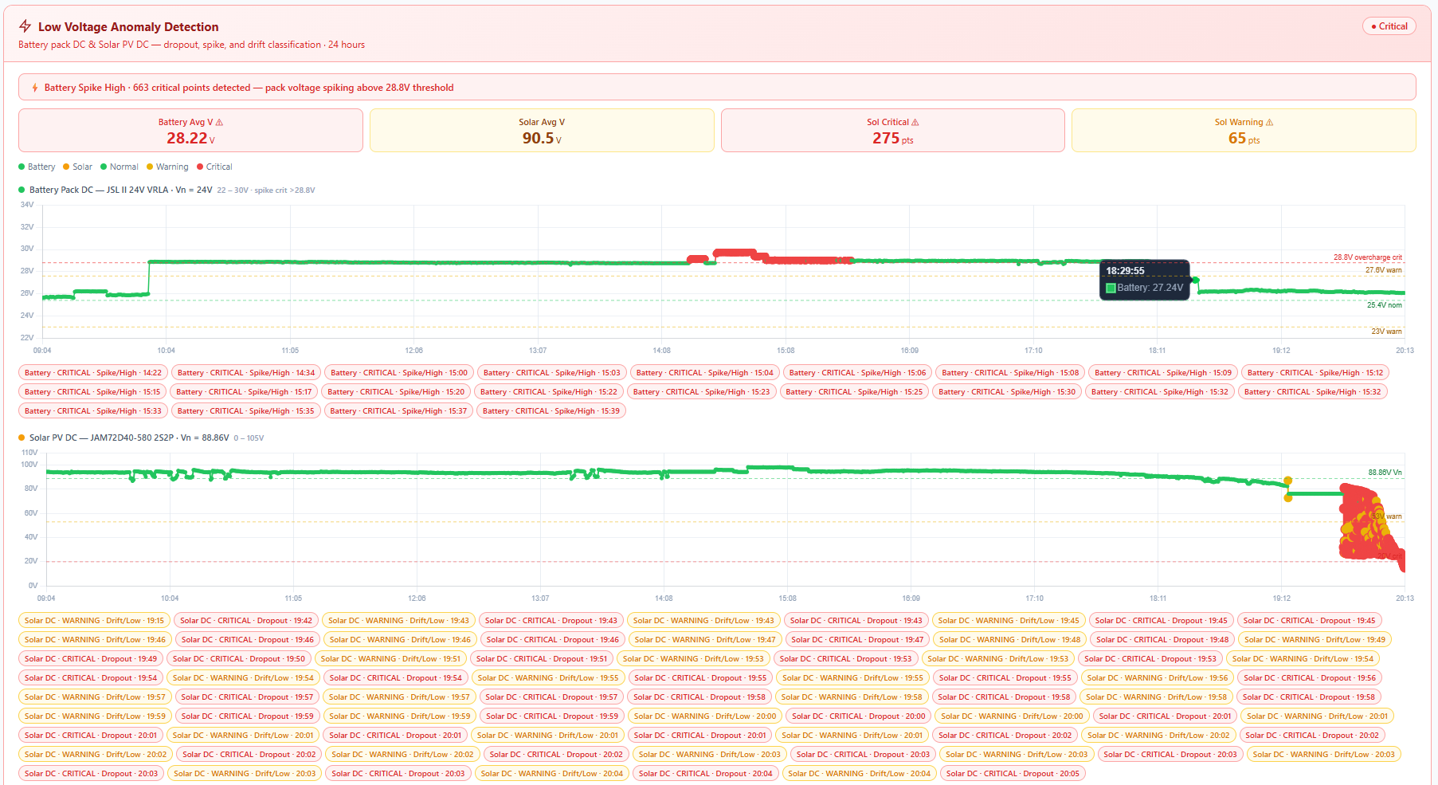
DEVELOPMENT AND PERFORMANCE EVALUATION OF A REAL-TIME ANOMALY DETECTION SYSTEM FOR HYBRID POWER OPERATION USING RULE-BASED SIGNAL ANALYSIS
ANDES, BUENAVENTURA, CALIMUTAN, CORDONATO, MANGUIAT, OCLARINO, OROZCO, RAZON
SYSTEM PERFORMANCE, RELEVANT GRAPHS AND FIGURES, ANALYSIS
April 26,2026
Figure 17. Grid and Inverter Voltage Trend (April 26)

Slide 28
DEVELOPMENT AND PERFORMANCE EVALUATION OF A REAL-TIME ANOMALY DETECTION SYSTEM FOR HYBRID POWER OPERATION USING RULE-BASED SIGNAL ANALYSIS
ANDES, BUENAVENTURA, CALIMUTAN, CORDONATO, MANGUIAT, OCLARINO, OROZCO, RAZON
SYSTEM PERFORMANCE, RELEVANT GRAPHS AND FIGURES, ANALYSIS
April 26, 2026
Figure 18. Solar PV and Battery Voltage Trend (April 26)

Slide 29
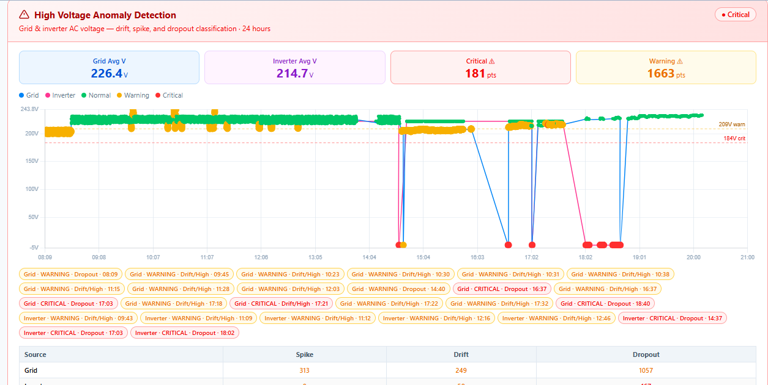
DEVELOPMENT AND PERFORMANCE EVALUATION OF A REAL-TIME ANOMALY DETECTION SYSTEM FOR HYBRID POWER OPERATION USING RULE-BASED SIGNAL ANALYSIS
ANDES, BUENAVENTURA, CALIMUTAN, CORDONATO, MANGUIAT, OCLARINO, OROZCO, RAZON
SYSTEM PERFORMANCE, RELEVANT GRAPHS AND FIGURES, ANALYSIS
April 27, 2026
Figure 19. Grid and Inverter Voltage Trend (April 27)

Slide 30
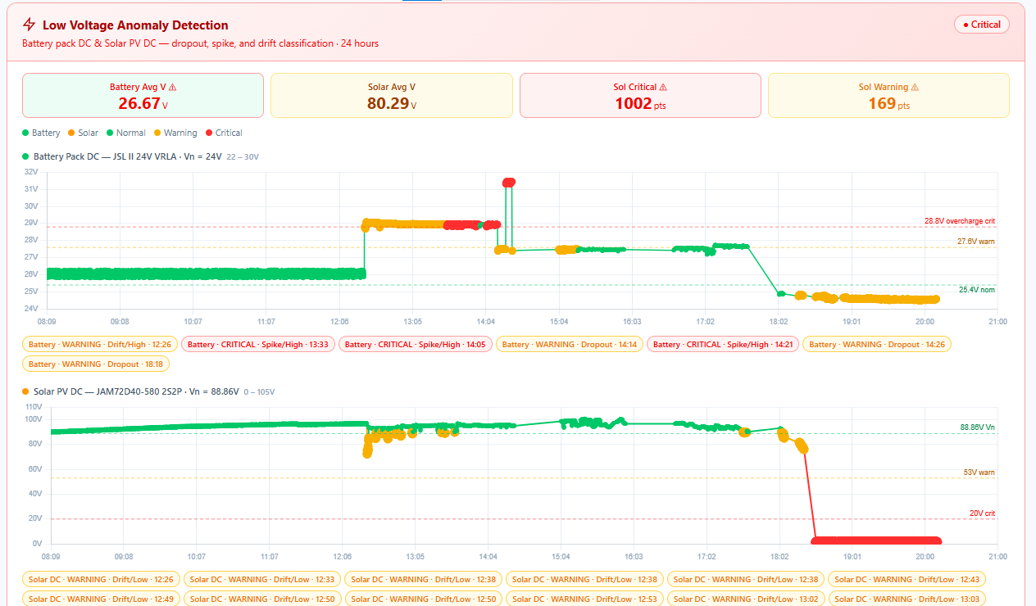
DEVELOPMENT AND PERFORMANCE EVALUATION OF A REAL-TIME ANOMALY DETECTION SYSTEM FOR HYBRID POWER OPERATION USING RULE-BASED SIGNAL ANALYSIS
ANDES, BUENAVENTURA, CALIMUTAN, CORDONATO, MANGUIAT, OCLARINO, OROZCO, RAZON
SYSTEM PERFORMANCE, RELEVANT GRAPHS AND FIGURES, ANALYSIS
April 27, 2026
Figure 20. Solar PV and Battery Voltage Trend (April 27)

Slide 31
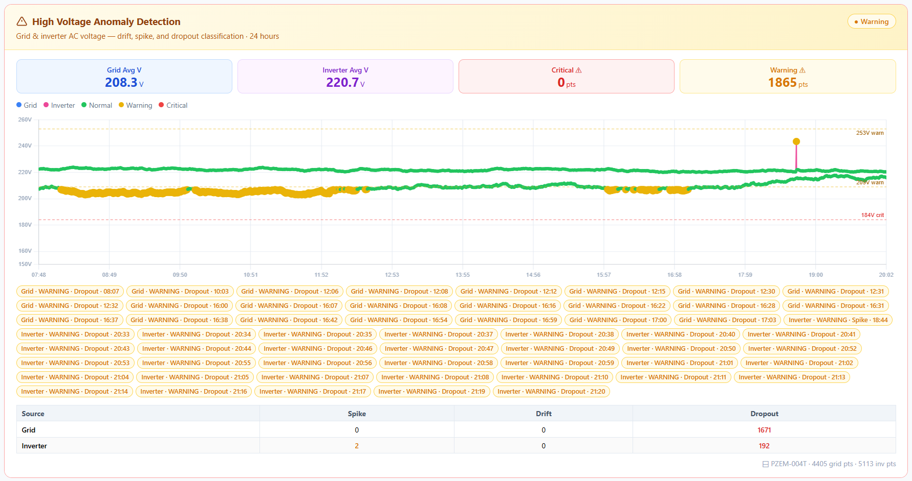
DEVELOPMENT AND PERFORMANCE EVALUATION OF A REAL-TIME ANOMALY DETECTION SYSTEM FOR HYBRID POWER OPERATION USING RULE-BASED SIGNAL ANALYSIS
ANDES, BUENAVENTURA, CALIMUTAN, CORDONATO, MANGUIAT, OCLARINO, OROZCO, RAZON
SYSTEM PERFORMANCE, RELEVANT GRAPHS AND FIGURES, ANALYSIS
April 28, 2026
Figure 21. Grid and Inverter Voltage Trend (April 28)

Slide 32
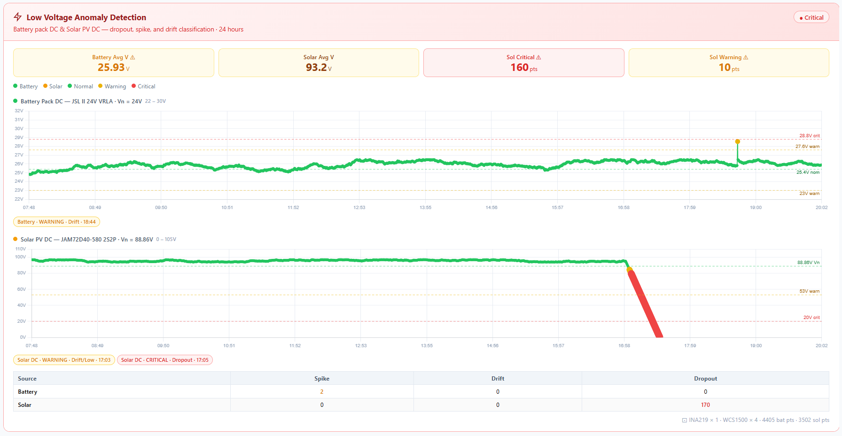
DEVELOPMENT AND PERFORMANCE EVALUATION OF A REAL-TIME ANOMALY DETECTION SYSTEM FOR HYBRID POWER OPERATION USING RULE-BASED SIGNAL ANALYSIS
ANDES, BUENAVENTURA, CALIMUTAN, CORDONATO, MANGUIAT, OCLARINO, OROZCO, RAZON
SYSTEM PERFORMANCE, RELEVANT GRAPHS AND FIGURES, ANALYSIS
April 28, 2026
Figure 22. Solar PV and Battery Voltage Trend (April 28)

Slide 33
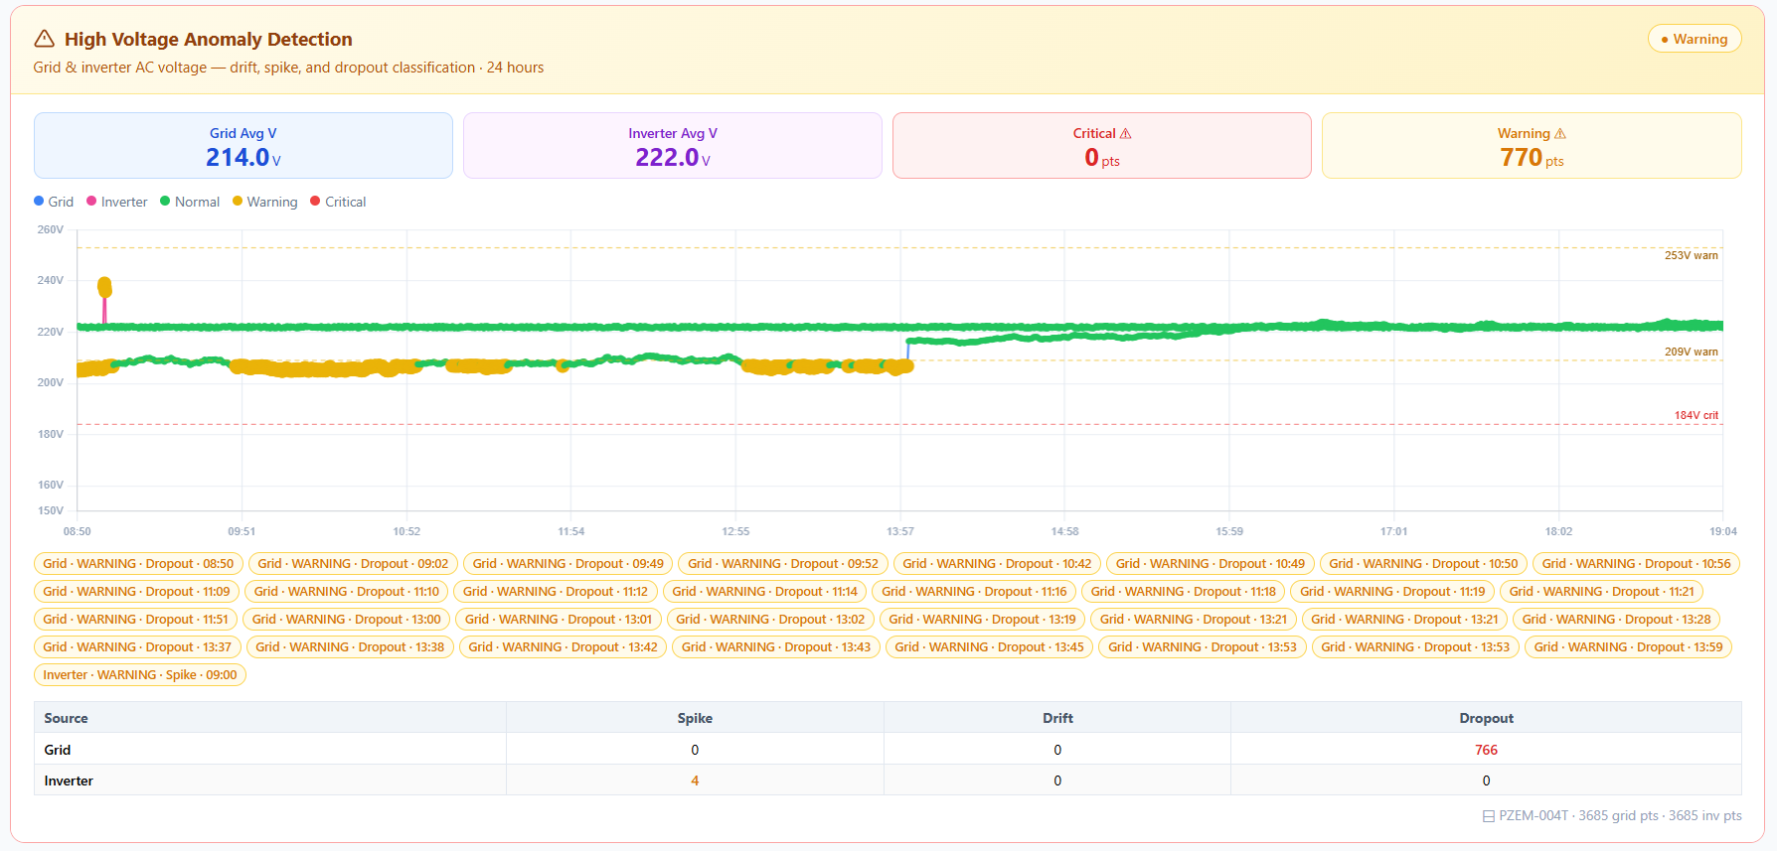
DEVELOPMENT AND PERFORMANCE EVALUATION OF A REAL-TIME ANOMALY DETECTION SYSTEM FOR HYBRID POWER OPERATION USING RULE-BASED SIGNAL ANALYSIS
ANDES, BUENAVENTURA, CALIMUTAN, CORDONATO, MANGUIAT, OCLARINO, OROZCO, RAZON
SYSTEM PERFORMANCE, RELEVANT GRAPHS AND FIGURES, ANALYSIS
April 29, 2026
Figure 23. Grid and Inverter Voltage Trend (April 29)

Slide 34
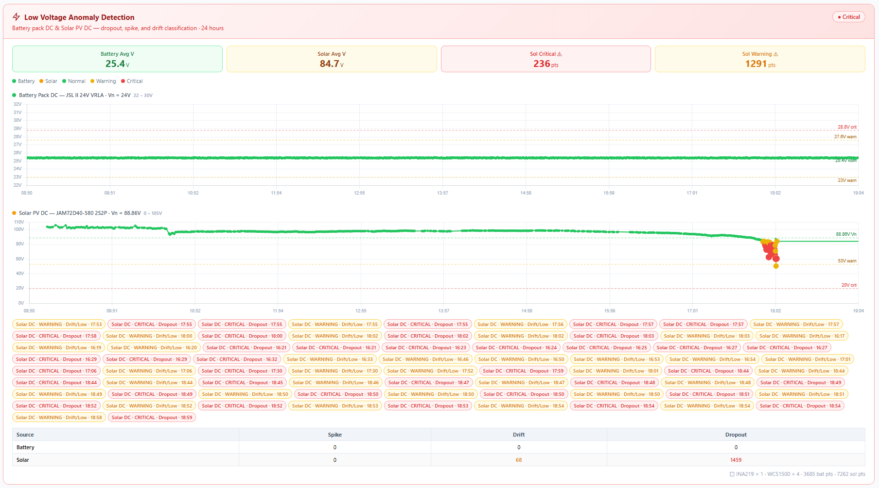
DEVELOPMENT AND PERFORMANCE EVALUATION OF A REAL-TIME ANOMALY DETECTION SYSTEM FOR HYBRID POWER OPERATION USING RULE-BASED SIGNAL ANALYSIS
ANDES, BUENAVENTURA, CALIMUTAN, CORDONATO, MANGUIAT, OCLARINO, OROZCO, RAZON
SYSTEM PERFORMANCE, RELEVANT GRAPHS AND FIGURES, ANALYSIS
April 29, 2026
Figure 24. Solar PV and Battery Voltage Trend (April 29)

Slide 35
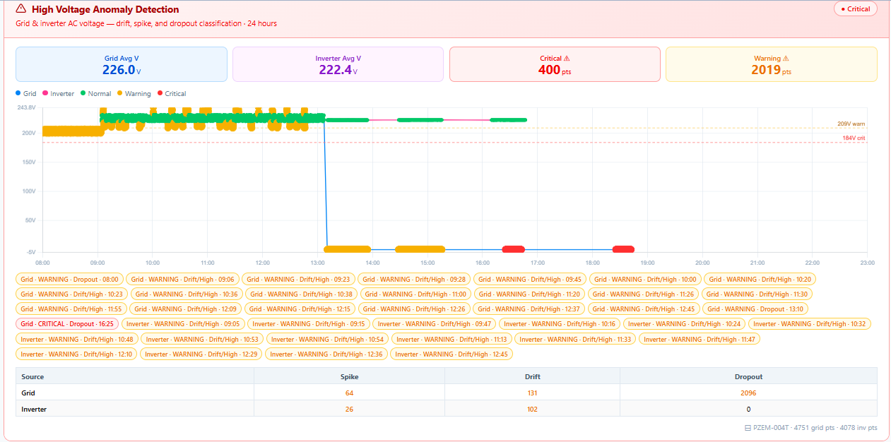
DEVELOPMENT AND PERFORMANCE EVALUATION OF A REAL-TIME ANOMALY DETECTION SYSTEM FOR HYBRID POWER OPERATION USING RULE-BASED SIGNAL ANALYSIS
ANDES, BUENAVENTURA, CALIMUTAN, CORDONATO, MANGUIAT, OCLARINO, OROZCO, RAZON
SYSTEM PERFORMANCE, RELEVANT GRAPHS AND FIGURES, ANALYSIS
April 30, 2026
Figure 25. Grid and Inverter Voltage Trend (April 30)

Slide 36
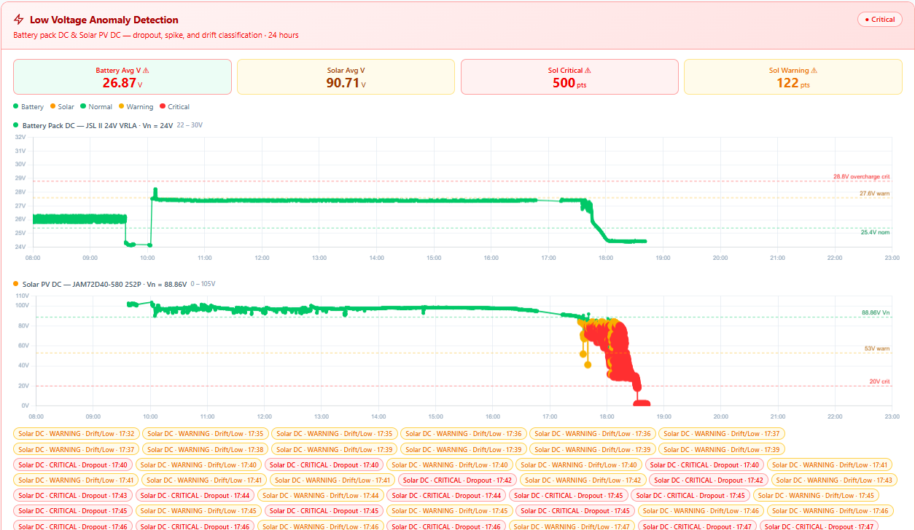
DEVELOPMENT AND PERFORMANCE EVALUATION OF A REAL-TIME ANOMALY DETECTION SYSTEM FOR HYBRID POWER OPERATION USING RULE-BASED SIGNAL ANALYSIS
ANDES, BUENAVENTURA, CALIMUTAN, CORDONATO, MANGUIAT, OCLARINO, OROZCO, RAZON
SYSTEM PERFORMANCE, RELEVANT GRAPHS AND FIGURES, ANALYSIS
April 30, 2026
Figure 26. Solar PV and Battery Voltage Trend (April 30)

Slide 37
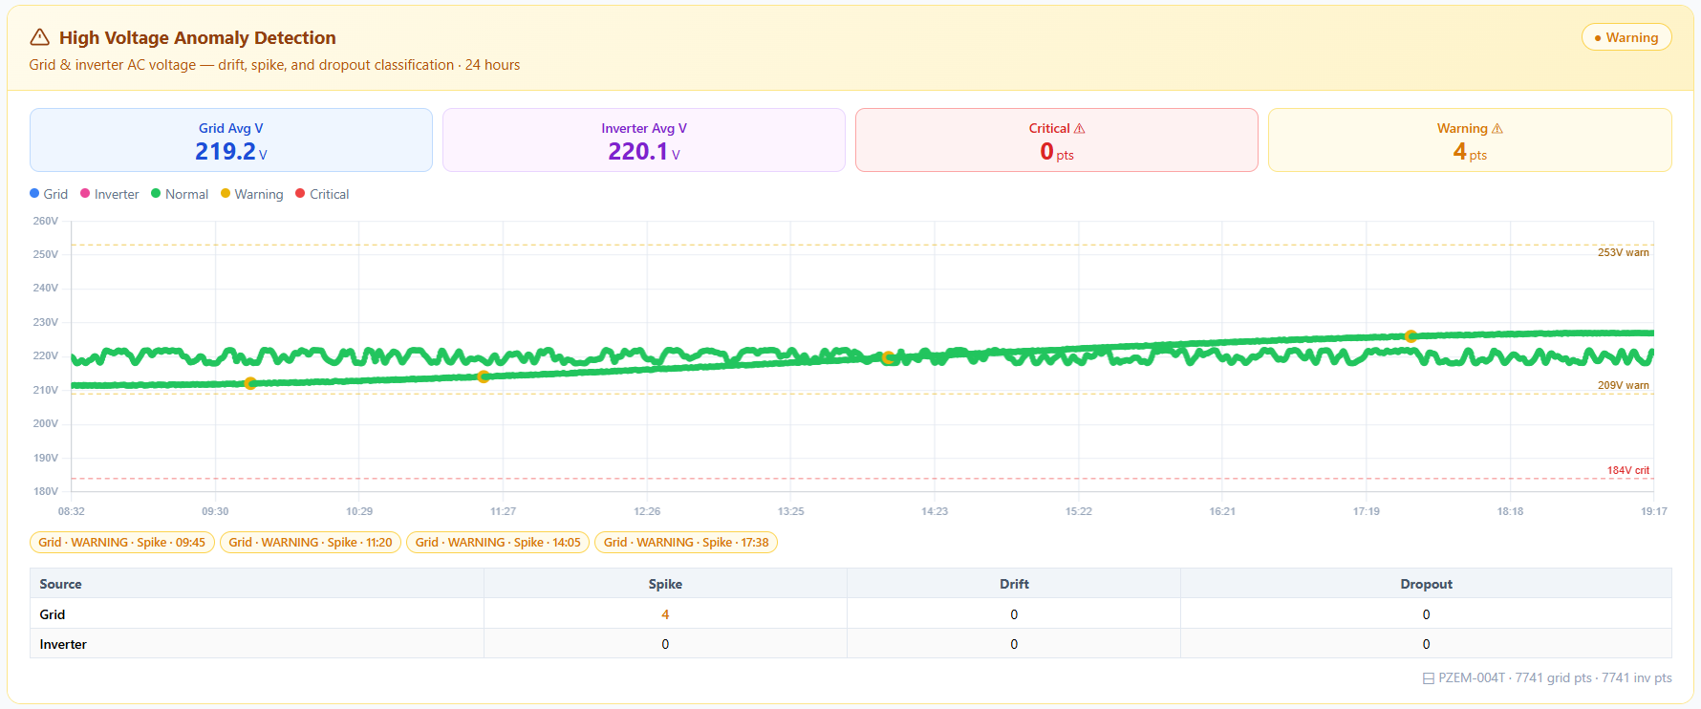
DEVELOPMENT AND PERFORMANCE EVALUATION OF A REAL-TIME ANOMALY DETECTION SYSTEM FOR HYBRID POWER OPERATION USING RULE-BASED SIGNAL ANALYSIS
ANDES, BUENAVENTURA, CALIMUTAN, CORDONATO, MANGUIAT, OCLARINO, OROZCO, RAZON
SYSTEM PERFORMANCE, RELEVANT GRAPHS AND FIGURES, ANALYSIS
With Load Phase
May 3, 2026
Figure 27. Grid and Inverter Voltage Trend (May 3)

Slide 38
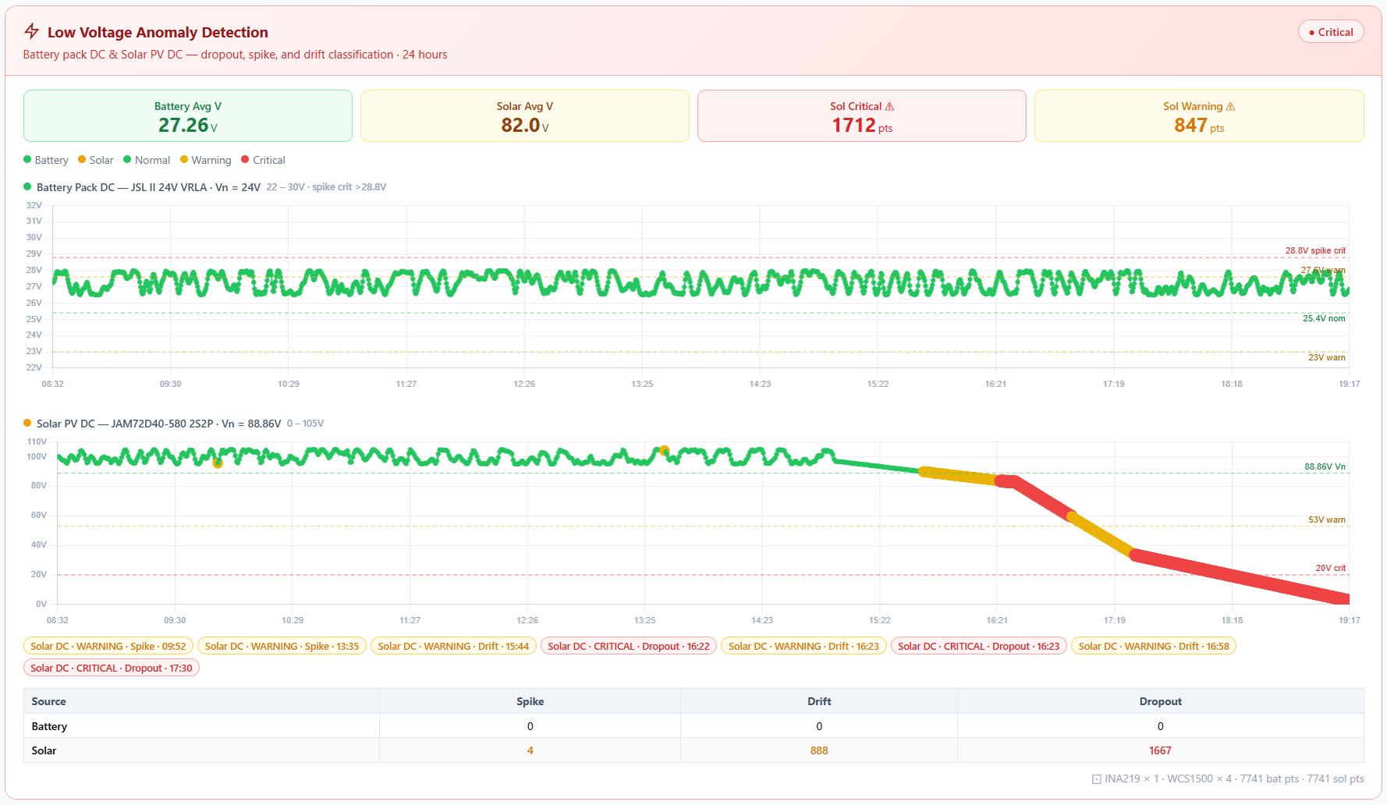
DEVELOPMENT AND PERFORMANCE EVALUATION OF A REAL-TIME ANOMALY DETECTION SYSTEM FOR HYBRID POWER OPERATION USING RULE-BASED SIGNAL ANALYSIS
ANDES, BUENAVENTURA, CALIMUTAN, CORDONATO, MANGUIAT, OCLARINO, OROZCO, RAZON
SYSTEM PERFORMANCE, RELEVANT GRAPHS AND FIGURES, ANALYSIS
May 3, 2026
Figure 28. Solar PV and Battery Voltage Trend (May 3)

Slide 39
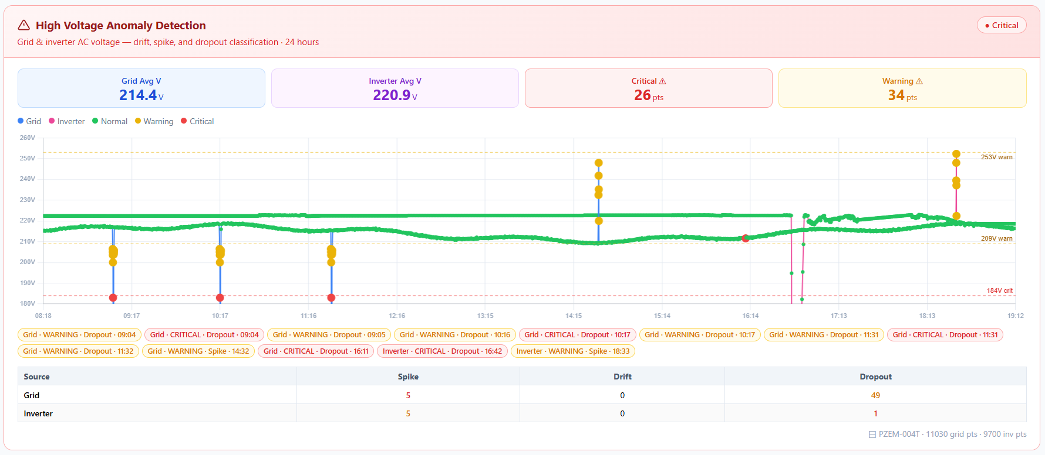
DEVELOPMENT AND PERFORMANCE EVALUATION OF A REAL-TIME ANOMALY DETECTION SYSTEM FOR HYBRID POWER OPERATION USING RULE-BASED SIGNAL ANALYSIS
ANDES, BUENAVENTURA, CALIMUTAN, CORDONATO, MANGUIAT, OCLARINO, OROZCO, RAZON
SYSTEM PERFORMANCE, RELEVANT GRAPHS AND FIGURES, ANALYSIS
May 4, 2026
Figure 29. Grid and Inverter Voltage Trend (May 4)

Slide 40
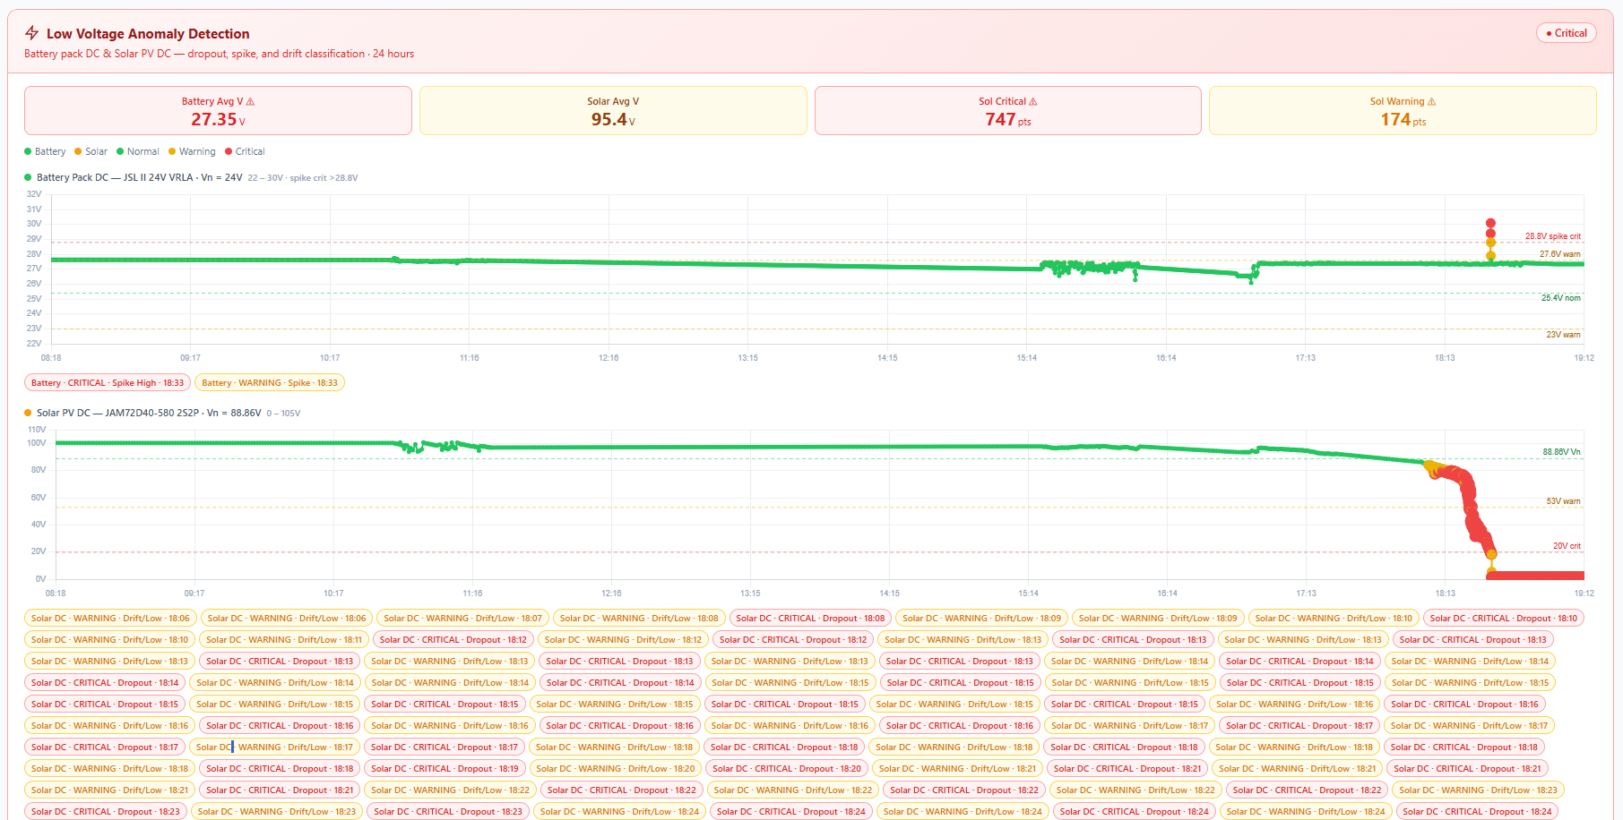
DEVELOPMENT AND PERFORMANCE EVALUATION OF A REAL-TIME ANOMALY DETECTION SYSTEM FOR HYBRID POWER OPERATION USING RULE-BASED SIGNAL ANALYSIS
ANDES, BUENAVENTURA, CALIMUTAN, CORDONATO, MANGUIAT, OCLARINO, OROZCO, RAZON
SYSTEM PERFORMANCE, RELEVANT GRAPHS AND FIGURES, ANALYSIS
May 4, 2026
Figure 30. Solar PV and Battery Voltage Trend (May 4)

Slide 41

DEVELOPMENT AND PERFORMANCE EVALUATION OF A REAL-TIME ANOMALY DETECTION SYSTEM FOR HYBRID POWER OPERATION USING RULE-BASED SIGNAL ANALYSIS
ANDES, BUENAVENTURA, CALIMUTAN, CORDONATO, MANGUIAT, OCLARINO, OROZCO, RAZON
SYSTEM PERFORMANCE, RELEVANT GRAPHS AND FIGURES, ANALYSIS
May 6, 2026
Figure 31. Grid and Inverter Voltage Trend (May 6)

Slide 42

DEVELOPMENT AND PERFORMANCE EVALUATION OF A REAL-TIME ANOMALY DETECTION SYSTEM FOR HYBRID POWER OPERATION USING RULE-BASED SIGNAL ANALYSIS
ANDES, BUENAVENTURA, CALIMUTAN, CORDONATO, MANGUIAT, OCLARINO, OROZCO, RAZON
SYSTEM PERFORMANCE, RELEVANT GRAPHS AND FIGURES, ANALYSIS
May 6, 2026
Figure 32. Solar PV and Battery Voltage Trend (May 6)

Slide 43

DEVELOPMENT AND PERFORMANCE EVALUATION OF A REAL-TIME ANOMALY DETECTION SYSTEM FOR HYBRID POWER OPERATION USING RULE-BASED SIGNAL ANALYSIS
ANDES, BUENAVENTURA, CALIMUTAN, CORDONATO, MANGUIAT, OCLARINO, OROZCO, RAZON
SYSTEM PERFORMANCE, RELEVANT GRAPHS AND FIGURES, ANALYSIS
May 7, 2026
Figure 33. Grid and Inverter Voltage Trend (May 7)

Slide 44

DEVELOPMENT AND PERFORMANCE EVALUATION OF A REAL-TIME ANOMALY DETECTION SYSTEM FOR HYBRID POWER OPERATION USING RULE-BASED SIGNAL ANALYSIS
ANDES, BUENAVENTURA, CALIMUTAN, CORDONATO, MANGUIAT, OCLARINO, OROZCO, RAZON
SYSTEM PERFORMANCE, RELEVANT GRAPHS AND FIGURES, ANALYSIS
May 7, 2026
Figure 34. Solar PV and Battery Voltage Trend (May 7)

Slide 45

DEVELOPMENT AND PERFORMANCE EVALUATION OF A REAL-TIME ANOMALY DETECTION SYSTEM FOR HYBRID POWER OPERATION USING RULE-BASED SIGNAL ANALYSIS
ANDES, BUENAVENTURA, CALIMUTAN, CORDONATO, MANGUIAT, OCLARINO, OROZCO, RAZON
SYSTEM PERFORMANCE, RELEVANT GRAPHS AND FIGURES, ANALYSIS
May 8, 2026
Figure 35. Grid and Inverter Voltage Trend (May 8)

Slide 46

DEVELOPMENT AND PERFORMANCE EVALUATION OF A REAL-TIME ANOMALY DETECTION SYSTEM FOR HYBRID POWER OPERATION USING RULE-BASED SIGNAL ANALYSIS
ANDES, BUENAVENTURA, CALIMUTAN, CORDONATO, MANGUIAT, OCLARINO, OROZCO, RAZON
SYSTEM PERFORMANCE, RELEVANT GRAPHS AND FIGURES, ANALYSIS
May 8, 2026
Figure 36. Solar PV and Battery Voltage Trend (May 8)

Slide 47

DEVELOPMENT AND PERFORMANCE EVALUATION OF A REAL-TIME ANOMALY DETECTION SYSTEM FOR HYBRID POWER OPERATION USING RULE-BASED SIGNAL ANALYSIS
ANDES, BUENAVENTURA, CALIMUTAN, CORDONATO, MANGUIAT, OCLARINO, OROZCO, RAZON
SYSTEM PERFORMANCE, RELEVANT GRAPHS AND FIGURES, ANALYSIS
May 9, 2026
Figure 37. Solar PV and Battery Voltage Trend (May 9)

Slide 48

DEVELOPMENT AND PERFORMANCE EVALUATION OF A REAL-TIME ANOMALY DETECTION SYSTEM FOR HYBRID POWER OPERATION USING RULE-BASED SIGNAL ANALYSIS
ANDES, BUENAVENTURA, CALIMUTAN, CORDONATO, MANGUIAT, OCLARINO, OROZCO, RAZON
SYSTEM PERFORMANCE, RELEVANT GRAPHS AND FIGURES, ANALYSIS
May 9, 2026
Figure 38. Solar PV and Battery Voltage Trend (May 9)

Slide 49

DEVELOPMENT AND PERFORMANCE EVALUATION OF A REAL-TIME ANOMALY DETECTION SYSTEM FOR HYBRID POWER OPERATION USING RULE-BASED SIGNAL ANALYSIS
ANDES, BUENAVENTURA, CALIMUTAN, CORDONATO, MANGUIAT, OCLARINO, OROZCO, RAZON
SYSTEM PERFORMANCE, RELEVANT GRAPHS AND FIGURES, ANALYSIS
May 10, 2026
Figure 39. Grid and Inverter Voltage Trend (May 10)

Slide 50

DEVELOPMENT AND PERFORMANCE EVALUATION OF A REAL-TIME ANOMALY DETECTION SYSTEM FOR HYBRID POWER OPERATION USING RULE-BASED SIGNAL ANALYSIS
ANDES, BUENAVENTURA, CALIMUTAN, CORDONATO, MANGUIAT, OCLARINO, OROZCO, RAZON
SYSTEM PERFORMANCE, RELEVANT GRAPHS AND FIGURES, ANALYSIS
May 10, 2026
Figure 40. Solar PV and Battery Voltage Trend (May 10)

Slide 51

DEVELOPMENT AND PERFORMANCE EVALUATION OF A REAL-TIME ANOMALY DETECTION SYSTEM FOR HYBRID POWER OPERATION USING RULE-BASED SIGNAL ANALYSIS
ANDES, BUENAVENTURA, CALIMUTAN, CORDONATO, MANGUIAT, OCLARINO, OROZCO, RAZON
SYSTEM PERFORMANCE, RELEVANT GRAPHS AND FIGURES, ANALYSIS
Table 8. Anomaly Type Distribution — Both Periods Combined.

Slide 52


DEVELOPMENT AND PERFORMANCE EVALUATION OF A REAL-TIME ANOMALY DETECTION SYSTEM FOR HYBRID POWER OPERATION USING RULE-BASED SIGNAL ANALYSIS
ANDES, BUENAVENTURA, CALIMUTAN, CORDONATO, MANGUIAT, OCLARINO, OROZCO, RAZON
SYSTEM PERFORMANCE, RELEVANT GRAPHS AND FIGURES, ANALYSIS
Table 9. Classification Dataset Summary per Source and Period (Threshold-Verified)

Slide 53

DEVELOPMENT AND PERFORMANCE EVALUATION OF A REAL-TIME ANOMALY DETECTION SYSTEM FOR HYBRID POWER OPERATION USING RULE-BASED SIGNAL ANALYSIS
ANDES, BUENAVENTURA, CALIMUTAN, CORDONATO, MANGUIAT, OCLARINO, OROZCO, RAZON
SYSTEM PERFORMANCE, RELEVANT GRAPHS AND FIGURES, ANALYSIS
Table 10. System Performance Metrics per Period (Threshold-Verified Ground Truth)

Slide 54
DEVELOPMENT AND PERFORMANCE EVALUATION OF A REAL-TIME ANOMALY DETECTION SYSTEM FOR HYBRID POWER OPERATION USING RULE-BASED SIGNAL ANALYSIS
ANDES, BUENAVENTURA, CALIMUTAN, CORDONATO, MANGUIAT, OCLARINO, OROZCO, RAZON
FINDINGS
The study successfully developed and deployed a real-time anomaly detection system for hybrid power operation that monitored AC and DC voltage across four sources — utility grid, inverter AC output, solar photovoltaic panels, and battery storage. Controlled prototype testing confirmed the system correctly identified all simulated voltage conditions before field deployment. Over a 14-day monitoring period split into no-load (April 24–30) and with-load (May 3–10) phases, the system logged over 400,000 readings and classified 30,611 anomaly events, with dropout anomalies being the most dominant at 83.93% of all detected events. The solar PV source was the most consistently affected, primarily due to declining irradiance in the late afternoon and evening. Notably, the with-load phase showed improved overall stability at 92.98% normal readings compared to 89.99% during no-load, and the system achieved an overall accuracy of 97.71% and an F1-score of 91.15%.

Slide 55
DEVELOPMENT AND PERFORMANCE EVALUATION OF A REAL-TIME ANOMALY DETECTION SYSTEM FOR HYBRID POWER OPERATION USING RULE-BASED SIGNAL ANALYSIS
ANDES, BUENAVENTURA, CALIMUTAN, CORDONATO, MANGUIAT, OCLARINO, OROZCO, RAZON
CONCLUSIONS
The system effectively fulfilled its core objectives, delivering continuous voltage monitoring, rule-based anomaly classification, real-time visualization, and automated alerts throughout actual field deployment. The rule-based approach using voltage magnitude, rate of change, and persistence-based evaluation proved to be a functionally sound and interpretable method for distinguishing between normal and abnormal voltage conditions. The behavioral patterns observed across both phases confirmed that solar PV dropouts and utility grid undervoltage were the most recurring disturbances, while the hybrid inverter consistently maintained stable output. The presence of a connected load actually helped stabilize voltage behavior in the battery and inverter subsystems, and the system's stronger performance during the with-load phase further validated the reliability of the detection logic under real operating conditions.

Slide 56
DEVELOPMENT AND PERFORMANCE EVALUATION OF A REAL-TIME ANOMALY DETECTION SYSTEM FOR HYBRID POWER OPERATION USING RULE-BASED SIGNAL ANALYSIS
ANDES, BUENAVENTURA, CALIMUTAN, CORDONATO, MANGUIAT, OCLARINO, OROZCO, RAZON
RECOMMENDATIONS
The study recommends that the spike detection logic for the Inverter and Solar PV sources be reviewed and corrected to strictly enforce the defined percentage-based ΔV thresholds 5% and 10% of nominal voltage respectively to eliminate false positive detections, and that the drift detection rule for the Grid source be corrected to evaluate sustained deviation rate over the defined time window rather than triggering on instantaneous voltage magnitude, consistent with the operational definition of drift as a gradual and persistent condition; additionally, strict floating-point boundary comparison should be applied across all sources to prevent classification inconsistencies at threshold edges, particularly for borderline dropout readings near the warning thresholds of the Grid and Inverter sources. Beyond these technical refinements, subsequent studies should extend the monitoring duration across multiple weeks or months to capture seasonal variations in solar generation, a wider range of utility supply behaviors, and more diverse environmental and load conditions to support more statistically robust performance evaluation, while future research should explore the integration or comparative evaluation of machine learning and deep learning methods alongside the rule-based approach to assess whether adaptive detection models can improve recall performance, particularly for anomaly types exhibiting borderline or gradual threshold violations such as those observed in grid undervoltage conditions. Finally, the system should be deployed and evaluated in other hybrid power configurations, including setups incorporating wind energy, lithium-based battery storage, different inverter technologies, or multiple utility feeders, to validate its generalizability and practical scalability beyond the specific hybrid system evaluated in this study.

Slide 57
DESIGN AND DEVELOPMENT OF EQUILOCK – AN INNOVATIVE AUTOMATED OFFICE EQUIPMENT VAULT WITH KIOSK INTERFACE FOR COLLEGE OF ENGINEERING
CAMACHO, DE CASTRO, LLARENA, TENORIO
THANK YOU!

Slide 58
DESIGN AND DEVELOPMENT OF EQUILOCK – AN INNOVATIVE AUTOMATED OFFICE EQUIPMENT VAULT WITH KIOSK INTERFACE FOR COLLEGE OF ENGINEERING
CAMACHO, DE CASTRO, LLARENA, TENORIO

Slide 59
DESIGN AND DEVELOPMENT OF EQUILOCK – AN INNOVATIVE AUTOMATED OFFICE EQUIPMENT VAULT WITH KIOSK INTERFACE FOR COLLEGE OF ENGINEERING
CAMACHO, DE CASTRO, LLARENA, TENORIO

Slide 60
DESIGN AND DEVELOPMENT OF EQUILOCK – AN INNOVATIVE AUTOMATED OFFICE EQUIPMENT VAULT WITH KIOSK INTERFACE FOR COLLEGE OF ENGINEERING
CAMACHO, DE CASTRO, LLARENA, TENORIO

Slide 61
DESIGN AND DEVELOPMENT OF EQUILOCK – AN INNOVATIVE AUTOMATED OFFICE EQUIPMENT VAULT WITH KIOSK INTERFACE FOR COLLEGE OF ENGINEERING
CAMACHO, DE CASTRO, LLARENA, TENORIO

Slide 62
DESIGN AND DEVELOPMENT OF EQUILOCK – AN INNOVATIVE AUTOMATED OFFICE EQUIPMENT VAULT WITH KIOSK INTERFACE FOR COLLEGE OF ENGINEERING
CAMACHO, DE CASTRO, LLARENA, TENORIO

Slide 63
DEVELOPMENT AND PERFORMANCE EVALUATION OF A REAL-TIME ANOMALY DETECTION SYSTEM FOR HYBRID POWER OPERATION USING RULE-BASED SIGNAL ANALYSIS
ANDES, BUENAVENTURA, CALIMUTAN, CORDONATO, MANGUIAT, OCLARINO, OROZCO, RAZON
Thesis Defended!

