Slide 1
NoteAnt
AI powered Note Taking App
Team 5
Nick, Chris, Frankie
Wayne, Siyuan, Yibo

Slide 2
01
Overview

Slide 3
What Does NoteAnt do?
NoteAnt is an AI empowered note-taking assistant app:
Manage your documents with ease
Rich text editor
Side-by-side AI Assistant

Slide 4
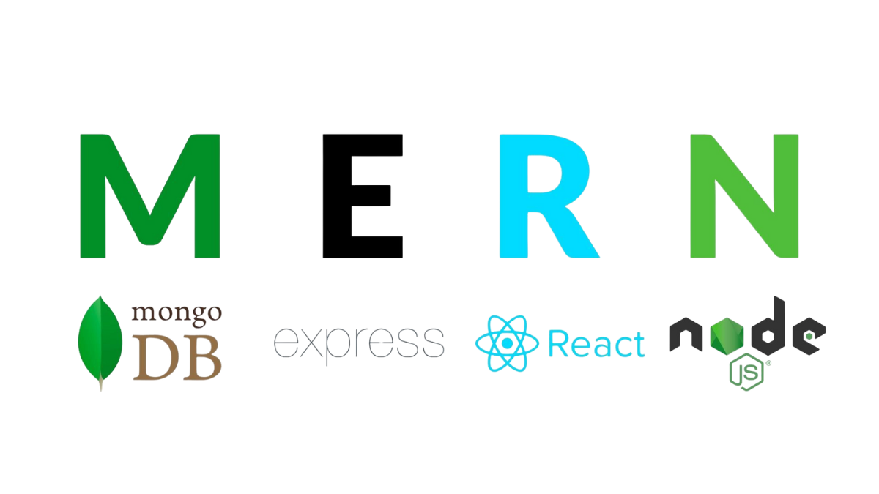
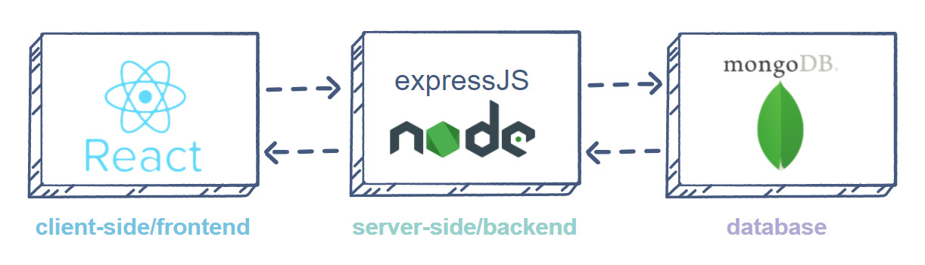
Tech Stack

Slide 5


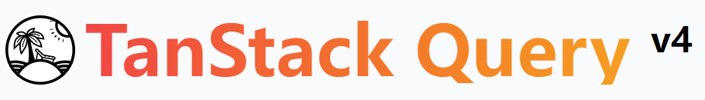
Libraries used for Front-end
Mantine UI: Provides a set of high-quality React components and hooks.
Tanstack query: Handles API requests and data fetching in React applications.
React router: Manages navigation and routing for React applications.
Axios: Connection with back-end and database.

Slide 6


Libraries used for Back-end
Langchain: Provides easy connection to OpenAI services
Mongoose: Easy MongoDB connection, data schema, data relation.
Express: Runs server-side API ports
JWT (Jsonwebtoken): Token management
UUID: Assign unique id for objects.

Slide 7
02
Requirement
Analysis

Slide 8
Requirement Analysis
Highest priority is to make sure that students can create notes, get their summaries, and have their own account.
The desirable features and optional features are of second and third priority respectively.
Total 7 user stories planned
Total 3 out of 3 essential requirements completed
Total 5 out of 5 nonfunctional requirements completed

Slide 9
Functional Requirements
Essential Features
Create, delete, edit notes
Get summary of the note
Own user account

Slide 10
Nonfunctional Requirements
Security requirements
Make sure that student’s private information is not stolen
Protect injection attack
Sanitize html
Invalid access
An Error 404 catcher when a user put in a wrong url.
Matching use sessions

Slide 11
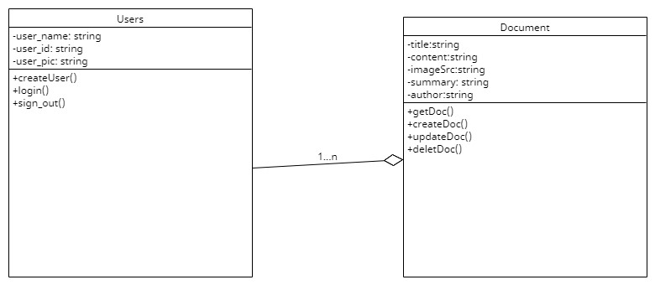
Class diagram

Slide 12
List of User Stories for login page
As a user, I want to …
be able to login the app with my Google account
See my name and profile picture in the home page
Stay logged in after Google verification
Notes:
Yichen

Slide 13
List of User Stories for homepage
As a user, I want to …
See all my notes in the form of card
Create a new doc
Delete the note
See the short description of summary by clicking the show summary shortcut
Go to my document page(double click)
Sign out of my account
Notes:
Wan

Slide 14
List of User Stories for document page
As a user, I want to…
Edit my note in a text editor
Save my note online
Generate a summary and generate a new summary after I update my note
Go back to homepage

Slide 15
Desirable and optional user stories
Desirable Features
As a user, I want to…
Have quizzes from the note
Have flash cards from the note
Optional Features
As a user, I want to…
Collaborate with others in the same note
Have a folder system
Share files

Slide 16
03
Design
Notes:
Nicholas

Slide 17



Software Architecture Client-Server
getDoc()
respond
Update doc
new User()
getDocs()
request
GSI Token
new Doc()
Home Page
Document Page
Login Page
Access Token
Doc._id
Notes:
Nicholas

Slide 18
Database Design
Document:
title
document_id
content
imageSrc
summary
Last_modified: Date
Date_created: Date
Author: ref(user_id)
User:
user_id
user_name
user_pic
Notes:
Nicholas

Slide 19
04
Implementation

Slide 20
Project Structure
Client - Frontend
All the frontend code belongs in this folder
Server - Backend
All the backend code belongs in this folder
How to start the project:
Client folder:
npm run dev
Server folder:
npm run start

Slide 21
Client
Cypress - E2E Testing folder
Components - Custom components
Constants - Mock Data
Functions - Parsers for displaying summary
Hooks - React Hooks (contexts, and other global variables)
Images - Images used in project
Models - Base models for typescript (user model and document model)
Pages - Code for pages (login, home and document)
Page is split into main.tsx and view.tsx
Main.tsx - handles all the Javascript logics and API fetches
View.tsx - handles all the UI and the different states (loading, error, etc)

Slide 22
Server
Ai - OpenAI models and functions
Controller - Methods for each page
Split files for different pages
Middleware - Middleware to verify token
Model - User and Document model
Routes - API endpoint for each method
Split files for different pages
Test - Backend testing

Slide 23
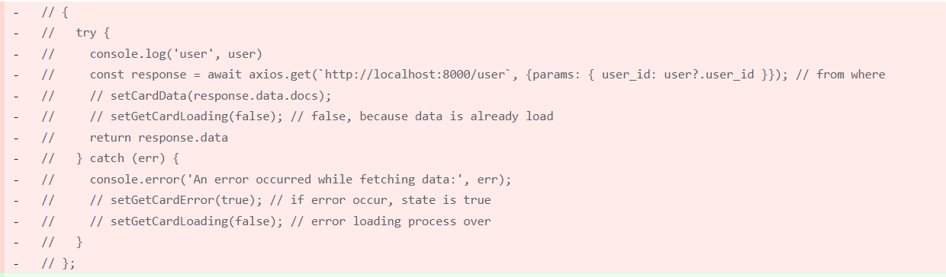
Refactor for Front-end
Before Refactor

Slide 24
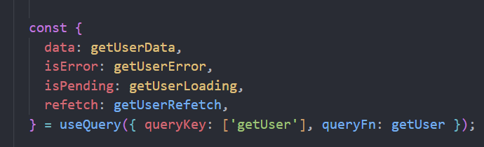
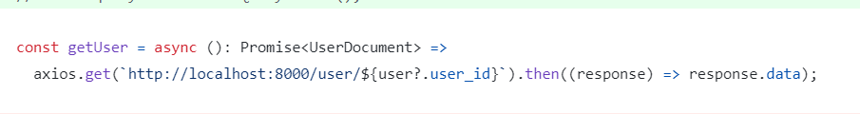
Refactor for front-end
After Refactor

Slide 25
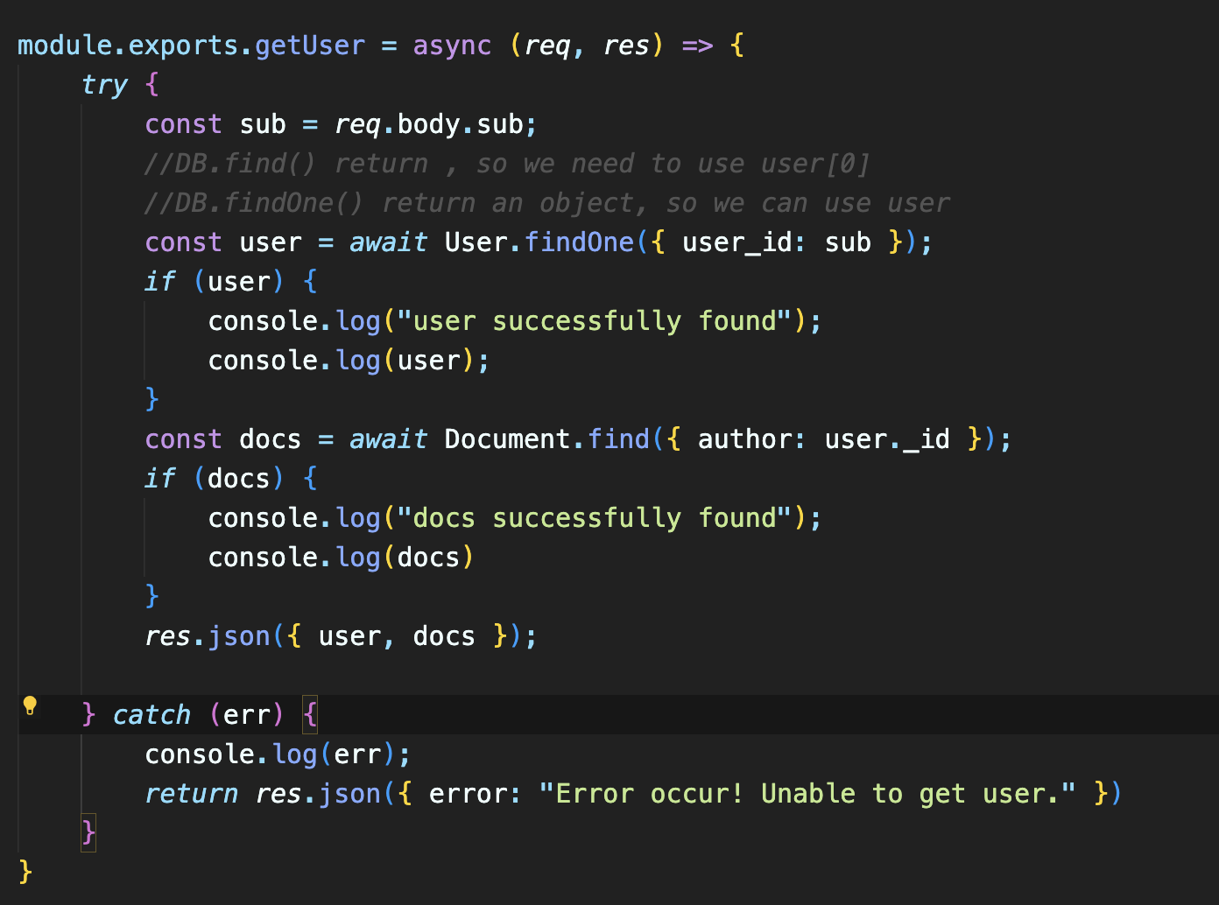
Refactor for back-end
Before refactoring
Notes:
Chris

Slide 26
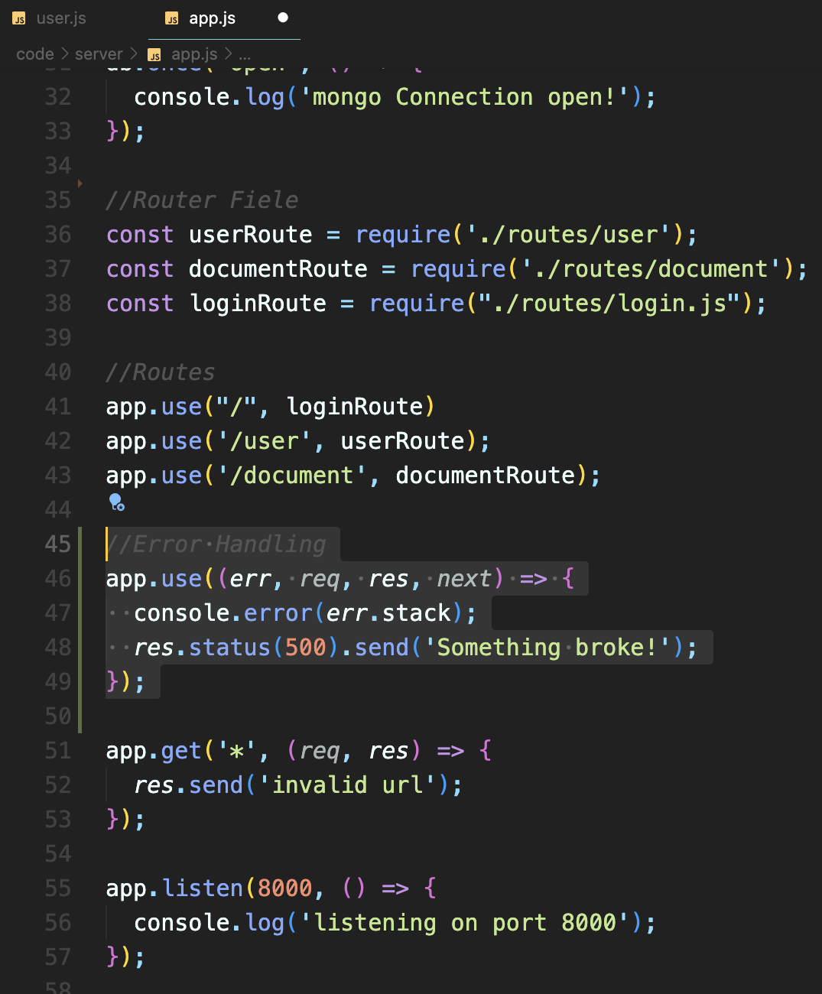
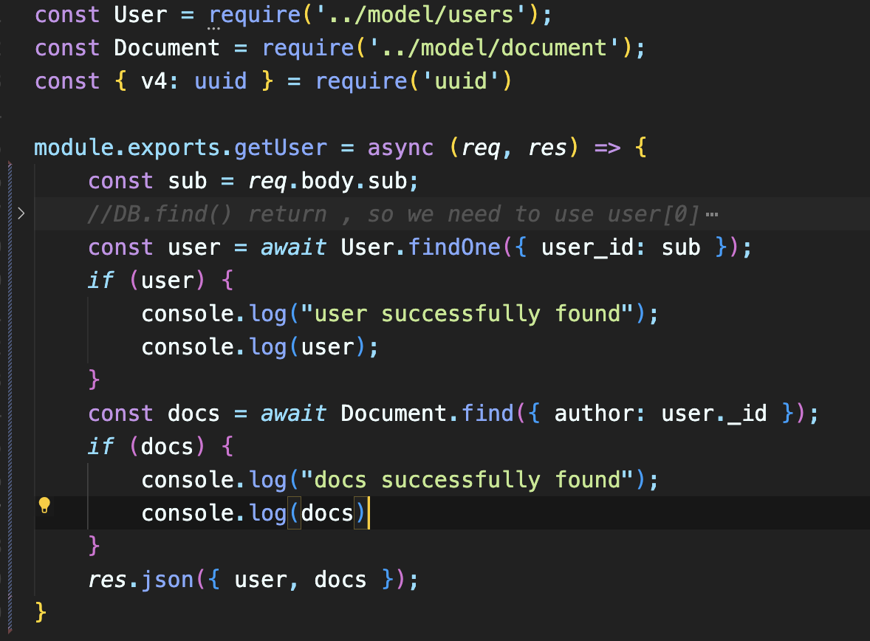
Refactor for back-end

Slide 27
Login Page
Methods
Notes:
Frankie

Slide 28
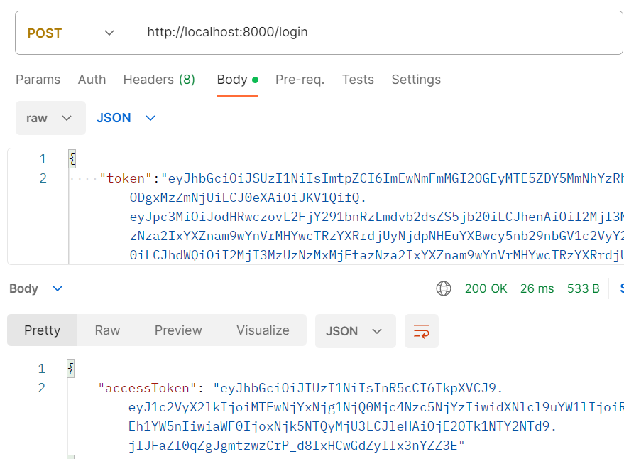
POST Methods
Endpoint: /login
Method: Post
Body: String token
Response:
An access token used for user login signed with user_id, user_name, secretkey and Expiry.
Action:
Decode the token and get the user name, user id,user profile picture
Check is the user already exists and create a new user in the database if don’t exist
Status:
200
If jwt token invalid
Return error message
Notes:
Frankie

Slide 29
Home Page
Methods

Slide 30
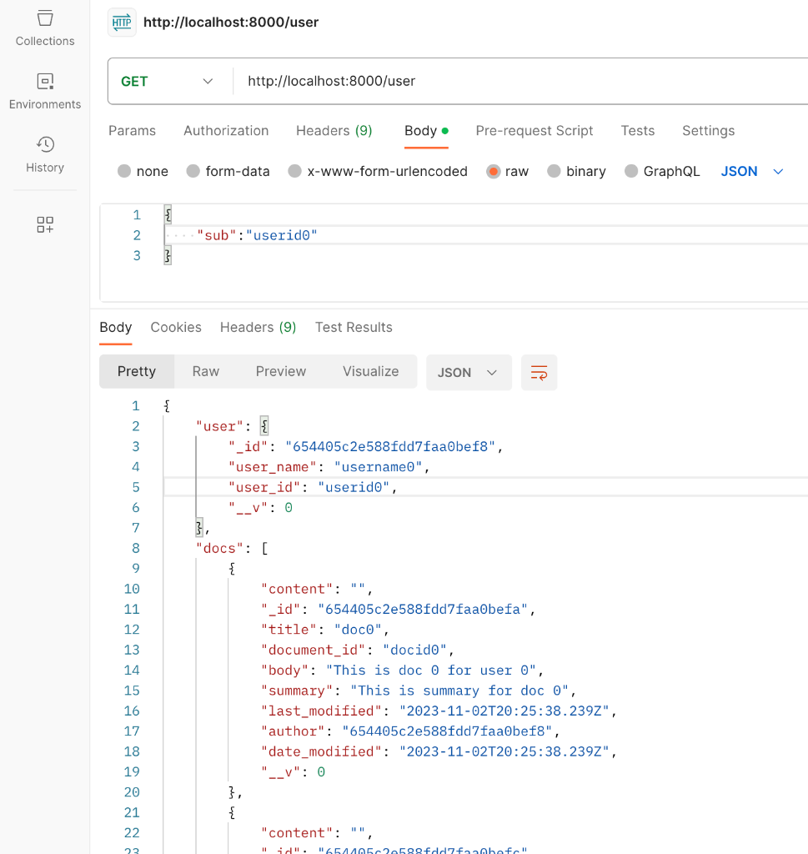
GET Methods - getUser(user_id)
Endpoint: /user
Method: Get
Req.user : String user_id
Response:
The User associated with this user_id
All documents belong to this User.
Status:
200
If user_id is incorrect || user_id is not found
Return error message

Slide 31
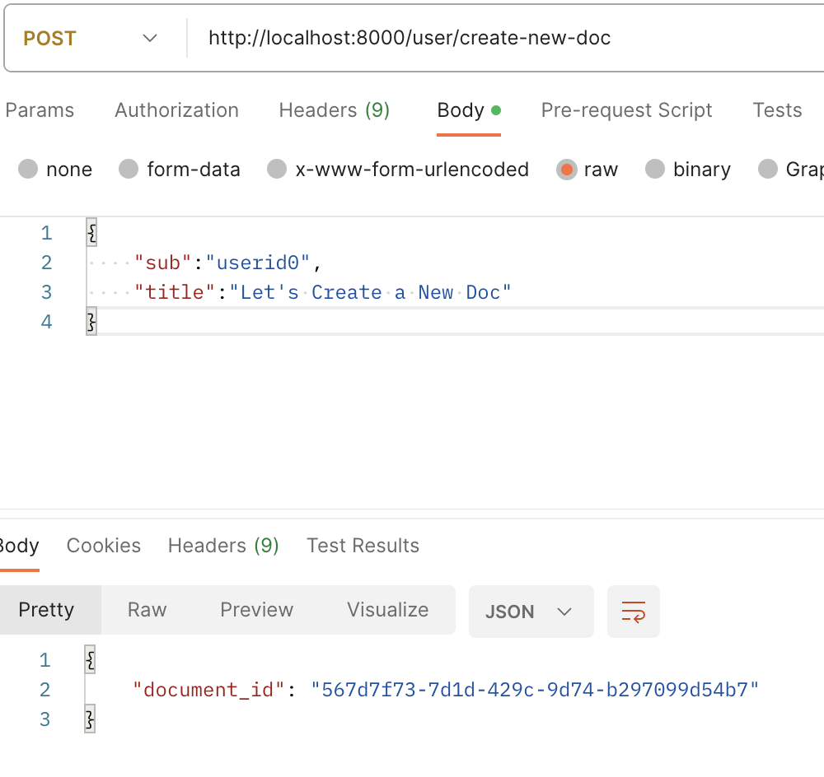
POST Methods - CreateDoc
Endpoint: /user/create-new-doc
Method: Post
Body: String title, user_id
Response:
The new document id for front end page to navigate.
Action:
Create a new document for the specific user
Status:
200
If user_id is incorrect || user_id is not found
Return error message

Slide 32
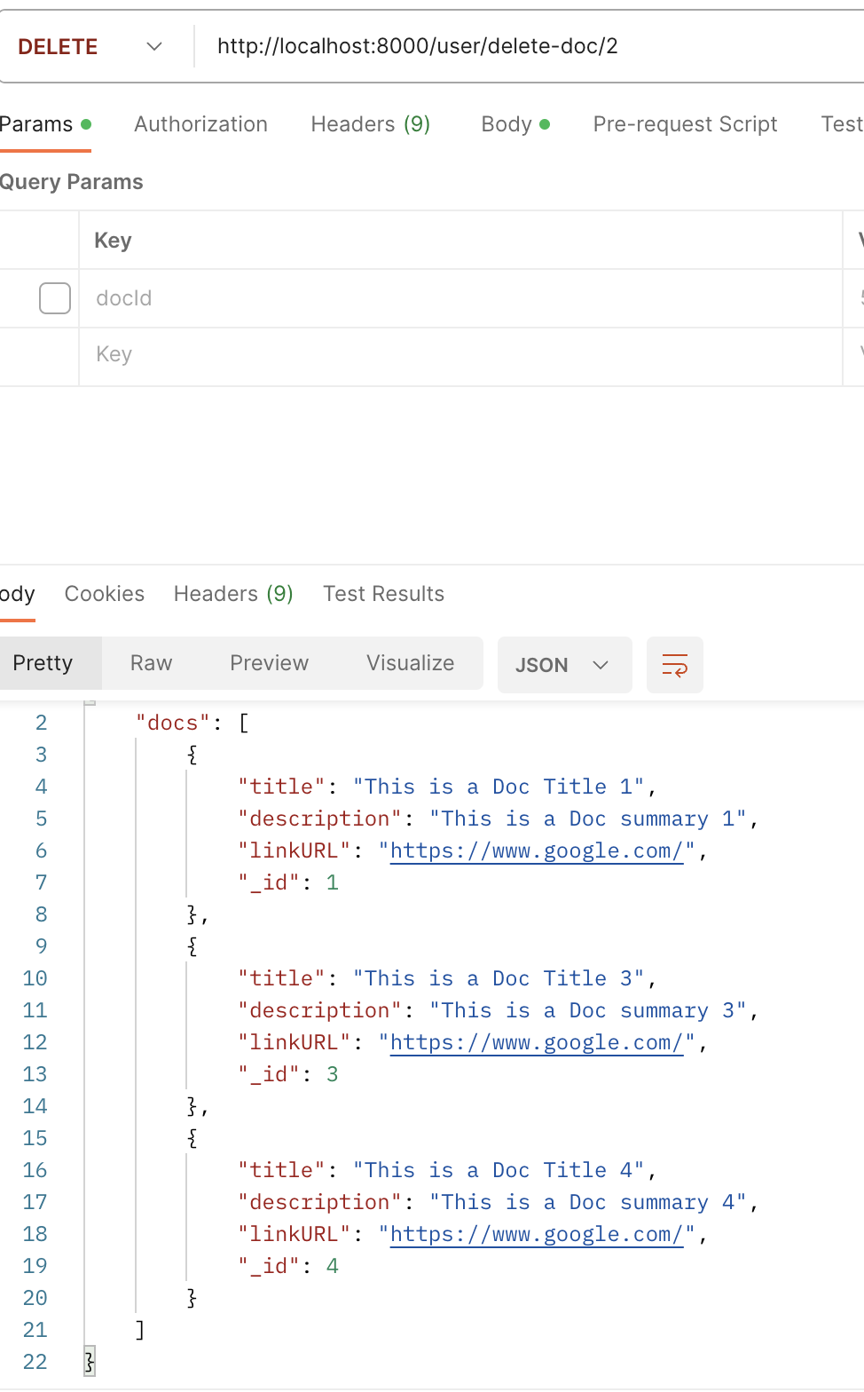
POST Method - DeleteDoc
Endpoint: /user/delete-doc/:docId
Method: Post
Param: docId
Response:
The updated list of Docs belong to this user
Action:
Delete user selected doc from the DB
Status:
200
If user_id is incorrect || user_id is not found
Return error message

Slide 33
Document Page
Methods

Slide 34
GET Methods - getDocument
Endpoint: /document/:docId/
Method: Get
Body: String document_id
Response:
The Document content and summary associated with this document_id
Status:
200
If document_id is incorrect || document_id is not found
Return error message

Slide 35
POST Methods - updateContent
Endpoint: /document/:docId/update-content/
Method: Post
Body: String document_id, content
Response:
Success message, “Document Updated!”
Status:
200
If document_id is incorrect || document_id is not found
Return error message

Slide 36
POST Methods - updateSummary
Endpoint: /document/:docId/update-summary/
Method: Post
Body: String document_id
Response:
Success message, “Summary Updated!”
Status:
200
If document_id is incorrect || document_id is not found
Return error message

Slide 37
Middleware
Methods
Notes:
Frankie

Slide 38
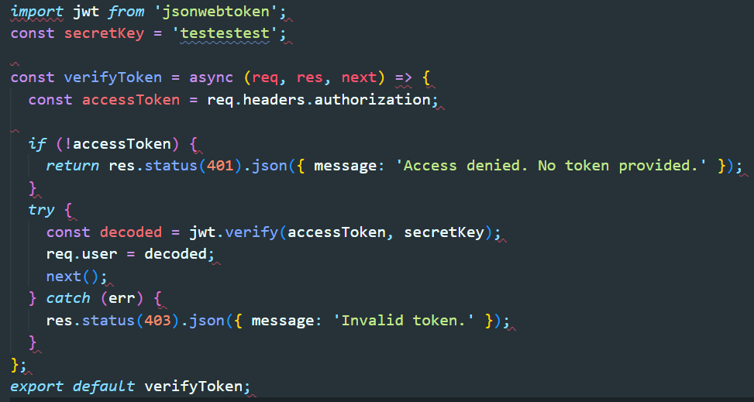
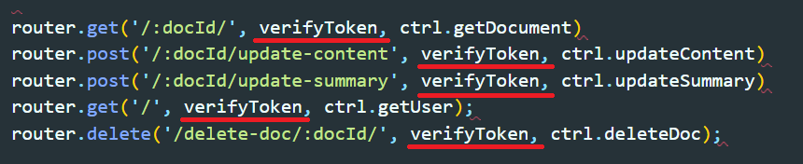
Verify Token
Method: jwt.verify()
Header: authorization
Action:
jwt.verify() to decode the token and assign the decode object to req.user
Status:
200
If no access token || jwt.verify() error
Return error message
Notes:
Frankie

Slide 39
05
Testing

Slide 40

Front-end Testing
TypeScript Testing Framework: Cypress
Why E2E:
Pre-Tested Components:
Mantine's components are already rigorously tested, reducing the need for additional Component Testing in our project.
Integration Over Isolation:
E2E Testing captures complex interactions, unlike Component Testing isolated focus.
Real User Experience Validation:
E2E Testing evaluates the full user experience, beyond Component Testing's limited scope.
Notes:
Yichen

Slide 41
User Stories And Testing for homepage
As a user, I want to…
Create a new doc
See all my notes in the form of card
Delete the note
See summary shortcut
Sign out of my account
For Testing
Test for create new document with keyboard “enter”.
Test for click button with mouse.
Test for delete document
Test for double click and navigated to doc page.
Test for show summary function
Test for sign out function
Notes:
Wan

Slide 42
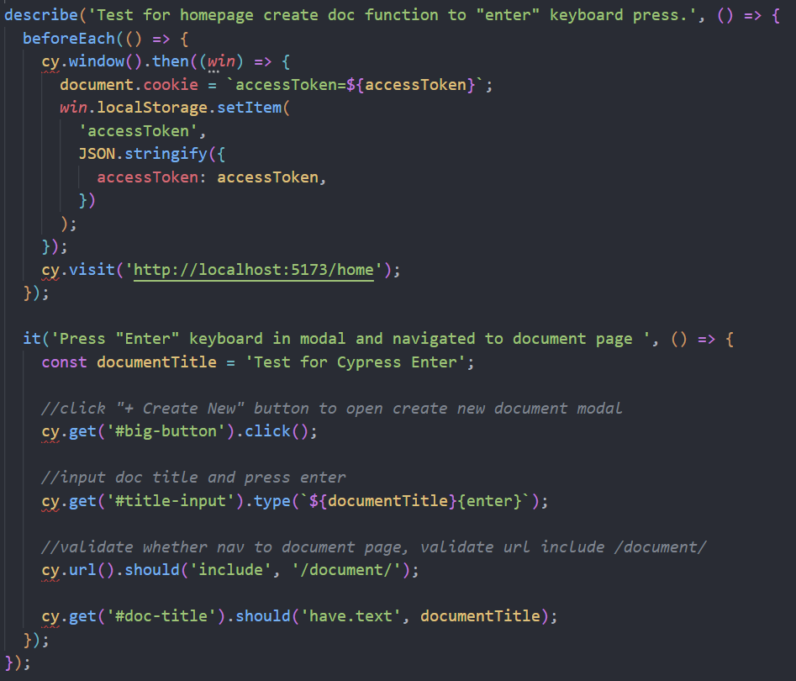
Testing for homepage
Notes:
Wan

Slide 43
Testing for document page
As a user, I want to…
Edit my note in a text editor
Save my note online
Generate a summary with AI and generate a new summary after I update my note
I want to be able to go back to homepage
For Testing
Text editor
Editing content in the text editor
Save button
Color change from blue(Save) to green(Saved)and back to blue(Save) after 5 second
Generate button
When the tip is shown, after clicking generate button, tip become summary of the note
Back button
Going back to home page

Slide 44



Back-end Testing
JavaScript Testing Framework: Mocha, Sinon, Chai
Unit Testing for every controller methods:
Test with mock input
Stub MongoDB functions, req and res methods, other methods used
In the controller methods
Expect response behavior

Slide 45
Back-end Testing
login( string : Google token ):
Expected:
Find user in DB, Create user obj if user is new
Assign access token
verifyToken(string : accessToken)
Expected:
Correctly verify accessToken and decode
Return 401 when no accessToken given
Return 403 when invalid accessToken given

Slide 46
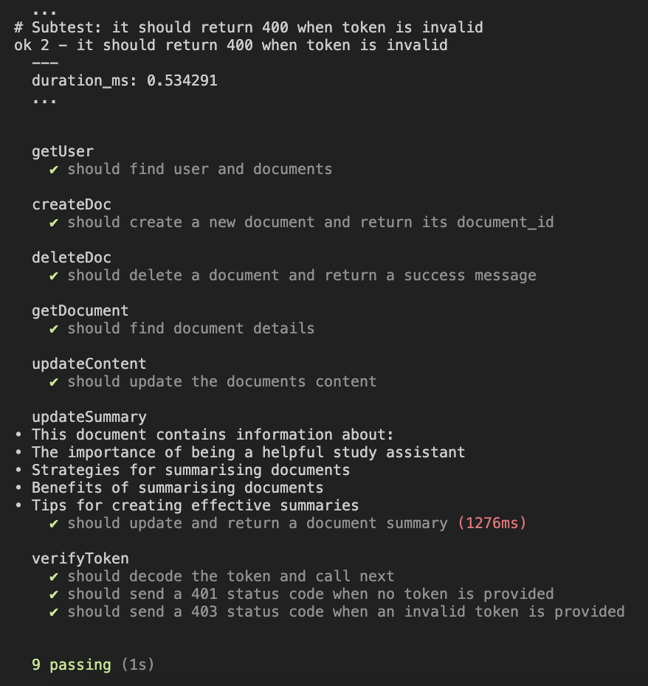
Back-end Testing
getUser(string: user_id) | expect {user, docs}
createDoc(string: title) | expect {newDoc_id}
deleteDoc(string: doc_id) | expect {res return message “delete success”}
getDoc(string: doc_id) | expect {Document}
updateContent(string: Content, string: docId) | expect {updatedDoc}
updateSummary() | expect {updatedSummary}

Slide 47
06
Security
Notes:
Yichen

Slide 48
Security
Utilizing OAuth 2.0 for Google API access
Our security process starts with sending a secure token upon user login. This token is then decoded using JWT (JSON Web Tokens), ensuring data integrity and authentication.
Backend methods
Our backend employs a verification token middleware with secret key, requiring a valid token for all actions beyond login. This security prevents unauthorized data alterations, ensuring system integrity.
Notes:
Yichen

Slide 49


Config and Deployment
Linting and code consistency
Use ESLint and Prettier for code consistency throughout the project
Notes:
Nicholas

Slide 50
07
Project Management
Notes:
Nicholas

Slide 51
Roles
Back-end Team
Frankie | Requirement Leader
Chris | Design and Implementation Leader
Nicholas | Team Leader
Front-end Team
Wayne | Configuration Leader
Siyuan | Security Leader
Yibo | QA Leader

Slide 52
Pairing
Login Page
Wayne | Frankie
Home Page
Chris | Siyuan
Document Page
Yibo | Nick

Slide 53
Achievement
Everyone learn a lot from project.
For frontend, learned how to use Google Login Method.
Use React successfully to create the pages and make connection of different components.
Use “mutate” to refactor the code.
Use Cypress to test our code.
For backend, learned how to use ChatGPT API to achieve our main function.
Know how to use different method to fetch data and create Mongo database.
Solved a lot of bug problems

Slide 54
Challenges
Inexperienced Development Team:
Efforts required to overcome learning curve obstacles.
Commitment to try our best to achieve project goals.
Testing Challenges:
Lack of familiarity with Cypress and Mocha testing framework.
Authentication Complexity:
Authentication proved challenging.
Opting for login and user management
Meeting barriers in effectively testing Google authentication.
Large Group Dynamics:
Coordination difficulties in organizing meetings with a large group.
Ensuring everyone stays on track with assigned tasks.

Slide 55
Previous Iterations
A quick overview of what we have done so far for each iterations:
Iteration 0: established project idea, functional and non-functional requirements, data schemas.
Iteration 1: Finished front-end design and implementation without connecting to server. Constructed database using MongoDB. Established working connection with OpenAI.
Iteration 2: Finished building both frontend and backend routing. Finished building backend controllers. Enabled CRUD operations based on RESTful architecture.

Slide 56
Current Iteration
As an overview
Done all bug-fixing to deliver smooth user experience.
Implemented TanStack to handle all Promises in a more sophisticated way.
Tested front-end using Cypress and back-end with Mocha.

Slide 57
08
Demo

Slide 58
Thank you
Feel free to ask any questions!

