Slide 1
NoteAnt
Team5-MERN
Backend method
Back-end: Nick, Frankie, Chris
Front-end: Wayne, Yibo, Siyuan

Slide 2
List of Pages
Login
Home
Document

Slide 3
Login Page
Methods

Slide 4
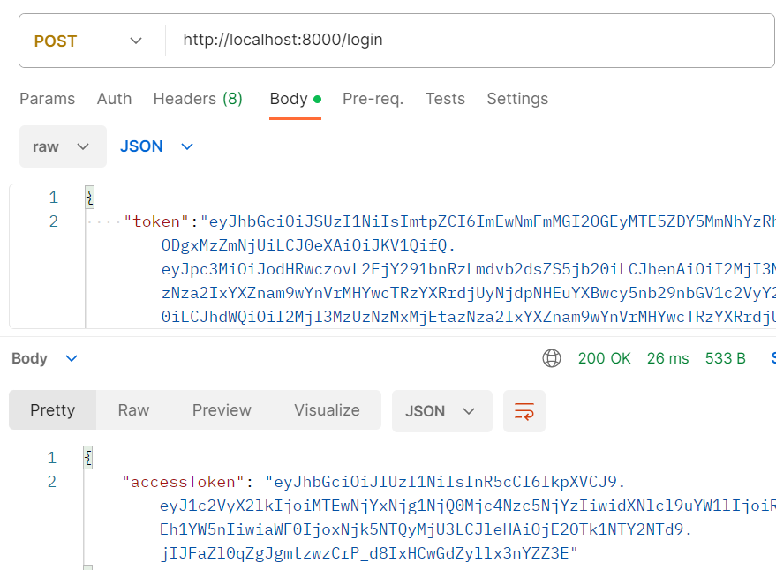
POST Methods
Endpoint: /login
Method: Post
Body: String token
Response:
An access token used for user login signed with user_id, user_name, secretkey and Expiry.
Action:
Create a new user in the database if don’t exist
Check is the user already exists
Status:
200
If jwt token invalid
Return error message

Slide 5
GET Methods
Endpoint: /login/verify-token
Method: Get
Body: String token
Response:
A boolean value represent verification successful or not
Status:
200
If token verified error
Return error message

Slide 6
Home Page
Methods

Slide 7
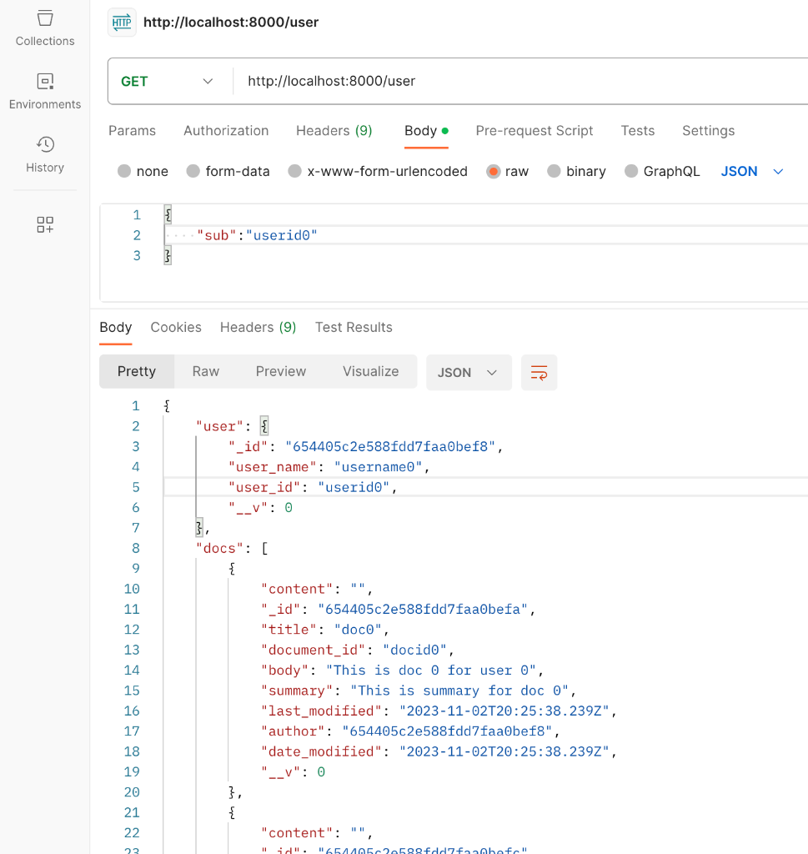
GET Methods - getUser(user_id)
Endpoint: /user
Method: Get
Body: String user_id
Response:
The User associated with this user_id
All documents belong to this User.
Status:
200
If user_id is incorrect || user_id is not found
Return error message

Slide 8
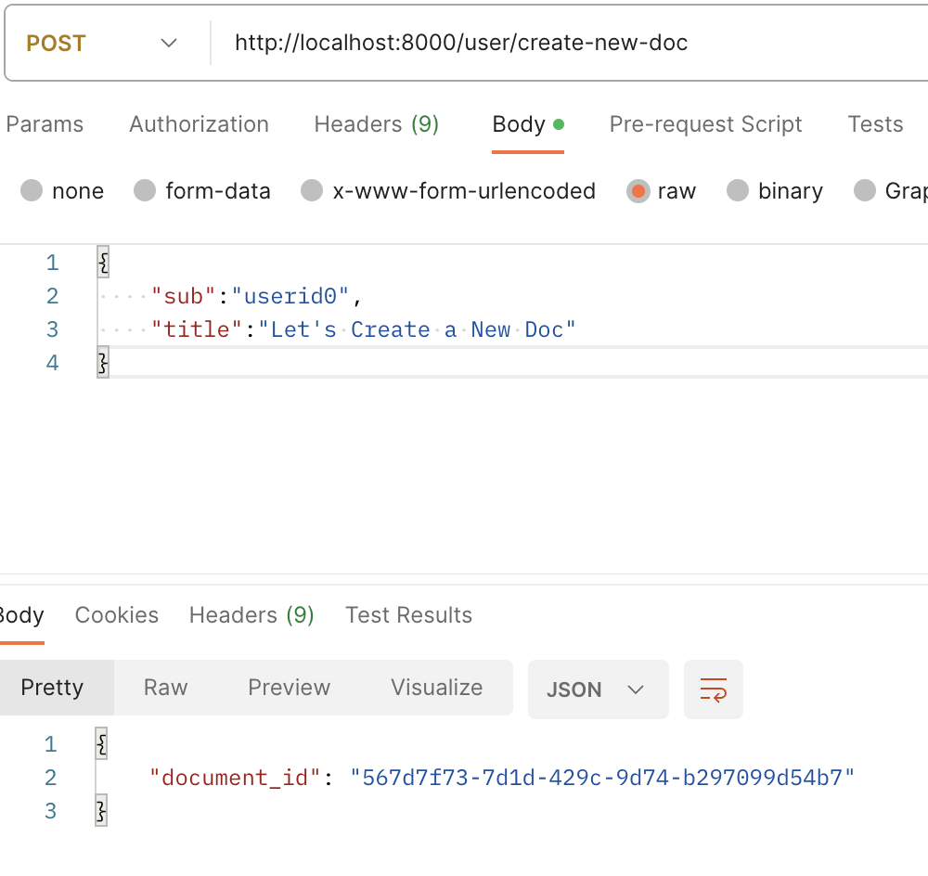
POST Methods - CreateDoc
Endpoint: /user/create-new-doc
Method: Post
Body: String title, user_id
Response:
The new document id for front end page to navigate.
Action:
Create a new document for the specific user
Status:
200
If user_id is incorrect || user_id is not found
Return error message

Slide 9
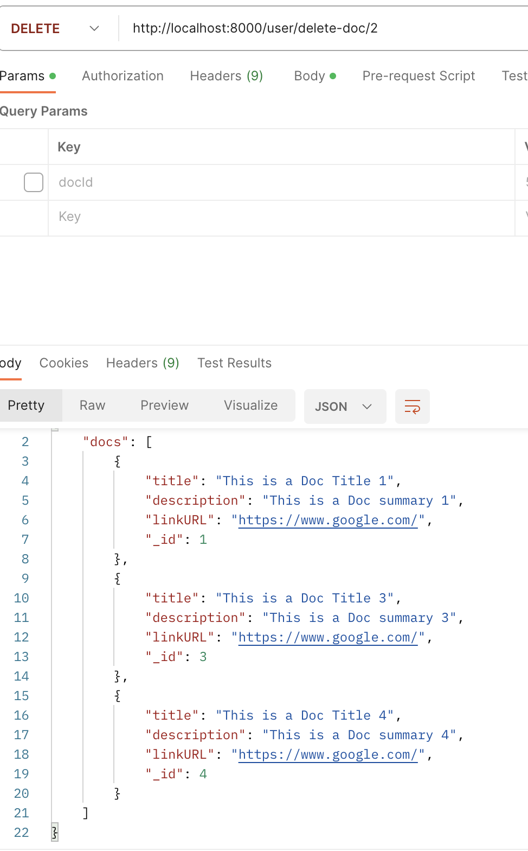
POST Method - DeleteDoc
Endpoint: /user/delete-doc/:docId
Method: Post
Param: docId
Response:
The updated list of Docs belong to this user
Action:
Delete user selected doc from the DB
Status:
200
If user_id is incorrect || user_id is not found
Return error message

Slide 10
Document Page
Methods

Slide 11
GET Methods - getDocument
Endpoint: /document/:docId/
Method: Get
Body: String document_id
Response:
The Document associated with this document_id
Status:
200
If document_id is incorrect || document_id is not found
Return error message

Slide 12
POST Methods - updateContent
Endpoint: /document/:docId/update-content/
Method: Post
Body: String document_id, content
Response:
Success message, “Document Updated!”
Status:
200
If document_id is incorrect || document_id is not found
Return error message

Slide 13
POST Methods - updateSummary
Endpoint: /document/:docId/update-summary/
Method: Post
Body: String document_id
Response:
Success message, “Summary Updated!”
Status:
200
If document_id is incorrect || document_id is not found
Return error message

Slide 14
Iteration 3

Slide 15
Todo List
Fix Bugs
Add missing features
Refactor
Testing

Slide 16
Bugs/Missing Features
Frontend:
Login is not persisting
Save token to local storage
Use sessions
UI not showing after data is fetched
Use library to handle queries
Handle error & loading states better
New user sign-ins not redirecting to app
Backend:
OpenAI API not working
Convert javascript to ES6
Instances in database not working properly
Test the whole app once more

Slide 17

Testing
Component Testing & E2E Testing

Slide 18
Refactor Code
Look for duplicate codes, and make functions that call them
Compile a list of custom React Hooks to be used in common functions

