Slide 1
Iteration 1 Report
Team 5 - NoteAnt
Guancheng Huang, Wenhao Tian (Chris),
Nicholas Narmada, Yichen Li,
Siyuan Wan, Yibo Wang
Notes:
Everybody

Slide 2
Frontend

Slide 3
Backend

Slide 4

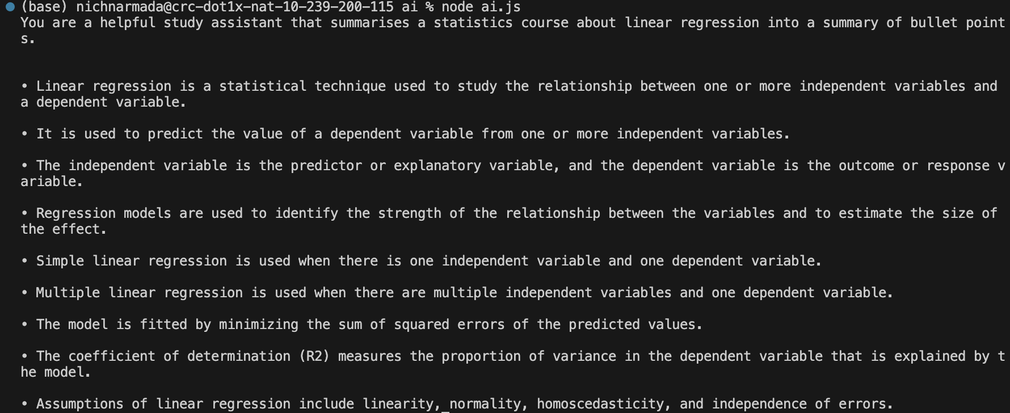

OpenAI and LangChain Connection

Slide 5


Flow
getDoc()
respond
Update doc
new User()
getDocs()
request
GSI Token
new Doc()
User Docs Page
Docs Page
Log In
Access Token
Doc._id

Slide 6
Task for Iteration 2
Set up and test backend API:
Login:
Assign access token
if(!user) new User()
User Docs Page
getDocs(user._id)
createDoc()
deleteDoc(doc._id)
Document Page
updateDoc(doc._id)
getSummary(doc._id)

Slide 7
Thanks for your time
Any questions?
Notes:
Everybody

