Slide 1
Iteration 0
Team 5
Guancheng Huang, Wenhao Tian (Chris),
Nicholas Narmada, Yichen Li,
Siyuan Wan, Yibo Wang
Notes:
Everybody

Slide 2
Logistic Roles
Team Leader
Requirement Leader
Design and Implementation Leader
Configuration Leader
Security Leader
QA Leader
Notes:
Yibo
Frankie
Requirement leader
Chris
Design and Implementation leader
Nicholas
Team Leader
Wayne
Configuration leader
Siyuan Wan
Security Leader
Yibo(Wilbur)
QA Leader

Slide 3
Technical Roles
Front End Team
Yibo
Siyuan
Wayne
Back End Team
Chris
Nicholas
Frankie
Notes:
Who did frontend(yibo, siyuan, wayne), backend(chris, nicholas, frankie)

Slide 4

Idea of Project
Problem:
Traditional note-taking
Lengthy
Inefficient
Difficult to condense
Notes:
Chris. Split problem and solution into 2 slides. (bigger font size plz)

Slide 5

Idea of Project
Solution:
Utilize ChatGPT’s natural language processing and understanding capabilities to summarize notes.
Why?
More efficient
Improve learning experience.

Slide 6
Plan/roadmap
Six people:
frontend 3 people
backend 3 people.
Itera0
1. Project development ideas.
2. Clear division and familiar with own part.
Notes:
Siyuan

Slide 7
Iteration 1
Frontend
Finish making UI
Use dummy data
Backend
Research about ChatGPT API and Langchain
Setup Express and MongoDB

Slide 8
Iteration 2
Frontend
Remove dummy data, use real time data from backend
Create loading and error states
Backend
Finish CRUD (create, read, update, delete) operations
Finish building MongoDB data models
Finish register, login, logout
User sessions

Slide 9
Iteration 3
Frontend & Backend
Make sure everything works
Add new features from surveys

Slide 10
Prototype
Page list:
Login
Home
Document
Websites for design inspiration for our pages
Pinterest
Dribbble
Notes:
Nicholas Bigger font size

Slide 11
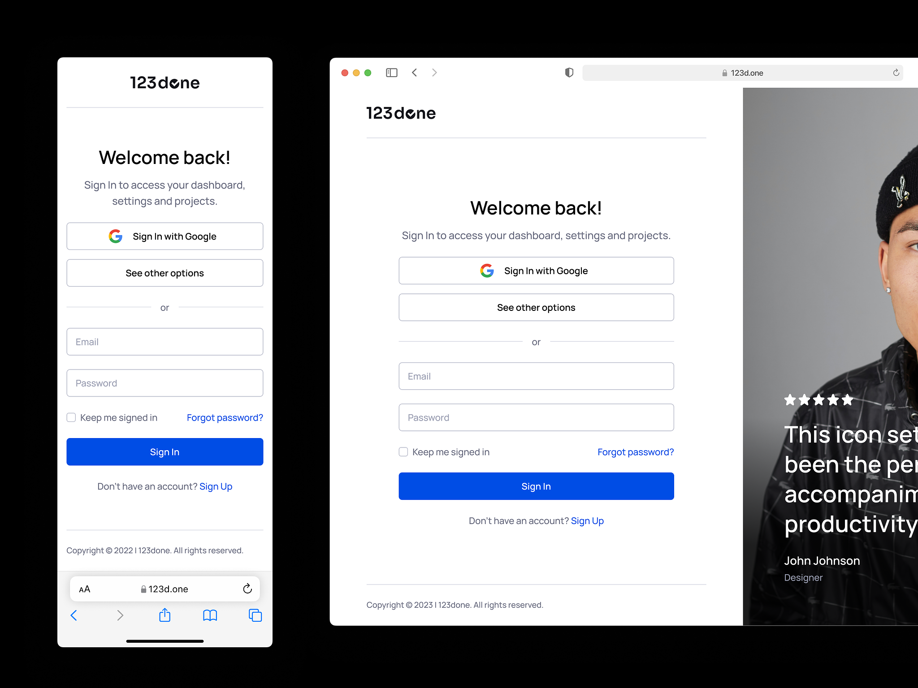
Login
/login
Notes:
Nicholas

Slide 12
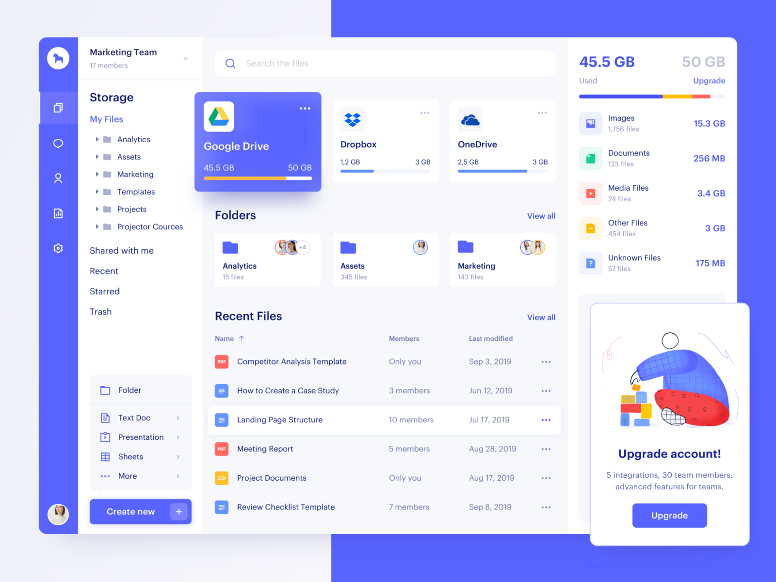
Home
/{user}
Notes:
Nicholas

Slide 13
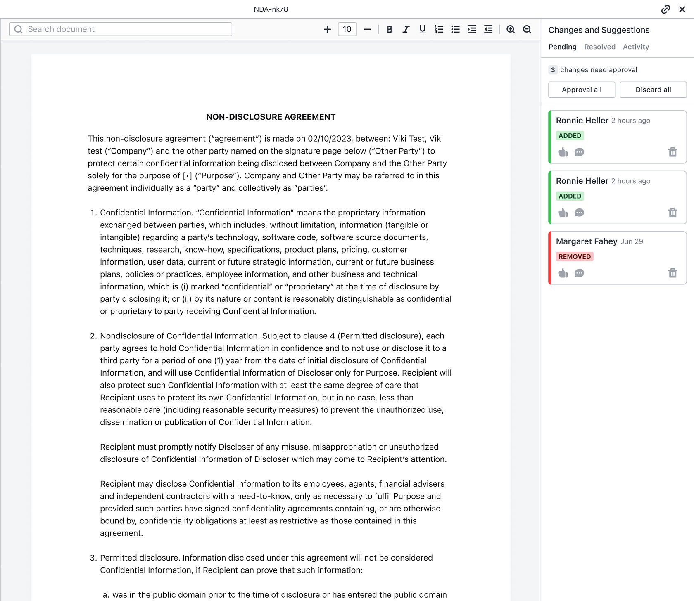
Document
/{user}/{doc}
Notes:
Nicholas

Slide 14
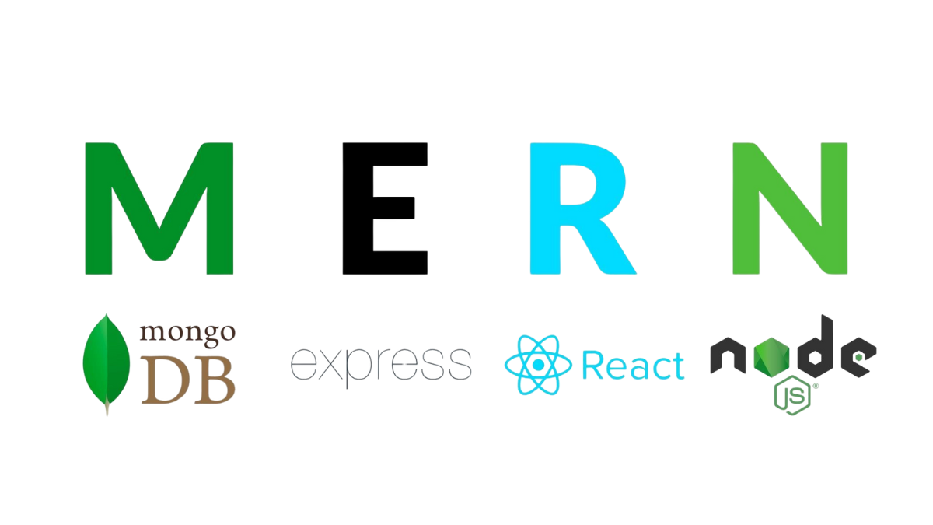
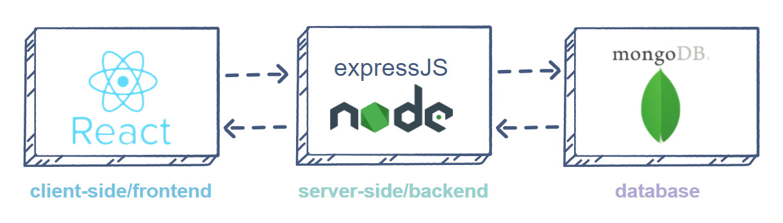
Tech stack
Notes:
Frankie

Slide 15



Library used for frontend
Mantine UI : Provides a set of high-quality React components and hooks.
Tanstack query :Handles API requests and data fetching in React applications.
React router: : Manages navigation and routing for React applications.

Slide 16



Library used for backend
Langchain : API for AI connection
Mongoos : MongoDB connection
express: runs server-side
Path; passport; joi; uuid
Axios ; dotenv; connect-flash; connect-mongo; method-override; cloudinary
Notes:
Wayne Back-end libs (definite inclusion): langchain(API for AI connection), Mongoose(MongoDB connection), path(traverse folders and files), express(runs server-side), passport(for username & password auth and protection), joi(server-side validation), uuid(generate unique ID for each entry) Back-end libs (maybe used): axios(for internet access), dotenv(for development before release), connect-flash(for flash messages), connect-mongo, method-override(for handling http delete and update requests), cloudinary(cloud storage for img, videos, pdf, …)

Slide 17
Thanks for your time
Any questions?
Notes:
Everybody

