Slide 1

cheffy
CS 673 Team 1 Iter 1
9/26/2021

Slide 2
Agenda
Overview
Software Architecture
Database & Security Design
UI Design
User Stories
App Demo

Slide 3




Overview

Slide 4
Design Goals
Maintainability
Reusability

Slide 5
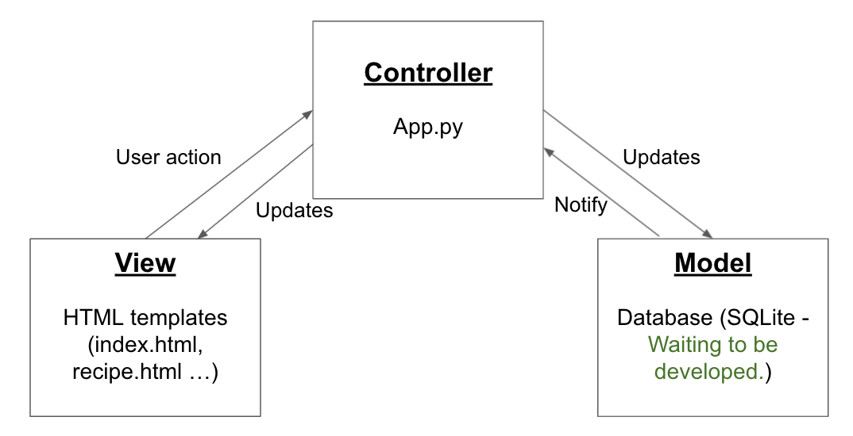
Software Architecture: MVC

Slide 6
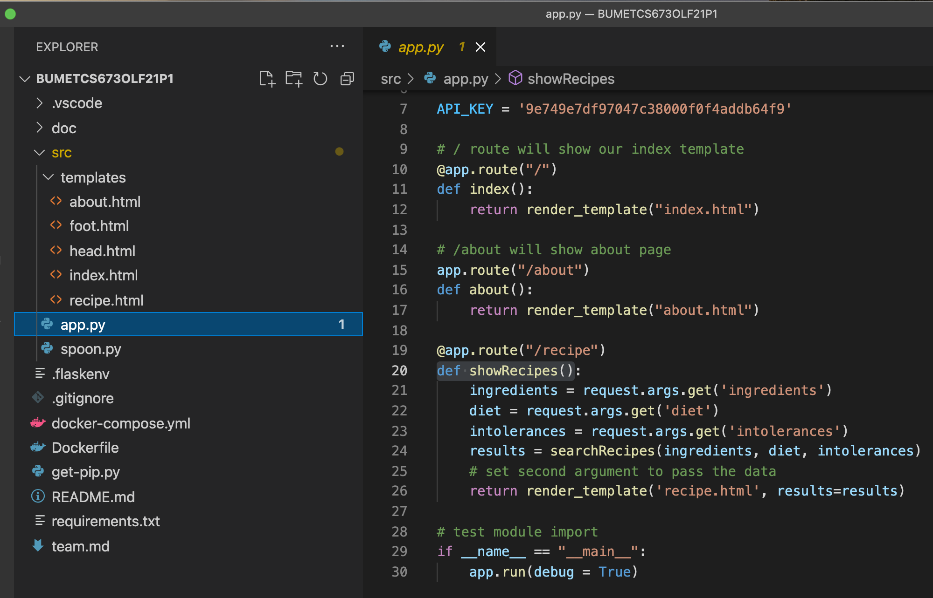
Software Architecture: MVC
View
One of our APIs
Controller

Slide 7
Software Architecture: MVC
Controller
App.py
User action
Updates
Updates
Notify
Save success!
View
Model
User ID | Favorites
888 | RecipeID123
💗 save it
👆

Slide 8
Database and Security Design
Database: SQLite
UserID
Email
Password
Favorites
Pantries
Security: Auth0 for password saving; HTTPS request; Integrate cookies for session management

Slide 9
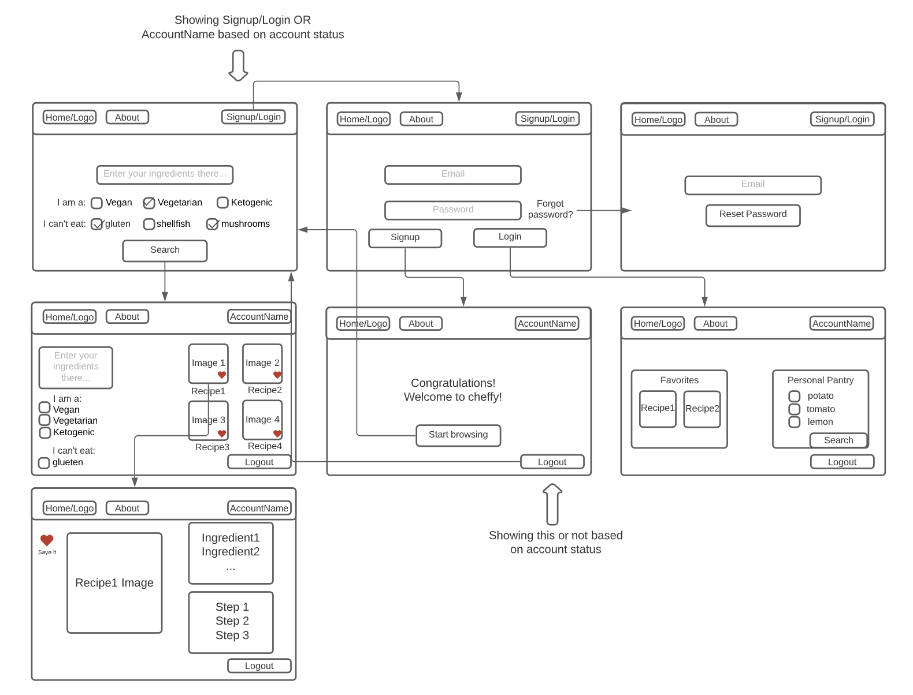
UI Wireframe

Slide 10
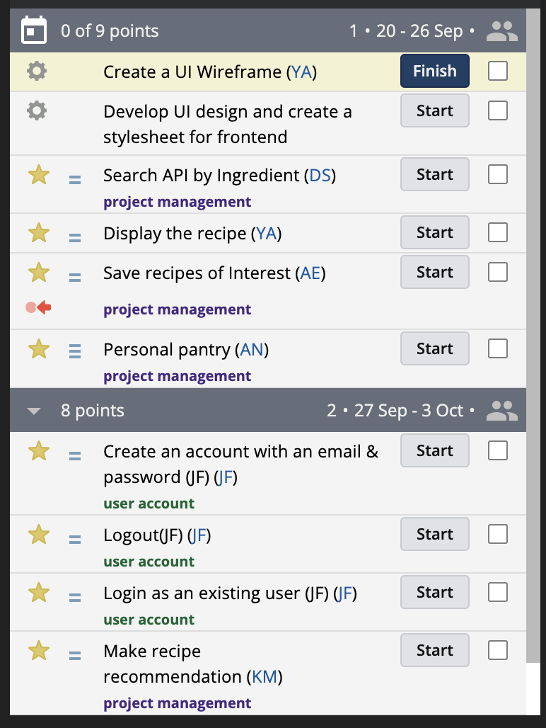
User Stories

Slide 11
Demo (Another presentation)

