Slide 1

Cheffy
Final Presentation
CS673
October, 2021

Slide 2
Cheffy Team:
Aidan Duffy
Jean Shalenkova
Justin Fanning
Kyle Mabry
Yanru (Grace) Zhu

Slide 3
Agenda
App Overview/Requirement
Design
Implementation
Testing
Security
Project management
Future Steps
Demo (separate video)

Slide 4
Cheffy Overview
Cheffy is an application designed to allow users to search for recipes that use leftover ingredients from their fridge and pantry
It allows user to select from dietary restrictions to influence their search
Users* can also maintain a pantry to keep a persistent inventory of the ingredients they have
Additionally users* can save recipes they have liked into a persistent favorites list
Finally users can use the application to find recipes similar to ones they currently viewing
The idea behind this app is to allow users to find uses for ingredients they have laying around that might otherwise go to waste
*logged-in users

Slide 5
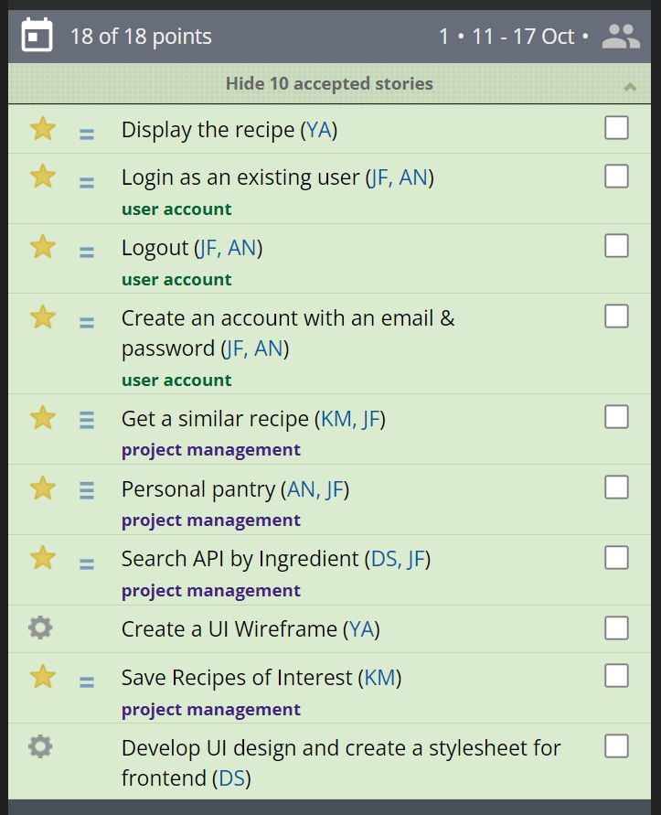
Cheffy Overview - Functional Requirements
User Login
User logout
User Password
Search Recipes
Filter by allergies
Save Recipe
User Pantry
Suggest Recipe
Translated into our core user stories →
All core stories were completed
One reach feature, suggest recipe, was also completed
PivotalTracker was used to track and monitor requirement progress along with github

Slide 6
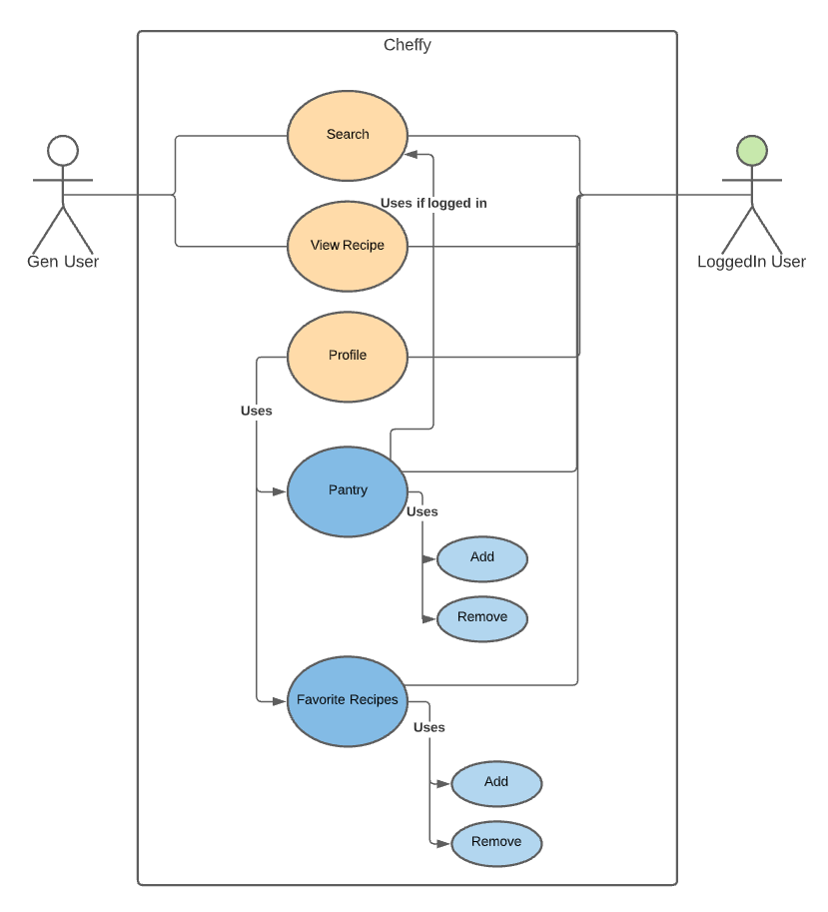
Cheffy Overview - Use Case Diagram
Divided by our two user groups
General users
Logged-in Users
Features available to them are determined by their logged in status
General users have access to basic search functions
Logged-in users gain access to user specific features (favorites and pantry)

Slide 7
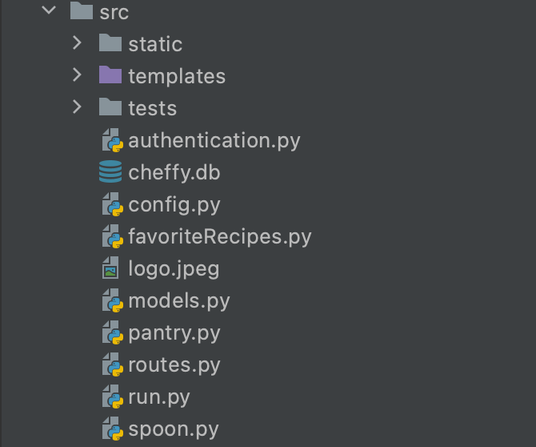
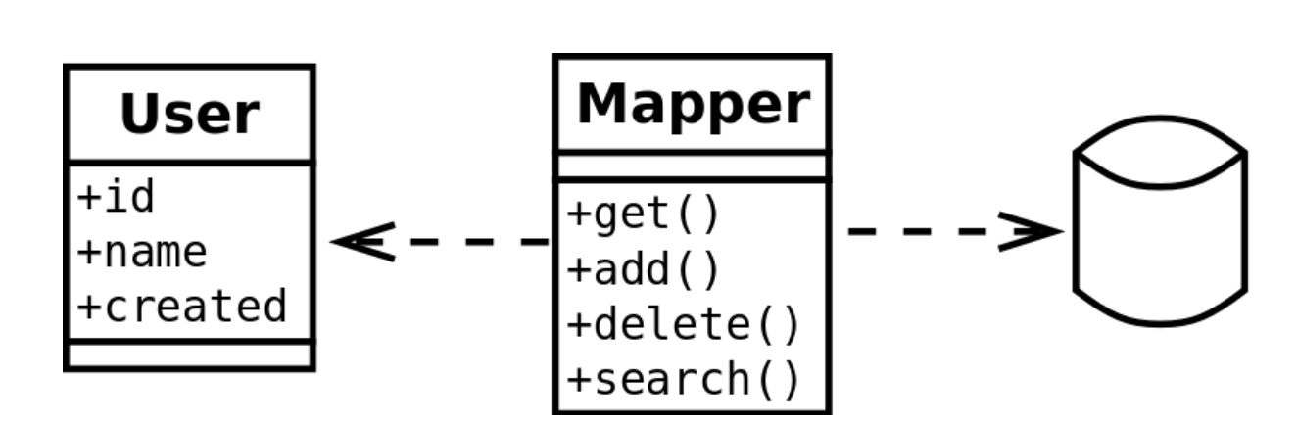

Design - Database
Data Mapper design pattern
User
Database
Mapper
A specialist class handles the interaction between a user and the relational database.

Slide 8
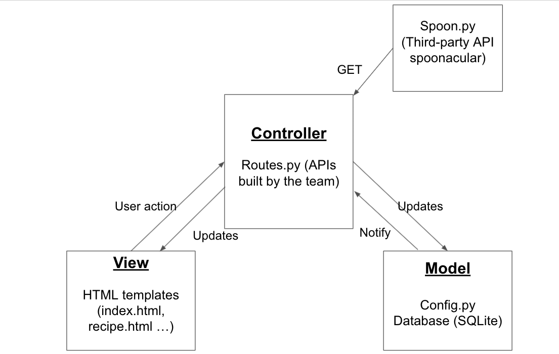
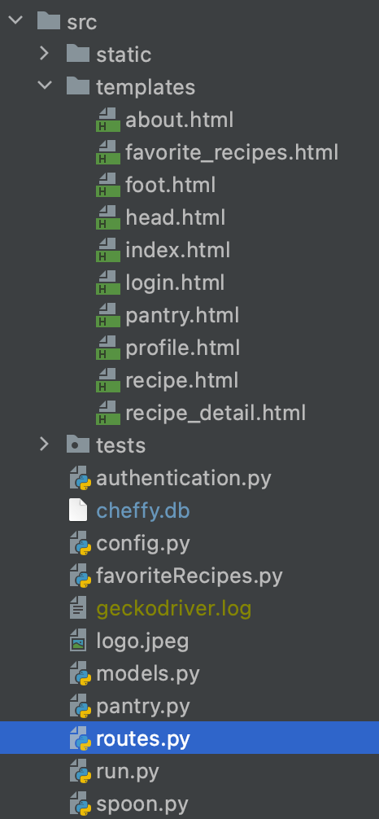
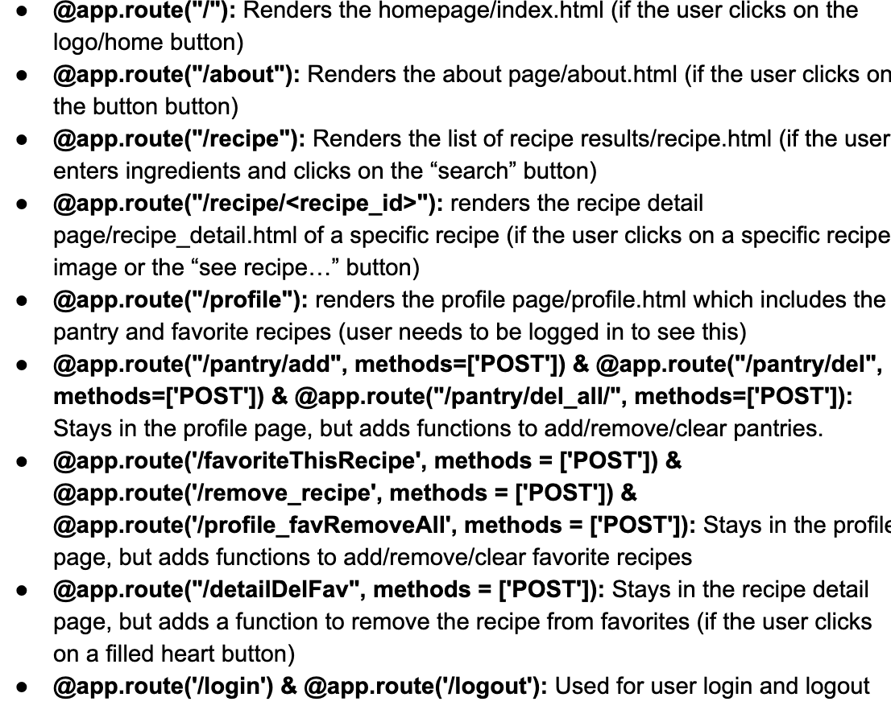
Design - Software Architecture
View
Model
Controller

Slide 9
Implementation - Reached MVP goal + some features
· MVP goals:
· User can create an account
· User can search for a recipe containing specific ingredients
· User's search can filter by dietary restrictions and intolerances
· Recipe will display in its own page with instructions and ingredients list
· User can save ingredients they have in their pantry***
· Registered user with a nonempty pantry can search recipes by pantry contents***
· Additional features added:
· User can like a recipe***
· User's favorite recipes will be saved in their profile page***
· Searches can include some, but not all ingredients listed in a search
***contingent on account creation

Slide 10
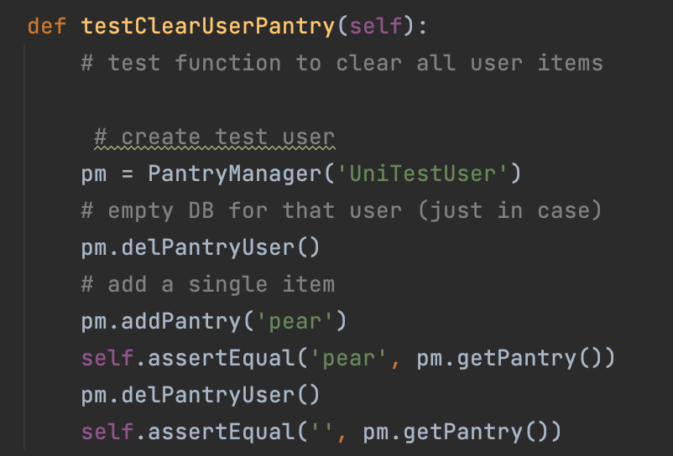
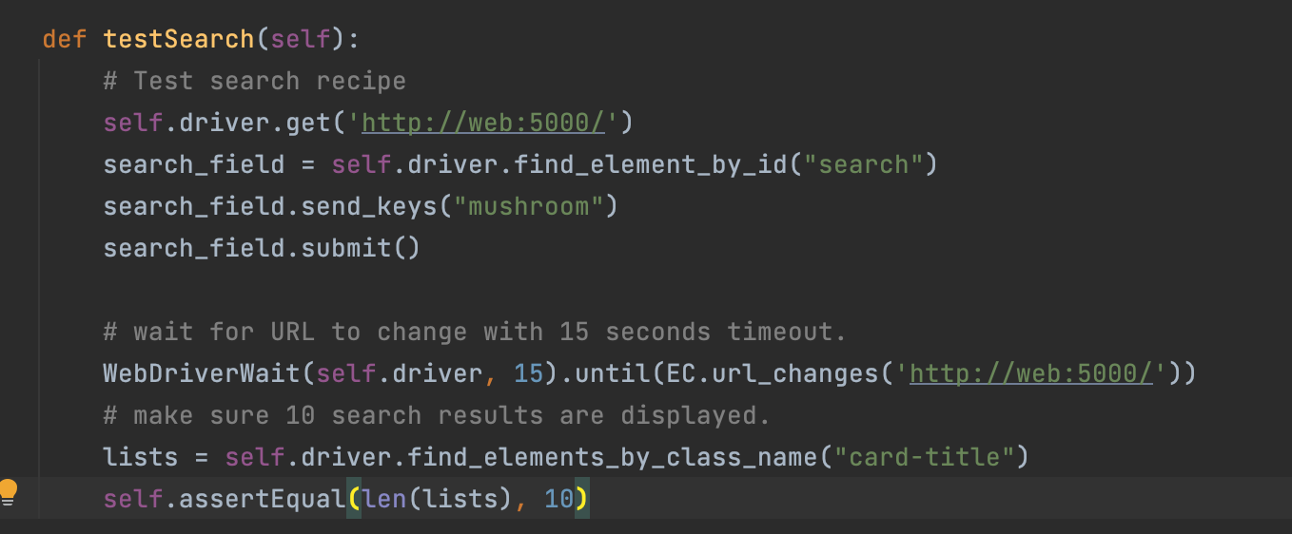
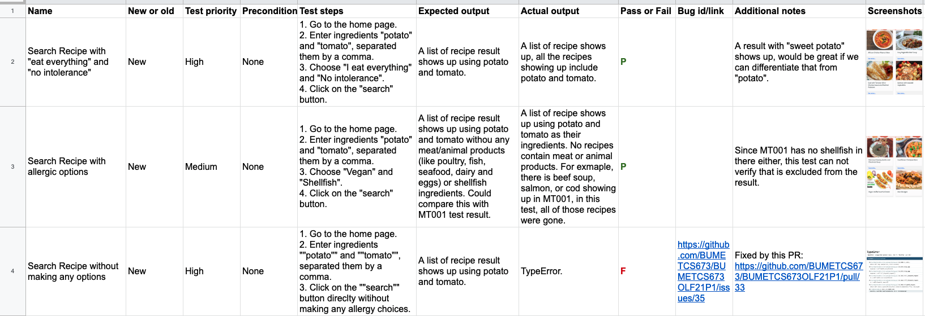
Testing - Types of testing
Unit Tests
10 + tests
Features : recipe detail; pantry; favorites
Selenium Tests (a separate demo video, click here to watch)
3 + tests
Features: visit the site; search; display a recipe detail; login…
Manual Tests
15 + tests
Covers all features
An example of a unit test
An example of a selenium test
Examples of manual tests
Notes:
Unit tests: white-box testing
Manual tests: black-box testing

Slide 11
Testing - Quality Assurance metrics
Product Metrics
Metric Name | Iteration 0 | Iteration 1 | Iteration 2 | Iteration 3
Unit Tests Passing Rate (Unit Tests Passed/Unit Tests Written) | None | None | 8/8 = 100% | 11/11 = 100%
System Tests Passing Rate (System Tests Passed/System Tests Written) | None | None | 3/3 = 100% | 3/3 = 100%
Manual Tests Passing Rate (Manual Tests Passed/Manual Tests Written) | None | None | 10/12 = 83% | 12/15 = 80% (Fixed and currently 100%)
User story counts | None | 8 (finished 1) | 8 (finished 7) | 8 (finished 8)

Slide 12
Testing - Quality Assurance metrics
Process Metrics
Metric Name | Iteration 0 | Iteration 1 | Iteration 2 | Iteration 3
Defects fix rate (defects fixed/total defect counts) | None | 1/1 = 100% | 3/3 = 100% | 4/4 = 100%
Project effort (total hours spent) | 47 | 88 | 154

Slide 13
Security Design - General Overview and Auth0
We run most of queries through the Spoonacular API
Helps sanitize user input from the beginning to avoid any vulnerabilities such as a SQL injection
Outsourced sensitive user data (username/password) storage to a third party, reputable API called Auth0
Auth0 handles our authentication and user verification

Slide 14
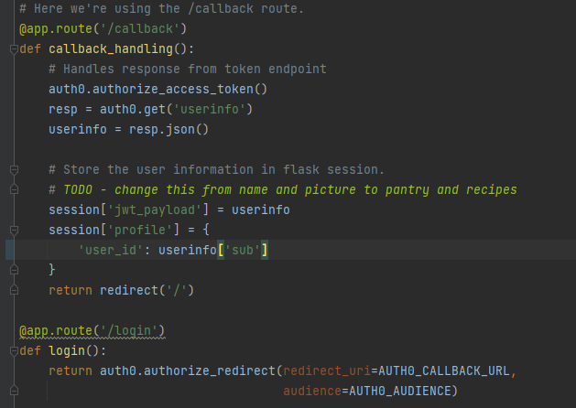
Security Design - Integrating Auth0 w/ Flask
Flask package has a sub-module called Flask-login
Flask-login stores session information
Auth0 supplies the session with a unique userID with which to interact with user data in the backend

Slide 15
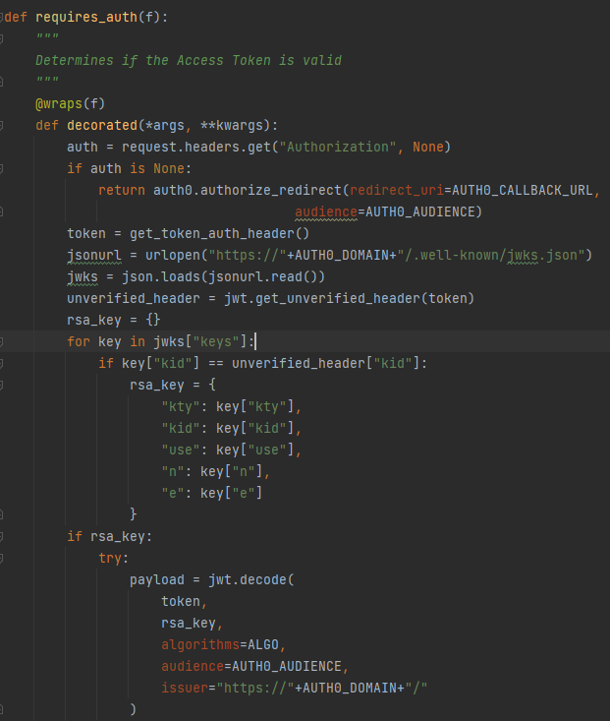
Security Design - Token Verification

Slide 16
Project Management - Team Roles
Aidan Duffy - Security Leader
Jean Shalenkova - Design and Implementation Leader, Configuration Leader
Justin Fanning - Team Leader, Requirement Leader
Kyle Mabry - Backup Team Leader
Yanru (Grace) Zhu - QA Leader
Lost team members:
Andrew Fish - Requirement Leader

Slide 17
Project Management - Risk Management
Risk Management Review
The initial risk analysis proved to be useful for the duration of our project
Well defined MVP(minimum viable product) proved very useful
By focusing on a realistic and achievable requirements we were able to hit our target features
Time permitted an additional feature to be added
Our estimate closely matched what we were able to accomplish
A project risk overcome was an unfamiliarity with the flask framework
Skeleton code, team discussions, and individual learning helped to overcome that risk
Lack of communication was identified as a potential risk and did present some difficulty during this project, complicated by different time zones and real life
Using slack and mini meetings in addition to our standard weekly meeting were useful in realigning the team when needed

Slide 18
Project Management - Code Iteration Evolution
Iteration 0:
Environment setup, Flask “hello world” example
Iteration 1:
Initial Skeleton code - rough UI, initial app windows, initial search function
Iteration 2:
UI cleaned up + Stylesheet for overall app look
Favorites Feature Implemented
Pantry Feature Implemented
Detailed Recipe View Implemented
Find Similar Feature Implemented
Login/out Feature Implemented
Iteration 3:
Favorites and Pantry Consolidated into User Profile Page
Further UI cleanup
App Security - Page Permissions implemented
Minor Feature Tweaking for usability or cosmetic improvements

Slide 19
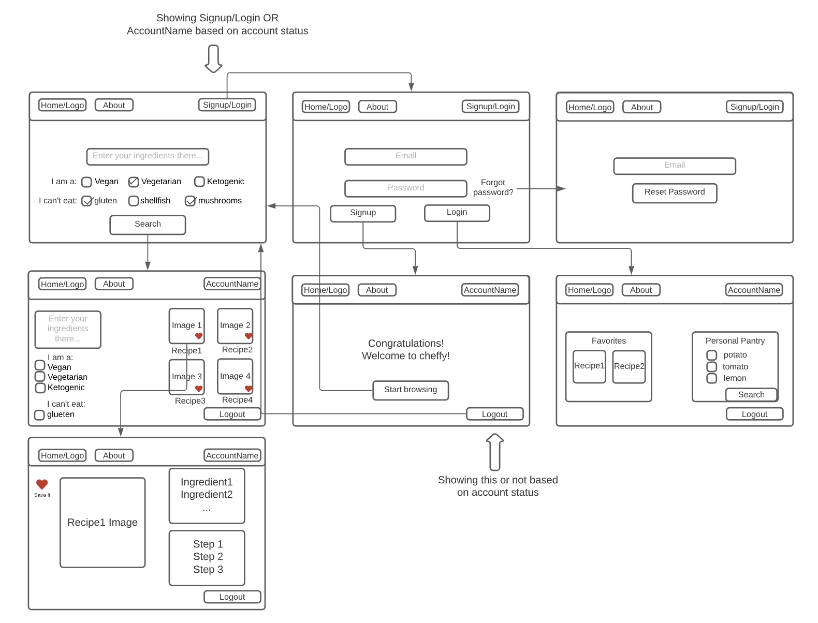
Project Management - Implementation Achievements
Ended up close to our envisioned wireframe from iteration 1

Slide 20
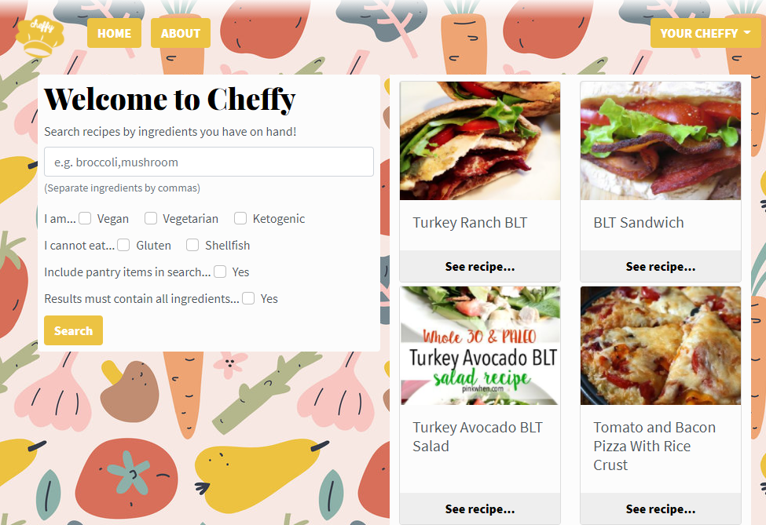
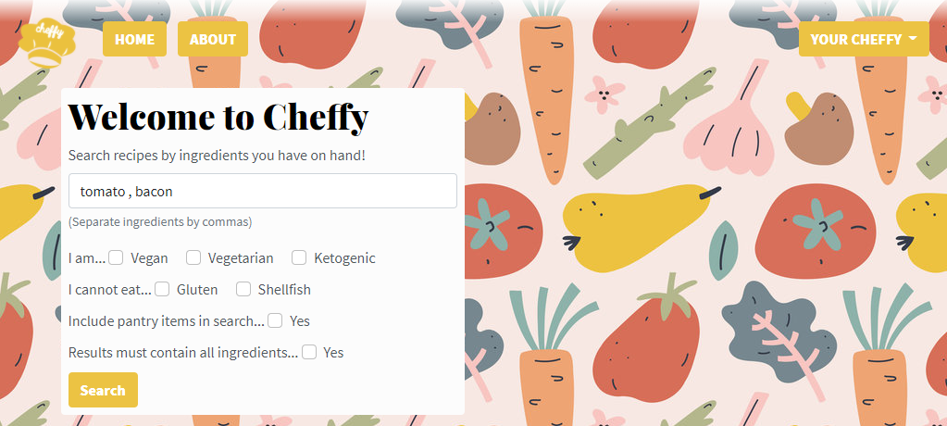
Project Management - Implementation Achievements
App core search function to search for recipes given target ingredients

Slide 21
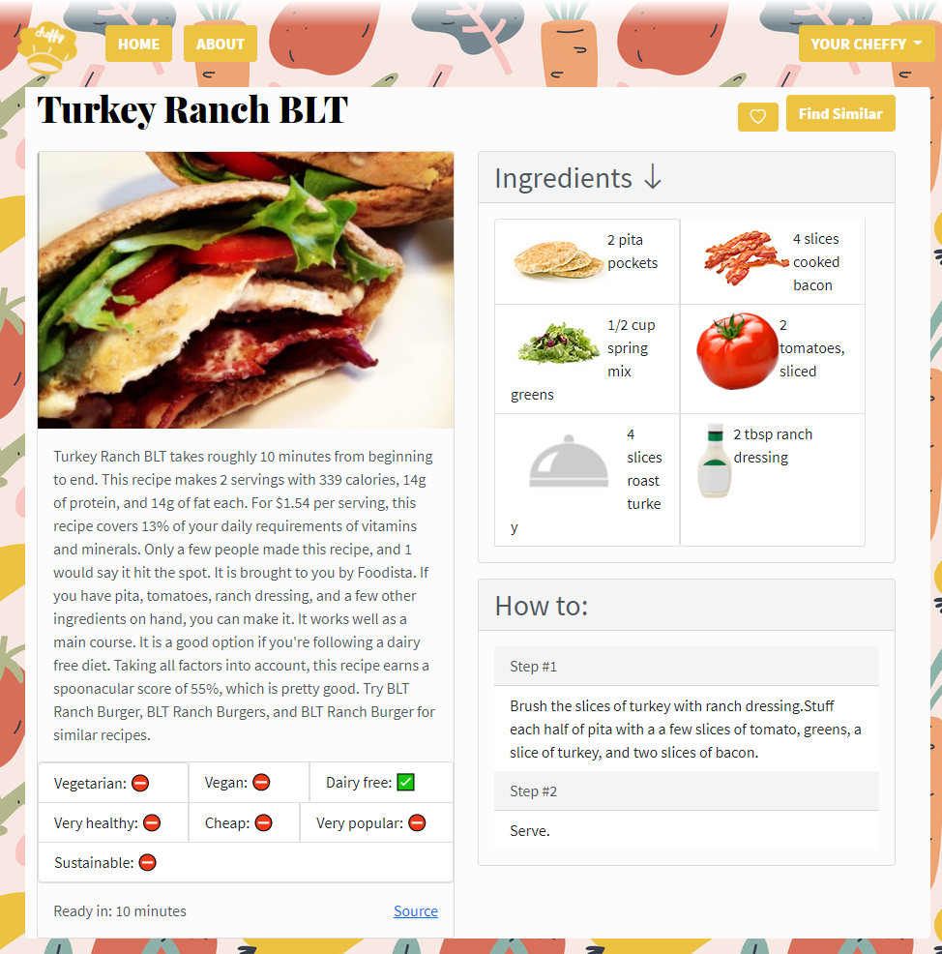
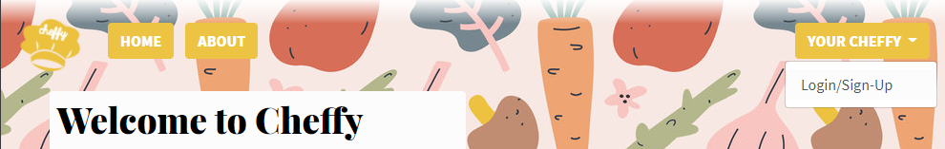
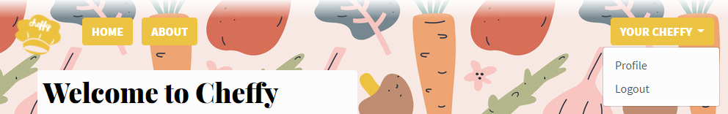
Project Management - Implementation Achievements
Detailed recipe view
User Login/out

Slide 22
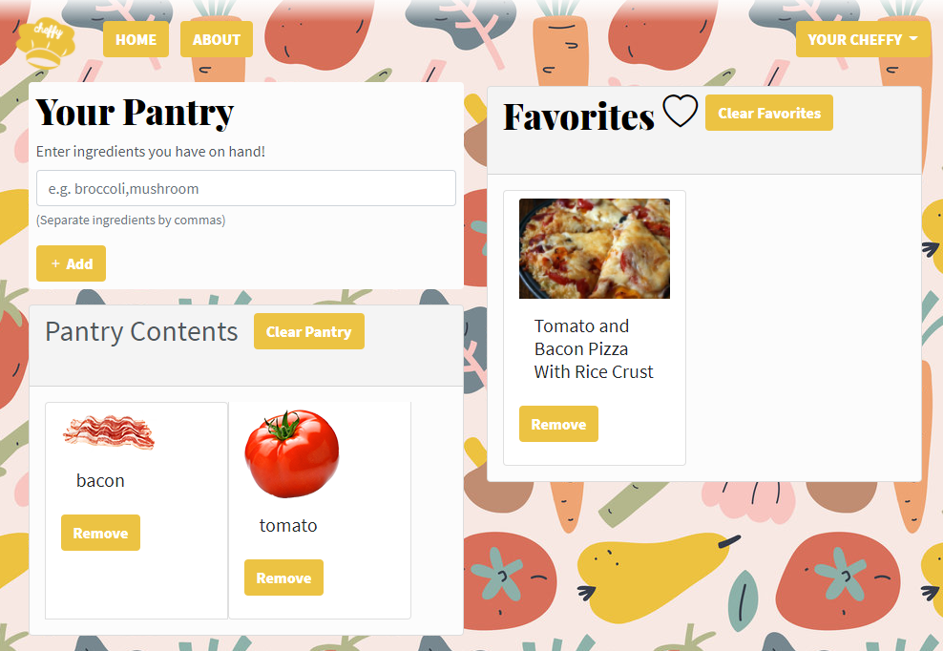
Project Management - Implementation Achievements
Logged-in User Features
User Pantry
User Favorites

Slide 23
Icebox & Future Goals
Frontend: Allow users to search for recipes by their name
Frontend: Allow users to rate/review recipes beyond simply favoriting/saving them
Security: Integrate specific page permission scopes (ex: read:pantry)
ML Work: Given a user’s history of liked recipes, recommend to users possible recipes they may enjoy

Slide 24

Click to watch demo!

