Slide 1

cheffy
CS 673 Team 1 Iter 2
10/12/2021

Slide 2
Agenda
Overview
Software Architecture
Database Design
Security Design
Testing
User Stories
App Demo

Slide 3






Overview

Slide 4
Design Goals
Maintainability
Reusability
Security

Slide 5
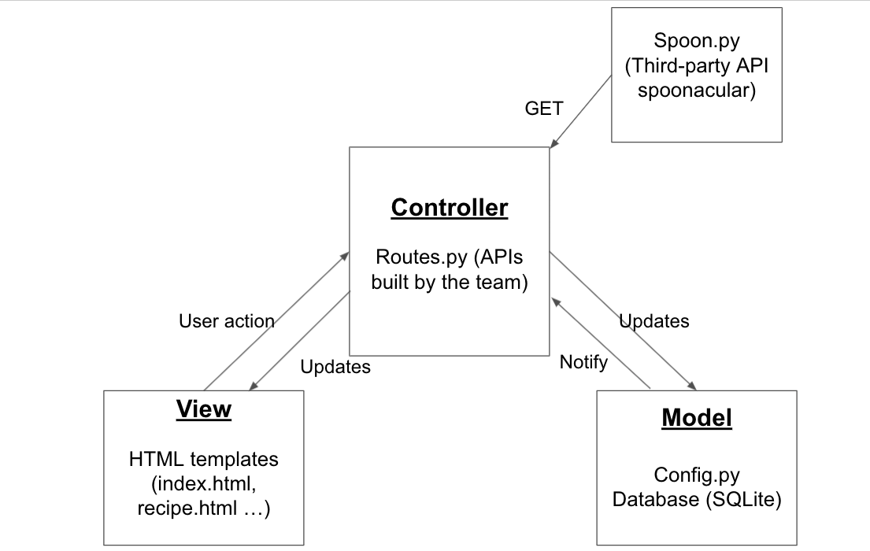
Software Architecture: MVC

Slide 6
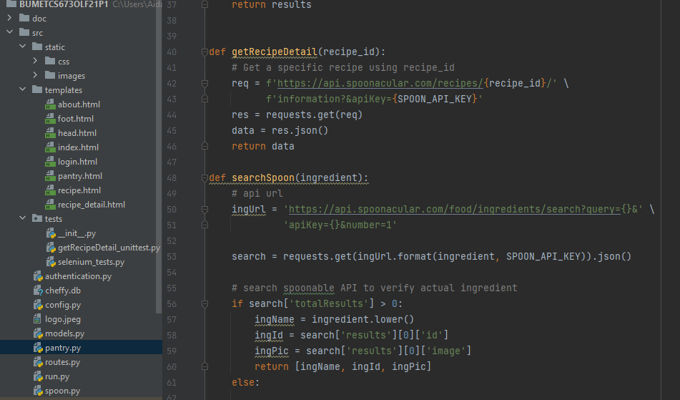
Software Architecture: MVC
View
One of our APIs
Controller

Slide 7
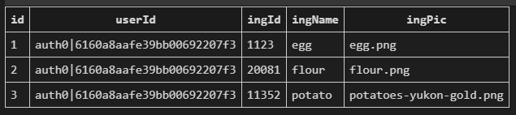
Database
Database: SQLite Example Pantry Entry:
UserID
Favorites
Pantries
User login stored with Auth0

Slide 8
Security Design
Auth0 stores:
username and password
authenticates HTTPS requests
Helps Flask-login package with session information

Slide 9
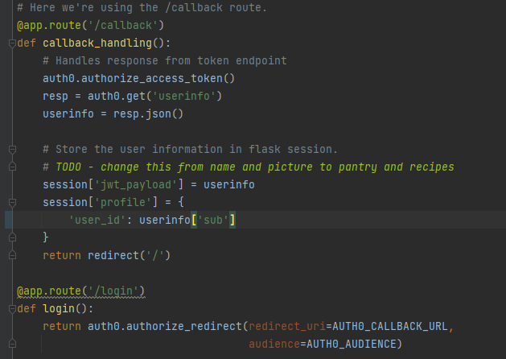
Login Operation

Slide 10
Testing Overview
Documented testing strategy with unit, system, and manual testing. Ex:
Unit: searching for a recipe
System: Display recipe after clicking on it
Manual: Login to an existing account
Metrics:
Passing 100% of unit and systems tests
Passing 83% of manual tests
Finished 7 of 8 user story tests
Process metrics: detected and fixed 100% of defects

Slide 11
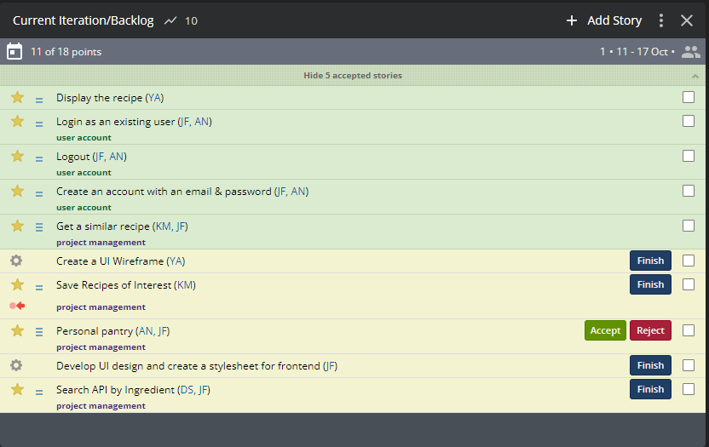
User Stories

Slide 12
Demo (Another presentation)

