Slide 1
MBTA Tracker
A web app for arrivals and service alerts
Presentation Iteration 1

Slide 2
Problem
Commuters need reliable departure information before heading to a subway station.
Scheduled train times may differ from actual service conditions.
Service disruptions can affect travel plans.
Target Users
Boston University students
Commuters along the Green Line B Branch
Visitors unfamiliar with local subway routes
Our Goal
Help users plan their trips using MBTA departure predictions, route information, and service alerts.

Slide 3
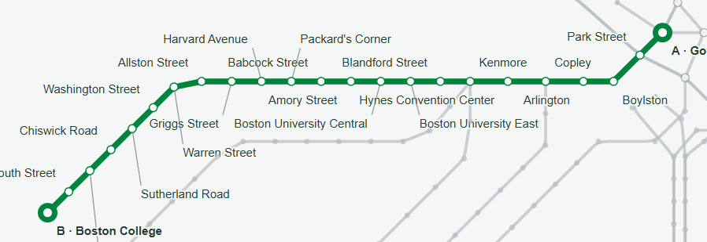
Current Scope
Support Green Line B journeys between Boston College and Government Center.
Provide interactive route planning and visualization.
Display train predictions, arrival times, and service alerts.
Limitations
Other subway lines are for map reference only.
No transfers between lines.
No user accounts or favorite stations.

Slide 4
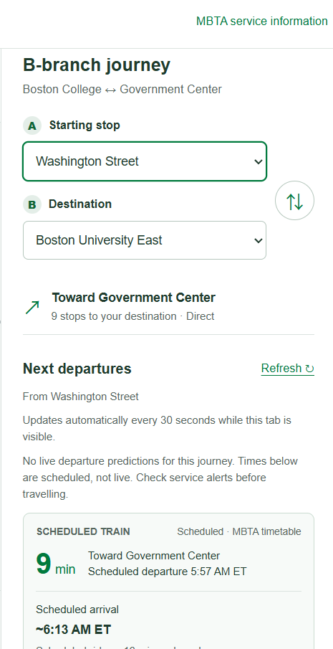
Journey: Boston University East to Washington Street
The user selects Boston University East as the starting station.
The user selects Washington Street as the destination.
The user checks available departure information and service alerts
before leaving.
Result
A single interface provides the route and relevant transit information
for the selected journey.

Slide 5
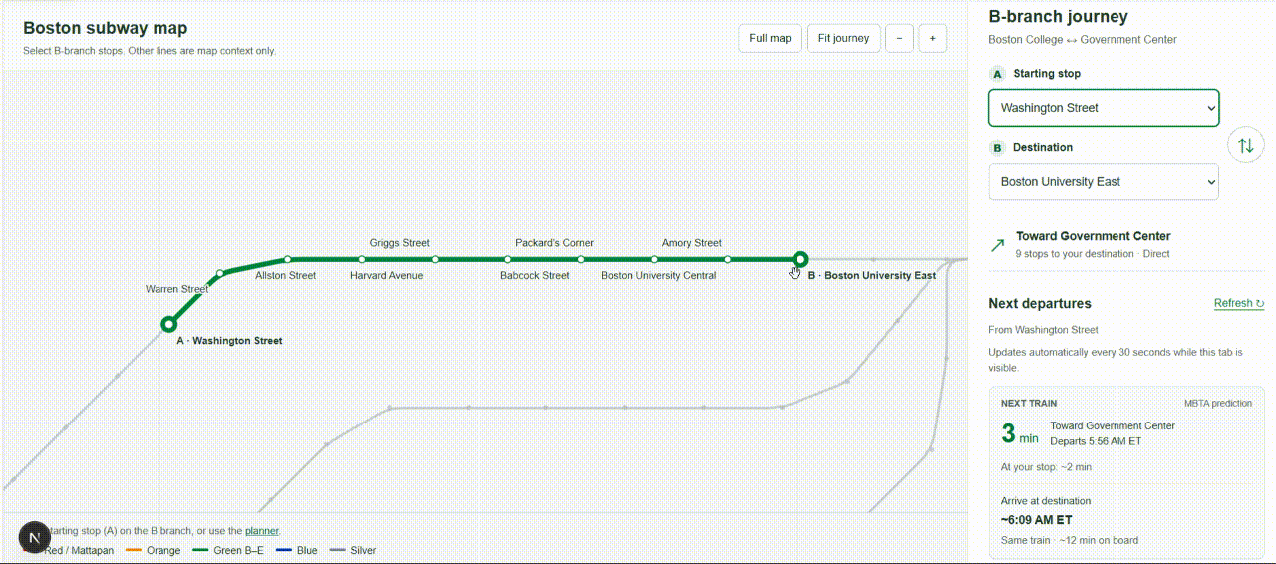
Interactive Subway Map
Click stations directly on the map to select the starting point and destination.
Zoom, pan, and highlight the selected route.
Journey Planning
Display travel direction and number of stops.
Swap starting and destination stations.

Slide 6
Frontend and Backend
React and Next.js provide the user interface.
Next.js API routes process requests for transit information.
Users interact with the subway map and journey planner through the browser.
The official MBTA V3 API provides routes, predictions, schedules, vehicle information, and service alerts.
Development Environment
Node.js and npm for local development
GitHub for version control
Docker support for containerized deployment

Slide 7
Risks and Error Handling
Risk | Implemented Handling
API failures | Error messages and delayed retries
Rate limiting | Caching and request backoff
Missing live predictions | Scheduled fallback when available
Outdated information | Timestamps and stale-data warnings
Invalid journeys | Clear messages for unsupported routes

Slide 8
Testing and Validation
Test Case | Expected Result | Status
Application Startup | Application loads correctly | Passed
Station Selection | Correct journey is displayed | Passed
Map Interaction | Users can select stations clearly | Needs Improvement
Route Visualization | Selected route is highlighted | Passed
Missing Predictions | Clear fallback message is displayed | Passed
Automatic Refresh | Data refreshes at expected intervals | Pending Verification
API Failure | Errors and retries are handled correctly | Pending Verification

Slide 9
Current Challenges
Confusing Map Selection: Users may not know whether a map click selects the starting point or destination.
Limited Coverage: Journey planning currently supports only the Green Line B corridor.
API Dependency: Live information depends on MBTA API availability and data freshness.
Next Iteration Deliverables
Improved Map Interaction: Clear starting/destination selection controls and visual feedback.
Enhanced Testing: Additional interaction, API failure, and refresh tests with documented results.
Verified Live Data: Validate departure predictions and fallback behavior during service hours.
Deployment Package: A stable demo, updated README, and reproducible setup instructions

Slide 10
Thank you for watching!

