Slide 1
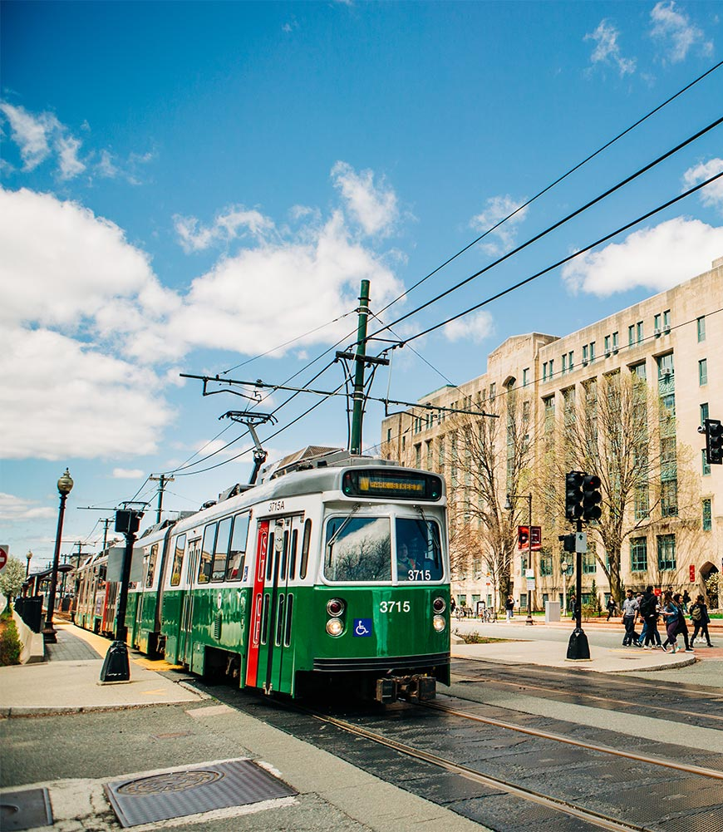
Team 2
MBTA
Tracker
Presentation Iteration 0
A web app for arrivals
and service alerts
Notes:
We are Team 2, and our project is an MBTA tracker. We want to build a simple web app that helps a rider check upcoming trains and service alerts before going to a stop.
For Iteration 0, we are presenting the project idea, a proposed scope, and our plan for the first working version.
Sources
Cover photo: Janice Checchio / Boston University, 2019. https://www.bu.edu/articles/2019/bu-commuter-benefits/
Image: https://www.bu.edu/files/2019/08/resized-19-1294-SPRINGSTOCK-113.jpg

Slide 2
Team roles
Lead role | Assigned member
Team Leader | Wenbo Fan
Requirement Leader | Yuexian Feng (Luna)
Design and Implementation Leader | The Anh Tran (Bill)
Configuration Leader | Yuchen Bao
QA Leader | Zhiao Chu
Security Leader | Wenbo Fan
Notes:
These are the lead responsibilities for our group. A lead coordinates that area, and the rest of the group still contributes.
The role list has six responsibilities for five members, so a member may hold more than one lead role.
Sources
Role labels: the team table supplied for this presentation.

Slide 3
Project idea
A quick way to check the next train
before heading to a stop.
Initial users
Example user story
BU students and nearby riders
who use the Green Line.
“As a student, I want to see arrivals
and alerts for my stop so I can
plan when to leave.”
Notes:
Our initial users would be students and other riders near BU. We are using that group as a starting point for the design, rather than claiming that we have already conducted user interviews.
A typical user chooses a route, direction, and stop, then checks the upcoming predictions and relevant service alerts. The Green Line B branch is a proposed first demonstration case. We can confirm the exact coverage as a group.
This project gives us a familiar problem to practice requirements, interface design, API integration, and testing. We are not promising to make the MBTA predictions more accurate.
Sources
Green Line B connection to BU: https://www.bu.edu/articles/2019/bu-commuter-benefits/

Slide 4
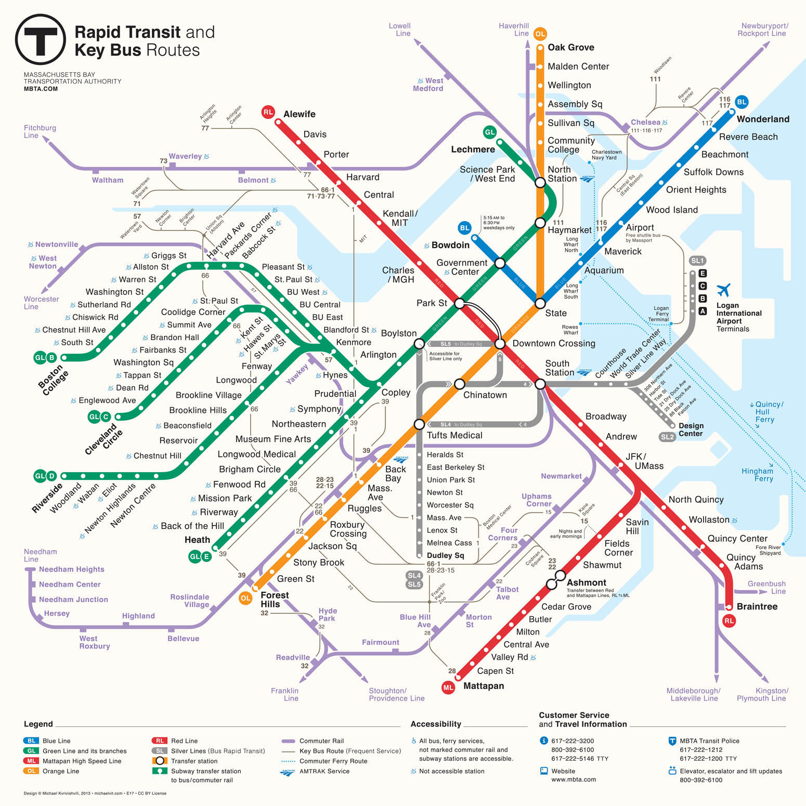
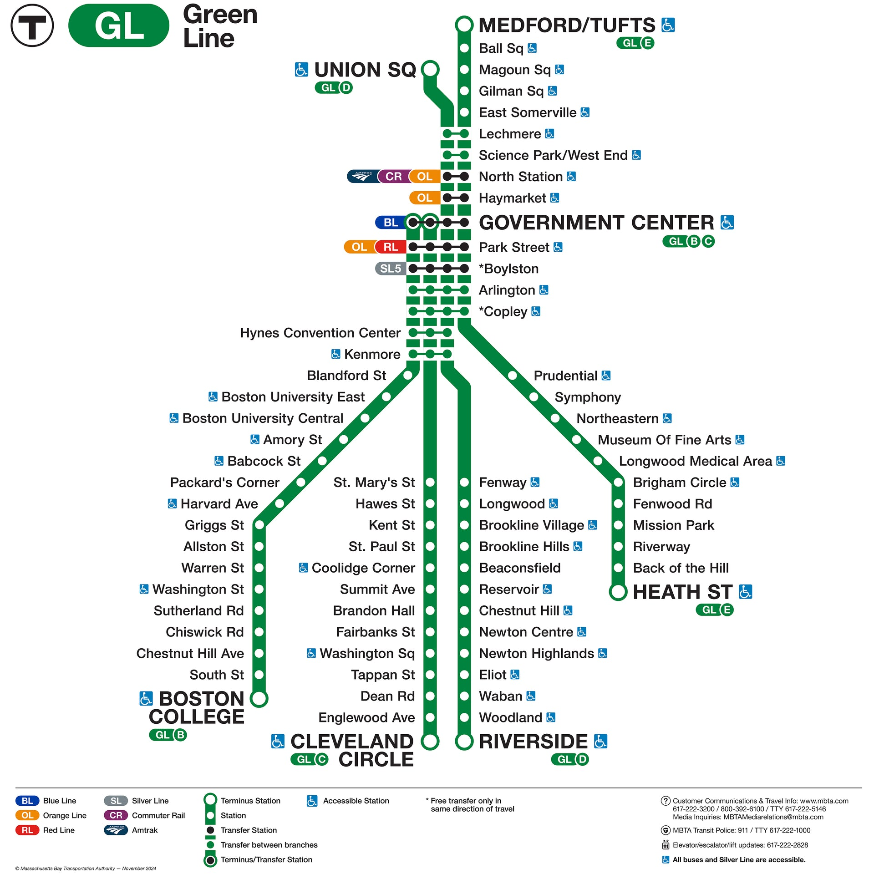
Project idea
Proposed first demo: the Green Line B branch near BU.
Notes:
Our initial users would be students and other riders near BU. We are using that group as a starting point for the design, rather than claiming that we have already conducted user interviews.
A typical user chooses a route, direction, and stop, then checks the upcoming predictions and relevant service alerts. The Green Line B branch is a proposed first demonstration case. We can confirm the exact coverage as a group.
This project gives us a familiar problem to practice requirements, interface design, API integration, and testing. We are not promising to make the MBTA predictions more accurate.
Sources
Green Line B connection to BU: https://www.bu.edu/articles/2019/bu-commuter-benefits/

Slide 5
First version scope
Proposed scope for the group to confirm
Core features
Possible additions
Choose a route, direction, and stop.
See up to three upcoming predictions.
Read alerts for the selected route.
Save favorite stops in this browser.
Additional subway lines
A simple vehicle map
Outside the first version
Accounts and trip planning
Push notifications
Our own prediction model
Notes:
The proposed first version has four main features: a route and stop selector, upcoming arrival information, service alerts, and favorite stops saved in the same browser.
We would first complete this flow for the Green Line B branch. Other subway lines or a basic vehicle map could follow only after the core flow works reliably. If time is tight, favorites can move to a later iteration.
We are keeping account systems, journey planning, push notifications, and our own prediction algorithm outside the first version. A complete small application still includes useful work in loading states, error handling, accessibility, and testing.

Slide 6
Official MBTA data
The MBTA V3 API supplies the transit information
Endpoint | How we plan to use it
/routes | Route names and direction labels
/stops | Stops associated with a selected route
/predictions | Estimated arrival and departure times
/alerts | Service alerts for the selected route
The app will display MBTA estimates and show when it last fetched them.
MBTA API documentation
Notes:
The official API provides the information we need. Routes and stops populate the selection controls. Predictions provide estimated times, and alerts provide service information for the selected route.
We need to filter the predictions request. We should also use readable direction labels and destinations from MBTA rather than assume that direction 0 always means the same thing on every route.
Some predictions have a missing arrival or departure time. We will handle missing values and show a clear message when no usable predictions are available. Scheduled times are a separate type of data and should not be presented as live predictions.
The developer portal allows experimentation without a key and recommends requesting a key for each app. We will not assume a fixed universal request limit.
Sources
MBTA V3 API developer portal: https://api-v3.mbta.com/
Official API specification: https://api-v3.mbta.com/docs/swagger/swagger.json

Slide 7
Proposed tech stack
A small web app with one backend
Part | Proposed choice | Purpose
Frontend | HTML, CSS, JavaScript | Selection controls and results
Backend | NodeJS, Python with Flask | Request and organize MBTA data
Saved stops | Browser localStorage | Keep favorites on this device
Team workflow | Git and GitHub | Track changes and shared tasks
The browser asks Flask for transit data. Flask calls the MBTA API.
Notes:
This stack is a proposal for discussion. The group can replace it with tools everyone already knows or tools the course requires.
The browser would handle the interface. One Flask backend would request the MBTA data and return the fields the page needs. Any API key would stay on the backend and outside the repository.
Favorites can use browser localStorage, so the first version does not need user accounts or a database. Favorites would remain in that browser and would not automatically sync across devices.
A proposed starting point is to refresh every 30 seconds, with a manual refresh option and a small shared backend cache. This is our proposed application behavior, not a claim about MBTA update frequency. We can adjust it after checking the available request allowance.
Sources
MBTA key and API access information: https://api-v3.mbta.com/
MBTA response and rate-limit details: https://api-v3.mbta.com/docs/swagger/swagger.json

Slide 8
Requirements and checks
Requirement | What a passing check looks like
Correct selection | Predictions match the chosen stop and direction.
Readable arrivals | Up to 3 available predictions appear in time order.
Useful alerts | Show relevant alerts or a clear no-alerts message.
Saved stops | Favorites remain after a refresh in the same browser.
Clear update status | Show the last update, empty results, and failures clearly.
Test with sample API responses, then check the complete flow with live data.
Notes:
These are proposed acceptance checks. They give us concrete ways to decide whether a feature works instead of only judging its appearance.
Changing the route or direction should clear incompatible selections and previous results. Arrivals should stay in chronological order, with fewer than three shown if fewer are available. The displayed context should include the selected stop and the destination or direction.
A successful response with no predictions is different from an API failure. We should show a clear message for each and offer refresh or retry. If old results remain after a failed refresh, the screen should clearly identify them as outdated.
We can test filtering, time ordering, and missing values with fixed sample responses. Then we can check a live request and the full browser flow. Basic interface checks should include keyboard use and a narrow screen. We will also keep secrets out of Git and display API text safely.
Sources
Prediction time fields and filters: https://api-v3.mbta.com/docs/swagger/swagger.json

Slide 9
Development plan
Proposed milestones
Stage | Planned outcome
Iteration 0 | Agree on the scope, requirements, and initial design.
First prototype | Show predictions for one selected stop.
Feature build | Add selection, alerts, favorites, and refresh behavior.
Final checks | Test failure cases, finish setup instructions, and demo.
Suggested workflow: small GitHub tasks, branches, and review before merging.
Notes:
These are proposed milestones, rather than a fixed course calendar. We can map them to the assignment deadlines once the group confirms them.
Our first technical milestone should be deliberately small: retrieve usable predictions and show them for one selected stop. After that works, we can add the complete selection flow, alerts, favorites, and refresh behavior.
We should integrate work regularly so that the frontend and backend do not become separate pieces that only meet at the end. A shared task list, short check-ins, and review before merging should be enough for a team of five.
The final version should include a repeatable setup process and a demonstration of both normal use and missing-data or error cases.

Slide 10
Iteration 0 status
Decided
Next decisions
Five members in Team 2
MBTA tracker project
Official MBTA API
Roles chosen by the group
Confirm initial route coverage
Agree on the tech stack
Finalize requirements and a screen sketch
Next milestone
A working screen that shows arrivals for one selected stop.
Notes:
We have selected the project, formed the team, chosen roles, and decided to use the official MBTA API.
The proposed feature scope, route coverage, and technology choices still need the group's agreement. Our next step is to settle those choices, examine sample API responses, and sketch the first screen.
The immediate goal is a working screen for one selected stop. That gives us a concrete base to extend in the following iteration.

