Slide 1

Team 2
Presenter: Qi Chen, Pedro Ramirez

Slide 2
Outline
Frontend architecture
Frontend example architecture
Backend architecture
Backend example requirement
Current progress
Plan for the next iteration

Slide 3
#1 Frontend Architecture

Slide 4
Frontend Architecture - Client Server
Our React + TypeScript frontend is organized into pages and reusable components.
An API client centralizes the base URL, JSON handling, and JWT auth headers.
The Content page uses another external API to fetch job listings;
The Login/Register pages use it to obtain a JWT, which we store and attach to all subsequent requests. From then on, every job action—browse, save, apply, and delete—runs through this client.
The Listings view uses a three-panel layout: a job list (left), selected job details (center), and filters with a theme toggle (right).

Slide 5
Frontend Architecture - Client Server
Stack: React 18 + TypeScript, Vite, Bootstrap
Pages (React-Routing): Login, Register, Content (Job Listings), MyJobs
Key Components:
JobsViewList (left list) + JobCard (details panel)
Aside with filters (Field, Location, Type)
Header / Footer
State & Theming: ThemeContext (light/dark), local UI state per component
API Client: REST api to fetch the jobs, and connect with the back end
Auth Flow: login/register → store JWT → attach Authorization: Bearer <token> to requests Data Flow: UI ➜ API Client ➜ Spring controllers ➜ responses hydrate UI

Slide 6
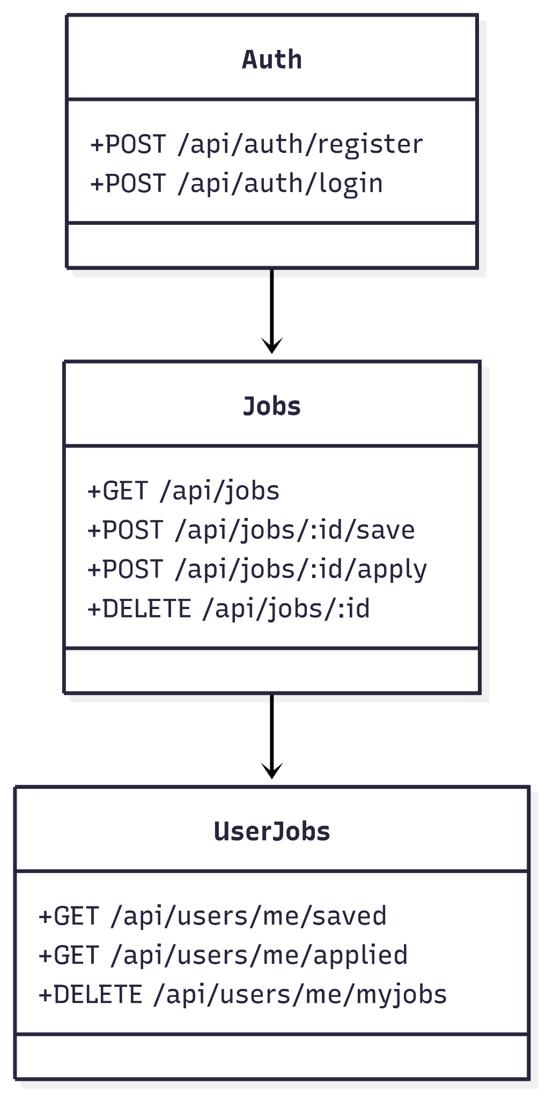

Slide 7
#2 Frontend example requirement

Slide 8
Example Requirement
User Story As an authenticated user, I want to save a job from the listings so I can review it later in My Jobs.
Acceptance Test (Gherkin)
Given I’m logged in and on the Job Listings page
When I click Save on a job card
Then I see a success message and the job appears in My Jobs → Saved
And saving the same job again does not create duplicates
And GET /api/users/me/saved returns the saved job
API Contract
POST /api/jobs/:id/save (JWT required) → 201 Created + SavedJob
GET /api/users/me/saved (JWT required) → [SavedJob]

Slide 9
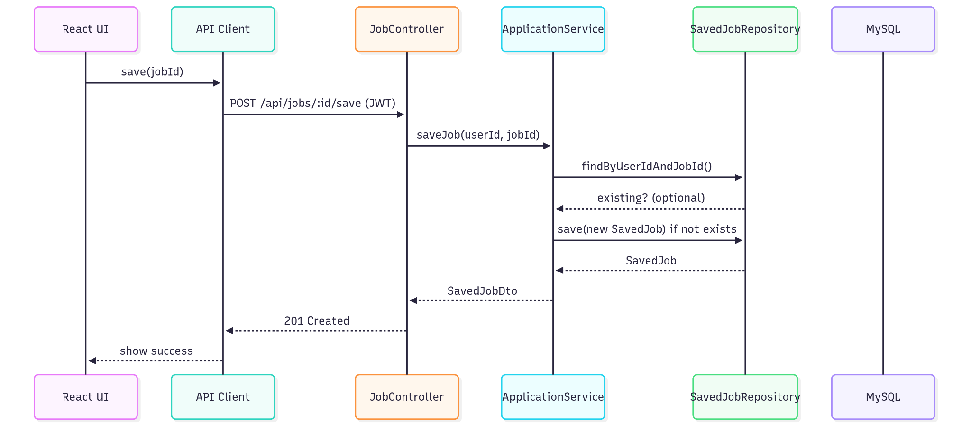
UML and Data flow diagrams

Slide 10
Implementation - Frontend
async function saveJob(jobId: number, token: string) {
const res = await fetch(`${BASE_URL}/api/jobs/${jobId}/save`, {
method: 'POST',
headers: { 'Content-Type': 'application/json', Authorization: `Bearer ${token}` },
});
if (!res.ok) throw new Error('Save failed');
return res.json();
}

Slide 11
#3 Backend Architecture

Slide 12
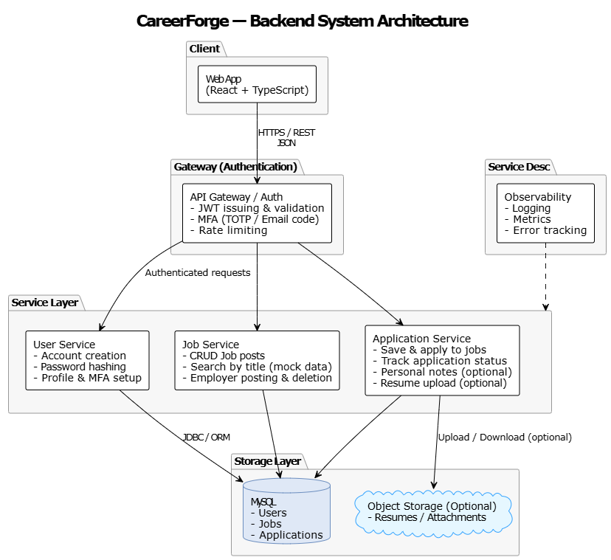
Backend Architecture

Slide 13
#5 Backend example requirement

Slide 14
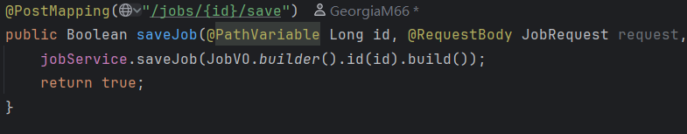
Implementation - Backend

Slide 15
#4 Current progress

Slide 16
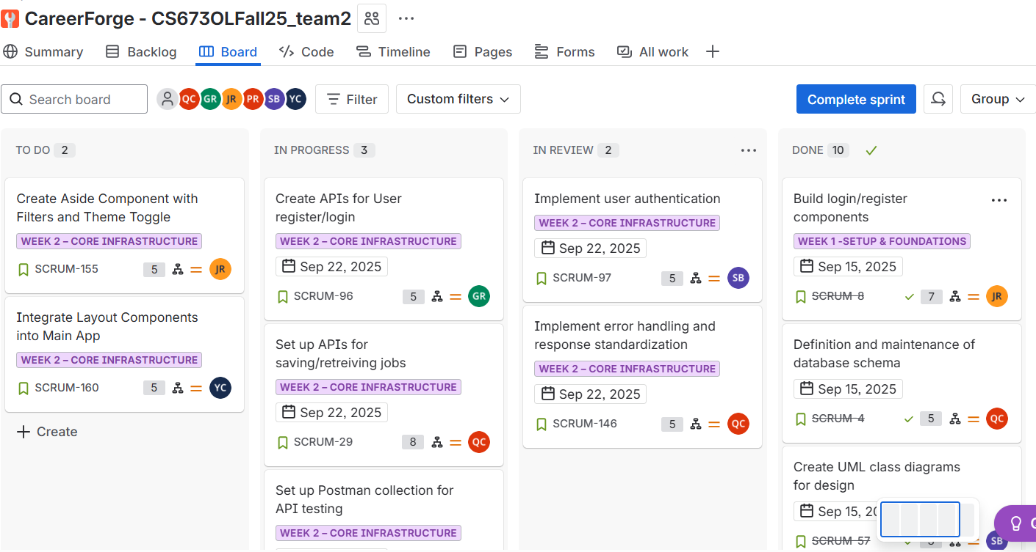
Current progress

Slide 17
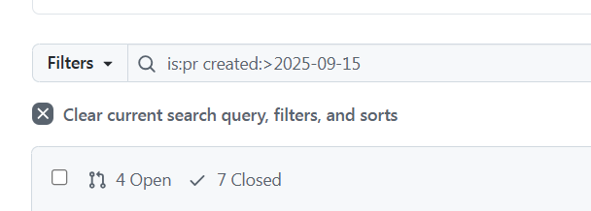
Current progress
11 PRs during this week

Slide 18
#5 Plan for the next iteration

Slide 19
Plan for the next iteration
Extend REST APIs:
Save job
Applied job
All jobs
Delete job
Set up database persistence for saved/applied jobs.
Implement “My Jobs” dashboard (saved + applied jobs).
Hook UI to real backend.
Add login/logout integration with JWT.

