Slide 1

Project by: Stacey Burns, Gopi Rayini, Qi Chen, Yongxiang Chen, Pedro Ramirez, and James Rose

Slide 2
Outline:
Recap of Project Overview
Requirement Analysis
Design
Security
Testing
Deployment
Project Management

Slide 3
Project Overview

Slide 4
Overview
This project is a job search application aimed at helping individuals stay organized in their career search by saving, applying to, and tracking jobs in one place. The motivation is to provide users with a simple system to monitor jobs the user has applied to instead of relying on scattered tools. Its purpose is to connect employers and employees, with potential users being anyone on the job market. Core functionality includes creating user accounts, viewing and searching job posts, saving and applying to jobs, and tracking the status of applications.

Slide 5
2. Requirement Analysis

Slide 6
Main Features
Fetch and display real job postings from Rise Jobs API
Basic filters (job type, field, myJobs)
User accounts creation
Save applied jobs and delete old ones
Secure login

Slide 7
Example Requirement
User Story As an authenticated user, I want to save a job from the listings so I can review it later in My Jobs.
Acceptance Test (Gherkin)
Given I’m logged in and on the Job Listings page
When I click Save on a job card
Then I see a success message and the job appears in My Jobs → Saved
And saving the same job again does not create duplicates
And GET /api/users/me/saved returns the saved job
API Contract
POST /api/jobs/:id/save (JWT required) → 201 Created + SavedJob
GET /api/users/me/saved (JWT required) → [SavedJob]

Slide 8
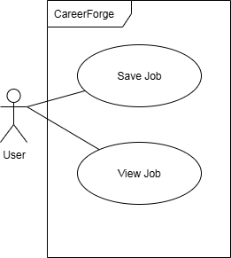
Use Case Analysis
One entity is mentioned:
User
And two features:
Save job
View job

Slide 9

Class Diagram (Simplest Form)
Two entities are needed:
User
Job
In User class, saved jobs can be stored as a list.

Slide 10
3. Design

Slide 11
Tech Stack
Frontend: React, TypeScript, Vite
Backend: Java Spring Boot, Maven
Database: SQL RDBMS (MySQL, AWS RDS)
Data Source: Rise Jobs API
Styling: Bootstrap

Slide 12
High Level of Architecture
React (client)
└── Java Backend (REST)
├── Rise Jobs API (read-only)
└── SQL Database (users, saved jobs, applications)

Slide 13
Frontend Architecture - Client Server
Our React + TypeScript frontend is organized into pages and reusable components.
An API client centralizes the base URL, JSON handling, and JWT auth headers.
The Content page uses another external API to fetch job listings;
The Login/Register pages use it to obtain a JWT, which we store and attach to all subsequent requests. From then on, every job action—browse, save, apply, and delete—runs through this client.
The Listings view uses a three-panel layout: a job list (left), selected job details (center), and filters with a theme toggle (right).

Slide 14
Frontend Architecture - Client Server
Stack: React 18 + TypeScript, Vite, Bootstrap
Pages (React-Routing): Login, Register, Content (Job Listings), MyJobs
Key Components:
JobsViewList (left list) + JobCard (details panel)
Aside with filters (Field, Location, Type)
Header / Footer
State & Theming: ThemeContext (light/dark), local UI state per component
API Client: REST api to fetch the jobs, and connect with the back end
Auth Flow: login/register → store JWT → attach Authorization: Bearer <token> to requests Data Flow: UI ➜ API Client ➜ Spring controllers ➜ responses hydrate UI

Slide 15
Implementation - Frontend
async function saveJob(jobId: number, token: string) {
const res = await fetch(`${BASE_URL}/api/jobs/${jobId}/save`, {
method: 'POST',
headers: { 'Content-Type': 'application/json', Authorization: `Bearer ${token}` },
});
if (!res.ok) throw new Error('Save failed');
return res.json();
}

Slide 16
Backend Architecture
Controllers → services → repositories (typical Spring layering)
Endpoints: auth, /jobs/saved, /jobs/applied (save/apply/list/delete)
DTOs for clean contracts; validation/error handling

Slide 17
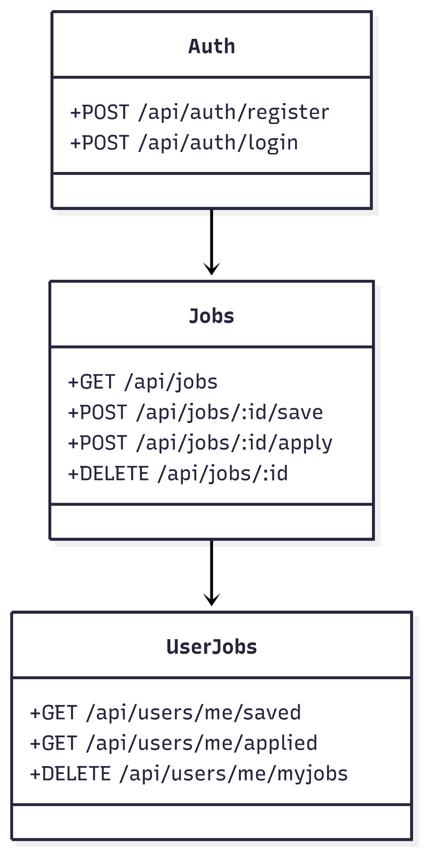

Slide 18
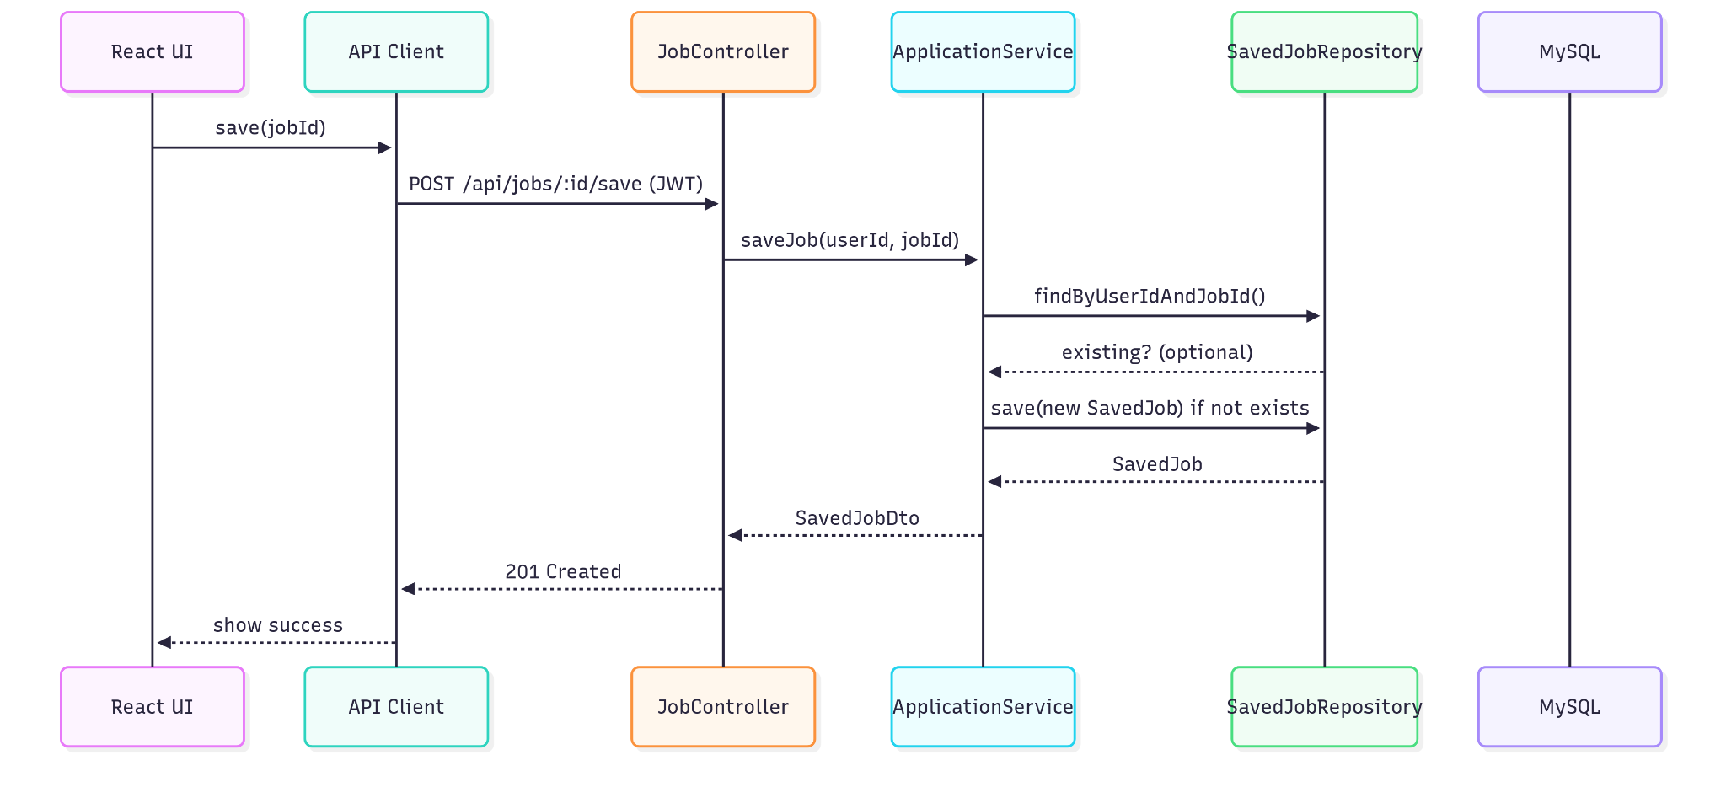
UML and Data flow diagrams

Slide 19
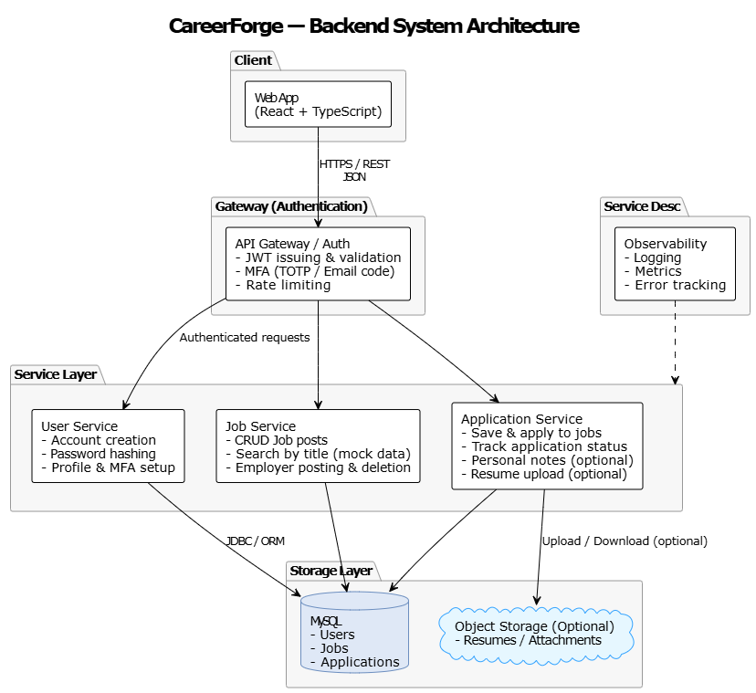
Backend Architecture

Slide 20
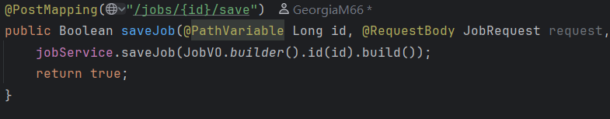
Implementation - Backend

Slide 21
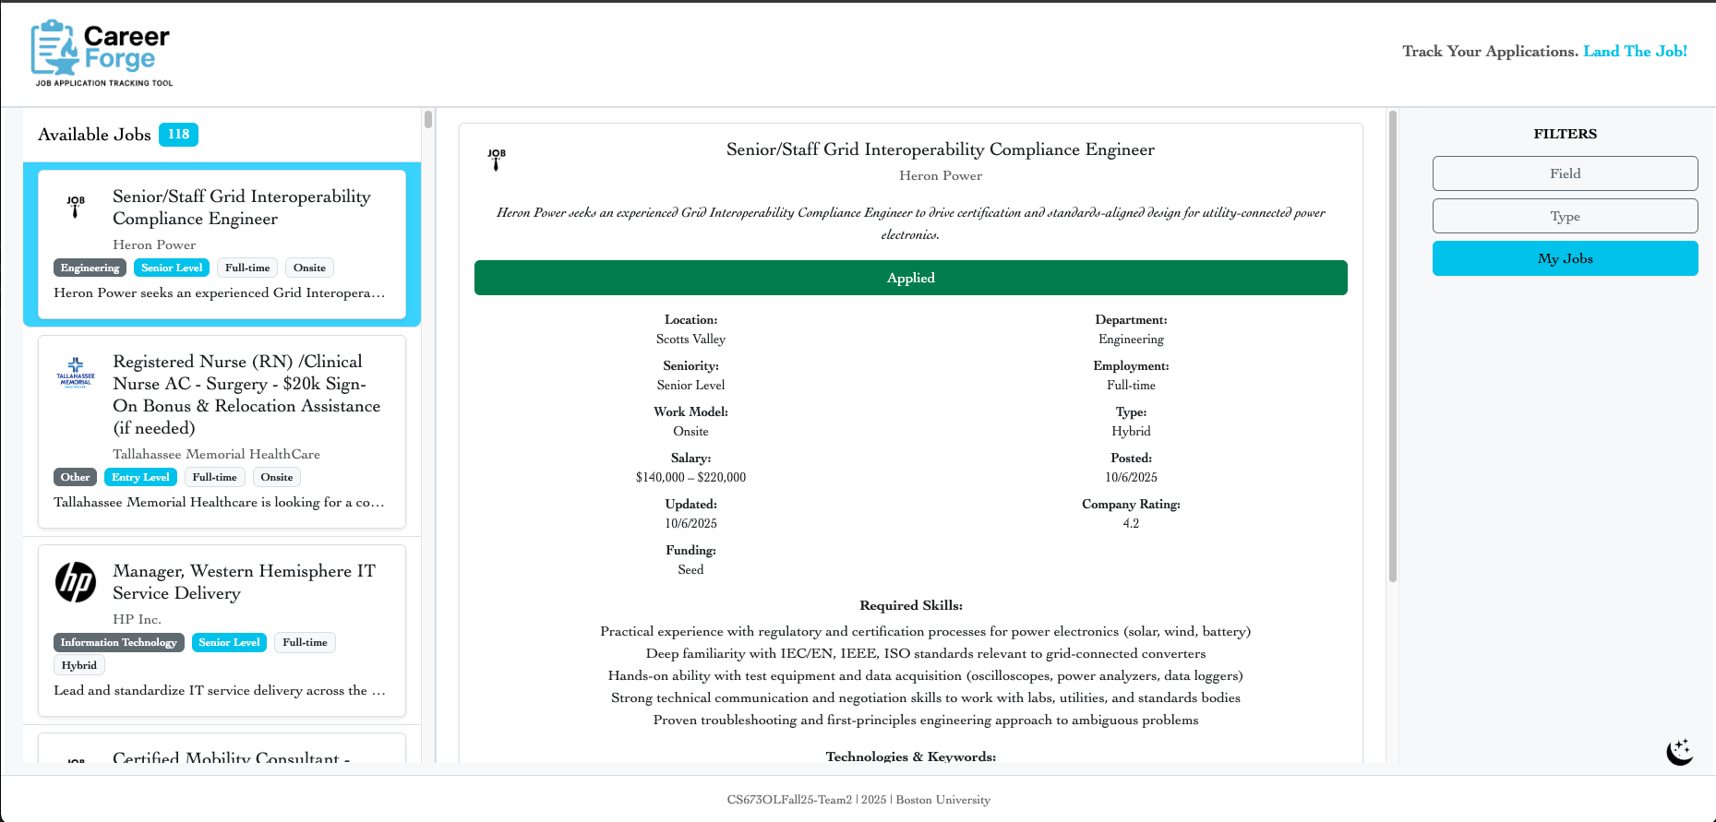
Implementation highlights (frontend)
Three-panel layout: list, details, filters (desktop) + modal details (mobile)
Filter pub/sub via custom events; no prop drilling
Optimistic delete with rollback; success toasts; accessibility roles/ARIA

Slide 22
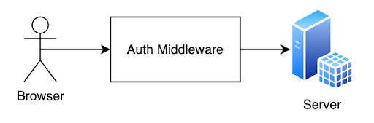
Implementation highlights (backend)
JWT middleware (issue/verify); secured endpoints
Bulk delete operations (saved/applied) with user ID from token
Normalized payloads; envelope stripping; error surfaces to client

Slide 23
4. Security

Slide 24
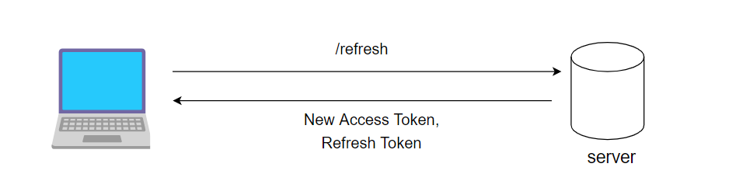
Security
JWT: short-lived tokens; auth headers on protected routes
Input validation + server-side checks
Minimal PII; safe external links (noopener/noreferrer)

Slide 25
Security
CI/CD security involving SAST
Scans for SQL injection, XSS, hard coded secrets, insecure API usage, weak cryptography
Analyzes both codebases
Runs on every push or PR
DB stores hashed passwords using BCrypt
User details encrypted with AES
JWT, DB credentials, and API tokens injected at runtime

Slide 26
5. Testing

Slide 27

Frontend Testing Approach:
Frameworks: Jest, React Testing Library(RTL), @testing-library/user-event, MemoryRouter, ThemeProvider, jest.mock
Automation: CI pipeline
Techniques: Mock APIs/localStorage
Focus: Component rendering, routing, form validation, user interactions, utilities

Slide 28
Frontend Test Coverage:
Unit Tests (38 total):
Components: Aside, Validation, Field, Type, MyJobsButton, Login Form/Registration Form, ApplyJobButton, SaveJobButton, SavedJobApplyButton, ThemeToggler

Slide 29
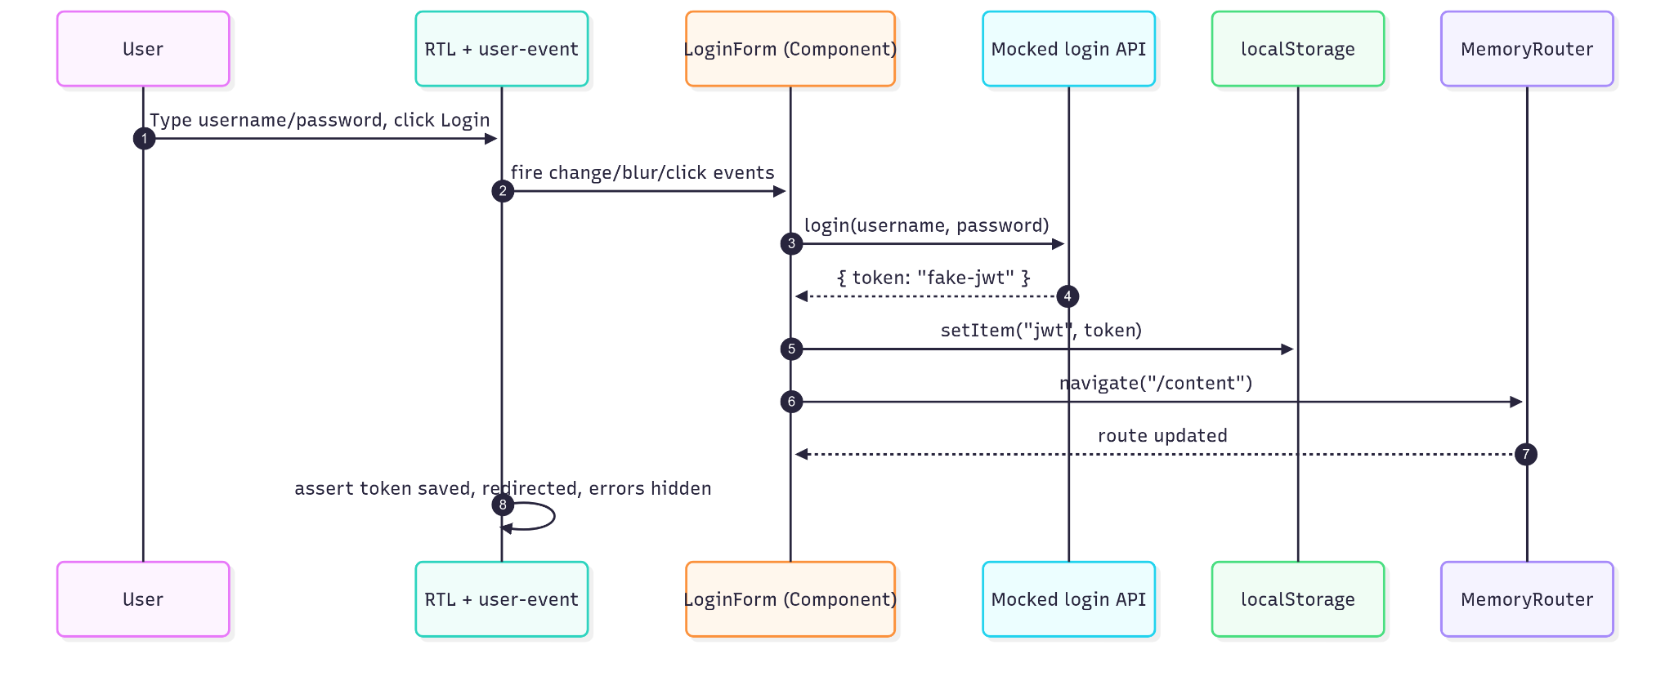
Frontend Testing Sequence Diagram:

Slide 30
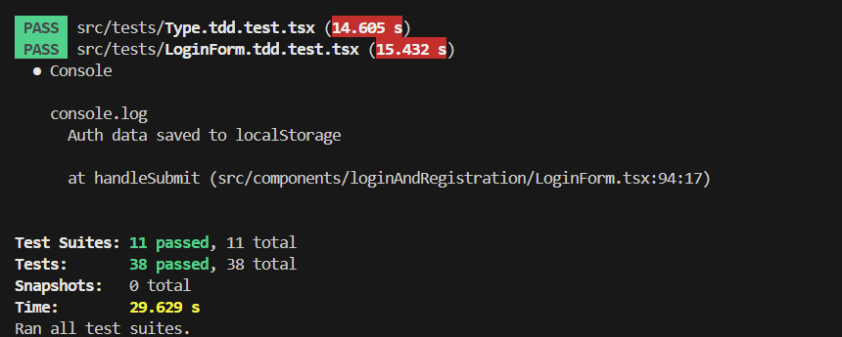
Current Status & Metrics:
Test Coverage: 11 unit test files; 38 total test cases
Test Pass Rate: All frontend tests pass locally

Slide 31

Backend Testing Approach:
Frameworks: JUnit5, Mockito, Spring Boot Test, Spring Test (MockMvc)
Automated in Maven build & CI/CD pipeline
Selenium WebDriver for acceptance/UI testing
Focus: Entities, services, security

Slide 32
Backend Test Coverage:
Unit Tests (121 total):
Entities: User, Job, ApplicationTracking, Benefits, Values, LocationCoordinates
Security: JwtUtil token generation/validation
Services: UserServiceImpl with mocks
Integration Tests:
Authentication, registration, JWT workflows
Postman API tests for endpoints

Slide 33

Backend Testing Metrics:
Unit tests = regression net (run every push)
121 tests → 100% passing
Full CI stack: unit, integration, system, E2E
Selenium covers login

Slide 34
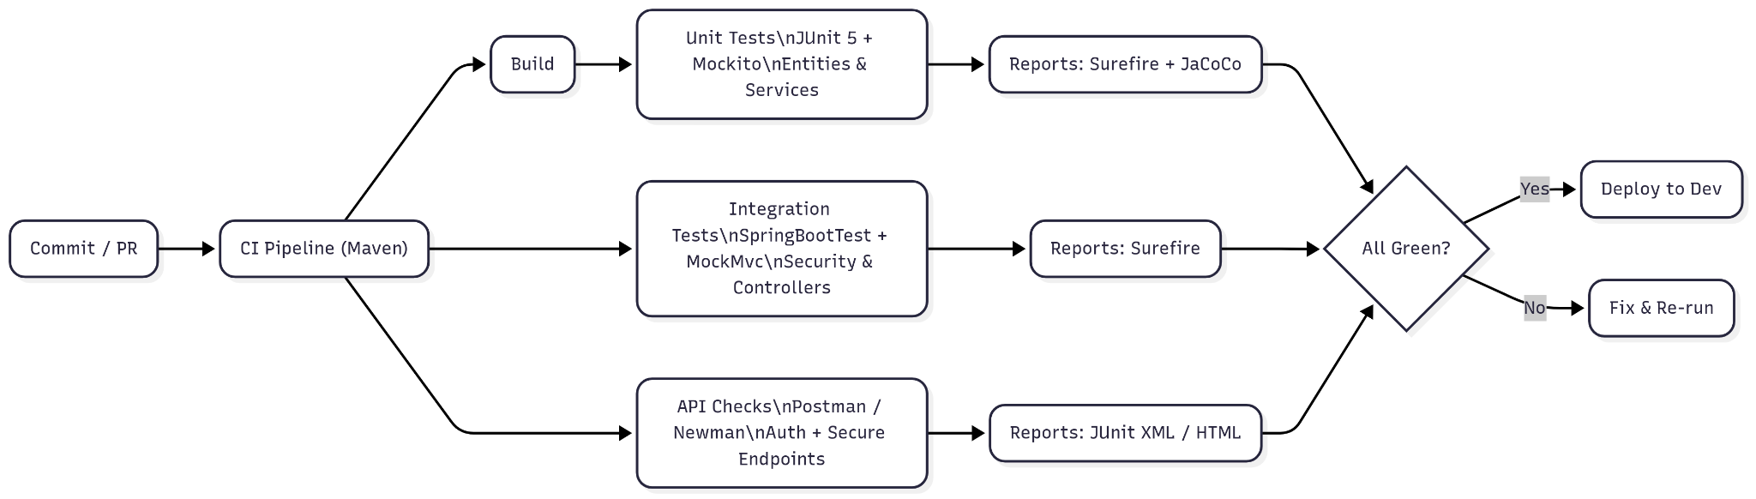
Backend Testing Flowchart:

Slide 35
6. Deployment

Slide 36
Deployment Process
Deployment Workflow via GitHub
Code Commit to trigger GitHub Actions CI/CD Pipeline
CI
Builds Spring Boot and React
Runs front and backend tests
Executes SAST security scan
Dockerization
Builds Docker images -> pushes to AWS ECR
CD
AWS EC2 pulls latest images from ECR
Containers start
Connects to AWS RDS MySQL for persistent data

Slide 37
7. Project Management

Slide 38
Team
Team Member | Role(s)
Gopi Rayini | Configuration Leader
Pedro Ramirez | Design and Implementation
James Rose | Team Leader
Qi Chen | Requirement Leader
Stacey Burns | QA Leader
Sean Chen | Security Leader

Slide 39
Project Management
Risk & Quality Management
Risk Identification: Regularly reviewed potential risks—deployment issues, database outages, integration failures, and missed deadlines.
Mitigation Strategies:
Maintained separate dev/test/prod environments.
Monitored coverage and static analysis through JaCoCo and CodeQL.
Quality Assurance:
Automated tests run in GitHub Actions.
Code reviews required before merge.
Regularly met with team to discuss progress and road blocks

Slide 40
Process Improvement and Iteration Evolution
Adopted Agile Scrum with 2 week sprints and continuous feedback loops
Incorporated CodeQL Advanced SAST and CI/CD automation mid-project for security and efficiency gains.
Enhanced documentation and test coverage over time.
Jira enhancement iteration (using stories and tasks)

Slide 41
Iteration 3 Key Updates
Frontend was deployed and set up a CI/CD pipeline
Backend fixed issue with containers and configs
Front end mobile issues were addressed and cleaned up for better user experience
More front end tests were created
Added JaCoCo to measure code coverage

Slide 42
Achievements, Challenges, Lessons Learned
Key Achievements
Deployed full-stack CareerForge (Spring Boot + React) on AWS EC2, with RDS and Docker Compose
Integrated automated testing, security scanning, and DevOps pipeline
Delivered a responsive, secure, and maintainable product meeting user and stakeholder expectations
Challenges Faced
Ran into issues with our container at one point due to managing JWT secret injection between environments
Database connection issues during Docker and AWS integration
Balancing development pace with academic deliverables and documentation
Lessons Learned
Early integration of CI/CD and SAST saves time and prevents defects later.
Clear communication and sprint retrospectives improve team coordination.
Agile iteration enables adaptability to evolving requirements and feedback.

Slide 43
Thank you!

