Slide 1

Team 2
Presenters: James Rose, Yongxiang Chen

Slide 2
Outline:
Frontend Testing
Backend Testing
Current Functionality
Hopes for CareerForge

Slide 3
#1 Frontend Testing

Slide 4
Frontend Testing Approach:
Frameworks: Jest, React Testing Library(RTL), @testing-library/user-event, MemoryRouter, ThemeProvider, jest.mock
Automation: CI pipeline
Techniques: Mock APIs/localStorage
Focus: Component rendering, routing, form validation, user interactions, utilities

Slide 5
Frontend Test Coverage:
Unit Tests (8 total):
Components: Aside, Field, MyJobsButton, Login Form, Registration Form
Utilities: API Client

Slide 6
Current Status & Metrics:
Test Coverage: 6 unit test files; 8 total test cases
Test Pass Rate: All frontend tests pass locally

Slide 7
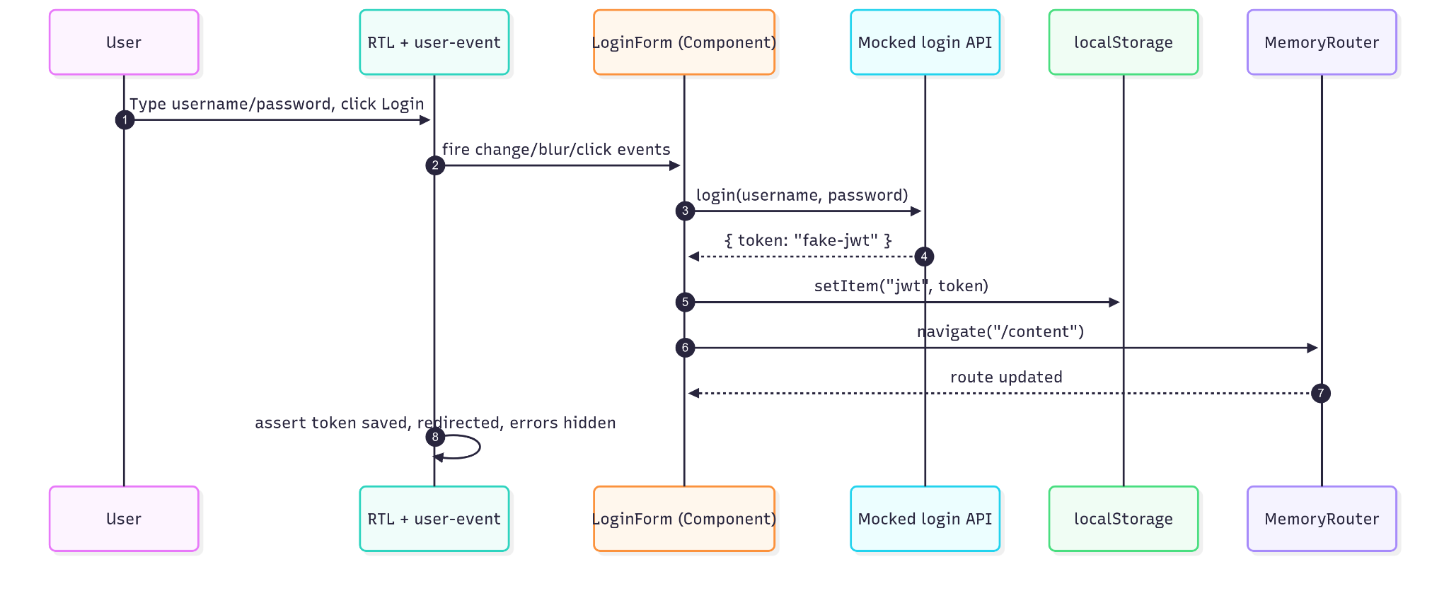
Frontend Testing Sequence Diagram:

Slide 8
#2 Backend Testing

Slide 9

Backend Testing Approach:
Frameworks: JUnit5, Mockito, Spring Boot Test, Spring Test (MockMvc)
Automated in Maven build & CI/CD pipeline
Selenium WebDriver for acceptance/UI testing
Focus: Entities, services, security

Slide 10
Backend Test Coverage:
Unit Tests (118 total):
Entities: User, Job, ApplicationTracking, Benefits, Values, LocationCoordinates
Security: JwtUtil token generation/validation
Services: UserServiceImpl with mocks
Integration Tests:
Authentication, registration, JWT workflows
Postman API tests for endpoints

Slide 11

Current Status & Metrics:
Regression: unit tests double as regression checks
Passing rate: ~86% (16 failures to fix)
System testing: planned, not complete
Acceptance testing: Selenium login test created, workflows in progress

Slide 12
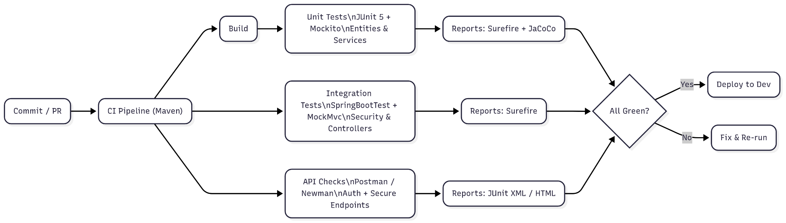
Backend Testing Flowchart:

Slide 13
#3 Current Functionality

Slide 14
Current Functionality:
User Authentication
Theme Mode
Job Application
Job Filtering
Error Handling

Slide 15
#4 Hopes for CareerForge

Slide 16
Our Hopes for CareerForge:
More filters (salary, education, experience minimums)
Smart resume/cover tailoring
Email & phone notifications + reminders
Application progress tracking
AI-powered matching & semantic search (auto-extract skills from resumes/JDs)

