Slide 1
GetActive

Slide 2
Project Vision
Many students struggle to make new friends due to a lack of simple tools for social engagement. GetActive is a platform designed to help students stay socially active by discovering and participating in group activities. Our goal is to enhance student life and build a stronger campus community.

Slide 3
Iteration 2 Overview
In this Iteration, we
Design the homepage of the app. (still in process)
Implemented the Create Activity functionality.
Implemented the Join/Leave Activity functionality.
Implement the Activity Discovery functionality. (still In process)
Implemented the registration verification functionality.
Implemented the backend API to update and delete an activity.

Slide 4
Home Page (Frontend)
Added a search bar to search for a specific activity.
Added a sort to sort activities by date: newest first or oldest first.
Added a "Create Activity" button that navigates to the create activity page.
Added two tabs: Recent Activities and Participated Activities.
Displayed each activity with its name, description, start date/time, end date/time, and location.
Added "Join Activity" and "Leave Activity" buttons for each activity.
Added User info section with username and email address.

Slide 5
Development Plan
Timeline for iteration 3 (final iteration Jun 10- Jun 16)
Jun 10 - Jun 13
Continue to implement the remaining features
Admin Edit & Save
Roster Display
Delete Activity
Jun 14 - Jun 15
Test the features
Final testing
Jun 16
Finalize the document
Final presentation and demo
Submit the final project deliverable
Key Milestones
Minimum viable product deployment
Roles
Everyone in our team will choose the part they are best at in a new iteration.
Assign the testing
Risks and Mitigation
Feature incomplete by deadline
Prioritize core features, make sure minimum viable product works perfectly

Slide 6
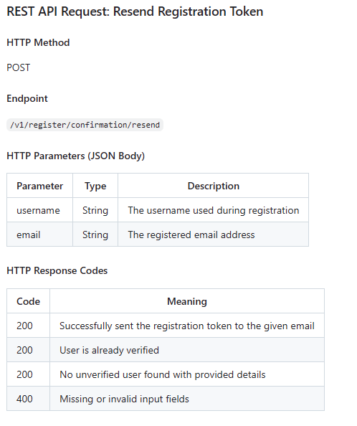
Registration Verification(backend)
Upon registration, an email is sent to the user which includes a verification token that the user must enter in the UI in order to access secured REST APIs.
/v1/register/confirmation POST endpoint is created that verifies the registration token.
/v1/register/confirmation/resend POST API is created that allows to resend the registration email.
Notes:
JWT tokens were used to allow

Slide 7
Activity Delete and Update API (backend)
API to update an activity with the following fields: name, location, description, start and end datetime.
PUT /v1/activity/{id}
API to delete an activity
DELETE /v1/activities/{id}

Slide 8
Join/Leave Activity
Backend:
Get all activities that the user has participated in.
GET v1/activity/participants
Check if the user has already participated in the activity; otherwise, return an error.
POST v1/activity/participants
Check if the user has already participated in the activity. If so, delete the record.
DELETE v1/activity/participants
Frontend:
Implement the ActivityService to connect to backend.

Slide 9
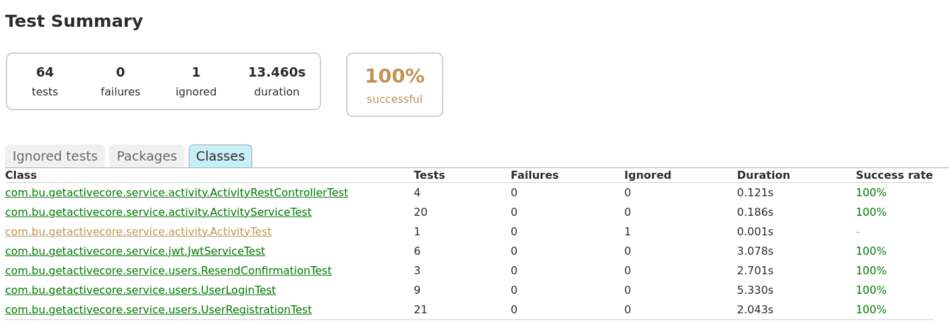
QA
backend unit test
frontend E2E test

Slide 10
