Slide 1

My Magical Bedtime
A bedtime story generator
Iteration 3
Team 2

Slide 2

App Recap
My Magical Bedtime is an app catered towards young children and their parents that allows customized story creation
The app features multiple options to customize the main character, theme, and setting of the story, as well as audio narration and a read-along text highlighting
Designed using the MERN stack (MongoDB, Express.js, React, Node.js)
Utilizes GPT-based API to generate stories

Slide 3
Roles and Responsibilities
Roles were self-selected based on interest/skill
Hongjie Zhang (Zack) - Design & Implementation and Security Lead
Tetiana Korchynska - Requirement and Design & Implementation Lead
Thomas Iliev - QA Lead
Xuelin Min (Barry) - Security Lead
Grant Hovey - Configuration Lead
Iqra Chaudhary - Team Lead
We supported one another throughout the process
Teammates took on some responsibilities to help reduce the load on others
Created space for each other to make mistakes
Recognized that everyone came in with different skill levels and learning curves

Slide 4
Risk Management
Low communication between teammates
Teammates hesitant to speak up when prompted
Confusion in early iterations about who was responsible for which tasks
Some difficulties with deployment platforms, testing tools cause setup delays
Docker issues in local environments affected deployment readiness
Risks were managed by:
Communicating the technical issues with teammates
Utilized GitHub Kanban Board & Discord to eliminate any confusion
Encouraging teammates to be more direct and proactive in speaking up

Slide 5
Quality Management
Team walkthroughs helped surface visual and functional bugs
Logged and resolved several bugs throughout development
Consistent use of pull requests supported smooth integration
Focused on addressing technical paybacks to maintain clean, stable code
Testing tools: Jest, Vite, React Testing Library
Maintained automated tests to ensure continuous quality
Achieved high unit test coverage across all pages

Slide 6
Iteration Evolution & Process Improvement
Early iterations had teammates more involved in the brainstorming process; new members adapted quickly due to supportive environment
Iteration 1 involved some uncertainty around individual expectations but eventually got the hang of it
Iteration 2 responsibilities were better understood and teammates were contributing more actively
Use of Kanban board improved task visibility and self-assignment
More consistent completion of team deliverables
Team made better use of pull requests, version control, CI/CD practices over time to streamline integration and testing

Slide 7
Achievements & Lessons Learned
Completed a basic, working version of the app with essential features:
AI-powered story generation
Customizable characters, settings, themes
Text highlighting and audio narration
Story saving
Cohesive, visually appealing design appropriate for the target audience
Successfully delivered a unified user experience from start to finish
Learned new tools (Docker, testing frameworks)
Learned Agile methodology and collaborating in a team setting
Key lessons:
Organized workflows lead to stronger team productivity
Communicate early and consistently
Ensure that each team member is comfortable with their role

Slide 8
Requirement Analysis

Slide 9
Requirement Analysis
Overview of Functional Requirements
Essential Features:
User Registration & Login
Story Generation
Story Read-Along Mode
Story Saving
Parent Controls
Desirable Features:
Story Character Customization
Theme Customization
Audio Narration Download
Story Sharing (within app)
Optional Features:
Accessibility Narration Mode
Visual Story Enhancements
Usage Tracking Dashboard
Voice Assistant for Story Selection
Offline Mode
Reward System

Slide 10


Requirement Analysis
Total: 15
Done: 8 Not done: 7
Overview of Functional Requirements
Essential Features:
User Registration & Login
Story Generation
Story Read-Along Mode
Story Saving
Parent Controls
Desirable Features:
Story Character Customization
Theme Customization
Audio Narration Download
Story Sharing (within app)
Optional Features:
Accessibility Narration Mode
Visual Story Enhancements
Usage Tracking Dashboard
Voice Assistant for Story Selection
Offline Mode
Reward System

Slide 11

Requirement Analysis
Story Points
Essential Features:
User Registration & Login
Story Generation
Story Read-Along Mode
Story Saving
Parent Controls
Desirable Features:
Story Character Customization
Theme Customization
Audio Narration Download
Story Sharing (within app)
7
3
10
3
8
3
5
3
1
Optional Features:
Accessibility Narration Mode
Visual Story Enhancements
Usage Tracking Dashboard
Voice Assistant for Story Selection
Offline Mode
Reward System
2
3
3
2
3
2

Slide 12
Requirement Analysis
User Stories
We wrote user stories for each feature to capture user needs.
Functional requirements: 15 user stories (58 SP total): Essential Total: 31 SP Desirable Total: 12 SP Optional Total: 15 SP 8 done - total 40 SP
Non-functional requirements: 5 user stories: total 5 SP 5 done - total 5 SP

Slide 13
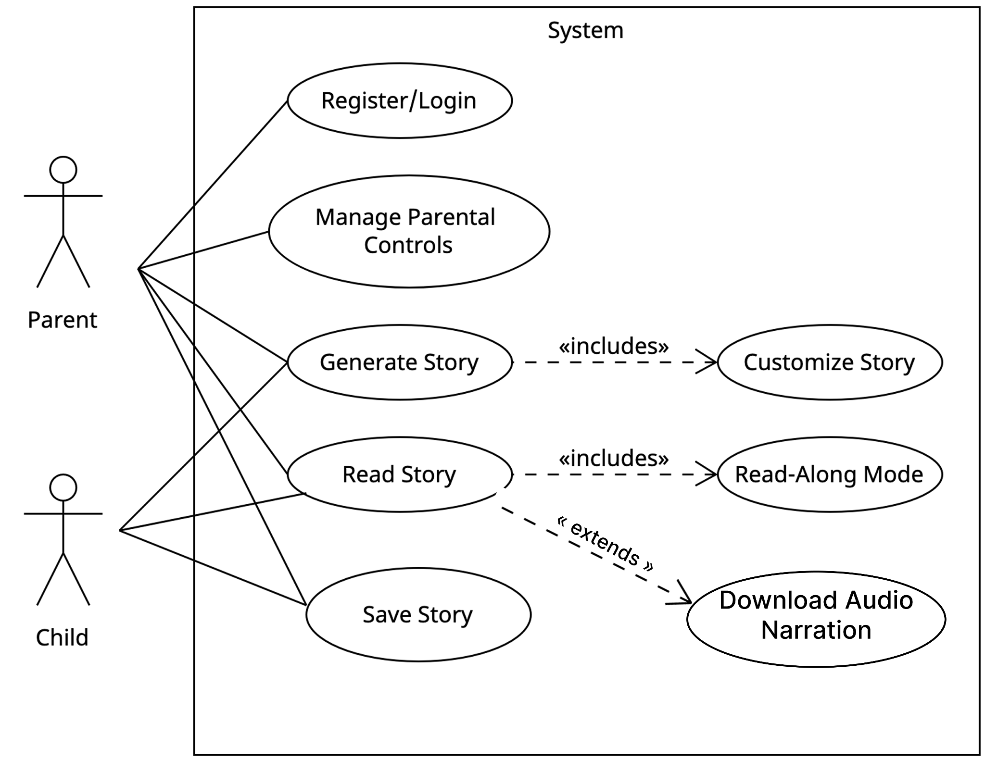
Requirement Analysis
Use Case Diagram
Essential Features:
User Registration & Login
Story Generation
Story Read-Along Mode
Story Saving
Parent Controls
Desirable Features:
Story Character Customization
Theme Customization
Audio Narration Download

Slide 14
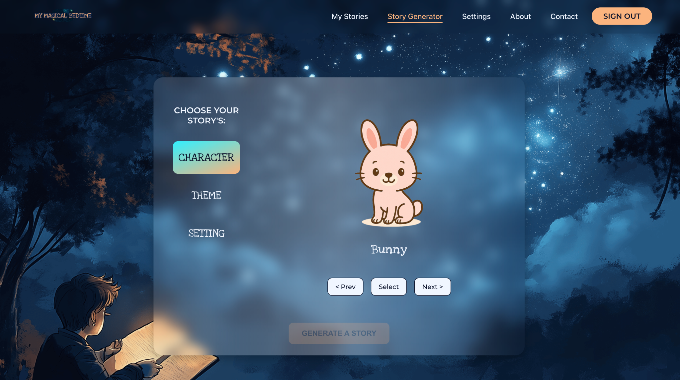
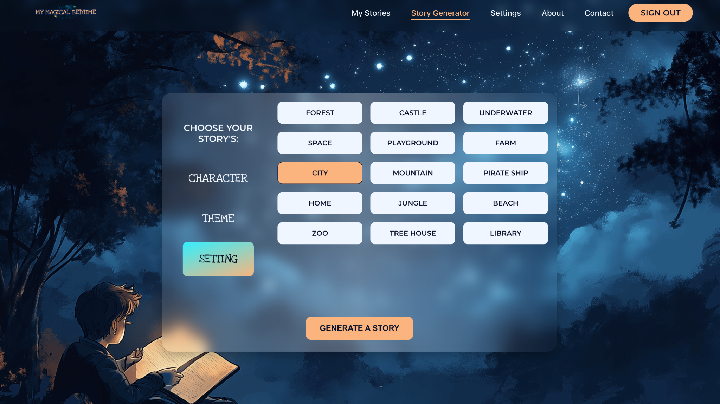
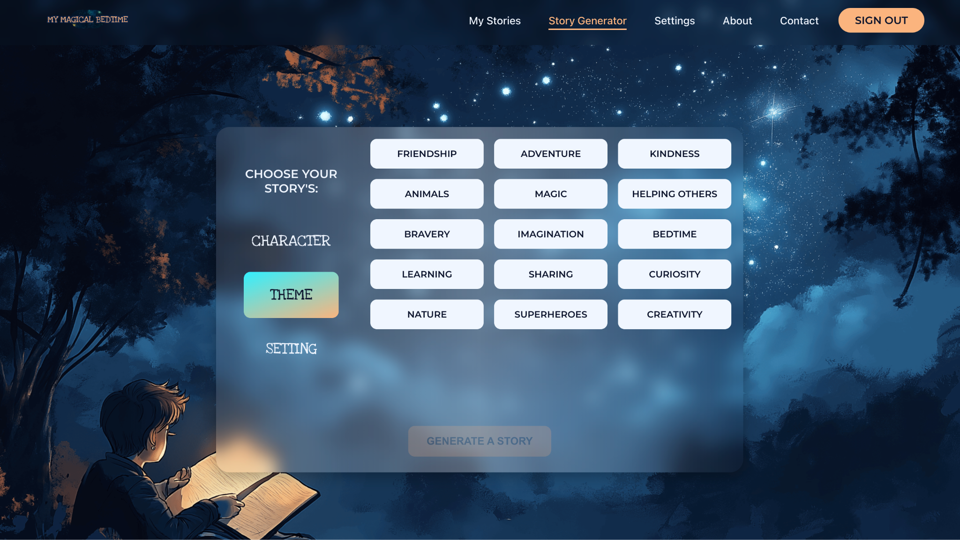
Requirement Analysis
User story example
As a child with help from a parent, I want to generate a customized bedtime story by selecting characters, themes, and settings, so that I can enjoy a personalized reading experience.

Slide 15
Requirement Analysis
We managed requirements via:
GitHub Kanban board for task tracking and assigning
Weekly planning sessions to manage requirement changes
Regular communication to avoid duplicate work or misalignments
Git branching strategy to organize code contributions

Slide 16
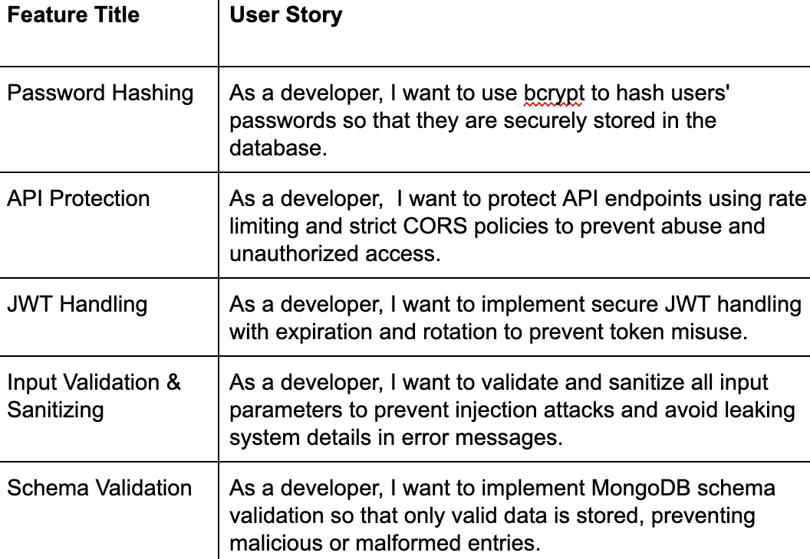
Requirement Analysis
Nonfunctional requirements

Slide 17
UI Design

Slide 18
UI Design
Focus on child-friendliness, simplicity, and bedtime atmosphere.
Goals:
Simple navigation for both kids and parents
Calming bedtime look & feel
Large tap areas and readable fonts
Fully responsive on desktop, tablet, and mobile

Slide 19
UI Design
We analyzed several existing designs:
Bedtime Stories for Kids (our main inspiration)
Lullaby – Magical Bedtime Stories
Znichka Bedtime Story App
These provided insights into color schemes, layouts, and UX patterns suitable for young children

Slide 20
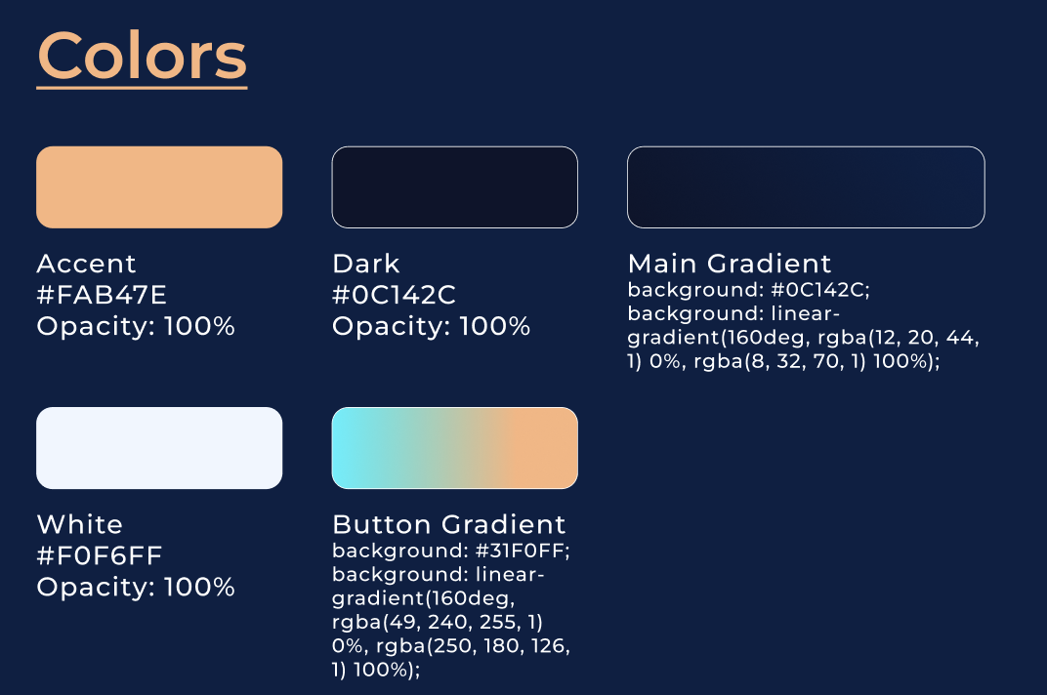
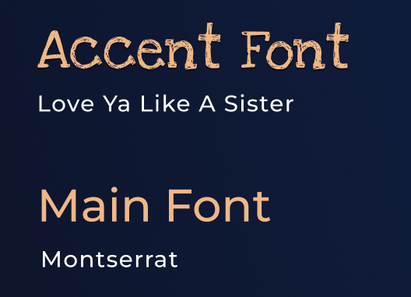
UI Design
Our main color and typography choices

Slide 21
UI Design
Tools used
Figma - full UI prototyping and mockup creation
Remove.bg - free background remove tool; can be installed as a plugin in Figma;
React & Vite - responsive frontend development
ChatGPT & MidJourney - image generation (Chat GPT for characters selections, MidJourney for pages backgrounds).

Slide 22
UI Design
Accessibility and Usability
Large fonts
No clutter
Clear labels and error states
Big buttons for easy tapping
Visual consistency across all pages

Slide 23
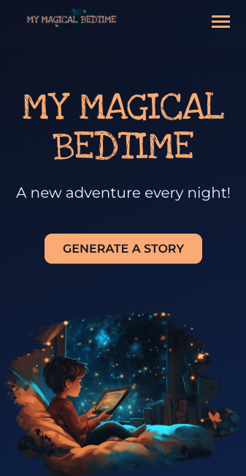
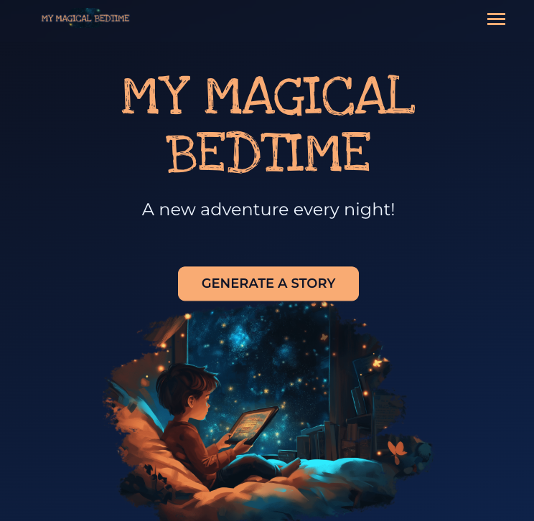
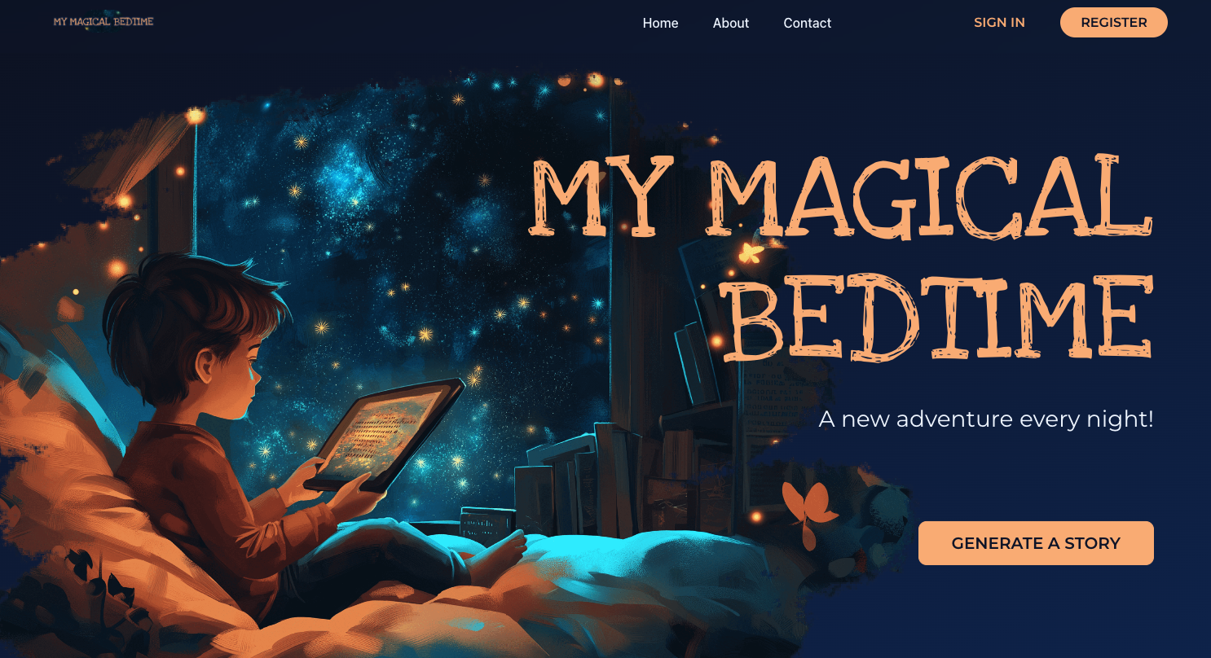
UI Design
App Responsiveness
Mobile
Tablet
Desktop

Slide 24
Design & Implementation

Slide 25
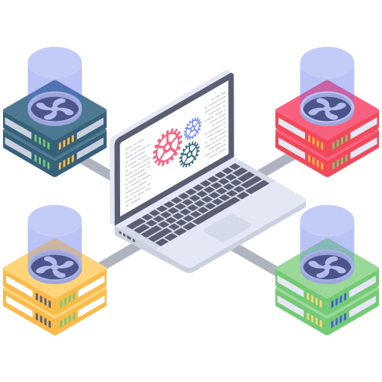
System Architecture
Frontend: React + Vite (Modern, fast development)
Backend: Node.js + Express (RESTful API)
Database: MongoDB (Flexible document storage)
AI Integration: OpenAI GPT API
Deployment: Netlify + Heroku with Docker

Slide 26

Key Implementation Challenges & Solutions
Critical Technical Decisions:
Challenge 1: Child Safety & Content Filtering
Solution: Multi-layer content validation with parental controls
Challenge 2: Real-time Audio Generation
Solution: Optimized API calls with caching and progressive loading
Challenge 3: Scalable Story Storage
Solution: MongoDB with indexed user collections and favorites system

Slide 27

Database Design Architecture
MongoDB Schema Design - 3 Core Collections:
User Schema:
Authentication with bcrypt + JWT
Login attempt limiting (5 attempts → 5min lock)
Password validation & security
ParentalControls Schema:
TTS configuration (10 voice options, 3 models)
Content filtering: 15 allowed themes, 15 blocked topics
Image generation controls
Word count limits (150-500 words)
Story Schema:
Metadata: character, setting, theme, age group
Multi-media support: text, images, audio buffers
User interaction: favorites, categories
AI integration fields: revised prompts, voice models

Slide 28
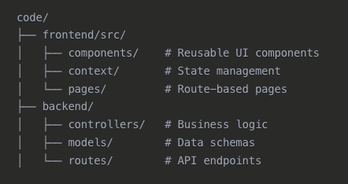
Code Architecture Highlights
Project Structure & Design Patterns:
Key Patterns Used:
MVC Pattern for backend organization
Context API for state management
RESTful API design

Slide 29
Security

Slide 30
Functional Requirements
Core Features (Security-Reviewed)
Secure Login / Registration
Story Generation
Read-Along Mode
Story Saving (User-specific access)
Parent Controls (Feature restrictions)
Additional Features
Character & Theme Customization
Audio Narration
Story Download / Sharing (future-secured)

Slide 31
Use Case Diagram
Secure Role-Based Access
Parents: Full access (generate, save, manage stories)
Children: Limited access (read, listen)
Auth required for saving and editing
Parent controls restrict sensitive features

Slide 32
User Stories & Tracking
User Story Summary
20 stories total, 13 completed
63 story points, 45 completed
Managed via GitHub + Kanban
Security Focus
Stories tagged for sensitive logic
Pull requests reviewed for auth/data handling

Slide 33
Nonfunctional Requirements
Q.VmNF
Security & Quality Goals
JWT auth, password hashing
Private story storage
Input validation, safe API access
Other Priorities
Fast response time
Mobile-friendly UI
CI/CD with automated tests

Slide 34
Testing

Slide 35
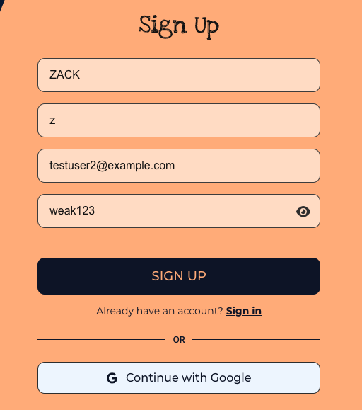
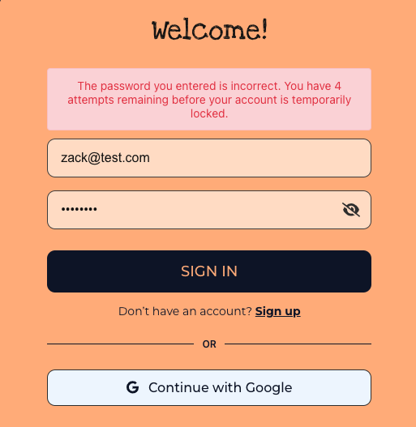
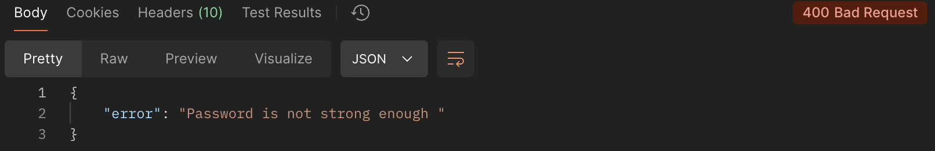
Types of Testing
Unit testing
Integration testing
Acceptance testing
Security testing
System testing
Manual testing

Slide 36



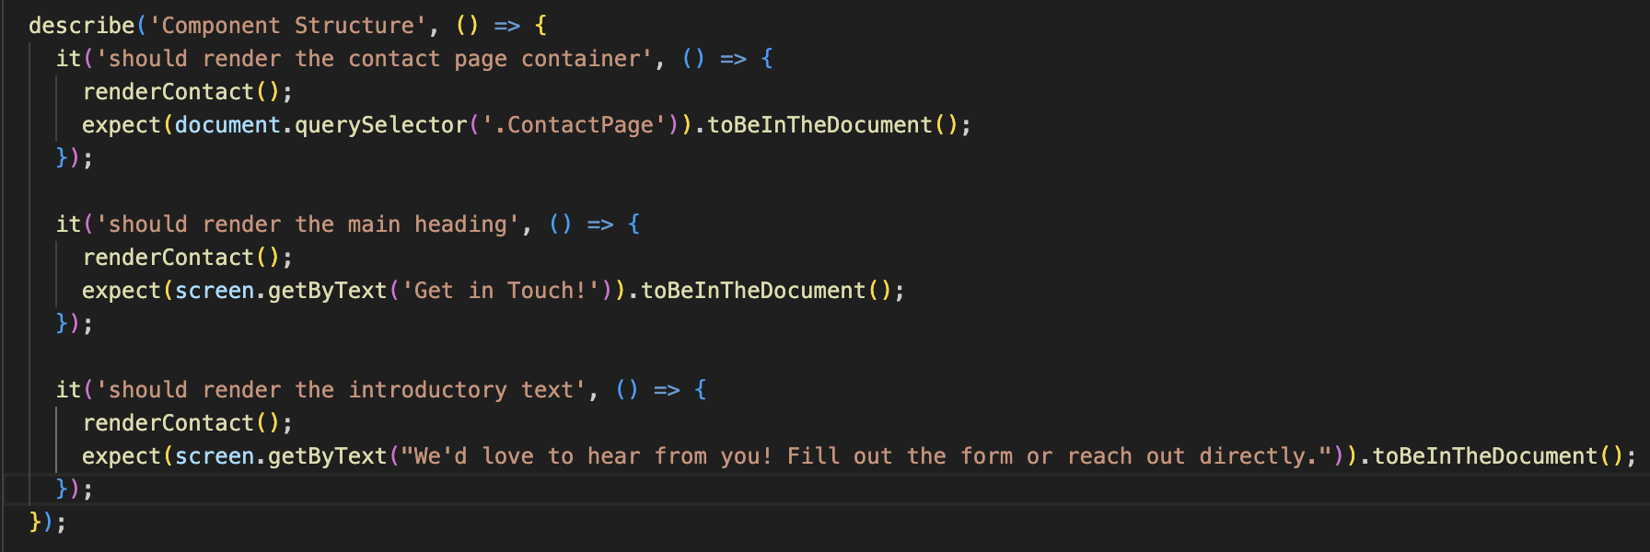
Test Case Examples
Unit testing

Slide 37
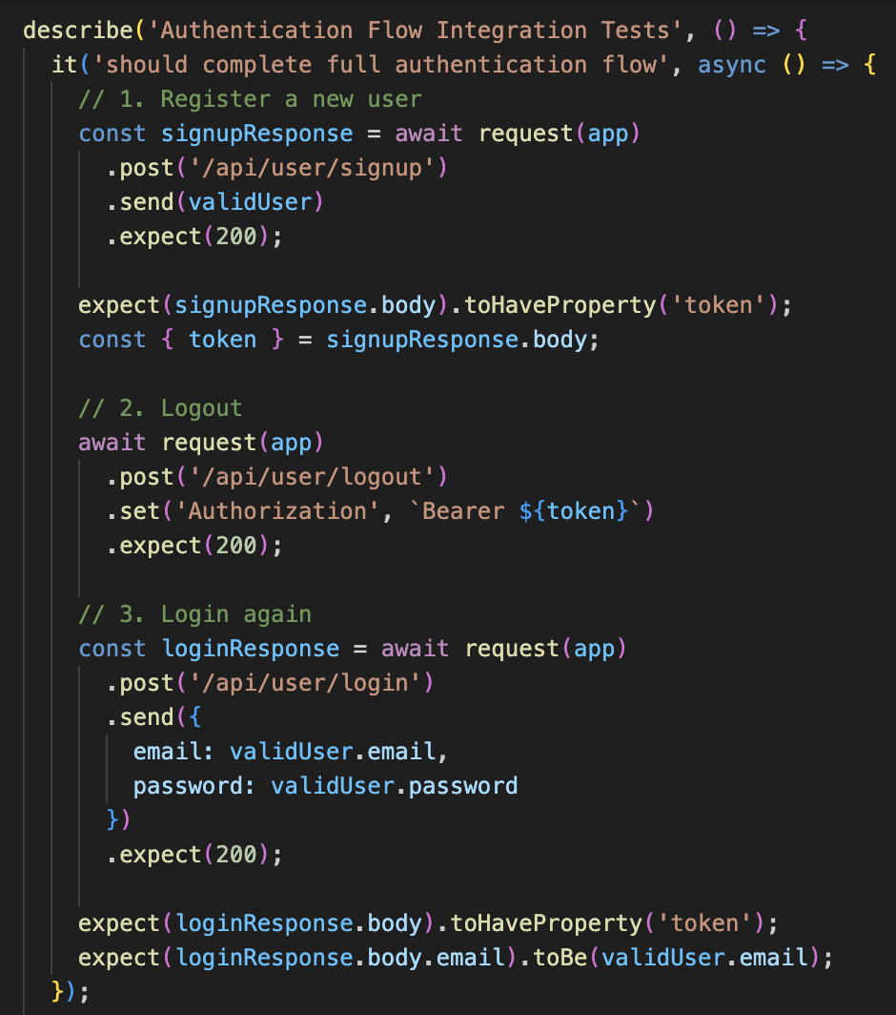
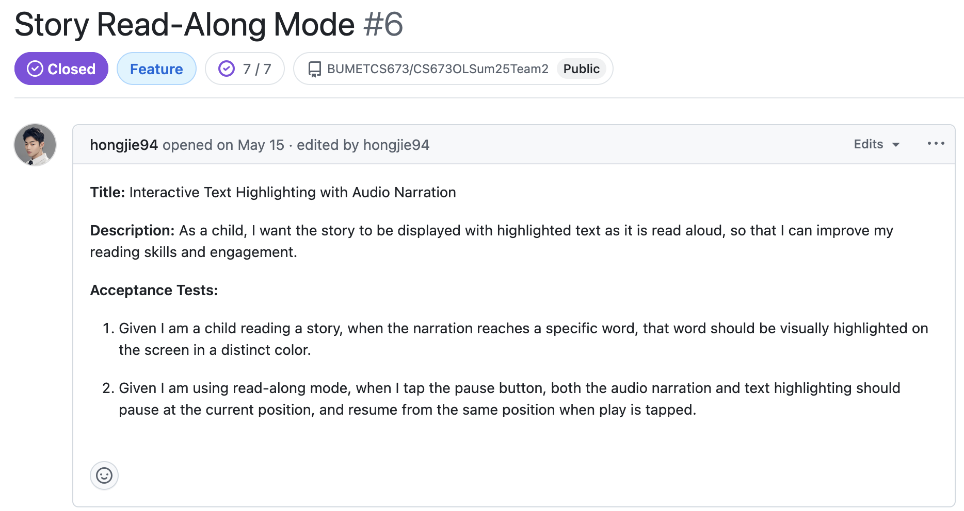
Test Case Examples
Integration testing
Acceptance testing

Slide 38
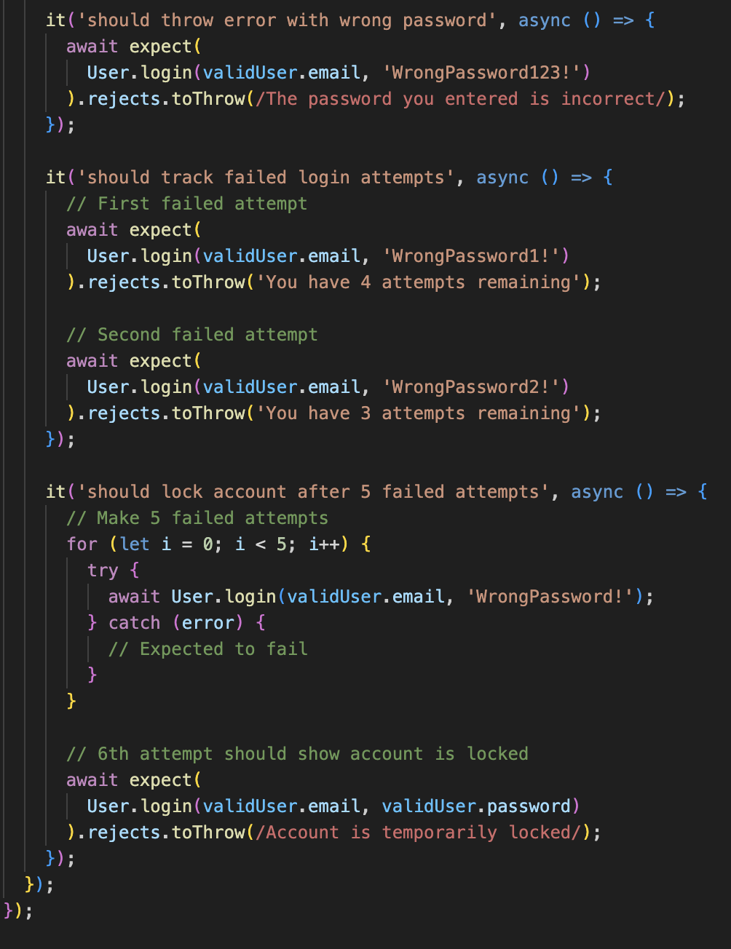
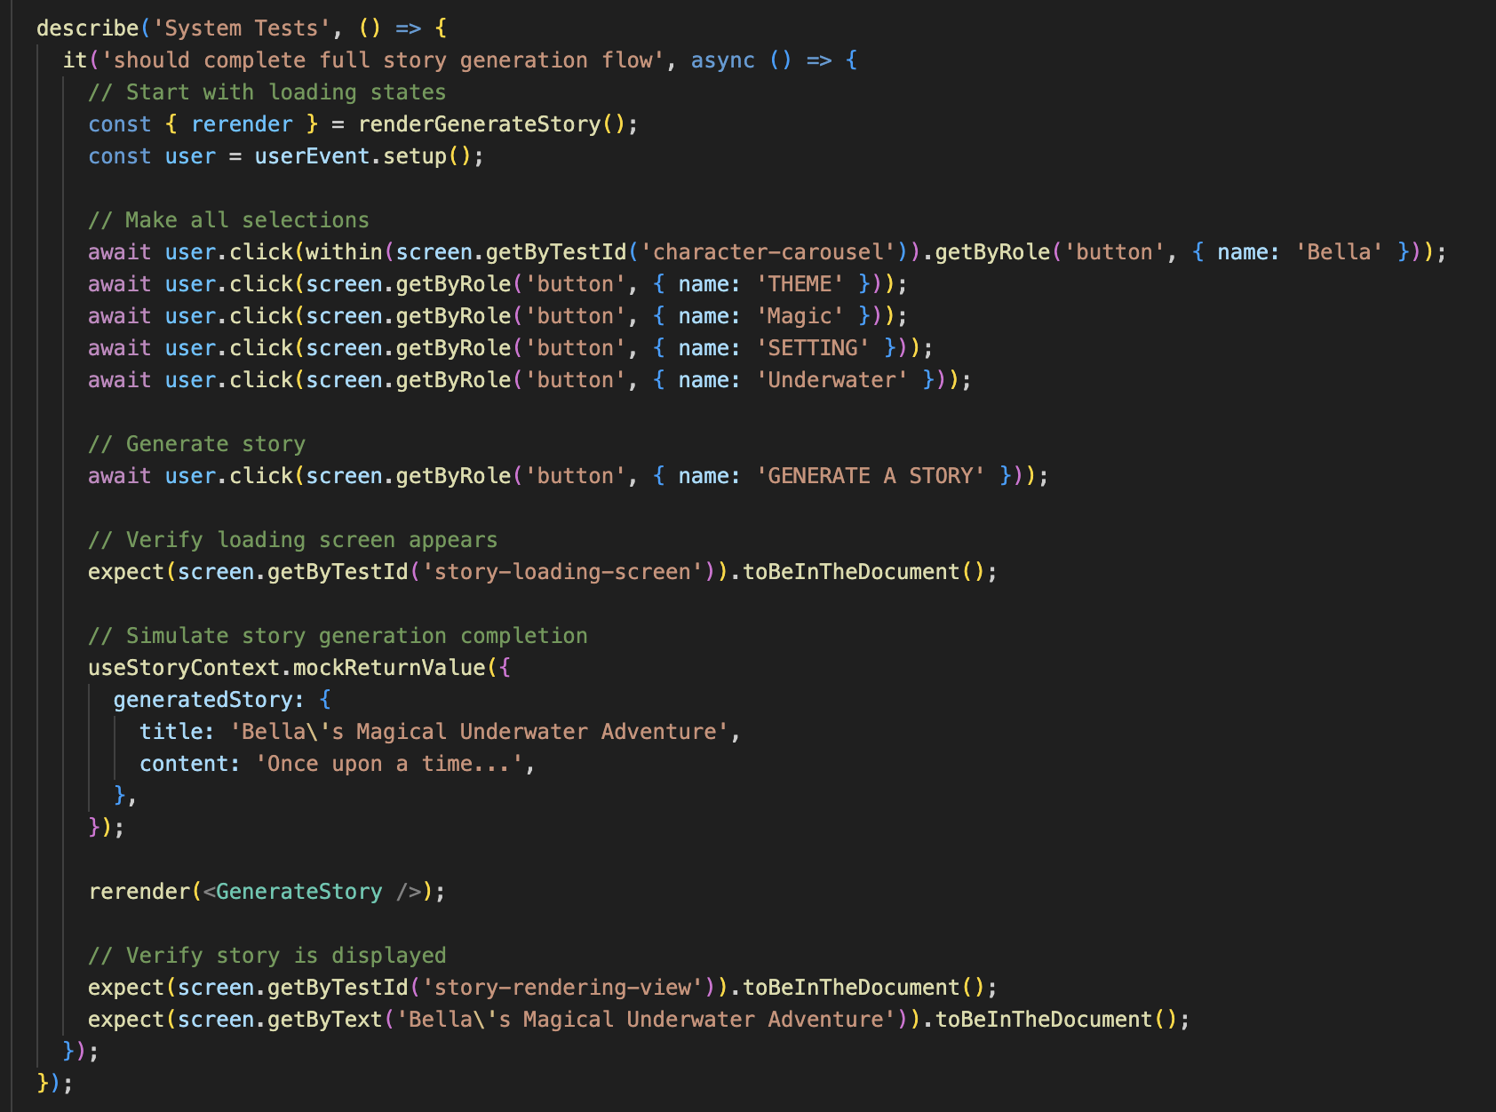
Test Case Examples
Security testing
System testing

Slide 39
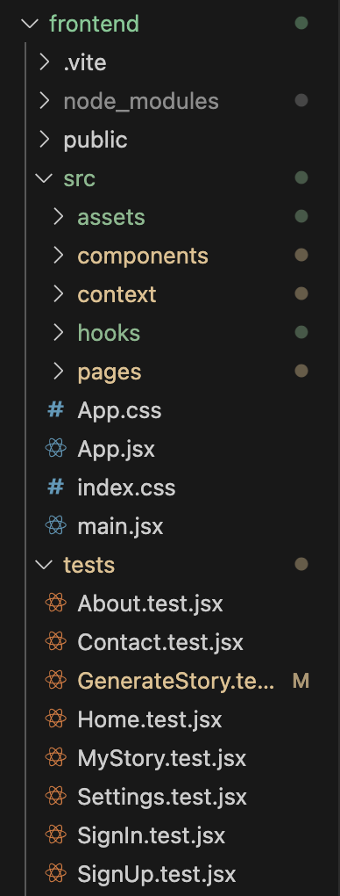
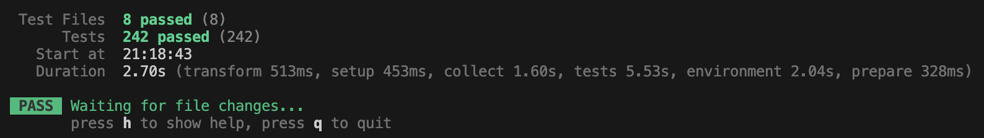
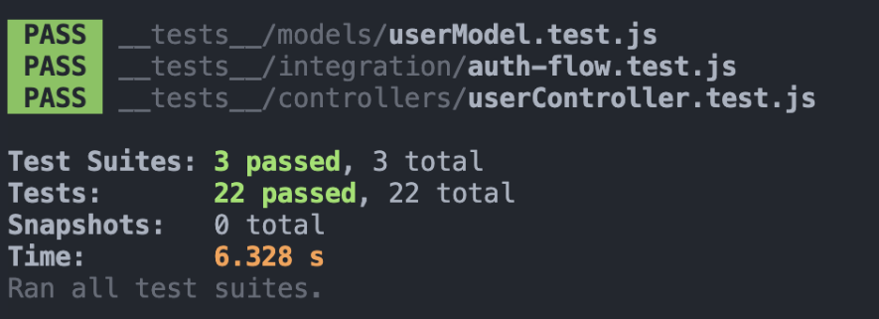
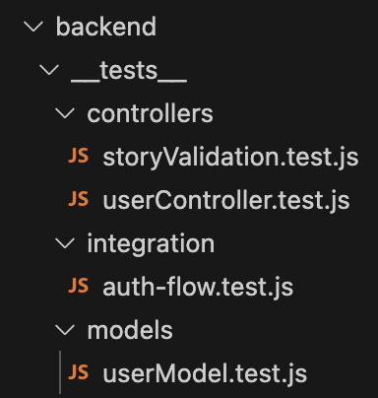
Testing Coverage
Over 85% of the frontend was tested

Slide 40
Configuration Management

Slide 41





Configuration management
Overview of tools
Version Control:
Github
Containerization:
Docker
Package Management:
NPM
CI Pipeline:
Github Actions
Deployment Platforms :
Heroku
Netlify

Slide 42
Docker
Benefits of Docker:
Consistent environment - runs the same every time
Isolation - system doesn’t rely on outside
Portable - can run locally or in CI
Security - Sandboxes application, limits area of attack
Version Control - environment configuration live as code artifacts (dockerfile and docker compose)
Our configuration:
Two Dockerfiles one for front end and one for back end code
Docker-compose in root code folder to orchestrate full application

Slide 43
Github/Github Actions
Benefits of Github:
Version control,Issue Tracking, and CI/CD pipeline all in one application
Code review using pull request feature integrated with pipeline results
Ecosystem integrations with CI tools for code analysis, test coverage, and security scans
Our Configuration:
A single ci.yml that runs analysis, builds and tests in docker container, reports code coverage, and conditionally deploys code if on the main branch

Slide 44
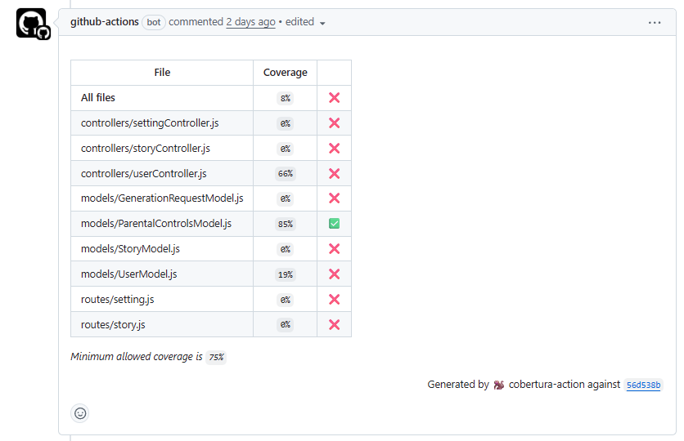
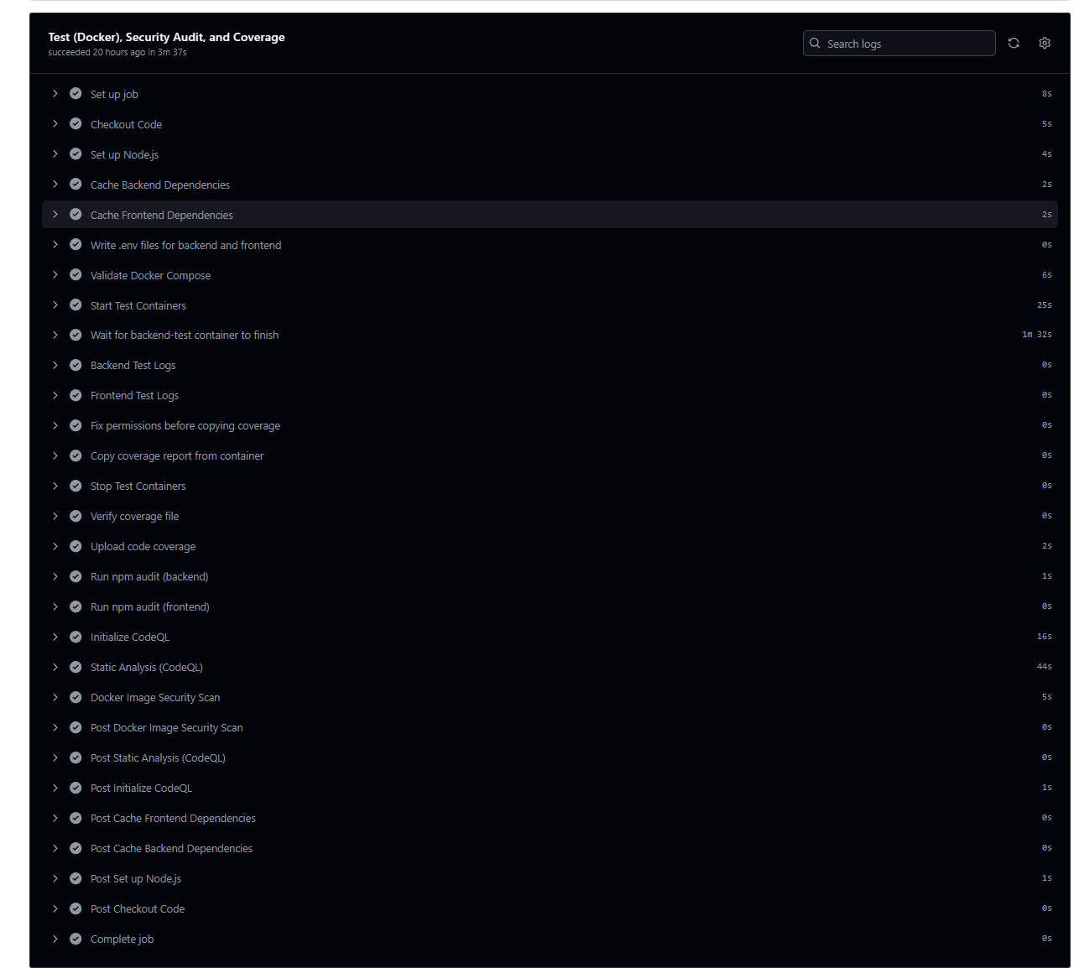
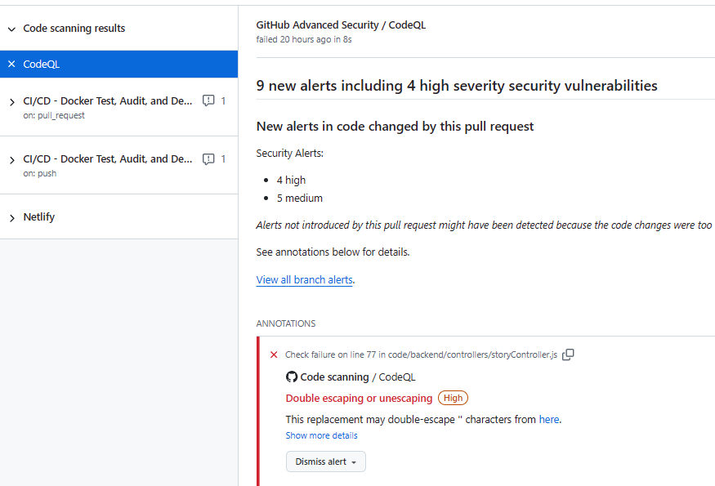
Github/Github Actions
Integrated tools:
Npm audit
Trivy
CodeQL
Cobertura

Slide 45
Thank you!

