Slide 1
My Magical Bedtime
A bedtime story generator
Iteration 1

Slide 2
App Recap
My Magical Bedtime is a bedtime story generator for preschool aged children
Features include generating customizable stories, audio narration, read-along feature
Designed to support early literacy and engagement for non-readers
Built with React, Node.js w/ Express, MongoDB
Utilizing GPT-based API for story generation

Slide 3
Iteration 1 Overview
Built secure use authentication (reg, login, session handling)
Implemented backend logic with JWT, bcrypt, input validation
Created UI screens: homepage, sign-in, sign-up
Set up REST API endpoints
Design data models for users, children, stories

Slide 4
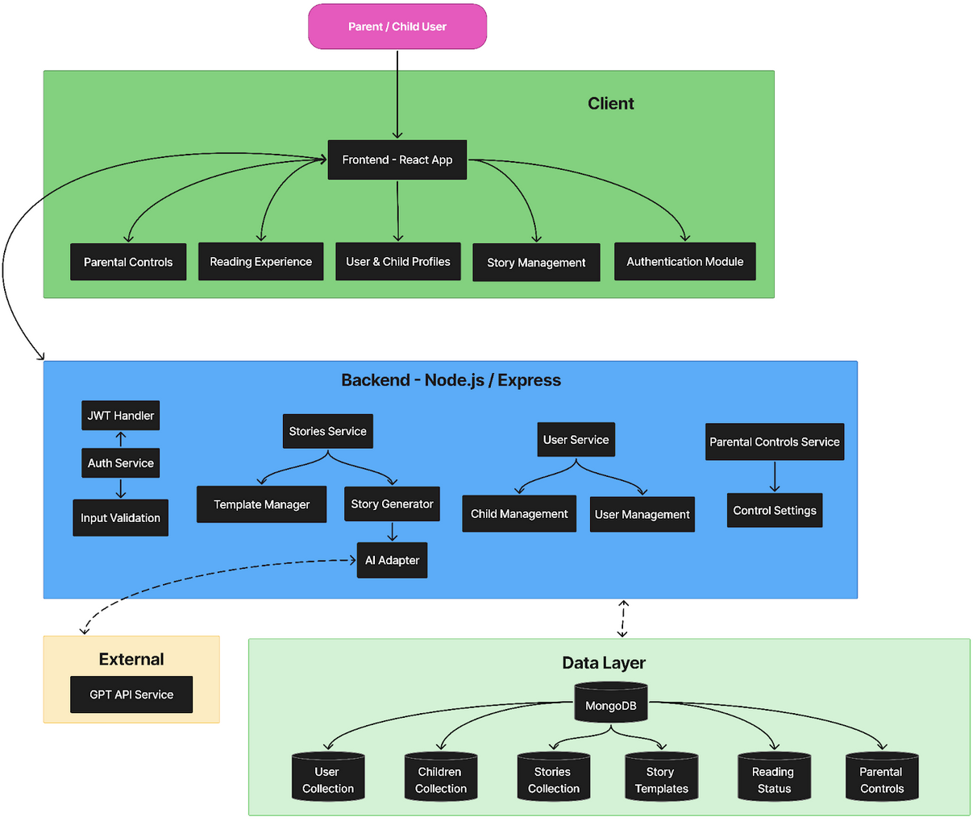
Architecture Overview
3-tier system: Client (React), Backend (Node/Express), Data Layer (MongoDB)
Clear separation of concerns for scalability and maintainability
External GPT API service part of planned architecture for story generation

Slide 5
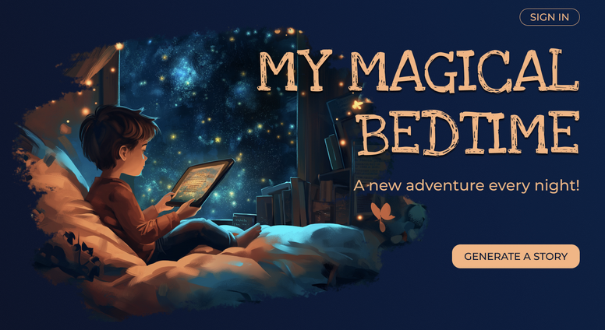
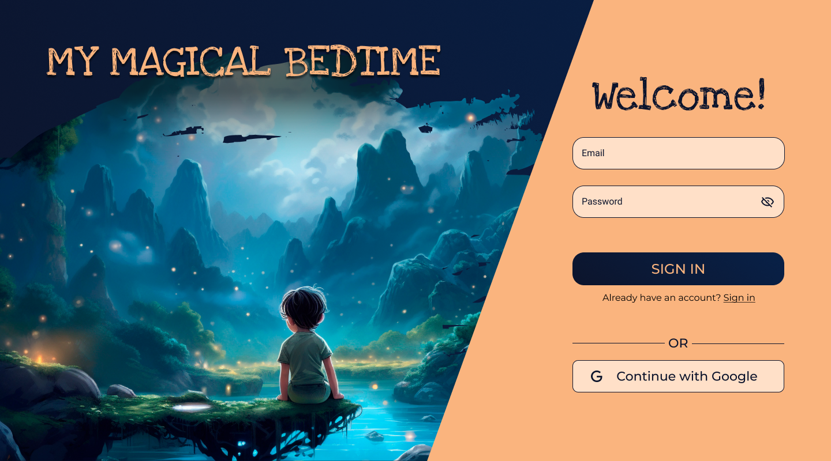
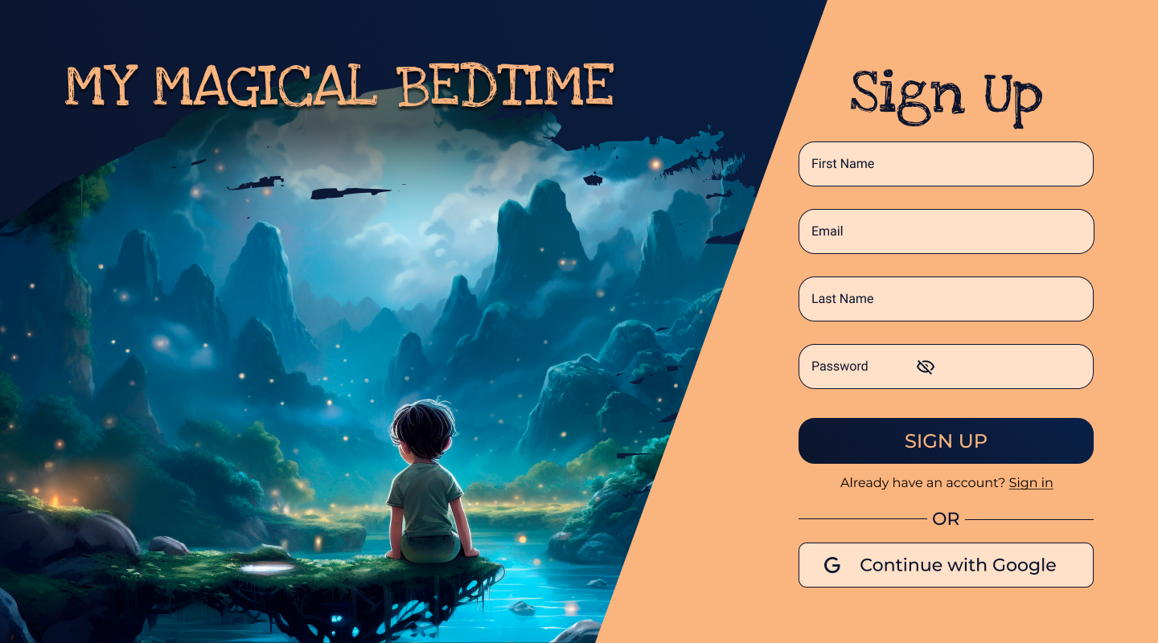
UI Design
Built with React and Vite using modular components
Design for children: simple layout, large buttons, minimal text
Responsive across desktop, tablet, mobile
Includes accessibility features like large tap targets and clear labels

Slide 6
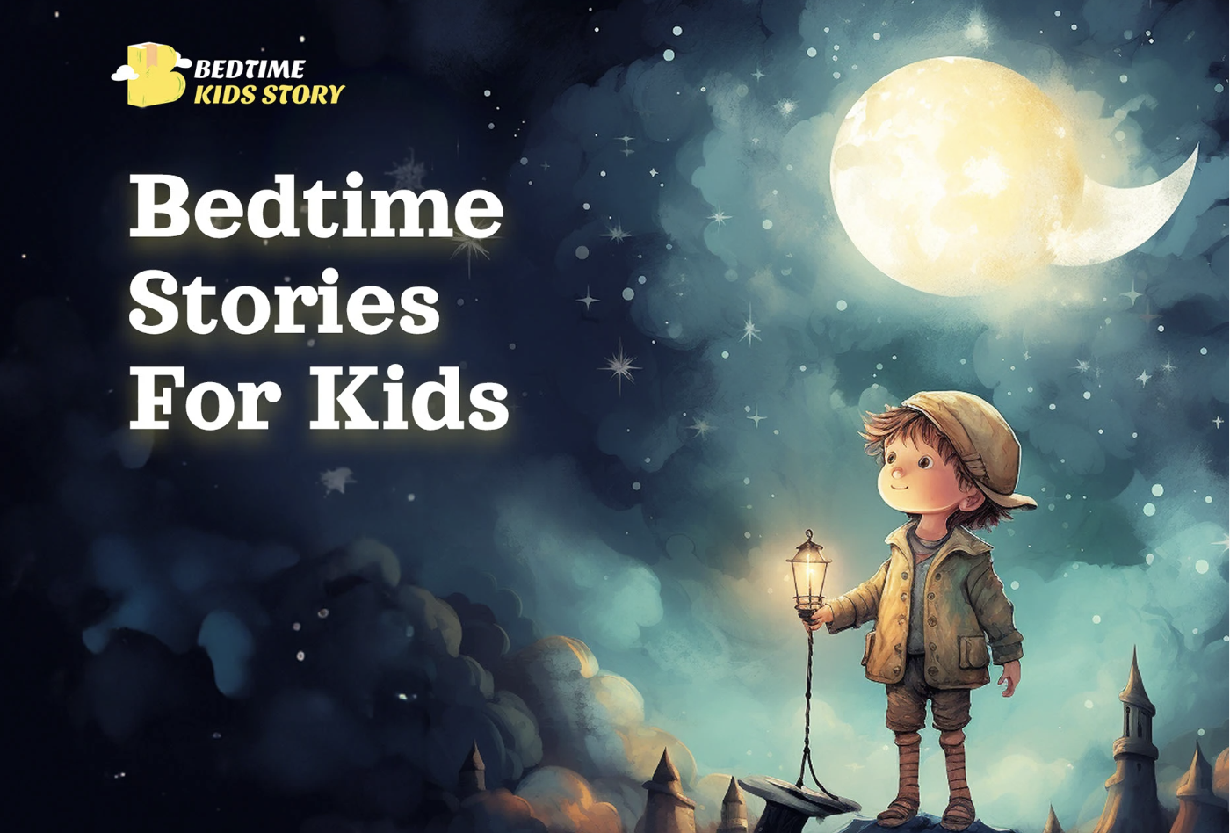
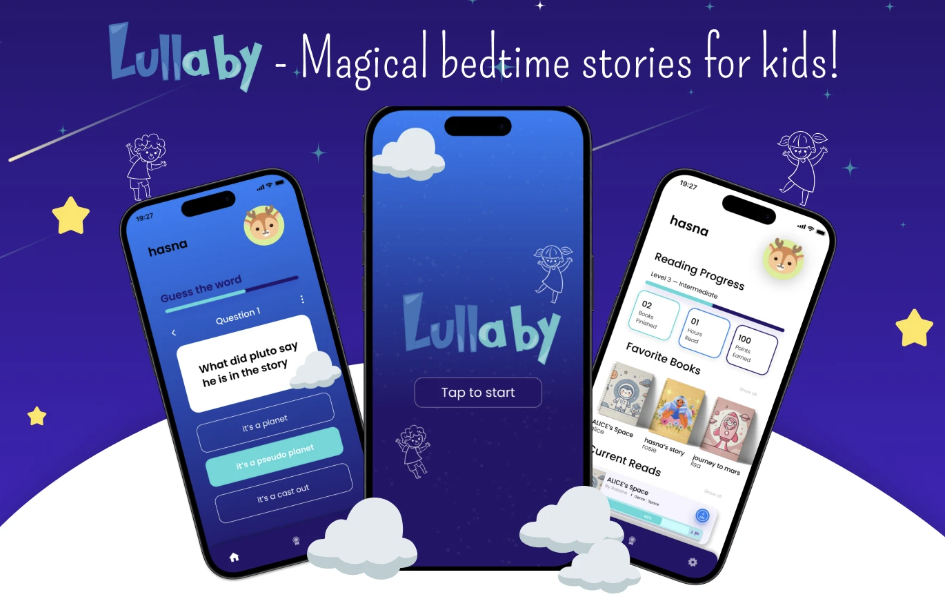
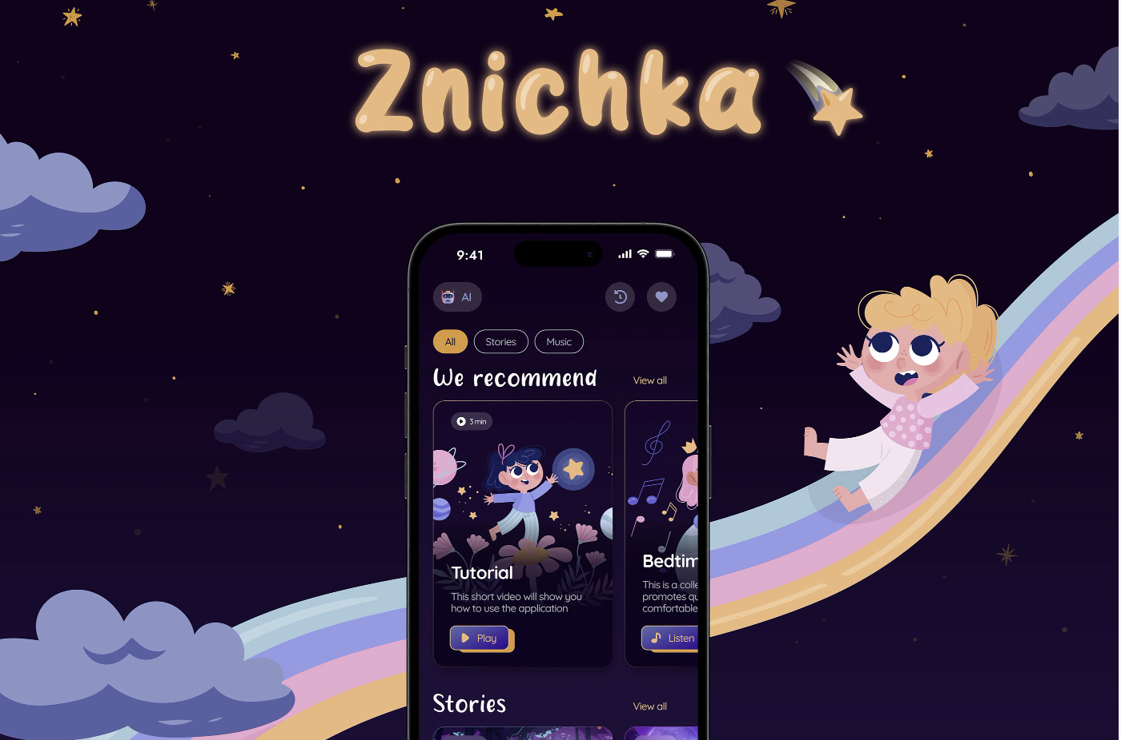
UI Design
The goal was to create a calm, bedtime-friendly atmosphere with a fun and magical feel. Before designing, we looked at several similar apps to understand what works well for bedtime story platforms.

Slide 7
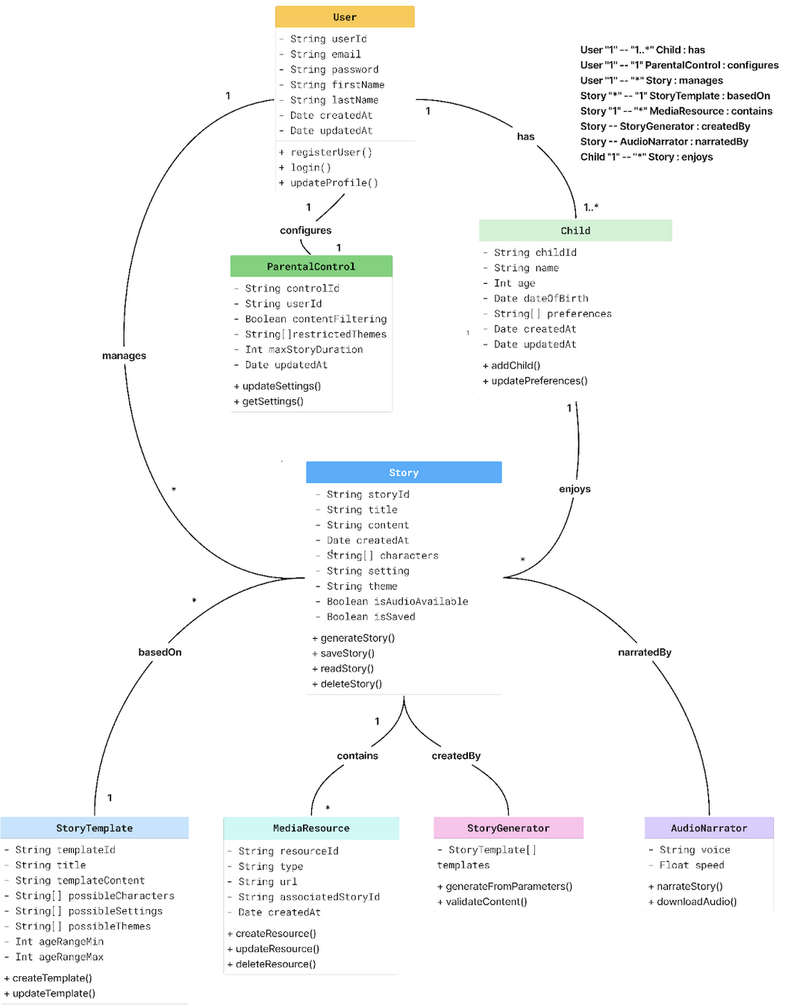
Backend
Built schema and class diagrams to guide structures
Backend uses MVC structures: controllers, models, routes
Class structure applies object-oriented design to define and connect core entities, aligning with modular design of MERN stack

Slide 8
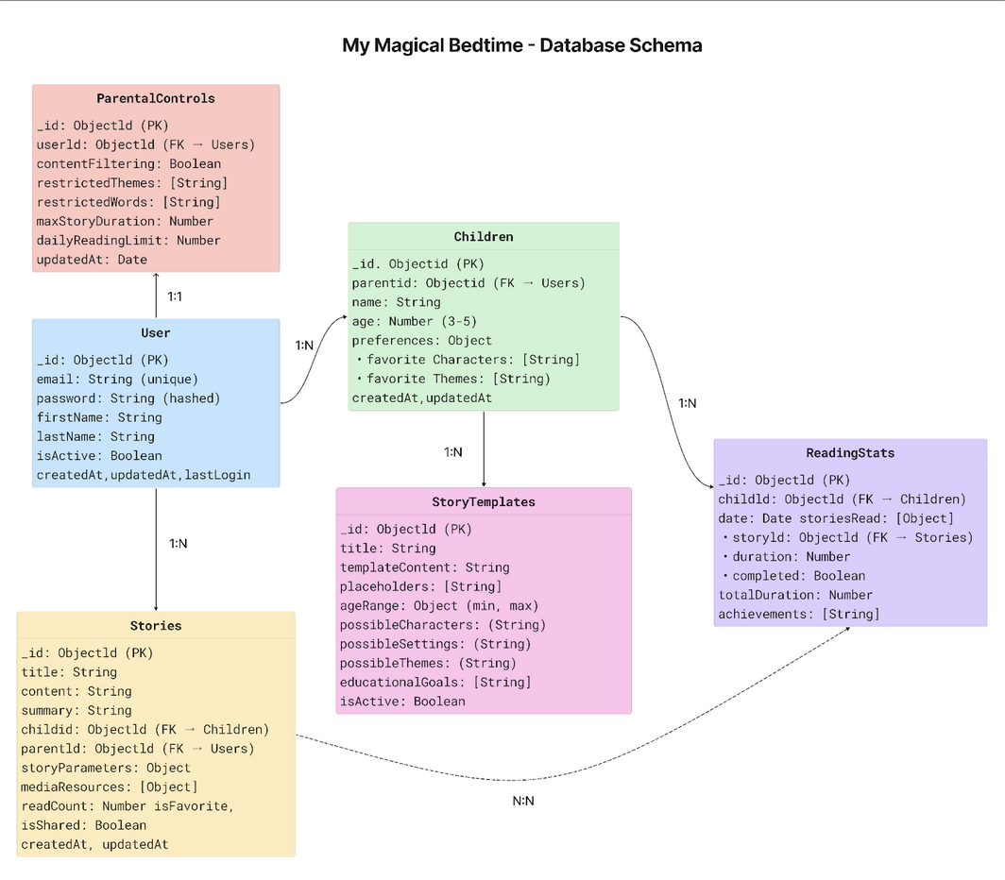
Database
Designed using MongoDB and Mongoose with multiple collections
Data model structure supports scalability for story generation and reading track

