Slide 1

My Magical Bedtime
A bedtime story generator
Iteration 2
Team 2

Slide 2

App Recap
My Magical Bedtime is an app catered towards young children and their parents that allows customized story creation
The app features multiple options to customize the main character, theme, and setting of the story, as well as audio narration and a read-along text highlighting
Designed using the MERN stack (MongoDB, Express.js, React, Node.js)
Tested using Jest, Vite, and the React Testing Library
Utilizes GPT-based API to generate stories

Slide 3
Iteration 2 Overview
Designed UI screens: My Stories, Story Generator, Contact, About
Implemented the story generation, illustration generation, read-along highlighting feature, and audio narration
Tested front end components using Vite, Jest, and the React Testing Library
Created REST API endpoints for user stories
Expanded data models for stories

Slide 4
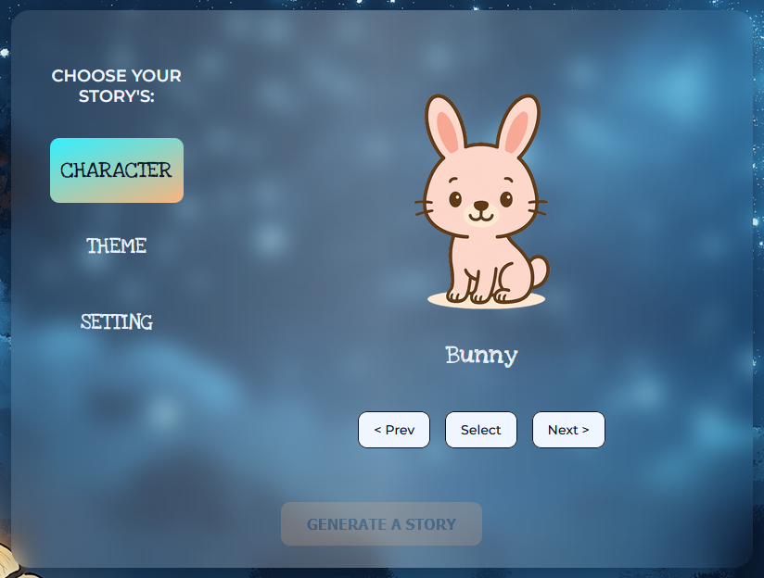
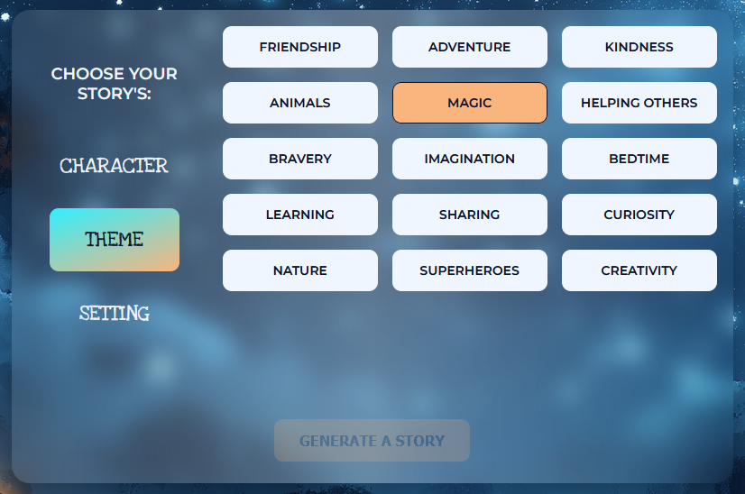
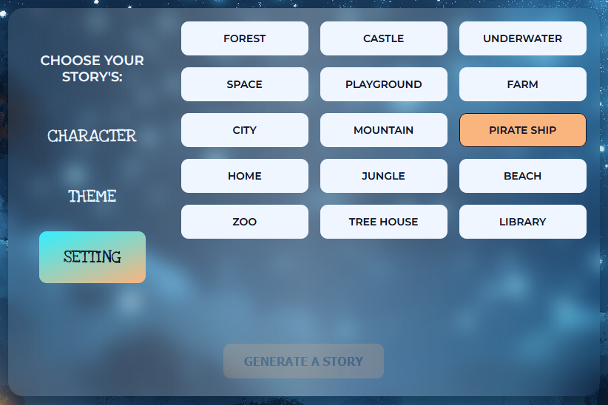
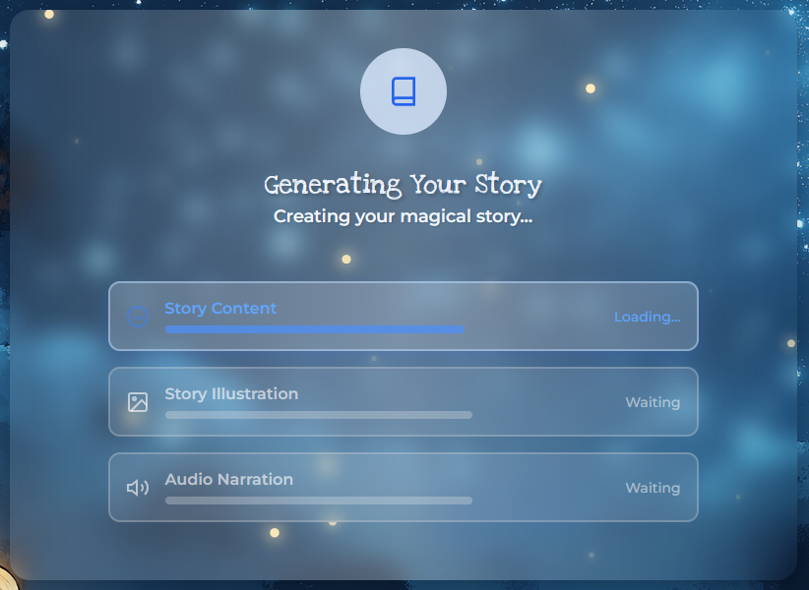
UI Design
Built with React and Vite using modular components
Design for children: simple layout, large buttons, minimal text
Responsive across desktop, tablet, mobile
Includes accessibility features like large tap targets and clear labels

Slide 5
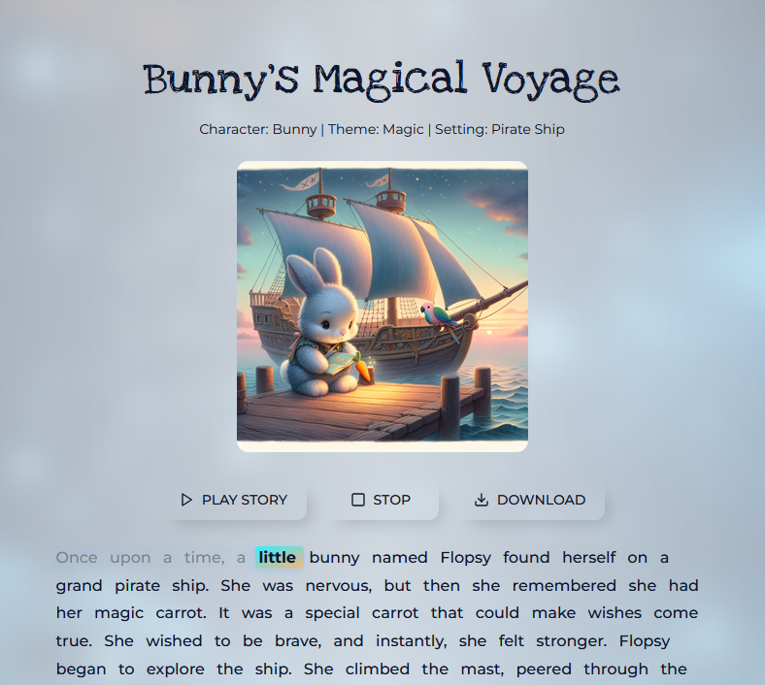
UI Design
Stories feature a child-friendly illustration that matches the story
Each story has audio narration and text highlighting to show the words being read
Story narration can be paused and reset at any time

Slide 6
Testing
Vite (Build tool and test runner)
Jest (Testing framework)
React Testing Library (Component testing)
100% unit test coverage across all pages
Automated testing pipeline for continuous quality

Slide 7
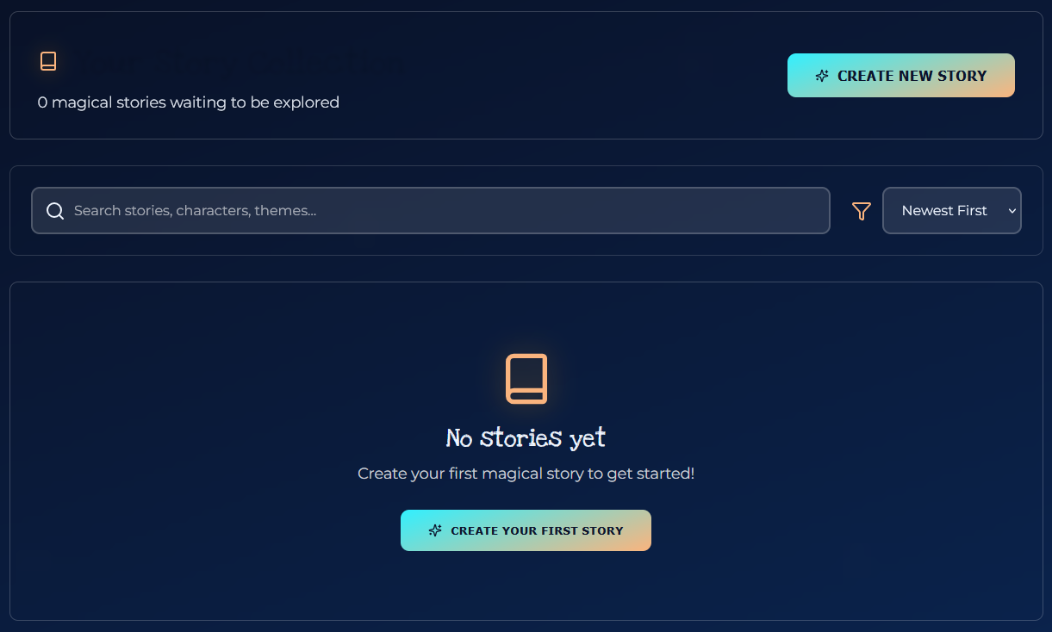
Final Plans
We have a few more features and pages that we would like to implement
The “My Stories” page that stores any stories the user would like to save for the future
The user dashboard must be designed and we need to add routes to the contact and about pages for logged in users
We would like to add the ability for users to favorite stories

