Slide 1
BU METCS 673
Team 3 Project: MyMedic
Iteration 2
John Gutierrez, Indra Sigicharla, Adriel Domingo, Mengliang Tan, Uzay Isin Alici, Tyler Gonsalves, Hongcheng Ding

Slide 2
Roles
Lead - Indra Sigicharla and John Gutierrez
Requirements Lead - Adriel Domingo and John Gutierrez
Design and Implementation Lead - John Gutierrez, Tyler Gonsalves, and Hongcheng Ding
QA Lead - Mengliang Tan and John Gutierrez
Configuration Lead John Gutierrez, Indra Sigicharla, and Tyler Gonsalves
Security Lead - Uzay Isin Alici and John Gutierrez

Slide 3
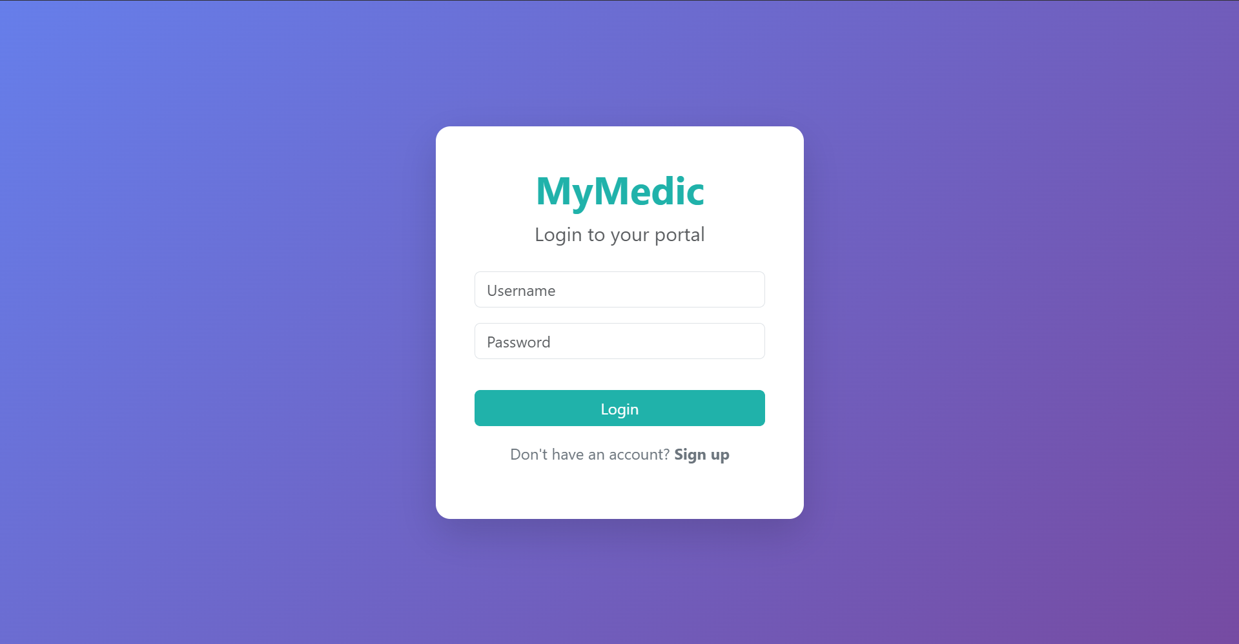
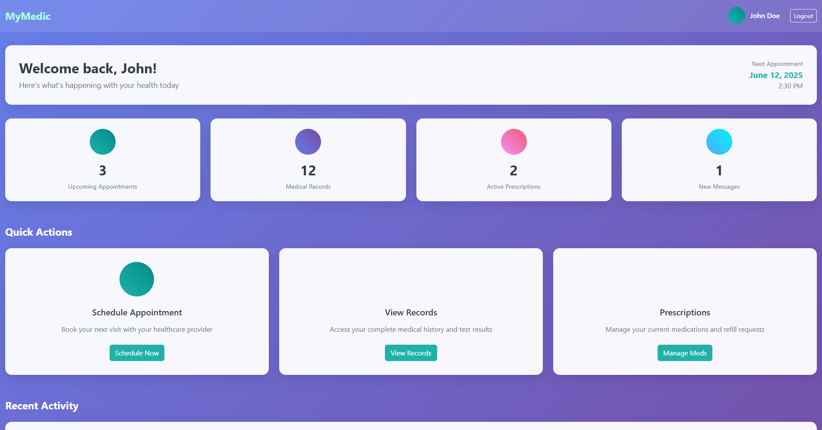
MyMedic Concept
Purpose
Personal medical system designed to empower patients by giving them secure and convenient access to their complete medical history with just one click.
Offers centralized patient-controlled health records, efficient care coordination, patient convenience.
Potential Users:
Patients - individuals managing their own or a family member’s health records.
Healthcare providers - clinics, hospitals, providers, insurance companies who need patient history.
Pharmacies - for prescription tracking.

Slide 4
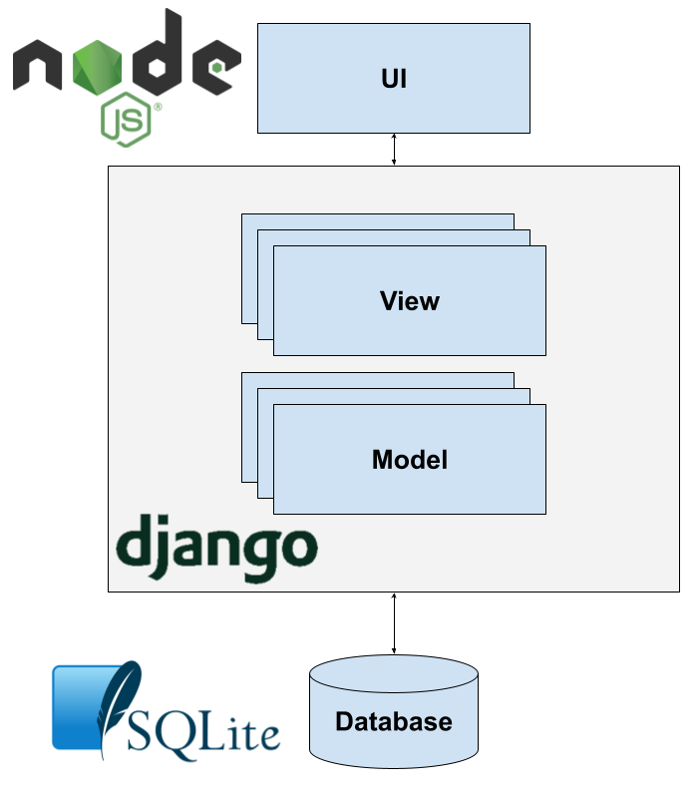
MyMedic Software Architecture

Slide 5
Project Risks
26 Risks Identified
Personel
Communication
Requirements
Management
Technology Stack Proficiency
Design and Implementation
Testing
Integration and Deployment
Security
2 already closed
2 remain high priority
Recently mitigated risk: Jira and GitHub integration
Issue: API failure integrating Jira and GitHub
Effect: double the amount of work to manually synchronize two issue repositories
Action Taken: Migrate Jira issues to GitHub and begin using GitHub projects

Slide 6
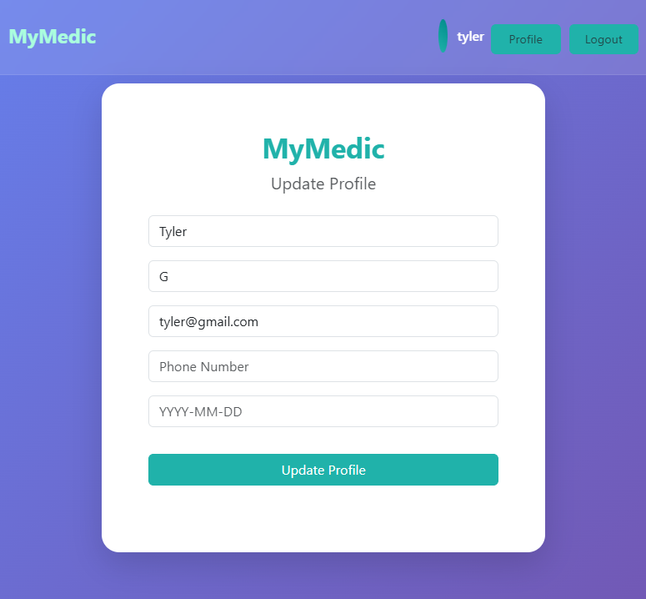
Edit Profile Feature
Profile information saved on user registration
Can click “Profile” to view and edit profile information
Testing completed to validate data is properly created and updated with PyTest

Slide 7
Reset Password feature
Users can securely reset passwords through email verification
User requests generate a unique, time-sensitive reset link.
Reset link sent directly to the user's registered email.
Secure form provided via link for entering a new password.
Enhances security by validating user identity through email.

Slide 8
Security
Security Goals
Ensure Confidentiality, Integrity, Availability (CIA)
Align with HIPAA requirements
HIPAA Compliance
Protecting user health data (PHI)
Audit logs & user consent
Access Control & Authentication
Role-based access (patients, doctors, admins)
Multi-factor authentication (MFA)
JWT-based login implemented using Django
REST Framework
Data Encryption
HTTPS with SSL/TLS
Encrypting sensitive data at rest and in transit (planned)
Vulnerability Assessment
Security scans planned in CI/CD phase
Incident Response
Procedure for data breaches or system attacks
Timely notification and containment steps
Backup & Recovery
Secure daily backups
Recovery plan in case of data loss
Threat Modeling (STRIDE):
Risks identified: spoofing, DoS, privilege escalation
Mitigations planned (rate limiting, RBAC)

Slide 9
MFA
Implemented extra layer of login security using MFA. MFA is simulated via terminal instead of a real-time delivery method to make login easier for everyone.
The user must enter this code to access the dashboard.
This feature prevent unauthorized access and keep accounts more secure.

Slide 10
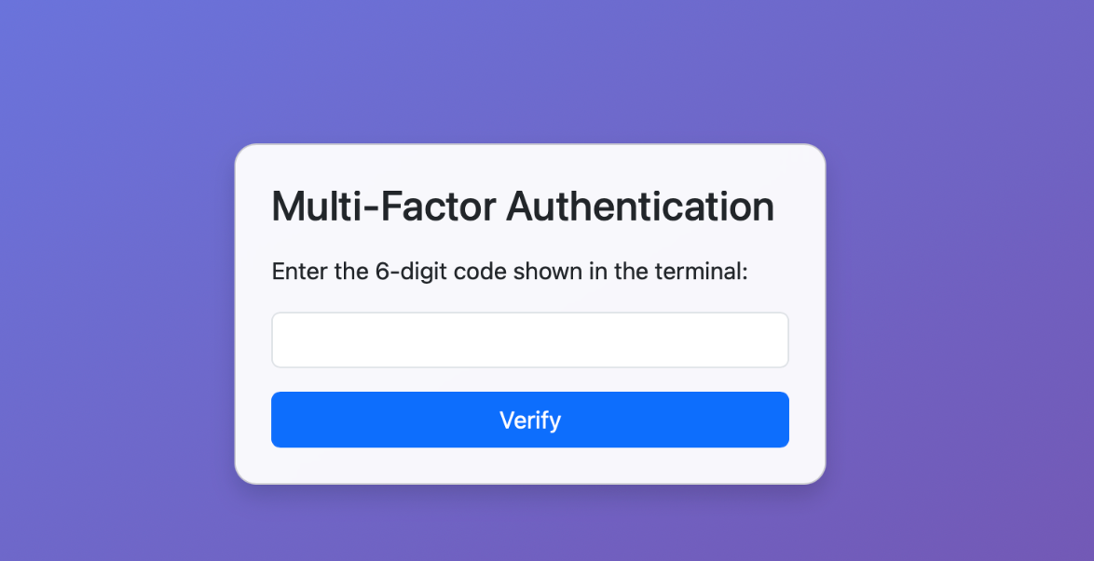
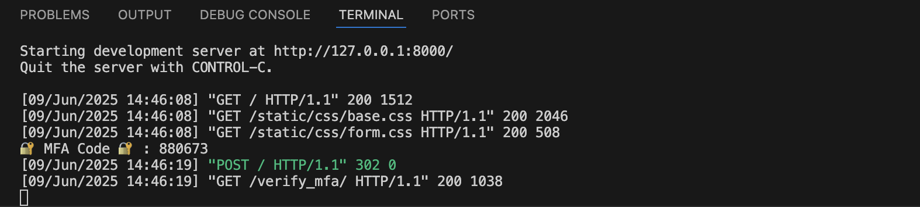
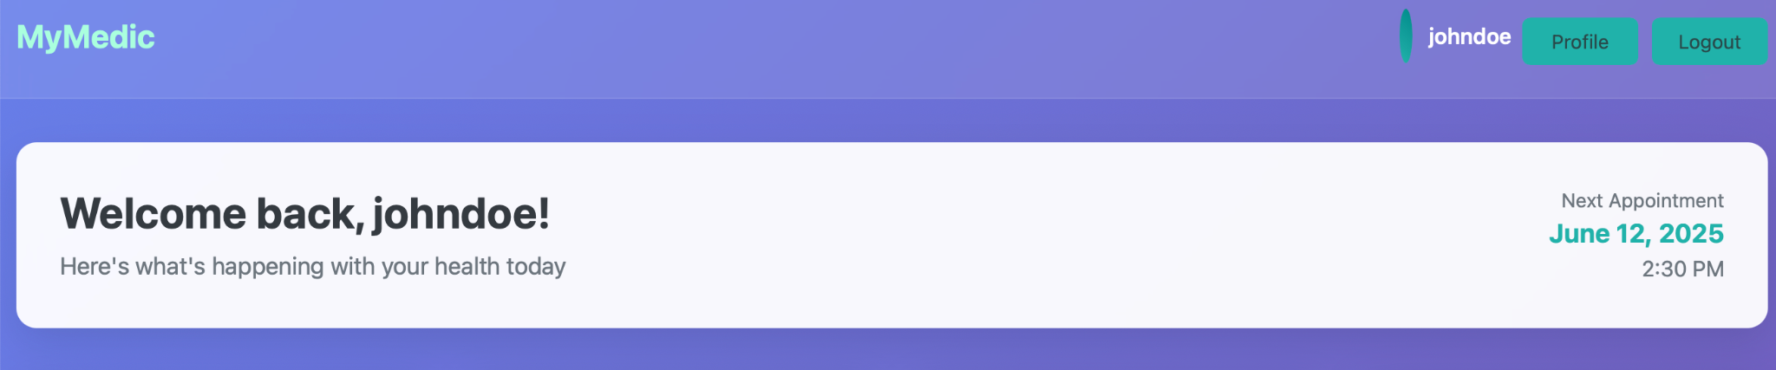
MFA

Slide 11
Project Status and Next Steps
Status
Software Architecture defined
Class diagrams created
Testing frameworks identified
Database schema created
Login/Signup features ready
Next Steps
Test Signup/login and authentication
Implement database integration
Implement front-end GUI
Implement unit tests
Implement CI/CD
Implement security audit

