Slide 1
BU METCS 673
Team 3 Project: MyMedic
Iteration 0
John Gutierrez, Indra Sigicharla, Adriel Domingo, Mengliang Tan, Uzay Isin Alici, Tyler Gonsalves

Slide 2
Roles
Lead - Indra Sigicharla and John Gutierrez
Requirements Lead - Adriel Domingo and John Gutierrez
Design and Implementation Lead - John Gutierrez, Tyler Gonsalves, and Hongcheng Ding
QA Lead - Mengliang Tan and John Gutierrez
Configuration Lead John Gutierrez, Indra Sigicharla, and Tyler Gonsalves
Security Lead - Uzay Isin Alici and John Gutierrez

Slide 3
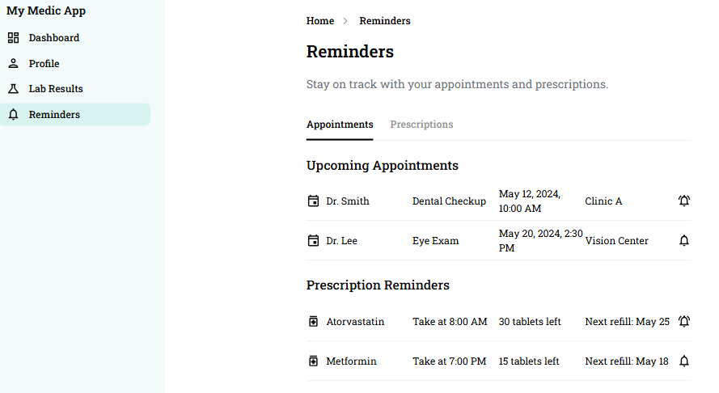
MyMedic Concept
Purpose
Personal medical system designed to empower patients by giving them secure and convenient access to their complete medical history with just one click.
Offers centralized patient-controlled health records, efficient care coordination, patient convenience.
Potential Users:
Patients - individuals managing their own or a family member’s health records.
Healthcare providers - clinics, hospitals, providers, insurance companies who need patient history.
Pharmacies - for prescription tracking.

Slide 4
Functional Requirements
Essential
User Registration and Login
View and Edit Personal Information
Desirable
Family Accounts
Notification System
Optional
Voice Assistant

Slide 5
UI Design Principles and Workflow
Why UI Matters？
Patients interact with the system daily — interface affects usability and trust
Design Guidelines:
Consistency: Elements (buttons, colors) will be reused across all screens
Mobile-first: Designed primarily for phone use (dashboard cards, swipe gestures)
Accessibility: High contrast text, large tappable areas, and readable fonts
Minimalism: Show only relevant information per screen to avoid overwhelming the user

Slide 6
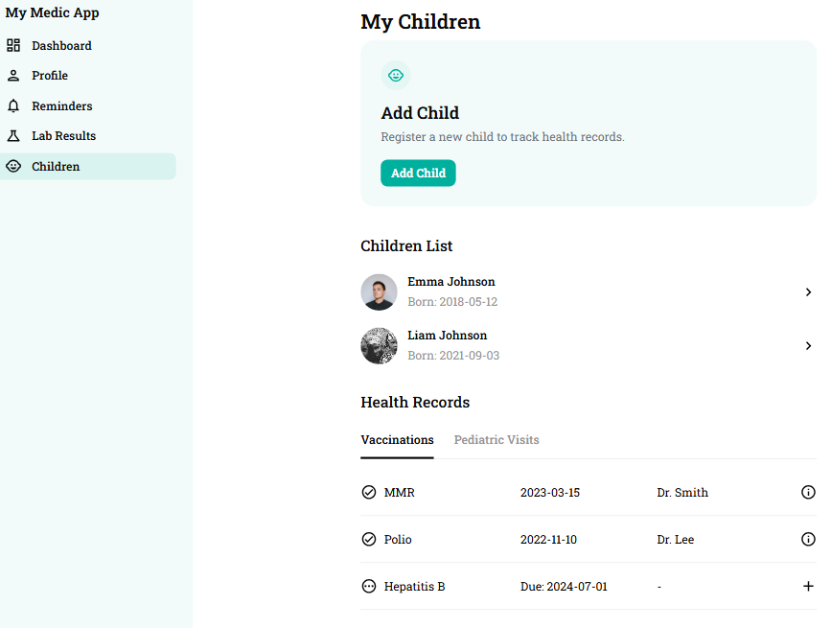



MyMedic Technology Stack
Python Django Back End
OAuth
Authentication
Javascript Front End
SQLite Database

Slide 7
Development Strategy
TrunkFlow Development:
All production-ready code lives in the main branch
Each feature is developed in a separate branch, also applies to bug fixes and urgent production fixes
All changes are submitted via pull requests, which must pass automated CI checks and be reviewed by at least one group member
Merged back to main

Slide 8
Project Risks
26 Risks Identified
Personel
Communication
Requirements
Management
Technology Stack Proficiency
Design and Implementation
Testing
Integration and Deployment
Security
2 already closed
2 remain high priority (integration and deployment, and security)

Slide 9



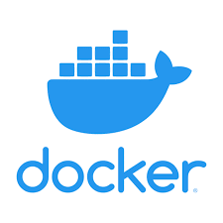

Project Tools Infrastructure
GitHub
Google Drive
Discord
Jira
Docker

Slide 10
Security
HIPAA Compliance
Protecting user health data (PHI)
Audit logs & user consent
Access Control & Authentication
Role-based access (patients, doctors, admins)
Multi-factor authentication (MFA)
Data Encryption
HTTPS with SSL/TLS
Encrypting sensitive data at rest and in transit
Vulnerability Assessment
Regular security scans
Incident Response
Procedure for data breaches or system attacks
Timely notification and containment steps
Backup & Recovery
Secure daily backups
Recovery plan in case of data loss

Slide 11
Project Status and Next Steps
Status
Identified technology stack
Identified risks and planned mitigations
Drafted several requirements and user stories
Reorienting with new team member
Next Steps
Refine requirements and user stories
Draft Software Design Document (SDD)
Draft Software Test Document (STD)
Refine design
Start mock ups
Start container setup

