Slide 1
BU METCS 673
Team 3 Project: MyMedic
Iteration 1
John Gutierrez, Indra Sigicharla, Adriel Domingo, Mengliang Tan, Uzay Isin Alici, Tyler Gonsalves, Hongcheng Ding

Slide 2
Roles
Lead - Indra Sigicharla and John Gutierrez
Requirements Lead - Adriel Domingo and John Gutierrez
Design and Implementation Lead - John Gutierrez, Tyler Gonsalves, and Hongcheng Ding
QA Lead - Mengliang Tan and John Gutierrez
Configuration Lead John Gutierrez, Indra Sigicharla, and Tyler Gonsalves
Security Lead - Uzay Isin Alici and John Gutierrez

Slide 3
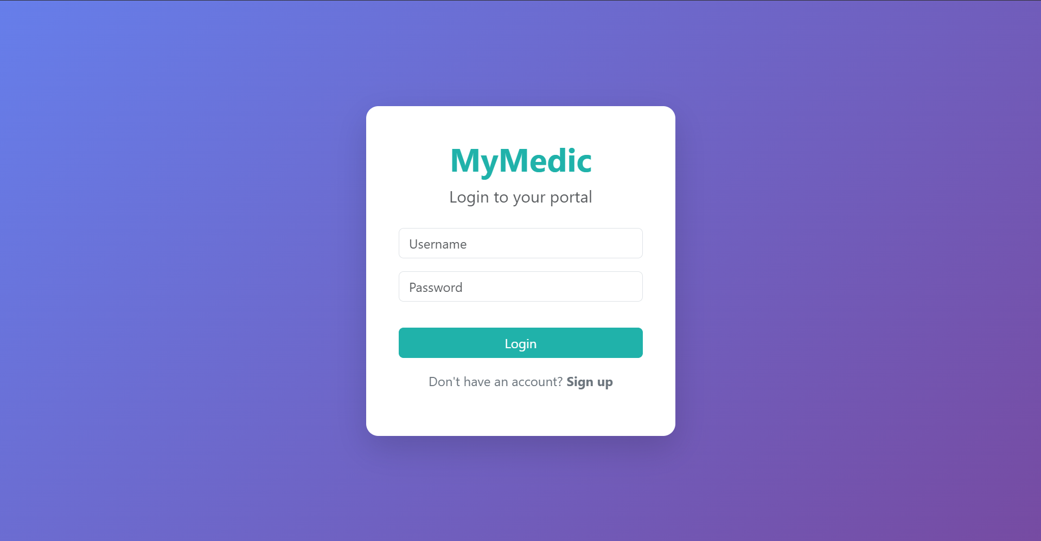
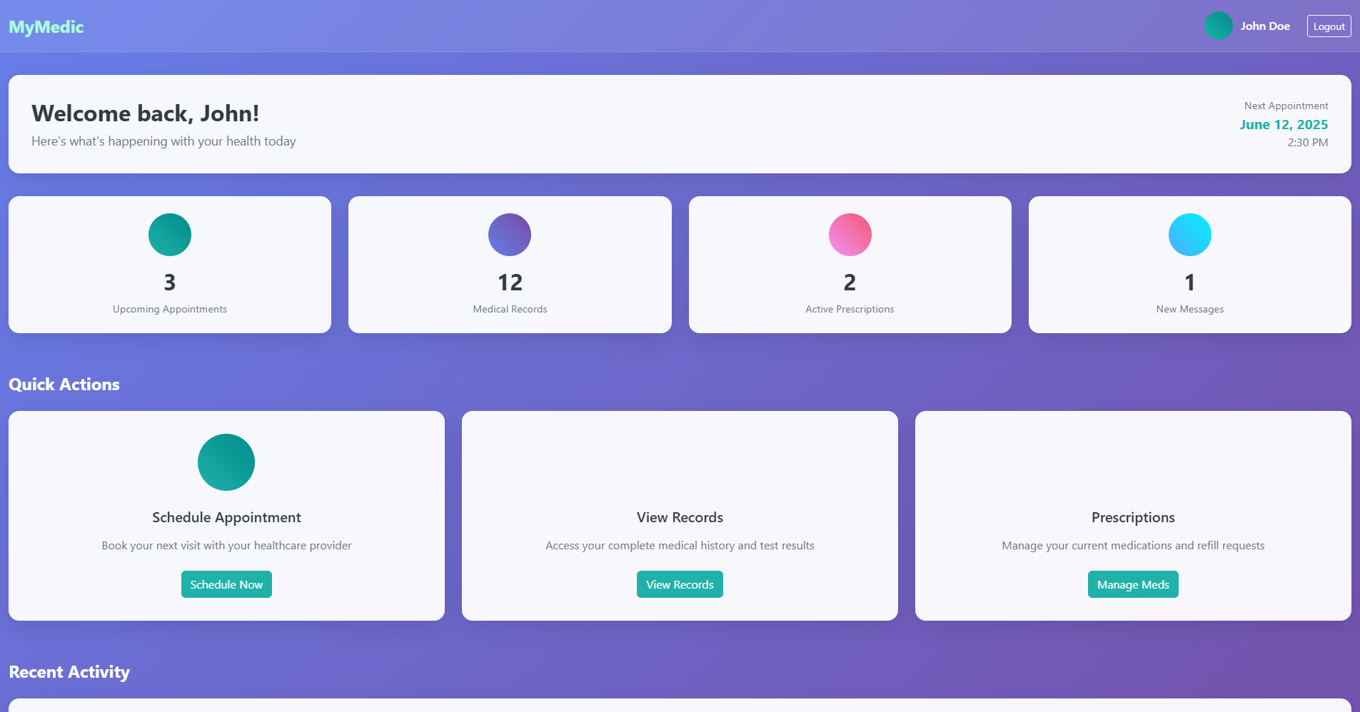
MyMedic Concept
Purpose
Personal medical system designed to empower patients by giving them secure and convenient access to their complete medical history with just one click.
Offers centralized patient-controlled health records, efficient care coordination, patient convenience.
Potential Users:
Patients - individuals managing their own or a family member’s health records.
Healthcare providers - clinics, hospitals, providers, insurance companies who need patient history.
Pharmacies - for prescription tracking.

Slide 4
Functional Requirements
Essential
User Registration and Login
View and Edit Personal Information
Desirable
Family Accounts
Notification System
Optional
Voice Assistant

Slide 5
UI Design Principles and Workflow
Why UI Matters？
Patients interact with the system daily — interface affects usability and trust
Design Guidelines:
Consistency: Elements (buttons, colors) will be reused across all screens
Mobile-first: Designed primarily for phone use (dashboard cards, swipe gestures)
Accessibility: High contrast text, large tappable areas, and readable fonts
Minimalism: Show only relevant information per screen to avoid overwhelming the user

Slide 6
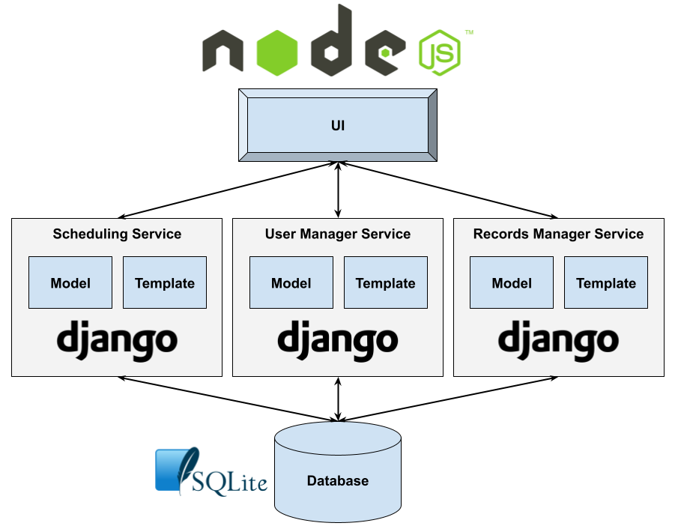
MyMedic Software Architecture

Slide 7
Development Strategy
TrunkFlow Development:
All production-ready code lives in the main branch
Each feature is developed in a separate branch, also applies to bug fixes and urgent production fixes
All changes are submitted via pull requests, which must pass automated CI checks and be reviewed by at least one group member
Merged back to main

Slide 8
Project Risks
26 Risks Identified
Personel
Communication
Requirements
Management
Technology Stack Proficiency
Design and Implementation
Testing
Integration and Deployment
Security
2 already closed
2 remain high priority
Recently mitigated risk: Jira and GitHub integration
Issue: API failure integrating Jira and GitHub
Effect: double the amount of work to manually synchronize two issue repositories
Action Taken: Migrate Jira issues to GitHub and begin using GitHub projects

Slide 9



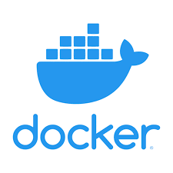
Project Tools Infrastructure
GitHub
Google Drive
Discord
Docker

Slide 10
Security
Security Goals
Ensure Confidentiality, Integrity, Availability (CIA)
Align with HIPAA requirements
HIPAA Compliance
Protecting user health data (PHI)
Audit logs & user consent
Access Control & Authentication
Role-based access (patients, doctors, admins)
Multi-factor authentication (MFA)
JWT-based login implemented using Django REST Framework
Data Encryption
HTTPS with SSL/TLS
Encrypting sensitive data at rest and in transit (planned)
Vulnerability Assessment
Security scans planned in CI/CD phase
Incident Response
Procedure for data breaches or system attacks
Timely notification and containment steps
Backup & Recovery
Secure daily backups
Recovery plan in case of data loss
Threat Modeling (STRIDE):
Risks identified: spoofing, DoS, privilege escalation
Mitigations planned (rate limiting, RBAC)

Slide 11
Rest API
Purpose: Enables new users to register and sign-in into accounts by sending a POST request with user credentials to the backend. Once backend has successfully processed the request, the user data is stored, and responds with an access token JWT.
User Authentication (Sign-Up & Sign-In): Uses Django Rest Framework (DRF) with JWT auth
EndPoint | Method | Description
/api/signup/ | POST | Register new user (email, password)
/api/login/ | POST | Authenticate user and return token
/api/logout/ | POST | Log out user and invalidate token
/api/token/refresh | POST | Get a new access token (JWT-based)

Slide 12

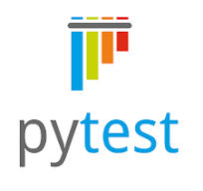

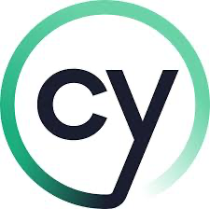
Testing Framework
Both manual and automated testing
Each developer is responsible for testing their own code
The QA lead is responsible for making sure code implementation doesn’t cause other code to break.
Jest will be used for Javascript testing
Pytest will be used for python testing
Selenium and Cypress will be used for web application testing.

Slide 13
Code Implementation
For this iteration, we’ve implemented a Dockerized Django backend with REST API endpoints for login, signup, and authentication.
Frontend templates are cleanly separated into HTML, CSS, and JS, using CDN libraries like Bootstrap and Animate.css for styling and animation.
User authentication is handled via JSON Web Tokens (JWT) using djangorestframework-simplejwt.
SQLite is used as the development database, mounted via Docker volumes for persistence.
All key functionality for this iteration (login, signup) is modular and ready for expansion in future iterations.

Slide 14
Project Status and Next Steps
Status
Software Architecture defined
Class diagrams created
Testing frameworks identified
Database schema created
Login/Signup features ready
Next Steps
Test Signup/login and authentication
Implement database integration
Implement front-end GUI
Implement unit tests
Implement CI/CD

