Slide 1
HealthNest
Boston University
Semester: Summer 2026
Date: May 23
CS673 Software Engineering | Team 2 | Iteration 1 Presentation
Chamarr Auber, Aaron Brown, Deven Shah, Stephanie Wang

Slide 2
Project Overview
HealthNest is a unified medical dashboard for both patients and healthcare providers. The goal is to centralize appointments, lab results, prescriptions, messages, and AI-assisted support into one clean platform.
In Iteration 1, our team focused on turning this concept into the first working version through authentication, dashboard interfaces, testing, and CI/CD setup.

Slide 3

Iteration 1 Goals
✔
✔
✔
✔
✔
UI Design
Authentication Flow
Appointment Scheduler
Home Dashboard
Lab Results
Implemented the wireframe into the application. Refined patient and provider dashboard layouts.
Built login and sign-up flow for both roles that complies with securing user personal and PHI.
Designed a system that schedules frictionless appointments between provider and patient.
Implemented the home dashboard for both the patient and provider, in which all important information is accessible within 0-1 clicks.
Providers are able to upload lab results, review it, and manage visibility to the patient all through the application.

Slide 4
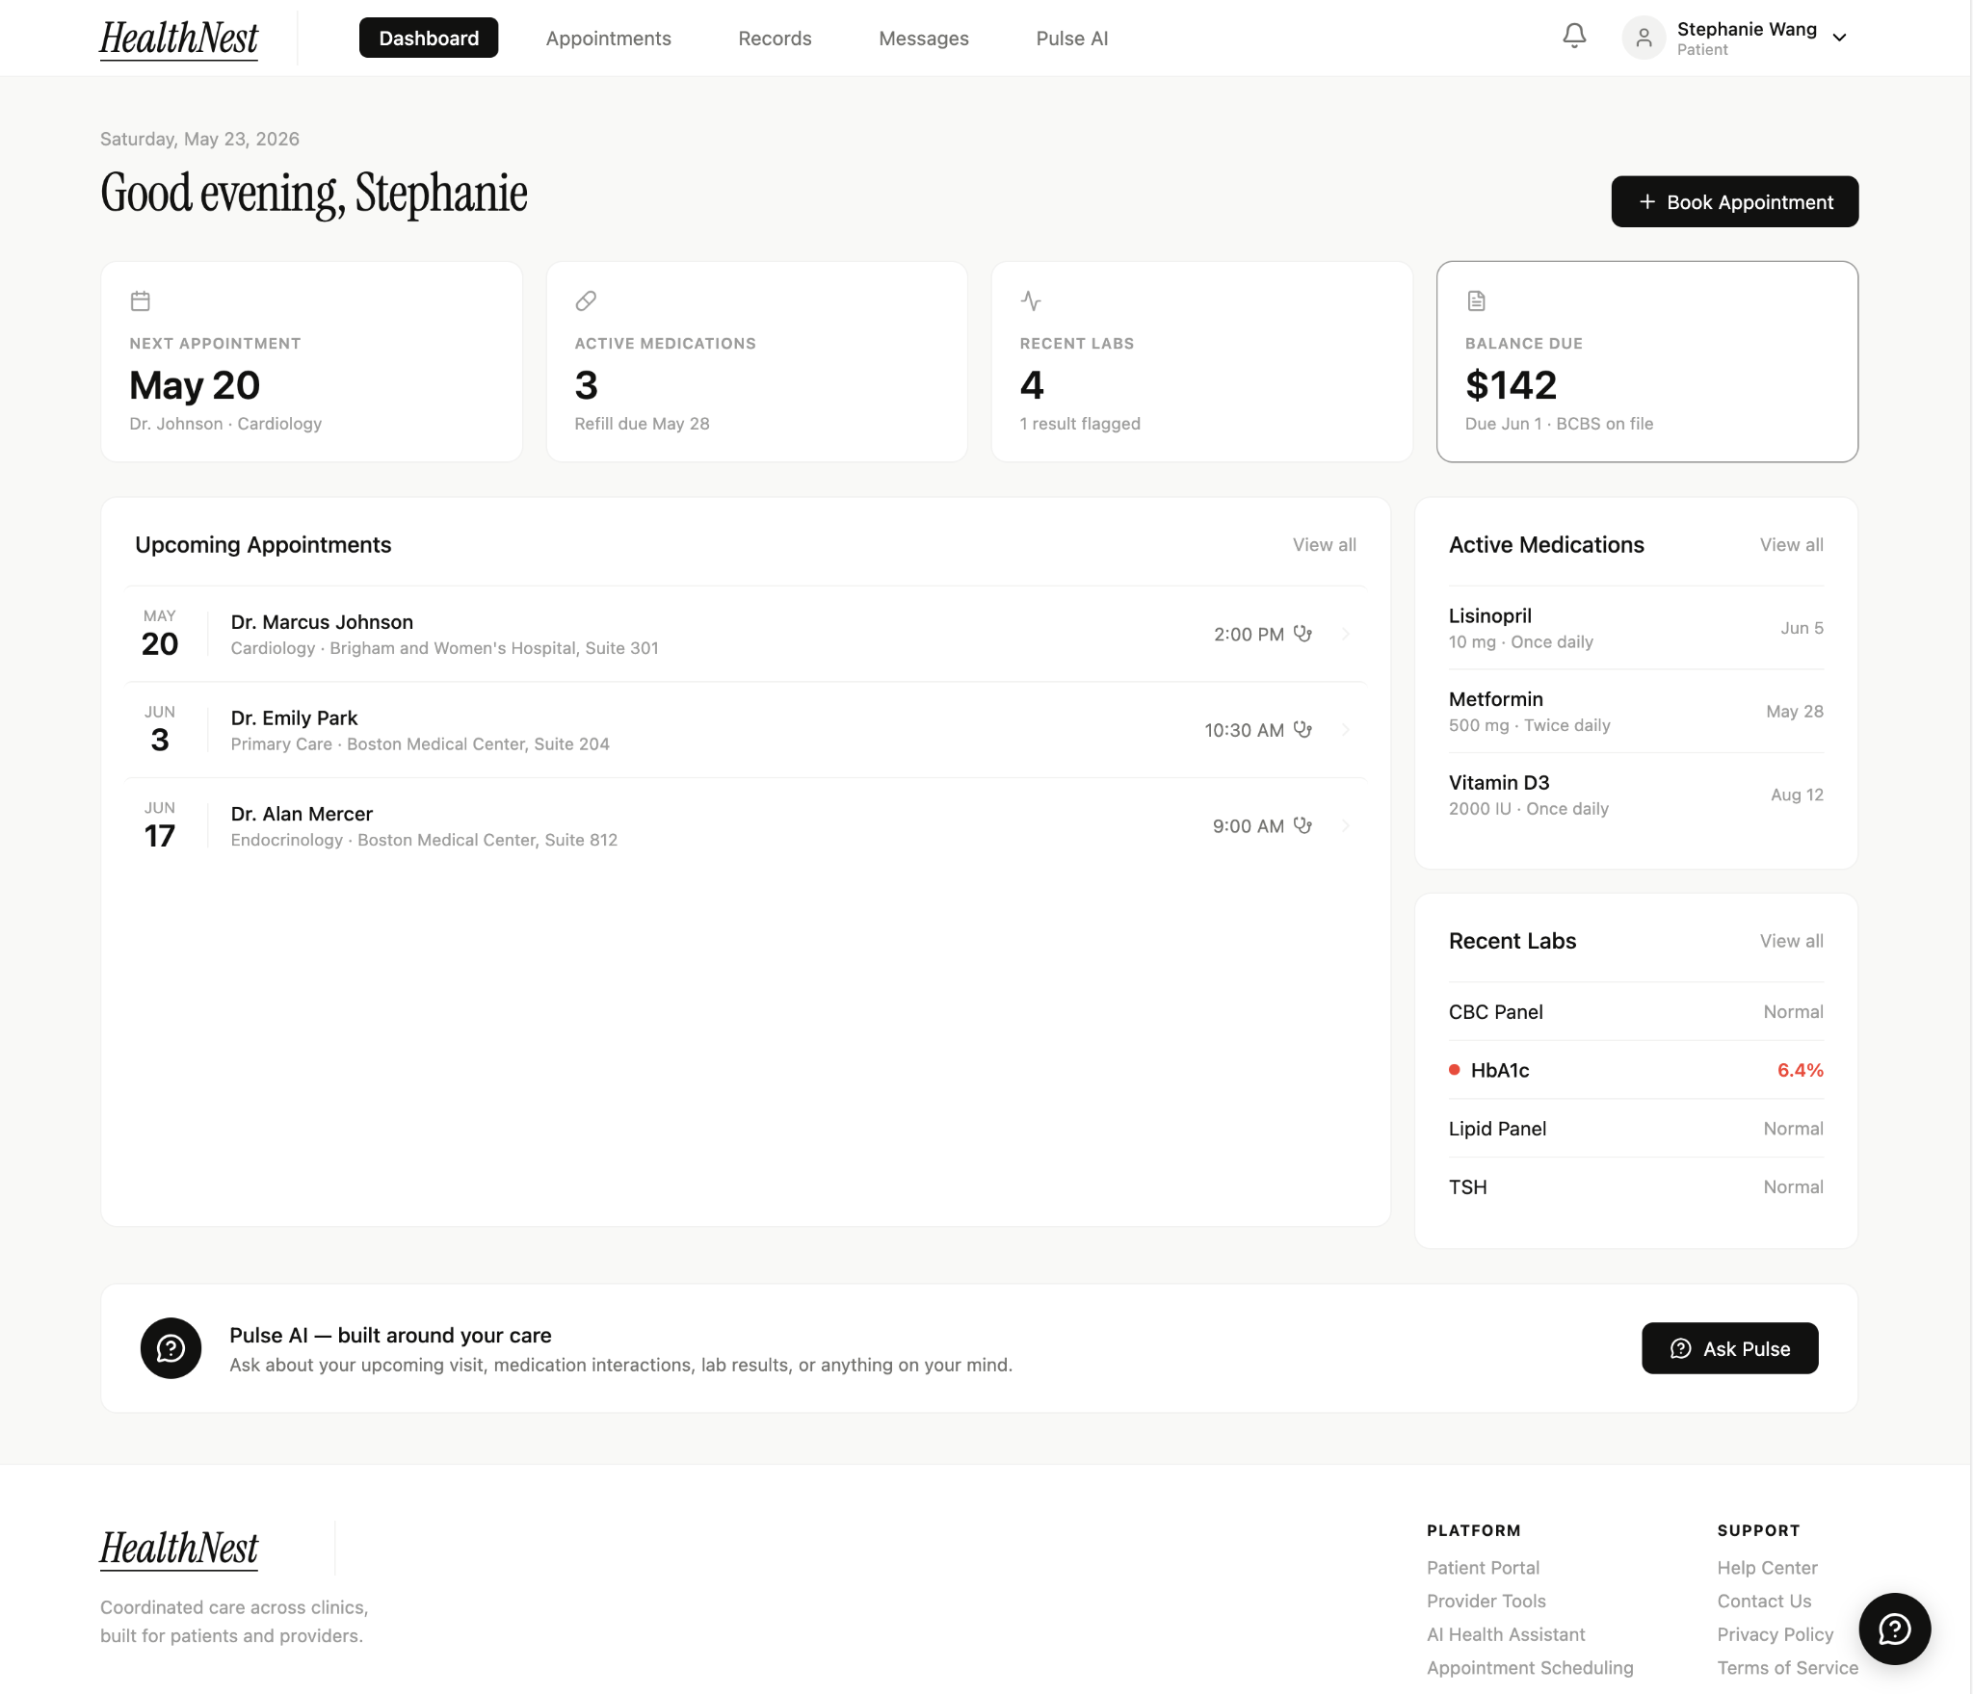
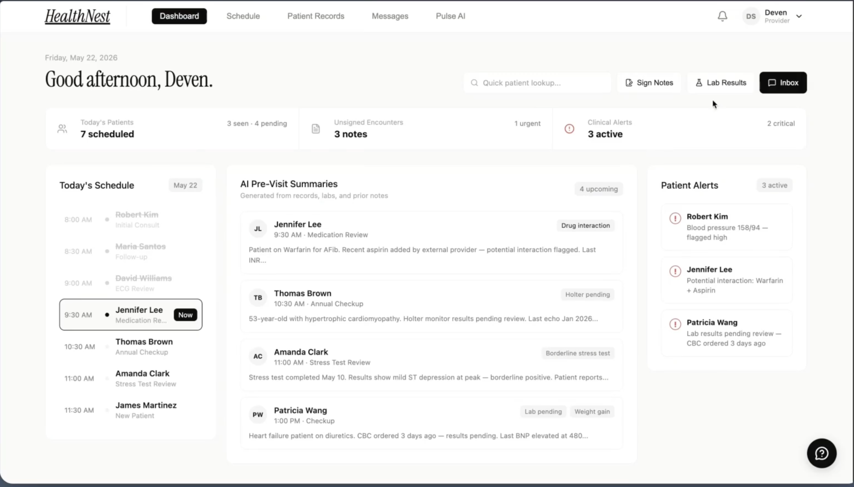
Two user experiences:
Patient-Facing
Provider-Facing

Slide 5
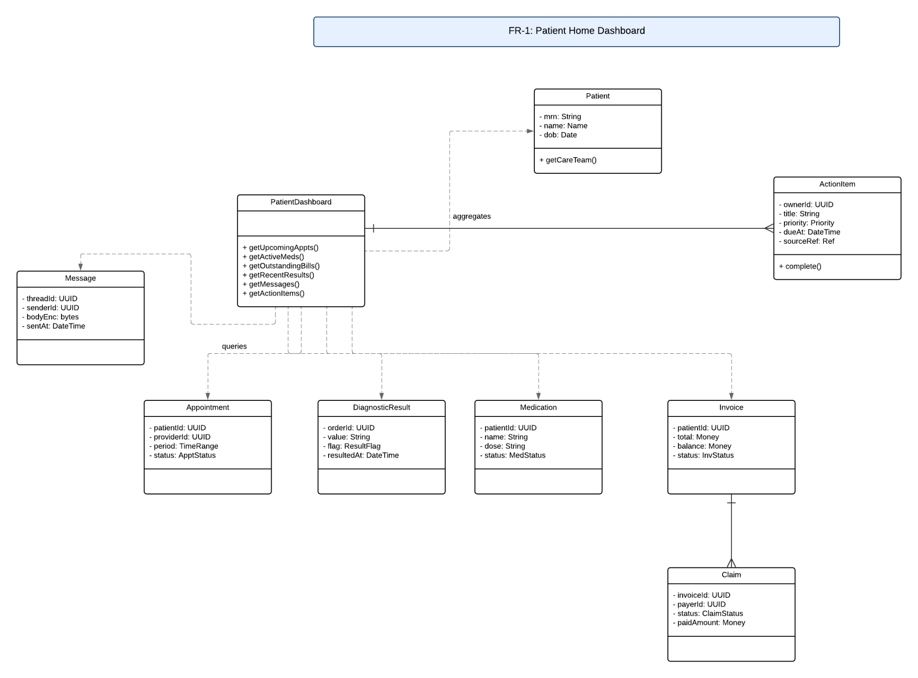
Patient Dashboard Design
The SDD defines the patient dashboard as a central home view for managing care. It connects appointments, medications, diagnostic results, messages, invoices, and action items into one patient-facing structure.

Slide 6
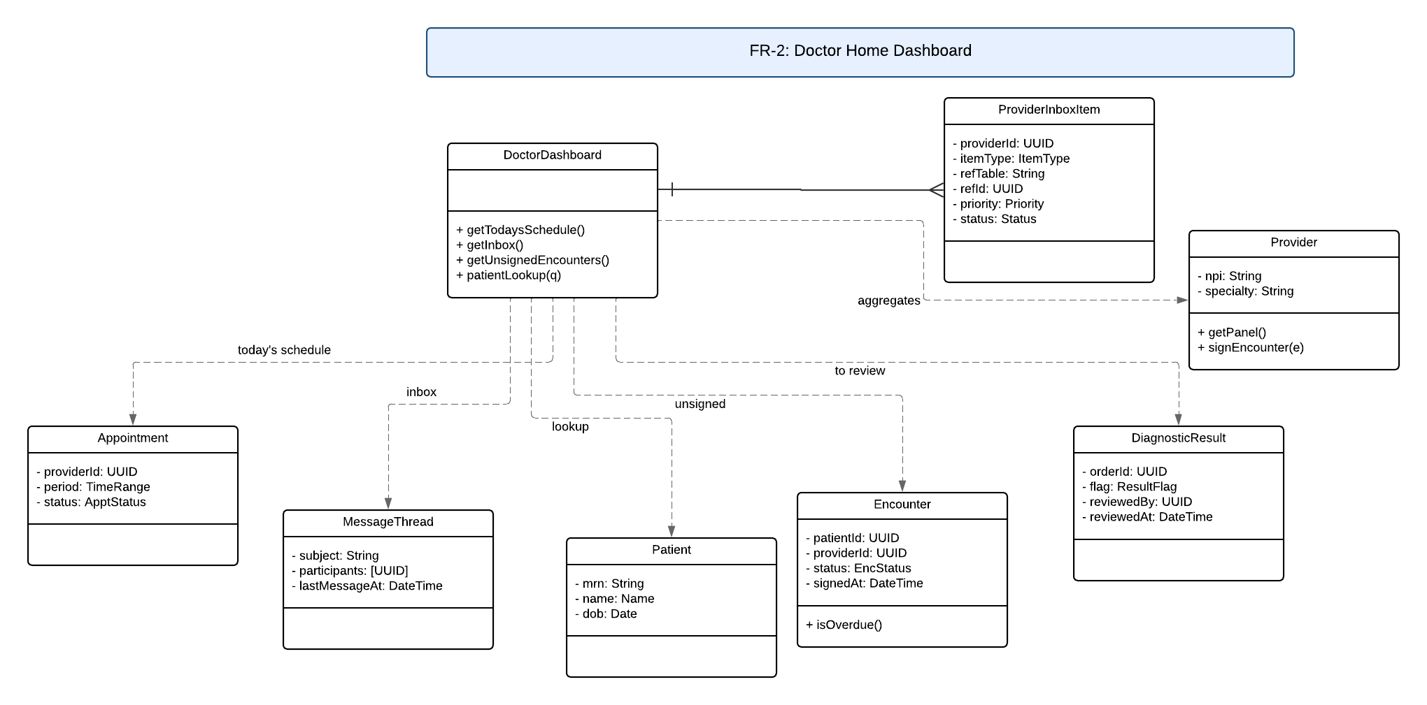
Provider Dashboard Design
The SDD defines the provider dashboard as the doctor’s central workspace. It connects schedule, inbox items, encounters, lab result review, and patient lookup so providers can review clinical tasks from one place.

Slide 7
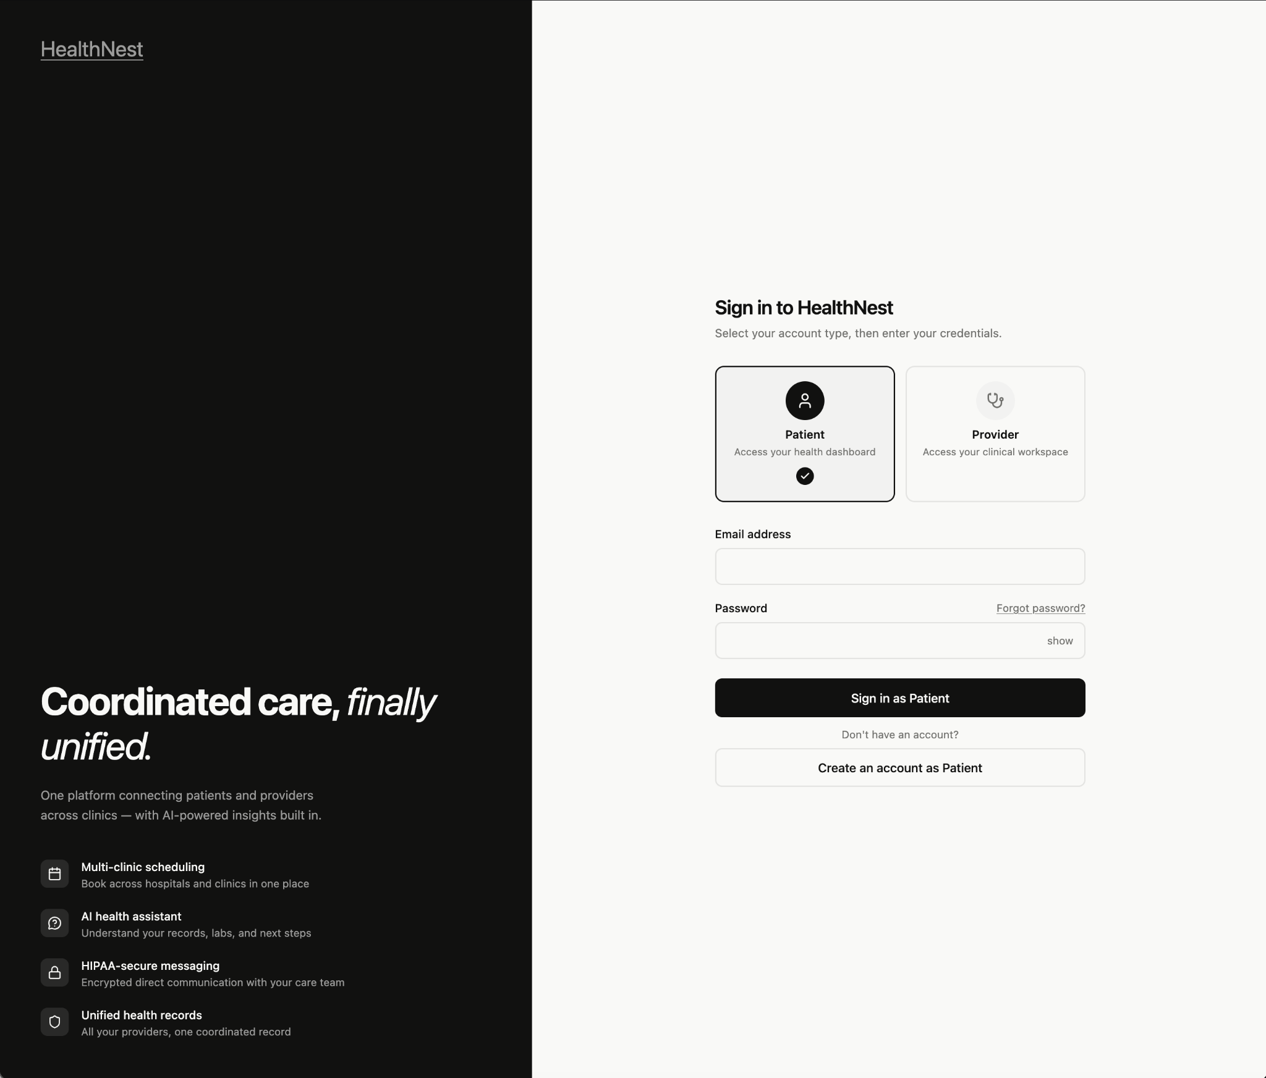
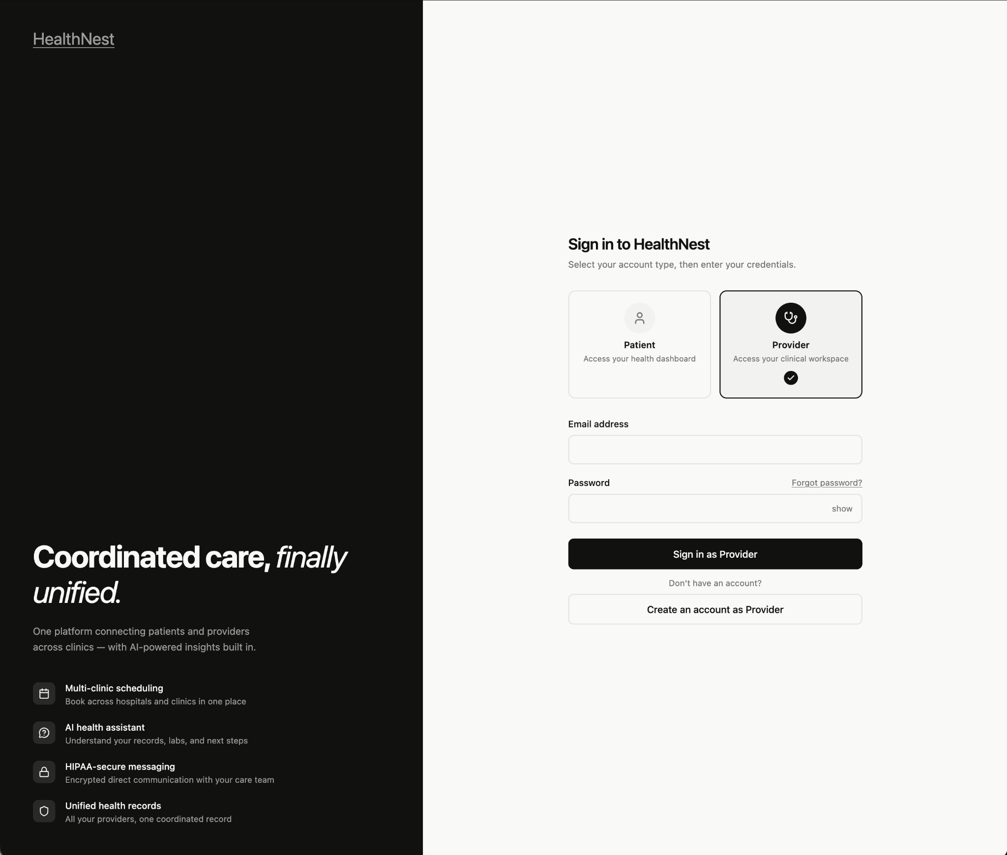
Authentication Flow
Log In / Sign Up
Users can enter the system through the authentication page.
Role Selection
The flow supports different experiences for patient and provider users.
Dashboard Routing
After authentication, the app shows the matching dashboard view.
Backend Connection
Authentication connects the frontend login flow with backend/Supabase services.

Slide 8
CI/CD & Development Process
Validate Jira Key
Every commit must begin with a Jira ticket ID
Iteration 1 Stats
4 PRs merged to main
6 CI/CD checks passing
0 unresolved build failures
Frontend Build & Test
ESLint runs on all .js/.jsx files
Docker Build Check
Full application builds correctly inside Docker
Release Build
Triggered on merge to main

Slide 9
Testing Summary
Testing Coverage
Acceptance / Manual Testing | ✅ Active | 7 test cases for login flow — all passed
System Testing | ✅ Active | Full flow verified locally via Docker sign-up → confirm → sign-in →dashboard → sign-out
CI/CD Regression Safety Net | ✅ Active | ESLint + build check on every PR blocks merges on failure
Unit Testing | 🗒Planned | Planned for Iteration 2 once frontend components stabilize
Integration Testing | 🗒Planned | Authentication flow manually verified broader frontend↔backend integration planned for Iteration 2

Slide 10
Sprint Backlog – Iteration 1
✅ Completed for Iteration 1 Scope
🗒In Progress
SCRUM-7
User Login
Sign-up, sign-in, sign-out — both roles
SCRUM-5
Appointment Scheduler
SCRUM-56
Biometric Authentication
SCRUM-59
Patient Dashboard
Frontend complete with mock data.
SCRUM-53
Role Based Access Control
SCRUM-26
Doctor Dashboard
Frontend complete with mock data.
SCRUM-54
Secure Messaging
SCRUM-61
Lab Result
Backend support added.

Slide 11

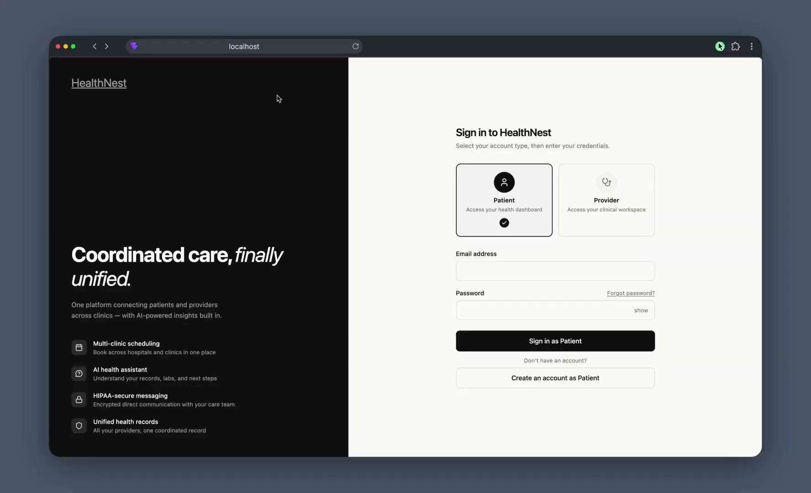
Demo Overview
Patient Dashboard
Lab Uploading & Results

Slide 12
Demo Overview
Appointment Scheduler

Slide 13
What’s Next – Iteration 2
Data Integration
Move dashboards from mock data toward backend-driven content
Testing Coverage
Expand beyond manual login and local Docker testing
Add unit and integration tests in Iteration 2
Feature Depth
Continue lab results, secure messaging, and appointment scheduling workflows
Strengthen role-based access control for patient/provider permissions

Slide 14
Thank you!

