Slide 1

Restaurant Review Website
Team 1 FINAL ITERATION
MENUMATCH
Notes:
Hello everyone, good afternoon!
We are Team 1, presenting MenuMatch, your new go-to restaurant review website. We aim to enhance your dining experience by providing easy access to comprehensive and honest reviews. Thank you for your attention, and we hope you enjoy discovering what MenuMatch has to offer!

Slide 2
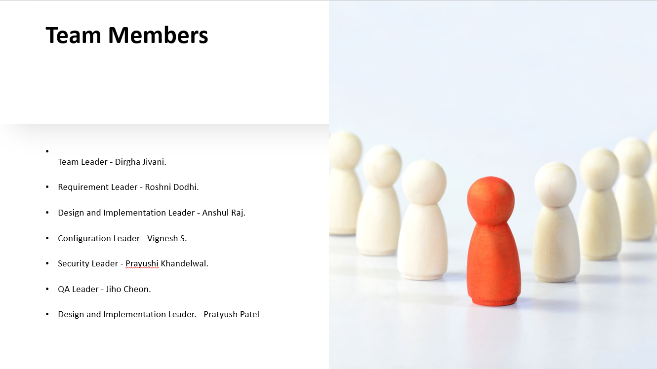

Slide 3
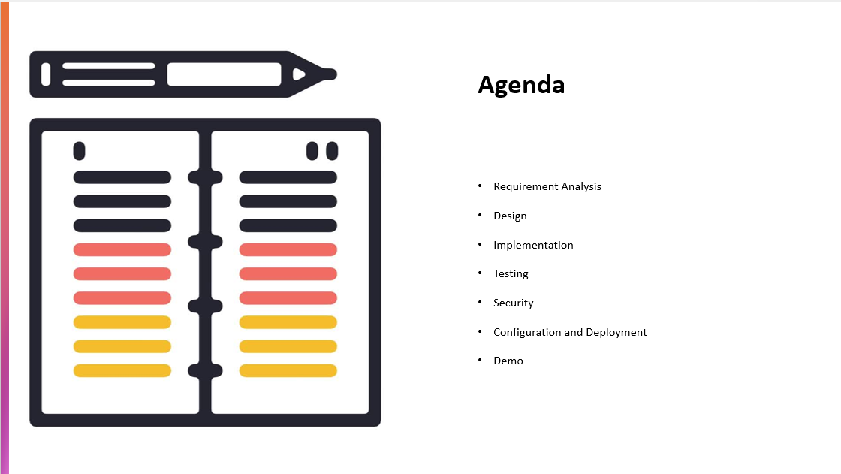
Notes:
Let's take a look at our agenda for today’s presentation. We will start with the Requirement Analysis, where we detail how we gathered and defined the needs for MenuMatch. Next, we'll discuss the Design phase, outlining the architectural and user interface designs.
Following that, we'll move into the Implementation section, where we'll talk about how our development process brought the design to life. After implementation, we'll cover the Testing phase to demonstrate the methods and results of our rigorous quality assurance practices.
We'll then delve into the Security measures we've implemented to protect both user data and our service. This is followed by Configuration and Deployment, where we'll explain how we've set up and launched MenuMatch for public use.
Lastly, we’ll wrap up with a Demo of MenuMatch, showcasing the real-time functionality of our platform.

Slide 4
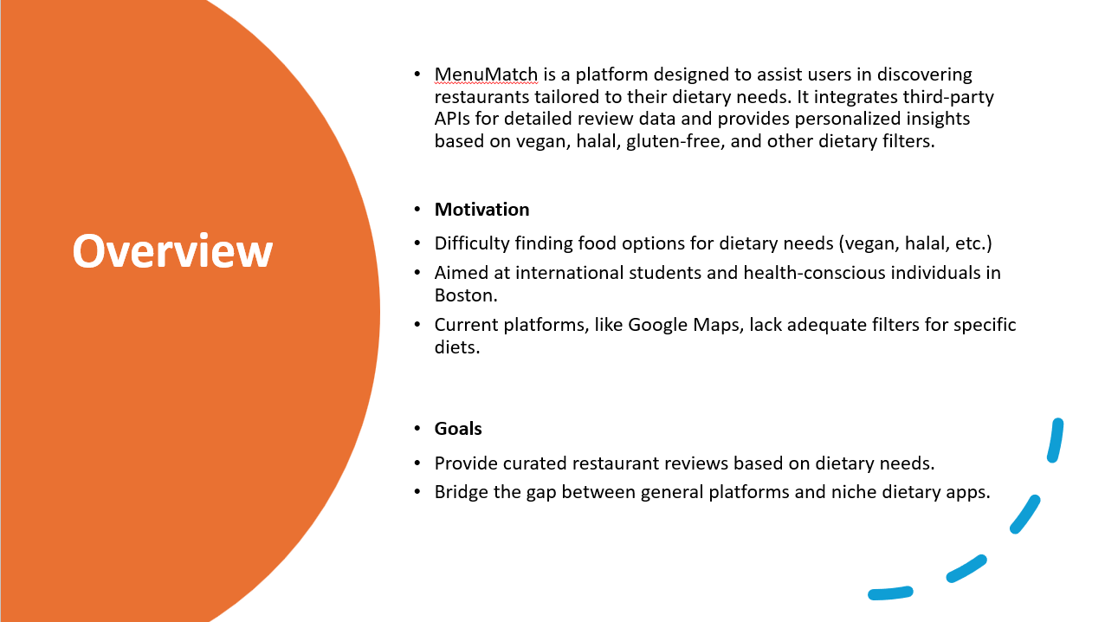
Notes:
Welcome to an overview of MenuMatch, a platform tailored for finding restaurants that cater to specific dietary needs like vegan, halal, and gluten-free options. Our motivation stems from the challenge many face, especially international students and health-conscious individuals in Boston, in locating suitable dining options. Existing services like Google Maps lack the necessary dietary filters.
Goals: MenuMatch aims to fill this gap by providing personalized, curated restaurant reviews based on dietary preferences, bridging the gap between generic platforms and specialized dietary needs.

Slide 5
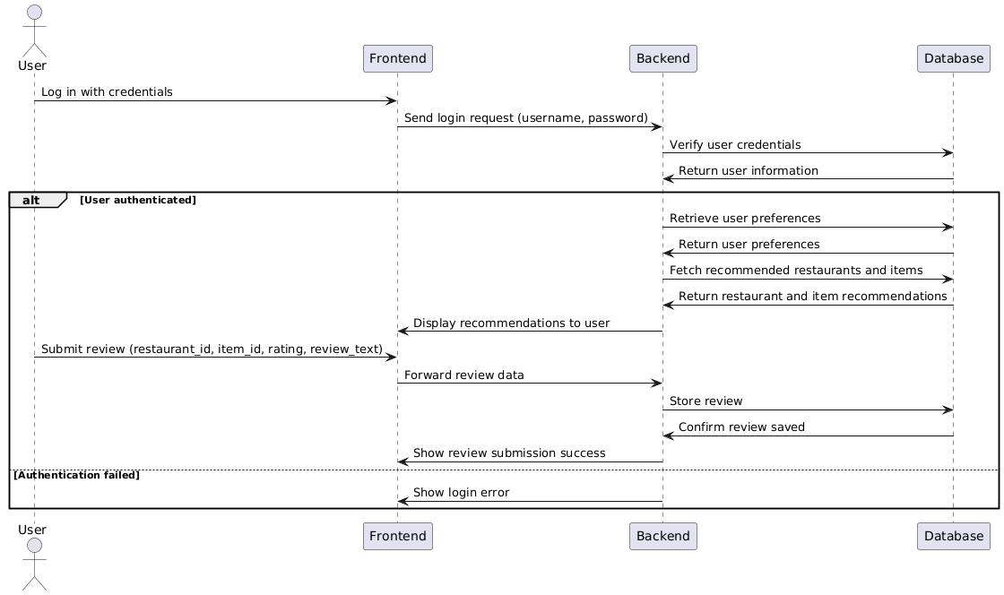
Functional Requirements
Functional Requirements
Overview:
Users can filter restaurants by dietary preferences (e.g., vegan, halal, gluten-free).
User authentication and authorization using Auth0/Okta.
Review and rating system for menu items and restaurants.
Sequence Diagram:
Captures how interactions work between users and the system, including:
Registering and logging in.
Browsing restaurants and filtering by diet.
Submitting reviews and ratings.
Notes:
In this section, we'll delve into the functional requirements that define what MenuMatch must do to serve our users effectively.
Overview:
Dietary Filters: Users can seamlessly filter restaurants by dietary preferences, such as vegan, halal, or gluten-free, making it easy to find meals that meet their needs.
Authentication and Authorization: We ensure secure access by using robust platforms like Auth0 or Okta for user authentication and authorization.
Review and Rating System: Our platform allows users to post reviews and rate menu items and restaurants, providing valuable feedback and insights to the community.
Sequence Diagram: Next, we’ll look at the sequence diagram which outlines the user-system interaction:
User Registration and Login: This is where users start their journey with us, registering and logging into our system.
Browsing and Filtering: Users can browse restaurants and apply filters based on their dietary restrictions.
Submitting Reviews and Ratings: After dining, users can submit reviews and rate their experience to assist other diners.

Slide 6
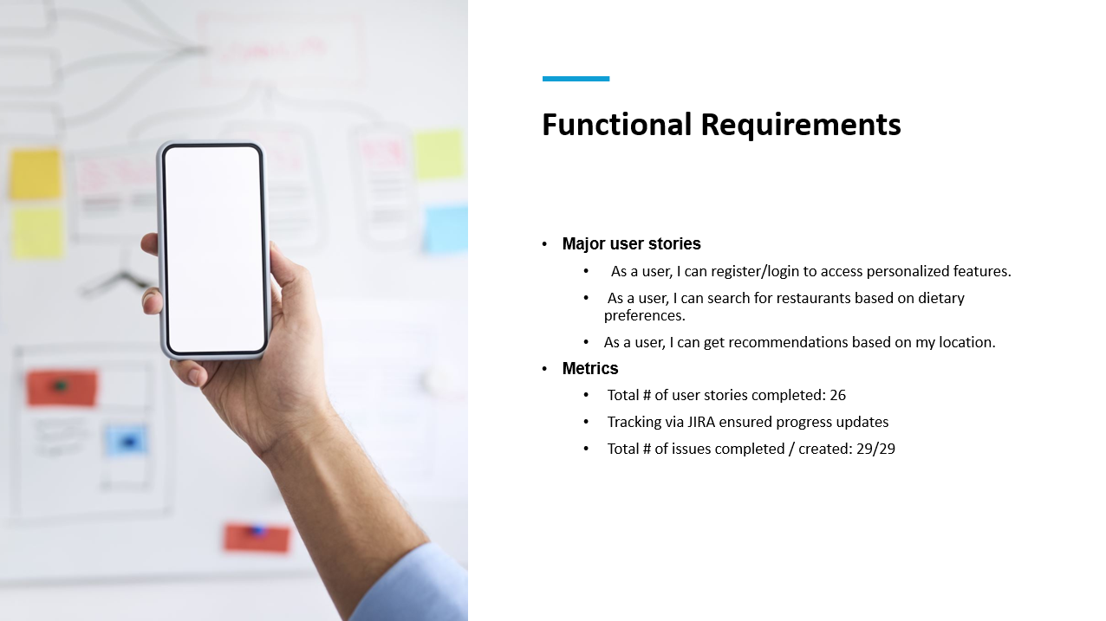
Notes:
Let's explore the functional requirements of MenuMatch through our major user stories, which outline the key functionalities our platform offers to enhance user experience.
Major User Stories:
User Registration/Login: Users can register and log in to access personalized features, ensuring a tailored experience on our platform.
Search by Dietary Preferences: Users have the ability to search for restaurants that cater specifically to their dietary needs, such as vegan, gluten-free, or halal.
Location-Based Recommendations: Users can receive restaurant recommendations based on their current location, making it easier to find suitable dining options nearby.
Metrics:
We have completed a total of 26 user stories, reflecting our team’s commitment to delivering a comprehensive user experience.
Progress has been meticulously tracked via JIRA, allowing us to stay updated and agile in our development process.
We successfully addressed all 29 issues raised during development, achieving a completion rate of 100%.

Slide 7
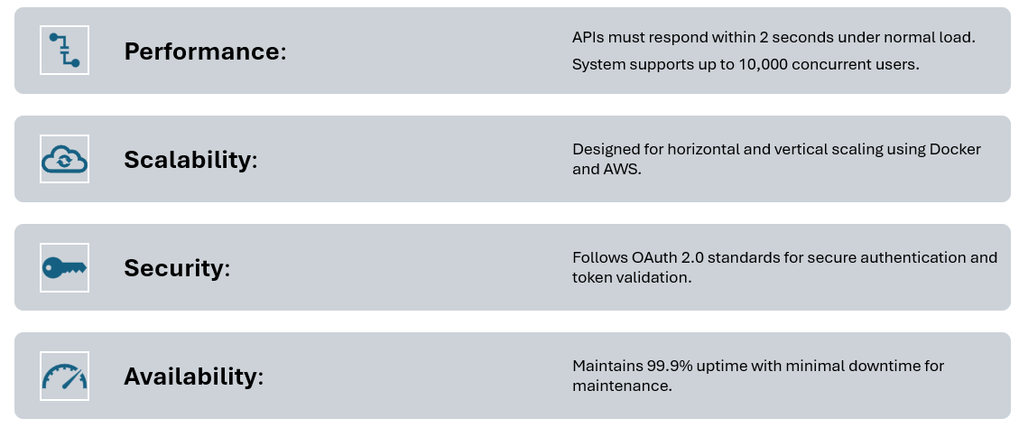
Nonfunctional Requirements
Notes:
Let’s look at the nonfunctional requirements that ensure MenuMatch is fast, scalable, secure, and always available:
Performance:
APIs respond within 2 seconds, supporting up to 10,000 concurrent users.
Scalability:
Built with Docker and AWS to facilitate easy scaling.
Security:
Implements OAuth 2.0 for secure authentication and token validation.
Availability:
Aims for 99.9% uptime, minimizing downtime even during maintenance.

Slide 8
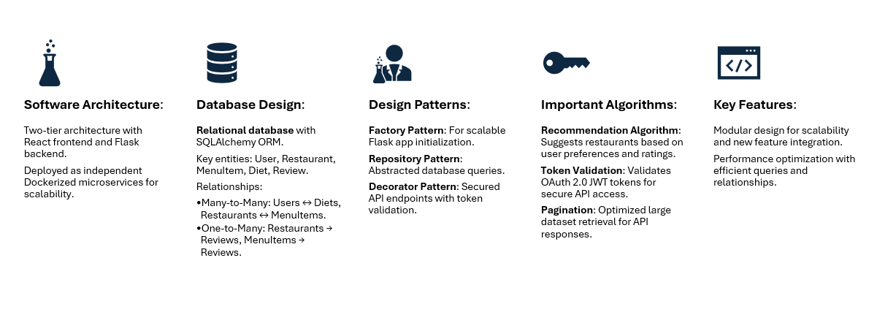
Design
Notes:
Software Architecture
Two-Tier Architecture:
The application follows a two-tier architecture, ensuring separation of concerns:
Frontend: Built using React to provide a highly responsive and interactive user interface. It communicates with the backend through RESTful APIs.
Backend: Implemented using Flask, which handles all the business logic and API endpoints, acting as the bridge between the frontend and the database.
Microservice Approach:
The system adopts a microservice model, where the frontend and backend are containerized using Docker.
This setup allows:
Scalability: Independent scaling of frontend and backend services based on load.
Independence: Easy maintenance and deployment of individual components.
Database Design
Relational Database:
The database is structured using SQLAlchemy ORM for efficient and flexible data manipulation.
Key Entities:
User: Stores user profiles and authentication data.
Restaurant: Tracks restaurant details, including attributes and dietary options.
MenuItem: Links individual food items to restaurants and dietary preferences.
Diet: Represents dietary restrictions, such as vegan or halal.
Review: Manages user reviews and ratings for both restaurants and menu items.
Relationships:
Many-to-Many:
Between users and diets through UserPreference.
Between restaurants and menu items.
One-to-Many:
Restaurants to their reviews.
Menu items to their reviews.
Classes
Key Backend Classes:
User: Handles user information, including authentication and preferences.
Restaurant: Manages restaurant details like name, location, and attributes.
Review: Stores user feedback and ratings, linking them to restaurants and menu items.
MenuItem: Tracks individual menu items and their association with dietary preferences.
Diet: Represents dietary restrictions or preferences.
Design Patterns
Factory Pattern:
Used in Flask's application factory, enabling scalable and modular initialization of the application.
Repository Pattern:
Abstracts database operations, allowing clear separation of data access and business logic.
Decorator Pattern:
Ensures API endpoint security by validating tokens, using decorators for authentication checks.
Important Algorithms
Recommendation Algorithm:
Suggests restaurants based on:
Dietary preferences.
User reviews and ratings.
Uses a weighted average to prioritize restaurants that best match user needs.
Token Validation:
Ensures secure authentication with OAuth 2.0, leveraging JWT tokens.
Tokens are decoded and validated using services like Auth0 or Okta.
Pagination:
Efficiently retrieves large datasets (e.g., restaurants, reviews), reducing response times by serving data in chunks.
Key Features
Scalability:
The modular design supports future enhancements, such as advanced search filters or enhanced recommendation systems.
Performance:
Optimized database queries and well-structured relationships ensure efficient data retrieval and minimal latency.

Slide 9
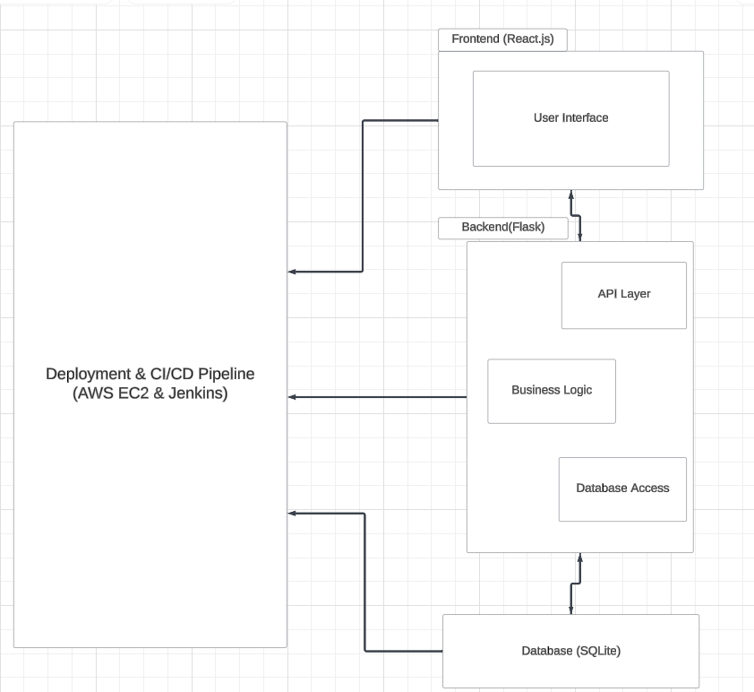
Software Architecture
Frontend (React Framework): This component is responsible for all user interactions, including searching for restaurants and submitting reviews.
Backend (python): Handles API requests, authentication, and database operations.
Database (SQLite): Stores structured data including user profiles, restaurant details, reviews, and dietary preferences.
CI/CD Pipeline (Jenkins): Automates the development, testing, and deployment processes.
Deployment (AWS): The platform is deployed on AWS EC2 to ensure reliability and scalability.
Notes:
Frontend (React Framework):
The frontend is built using the React framework, which offers a responsive and interactive user experience.
Key responsibilities:
Allows users to search for restaurants based on criteria such as location, ratings, or dietary preferences.
Provides forms for users to submit reviews, including ratings and comments.
Ensures a seamless flow between pages and components, creating a modern user interface.
Backend (Python):
The backend is developed using Python, enabling robust API handling and logic processing.
Core functionalities include:
Handling API requests from the frontend.
Managing authentication for secure user logins and data access.
Performing database operations, such as fetching restaurant details, storing user-submitted reviews, and updating dietary preferences.
Database (SQLite):
SQLite is used for storing structured data.
Key types of data stored include:
User profiles (e.g., name, email, preferences).
Restaurant details, such as name, location, ratings, and dietary options.
Reviews, capturing user feedback.
Dietary preferences, enabling personalized recommendations.
CI/CD Pipeline (Jenkins):
The development pipeline is powered by Jenkins, which automates key workflows.
Jenkins is set up to:
Run automated tests after every code commit.
Deploy the latest stable builds, ensuring continuous integration and delivery.
Reduce manual errors and improve deployment efficiency.
Deployment (AWS):
The entire platform is deployed on AWS EC2 to guarantee reliability and scalability.
AWS EC2 provides:
High availability for handling user traffic.
The flexibility to scale resources up or down based on demand.
Integration with other AWS services, like storage and security, to enhance platform robustness.
Closing Note: This architecture ensures a seamless, secure, and scalable user experience, leveraging modern frameworks and cloud technologies to support both user interactions and business needs efficiently.

Slide 10
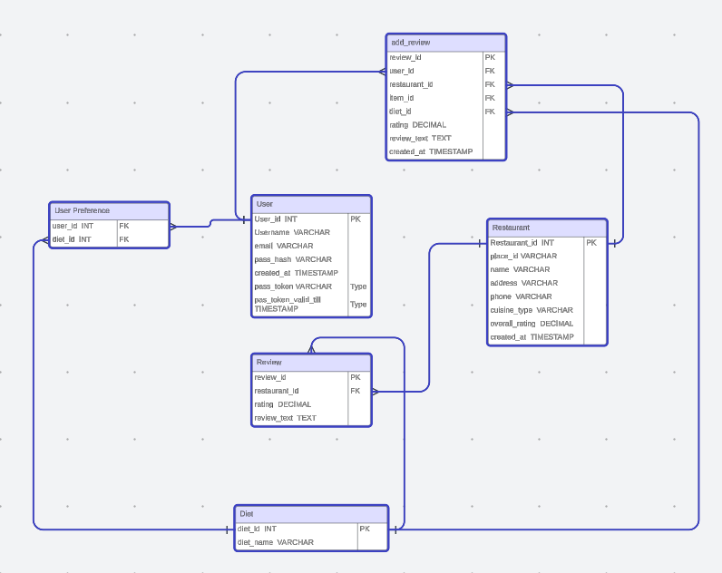
Database Design
The database is designed using SQLite, organizing data into relational tables for users, restaurants, reviews, and menu items. Foreign key constraints maintain relationships between tables, ensuring consistency and organization, such as linking reviews to users and menu items to restaurants.
Sensitive data, like user credentials, are encrypted to ensure privacy and prevent unauthorized access. This approach, combined with the relational design, ensures both data security and integrity while allowing the system to scale efficiently.

Slide 11
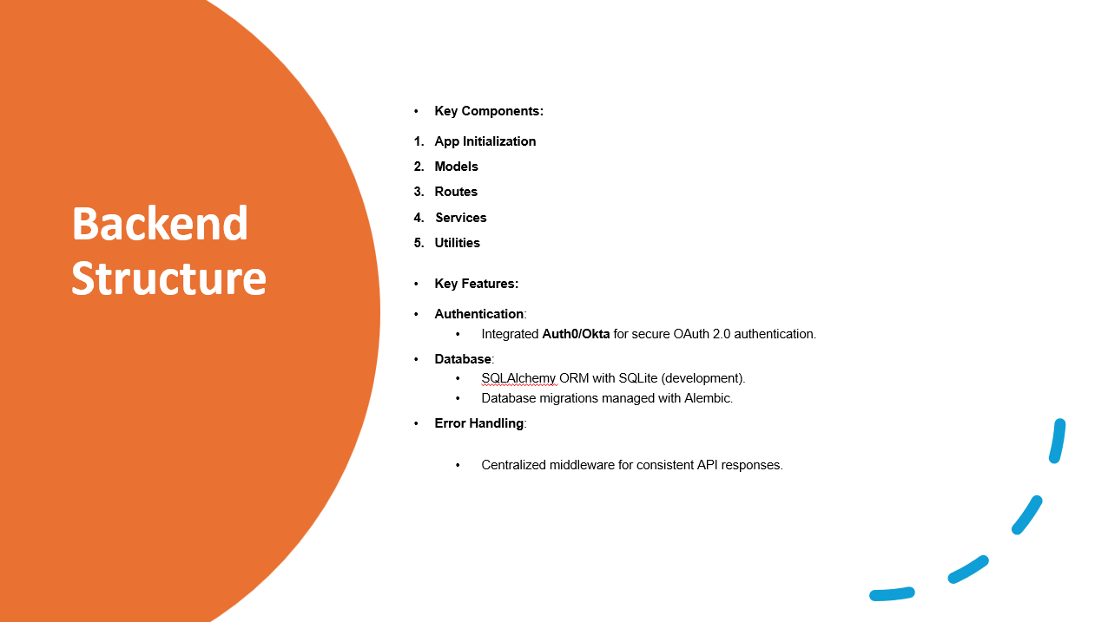
Implementation
Notes:
Overview
The backend for MenuMatch is implemented using Flask, following the Model-View-Controller (MVC) architecture for modularity and maintainability. It provides RESTful APIs to serve the frontend and handles user authentication, data storage, and business logic.
Directory Structure
server/
├── app/
│ ├── __init__.py # App factory and initialization
│ ├── models.py # Database models (SQLAlchemy ORM)
│ ├── routes.py # API endpoints
│ ├── services/ # Business logic and reusable functions
│ │ ├── user_service.py # User-related logic
│ │ ├── review_service.py # Review-related logic
│ └── utils/ # Helper functions (e.g., token validation)
├── migrations/ # Database migration scripts
├── tests/ # Unit and integration tests
├── requirements.txt # Python dependencies
└── run.py
Key Components
App Initialization (__init__.py):
Configures Flask, SQLAlchemy, and external services like Auth0/Okta.
Implements the application factory pattern for scalability.
Models (models.py):
Defines database tables using SQLAlchemy ORM.
Relationships include users, restaurants, reviews, diets, and menu items.
Routes (routes.py):
Implements RESTful API endpoints (e.g., /reviews, /restaurants, /users).
Uses Flask-RESTful for route organization.
Services (services/):
Contains reusable business logic (e.g., user authentication, review validation).
Decouples application logic from the routes for better testability.
Utilities (utils/):
Helper functions like token validation, input sanitization, and error handling.
Key Features
Authentication:
Integrated with Auth0/Okta for secure OAuth 2.0-based user authentication.
Validates tokens in protected endpoints.
Database:
SQLAlchemy ORM with SQLite (development) and PostgreSQL (production).
Used Alembic for database migrations.
Error Handling:
Centralized error-handling middleware for consistent API responses.

Slide 12
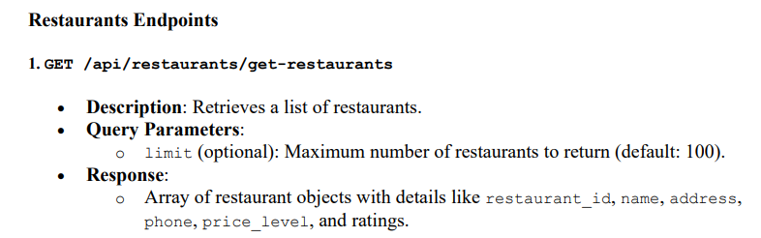
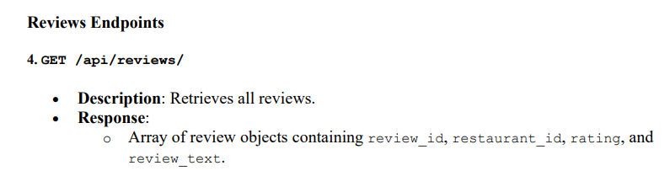
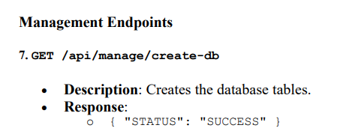
API Endpoints

Slide 13
Configuration and Deployment
CI/CD Pipeline
Dockerized containers for consistent environments.
Jenkins pipeline automates testing and deployment.
AWS for scalable hosting.
Tools for configuration
GitHub for version control and collaboration.
Docker for containerization.
Jenkins for continuous integration and deployment.

Slide 14
Workflow & Process Overview
Development Process
Code Development: Developers commit code to the GitHub repository regularly.
Code Review: Peer review process ensures high-quality code before merging.
Branching Strategy: Use feature branches, and pull requests to integrate with the main branch.
Continuous Integration
GitHub Integration: Every commit triggers Jenkins to pull code from GitHub.
Automated Testing: Jenkins runs unit tests and code linting tools to ensure code quality and functionality.
Continuous Deployment
Dockerized Environment: The code is packaged into Docker containers to ensure consistency across environments.
Deployment Pipeline: Jenkins automatically deploys the Docker containers to AWS for scalable hosting.
Rollback Capability: In case of failure, Jenkins ensures the rollback to the previous stable version.
Monitoring and Maintenance
AWS Monitoring: Monitor the application’s performance and scalability.
Error Logging: Track errors and deploy hotfixes when necessary.

Slide 15
Workflow & Process Overview Cont’d
CI/CD Pipeline Configuration
Set up and configured Docker containers for consistent development and production environments. Implemented a Jenkins pipeline to automate build, test, and deployment processes, ensuring efficient and continuous integration. Configured AWS hosting (EC2, S3) for scalable and reliable application deployment.
Frontend Development
Pair Programing with Team members Vignesh, Pratyush and Dirgha we developed the search bar for restaurant filtering, implementing state management and real-time updates. Integrated maps for displaying restaurant locations, ensuring smooth user interaction. Used React to build dynamic components and Tailwind CSS for responsive and quick styling of UI elements.
Automation & Monitoring
Automated testing and deployment using Jenkins, improving the workflow by reducing manual interventions. Ensured high availability and scalability with AWS cloud infrastructure.

Slide 16
Front End Design
Frontend Framework: React
Purpose: React provides a responsive and component-based structure that perfectly aligns with the dynamic needs of the MenuMatch project, such as real-time restaurant searches and filtering. Its modular design ensures scalability and maintainability as the application evolves.
Key Features using Reactjs:
Reusable Components:
Search Bar: A flexible and reusable component for input fields and dropdowns to filter restaurants by dietary preferences or cuisine type.
Restaurant Cards: Modular components to display key restaurant details like name, cuisine, ratings, and location.
State Management:
Local State: To manage UI elements like toggles, search inputs, or filters seamlessly.
Global State: Leveraging tools like Redux or React Context API to handle data fetched from Google APIs and manage user authentication consistently across the app.
Efficient DOM Updates:
Ensures a smooth user experience with optimized rendering, even during frequent updates like search results or filtering changes.
Notes:
For the frontend framework we have used react, Its ability to create dynamic, responsive applications aligns perfectly with the real-time features we aim to deliver, such as restaurant searches and filtering. Additionally, React's modular structure ensures our application remains scalable and easy to maintain as it evolves.
Key Features using react:
Reusable Components:
Search Bar: Handles user inputs and dropdowns for filtering by cuisine or preferences.
Restaurant Cards: Displays restaurant details like name, cuisine, ratings, and location.
State Management:
Local State: Manages UI elements.
For Global State: Tools like Redux or Context API manage user authentication and Google API data.
Efficient DOM Updates:
React’s virtual document object model ensures smooth performance during frequent updates, such as search and filter changes.

Slide 17
Styling Framework: Tailwind CSS
Purpose: Tailwind CSS facilitates rapid UI development with pre-designed utility classes, ensuring a clean and cohesive design that complements the food discovery theme of MenuMatch.
Project-Specific Benefits:
Quick Customization: Enables rapid adjustments to create a polished and user-friendly interface tailored to the platform's requirements.
Consistent Design: Ensures uniformity across all components, maintaining a professional look and feel.
Efficiency: Reduces the need to write custom CSS from scratch, speeding up development without compromising flexibility.
Routing: React Router DOM
Purpose: React Router DOM enables smooth client-side navigation, maintaining the flow of a single-page application (SPA). It allows users to switch between different pages without refreshing the entire app, ensuring a seamless experience.
Project-Specific Benefits:
Intuitive Navigation: Facilitates smooth transitions between key pages such as Home, About, Map (for restaurant locations), and Login/Signup, enhancing the user experience.
Route-Based Code Splitting: Optimizes performance by loading only the components necessary for the current page, reducing load times and improving responsiveness.
Notes:
We used Tailwind CSS a styling framework that accelerates UI development with utility classes, creating a cohesive design that aligns with MenuMatch’s food discovery theme.
It allows for quick customization to craft a polished and user-friendly interface. And
Ensures consistent design across components, maintaining a professional appearance.
Next we have used, React Router Document object model that powers seamless navigation within our single-page application, enabling users to switch pages without full reloads.
It Enhances user experience with intuitive navigation between key pages like Home, Map, and Login/Signup.
Implements route-based code splitting to optimize performance, reducing load times by loading only the required components for each page.

Slide 18
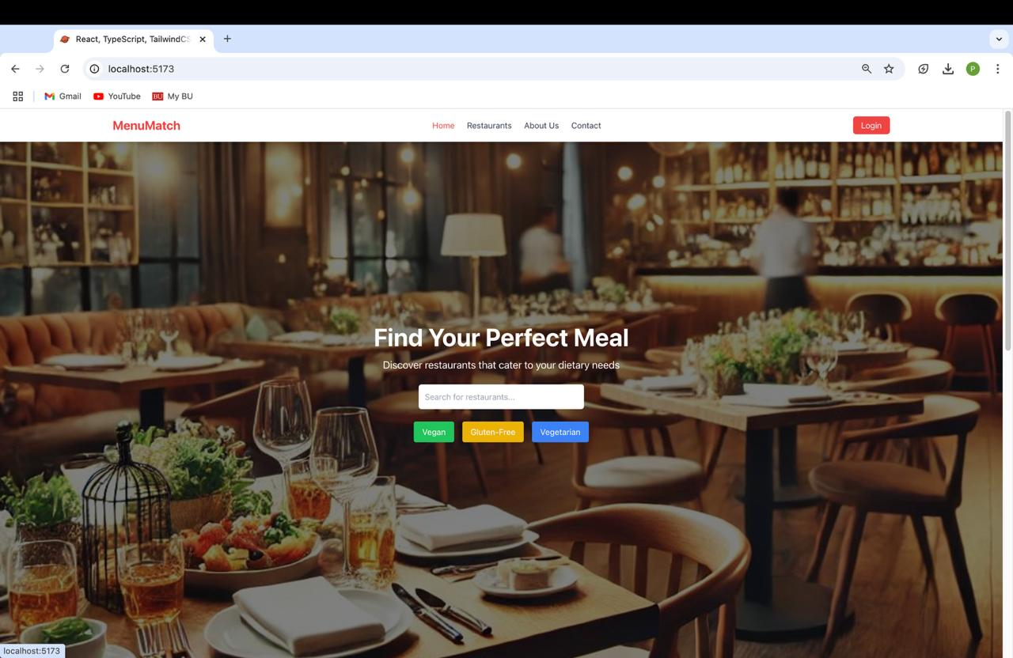
Frontend Features
Search Bar
Developed a dynamic, filterable search bar for users to find restaurants based on food type, dietary preferences, and other criteria.
Implemented real-time filtering and state management to provide an interactive and seamless experience.
Restaurant Cards
Designed reusable restaurant cards to display key information such as name, ratings, cuisine type, and distance.
Integrated conditional rendering to dynamically display restaurant data fetched from the backend.
Notes:
These are the frontend features:
Search Bar:
We created a dynamic, filterable search bar that enables users to easily find restaurants based on specific criteria, like food type and dietary preferences.
It features real-time filtering, ensuring users see immediate results as they adjust filters.
Restaurant Cards:
Reusable restaurant cards were designed to display essential details like name, ratings, cuisine type, and distance.
These cards use conditional rendering, dynamically updating with data fetched from the backend to reflect the most current information.
Maps Integration:
An interactive map was integrated to visually display restaurant locations, making it easier for users to navigate.
Features like zoom and location markers ensure smooth interaction and a user-friendly map experience.

Slide 19
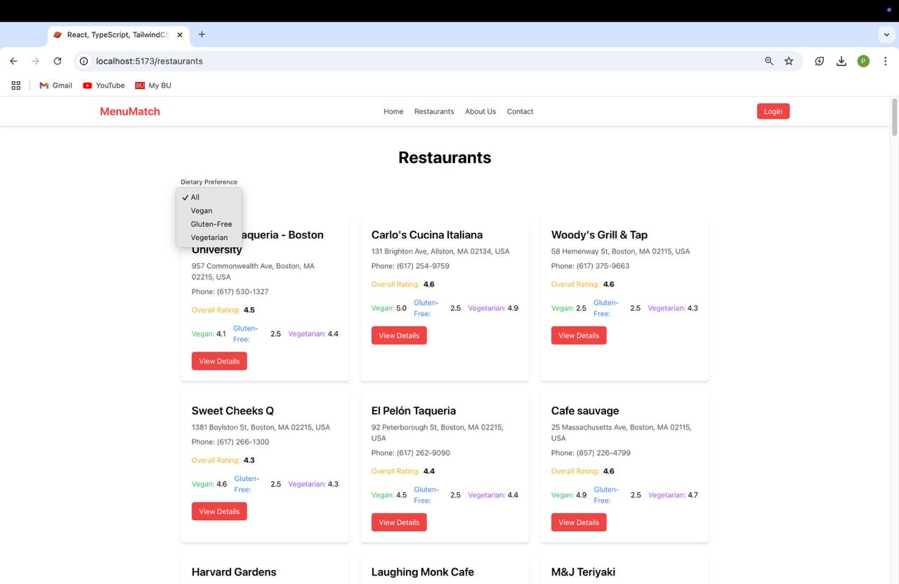
Frontend Features Cont’d

Slide 20
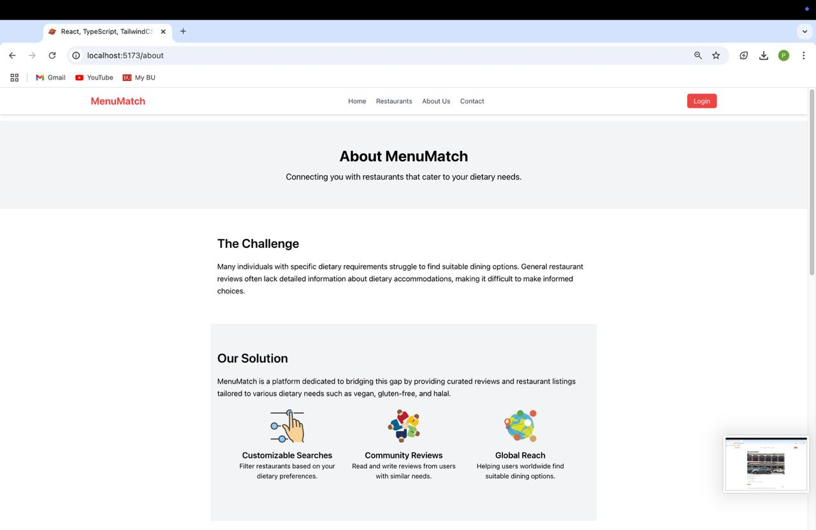
Frontend Features Cont’d
Responsive Design
Used React for dynamic component rendering and Tailwind CSS for responsive, mobile-first design, ensuring the app is accessible across all devices.
Ensured the UI adapts fluidly to various screen sizes, offering an optimal user experience on both mobile and desktop.
State Management
Implemented Reactjs state management to handle user inputs (e.g., search filters) and data fetched from APIs (e.g., restaurant information).
Ensured efficient data flow and real-time updates without page reloads.
Notes:
Responsive Design:
We leveraged React for dynamic component rendering and Tailwind CSS to achieve a mobile-first, responsive design.
This ensures the app adapts seamlessly to various screen sizes, providing an optimal user experience across mobile and desktop devices.
State Management:
React's state management was used to handle user inputs like search filters and data fetched from APIs, such as restaurant details.
This enables real-time updates and ensures smooth data flow without requiring page reloads, enhancing the interactivity of the app.

Slide 21
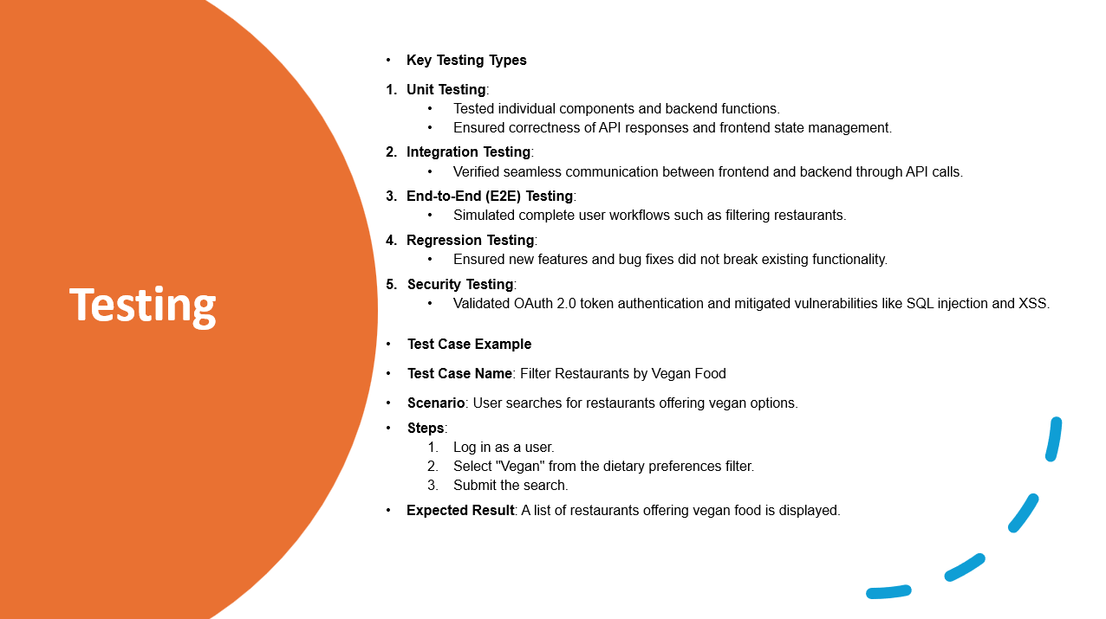
Notes:
This slide outlines our testing strategy, highlighting the key testing types we utilized and an example test case. Testing ensures that our application is functional, reliable, and secure.
We performed unit testing to validate the functionality of individual components, ensuring API responses and frontend state management were correct. Integration testing was used to verify seamless communication between the frontend and backend via API calls. End-to-end testing simulated complete user workflows, such as filtering restaurants, to ensure the system worked as intended from a user’s perspective. We also conducted regression testing to ensure that newly added features or bug fixes did not disrupt existing functionality, and security testing to validate OAuth 2.0 authentication and address vulnerabilities like SQL injection and XSS. A representative test case is 'Filter Restaurants by Vegan Food,' where the user logs in, selects 'Vegan' from the dietary preferences filter, and submits the search. The expected outcome is a list of restaurants offering vegan options, confirming the feature works as intended.
For the metrics, our code coverage for the backend reached 85%, ensuring thorough validation of the codebase. We achieved a test pass rate of 95%, indicating strong stability and reliability. The defect density was measured at 5 defects per 100 lines of code, and we successfully resolved all reported issues, maintaining a defect fix rate of 100%. These metrics reflect a well-tested, stable, and production-ready system
Code Coverage: Backend: 85%
Test Pass Rate: 95%
Defect Density: 5 defects per 100 lines of code
Defect Fix Rate: 100%
Tools Used
Pytest and Postman for various testing needs.

Slide 22
Quality Assurance
Lines of Code (LOC): This metric quantifies the total number of lines in the source code, providing insights into the software's size and complexity. Larger codebases can indicate higher development effort but may also increase maintenance challenges.
Cyclomatic Complexity: Cyclomatic complexity measures the number of independent paths through the code, reflecting its structural complexity. Higher values suggest more intricate logic, potentially increasing the likelihood of defects and the need for thorough testing.
Defect Rate (Defects per KLOC): This metric tracks the number of defects identified per 1,000 lines of code. It serves as a key indicator of software quality, helping to identify areas requiring attention during the development process.
Number of Test Cases: The total number of test cases created ensures comprehensive test coverage of all features and functionalities. It highlights the focus on validating critical paths and reducing the risk of undetected defects in production.
Test Case Pass Rate: The percentage of successfully passed test cases out of the total number provides a measure of the software’s stability and reliability. A higher pass rate indicates fewer issues and a higher degree of readiness for deployment.
Cost (Person-Hours): This metric tracks the total person-hours spent on development and testing activities. It helps evaluate productivity and provides insights into the project's overall cost and resource efficiency.
Notes:
This slide focuses on the key metrics we used to ensure the quality of our software throughout the development process.
"This slide highlights the key metrics we used to ensure software quality. Lines of Code (LOC) measured the size and complexity of the codebase, while Cyclomatic Complexity tracked the number of independent paths in the code to identify areas of higher risk. We monitored the Defect Rate, measuring bugs per 1,000 lines of code, to track software quality throughout development. The Number of Test Cases ensured comprehensive test coverage, and the Test Case Pass Rate measured the stability and reliability of the system. Lastly, we tracked Cost in Person-Hours to evaluate productivity and project efficiency. Together, these metrics helped us deliver a reliable and robust product."

Slide 23
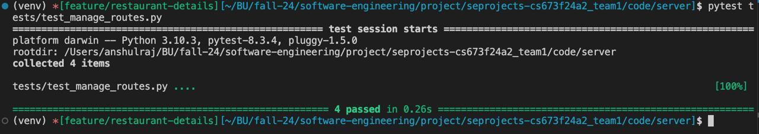
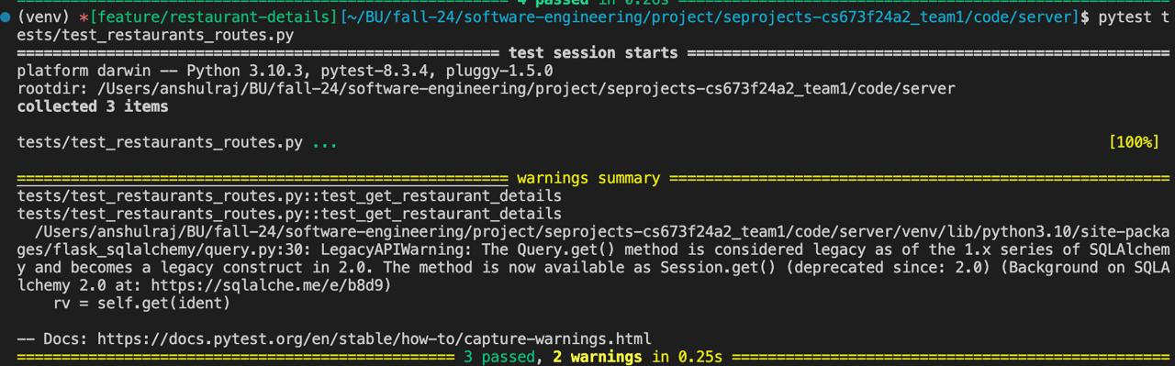

Slide 24
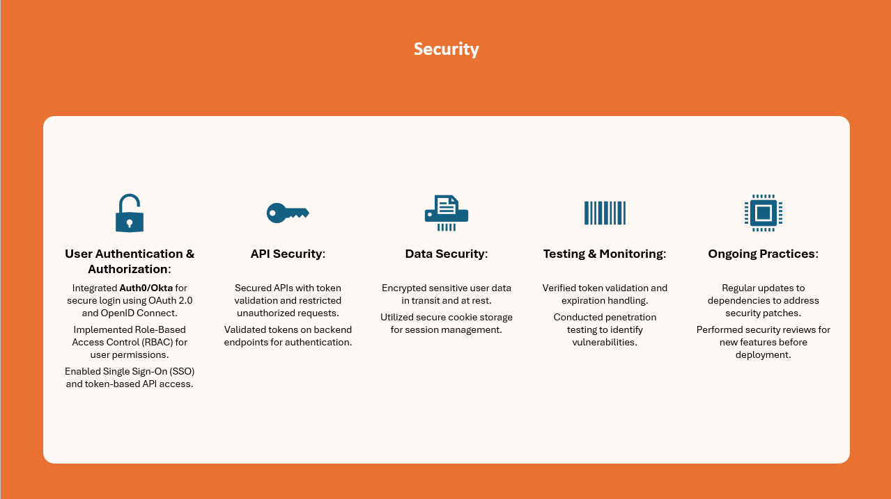
Notes:
During the Implementation Phase
User Authentication & Authorization:
We integrated Auth0/Okta to handle user authentication and authorization.
These platforms leverage OAuth 2.0 and OpenID Connect protocols, ensuring secure and standardized authentication flows.
Single Sign-On (SSO) was enabled for seamless login experiences across platforms.
Implemented Role-Based Access Control (RBAC) in Auth0/Okta to manage permissions based on user roles, such as admins and regular users.
API Security:
Secured all backend APIs using access tokens issued by Auth0/Okta.
Backend endpoints validate these tokens to ensure that only authenticated users can access or modify data.
Data Security:
Encrypted sensitive user data both in transit (via HTTPS) and at rest (using secure database configurations).
Used secure cookie storage to store session information, mitigating risks of session hijacking.
During the Testing Phase
Security Testing:
Verified proper token validation and handling of token expiration to prevent unauthorized access.
Conducted penetration testing to identify and address vulnerabilities like token replay attacks or session hijacking.
Key Iteration Challenge:
Initially used JWT tokens for authentication, but they posed security concerns.
Transitioned to Auth0/Okta for enhanced security, which resolved these issues by adding extra layers of protection for user authentication.
Ongoing Security Practices
Monitoring:
Continuously monitor user authentication logs through Auth0/Okta dashboards to detect suspicious activity.
Regular Updates:
Dependencies are frequently updated to incorporate the latest security patches and avoid vulnerabilities from outdated libraries.
Security Reviews:
Conduct thorough security reviews for every new feature before deployment to identify and resolve potential risks.

Slide 25
Conclusion and Future Work
Achievements:
- Successfully implemented a dietary-specific recommendation system.
Challenges Overcome:
- Transitioned to a more robust API source.
Future Enhancements:
- Expand dietary filters.
- Improve sentiment analysis accuracy.

Slide 26
Demo
Demo Video

Slide 27
THANK YOU

