Slide 1

Team 3
Presentation 0: Project Proposal

Slide 2
Our Team
Team Lead: Chris for Iteration 0, most likely Kenny moving forward
Requirements Lead: Chris
Some project management experience in prior role
Design and Implementation Lead: Abbie
Abbie specializes in front-end development and will leverage Figma
Configuration Lead: Eddie
Eddie has done this for work
QA Lead: Amanda
Amanda has done this for work
Security Lead: Alex
Alex has an interest in expanding his cybersecurity knowledge

Slide 3
Health and Wellness Manager
Problem: It can be easy to lose track of our own diet, exercise, and wellness routines when life gets busy.
Solution: This project seeks to provide a straightforward and user-friendly system that helps users stay accountable, motivated and on track.

Slide 4
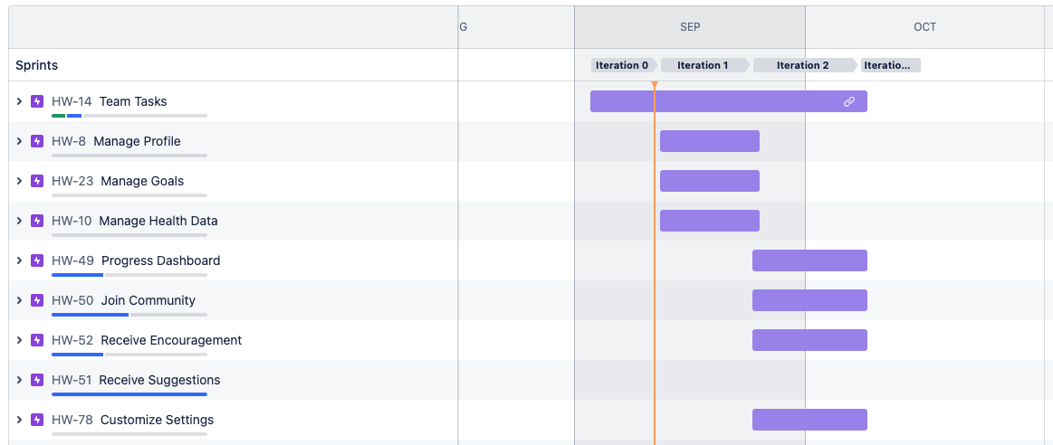
Key Features Overview | On Jira
Notes:
Basic user authentication
Set dietary and fitness goals
Input data related to your progress on those goals
See progress on a dashboard

Slide 5
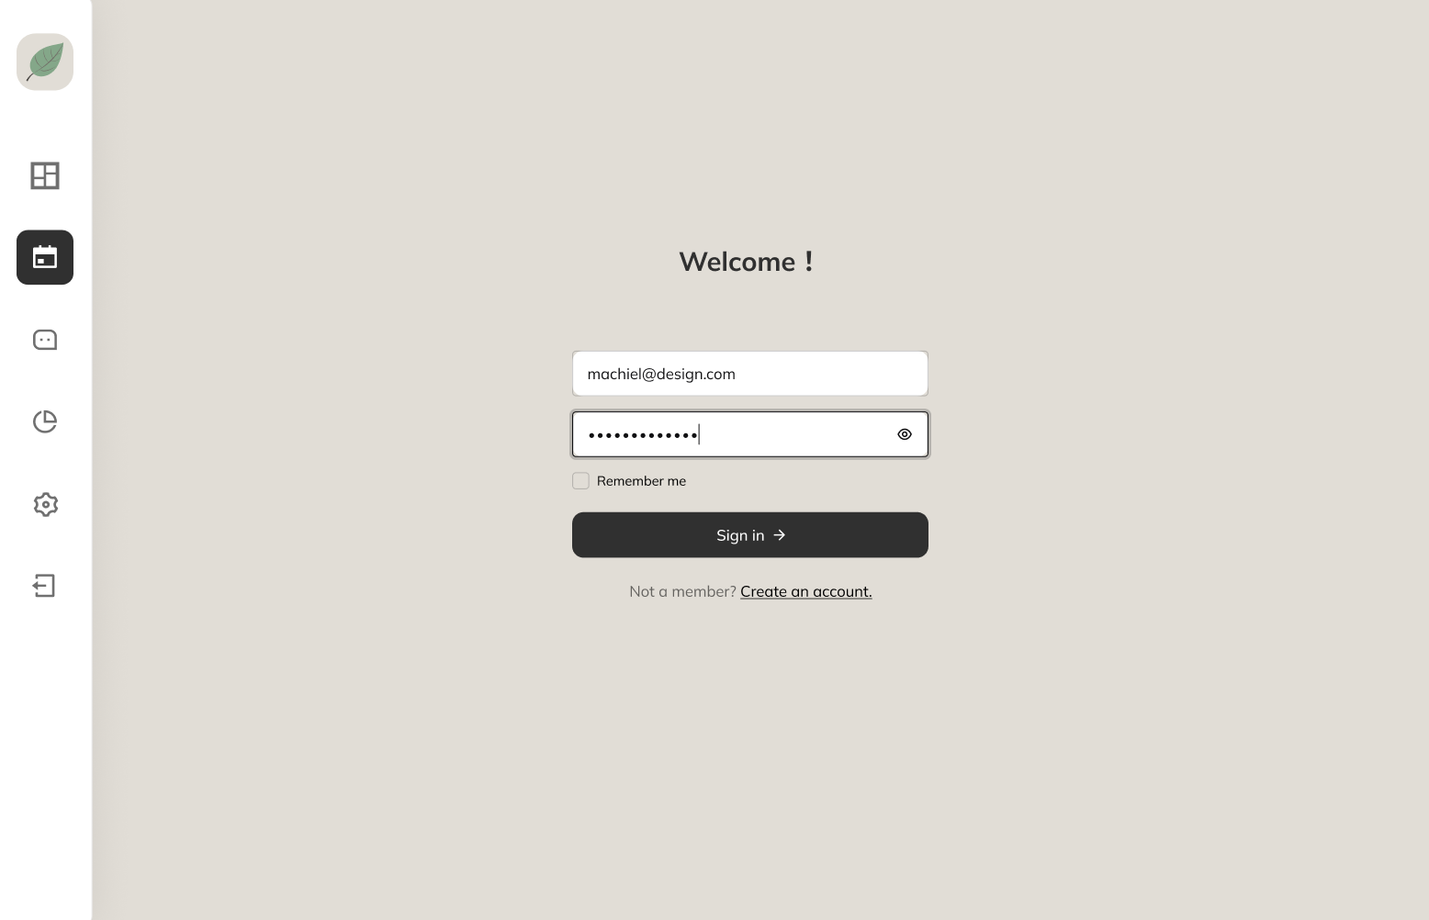
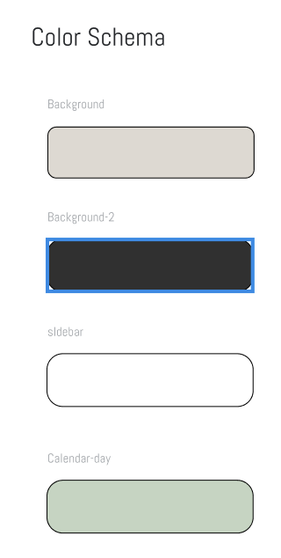
Figma Mockup - Login

Slide 6
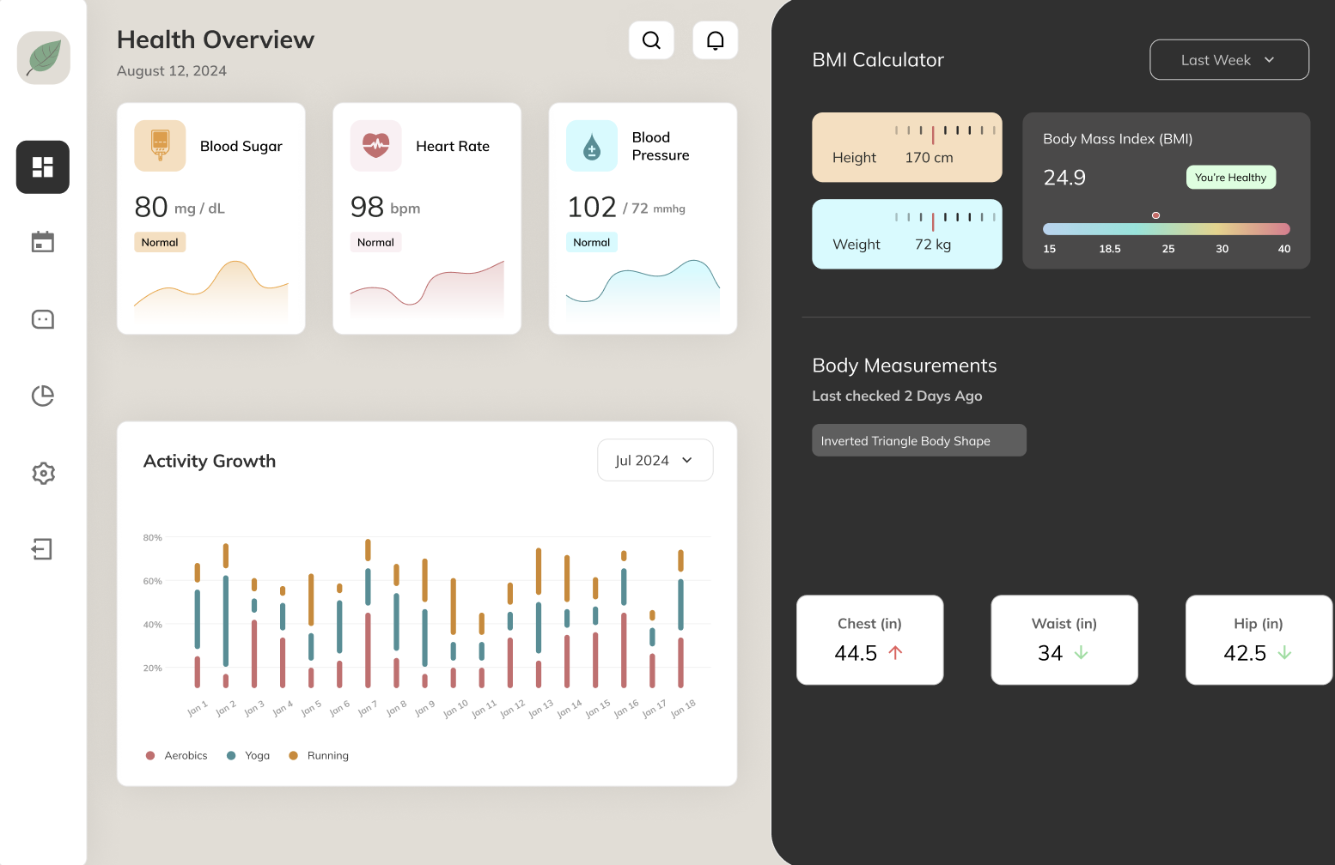
Figma Mockup - Main Page
Notes:
Team still determining what data to track. This will need to be determined early in order to build database schema and create various features of the application

Slide 7
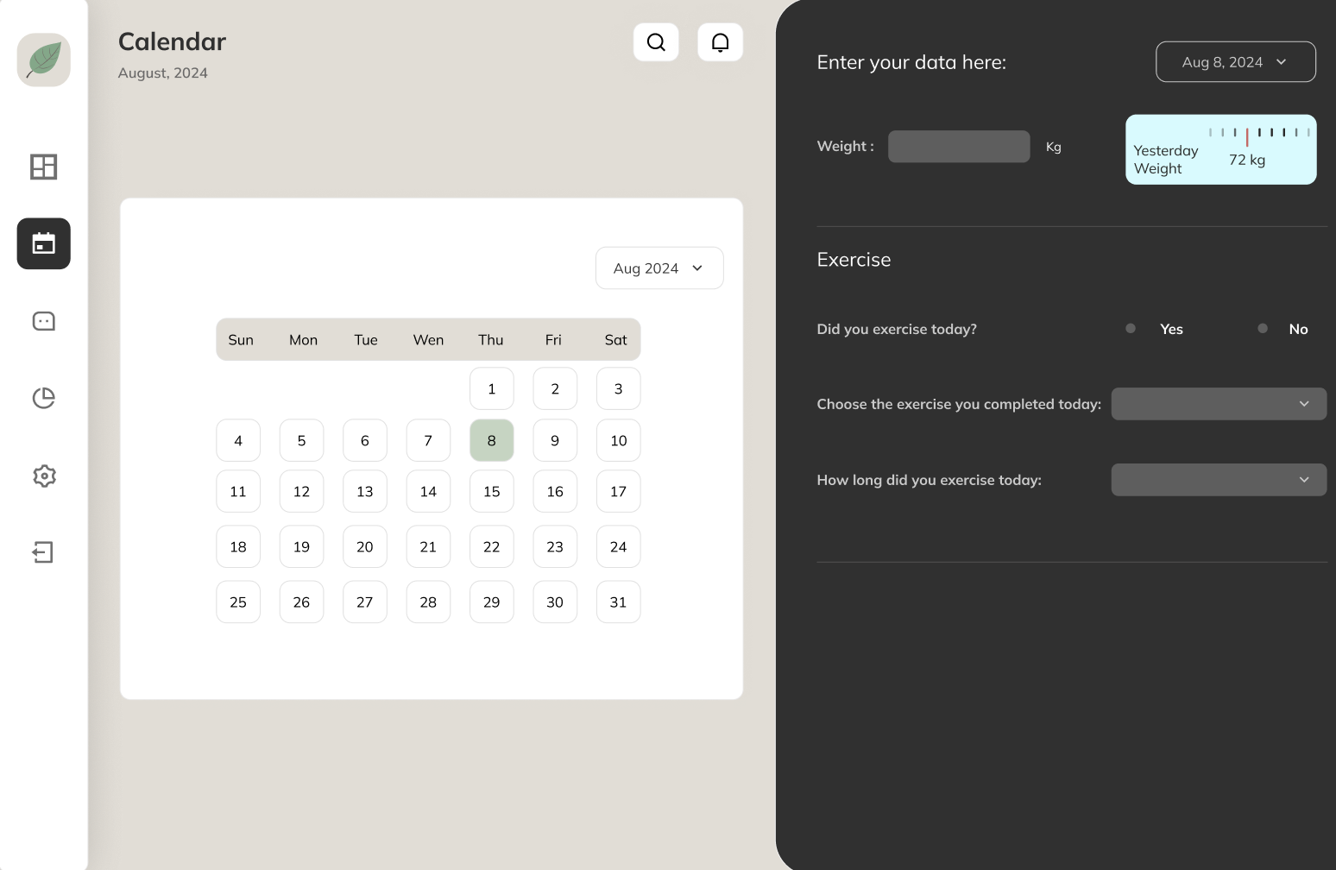
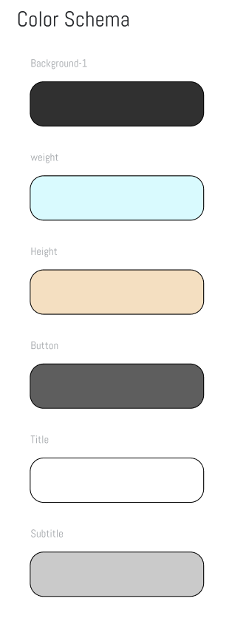
Figma Mockup - Calendar
Notes:
Example of fitness form

Slide 8
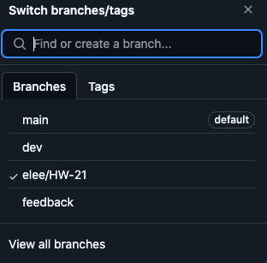
Configuration
Branching
There will be two main branches: dev and main
New features will be pushed to the dev branch
Branches will have the Jira ticket within the name
Tested features ready for release will be pushed to main
feature -> dev -> release/hotfix -> main
Branch protection rules will be put in place to require pull request reviews
Deployment
GitHub actions will be used to trigger when pushes are made to main. Updates will then be automatically deployed to a hosting service
Notes:
Will have an intermediary dev branch to review/test new features
Branch protection rules will require pull request reviews
We will automate deployment when pushes are made to main

Slide 9
Testing
We are planning to use Jest for JavaScript unit testing
QA Leader will research and set this up for the team
All team members are responsible for writing unit tests for any classes and methods that they create
The QA leader will be responsible for integration testing before each project iteration release
The objective is to oversee the interaction between components and ensure the application as a whole is running as expected e.g. data from back end is flowing into front end as expected

Slide 10
Security
Application will implement login with username and password
We will implement strong password policies and password encryption(Hash Functions)
Minimize data collection and avoid collecting unnecessary data
Avoid collecting sensitive information unless absolutely necessary
Use strong password requirements
To ensure that passwords created by users have sufficient complexity to improve security
Use HTTPS
Using HTTPS ensures that all data exchanges between users and websites are encrypted, protecting sensitive information
“Sanitize” form input data to prevent cross site scripting (XSS) attacks
XSS attacks affect users' browsing experience or steal user information by injecting malicious scripts into web pages.
Manage user access if implementing multiple roles
In a system with multiple user roles, effective access control management must be implemented

