Slide 1
Study Buddy App
Iteration 1 Presentation
Team Members: Bohan Lin, Dexiao Zhang, Junzhe Chen, Ittoop Shinu Shibu, Melissa Cron, Qiuting Zhao
Notes:
Study Buddy is a mobile app that helps users study more effectively by reducing smartphone distractions. It was inspired by the challenge many students face—staying focused in a world full of digital temptations.
The app combines gamification with study tracking. When users study with the app open, their time is recorded and helps grow their virtual companion—the “buddy.” The more you study, the stronger and happier your buddy becomes. But if you skip studying, your buddy might weaken or even die.
Study Buddy is designed for students and self-learners who want to boost productivity while having fun. Key features include study time tracking, buddy growth, mini-games, and progress visualization through stats and achievements.

Slide 2
Study Buddy
Agenda
1.
Requirement Analysis
2.
Design
3.
Implementation
4.
Testing
5.
Demo
6.
Timeline

Slide 3
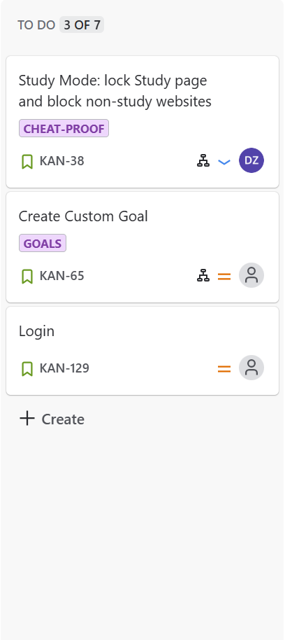
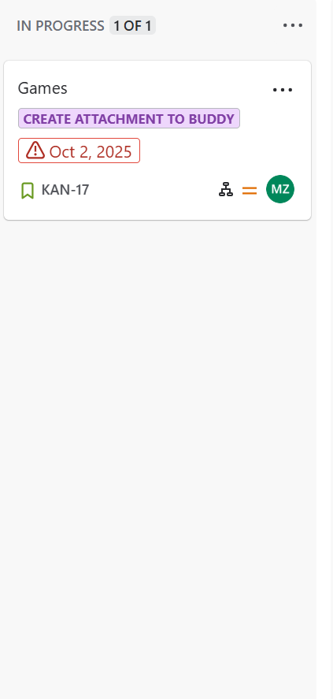
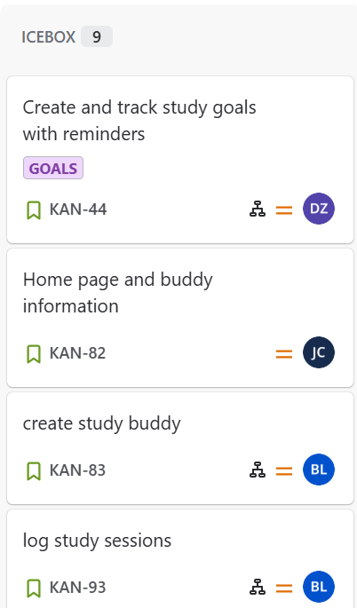
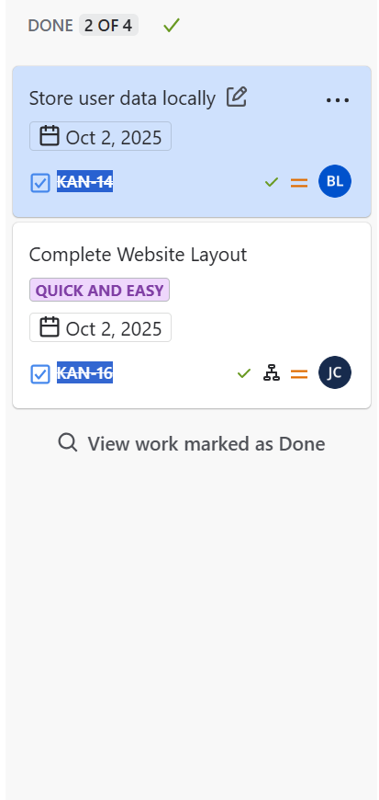
Company Name
Requirement Analysis
TO DO
IN PROGRESS
ICEBOX
DONE
Communication goals might include: increasing brand awareness, improving how your teams work together, or getting more consistent feedback from stakeholders.

Slide 4
Study Buddy
Design
Software Architecture
Database Design
Design Patterns Used
Client-server architecture with a three-tier structure
The app uses SQLite to store user information, study records, and personalization settings
Keep the structure simple and easy to maintain
Maintain data isolation for each user
MVC Pattern
Middleware Pattern
Notes:
Our Study Buddy app follows a three-tier client-server architecture, consisting of the frontend, backend, and database layers.
The frontend, built with React Native, is component-based and organized into two main folders:
Screens, which define the main pages such as login, study timer, and settings.
Components, which hold reusable UI elements like buttons and checkboxes.
The backend, developed with Express.js and Node.js, is structured into routes, models, and database folders.
Routes define API endpoints that handle HTTP requests and responses.
Models describe how data is stored and accessed.
The database folder manages SQLite connections and queries. The frontend communicates with the backend using RESTful APIs (GET, POST, PUT, DELETE), while the backend interacts with the database for persistent storage.
Our database uses SQLite, designed to be simple, scalable, and isolated per user. Finally, our system applies two key design patterns:
MVC Pattern, which separates the app into Models, Views, and Controllers for better organization and scalability.
Middleware Pattern, where Express middleware like auth.js and logger.js handle authentication and logging before reaching route logic — improving reusability and maintainability.

Slide 5
Study Buddy
Implementation
Tools & Techniques
Frontend: React Native
Backend: Express JS, Node JS
Test: Jest, Supertest
Other: Swagger, Github with CI

Slide 6
Study Buddy
Testing
Metrics
Unit Test
Integration Test
Acceptance Test
System Test
The unit tests focus on isolated middleware logic.
The integration tests cover the interaction between models and the database.
The acceptance tests verify the full API workflow via HTTP requests.
The system tests simulate a complete user journey across multiple components.
Test Suites: 5 passed, 5 total
Tests: 18 passed, 18 total
Notes:
Jest and supertest are tools used in backend testing. A mix of unit tests, integration tests, acceptance tests, and system tests are applied. The unit tests focus on isolated middleware logic, such as JWT authentication and logging, without relying on the database or HTTP layer. The integration tests cover the interaction between models and the database. The acceptance tests test the full API workflow via HTTP request. The system tests simulate a complete user journey across multiple components, which would be helpful to validate the end-to-end functionality, state changes, and security under realistic scenarios.

Slide 7
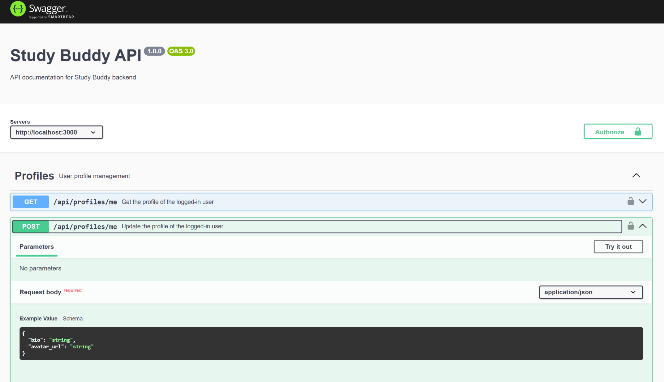
Study Buddy
Demo

Slide 8

Study Buddy
Demo

Slide 9
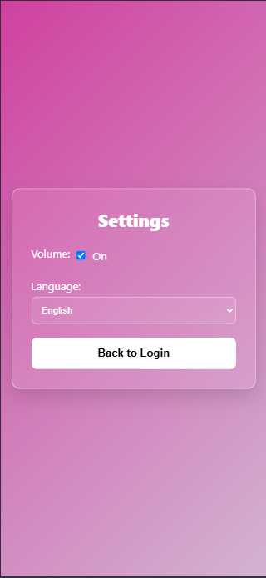
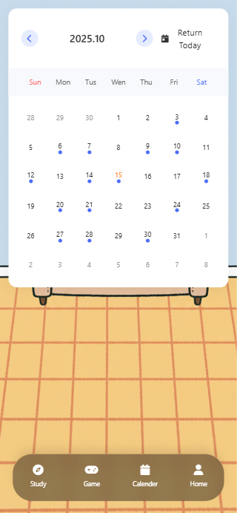
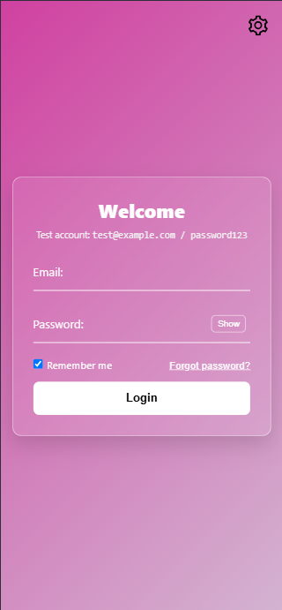
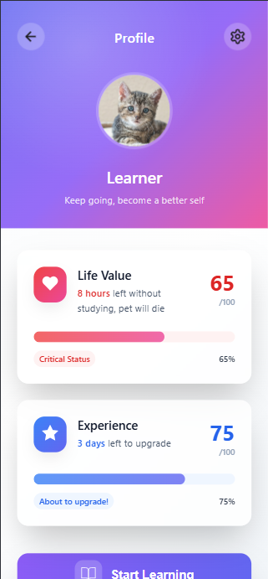
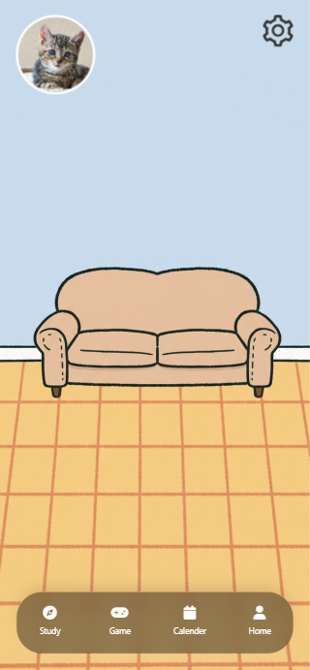
Study Buddy
Sneak Peaks

Slide 10
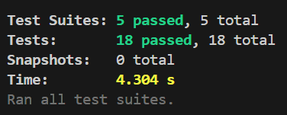
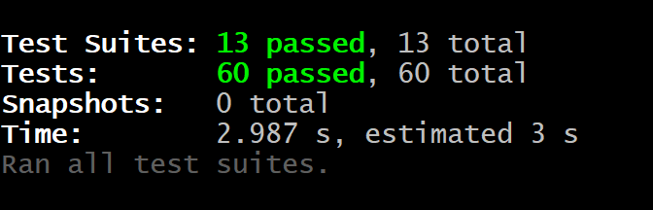
Study Buddy
Sneak Peaks
Iteration 1 Tests
On Progress Tests
Iteration 1 covers unit tests, integration tests, and acceptance tests.
Edge cases are implemented in acceptance tests. System tests are also added.

Slide 11
Study Buddy
Timeline
Review & Presentation
Conduct QA and prepare demo for iteration 2
Backend Integration
Connect frontend to backend APIs
Refractor Frontend
Convert HTML pages into React Native components
Design & Database
Database design finalized
Requirement Analysis
Functional & non-functional requirements, User stories
Planning & Setup
Github, Jira, and CI pipeline setup

