Slide 1

Beatmap: A Concert Discovery Platform
CS673
Fall O1 2025
S. Akerman, E. Cavallero, Z. Cheng, G. Grimaylo, M. Laszlo, Z. Liao

Slide 2


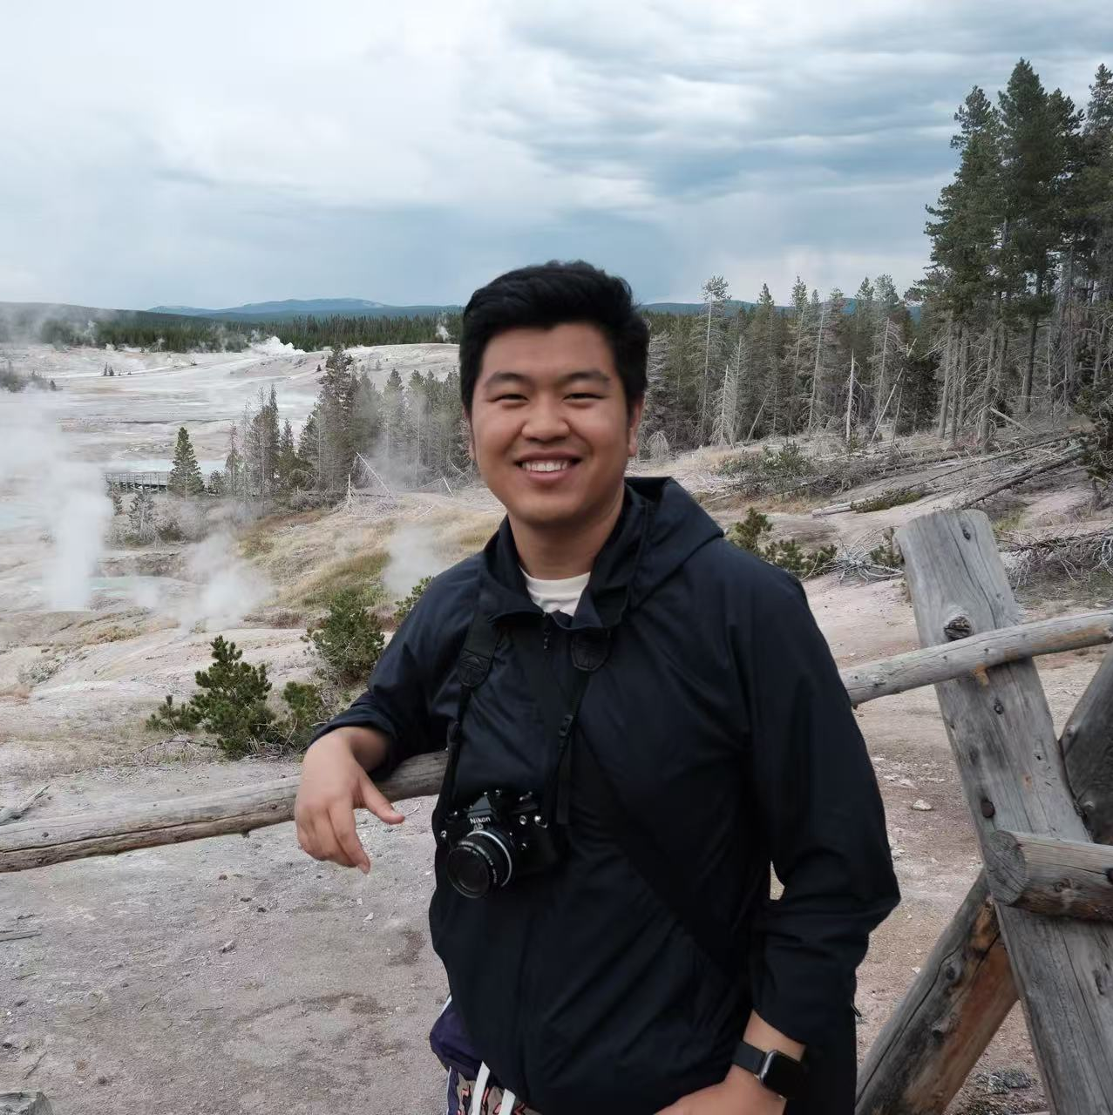
Meet the team
Samuel Akerman
Team and configuration leader
Ed Cavallero
Design and Implementation Leader
Zixuan Cheng
Design and Implementation Leader
Originally from Venezuela, Sam has an undergraduate degree in Telecom Engineering and has been working as a Software Engineer for the last 7 years.
Ed has an undergraduate degree in music and business administration and has been a concert manager in San Diego for the last two years. He is set to complete his MSSD this Fall.
Zixuan holds a bachelor’s degree in Computer Science from China, and is now completing the final semester in MSCS, hoping to gain more projects experience in this project.

Slide 3



Meet the team
Greg Grimaylo
QA Leader
Michael Laszlo
Security Leader
Zhehao Liao
Requirements Leader
Greg has an undergraduate degree in Computer Science and has been working as a Quality Assurance Automation Engineer for 2 years.
Michael has an undergraduate degree in Computer Science and has been a software engineer for 3 years with a focus on embedded systems.
CS Master’s student exploring AI and practical applications

Slide 4
Why Beatmap?
Find concerts while traveling
Personalized suggestions based on favorite artists, genres and streaming data
Great for both tourists and locals

Slide 5
Core Features
Concert Search (city, venue, dates)
Filters & sorting (date, location, genre, price)
Event details page (time, venue, lineup, ticket link)
Ticket link-out (safe external purchase)
Anonymous users
User accounts (with OAuth or passwordless login)
Favorites/Wishlist

Slide 6
Key Features
Desirable
Map view of events
Artist and venue profiles
Calendar export
Email alerts

Slide 7
Key Features
Optional
Personalized recommendations
Price tracking alerts
Social sharing
Multi-language support

Slide 8
Tech Stack
Backend: Python + FastAPI
Frontend: TBD
Database: Azure + SQL Server
CI/CD: Github Actions
Deployment: Docker + Google Cloud Run
Tools: Jira, VS Code, AI Helpers

Slide 9
High-Level Architecture
Frontend
Web client (possibly React)
Backend
Fast API: search, filters, authentication
OAuth or passwordless “magic link”
External event APIs provide concert listings
Infrastructure
Azure SQL: users, favorites, cache
CI/CD: GitHub Actions → Dockers → Google Cloud Run

Slide 10
Thank you for listening!

