Slide 1

Beatmap
Beatmap
Iteration 1
Beatmap
Sep.2025
S. Akerman, E. Cavallero, Z. Cheng, G. Grimaylo, M. Laszlo, Z. Liao

Slide 2
Beatmap
Contents
Sep.2025
1.
Iteration 1 Summary
2.
CI/CD Pipeline
3.
Pivot to AWS
4.
Security
5.
Demo: Front-end Back-end and Swagger UI
6.
Next Steps(Iteration 2)

Slide 3
Beatmap
Iteration 1 Summary - What we did?
Sep.2025
Frontend: Wrote and deployed a search page, ready for integration with backend.
Backend: Developed and deployed all backend services using for each Docker containers and handling the different APIs with FastAPI. There are currently three services: the backend service, which will serve the frontend; and two external API services to get concert data, one from Jambase and other for Ticketmaster. These two external API services will only be queried by the backend service.
Deployment: All services deployed on a AWS EC2 VM using Docker Compose.
CI/CD: Set up GitHub Actions for automated testing and deployment.

Slide 4
Beatmap
CI/CD Pipeline
Sep.2025
Continuous Integration (CI): GitHub Actions automatically runs tests, linter, format and security checks on each push/merge.
Continuous Deployment (CD):
On merge to main, code is automatically deployed to the AWS EC2 prod instance.
On merge to test, code is automatically deployed to the AWS EC2 test instance.
Setup: Upon deployment, images and containers are cleared to reclaim space. With Docker compose we instantiate all new containers for our services.
Benefit: Faster iteration and less manual work — “code → merge → live”.

Slide 5
Company Name
Pivot to AWS EC2
Year/Quarter/Month
Why not Google Cloud Run?
Each microservice requires a separate service → too complex for our scale.
Decision
Use AWS EC2 (single VM) inside of which we run all microservices.
Setup
Run frontend, backend, Jambase API service, Ticketmaster API service inside one VM with Docker Compose.
Benefit
Lightweight, simple to manage, easier to maintain, single instance to monitor health of the system, robust security infrastructure out of the box.

Slide 6
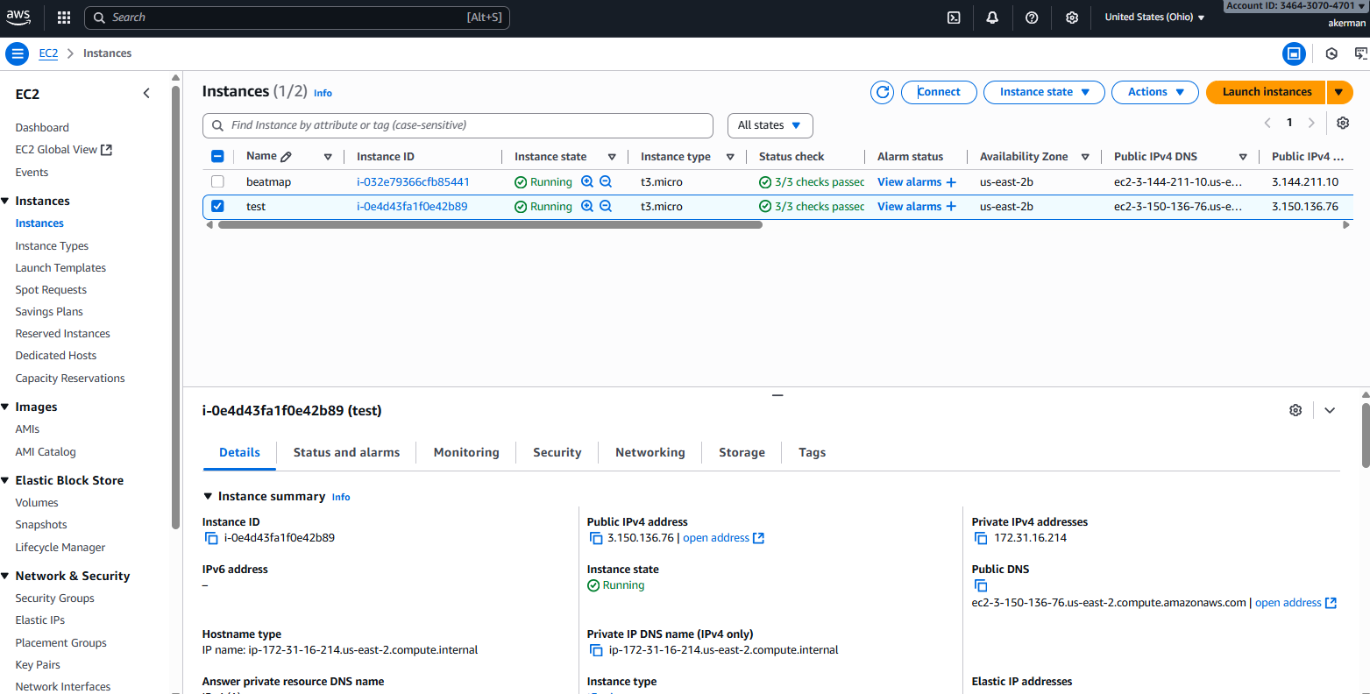
Pivot to AWS EC2(Cont.)
Beatmap
Sep.2025
AWS EC2 management console

Slide 7
Beatmap
Security
Sep.2025
Current Security Strengths:
Automated Security Workflows - Integrated security checks in CI/CD pipeline
Code Quality Gates - Automated vulnerability scanning before deployment
Access Control - Role-based permissions and authentication systems
Secure Development Lifecycle - Security reviews integrated into development process
Implemented Security Best Practices:
Regular Security Audits - Periodic assessment of application vulnerabilities
Dependency Management - Automated monitoring and updates for third-party libraries
Secure Coding Standards - Team follows established security guidelines
Incident Response Plan - Documented procedures for security event handling
Future Security Goals:
Enhanced Monitoring - Implement real-time threat detection and alerting
Security Training - Regular team education on emerging security threats
Zero-Trust Architecture - Migrate toward enhanced identity verification

Slide 8
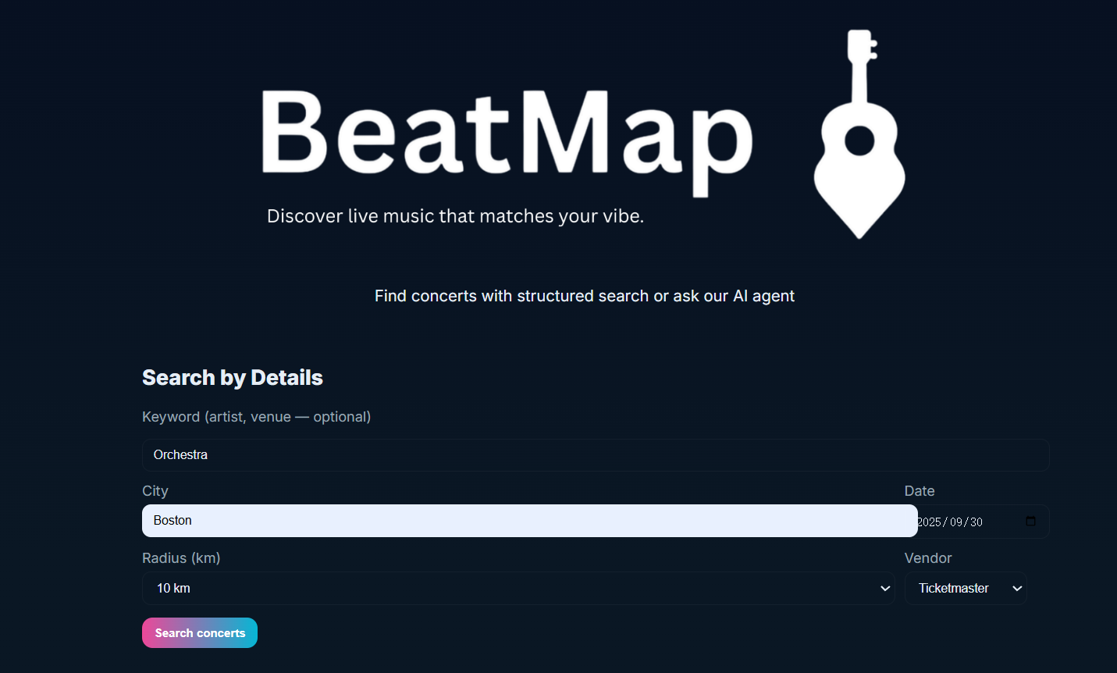
Demo 1: Frontend (Port 3000)
Beatmap
Sep 2025
Input: city, date range, radius
UI functional: buttons & forms working
Current limitation: results still empty
Reason: frontend–backend merge planned for iteration 2

Slide 9
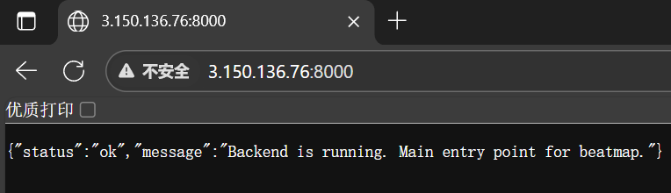
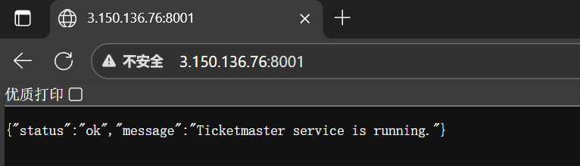
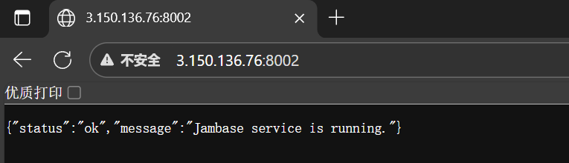
Demo 2: Backend + Microservices(8000, 8001, 8002)
Beatmap
Sep 2025
Backend (8000) – status JSON: Backend is running
Ticketmaster (8001) – status JSON: Service is running
Jambase (8002) – status JSON: Service is running

Slide 10
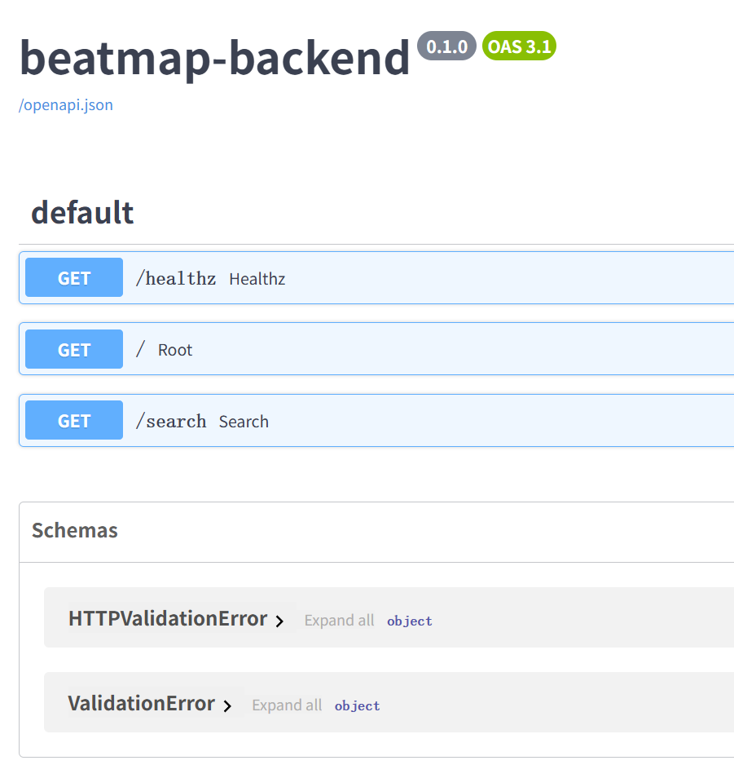
Demo 3: Swagger UI (Port 8000/docs)
Beatmap
Sep 2025
Auto-generated API documentation
Enables developers to test endpoints
Example: /search?city=Boston&start_date=2025-09-30&end_date=2025-12-01&provider=jambase

Slide 11
Next
steps
Beatmap
Sep 2025
01.
02.
03.
04.
Merge frontend & backend
Improve UI (loading states, error messages)
Start user system & database integration
Explore AI agent for natural language search

Slide 12
Thank you for listening!

Slide 13
CICD pipeline
Pivot from Google Cloud Run multi service approach to AWS single VM approach using docker compose to run micro services inside single VM.
Description of architecture: microservice architecture. One docker service container for: frontend, backend, jambase, ticketmaster. Easy to add more vendor/provider micro services for external calls.
DEMO: show frontend http://3.150.136.76:3000/search
DEMO: show backend service: http://3.150.136.76:8000/
DEMO: show external API microservices jambase and ticketmaster:
http://3.150.136.76:8001/
http://3.150.136.76:8001/
DEMO: show calls to jambase and ticketmaster using Swagger UI: http://3.150.136.76:8000/docs
Describe TENTATIVE next steps for iteration 2: integrate front and backend. Improve UI. Integrate AI agent. Hope to begin user/db integration.

