Slide 1

Beatmap
BeatMap
Iteration 2
BeatMap
October 2025
S. Akerman, E. Cavallero, Z. Cheng, G. Grimaylo, M. Laszlo, Z. Liao

Slide 2
BeatMap
Contents
Sep.2025
1. Iteration 2 Summary
2. Groq AI
3. HTTPS Overview
4. SSL Overview
5. Demo 1: Sending preferences to AI with personalized results
6. Demo 2: Front-end to Back-end with AI & HTTPS
7. Next Steps(Iteration 3)

Slide 3
BeatMap
Iteration 2 Summary - What we did
Sep.2025
AI Integration (Groq LLM microservice) – enables natural-language concert searches and personalized recommendations
HTTPS & SSL Security – all backend communication secured for production-ready deployment
Backend /Frontend Integration – full REST API pipeline working between React frontend and FastAPI backend

Slide 4
BeatMap
AI Integration
Sep.2025
What is Groq?
A platform that runs large language models on its own high-speed Language Processing Units (LPUs) for faster, more efficient AI responses
We used Groq’s standard GPT-compatible model for text parsing and recommendation logic
What it does in BeatMap
Parses user input into structured search parameters (artist, location, date)
Extracts user preferences for tailored recommendations
Ranks concert results from external APIs based on relevance

Slide 5
BeatMap
AI Integration
Sep.2025
Request Flow
Frontend → Concert Service: user submits text query
Concert Service → Groq Service: forwards the message to Groq for parsing
Groq Service → External APIs: generates structured queries for Ticketmaster & JamBase
Groq → Backend → Frontend: ranked recommendations returned to the UI

Slide 6
BeatMap
HTTPS Implementation
Sep.2025
Purpose of HTTPS
Encrypts communication between services to prevent data interception
Verifies server identity and prevents man-in-the-middle attacks
Ensures integrity: data cannot be altered in transit
Why it matters for BeatMap
Protects API keys, user queries, and concert data
Enables secure microservice communication when deployed across containers, VMs, or cloud environments
Establishes a production-ready foundation for future scaling

Slide 7
BeatMap
SSL Overview
Why use self-signed certificates?
Keep user data private, make sure users are connecting to our app w/ confidence. Aligned w/
Industry standards.
Decision
Use SSL for development, trusted certificates for production & testing (Let’s Encrypt cert provider).
Certs generated & trusted locally within dev environment.
Focus on Security
Prevents attacks via authentication, encrypts traffic to prevent data tampering, protect sensitive information.
Benefit
Ensures that all client-server communication is encrypted. Allows us to test HTTPS
Locally.
Guarantees data integrity for all public endpoints of our application.

Slide 8
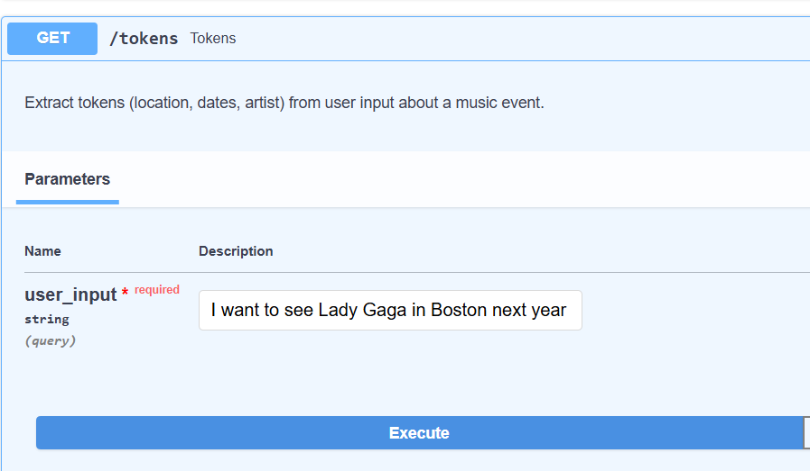
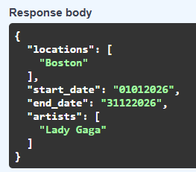
Demo 1: AI Tokens Endpoint
Beatmap
Oct 2025
Input: Location, dates, artists w/ natural language input
Output: JSON w/ info about music event
Motivation: leverage Groq to format natural language input (key info) into standardized format

Slide 9
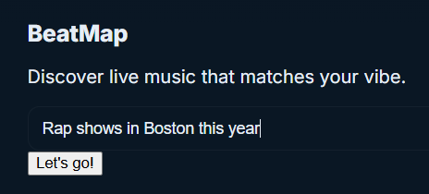
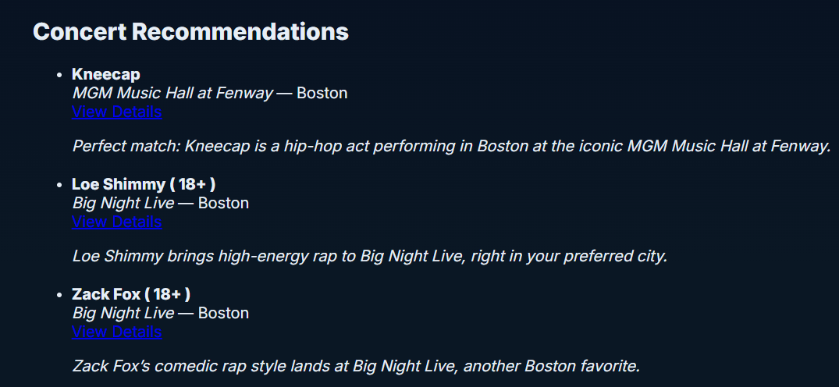
Demo 2: Full App w/ HTTPS
Beatmap
Oct 2025
https://beatmap.live/search - uses https, takes in a natural language input
Output - concert recommendations based on your search parameters leveraging AI
HTTPS - protects API from interception, ensures trust b/w external services

Slide 10
Next
steps
Beatmap
Oct 2025
01.
02.
03.
Further polish our UI
Add comprehensive HTTPS testing
Expand testing, unit tests + integration tests

Slide 11
Thank you for listening!

Slide 12
Beatmap
Sep.2025
Goals achieved for this iteration: HTTPS, AI, Backend/Frontend integration.
HTTPS: all external and internal communication happens using HTTPS. However, having this capability from the start will allow the microservices to securely communicate if they are ever deployed to different environments—such as different networks, virtual machines (VMs), or geographically distributed locations. This ensures that even if the services are separated by firewalls, network boundaries, or physical distance, they can still communicate securely over the internet.
Talk about SSL. How for dev we use self signed certificates and for production and test we use trusted certificates (Let’s Encrypt)
AI: added LLM/AI service called Groq. The Groq api runs inside its own microservice wrapper/
Show some of the prompts we defined, for example the “tokens” one, describing what we want to achieve. Do a demo from https://beatmap.live:8003/docs showing the results from the AI call.
Talk about the recommendation submission to the AI. Explaining that we submit both user preferences and a list of concerts received from jambase/ticketmaster and the AI curates the list of events to present the user.
Do a demo from https://beatmap.live. Emphasize the use of HTTPS. Do a couple of searches, highlighting how the results match the user’s input.

