Slide 1

Beatmap
BeatMap
Iteration 3
Wrap-up
BeatMap
October 2025
S. Akerman, E. Cavallero, Z. Cheng, G. Grimaylo, M. Laszlo, Z. Liao

Slide 2
BeatMap
Contents
Oct.2025
Iteration 3 Summary
Project Management
Requirement Analysis
Design and Architecture
Testing
Security
CI/CD
Demo

Slide 3
BeatMap
Iteration 3
Oct.2025
Final, short iteration. Focused on fixing known issues and improving quality.
Implemented ConcertProviderInterface for unified provider logic
Refined UI/UX for consistency and polish
Fixed key bugs and stability issues
Added backend integration tests
Added frontend security regression tests

Slide 4
BeatMap
Project Management
Oct.2025
Role Assignments and Contributions
Sam: CI/CD pipeline setup, containerization & microservice orchestration, AWS hosting, request flow logic, AI integration, testing, and AI implementation design.
Michael: Security configuration, HTTPS and SSL setup, and testing.
Zhehao: Requirement analysis, project management & coordination, frontend development, and backend/frontend integration.
Greg: Provider microservice (external API integration), AI integration, and testing.
Zixuan: Provider microservice (external API integration), backend/frontend integration, and frontend features.
Ed: Frontend development, AI implementation design, and AI backend integration

Slide 5
BeatMap
Project Management
Oct.2025
Risk & Quality Management
Risks identified: scope creep, integration delays, and limited time for testing.
Mitigation: reduced non-essential features, parallelized development, early integration testing.
Quality metrics: API response success rate, test pass rate, container uptime, and system latency.

Slide 6
BeatMap
Process, Achievements and Lessons
Oct.2025
Iteration Evolution
Iteration 1: core backend and frontend setup
Iteration 2: AI microservice, frontend/backend integration, HTTPS + SSL
Iteration 3: Frontend and backend refinements
Highlights
AI-driven concert recommendations
AWS-hosted multi-service system
Clean frontend–backend workflow

Slide 7
BeatMap
Process, Achievements and Lessons
Oct.2025
Challenges and Lessons
Challenges: short timelines, merge conflicts, API limitations
Lessons: integrate early, keep scope focused, set realistic deadlines and objectives

Slide 8
BeatMap
Requirement Analysis
Oct.2025
“BeatMap is a concert discovery platform that lets users find live music events across multiple providers (Ticketmaster, Jambase, etc.) through a single interface with AI-powered search.”

Slide 9
BeatMap
Requirement Analysis
Oct.2025
Functional requirements:
Search concerts by artist, location, or date range.
Handle natural language inputs (“metal concerts in Lisbon this summer”).
Aggregate results from multiple providers into a unified format.
Secure HTTPS communication.
Non-Functional requirements:
Availability: ≥ 99% uptime (AWS EC2 + Docker deployment)
Scalability: Supports horizontal scaling of provider services
Maintainability: Modular microservice architecture with clean interfaces
Reliability: Graceful error handling and retry mechanisms for API calls
Testability: Automated unit, integration, and regression test coverage

Slide 10
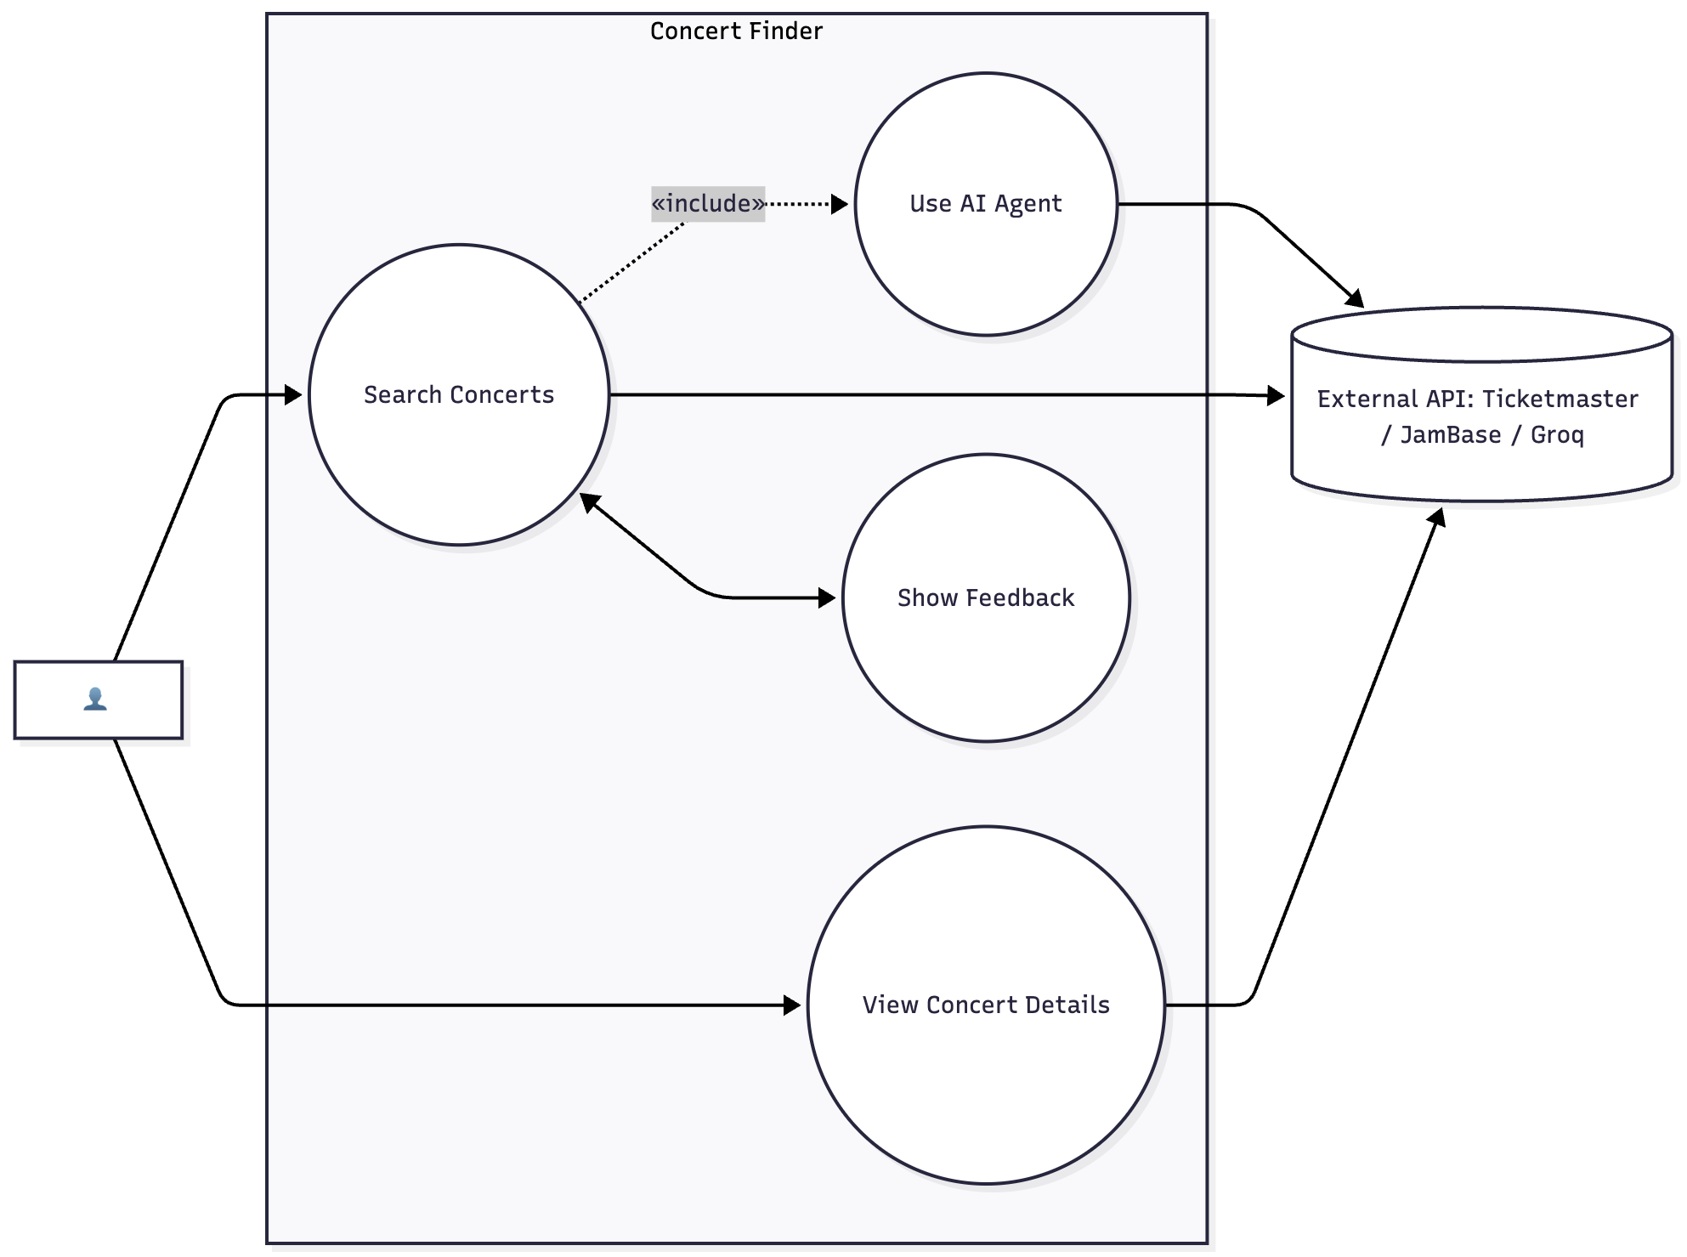
BeatMap
Requirement Analysis
Oct.2025
User stories:
As a visitor, I want to search concerts using natural language queries, so that I can easily find events that match my interests.
As a visitor, I want to view detailed concert information — including artist, venue, and ticket links — so that I can decide whether to attend.
As a user, I want the website to show clear loading and error feedback during data retrieval, so that I understand the system’s current state.

Slide 11
BeatMap
Design and Architecture
Oct.2025
Architecture overview:
Microservices architecture: Backend API coordinating 3 provider services (Ticketmaster, JamBase, Groq AI) for modular scalability.
Frontend: Built with React + Vite for speed and component reusability.
Backend: FastAPI-based REST API enabling clean async communication.
Reverse proxy: Nginx handles routing, HTTPS, and SSL termination.
Containerization: All components run on Docker, deployable to AWS EC2 or local environments.

Slide 12
BeatMap
Design and Architecture
Oct.2025
Design Patterns used:
Adapter Pattern: Unifies external APIs via the ConcertProviderInterface, ensuring all providers follow a consistent structure.
Facade Pattern: ConcertsService serves as a single gateway, coordinating communication among multiple providers.
Strategy Pattern: Dynamically selects the most suitable provider at runtime based on user input or availability.
Composite Pattern: Builds the React UI from reusable, nested components (ResultCard, ResultsPanel), improving maintainability and scalability

Slide 13
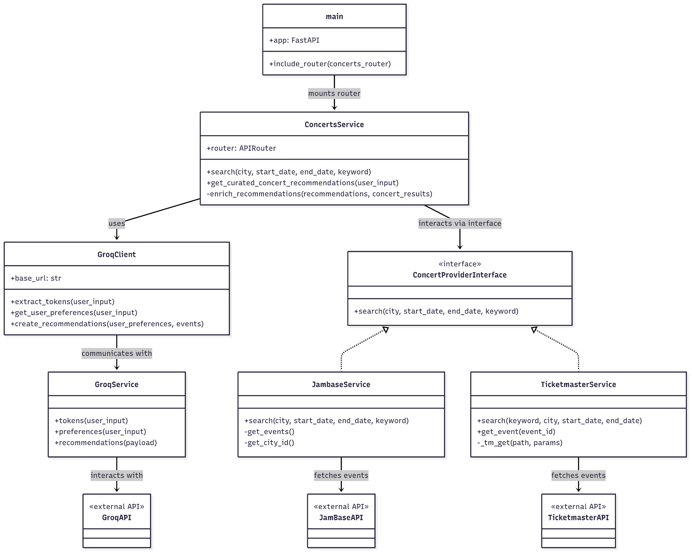
BeatMap
Design and architecture
Oct.2025

Slide 14
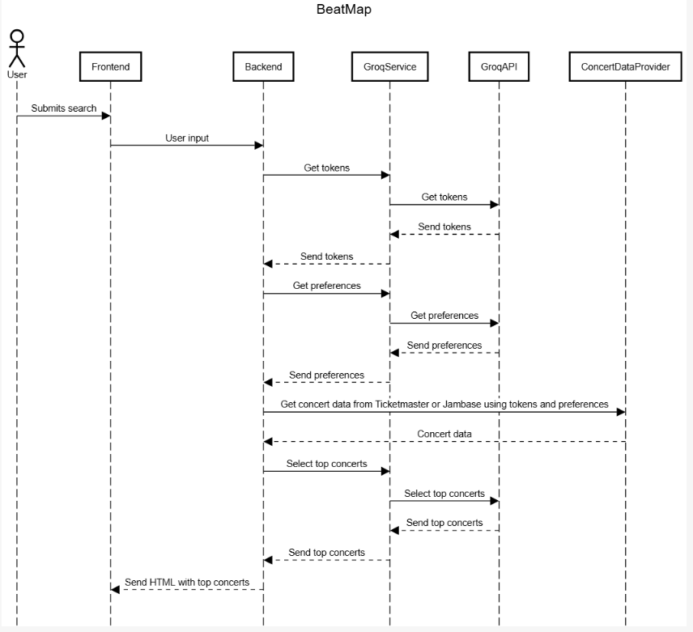
BeatMap
Design and architecture
Oct.2025

Slide 15
BeatMap
Design and Architecture
Oct.2025
Project structure:
beatmap/
└── src/
│ ├── backend/
│ │ ├── app/
│ │ │ ├── api/
│ │ │ ├── core/
│ │ └── scripts/
│ │
│ ├── frontend/
│ │ └── src/
│ │
│ ├── providers/
│ │ ├── jambase/
│ │ ├── ticketmaster/
│ │ ├── groq/
│ │
│ └── interfaces/
└── ssl/

Slide 16
BeatMap
Testing
Oct.2025
We incorporated various types of testing techniques throughout the lifecycle of our project:
Unit Testing with pytest
Integration Testing (API & SSL/HTTPS)
System & Acceptance Testing (manual end-to-end)
Regression Testing (CI on every commit)
TDD & BDD (Gherkin scenarios)
Security Testing (SSL/TLS, headers, redirection)
Complete end-to-end testing environment on AWS, fully matching the production setup.
Results:
Expanded from basic tests to 60+ automated test functions.
Verified API endpoints, SSL config, middleware, and AI integration.
Continuous regression coverage via GitHub Actions.
All critical tests passing; deployment verified over HTTPS.

Slide 17
BeatMap
Security
Oct.2025
End-to-End HTTPS: Enforced via Nginx reverse proxy and Let’s Encrypt SSL certificates.
Secure Configuration: HTTPS-only access with protective headers (HSTS, CSP, CORS) for safer browsing.
Secrets Management: Environment variables and GitHub Actions secrets for keys and API tokens.
Security testing:
Automated SSL/HTTPS validation tests (certificate paths, redirection).
Bandit, pip-audit, and Safety scans for dependency vulnerabilities.
Manual validation of HTTPS-only access in production.
Container Isolation: Each microservice runs in a separate Docker container.
TDD/BDD for Security: Test-driven SSL configuration and middleware validation.

Slide 18
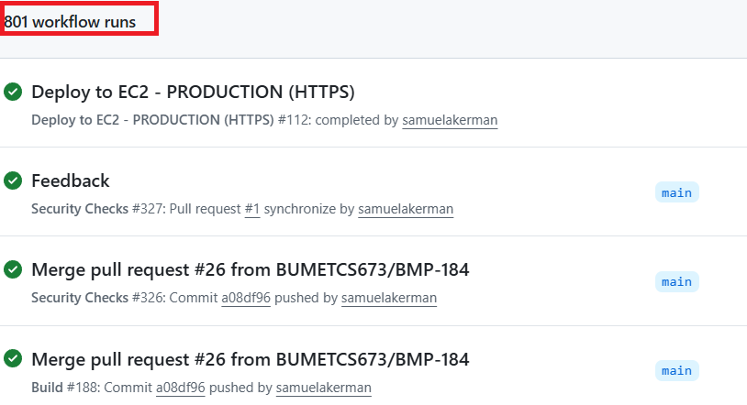
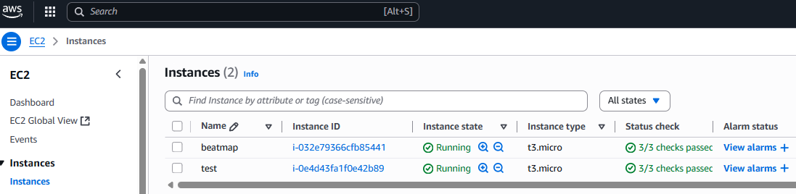
BeatMap
CI/CD
Oct.2025
GitHub Actions: Automated build and test on every push.
Security Scans: Bandit, pip-audit, and Safety run automatically.
Automated Testing: Executes all pytest suites (unit, integration, SSL, AI).
Dockerized Deployment: Builds and deploys containers to AWS EC2.
Environment Control: Separate .env.dev and .env.prod configs.
Reliable Delivery: Consistent, repeatable deployments with minimal manual steps.

Slide 19
BeatMap
BeatMap Demo
Oct.2025

Slide 20
BeatMap
Thank you!
Oct.2025

