Slide 1

BariatricPathway
A Clinical Evaluation Management System
FINAL ITERATION PRESENTATION
CS673 Software Engineering - Team 1 - Summer 2026
Presented by: Kai Fernandes - Shaima Nimeri - Fatimah Hassan - Kolya Gavlishin - Jianing Li

Slide 2






OUR TEAM
Meet BariatricPath’s Team
Problem: Bariatric surgery requires patients to navigate a complex, multi-stage evaluation process, but today that coordination happens across scattered spreadsheets, emails, and phone calls — leaving patients in the dark and coordinators without a reliable source of truth.
Solution: BariatricPath brings patients, coordinators, and program directors into one system with real-time status tracking, role-based access, an AI assistant, and a complete audit trail.
SN
KF
FH
JL
KG
Shaima Nimeri
Kai Fernandes
Fatimah Hassan
Jianing Li
Kolya Gavlishin
Team Lead
Design & Implementation Lead
Requirement Lead
Team Co-Lead
Configuration Co-Lead
Security Lead
Configuration Co-Lead
Requirement Co-Lead
QA Lead
Design & Implementation Co-Lead
CS673 - Team 1 - BariatricPath - Final Iteration - Summer 2026
2

Slide 3









Today's Agenda
Final iteration - emphasis on new work, with full project recap
01
Requirements & Project Management
05
Security
User stories, INVEST, sprint summary, and use case diagram.
Threat model, controls, SAST/DAST pipeline, ZAP results
02
Architecture & Design
06
Deployment & Operations
Three-tier + AI microservice, database design, key decisions
Docker Compose on DigitalOcean, architecture & limitations
03
Implementation & AI Chatbot
07
Live Demo
Project structure, code metrics, AI chatbot, refactoring
Live walkthrough AI contribution summary across the project
04
Testing & Quality Assurance
08
AI Usage & Lessons Learned
Coverage, metrics, pass rates, CI/CD pipeline
AI contribution summary across the project + retrospective
CS673 - Team 1 - BariatricPath - Final Iteration - Summer 2026
3

Slide 4
01
Requirements &
Project Management
User stories, INVEST, sprint summary, and use case diagram.
CS673 - Team 1 - BariatricPath - Final Iteration - Summer 2026
4

Slide 5

REQUIREMENT ANALYSIS
How We Manage Requirements
INVEST-compliant user stories tracked in Jira (Atlassian), broken into subtasks with Given/When/Then acceptance criteria.
230
130+
3
5
Total work items tracked in Jira
Stories / tasks completed
Sprints completed (Iter. 1-3)
Avg. story points (Fibonacci)
Every story follows INVEST
I
N
V
E
S
T
Independent
Negotiable
Valuable
Estimable
Small
Testable
stands alone
details can shift
delivers real value
team can size it
fits one iteration
clear acceptance
EXAMPLE - BARI-23
"As a patient, I want my portal status and notifications to update automatically every 30 seconds, so that I always see my current insurance and progress without refreshing."
Given/When/Then acceptance tests - 3 story points - Completed Iteration 2
CS673 - Team 1 - BariatricPath - Final Iteration - Summer 2026
5

Slide 6
PROJECT MANAGEMENT
Iteration Evolution - Sprint 3 Summary
Sprint 3 (Jun 11 - Jun 16): "AI and Deployment" - 6 user stories, 3 management tasks, application fully tested, deployed, and completed.
Completed items - Sprint 3
Ticket | Story | Area
BARI-25 | View All Patients | Program Director Dashboard
BARI-26 | Filter Patient by Specialist | Program Director Dashboard
BARI-27 | Sort Patients by Stage | Program Director Dashboard
BARI-28 | View Summary Metrics | Program Director Dashboard
BARI-31 | Project Deployment | Deployment
BARI-261 | Patient Forgot Password | Patient Portal - Security (Firebase reset flow)
Story Points Completed:
21
Across all 3 iterations: 230 total work items (including subtasks) - 139 Done - 90 To Do (Backlog/Icebox) - 1 In Progress
CS673 - Team 1 - BariatricPath - Final Iteration - Summer 2026
6

Slide 7



REQUIREMENT ANALYSIS - FUNCTIONAL OVERVIEW
Use Case Diagram - BariatricPath
System: BariatricPath Web Application (React + Express + AI Microservice)
Patient
Coordinator
Program Director
Register / Login (Firebase)
Login (Firebase)
Login (Firebase)
Reset Password
View Patient List / Queue
View All Patients (pipeline)
Accept Privacy Policy
Search & Filter Patients
Filter by Specialist / Stage
Complete BMI Intake
Update Insurance Status
Sort Patients by Stage
View Appointment Checklist
Update Clinical Checklist
View Summary Metrics
View Insurance & Specialist Status
Trigger Notifications
Ask AI Assistant (strategy)
Receive Notifications
View Patient Detail Page
Ask AI Assistant
Ask AI Assistant (workflow)
CS673 - Team 1 - BariatricPath - Final Iteration - Summer 2026
7
Notes:
Use case diagram built natively in PowerPoint shapes - fully editable. Each actor column lists their primary use cases. The AI Assistant use case appears for all three roles, reflecting our role-based RAG implementation.

Slide 8
02
Architecture
& Design
Four-tier architecture, database design, and key decisions.
CS673 - Team 1 - BariatricPath - Final Iteration - Summer 2026
8

Slide 9






System Architecture - Five Services in Production
ARCHITECTURE
What was a planned AI microservice in Iteration 2 is now fully built, tested, containerized, and deployed.
Nginx Reverse Proxy - HTTPS (TLS termination, port 443)
CLIENT TIER
API TIER
DATA TIER
AI SERVICE
React SPA + Vite
Node.js + Express
PostgreSQL + Prisma
FastAPI + LangChain + ChromaDB
Login / Register / Forgot Password
Patient Portal + AI Chat Widget
Coordinator Dashboard
Program Director Dashboard
REST endpoints
verifyAuth + RBAC
Audit logging (append-only)
Gateway / proxy to AI service
User & Patient tables
AuditLog table
Notifications table
Prisma migrations
Role-based RAG chatbot
Internal Docker network only
Called via Express only
Conversation memory (7 exchanges)
Security by design: the AI service runs on the internal Docker network only and is never exposed publicly. Every AI request is gated by Express, which first verifies the Firebase ID token (RBAC enforced before any data leaves the API tier).
CS673 - Team 1 - BariatricPath - Final Iteration - Summer 2026
9

Slide 10
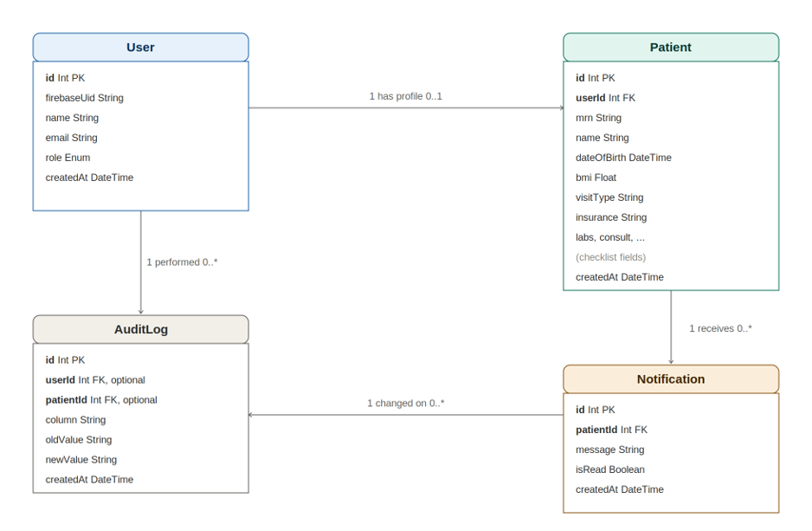
ARCHITECTURE - DATA TIER
Database Design
The application uses four tables in PostgreSQL, managed through the Prisma ORM: User, Patient, AuditLog, and Notification.
Key Design Decisions
User and Patient are kept as separate tables
All clinical checklist fields are plain strings on
Firebase handles authentication outside of the application database
Limitations:
AI conversation memory is NOT persisted to this database - documented limitation (in-memory only, scoped per session)
CS673 - Team 1 - BariatricPath - Final Iteration - Summer 2026

Slide 11
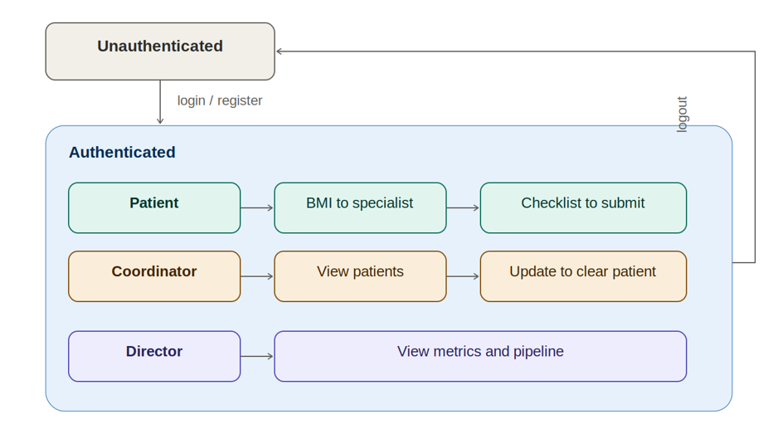
Overall System State Summary
How users move through the system
CS673 - Team 1 - BariatricPath - Final Iteration - Summer 2026
9

Slide 12
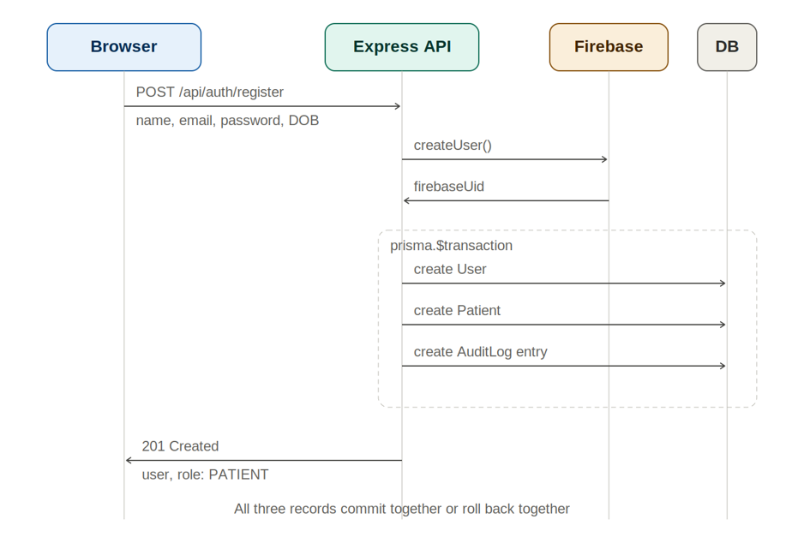
Sequence Diagrams
Patient Registration
CS673 - Team 1 - BariatricPath - Final Iteration - Summer 2026

Slide 13
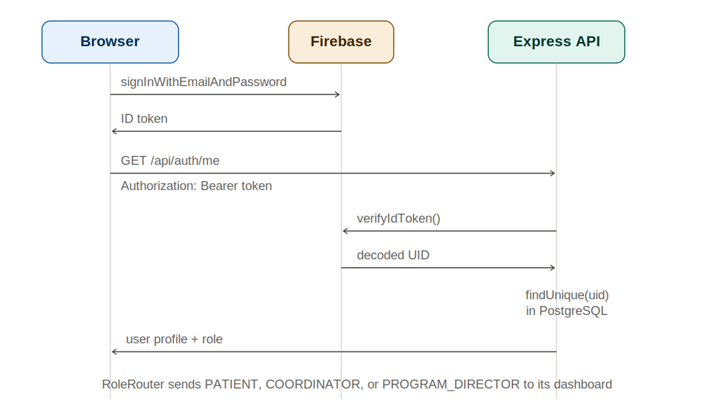
Sequence Diagrams
Login and Role-Based Routing
CS673 - Team 1 - BariatricPath - Final Iteration - Summer 2026

Slide 14
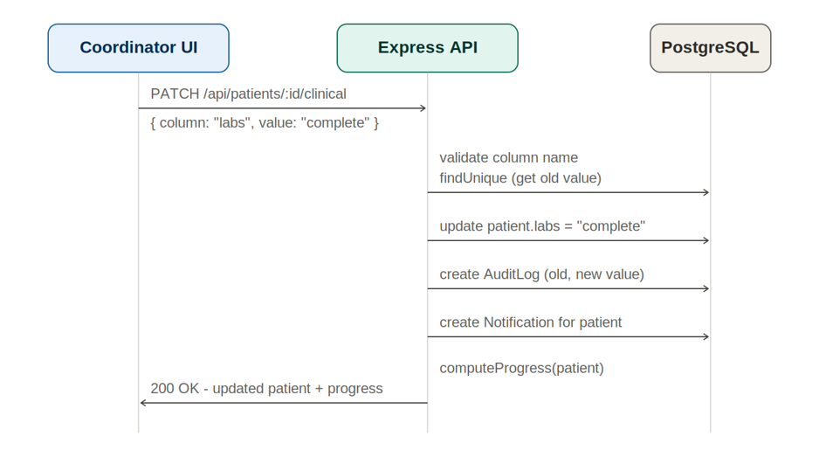
Sequence Diagrams
Coordinator Updates Clinical Status
CS673 - Team 1 - BariatricPath - Final Iteration - Summer 2026

Slide 15
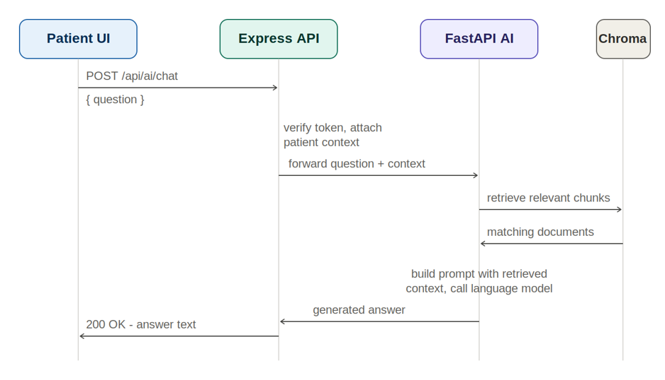
Sequence Diagrams
AI Chat (Retrieval-Augmented Generation)
CS673 - Team 1 - BariatricPath - Final Iteration - Summer 2026

Slide 16



ARCHITECTURE
Technology Stack & Key Decisions
Technology Stack
Key Architectural Decisions
Frontend | React + Vite + Bootstrap
Backend | Node.js + Express
Database | PostgreSQL + Prisma ORM
Auth | Firebase Authentication
AI Service | Python FastAPI + LangChain + ChromaDB + GPT-4.1-mini
Containers | Docker + Docker Compose (4 services)
CI/CD | GitHub Actions (CI, CodeQL, Trivy, ZAP)
Deployment | DigitalOcean Droplet + Nginx (HTTPS)
Project Mgmt | Jira (Scrum)
Firebase over custom JWT/bcrypt
Firebase issues ID tokens and hashes passwords - eliminates redundant security-sensitive code (less attack surface to maintain).
Python microservice for AI
FastAPI + LangChain + ChromaDB is the right ecosystem for RAG; Node stays focused on the web API.
Security woven in from Iteration 1
Audit logging, RBAC, input validation, and secrets management were not bolted on - they were part of the original design.
Named constants over magic numbers
MEMORY_WINDOW_SIZE and RETRIEVAL_TOP_K replace hardcoded 7/10/3 in the AI service for readability and maintainability (Iteration 3 fix).
CS673 - Team 1 - BariatricPath - Final Iteration - Summer 2026
11

Slide 17
03
Implementation
& AI Chatbot
Project structure, code metrics, and the BariatricPath AI assistant.
CS673 - Team 1 - BariatricPath - Final Iteration - Summer 2026
12

Slide 18




IMPLEMENTATION
Project Structure & Code Metrics
Repository Structure
Code Size & Test Metrics
cs673olsum26project-team1/
├── client/ React frontend (Vite)
│ └── src/
│ ├── components/ Reusable UI + AIChatWidget
│ ├── pages/ Portal, Dashboards, Auth
│ ├── context/ AuthContext
│ └── __tests__/ Vitest (34 tests)
├── server/ Express backend
│ ├── routes/ auth, patients, ai, notifications
│ ├── prisma/ schema + migrations
│ ├── middleware/ verifyAuth, RBAC
│ ├── searchDB/, utils/
│ └── __tests__/ Jest+Supertest (258 tests)
├── ai-service/ FastAPI RAG microservice
│ ├── main.py, rag.py
│ ├── data/ CSV knowledge bases x3
│ └── tests/ pytest (9 tests)
├── .github/workflows/ CI, CodeQL, Trivy, ZAP
└── docker-compose.yml 4-service orchestration
~23,000+
258
Lines of code (KLOC ~23)
Server tests (Jest/Supertest)
84
9
Client tests (Vitest)
AI service tests (pytest)
351
21/21
Total automated tests
Server suites - 100% passing
Every source file carries an AI-USAGE SUMMARY header documenting tool, % contribution, and human modifications - a project-wide convention for AI transparency.
CS673 - Team 1 - BariatricPath - Final Iteration - Summer 2026
13

Slide 19





IMPLEMENTATION - AI MICROSERVICE
The AI Assistant: Role-Based RAG
Retrieval-Augmented Generation: the AI answers from BariatricPath's own knowledge base, not just general training data.
1. Question
2. Embed
3. Retrieve
4. Augment
5. Generate
User asks a question via the chat widget
Question converted to a vector via OpenAI embeddings
ChromaDB returns top-3 matches, filtered by role metadata
Retrieved context + patient data + last 7 exchanges merged into prompt
GPT-4.1-mini produces a role-appropriate answer
Role-Based Prompt Behavior
Role | Prompt Style | Response Length | Knowledge Source
PATIENT | Warm, encouraging | 2-3 sentences | bariatric_program_faq.csv
COORDINATOR | Professional, direct | 3 sentences or steps | coordinator_guide.csv
PROGRAM_DIRECTOR | Strategic, data-focused | Max 5 bullet points (plain dashes) | director_guide.csv
Conversation Memory
MEMORY_WINDOW_SIZE = 7 (named constant)
Last 7 exchanges stored AND used per session_key (role + patient_id).
In-process dict for this iteration's scope - documented limitation with Redis/Prisma path forward.
CS673 - Team 1 - BariatricPath - Final Iteration - Summer 2026
14

Slide 20


IMPLEMENTATION - CROSS-CUTTING FLOW
Sequence Diagram - AI Chat Request
End-to-end flow showing authentication, role-based access control, and the AI microservice boundary.
User
React Frontend
Express API (verifyAuth)
Firebase Auth
Prisma / Postgres
AI Service (FastAPI)
1. Asks question in chat widget
2. POST /api/ai/chat + Firebase ID token
3. verifyIdToken(token) -> 4. Decoded UID + role returned
5. Fetch patient context -> 6. Insurance, specialist, progress returned
7. Forward question + role + context (internal Docker network only)
8. RAG: ChromaDB retrieve top-3 + GPT-4.1-mini generate
9. JSON answer returned through Express to frontend, rendered in chat bubble
CS673 - Team 1 - BariatricPath - Final Iteration - Summer 2026
15
Notes:
Native PowerPoint sequence diagram - editable. Steps 3-4 show RBAC enforcement before any AI call. Step 7 highlights the internal-only network boundary for the AI service.

Slide 21
IMPLEMENTATION - CODE QUALITY
Refactoring Example: Removing Magic Numbers
Professor feedback (Iteration 2): conversation memory used magic numbers 7 and 10 with no documented rationale. Fixed in rag.py for the final iteration.
BEFORE
AFTER
for msg in history[-7:]:
history_str += (
f"User: {msg['question']}\n"
f"Assistant: {msg['answer']}\n"
)
# ... later, in a different
# function entirely:
if len(history) > 10:
history = history[-10:]
# Configuration constants
MEMORY_WINDOW_SIZE = 7
# number of past exchanges
# kept AND used in the prompt
# (aligned - no unexplained gap)
RETRIEVAL_TOP_K = 3
# ChromaDB results per query
for msg in history[-MEMORY_WINDOW_SIZE:]:
...
if len(history) > MEMORY_WINDOW_SIZE:
history = history[-MEMORY_WINDOW_SIZE:]
Issues:
Two unrelated magic numbers (7 and 10) with no documented relationship
Unclear why 10 are stored but only 7 are used in the prompt
Hard for a new contributor to safely change either value
Result:
One named constant, single source of truth, self-documenting
Stored window = used window - no unexplained discrepancy
Documented as a known limitation with a Redis/Prisma production path in code comments
CS673 - Team 1 - BariatricPath - Final Iteration - Summer 2026
16

Slide 22
04
Testing
& Quality Assurance
Test types, coverage metrics, pass rates, and our CI/CD pipeline.
CS673 - Team 1 - BariatricPath - Final Iteration - Summer 2026
17

Slide 23




TESTING & QA
Testing Strategy & Coverage
351
100%
83.7%
79.2%
Total automated tests
Server test pass rate (258/258)
Server statement coverage
Client statement coverage
Testing Types & Levels
Unit Tests
Integration Tests
9 of 21 suites - isolated functions/components with mocked dependencies
13 of 21 suites - routes + DB/Firebase/AI mocks exercised together (Jest+Supertest, pytest)
Manual / Exploratory
End-to-End (Manual)
Each member manually tests own features against acceptance criteria each sprint
Full user journeys walked manually before each iteration demo; Playwright/Cypress scoped for future automation
Coverage Highlights by Area
server/utils & searchDB
server/middleware/verifyAuth.js
client/pages/PatientPortal.jsx
100% / 95-100% / 100%
68% / 50% / 68%
88.1% / 80% / 91.9%
Stmts / Branch / Lines - calculators, validators, audit
Auth middleware - hardening target for Iteration 3
Core patient-facing page, well covered
CS673 - Team 1 - BariatricPath - Final Iteration - Summer 2026
18

Slide 24
TESTING & QA
QA Strategies
43 PRs
11 Issues
83.7%
79.2%
Reviewed and merged
Resolved and closed
Server statement coverage
Client statement coverage
Merging Strategy
Dev Branch
Main Branch
At least one team member needs to review the code
All existing tests and CI/CD checks need to pass
All merge conflicts need to be resolved
All acceptance tests need to be met
All PRs reviewed and merged with dev branch
Merged with Main branch at the end of each iteration
GitHub Issues
Refactorings
UI Fixes
Refactoring needs
Missing Features
Security Flaws
Patient Portal
Stmts / Branch / Lines - calculators, validators, audit
Auth middleware - hardening target for Iteration 3
Core patient-facing page, well covered
CS673 - Team 1 - BariatricPath - Final Iteration - Summer 2026
18

Slide 25

TESTING & QA - AUTOMATION
CI/CD Pipeline (GitHub Actions)
Every push and pull request automatically runs four workflows - tests must pass before merge to dev.
CI - Tests & Linting
CodeQL Security Analysis
Trivy Container Scanning
OWASP ZAP - DAST
Server: Jest + Supertest (258 tests)
Client: Vitest (34 tests)
AI Service: pytest (9 tests)
ESLint code quality
npm audit (server + client)
Deep SAST for JavaScript + Python
SQL/NoSQL injection, XSS detection
Insecure auth pattern detection
Hardcoded credential scanning
Weekly scheduled re-scan
Secret detection (filesystem scan)
Container CVE scans (3 images)
Dockerfile misconfiguration checks
ignore-unfixed CVEs filtered
Weekly scheduled re-scan
Live attack on running AI service
Baseline scan (-a, all alerts)
Checks headers, info disclosure
HTML/JSON/MD report as artifact
Result: 0 High/Med/Low findings
Built incrementally by the Security Lead, one workflow at a time - each verified green before adding the next. All four workflows pass on every PR to dev.
CS673 - Team 1 - BariatricPath - Final Iteration - Summer 2026
19

Slide 26
05
Security
by Design
Threat model, layered controls, and an automated security pipeline.
CS673 - Team 1 - BariatricPath - Final Iteration - Summer 2026
20

Slide 27



SECURITY - STRATEGY
Defense in Depth - Our Security Model
BariatricPath handles protected health information (PHI). Security was a design requirement from Sprint 1, not an afterthought - every layer of the stack enforces its own controls so that a failure in one layer doesn't expose the whole system.
Identity & Access
Application Layer
Data & Privacy
Network & Infra
Continuous Verification
Firebase Authentication (ID tokens, password hashing)
verifyAuth middleware on every protected route
Role-Based Access Control (Patient / Coordinator / Director)
Input validation on all forms & API payloads
Parameterized queries via Prisma (no raw SQL)
Account-enumeration protection on password reset
Append-only AuditLog for every status change
No plaintext passwords stored anywhere
Mandatory Privacy Policy & Consent before access (BARI-156)
AI service isolated on internal Docker network only
HTTPS via Nginx reverse proxy in production
Secrets managed via environment variables, never committed
SAST (CodeQL) on every PR + weekly
Container/secret scanning (Trivy)
DAST (OWASP ZAP) against the running AI service
Layer 1: Who are you? -> Layer 2: What are you allowed to send? -> Layer 3: Is your data protected at rest? -> Layer 4: Can attackers reach internal services? -> Layer 5: Are we still secure as code changes?
CS673 - Team 1 - BariatricPath - Final Iteration - Summer 2026
21

Slide 28

SECURITY - THREAT MODELING
Threat Model: Key Risks & Mitigations
STRIDE-informed review of the patient data and AI chat flows - the highest-value targets given the PHI involved.
STRIDE Category | Risk Scenario | Mitigation | Status
Spoofing | An attacker impersonates a patient or coordinator to access records they shouldn't see. | Firebase ID tokens (signed JWTs) verified server-side on every request; no client-trusted role claims. | Mitigated
Tampering | A user modifies request payloads to alter another patient's clinical/insurance data. | Server-side RBAC + Prisma ownership checks; all writes go through verifyAuth before reaching routes. | Mitigated
Repudiation | A coordinator denies making a status change that affected a patient's care pathway. | Append-only AuditLog records who, what, old/new value, and timestamp for every change - immutable. | Mitigated
Information Disclosure (IDOR) | Object-level access control gap - could a user fetch another user's patient record by guessing an ID? | Documented gap owned by Security Lead; ownership checks added to patient routes; tracked for Iteration 3 hardening. | Tracked
Denial of Service | AI service or DB overwhelmed by repeated chatbot requests. | AI service isolated on internal network (not internet-facing); rate-limiting identified as a future hardening item. | Tracked
Elevation of Privilege | A patient-role user attempts to call coordinator/director-only endpoints or AI prompts. | Role passed server-side from verified token (not client input); role-based prompt templates enforced in rag.py. | Mitigated
IDOR (object-level access control) is our most actively tracked gap - owned by the Security Lead and on the Iteration 3 hardening backlog.
CS673 - Team 1 - BariatricPath - Final Iteration - Summer 2026
22

Slide 29


SECURITY - DYNAMIC APPLICATION SECURITY TESTING
OWASP ZAP: Live Attack Simulation Results
ZAP (Zed Attack Proxy) runs an automated baseline scan against the live AI service before every merge - simulating real attacker reconnaissance.
Risk Summary
The 5 Informational Findings - Explained
High
0
Sec-Fetch-Dest / Mode / Site / User headers missing
3 instances
Modern browser "fetch metadata" headers - informational hardening signal, not exploitable on a non-public, internal-only API.
Medium
0
Low
0
Storable and Cacheable Content
3 instances
JSON API responses are cacheable by default; recommendation is to set explicit Cache-Control headers on sensitive endpoints.
Informational
5
Zero High, Medium, or Low
risk findings on the AI
microservice endpoint
Scan Insights (127.0.0.1:8000 - 2 endpoints)
100%
100%
100%
responses w/ status 4xx on unauth probes
endpoints return application/json
endpoints accessed via GET (no risky verbs)
CS673 - Team 1 - BariatricPath - Final Iteration - Summer 2026
Full report: BariatricPath_ZAP_report.html (CI artifact, generated Jun 12 2026, ZAP 2.17.0)
23
Notes:
Speaking notes: emphasize that ZAP runs a LIVE attack against the running AI service in CI - this is dynamic, not static, testing. Zero exploitable findings. The 5 informational items are hardening suggestions, not vulnerabilities, and are explained on this slide. If you have a screenshot of the ZAP report or the GitHub Actions run, add it to the right side or as a follow-up slide.

Slide 30
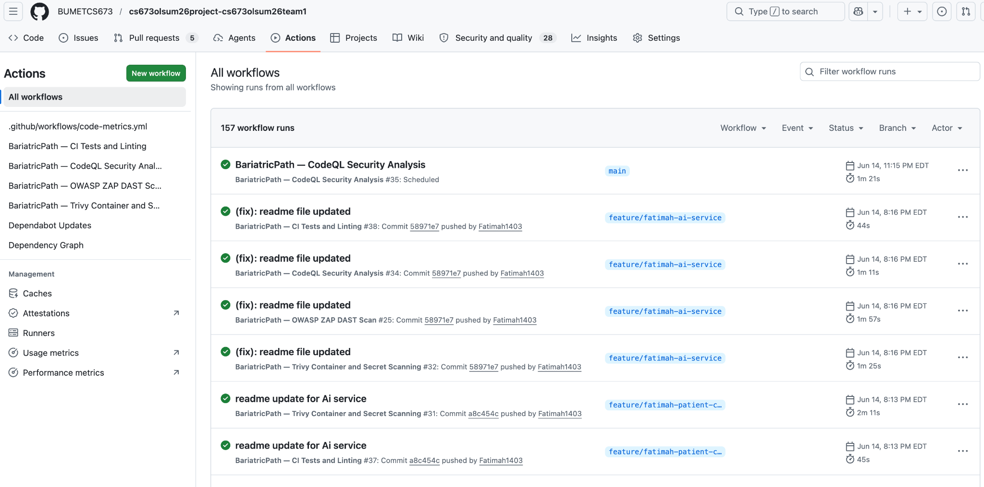
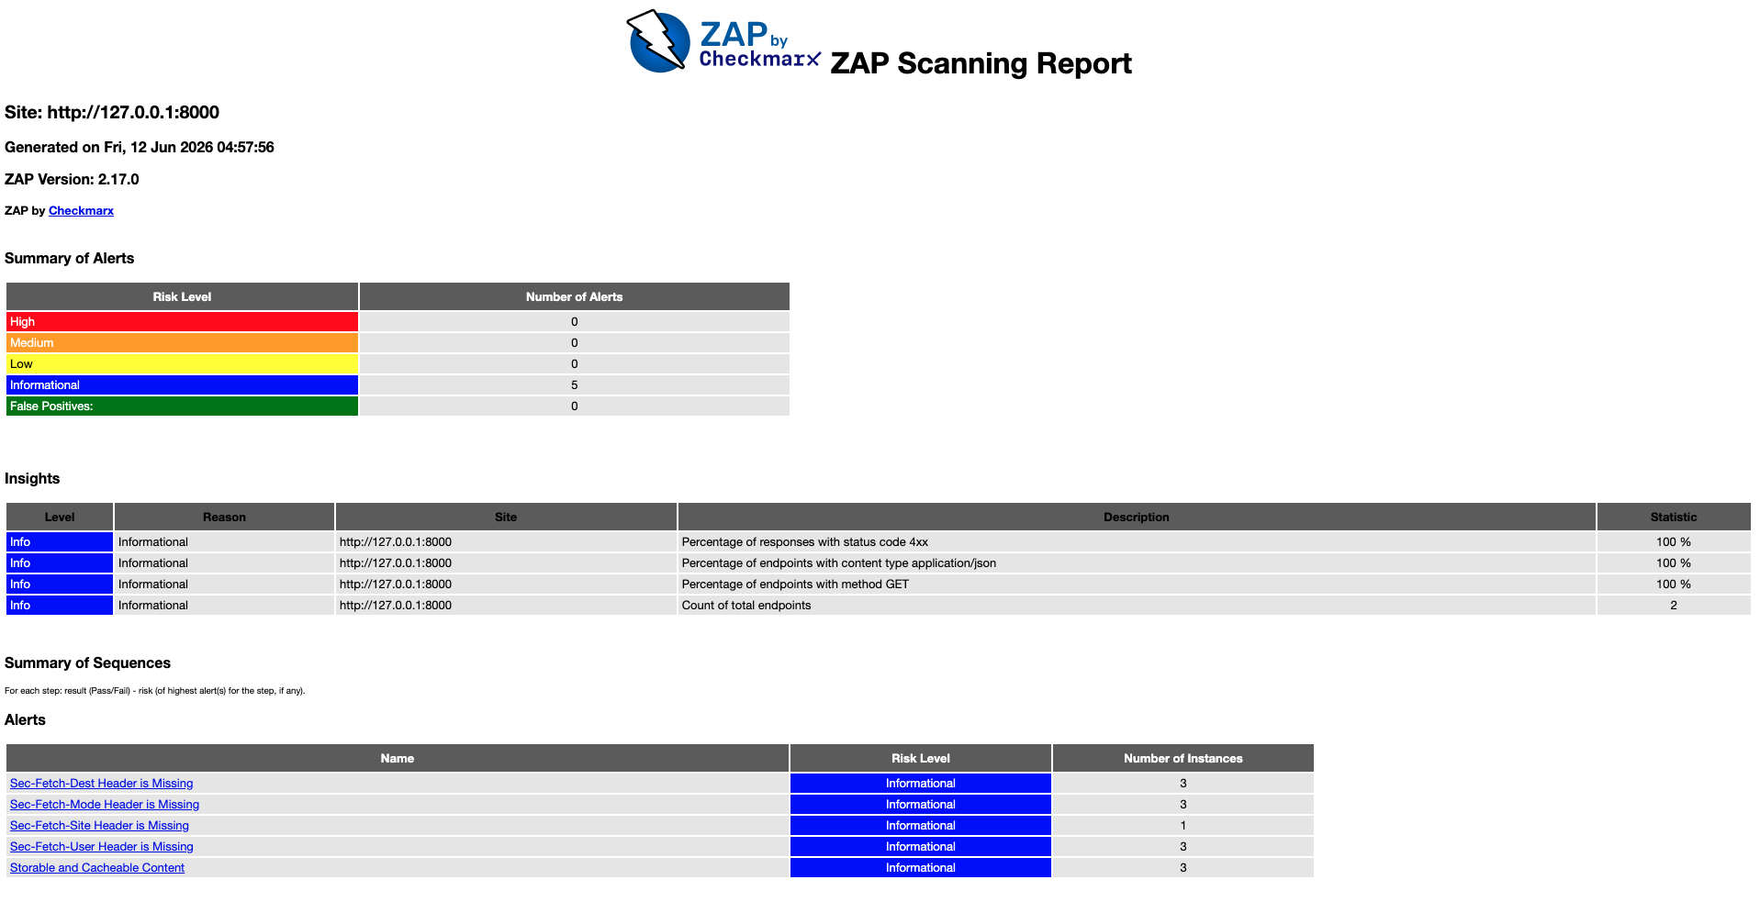
SECURITY - DYNAMIC APPLICATION SECURITY TESTING
OWASP ZAP: Live Attack Simulation Results and the CI
ZAP (Zed Attack Proxy) runs an automated baseline scan against the live AI service before every merge - simulating real attacker reconnaissance.
Risk Summary
Zero High, Medium, or Low
risk findings on the AI
microservice endpoint
Scan Insights (127.0.0.1:8000 - 2 endpoints)
100%
100%
100%
responses w/ status 4xx on unauth probes
endpoints return application/json
endpoints accessed via GET (no risky verbs)
CS673 - Team 1 - BariatricPath - Final Iteration - Summer 2026
Full report: BariatricPath_ZAP_report.html (CI artifact, generated Jun 12 2026, ZAP 2.17.0)
23
Notes:
Speaking notes: emphasize that ZAP runs a LIVE attack against the running AI service in CI - this is dynamic, not static, testing. Zero exploitable findings. The 5 informational items are hardening suggestions, not vulnerabilities, and are explained on this slide. If you have a screenshot of the ZAP report or the GitHub Actions run, add it to the right side or as a follow-up slide.

Slide 31
06
Deployment
& Operations
Containerized deployment, HTTPS, and known limitations.
CS673 - Team 1 - BariatricPath - Final Iteration - Summer 2026
24

Slide 32
DEPLOYMENT
Deployment Architecture - DigitalOcean
All five services run as Docker containers on a single DigitalOcean droplet, orchestrated via Docker Compose, behind an Nginx reverse proxy with HTTPS.
DigitalOcean Droplet (Ubuntu)
Operational Notes
Nginx Reverse Proxy - HTTPS (TLS termination, port 443)
Known Limitation: Email
Confirmation emails use Nodemailer with Gmail. Emails do not send on the deployed droplet because DigitalOcean blocks outbound SMTP. The app skips the email silently and the submission completes normally.
Production fix: verify a custom domain in Firebase or use SendGrid/Postmark.
Secrets
All Firebase service-account keys, DB URLs, and API keys are injected via environment variables - never committed to the repo.
CI/CD to Deploy
GitHub Actions runs all test + security workflows on PR to dev; deployment to the droplet is a manual pull + compose up for this iteration.
Client
Server
AI Service
PostgreSQL
Vite dev server
port 5173"
Express API
port 5001
FastAPI
port 8000 (internal)
+ ChromaDB
Persistent volume
for data
Docker container
Docker container
Docker container
Docker container
docker-compose.yml orchestrates all 5 containers - AI service joins the internal Docker network only (no public port)
CS673 - Team 1 - BariatricPath - Final Iteration - Summer 2026
25

Slide 33




Live Demo
Walking through the patient, coordinator, director, and AI assistant flows: Link to video in Drive
Privacy Policy & Registration
30-Second Auto Update
1
6
Appointment Checklist
Surgery Cleared Banner
2
7
Notifications (real-time)
Program Director Pipeline View
3
8
Coordinator Dashboard
AI Assistant - all 3 roles
4
9
Patient Detail & Status Update
Security: CI/CD pipeline + ZAP report
5
10
CS673 - Team 1 - BariatricPath - Final Iteration - Summer 2026
27

Slide 34

AI USAGE & REFLECTIONS
How We Used AI to Build BariatricPath
Every source file is tagged [AI] / [HYBRID] / [HUMAN] in its AI-Usage Summary header and commit messages (Conventional Commits).
Where AI Helped Most
AI Microservice Scaffolding
RAG pipeline structure, LangChain v0.3 LCEL patterns, ChromaDB integration - then hand-tuned prompts and role logic.
Test Suite Generation
Initial Jest/Vitest/pytest scaffolds and mocks, refined for correct mock ordering and edge cases by the team.
Security Pipeline Configuration
GitHub Actions YAML for CodeQL/Trivy/ZAP - built incrementally, each workflow verified green before the next.
Documentation
README files, AI-usage headers, and this presentation - drafted with AI, reviewed and corrected by the team.
Estimated overall AI contribution across code + documentation
Reflection: AI accelerated scaffolding and boilerplate, but architectural decisions, security review, and acceptance testing remained human-owned and human-verified throughout.
CS673 - Team 1 - BariatricPath - Final Iteration - Summer 2026
26

Slide 35
PROJECT MANAGEMENT - RETROSPECTIVE
Lessons Learned & Project Retrospective
Achievements
Challenges & How We Solved Them
Shipped a 4-service system: React + Express + PostgreSQL + AI microservice
357 automated tests, 100% server pass rate, 83.7% statement coverage
Full role-based RAG AI assistant with conversation memory
Automated security pipeline: CI, CodeQL, Trivy, OWASP ZAP - all green
Deployed to a live DigitalOcean environment with HTTPS
Python version conflicts (3.13 broke pydantic-core)
-> Pinned ai-service to Python 3.11 across local + Docker + CI.
Jest mock ordering caused intermittent failures
-> Documented the correct mockResolvedValueOnce/mockRejectedValueOnce sequencing for auth + DB mocks.
Docker volume cache hid missing dependencies
-> Standardized on running npm install inside the container shell when supertest errors appeared.
SonarCloud blocked by org-owner approval
-> Pivoted to CodeQL + Trivy for SAST coverage instead of waiting on access.
Risk & Quality Management
Key Lessons
PR branch protection on dev - 1+ reviewer, all tests passing, no merge conflicts
Reviewer assigned by ownership domain (e.g. Security Lead reviews auth/security PRs)
11 GitHub Issues tracked (All closed)
Weekly scheduled CodeQL + Trivy re-scans catch drift between PRs
Security and testing built in from Iteration 1 pay off - no late-stage scramble
Named constants and small refactors compound: easier review, fewer bugs
AI accelerates scaffolding, but architecture & review must stay human-led
Documenting known limitations (vs. hiding them) builds reviewer trust
CS673 - Team 1 - BariatricPath - Final Iteration - Summer 2026
28

Slide 36
Thank You
Questions & Feedback
Team 1 - BariatricPath
Kai Fernandes - Shaima Nimeri - Fatimah Hassan - Kolya Gavlishin - Jianing Li
CS673 Software Engineering - Final Iteration - Summer 2026

