Slide 1


BariatricPath
A Clinical Evaluation Management System
Iteration 2 Presentation
CS673 Software Engineering · Team 1 · Summer 2026
Presented by: Jianing Li & Kolya Gavlishin

Slide 2

OUR TEAM
Meet Team 1
BARIATRICPATH
A web-based clinical evaluation management system that digitizes the multi-stage bariatric surgery evaluation workflow — connecting patients, coordinators, and program directors through a single source of truth with role-based access and a complete audit trail.
SN
Shaima Nimeri
KF
Kai Fernandes
FH
Fatimah Hassan
Team Lead
Design & Implementation Lead
Requirement Lead
Team Co-Lead
Configuration Co-Lead
Security Lead
Configuration Co-Lead
JL
Jianing Li
KG
Kolya Gavlishin
Requirement Co-Lead
QA Lead
Design & Implementation Co-Lead
CS673 · Team 1 · Iteration 1
2 / 13

Slide 3



AGENDA
Today's Agenda
Three focus areas — per Prof's guidance
01
Requirement Analysis
User stories, INVEST principle, and what we've prioritized.
02
Architecture
Three-tier client-server design, technology stack, AI microservice, and key design decisions.
03
Implementation
What we built this iteration:
Patient Portal Features
Coordinator Dashboard Features
AI Microservice
CS673 · Team 1 · Iteration 1
2 / 13

Slide 4

AGENDA
Today's Agenda
Three focus areas — per Prof's guidance
04
Testing
Jest tests, Manual tests,
05
QA Practices
Pull Requests, Code Reviews, GitHub Issues, Refactoring,
06
Feedback Implementation
Clearer Instructions for how to run, file structure on GitHub
07
Q & A
Discussion and feedback from class.
CS673 · Team 1 · Iteration 1
2 / 13

Slide 5



BACKGROUND
The Problem We're Solving
Bariatric surgery evaluation is a multi-stage process involving surgeons, psychologists, dietitians, cardiologists, and more.
Fragmented data
Critical info scattered across systems
Today it's managed through phone calls, paper checklists, spreadsheets, and disconnected systems.
No patient visibility
Patients get no visibility. Coordinators track dozens of cases manually. Directors have no real-time pipeline view.
Patients can't see their own progress
Manual coordination
Hours lost on phone calls and updates
CS673 · Team 1 · Iteration 2
3 / 13

Slide 6



SOLUTION OVERVIEW
Our Solution: BariatricPath
A web app digitizing the full evaluation workflow with role-based access and audit trail.
Patient Portal
Coordinator Dashboard
Director View
Self-registration, checklist tracking, real-time status, and an AI assistant for questions about their journey.
Manage all patients, update workflow stages, search and filter, with every change automatically reflected in patient portals.
Real-time pipeline visibility, filter by specialist or stage, and pipeline metrics at a glance.
Master patient table as the single source of truth — all updates propagate automatically.
CS673 · Team 1 · Iteration 2
4 / 13

Slide 7
01
Requirement
Analysis
User stories, INVEST principle, and iteration scope.

Slide 8
REQUIREMENTS
How We Manage Requirements
INVEST-compliant user stories tracked in Jira with breakdown tasks and acceptance criteria.
30+
21
5
User Stories Written
Essential Features (Iter 1–3)
Story Points Avg (Fibonacci)
Every story follows INVEST
I
Independent
N
Negotiable
V
Valuable
E
Estimable
S
Small
T
Testable
stands alone
details can shift
delivers real value
team can size it
fits one iteration
clear acceptance
EXAMPLE — BARI-7
"As a patient, I want to create an account with my email and password, so that I can access my patient portal securely."
Given/When/Then acceptance tests · 6 breakdown subtasks · 5 story points
CS673 · Team 1 · Iteration 2
6 / 13

Slide 9
02
Architecture
& Design
Three-tier client-server design with deliberate security and AI-readiness.

Slide 10




ARCHITECTURE
System Architecture
Three-tier today, with a fourth service (AI) joining in Iteration 2
CLIENT TIER
API TIER
DATA TIER
AI SERVICE
ITER 2
React SPA + Vite
Node.js + Express
PostgreSQL + Prisma
FastAPI + LangChain
Login / Register
Patient Portal
Coordinator UI
Director UI
REST endpoints
verifyAuth + RBAC
Audit logging
Gateway to AI
User & Patient tables
AuditLog (append-only)
Notifications
Prisma migrations
RAG chatbot
Internal-only (no public access)
Called via Express only
Python ecosystem
Security note: the AI service will live on an internal Docker network, never exposed publicly. Every AI request is gated by Express, which verifies the Firebase token first.
CS673 · Team 1 · Iteration 2
8 / 13

Slide 11


ARCHITECTURE
Stack & Key Decisions
Technology Stack
Key Architectural Decisions
Frontend
React + Vite + Bootstrap
Firebase — not custom JWT/bcrypt
Backend
Node.js + Express
Firebase issues ID tokens (JWTs) and hashes passwords. Adding our own = redundant complexity.
Database
PostgreSQL + Prisma ORM
Auth
Firebase Authentication
Microservice for AI
Containers
Docker + Compose
Python service in Iteration 2 — best language for the AI ecosystem, Node for the web.
AI (Iter 2)
Python FastAPI + LangChain
CI/CD
GitHub Actions
Security from scratch
Project Mgmt
Jira (Scrum)
Audit log, input validation, secrets management, HTTPS, all woven into Iteration 1.
CS673 · Team 1 · Iteration 2
9 / 13

Slide 12
03
Implementation
& Demo
What we built in Iteration 2 — and what's working live.

Slide 13


IMPLEMENTATION
What We Built — Iteration 2
Patient Experience & Onboarding
Coordinator Tools
Real-Time Sync & AI
Appointment Checklist (BARI-17): Read-only overview of evaluation status with color-coded badges.
Surgery Cleared Banner (BARI-20): Green banner automatically unlocks when progress hits 100%.
Privacy & Consent (BARI-156): Mandatory sign-off on data usage policies before access.
Insurance & Clinical Updates (BARI-21 & 22):
A complete coordinator dashboard with direct status controls that log audits and notify patients.
New Registration Queue (BARI-24): Sorts new registrations (last 7 days) to the top of the dashboard.
30-Second Auto-Update (BARI-18 & 23): Updates checklist and progress bar without page refreshes.
Status Notifications (BARI-19): Real-time read/unread notifications for patient updates.
AI Chatbot Assistant (BARI-29): Chatbot pulls patient context to answer status questions.
CS673 · Team 1 · Iteration 2
11 / 13

Slide 14

IMPLEMENTATION
Live Demo
Let's walk through the patient and coordinator flows
1
Privacy Policy
2
Appointment Checklist
3
Notifications
4
Coordinator Dashboard
5
Patient Detail Page
6
Auto Update
7
Surgery Cleared Banner
8
AI Service
CS673 · Team 1 · Iteration 2
12 / 13

Slide 15
04
Testing
& QA

Slide 16
AGENDA
Testing
Automated testing:
Server side:
Jest + Supertest
13 test suites
258 test cases
Client side:
Vitest
3 test files
34 tests
AI-Microservice
pytest
9 tests
Testing Types:
Manual tests
Each team member for their own features
Unit Tests
7 out of 16 automated test suites
Integration Tests
9 out of 16 automated test suites
End-to-end Tests
Manually towards the end of the unit
CS673 · Team 1 · Iteration 2
2 / 13

Slide 17
AGENDA
When Testing Happens
Before merge:
Run automated test suites locally before PR
Tests must pass before review.
On PR review:
Reviewer manually verifies the change against acceptance criteria from the user story
Also runs the test suites on their end
End of iteration:
All manual test cases re-run
Full test suite re-run
Coverage report regenerated
CS673 · Team 1 · Iteration 2
2 / 13

Slide 18
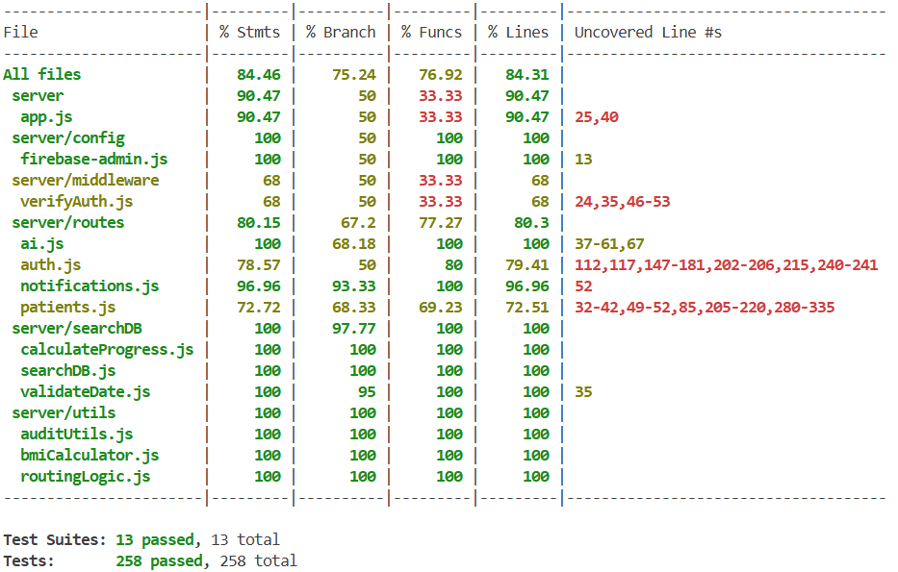
AGENDA
Test Coverage
Server:
CS673 · Team 1 · Iteration 2
2 / 13

Slide 19
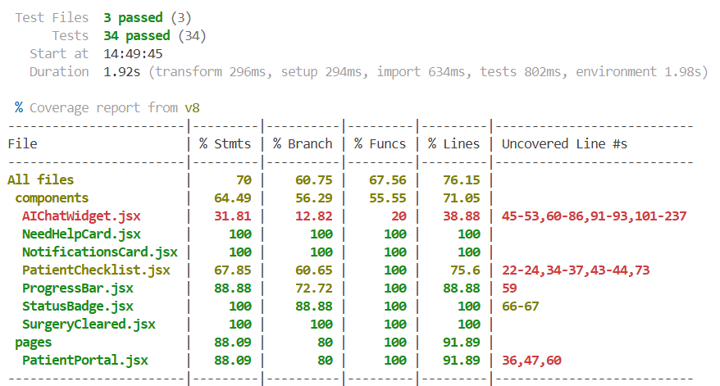
AGENDA
Test Coverage
Client:
CS673 · Team 1 · Iteration 2
2 / 13

Slide 20
AGENDA
QA Strategies
PR reviews:
To merge with the dev branch, at least one team member needs to review the code
All existing tests need to pass
All merge conflicts need to be resolved
All acceptance tests need to be met
New passing test cases covering new features need to be included
Code reviewed within 24 hours
12 PR closed and merged
CS673 · Team 1 · Iteration 2
2 / 13

Slide 21
AGENDA
QA Strategies
GitHub Issues:
Used for tracking bugs and refactoring
5 issues created
2 closed
3 open (to be addressed in iteration 3)
Refactoring:
Patient Portal
Problem: very long, varied, with unrelated functionality
Solution: Extract into smaller, single responsibility components that will be imported into Patient Portal
CS673 · Team 1 · Iteration 2
2 / 13

Slide 22

WRAP-UP
What's Next & Questions
Iteration 3 Roadmap
Thank you
CI/CD with GitHub Actions
Lint, tests, Prisma generate, security scans on every PR.
GitHub File Organization
Questions & Feedback
Separate code and tests into separate files in the directory
Deployment
Team 1 — BariatricPath
Digital Ocean
Kai · Shaima · Kolya · Jianing · Fatimah
Test Suite Expansion
Frontend coverage > 80% by end of Iteration 3.
CS673 Software Engineering — Summer 2026
CS673 · Team 1 · Iteration 2
13 / 13

