Slide 1
CS673 Software Engineering
Team 3 – DJVY
AI Test Generator
Project Proposal & Planning
Iteration 2
Danielle Leask Vy Trinh Jannatul Tuba Yuting Shi

Slide 2
Team Members and Roles
Presentation Title
Danielle Leask
Team Lead
Requirement Lead
Jannatul Tuba
Configuration Lead
QA Lead
Vy Trinh
Design & Implementation Lead
Security Lead
Yuting Shi
Design & Implementation Lead

Slide 3
Problem & Motivation
Current testing tools lack project context.
Generic test cases need manual changes.
Old documents slow down software releases.
Manual test creation takes too long.
Wrong requirements cause big system bugs.
Good AI tools fix these problems.

Slide 4
Project Overview
SpecCheck makes smart automatic test cases.
Main users are software QA teams.
System reads many different file types.
Simple dashboard helps manage test work.
Platform protects all private user data.
Project aims for fast test generation.

Slide 5
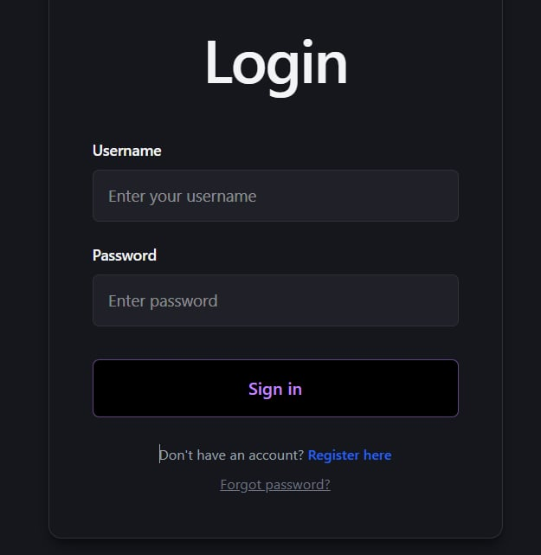
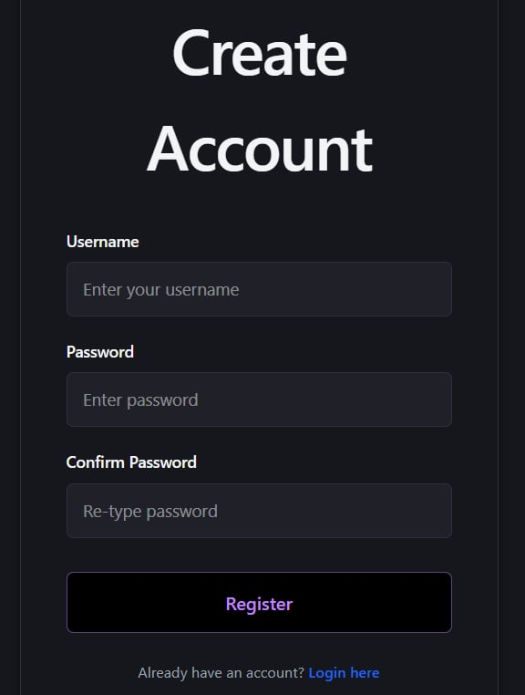
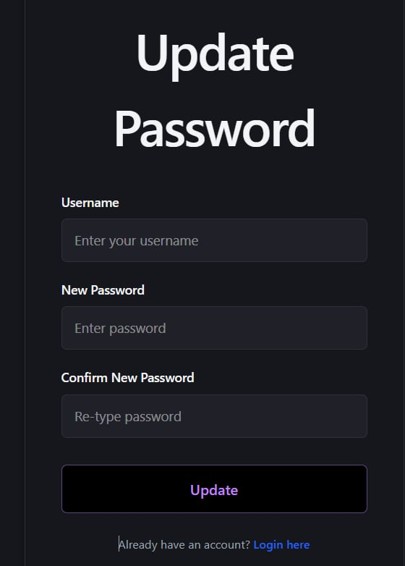
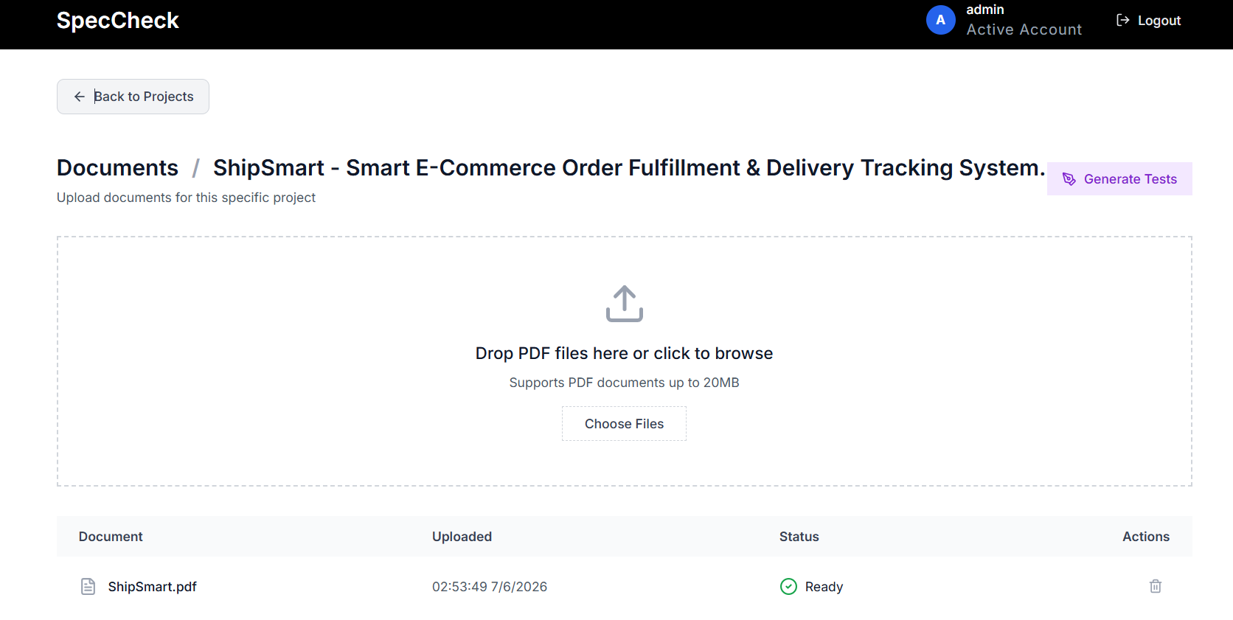
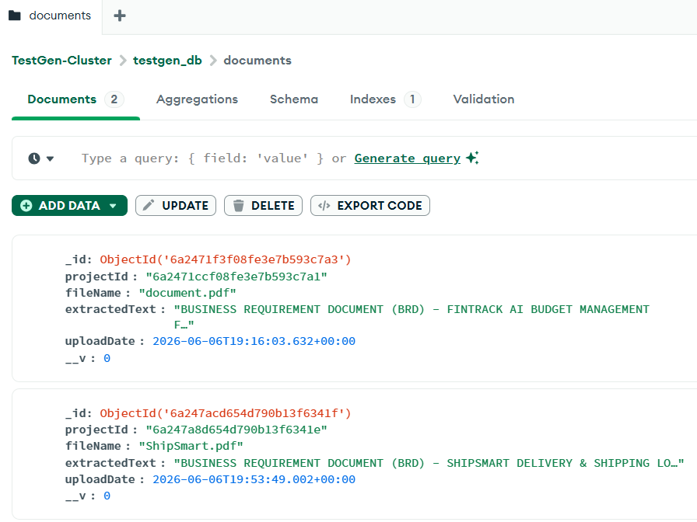
Key Features - Completed
User authentication system (Login & Logout) fully implemented.
User registration (Signup) completed and connected to MongoDB.
Document upload and storage functionality completed.
OCR/text extraction and document processing pipeline implemented.
RAG (Retrieval-Augmented Generation) knowledge indexing completed.

Slide 6
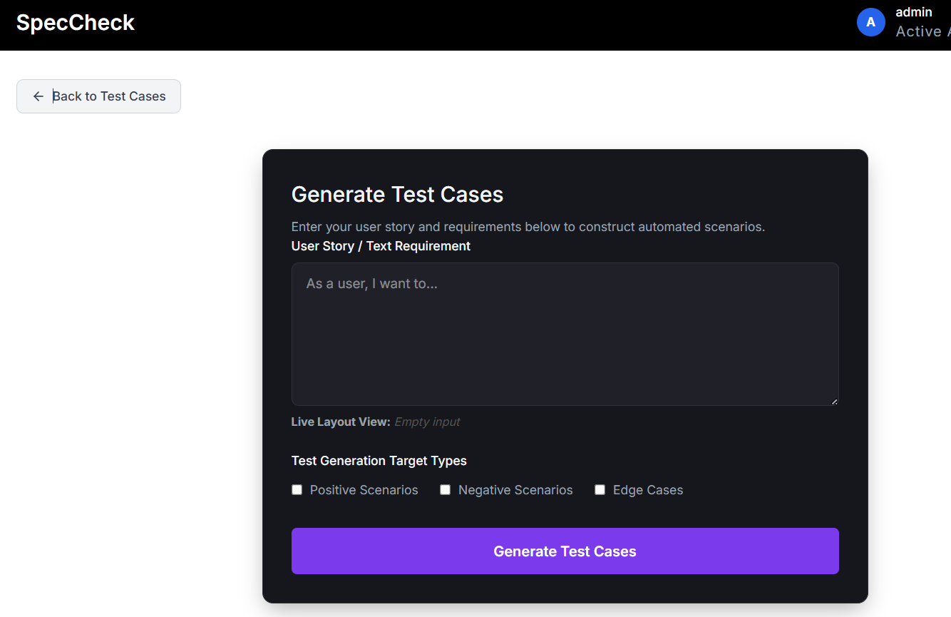
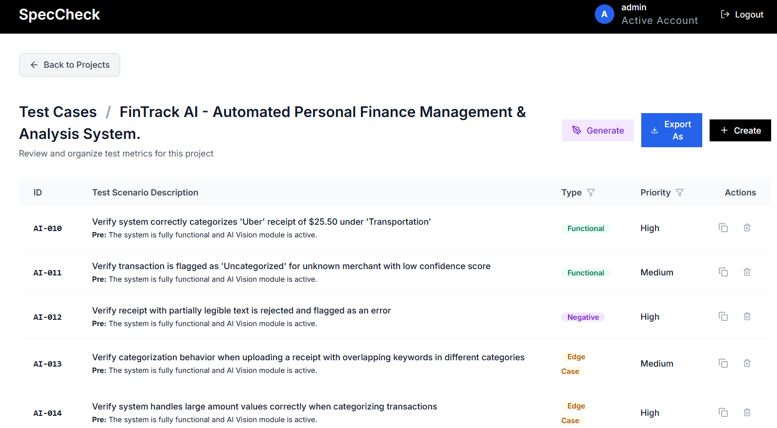
Key Features - Completed
AI-powered test case generation integrated using OpenAI APIs.
Test Case Dashboard implemented.
REST API endpoints documented and tested.
Frontend architecture refactored into reusable React components.
Docker containerization completed for development and testing.

Slide 7
Key Features - In Progress
Current Development
Password hashing using bcrypt.
Enhanced role-based access control.
AI output quality improvements.
Prompt optimization and hallucination reduction.
Test case coverage analysis.
Additional automated testing.
Dashboard UI refinement.

Slide 8
Key Features - Pending
Planned Features
Change Impact Analysis.
Historical test case search and filtering.
AI-generated test coverage metrics.
Cloud deployment.
Production monitoring and logging.
Multi-project management support.

Slide 9
Technology Stack
Frontend uses basic web design tools.
Backend uses stable Node Express setup.
MongoDB database stores all system data.
OpenAI models run the AI features.
GitHub code repository manages team work.
Jira platform tracks weekly group tasks.

Slide 10
Architecture & Workflow
System Workflow
User uploads project documents.
Documents are validated and stored.
Text is extracted and processed.
Content is chunked and indexed.
Relevant context is retrieved using RAG.
User submits requirements or user stories.
AI generates functional, negative, and edge test cases.
Generated results are stored in MongoDB.
Users review results through the dashboard

Slide 11
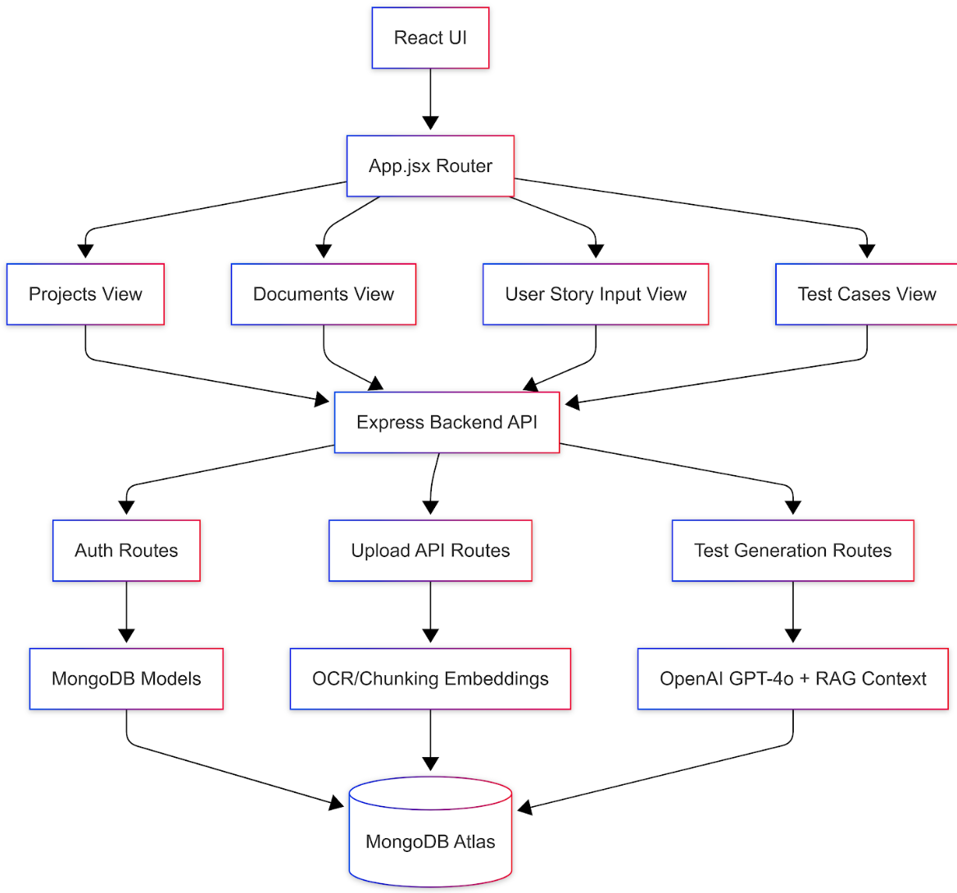
Architecture & Workflow
high-level architecture diagram

Slide 12
Current Status & Progress
Component | Status
Login | Complete
Logout | Complete
Signup | Complete
Document Upload | Complete
MongoDB Integration | Complete
Data Persistence | Complete
API Documentation | Complete
AI Generation | Complete
Component | Status
Test Case Dashboard | Complete
RAG Retrieval | Complete
Password Hashing | In Progress
Automated Testing | In Progress
Deployment | Planned
Overall Progress: ~75-80% complete

Slide 13
Timeline & Next Steps
Iteration 3 Goals
Security
Implement bcrypt password hashing.
Improve authentication security.
Quality
Expand automated testing coverage.
Add integration tests.
Add AI output evaluation metrics.
Features
Export generated test cases.
Change Impact Analysis.
Search and filtering capabilities.
Deployment
Cloud deployment.
Production environment setup.
CI/CD improvements

Slide 14
Risks & Mitigation
Technical Risks
Process Risks
Risk | Mitigation
AI hallucinated outputs | RAG grounding + prompt engineering
Security vulnerabilities | Password hashing + authentication review
MongoDB scaling issues | Optimized indexing and schema design
Incomplete test coverage | Automated testing pipeline
API dependency outages | Error handling and fallback logic
Risk | Mitigation
Requirement changes | Agile sprint planning
Merge conflicts | GitHub PR workflow
Defect accumulation | Jira tracking and prioritization

Slide 15
Testing

Slide 16
Testing Overview
1
2
3
4
5
Unit
Integration
System
Acceptance
Regression
Auth, upload, API
endpoints, DB CRUD,
AI logic, export
Frontend↔Backend
Backend↔MongoDB
AI↔Vector DB
Login, doc upload
AI generation
dashboard, export
Functional cases
negative/edge cases
export accuracy
Auth, AI pipeline
upload/export
dashboard re-test
Manual + automated testing conducted collaboratively each iteration

Slide 17
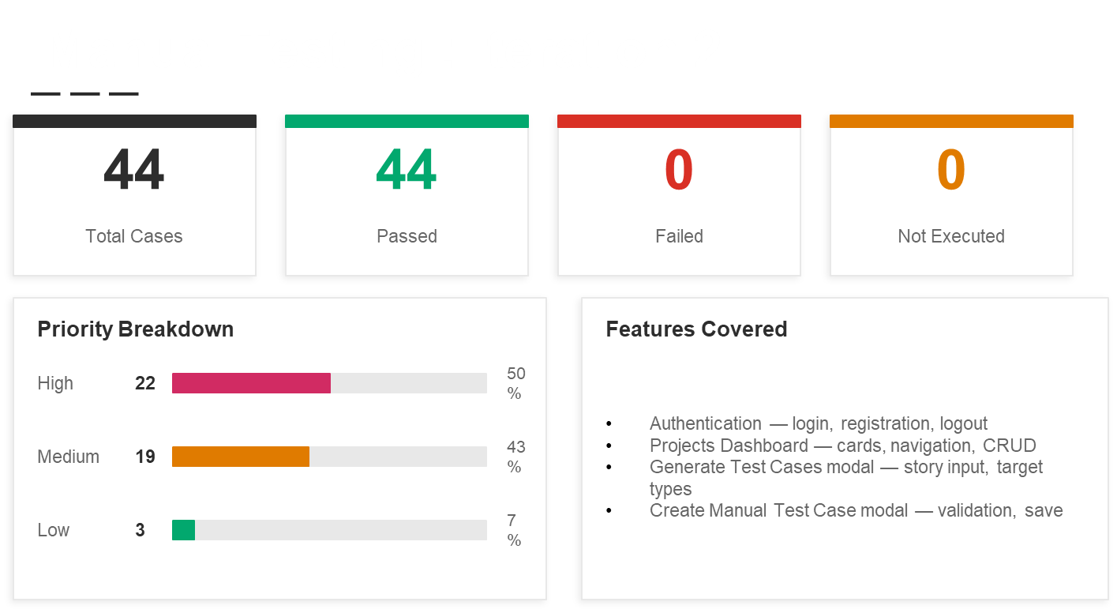

Slide 18
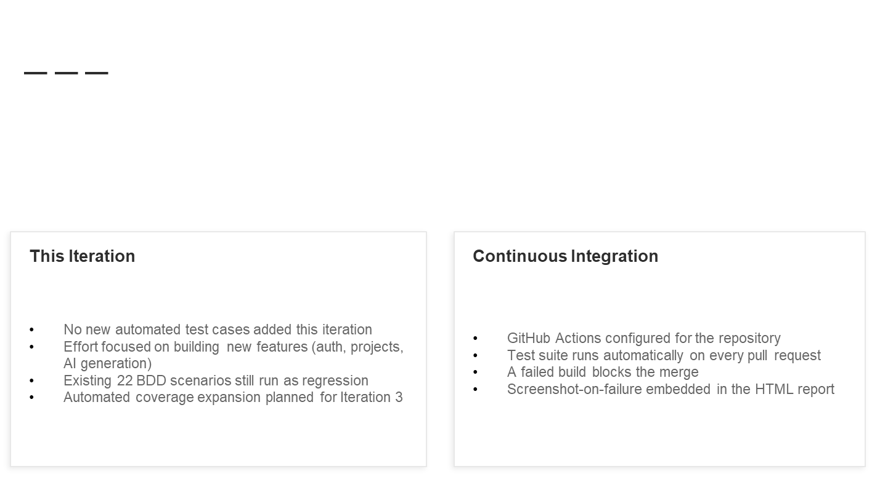

Slide 19
Automation Framework & Architecture
Browser
Automation
Test
Runner
BDD
Integration
HTML
Reports
Runtime
Playwright
1.44.0
Pytest 8.2
pytest-bdd
pytest-html
Python 3.12
Page Object Model Architecture
dashboard.feature
Gherkin BDD : 22 human-readable scenarios
dashboard_page.py
DashboardPage class : all locators & browser interactions
dashboard_steps.py
@given / @when / @then step definitions
conftest.py
Session fixtures, fetch mock, screenshot-on-failure hook
reports/report.html
Auto-generated HTML test report after every run

Slide 20
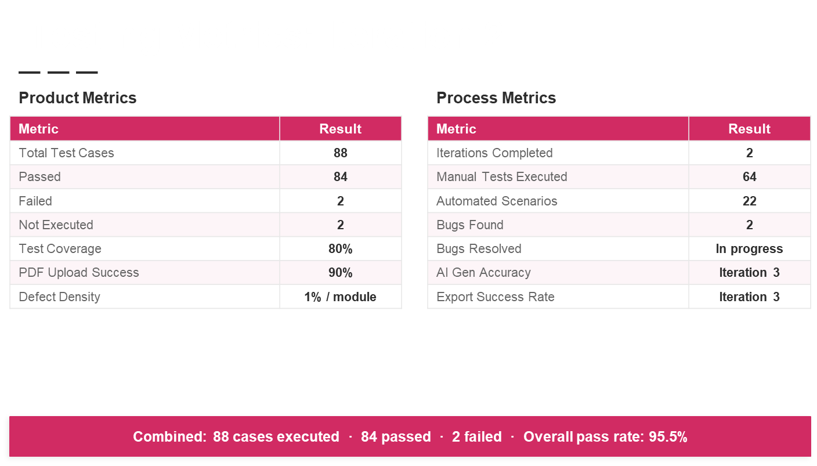

Slide 21
Thank you!

