Slide 1

CS673 Software Engineering
Team 3 – SpecCheck
AI Test Generator
Danielle Leask Vy Trinh Jannatul Tuba Yuting Shi

Slide 2
Team Members and Roles
Danielle Leask
Team Lead
Requirement Lead
Jannatul Tuba
Configuration Lead
QA Lead
Vy Trinh
Design & Implementation Lead
Security Lead
Yuting Shi
Design & Implementation Lead

Slide 3
Stakeholders
System Users
QA Engineers
QA Leads
Developers

Slide 4
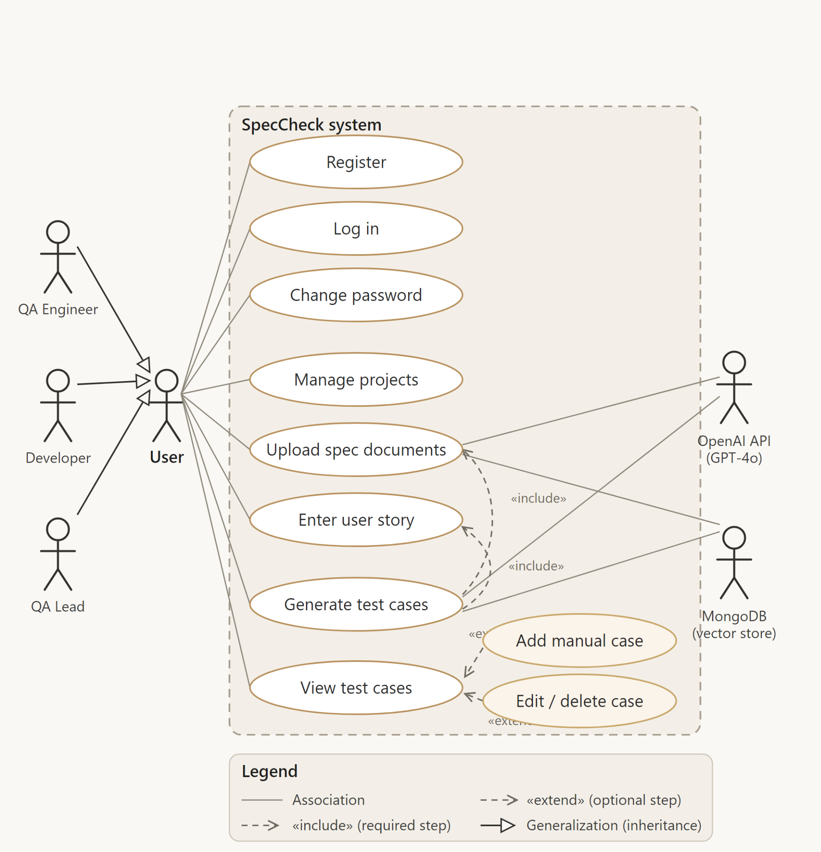

Slide 5
Requirement Analysis
Functional Requirements
User Login & Registration
Document Upload & Knowledge Indexing
User Story Input & Analysis
AI Test Case Generation
Document Management Dashboard
Export Test Cases (CSV/TXT)
Non-Functional Requirements
Secure Authentication & Data Protection
Fast Response Times (< 15 sec AI generation)
Reliable Document Storage
Scalable Architecture
User-Friendly Interface
Track requirements
Use Jira as backlog management tool.
Planned user stories: 20
Completed user stories: 18
Planned story points: 35
Completed story points: 30
Requirement Artifacts
User Stories
Use Case Diagram
Jira Product Backlog
Sprint Planning & Tracking

Slide 6
Project Management
Team Roles
Roles were assigned based on individual strengths, including frontend development, backend integration, testing, and documentation.
Jira Tracking
Jira was used to manage user stories, assign tasks, and track sprint progress. It ensured clear ownership of work, continuous monitoring of development progress, and balanced workload distribution across the team.
Agile Process
The team followed an Agile, sprint-based development approach. Each iteration focused on a specific feature set: authentication, document handling, and AI test case generation. This allowed continuous feedback, incremental improvement, and early detection of issues throughout development.
Iterations
The project was developed over three iterative development cycles with milestone-based goals. Each iteration built on the previous one, starting from core authentication, then document management, and finally AI-powered test case generation and refinement.

Slide 7
Project Management Continued
Risk Management
Key risks included merge conflicts, duplicate work, and varying technical experience across the team. These were addressed by improving communication, using Jira for task clarity, and enforcing a structured branching strategy in GitHub.
Quality Management
Quality was ensured through continuous testing using Playwright and pytest-bdd, along with manual testing. GitHub Actions supported integration checks to maintain stable builds during development.
Achievements
The project successfully delivered a working full-stack system with authentication, document management, and AI-based test case generation, along with automated testing and structured project documentation.
Challenges
Major challenges included merge conflicts, duplicate work, integrating AI features, and ensuring consistent testing across all components.
Lessons Learned
The team learned the importance of early integration, clear task ownership, frequent communication, and maintaining a strong branching and testing strategy throughout development.

Slide 8

AI Usage
How AI Contributed to our Project

Slide 9
AI Usage: Planning
Platform | Used for | Project Contribution
Zoom Notes + ChatGPT | Recording our meetings and generating meeting minute reports | Meeting Minutes
Claude + ChatGPT | Helped brainstorm functional requirements, and exploring possible tech stack options. The final evaluation, modifications, and implementation decisions were completed based on my own and team understanding and analysis. | SPPP, SDD
ChatGPT | Helped design defect management workflow, severity levels, release planning, and iteration task breakdown for project management documentation. | SPPP, SDD
ChatGPT | Created project logo | Logo
Estimated percentage: 30%

Slide 10
AI Usage: Code
Platform | Used for | Project Contribution
Copilot | Generating UI code for login | UI
ChatGPT | Helped create Docker documents and setup | Docker
Claude | Backend & Frontend URL configuration | Configuration
Claude | Debugging (examples: added .gitattributes to force LF line endings for *.sh files, generated wait_and_run.sh and set the executable bit to avoid failures in Linux/Docker, moved CRLF normalization and chmod into the container CMD so sed -i 's/\r$//' and chmod are run at runtime) | Code, Directory structure
Human Commits
17
Estimated percentage: 20%
Hybrid Commits
27
AI Commits
9

Slide 11
AI Usage: Testing
Platform | Used for | Project Contribution
Claude + Copilot | Built test automation frameworks using Playwright | Automated testing
Claude | Generated manual testing report template | Manual testing report
Estimated percentage: 70%

Slide 12
SOFTWARE ARCHITECTURE
Design
Database Design • Framework

Slide 13
Our Design Goals
External (User-facing)
Internal (Software)
Enable future scalability and deployment
Maintain modular frontend/backend architecture
Maintain user security
Uphold thorough documentation
Support collaborative development workflows
Build a scalable AI-assisted testing platform
Reduce manual QA effort
Support contextual AI test generation
Provide secure document upload handling

Slide 14
Software Architecture
Our app is a decoupled, full-stack web application.
The architecture consists of four primary layers working synchronously:
Frontend
Handles user interaction and responsive data visualization.
Backend
Manages RESTful API routing, business logic, and security workflows.
AI Processing
Governs document parsing, OCR extraction, and the RAG (Retrieval-Augmented Generation) pipeline.
Database
Provides permanent data storage for application states and assets.

Slide 15
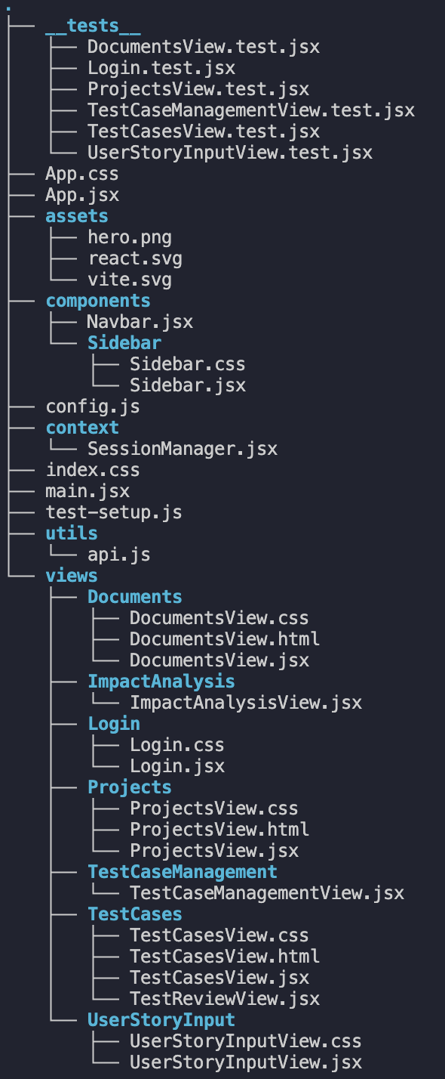
SOFTWARE ARCHITECTURE
Frontend
frontend/src:
Technology Stack
React, Vite, JavaScript, CSS3
Responsibilities
Renders the User Authentication interfaces (Sign In / Sign Up).
Provides an interactive drag-and-drop Document Upload interface.
Displays the Document Dashboard to monitor and manage processed files.
Contains the User Story submission form.
Renders the final generated AI test cases in a structured format.

Slide 16
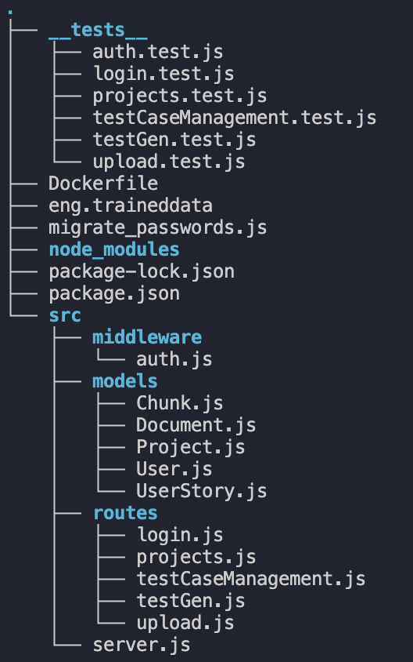
SOFTWARE ARCHITECTURE
Backend
frontend/src:
Technology Stack
Node.js, Express.js, JavaScript
Responsibilities
Handles incoming REST API requests from the frontend client.
Processes user authentication and session management.
Manages file upload streams via memory storage middleware (multer).
Orchestrates core system logic and routes requests to the AI pipeline.
Communicates securely with the database layer.

Slide 17
SOFTWARE ARCHITECTURE
AI-Processing
Technology Stack
Technology Stack
pdf-parse-fork, Tesseract.js, OpenAI API / Claude API
Responsibilities
Responsibilities
Extracts raw text content from uploaded PDF documents.
Performs Optical Character Recognition (OCR) to extract text from images (.png, .jpg).
Executes document text chunking and indexing.
Manages context retrieval using a RAG-based flow.
Generates structured software test cases via LLM processing.

Slide 18
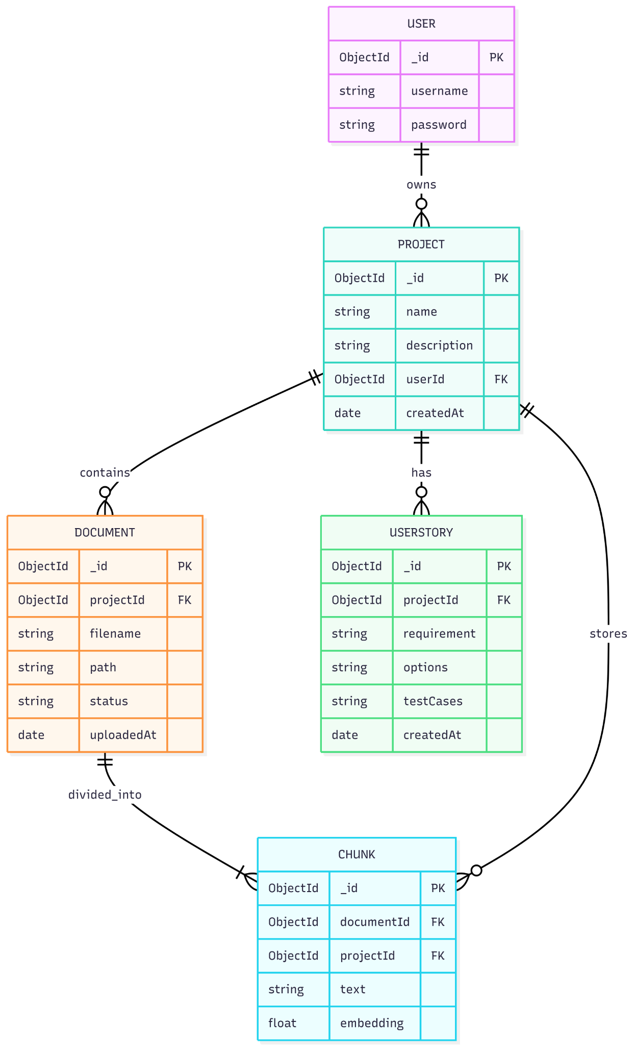
SOFTWARE ARCHITECTURE
Database Design
Technology Stack
Technology Stack
MongoDB
Responsibilities
Responsibilities
Stores permanent user account credentials and profiles.
Saves uploaded document metadata (e.g., file names, file sizes, upload timestamps).
Persists generated test cases and historical records.
Maintains the application dashboard states and execution histories.

Slide 19
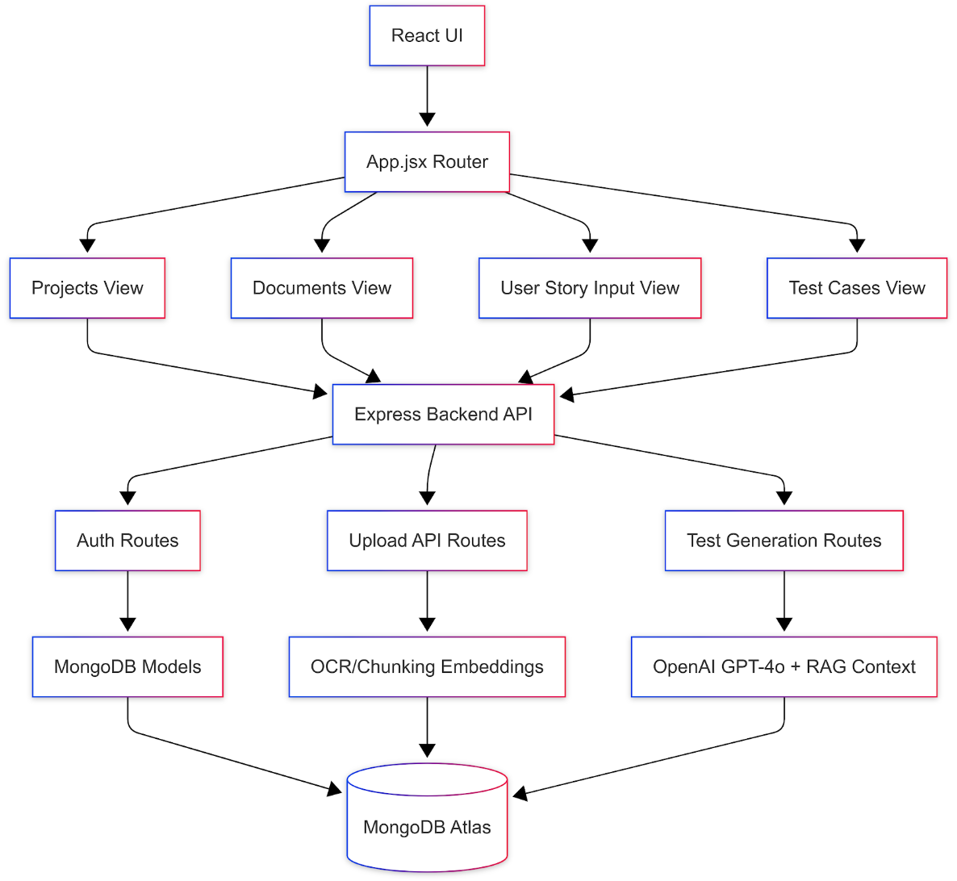
Data Pathways / Configuration
Component Relationships
Client Interaction:
Frontend → Express API → MongoDB
Knowledge Processing:
Frontend → Express API → AI Processing Layer
AI Generation Flow:
AI Pipeline → Vector Retrieval Context → External LLM APIs

Slide 20
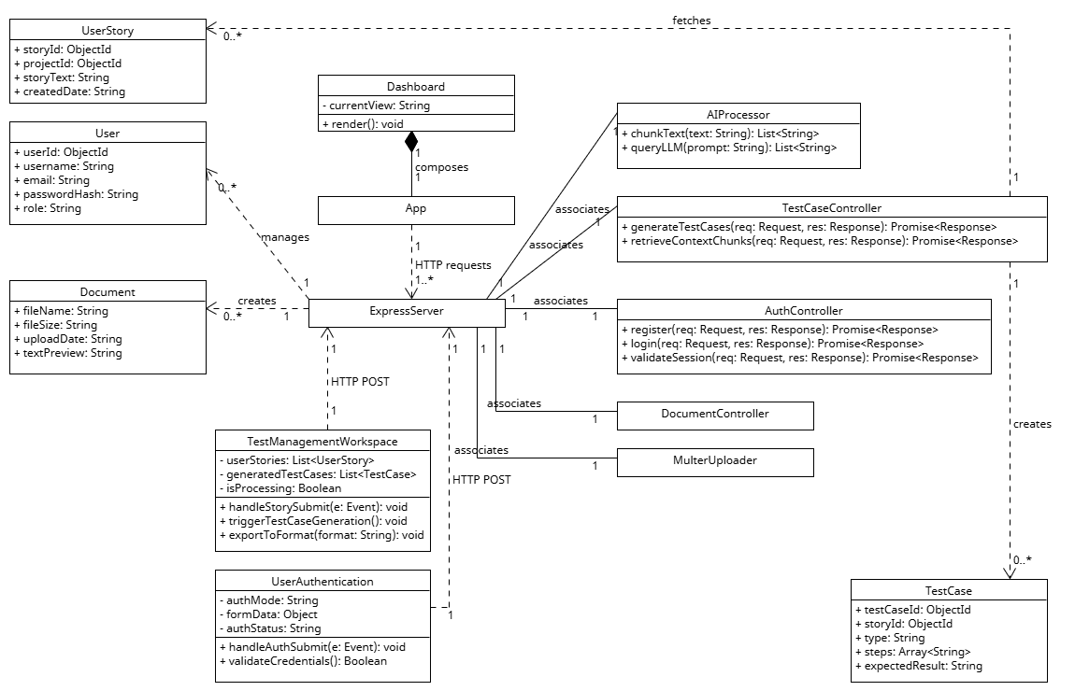
SOFTWARE ARCHITECTURE
Class Diagram

Slide 21
Implementation

Slide 22
IMPLEMENTATION
Agent 1 – Intelligent Test Case Generator
Analyzes user stories and project documentation.
Uses RAG (Retrieval-Augmented Generation) to understand project context.
Generates Functional, Negative, and Edge test cases.
Performs impact analysis to identify affected features.
Agent 2 – AI Quality Auditor
Reviews the test cases generated by Agent 1.
Evaluates coverage, relevance, and completeness.
Assigns a quality score and provides feedback.
Helps ensure consistency and QA best practices.

Slide 23
AI-Powered Test Generation
1. Prompt Engineering
- AI acts as a Senior QA Engineer
- Generates professional and structured test cases.
2. Context-Aware Generation
- Retrieves project documents and requirements.
- Creates test cases based on actual project context.
3. Structured JSON Output
- Returns test cases in a consistent JSON format.
- Easy to store, display, and process.
4. Impact Analysis (Regression)
- Identifies features affected by new requirements.
- Helps teams focus regression testing efforts.
5. AI Peer Review (Secondary Evaluation)
- A second AI reviews generated test cases.
- Provides quality scores and improvement feedback

Slide 24
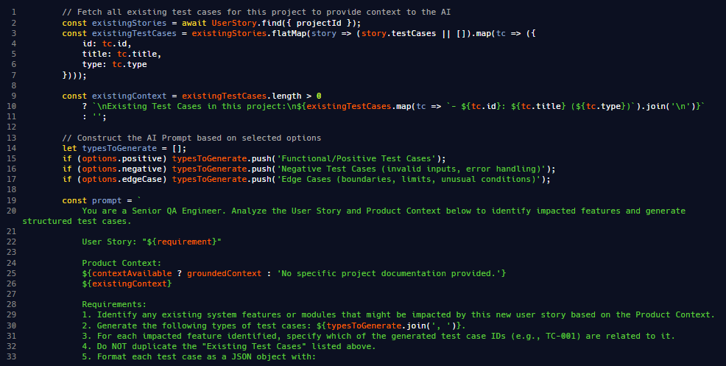
AI-Powered Test Generation (Implementation)
Agent 1: Intelligent Generation (RAG-Augmented)

Slide 25
AI Peer Review & Quality Assurance
1. Multi-Agent Architecture
- System utilizes multiple specialized AI agents.
- Primary agent generates initial test cases.
- Secondary agent audits the generated output.
- Collaborative workflow ensures high quality results.
2. Automated Quality Assessment
- Automatic evaluation of every test draft.
- Detect defects before saving to project.
- Analyze logical flow and test steps.
- Real time insights for review decisions.
3. Consistency Checking
- Verify alignment with original user story.
- Cross reference test cases with documents.
- Maintain uniform format across all projects.
- Ensure IDs and feature maps match.
4. Quality Scoring
- Score drafts from one to ten.
- Use objective metrics for evaluation score.
- Visualize quality levels using color codes.
- Facilitate faster approvals for software teams.

Slide 26
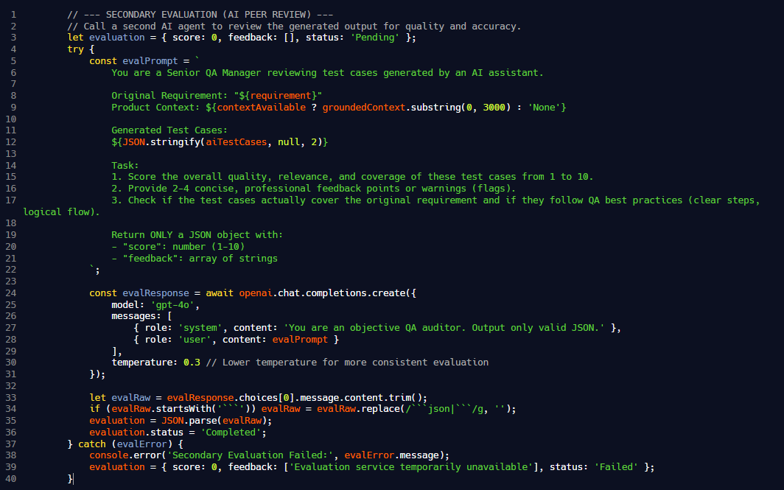
AI Peer Review & Quality Assurance
Agent 2: Automated Quality Auditor (Peer Review)

Slide 27
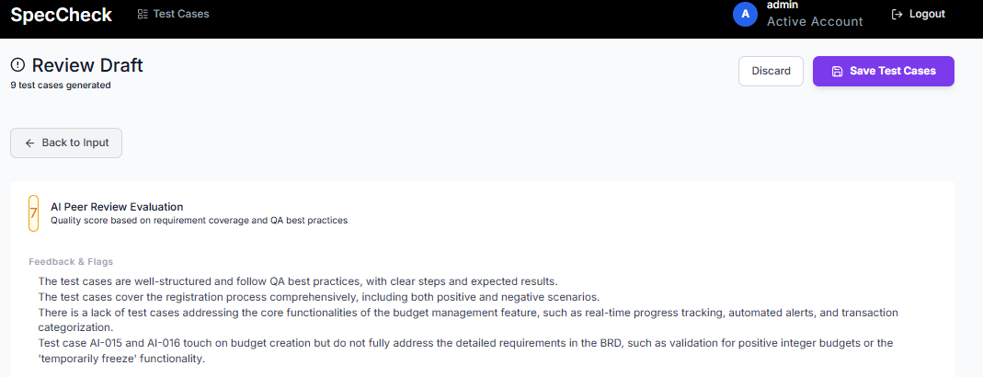
AI Peer Review & Quality Assurance
AI Peer Review Evaluation

Slide 28
Security

Slide 29
Security & Data Protection
1. JWT Authentication
- Issue secure tokens for user sessions.
- Validate identity using signed bearer tokens.
- Stateless verification enhances backend system performance.
- Encrypted payloads ensure safe data exchange.
2. Route Protection
- Guard private API endpoints with middleware.
- Deny access to all unauthenticated requests.
- Secure data access via authorized headers.
- Protect sensitive resources from external threats.
3. Password Hashing
- Encrypt user passwords using bcrypt algorithm.
- Never store plain text in database.
- Pre-save hooks automate secure hashing logic.
- Robust protection against unauthorized credential access.
4. Secure Credential Storage
- Hide secret keys using environment variables.
- Protect system integrity from potential leaks.
- Utilize local files for sensitive configurations.
- Prevent hard-coded secrets within source code.

Slide 30
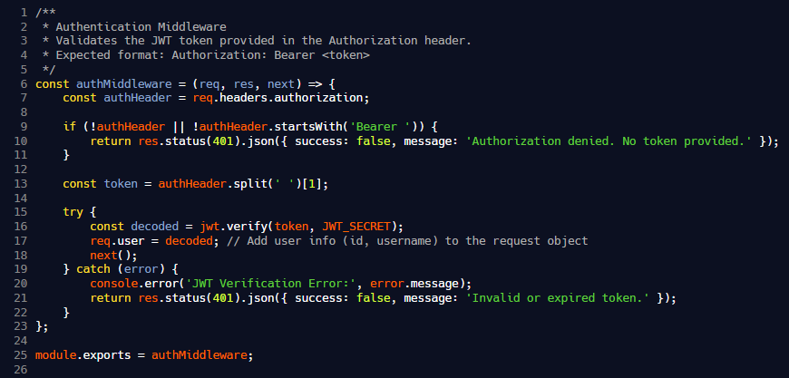
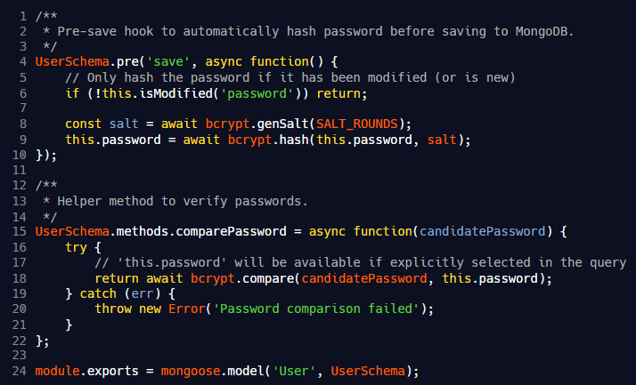
Security & Data Protection (implementation)
API Security: Prevents unauthorized external access.
Data Encryption: Ensures maximum protection for user identity and credentials.

Slide 31
Human-in-the-Loop Review Workflow
1. Human Oversight
- Users verify every single test case.
- Humans provide final check for quality.
- Manual edits ensure perfectly accurate results.
- AI assists but humans make decisions.
2. Approval Workflow
- Transition from draft to saved state.
- Structured process for finalized test cases.
- Professional review dashboard for software teams.
- Approve or reject scenarios with ease.
3. AI Governance
- Strict guidelines for large language models.
- Responsible AI usage within testing frameworks.
- Peer review agents ensure objective auditing.
- Maintain transparency with AI usage summaries.
4. Risk Mitigation
- Detect missing edge cases very early.
- Prevent generic results through grounded context.
- Identify impacted features for regression safety.
- Reduce human errors in manual testing.

Slide 32
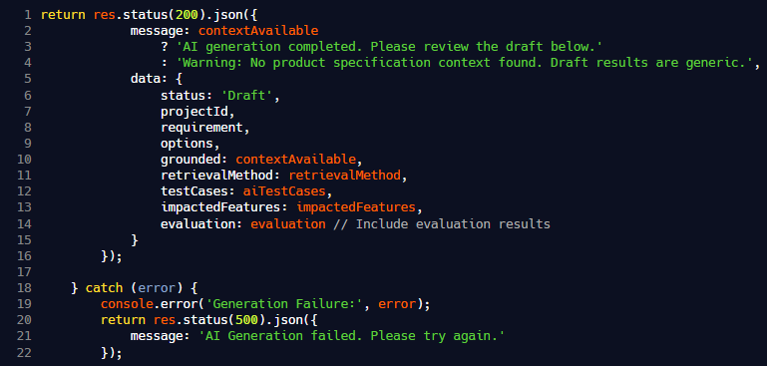
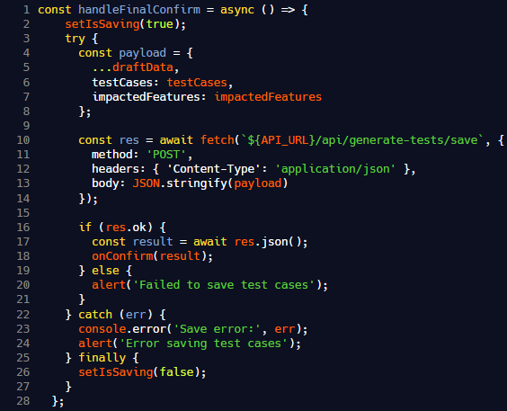
Human-in-the-Loop Review Workflow (implementation)
Test Case Draft Review
User-controlled approval process before saving AI-generated test cases

Slide 33
FINAL ITERATION • SPECCHECK
Testing & Quality Assurance
Unit • Integration • Functional • System • Acceptance • Regression

Slide 34
OUR QA STRATEGY
Testing Types
1
2
3
4
5
6
Unit
Integration
Functional
System
Acceptance
Regression
Functions & components tested in isolation
API routes & component–data flows
Feature behaves per requirements
Whole app exercised via the live UI
User-story criteria in Gherkin BDD
Full suite re-run on every change
These types overlap in practice — the Playwright BDD suite delivers functional, system, acceptance and regression coverage from one set of Gherkin scenarios, replacing most manual tests.

Slide 35
TESTING LIFECYCLE
When Each Test Runs
Type | When Performed | Example
Unit | During development, before each PR | login.test.js — bad credentials return 401
Integration | During dev — API & component flows | POST /api/projects creates project, returns 201 (Supertest)
Functional | After each new feature is added | Successful login & logout (LGN-002)
System | End of each iteration | Full upload → generate → export journey in a real browser
Acceptance | Per user story / at iteration demo | Gherkin Given / When / Then on a user-story scenario
Regression | Every PR + before each demo | Entire 200+ suite re-run via GitHub Actions
Left → right also reads as the testing pyramid: many fast unit tests at the base, fewer broad system / acceptance tests at the top.

Slide 36
COVERAGE
Test Suite at a Glance
162
46
51
208
Unit tests
E2E scenarios
E2E executions
Automated checks
Automated coverage by layer
Layer | Framework | Tests
Backend unit | Jest 29 + Supertest | 65
Frontend unit | Vitest 2 + React Testing Library | 97
End-to-end / BDD | Playwright 1.44 + pytest-bdd | 46 (51 runs)

Slide 37
HUMAN-EXECUTED QA
Manual Testing
64
58
2
0
Total cases
Pass
Fail
Not executed
Priority Breakdown
Features Covered
High
33
Document Management
Iter 1
20
Medium
26
Login / Registration / Logout
Iter 2
11
Projects Dashboard
Iter 2
11
Low
5
96.7% pass rate of executed cases (58 / 60)
Generate Test Cases modal
Iter 2
11
Create Manual Test Case modal
Iter 2
11

Slide 38
END-TO-END
Automated E2E — Framework & Architecture
Automation Stack
Test Structure
Python 3.12
features/
.feature Gherkin scenarios
pytest-bdd 7.1.2
step_definitions/
@given / @when / @then Python steps
Playwright 1.44.0
pages/
Page Object Model locator classes
Page Object Model
fixtures/
6 test files: PDF, PNG, JPG, EXE, MP3, oversized
pytest-html reports
conftest.py
Shared fixtures, fetch mock, screenshot hook
In-browser JS fetch mock — the suite runs with no real backend, MongoDB, or OpenAI.
reports/
HTML report + failure screenshots

Slide 39
END-TO-END
E2E Coverage by Feature
Feature Area | Scenarios | Executions
Login | 2 | 2
Registration | 10 | 10
Document Management | 13 | 18
Project Search | 4 | 4
Test Cases Dashboard | 17 | 17
Total | 46 | 51
Run Subsets (pytest markers)
smoke
13
test_case_dashboard
17
validation
9
management
5
drag_drop
5
search
4
registration
2
upload
2

Slide 40
WHY BOTH LAYERS
Unit vs End-to-End — Complementary Coverage
Unit Tests
162
End-to-End / BDD
46
SCOPE
SCOPE
One route or component, in full isolation
Whole app driven through the live browser UI
DEPENDENCIES
DEPENDENCIES
DB, OpenAI & network all mocked
Real rendered UI, routing & user interactions
CATCHES
CATCHES
Logic errors, edge cases, status codes, validation
Broken flows, integration gaps, UI regressions
CADENCE
CADENCE
Milliseconds — run on every pull request
Seconds — run in CI before merge & demo
Unit and end-to-end suites are kept separate by design — they verify different aspects of the system, so both are needed for confidence.

Slide 41
JEST 29 + SUPERTEST • 65 TESTS
Backend Unit Tests
15
login.test.js
Auth, registration & change-password — 400/401/404/500 paths
17
testCaseManagement.test.js
Edit, archive / unarchive & delete test cases
12
testGen.test.js
AI generation, ID sequencing (AI-### / HU-###), manual add
11
projects.test.js
Project CRUD + ordered cascade delete of chunks & docs
10
upload.test.js
File validation, storage, document + chunk removal
Mock strategy: jest.mock() for all Mongoose models, OpenAI, pdf-parse-fork and Tesseract — no real DB or API calls.

Slide 42
VITEST 2 + REACT TESTING LIBRARY • 97 TESTS
Frontend Unit Tests
24
TestCaseManagementView.test.jsx
Loading, search, dropdown / status filters, edit modal
17
UserStoryInputView.test.jsx
Render, checkbox logic, validation, generate API call
16
TestCasesView.test.jsx
Data load, type filter, row expansion, create modal
15
Login.test.jsx
Render, mode switching, validation, API interactions
15
ProjectsView.test.jsx
Empty state, project cards, New Project modal
10
DocumentsView.test.jsx
Drag-drop zone, document list, empty state, file input
Mock strategy: vi.fn() for global.fetch and callback props — components tested in isolation with no real HTTP.

Slide 43
TWO ISOLATED STACKS
Unit Test Structure
Two separate stacks
Tests sit 1:1 with routes & views
 | Backend | Frontend
Runner | Jest 29 | Vitest 2
HTTP / DOM | Supertest 7 | RTL 16
Mocks | jest.mock() | vi.fn()
Test env | Node | jsdom
test-case-generator/
├─ backend/
│ ├─ src/routes/ 5 route handlers
│ └─ __tests__/ 5 .test.js · 65
├─ frontend/
│ ├─ src/views/ 6 components
│ └─ src/__tests__/ 6 .test.jsx · 97
tests/ Playwright BDD E2E
Run: npm test / npm run test:run
Backend — each test
Frontend — each test
1
jest.mock() Mongoose models & OpenAI
1
global.fetch = vi.fn() for fake responses
2
Mount the route in a minimal Express app
2
render(<Component/>) into a jsdom DOM
3
Fire real HTTP requests via Supertest
3
Query DOM + simulate with userEvent

Slide 44
PIPELINE
CI/CD & Quality Engineering
1
GitHub Actions
2
Docker Compose
Full suite runs automatically on every pull request to development or main; failures block the merge.
CI spins up the app in containers so tests run against a consistent, production-like environment.
3
In-browser fetch mock
4
Screenshot on failure
Backend calls intercepted in conftest.py — reliable CI with no MongoDB or OpenAI dependency.
Every failing scenario auto-captures a screenshot embedded in the pytest-html report.
5
Reusable fixtures
6
Retained artifacts
6 real test files exercise all upload paths: PDF, PNG, JPG, EXE, MP3 and oversized PDF.
HTML test report uploaded as a 14-day CI artifact for review after each run.

Slide 45
DEFINED IN THE SPPP
Testing Metrics
Metric | Definition | Result
# of automated tests | Unit + end-to-end coverage | 162 unit + 46 E2E = 208
# of manual tests | manual test case(iteration 1+2) | 64
# of generated test cases | AI test cases produced per user story | 5–15 per request
# of user stories | Total stories planned | 13
Person-hours | Total project effort | 140 (planned)
Lines of code | Backend + frontend total | 8463
Test pass rate | Passing unit + E2E tests | 90%
Defect rate | Bugs logged per iteration | 5%
Test case accuracy | Generated cases match product docs | 95%

Slide 46
CONFIGURATION & RELEASE
Deployment
Live on Render • MongoDB Atlas • Auto-deployed from GitHub

Slide 47
RENDER
Deployment Architecture
RENDER
Frontend
MongoDB Atlas
GitHub
push
Static Site · React (Vite)
testgen-cluster · vector search
repository
API
Backend
OpenAI API
Web Service · Docker (Node/Express)
AI test-case generation
Deployed from branch main · Render auto-deploys on each push to that branch.
Frontend speccheck-frontend.onrender.com Backend speccheck-backend.onrender.com

Slide 48
DEPLOYMENT
Render Service Configuration
Backend — Web Service
Frontend — Static Site
speccheck-backend.onrender.com
speccheck-frontend.onrender.com
Type
Docker (Dockerfile)
Type
Static Site
Root
test-case-generator/backend
Root
test-case-generator/frontend
Instance
Free
Build
npm install && npm run build
Env vars
PORT = 5001
MONGODB_URI
OPENAI_API_KEY
Publish
dist
Env var
VITE_API_URL → backend URL
Secrets (MONGODB_URI, OPENAI_API_KEY) live in Render env vars and a local .env — never committed; the repo ships an .env template only.

Slide 49
DEPLOYMENT
Deployment
Status
Frontend — live
Static site serving the React build
Backend — live
Docker web service responding on Render
MongoDB — connected
Atlas testgen-cluster (DB: speccheck) connected; login & data persistence working
Free-tier cold start
First request may take ~60s after idle spin-down

Slide 50
Demo

