Slide 1
Team 3 - Rhettoric
Team 3 Rhett Iteration 2 – Adrian, Xi, Magnus, Jack
Refer: Go to BUMETCS673/cs673se_sum1_24_team_3/ our latest files and minutes

Slide 2
Iteration 2 Overview
Refine requirements
DB Design
Building out User Registration and User Login including unit tests
SQLlite3 testing of services

Slide 3


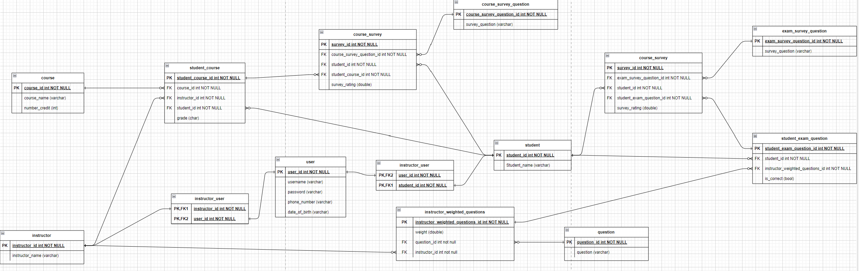

Database Design – Initial Design
z

Slide 4
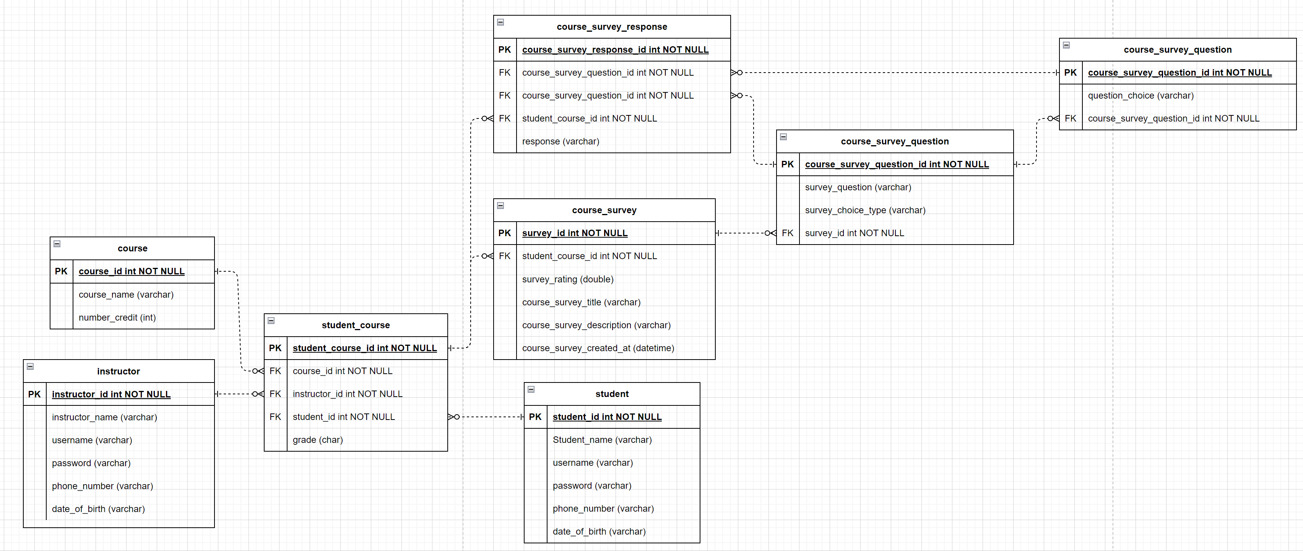
Database Design – Refined Design
z

Slide 5
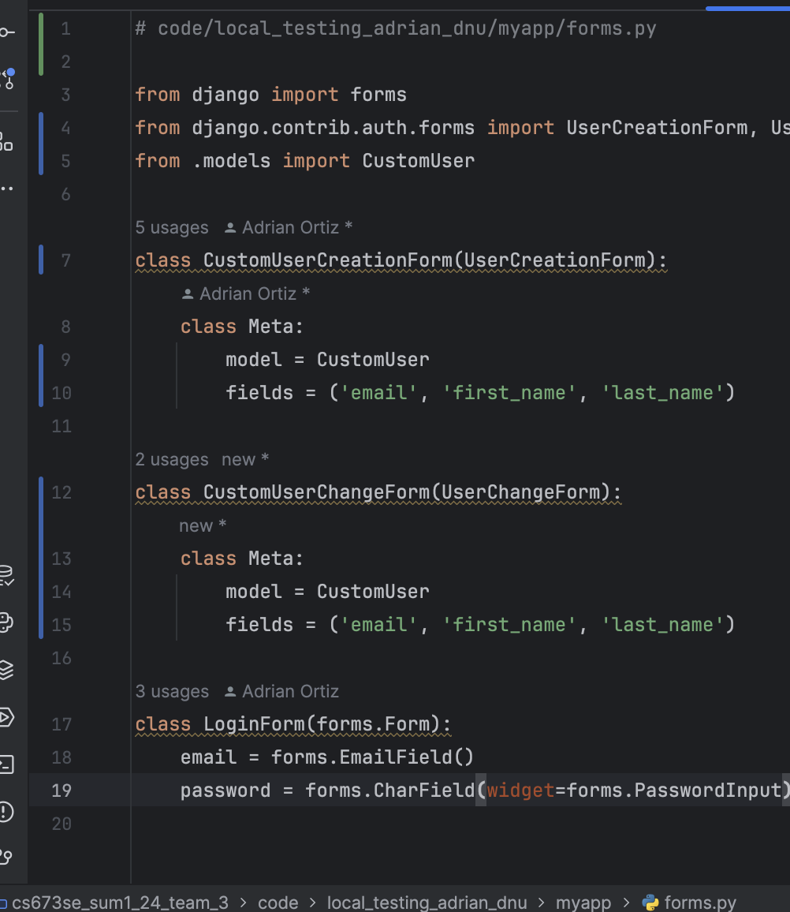
Coding Example: myapp/forms.py

Slide 6
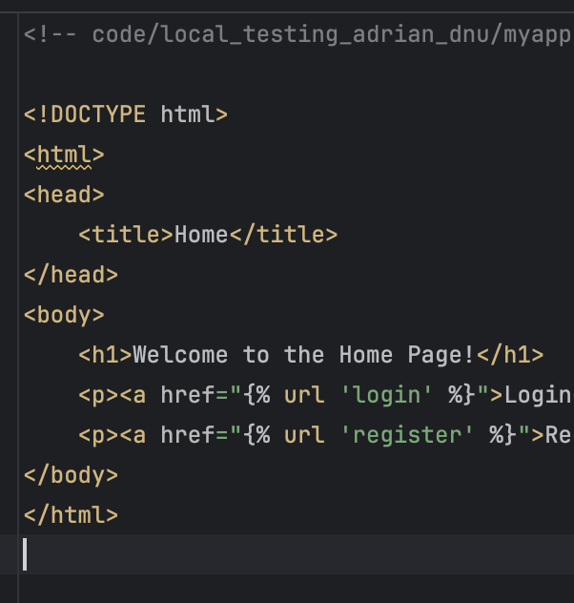
Creation of simple ”Home” Page (Code)

Slide 7
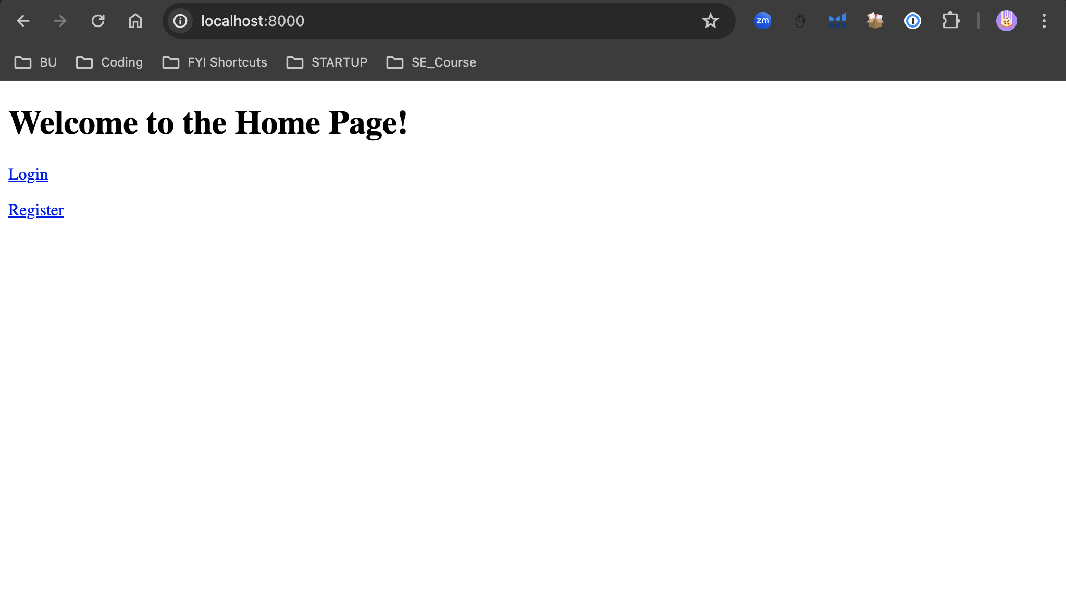
Creation of simple ”Home” Page (UI)

Slide 8
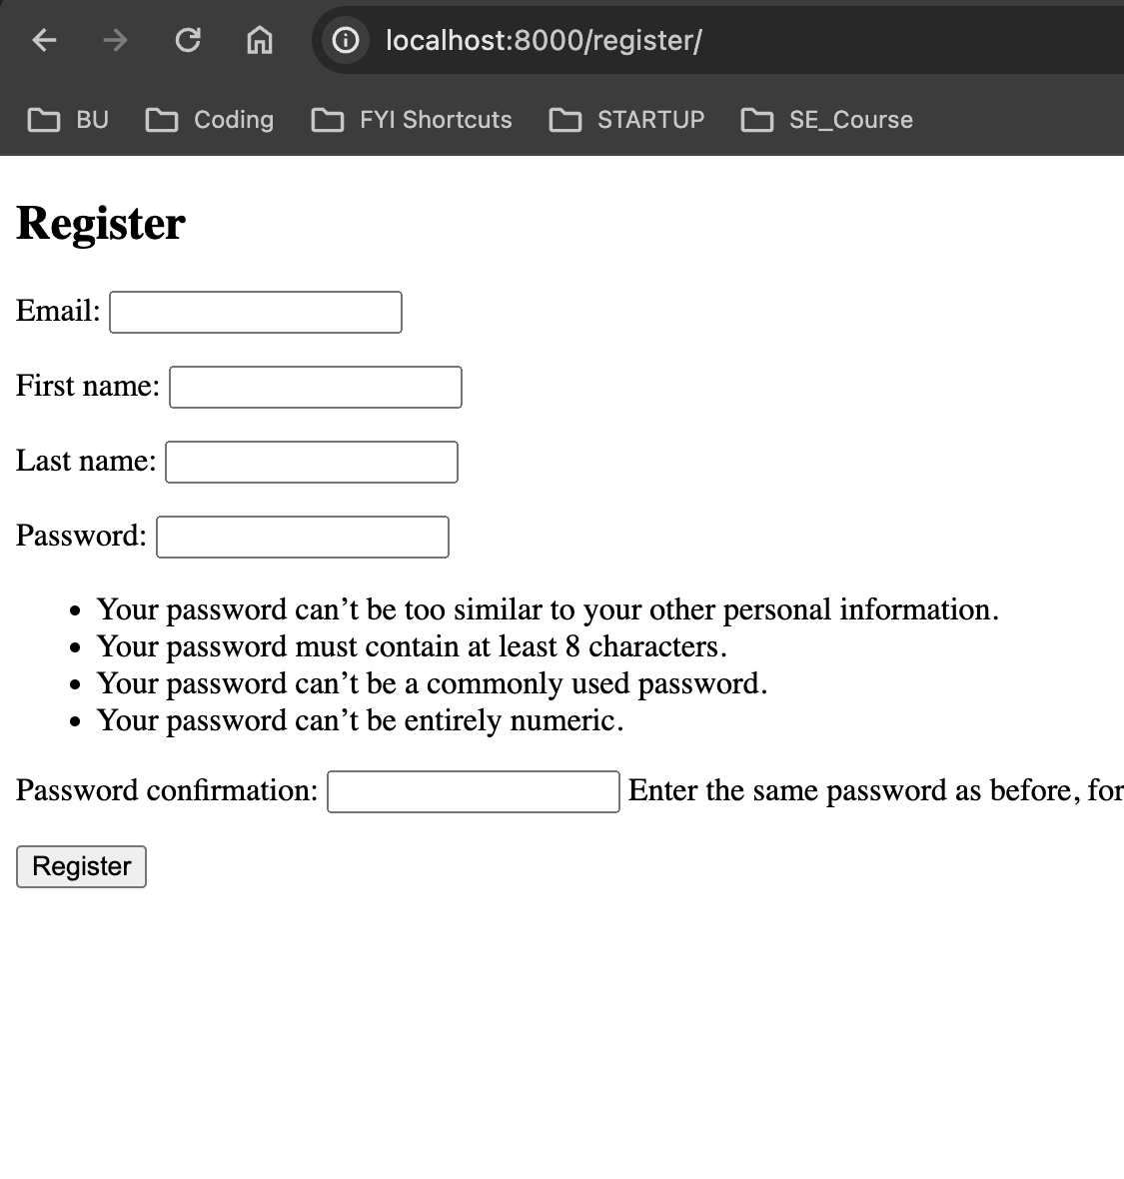
Register Page (UI) - Redesigned

Slide 9
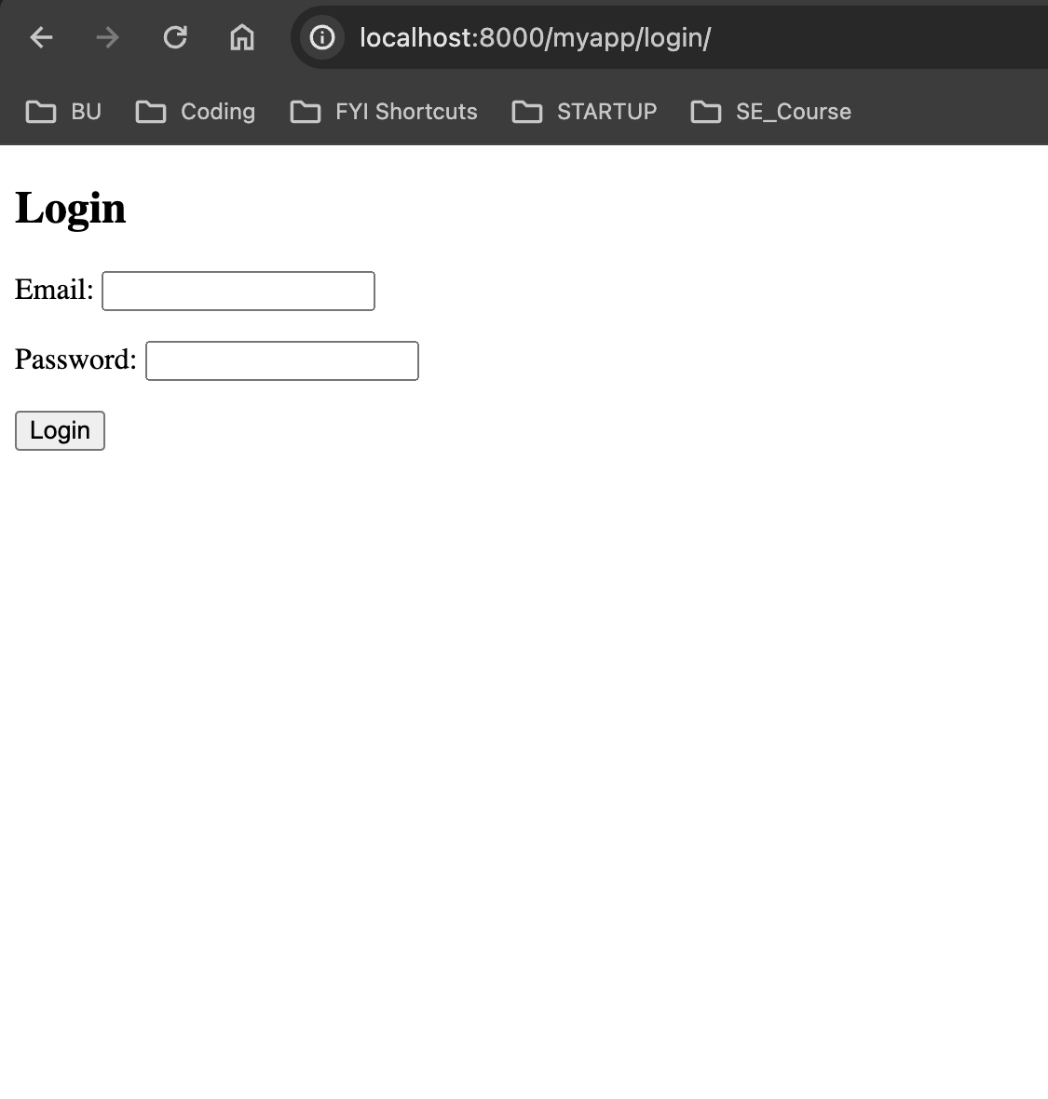
Login Page (UI)

Slide 10
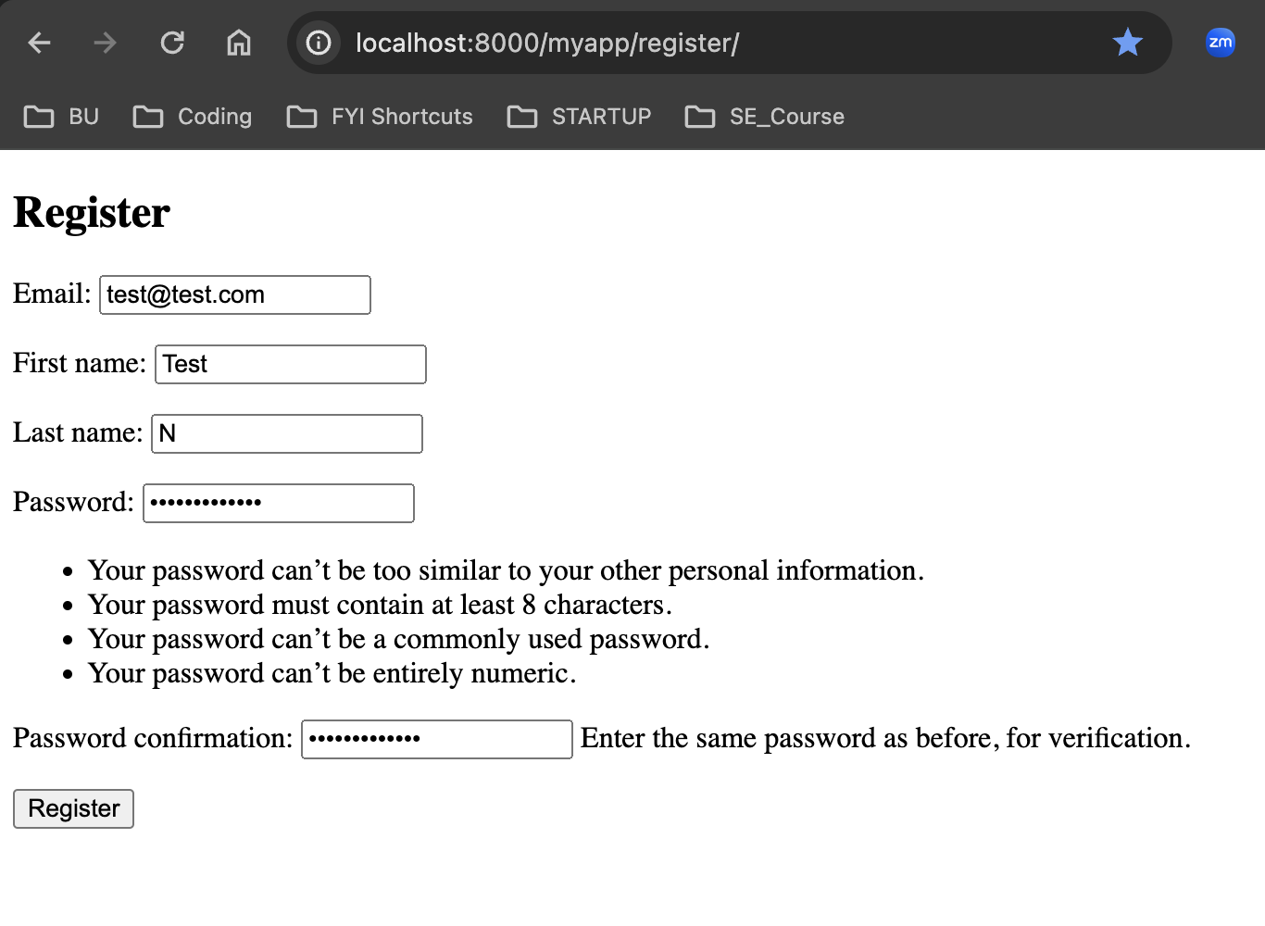
DB now persists created data (Part 1 – Registration)

Slide 11
Redirects to ”Home” Page (UI)

Slide 12
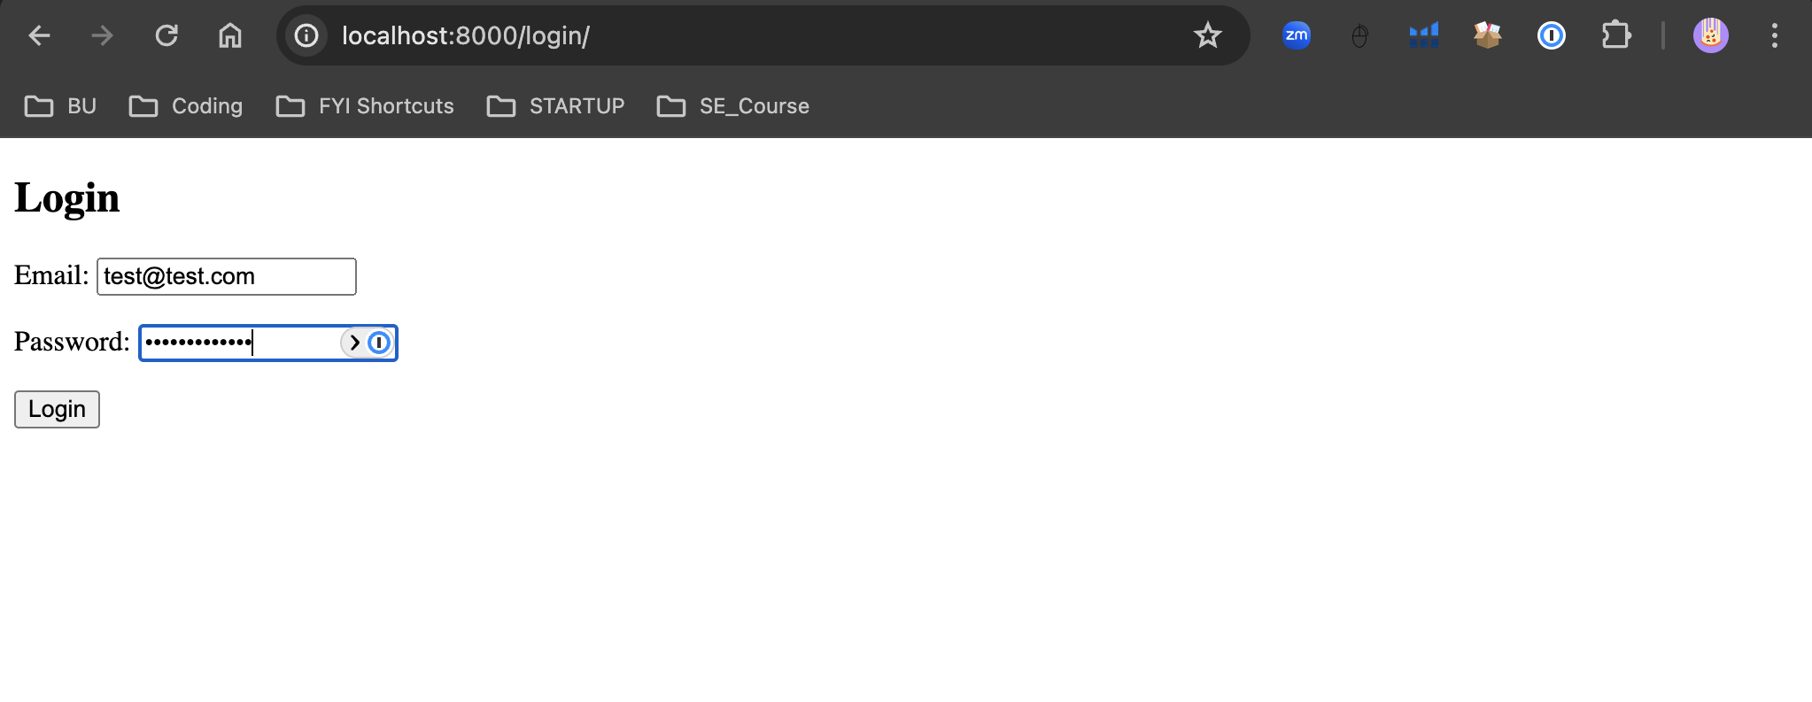
DB now persists created data (Part 2 – Login)

Slide 13
Redirects to ”Home” Page (UI)

Slide 14
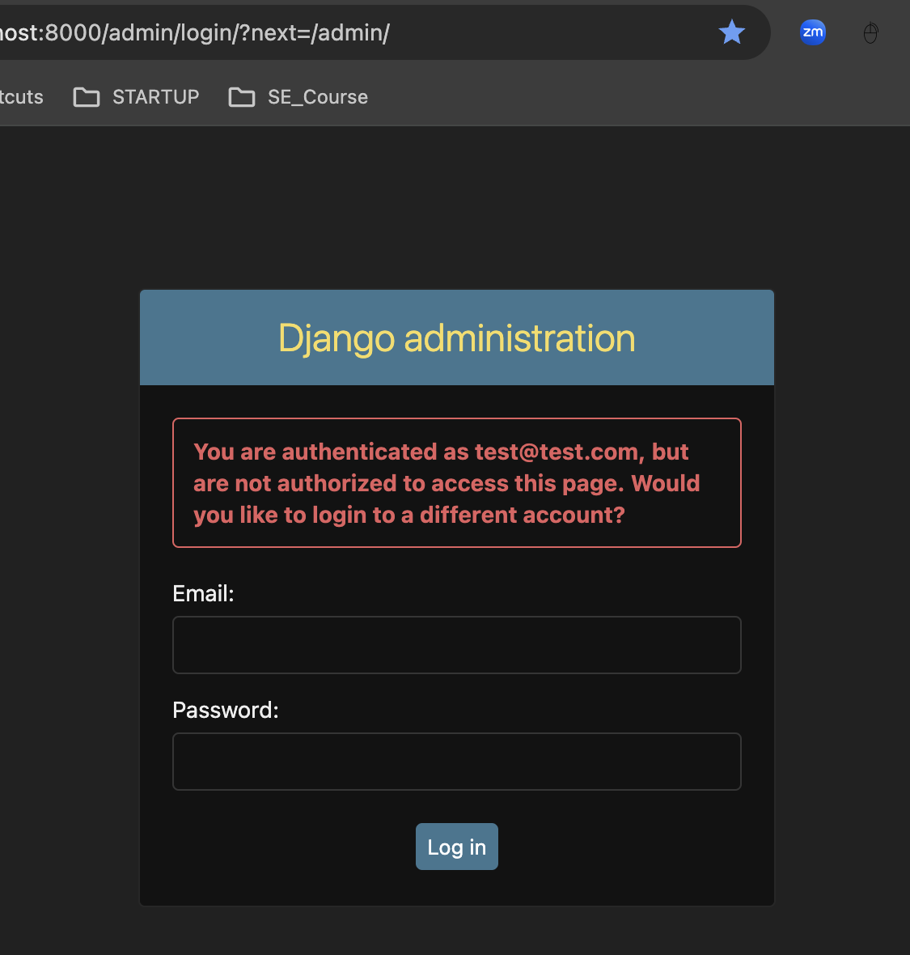
DB now persists created data (Part3a – Admin verification)

Slide 15
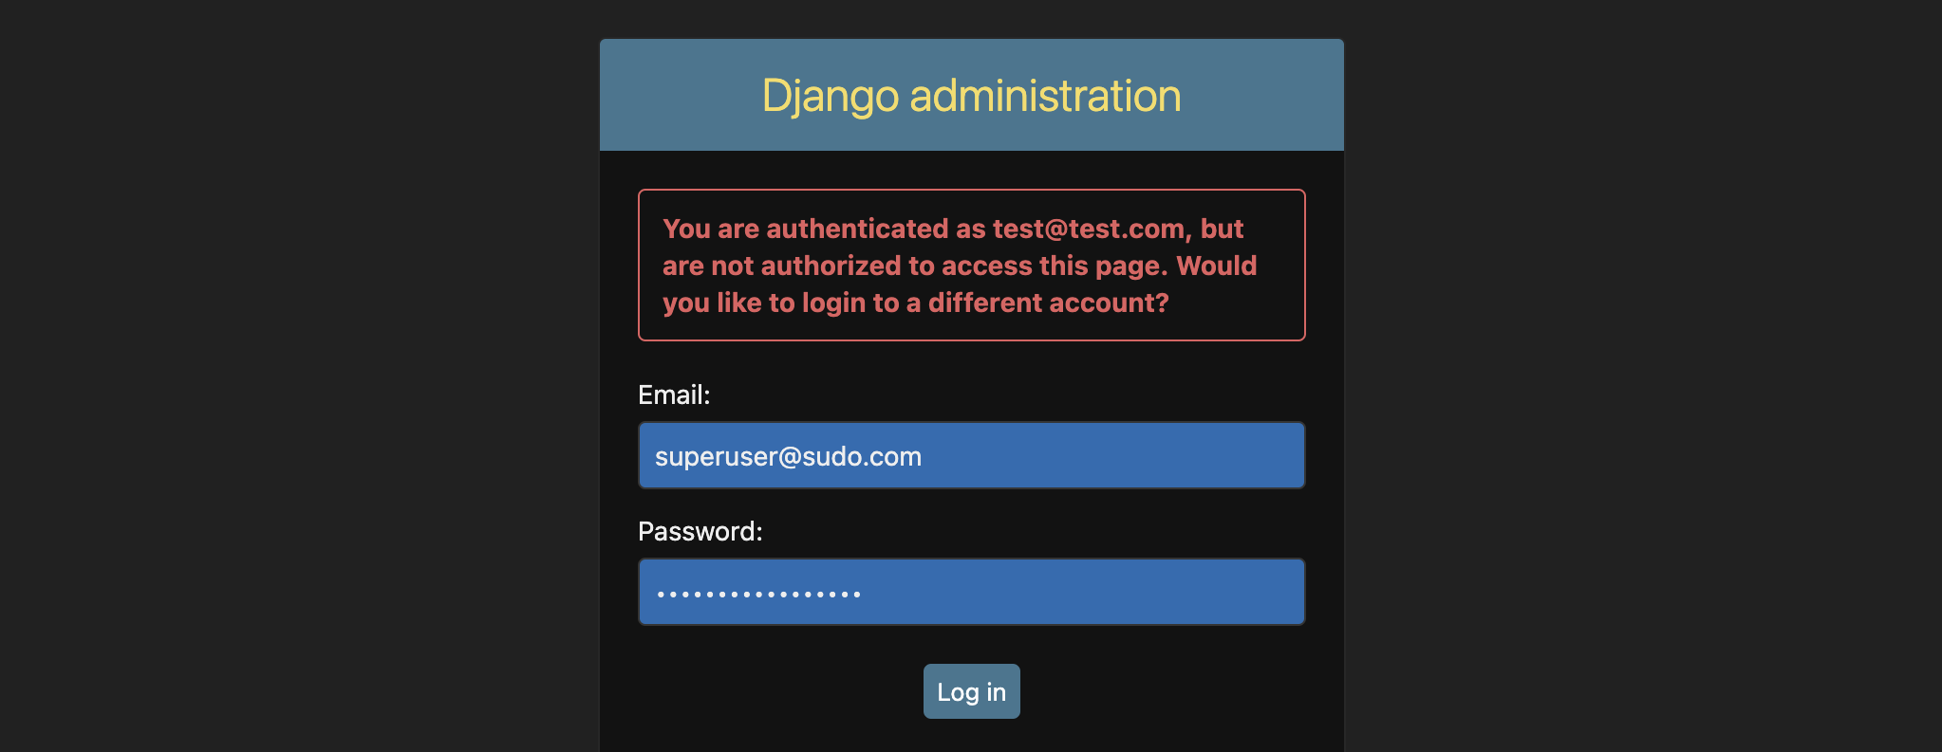
DB now persists created data (Part3b – Admin verification)

Slide 16
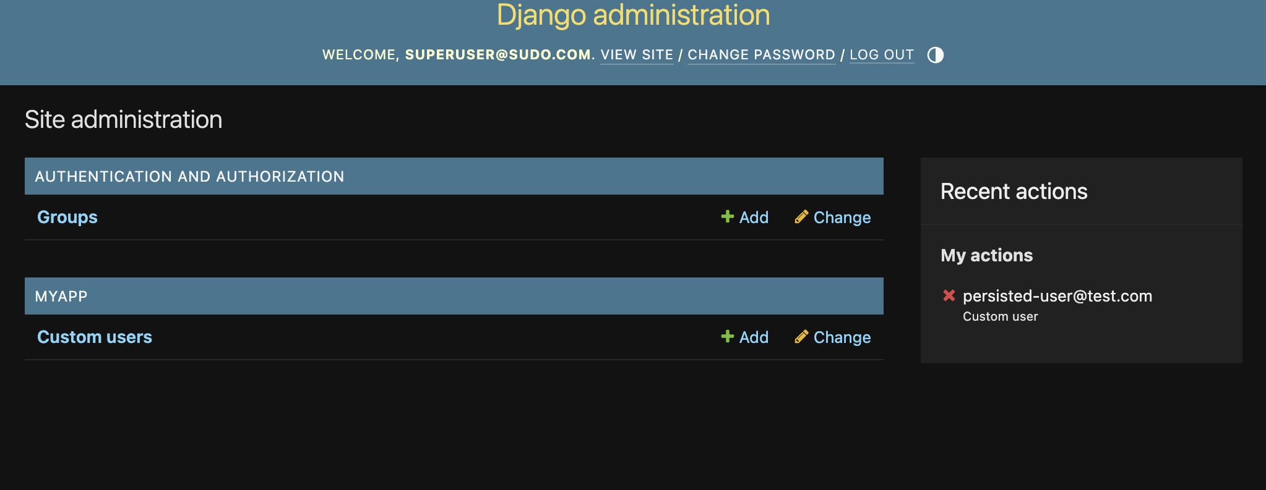
DB now persists created data (Part3c – Admin verification)

Slide 17
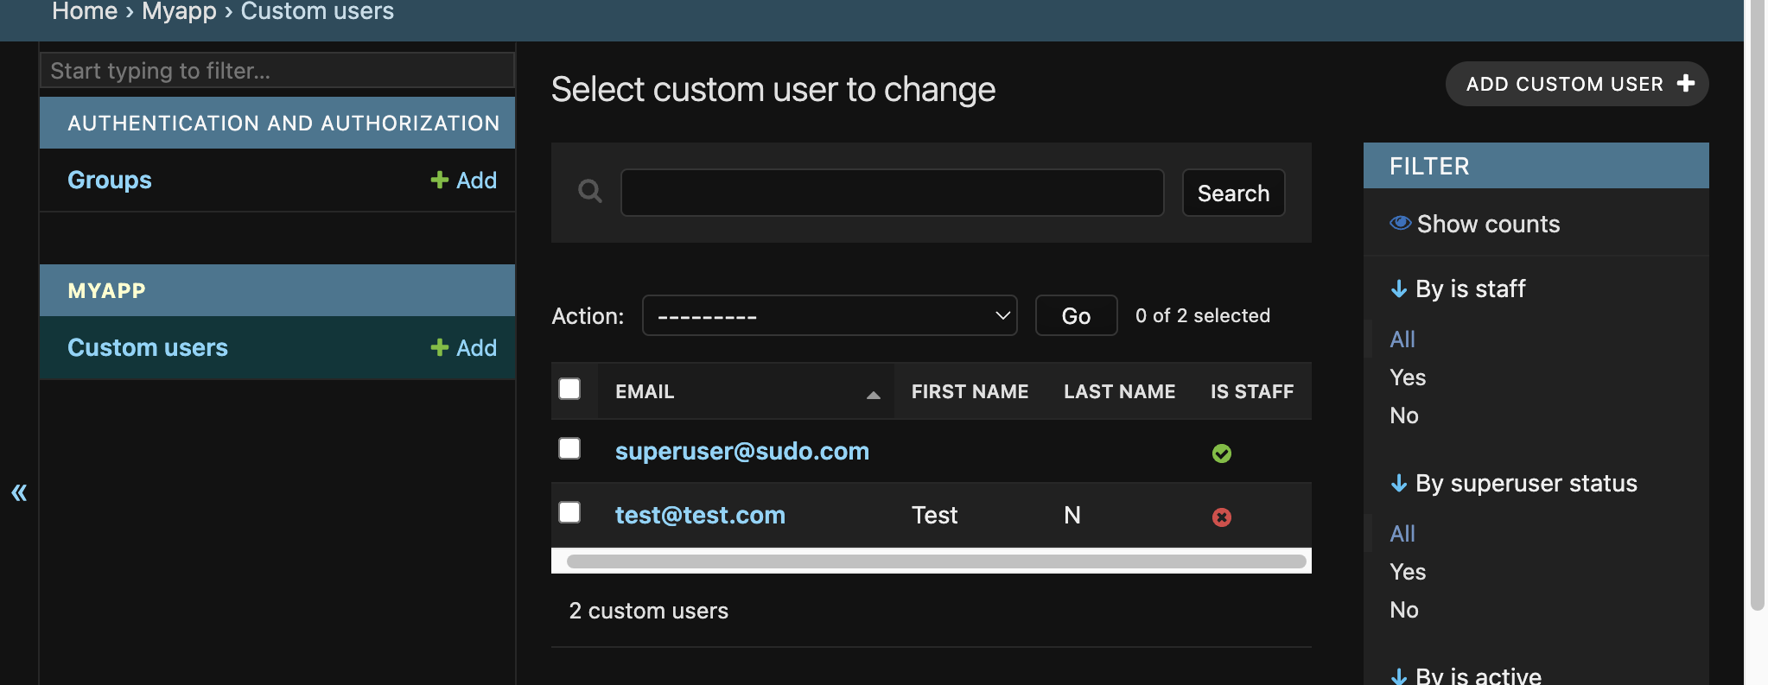
DB now persists created data (Part3d – Admin verification)

Slide 18
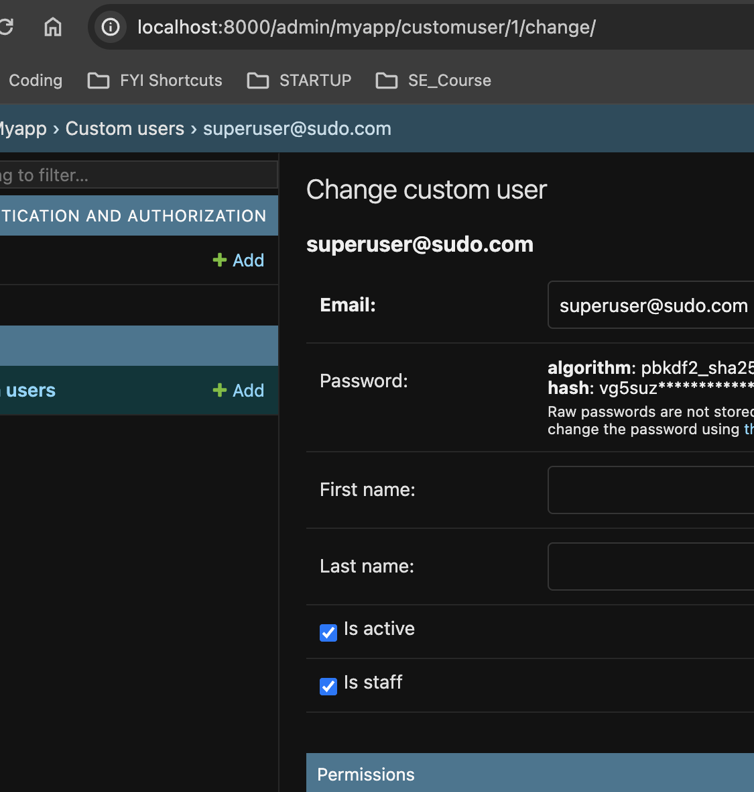
Admin Flag “Is staff” set (UI Verification pt1 - Checked)

Slide 19
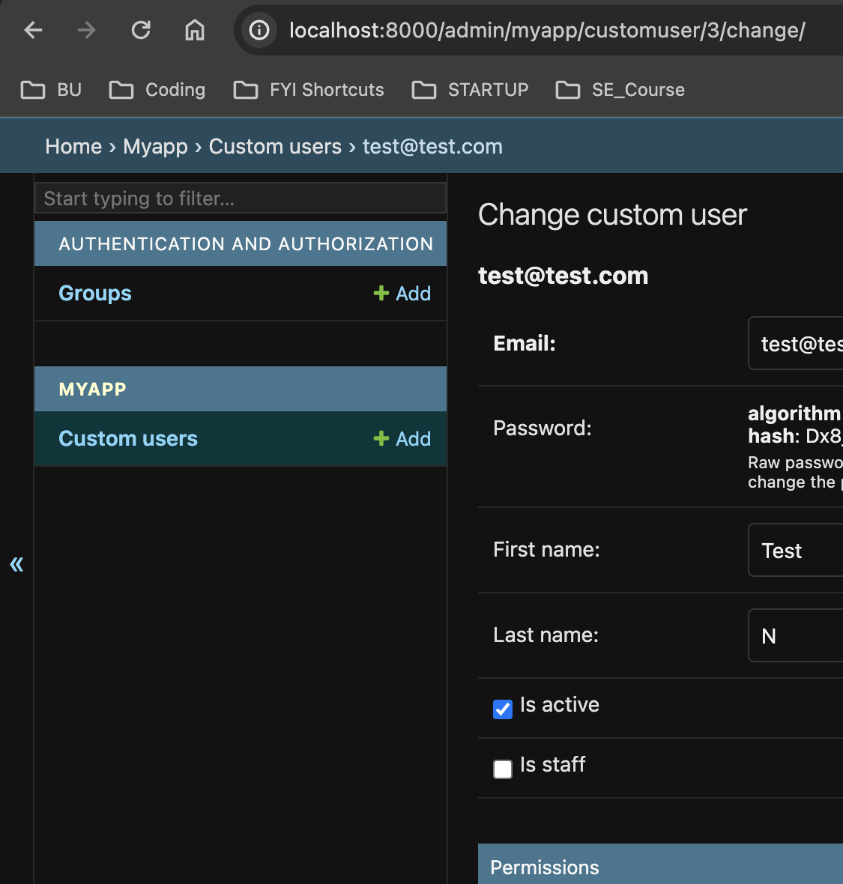
Admin Flag “Is staff” set (UI Verification pt2 - Unchecked)

Slide 20
DEMO!!!

Slide 21
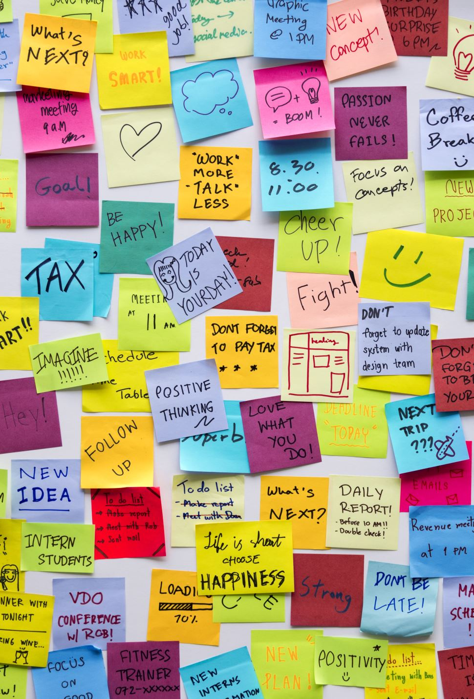
Next Steps：
z
Key Implementations：
Build out Database
Update User Reg/Login accordingly
Implement Survey Logic
Test code and refactor
Run finished product
Tasks：
Build out database and run queries to verify DB (CRUD)
Integrate Survey Logic into UI
Implement backend logic for storing data in PostgreSQL
Store data in PostgreSQL (used sqllite3 for staging)
Integrate group feature with notification service
Run unit tests
Test end-to-end functionality.

