Slide 1
Rhettoric
Iteration 3 - Final Presentation
Magnus, Adrian, Jack, Xi

Slide 2
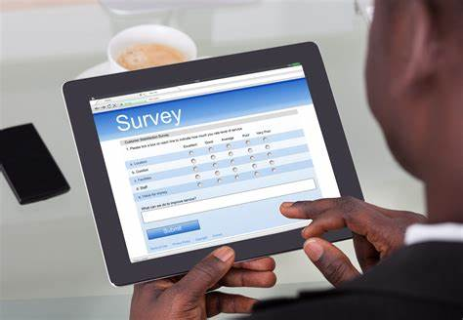
What is Rhettoric?
Theme of all projects - Online project based E - Learning
Backend survey implementation
Allows facilitators to receive feedback from users
Similar products
Survey monkey
Google forms

Slide 3
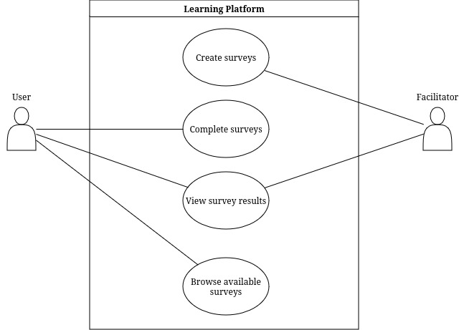
Requirement Analysis
Surveys
Create
Complete
View
Login
User
Facilitator

Slide 4
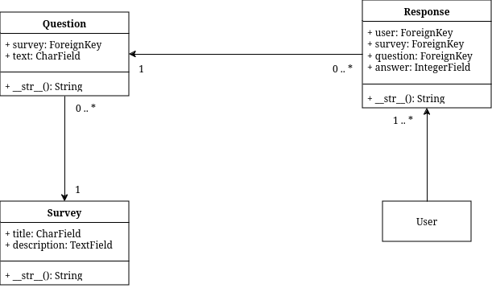
Design
Survey implementation
Django’s Object-Relational Mapping
Objects
Survey
Question
Reponse
User

Slide 5
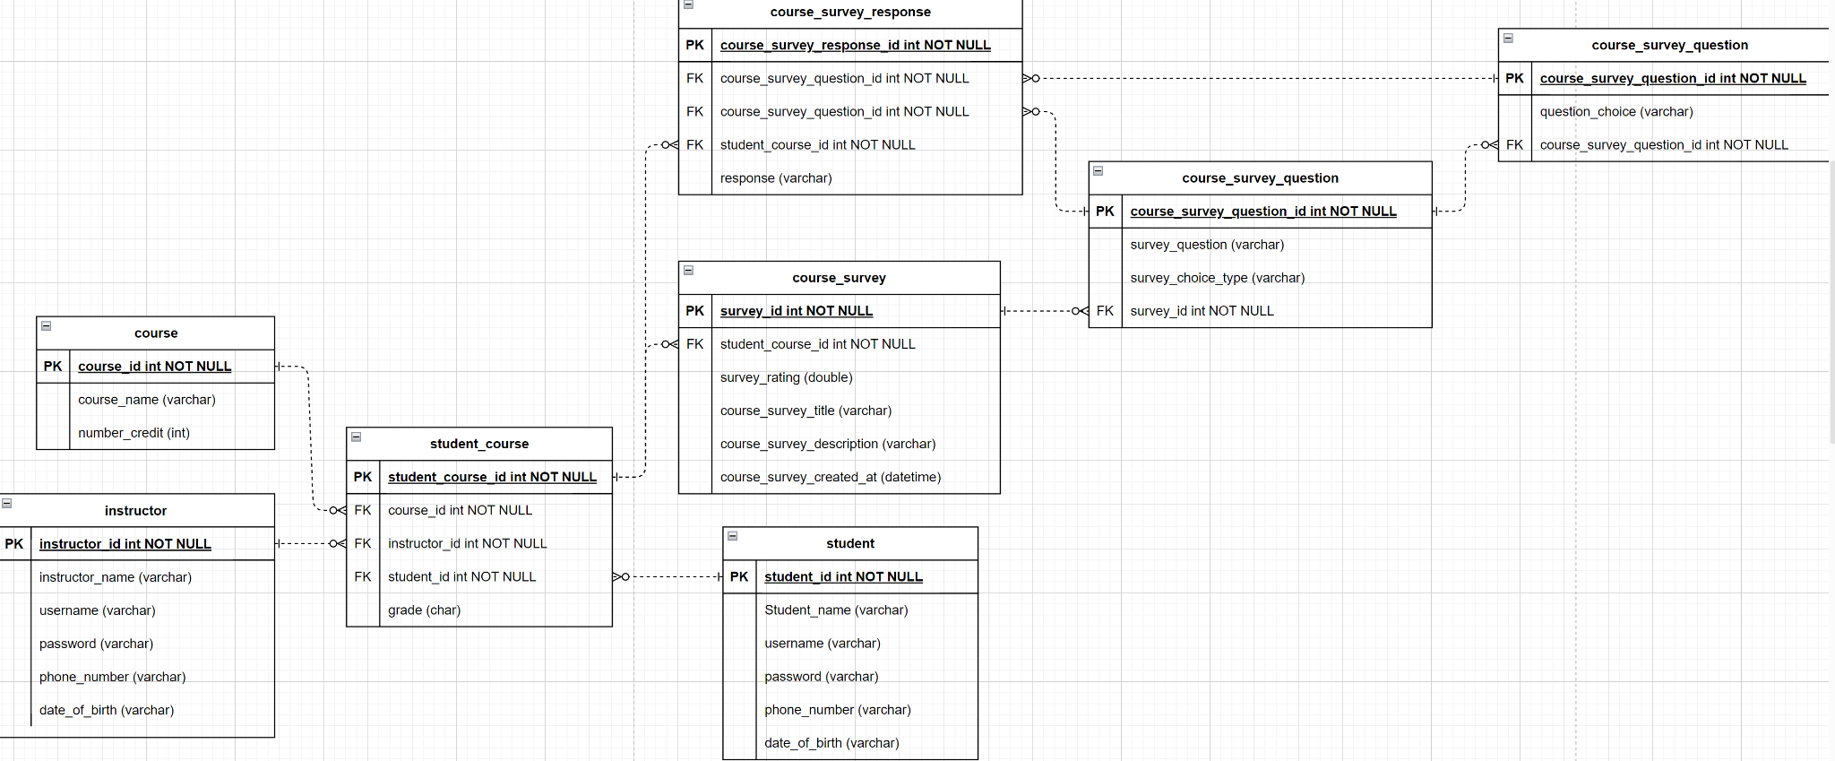
Design
Database
Hypothetical
SQLite as placeholder
ERD

Slide 6
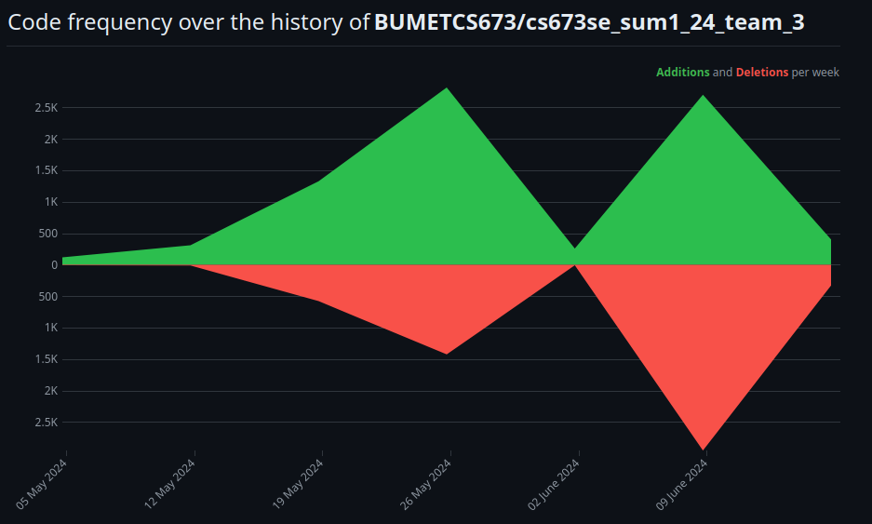
Implementation
Tech stack
Backend
Python, Django
Frontend
HTML, CSS, React.js
Refactoring
Code cleanup
Removing useless code
Easier to create new features

Slide 7

Testing
Testing tools
Built-in Django
Selenium - Frontend
Automated testing with Docker
Metrics
Number of cases passed 14 unit testing
Further metrics are in documentation
Will be shown in demo

Slide 8
Security Section
1. Security Issues
- Data Protection: Ensuring that user data, especially survey responses and personal information, is protected from unauthorized access and breaches.
- Authentication and Authorization: Ensuring only authorized users have access to specific parts of the application.
- Secure Data Transmission: Ensuring data transmitted between the client and server is encrypted to prevent interception.
- SQL Injection and Other Attacks: Preventing common web application attacks such as SQL injection, XSS, CSRF, etc.
2. Security Requirements
- User Authentication: Implement secure authentication mechanisms such as multi-factor authentication.
- Role-Based Access Control (RBAC): Implement RBAC to restrict access to different parts of the application based on user roles.
- Data Encryption: Use encryption for sensitive data storage and transmission.
- Input Validation: Implement strict input validation to prevent injection attacks.
- Regular Security Audits: Conduct regular security audits and vulnerability assessments.

Slide 9
Security Section (Continued)
3. Security Design
- Authentication and Authorization
- Implement Django’s built-in authentication system.
- Use libraries such as `django-allauth` for enhanced authentication features.
- Data Encryption
- Use HTTPS for secure data transmission.
- Store sensitive data encrypted in the database.
- Input Validation
- Use Django’s form validation features to ensure inputs are sanitized.
- Security Headers
- Implement security headers like Content Security Policy (CSP), X-Content-Type-Options, X-Frame-Options, and X-XSS-Protection.
4. Security Tools
- Django Security Features: Utilize built-in Django security features.
- SSL/TLS Certificates: Use services like Let's Encrypt to provide SSL/TLS certificates for HTTPS.
- Security Libraries: Use security libraries like `django-secure`, `django-axes`, and `djangorestframework-jwt`.
- Static Code Analysis Tools: Use tools like Bandit and SonarQube for static code analysis to detect security vulnerabilities.

Slide 10
Security Section (Continued) - Step 5A
5. Implementation
- Enable HTTPS
- Ensure the server is configured to serve the application over HTTPS.
- Authentication and Authorization
- Implement Django’s authentication and permission system.
- Example:
```python
settings.py
AUTHENTICATION_BACKENDS = (
'django.contrib.auth.backends.ModelBackend',
'allauth.account.auth_backends.AuthenticationBackend',
)
views.py
from django.contrib.auth.decorators import login_required
from django.http import HttpResponse
@login_required
def my_view(request):
return HttpResponse("Hello, authenticated user!")

Slide 11
Security Section (Continued) - Step 5B
- Data Encryption
- Ensure sensitive data is encrypted.
- Example:
```python
from django.db import models
from cryptography.fernet import Fernet
key = Fernet.generate_key()
cipher_suite = Fernet(key)
class SensitiveData(models.Model):
encrypted_data = models.BinaryField()
def save(self, args, kwargs):
self.encrypted_data = cipher_suite.encrypt(self.encrypted_data.encode())
super().save(args, kwargs)
- Input Validation
- Use Django’s form validation features.
- Example:
```python
from django import forms
class SurveyForm(forms.Form):
question = forms.CharField(max_length=200)
answer = forms.CharField(widget=forms.Textarea)

Slide 12
Security Section
6. Testing
- Automated Security Tests
- Use tools like OWASP ZAP or Burp Suite for automated security testing.
- Penetration Testing
- Conduct regular penetration testing to identify vulnerabilities.
- Unit Tests
- Implement unit tests to ensure security features work as expected.
- Example:
```python
from django.test import TestCase
from django.urls import reverse
class SecurityTests(TestCase):
def test_login_required(self):
response = self.client.get(reverse('my_view'))
self.assertRedirects(response, '/accounts/login/?next=/my_view/')

Slide 13

Project Management - Roles
Magnus - Team Leader / Design and Implementation Leader
Adrian - Configuration Leader / Security Leader
Xi - QA Leader / Design and Implementation Leader (Data Base)
Jack - Requirement Leader / Design and Implementation Leader
Smaller team
Sharing roles

Slide 14

Project Management - Achievements
Magnus - Initial code base and team management
Jack - Initial Django models and continued testing
Adrian - User login and code refactoring
Xi - Completion of survey implementation and testing
Everyone played a vital role

Slide 15
Project Management - Risk and Quality Management
Risks
Working on wrong components
Improper planning
Lack of motivation
Quality
Code reviews as team
Manual testing
Automated testing

Slide 16

Project Management - Challenges
Initial challenges
Lost a group member
Tight deadline
Slow start
Improving collaboration
Overcoming challenges
Sharing responsibilities
Being proactive
Gained momentum
Improved communications

Slide 17
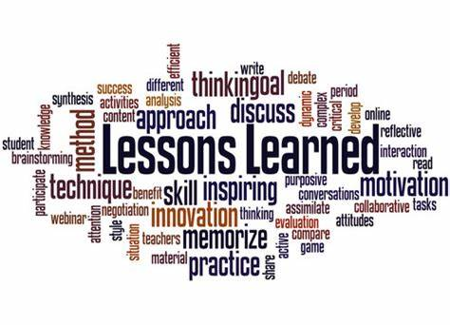
Project Management - Lessons Learned
Communication is vital
Divide and conquer tasks as a group
Play into everyone’s strengths
Set realistic goals
Approach every challenge with enthusiasm

Slide 18
Demo

