Slide 1
- Iteration 0 -
iGroup
Team 6 - Panda
CS673 Software Engineer Fall 2022

Slide 2
CONTENT
01
Introduction of Team 6
02
Project Description
03
Proposed High level Requirements
04
Management Plans & Reference

Slide 3
01
Team Introduction

Slide 4
iGroup
Team Name:
Panda
Shawn
Siming
Dawei
Haiyang
James (Lijian)
Team Leader
Security leader & Requirement Leader
Design and Implementation leader
QA Leader
Configuration leader

Slide 5
02
Project Description

Slide 6
iGroup
How to assign a Perfect team？
All Students
Team

Slide 7


iGroup
Team Assignment Tool
High-level Description: A Web-based Application for team assignment
01
02
Motivation: Help professors automatically assign teams based on the survey while focusing on Class size which is no more than 50 students.
03
Goal: Efficiently form teams and visualize the results on web page

Slide 8
iGroup
Workflow of iGroup
Groups
（final）
Exact role
Exact group
D
Manual Setting
Special Case
People Arrangement
Auto Assign
（initial）
Algorithm
Team size
Number of total Students
C
B
Online Survey
Experience
Language Preference
Leader role Preference
A

Slide 9
iGroup
Tech Stack and Frameworks
（Optional）
HTML
CSS
JavaScript （React）
Git/GitHub
Frontend
VCS
Backend
Database
（Optional）
MySQL
Java
Spring boat（Optional）

Slide 10
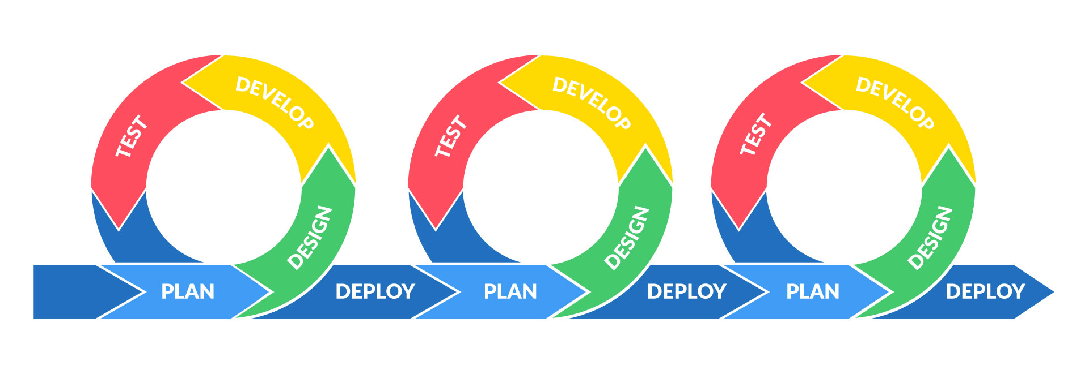
iGroup
Project Management Methodology: Agile

Slide 11
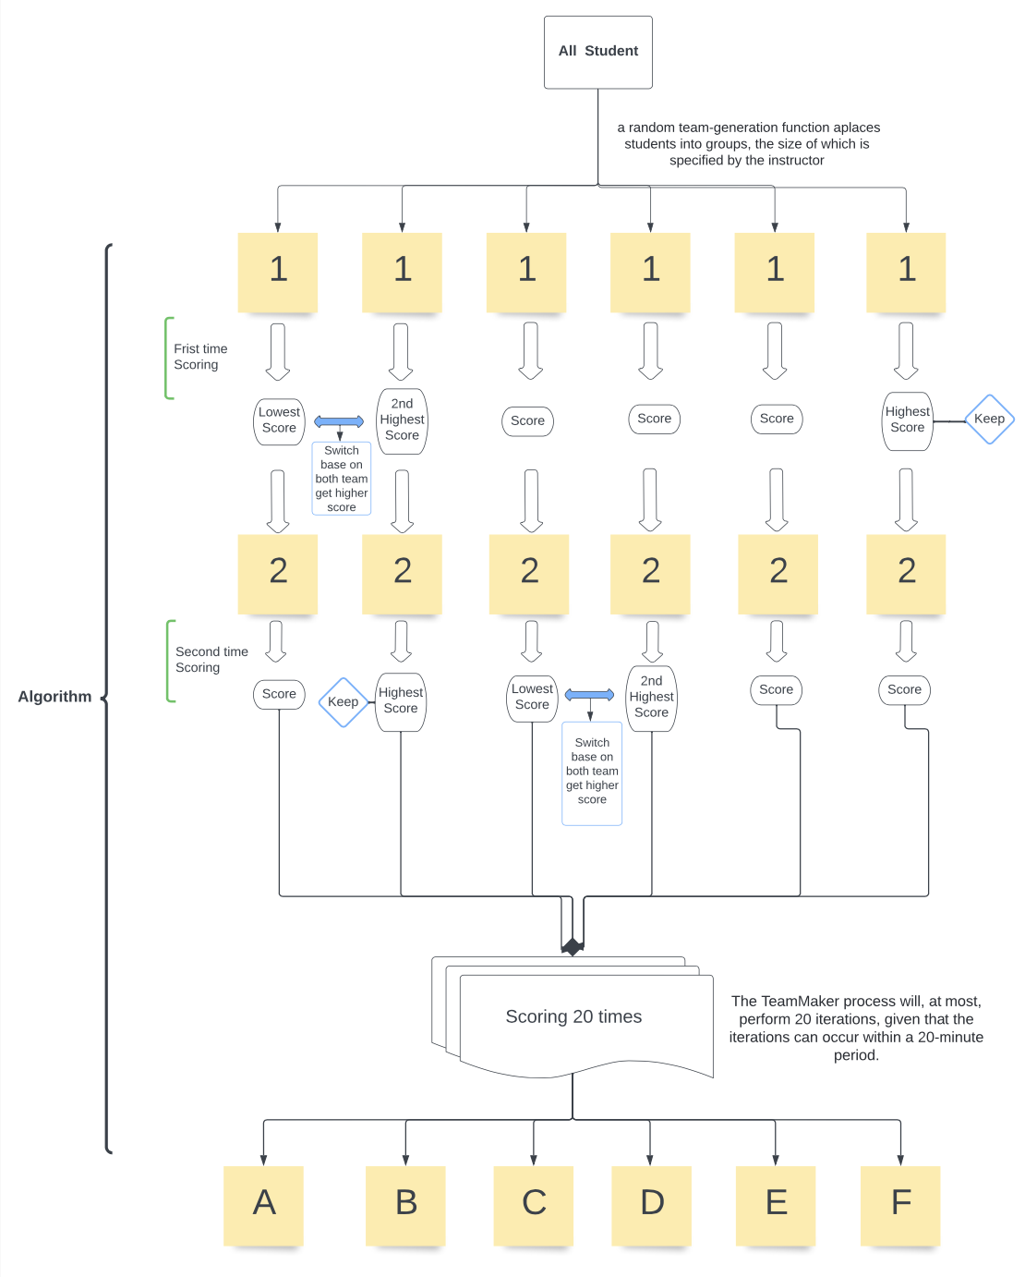
iGroup
Initial
Algorithm
flowchart

Slide 12

iGroup
Related Work
01
Previous Examples
https://github.com/BUMETCS673/BUMETCS673A1F21P3
https://github.com/BUMETCS673/group-project-team1
02
https://docs.google.com/forms/d/e/1FAIpQLSfkskHnSJLweJSulYyeBenhNPSyzHkQTRW6wzakM_Ffb3gJFA/viewform
Survey
Team sign
https://docs.google.com/document/d/1PzFrv9GLrKaXZP46fl1S_kaAev4Gb6BcfAxBUfSvNSs/edit
03
Algorithm
Forming_More_Effective_Teams_Using_CATME_TeamMaker_and_the_Gale
04

Slide 13
03
Proposed High
level Requirements

Slide 14
iGroup
Functional Requirements
Optional Features
Existing Features
Essential Features
Desirable Features
Security Requirements
Essentials
Client side
Fancy things
Reserved spaces

Slide 15
04
Management Plans
& Reference

Slide 16
iGroup
Configuration Management Plan
Tools :
Version Control: Git,Github
Database(optional):
DataGrip(PostgreSQL relational database)
CI/CD:TeamCity(optional)
Tools :
Front end (optional):
VS Code(HTML,CSS)
Back end: intellJ(IDE)(Java), framework(optional):Spring Boot,Maven
01
02
Deployment Plan if applicable :
Use Maven to pack our Spring Boot project to an executable jar file or in other ways.
GitHub-Flow :
Code Commit Guideline and Git Branching Strategy
04
03

Slide 17
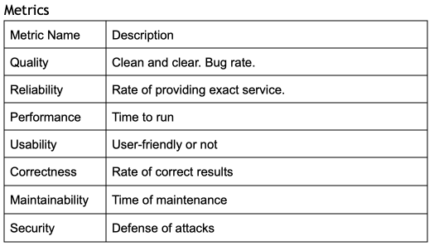
iGroup
Quality Assurance Management Plan

Slide 18
iGroup
Quality Assurance Management Plan
Testing
Coding Standard
Team members review each other’s code
Defect Management
Code Review Process
AAA model (Arrange, Act, Assert)
Please refer to this link: https://www.geeksforgeeks.org/coding-standards-and-guidelines/
Our standards will be based on the contents in this link.
We might use:
ClickUp https://clickup.com/
Bugzilla https://www.bugzilla.org/
These tools will help us upload bugs we find and eventually get them fixed.

Slide 19
iGroup
Communication Plan
Discord
Zoom
Instant messaging
For Weekly Meeting
04
03
02
01
GitHub
Coding Repository
Google Drive
Documents Share

Slide 20
iGroup
Risk Management Plan
Communication
Here is the link:
CS673_SPPP_RiskManagement
Design and implementation
Requirements
Quality Assurance
Technology competence

Slide 21
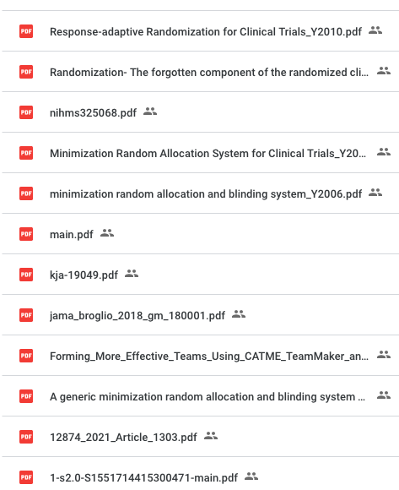
iGroup
Reference
Here is the Link!
Algorithm Literatures
1.0
Project Examples
2.0
Coding Design Reference
3.0

Slide 22
iGroup
Question?

Slide 23
Thanks for Watching!
Team 6 - Iteration 0
Sep 21, 2022

