Slide 1

Team 1 - AceTeam
Haoran Dai
Xiaocheng Kang
Qinchen Gu
Bhargav Gundapaneni
Huanzhou Wang

Slide 2
What Was Done
Engineering Practices
What Is Next
Content
Project Scope Change

Slide 3
Project Scope Change

Slide 4
Project Scope Change
Project focus:
Previous: Completed mall, including new, used goods, furnitures, bonus missions
Present: More focus on used furnitures and bonus missions
Function change:
Delete payment function
Reason: Payment function is too risky, money always matters
Frontend change:
Framework change from React to Vue
Reason: Vue is more simple, more flexible and make development more rapid

Slide 5
What Was Done

Slide 6
Front End
Technical Analysis & Interface Display

Slide 7
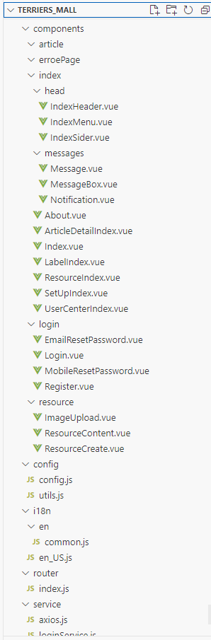

Frontend - Vue
Characteristics:
Simple, Rapid development
Framework -React is only a lib
Flexible

Slide 8
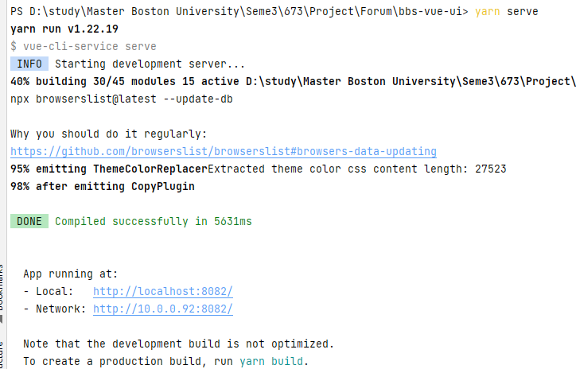
Frontend
yarn:
resource scheduling platform
public the project to localhost
a rapid, concise replace of npm
Start by: yarn serve

Slide 9
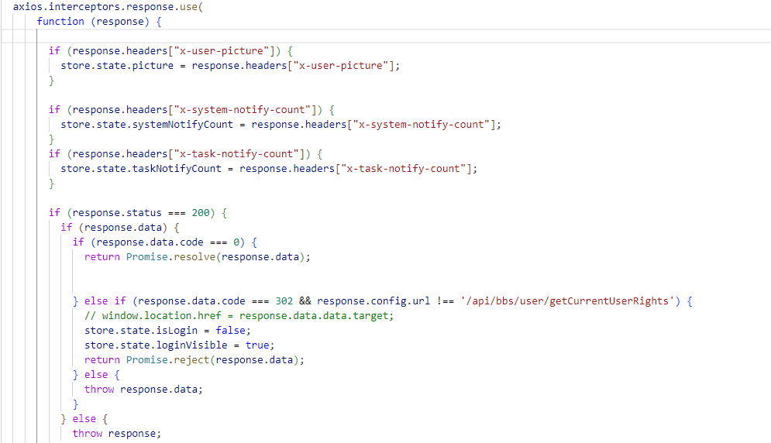
Frontend
Axios
ajax packaging by Promise
using for request in browser and nodejs

Slide 10
Frontend
Unpkg:
CDN hosting service (Content delivery network)
get npm package by URL
Leaflet:
open source javascript library
Ant-design-vue:
UI component library
used many times in the code
Unit test:
Jest

Slide 11
Back End
Implementation Module

Slide 12

Backend
Post Module Design and Implementation
Write Post
Edit Post
Like/Cancel Liking Post
Search Post
Delete Post
Review Post
Label Module Design and Implementation
Create Label
Check Label
Modify Label
Delete Label
User Module Design and Implementation
Registration
Login
Forget Password
...

Slide 13
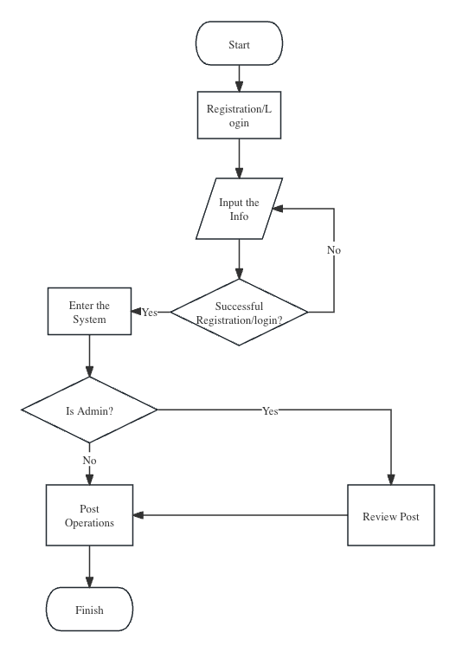
Backend - Post Module

Slide 14

Backend - Post Module
Delete Post Function
PostPo postPo = postPoMapper.selectByPrimaryKey(id);
if (!currentUser.getUserId().equals(postPo.getCreateUser())) {
throw BusinessException.build(ResponseCode.OPERATE_FAIL,
" Unable to delete, only posts uploaded by yourself can be deleted!");
}
postPo.setIsDeleted(true);
postPo.setUpdateTime(LocalDateTime.now());
postPo.setUpdateUser(currentUser.getUserId());
if (postPoMapper.updateByPrimaryKeySelective(postPo) <= 0) {
throw BusinessException.build(ResponseCode.OPERATE_FAIL, ”Fail to delete Post");
}

Slide 15
Backend - Label Module
Modify Label Function
if (StringUtils.isBlank(labelDTO.getLabelName())) {
throw BusinessException.build(ResponseCode.NOT_EXISTS, " Parameters are not compliant");
}
if (isNameExist(labelDTO.getId(), labelDTO.getLabelName())) {
throw BusinessException.build(ResponseCode.NAME_EXIST, " Duplicate label name");
}
labelDTO.setIsDeleted(null);
labelDTO.setCreateUser(null);
labelDTO.setUpdateUser(currentUser.getUserId());
labelDTO.setCreateTime(null);
labelDTO.setUpdateTime(LocalDateTime.now());
LabelPo labelPo = LabelMS.INSTANCE.toPo(labelDTO);
if (labelPoMapper.updateByPrimaryKeySelective(labelPo) <= 0) {
throw BusinessException.build(ResponseCode.OPERATE_FAIL, " Fail to update label");
}
return true;

Slide 16
Engineering Practices
Expected Project Function Modules

Slide 17
Github Actions - CI(Continuous Integration)
What is CI:
Help to check the committed code
Make restrictions easily
What we have used:
Node js scanner: For check security
Check Java version: Have same version for committed codes

Slide 18
Github Actions - CI
Actions:
name: Name what we want to call this
on: In which situation it will run CI
push/pull_request: Github tools
branches: Target branch to run CI
jobs: Like class, show what to do
runs-on: Using what kind of system

Slide 19
Github Actions - CI
Advantages:
Help to check committed code automatically
Show errors in an easy way
Clean up our branches
Disadvantages:
Takes long time if codes didn’t meet requirements
Require time for newcomers

Slide 20



Backend Unit Test - Create Label Functionality Example
Objective:
Ensure the correct functionality of the "Create Label" feature.
Submit POST request with LabelDTO.
Backend Create() processes data.
LabelMapper executes database insertion.
Preconditions:
Access restricted to administrators.
Feature unavailable for ordinary users.
Input Data:
Interaction: User clicks on “Create Label” button.
Data: Submission of labelName and logo.

Slide 21
Backend Unit Test
Test Steps:
Trigger create() in LabelController.
Submit POST request with LabelDTO.
Backend Create() processes data.
LabelMapper executes database insertion.
Backend Workflow:
Visual representation of the request flow from LabelController to LabelService, then to LabelMapper, and finally to the database.

Slide 22
Backend Unit Test
Expected Output:
Successful label creation with confirmation message.
Postconditions:
Frontend displays results with UI prompt and page redirection.
Conclusion:
Verification of the label creation process aligns with system requirements
and administrative controls.

Slide 23
What Is Next
Project Planning

Slide 24
Frontend
Make our code perfect:
Fix bugs
Test
Unit test: Jest
Change CSS format make it fit our theme better
UI color
background photos

Slide 25
Interface Display

Slide 26



Backend Unit Test
Finish the Rest Modules
User Module
Comment Module
Test
Test-driven development (TDD) using JUnit for Spring Boot
Synchronize front-end and back-end Code
Postman
Deploy it on the Node.js
Use a third-party service platform (Firebase etc.) to deploy to the network

Slide 27
Thanks For Listening!

