Slide 1

TEAM TWO - DAMPP
Iteration 2 Github Link: https://github.com/BUMETCS673/project-microserviceteamtwo

Slide 2
Team Members | Roles
Praveen Singh | Team Lead
Pranjal Ekhande | Requirement Lead
Dipayan Mazumder | Security Lead
Aman Jain | Configuration Lead , QA Lead
Mukul Jangid | Design and Implementation Lead

Slide 3
INTRODUCTION - ProManage
ProManage project management platform to streamline project creation, editing, management, search, and rating processes.
Offers project-based learning for students and professionals.
The platform will provide an environment where users can create and manage projects, access learning resources, collaborate with team members, and receive assessments and feedback on their work.
With ProManage which empowers organizations and institutions to effectively plan, execute, and monitor projects with ease.
Users will be able to optimize resources, mitigate risks and deliver projects on time and within budget.

Slide 4
Project Planning
Iteration | Functional Requirements(Essential/Disable/Option) | Tasks (Cross requirements tasks) | Estimated/real person hours
1 | Iteration 0 | Environment Setup, Documentation, Initialisation | 50 - 60
2 | Iteration 1 Code Skeleton Project Creation | Design, Implementation, Testing | 150 - 160
3 | Project Search and Filtering (Essential) Project Reporting and Analytics (Desirable) | Design, Implementation, Testing Design, Implementation, Testing | TBD TBD
4 | Integration with Other Services (Desirable) Project Templates (Desirable) Optional Features (if time permits) | Design, Implementation, Testing Design, Implementation, Testing | TBD TBD

Slide 5
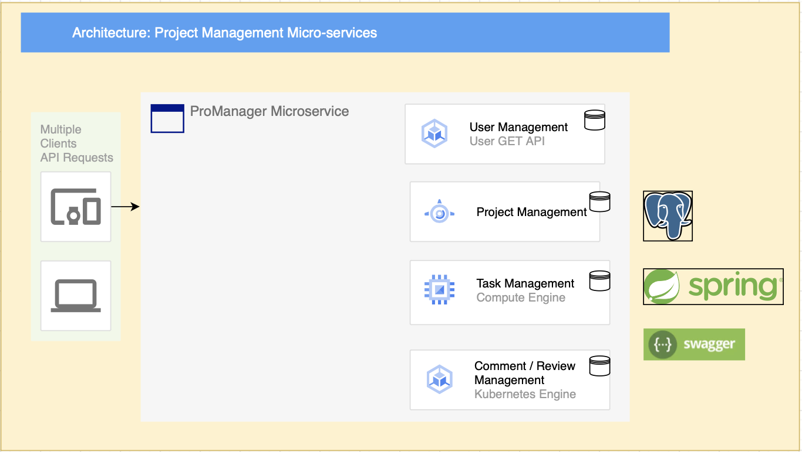
Architectural Diagram

Slide 6
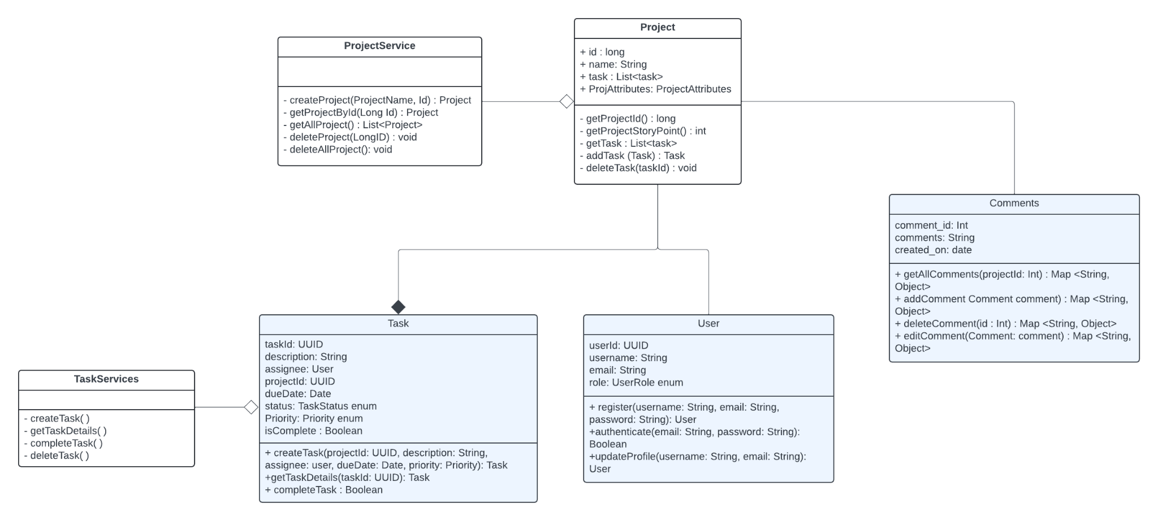
Class Diagram

Slide 7
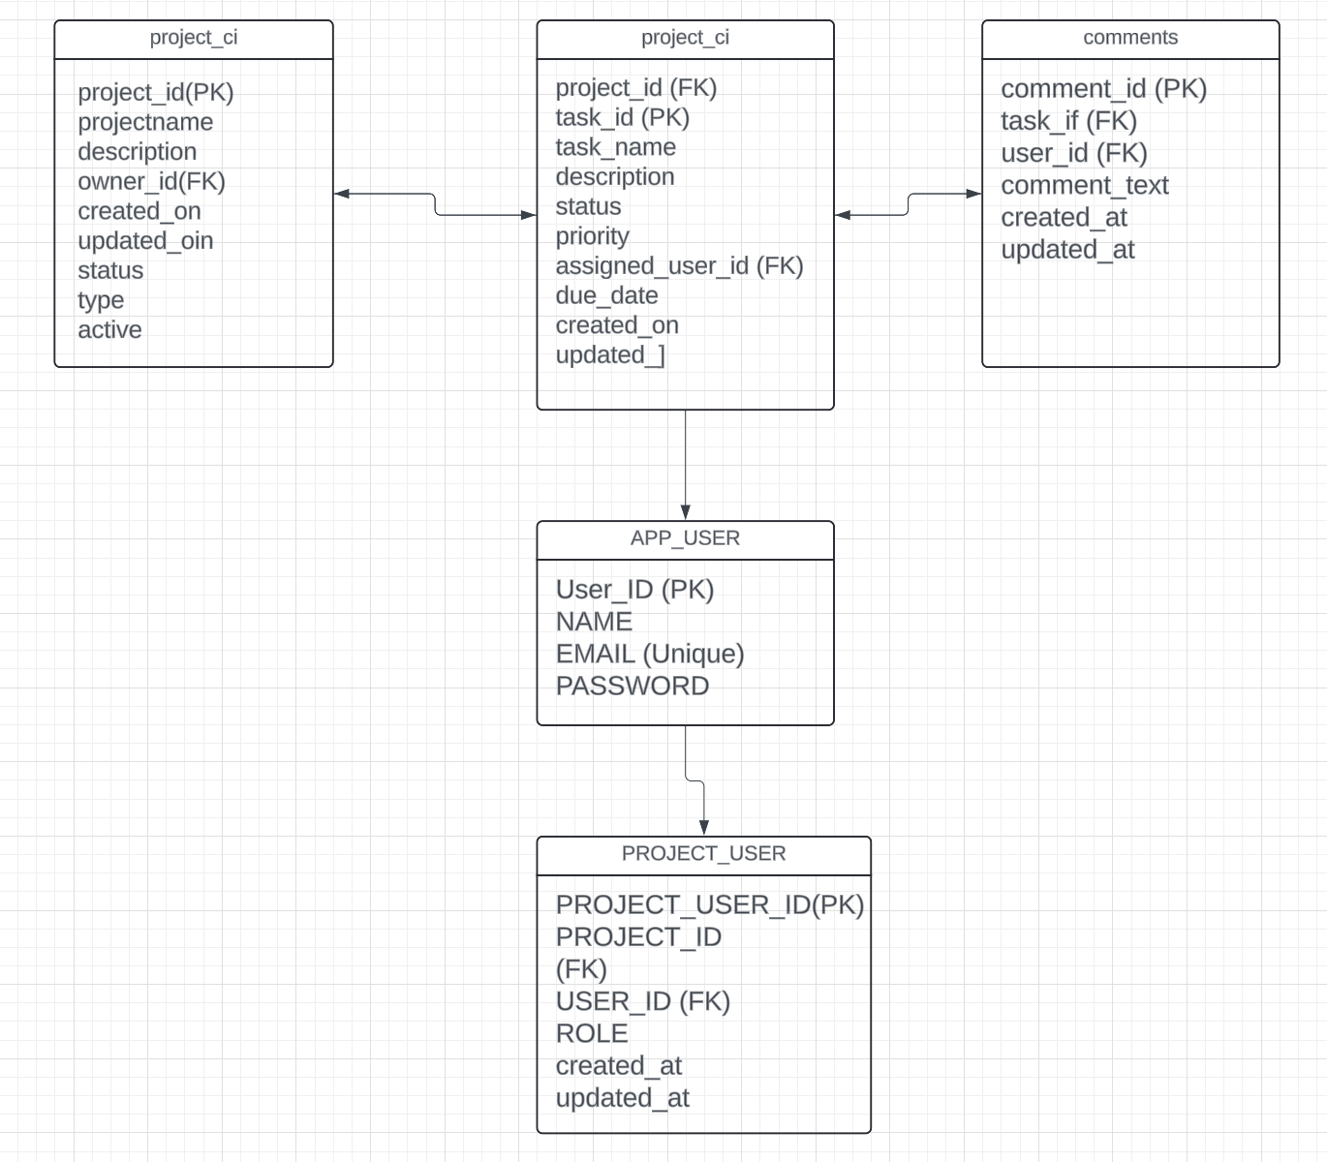
Database Diagram

Slide 8
CONFIGURATION TOOLS
Version Control: Git and GitHub
IDE: IntelliJ / Spring Tool Suite
Code Editor: VSCode
CI/CD: GitHub Actions
Dependency Management: Maven

Slide 9
Code Review Process
For Development branch the following processes will be followed:
Development branch -> Dev Testing -> PR raise -> peer review -> Testing -> Dev (preprod) -> Prod -> Ticket close
Peer Review would be mainly done by Mukul and Pranjal.

Slide 10
TESTING & QA
Our team adheres to the Google Java Coding Standards for writing Java code and Black code style for writing Python code.
Manual Testing: - Exploratory Testing - Usability Testing - Regression Testing
Automated Testing: - Unit Testing (JUnit) - Integration Testing (JUnit, Mockito) - Code Coverage (JaCoCo)
We use Postman for API testing.

Slide 11
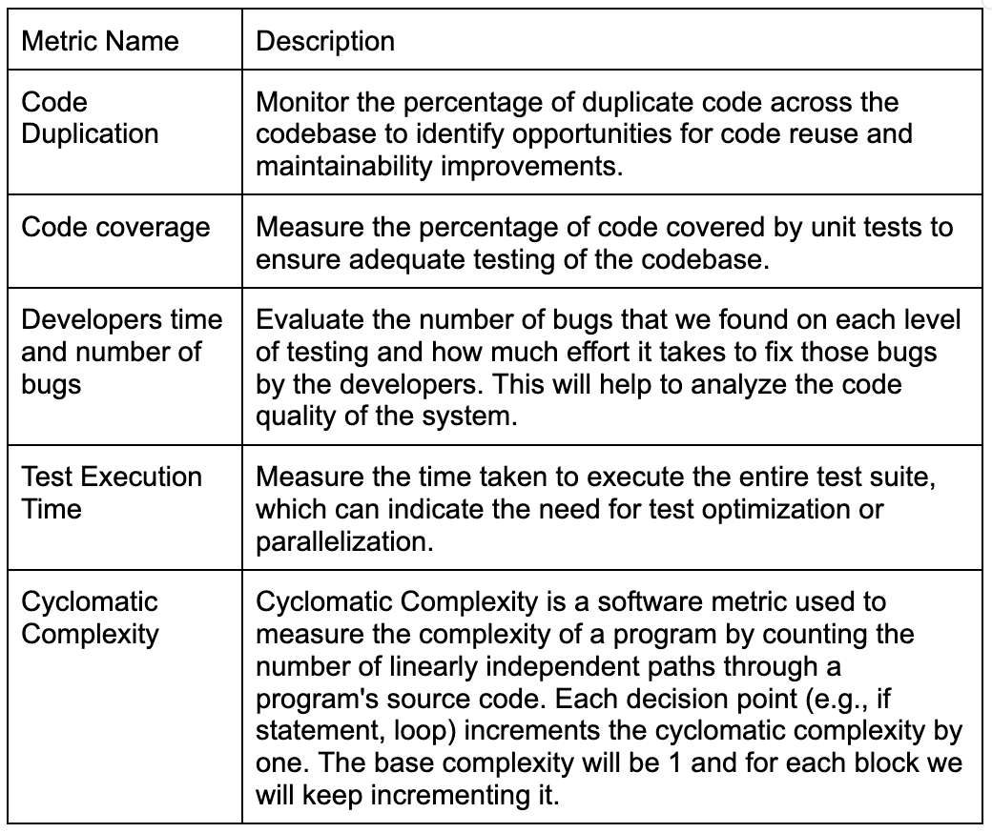
QA Matrix

Slide 12
THANK YOU

