Slide 1
PennyWise - Personal Budgeting and Finance Application
Iteration 0 - Team #1: Sean Rawson, Sherif Zeyada, Jisoo Lee, Mali Rivera, Brian Fenstermacher, Clyde Yeung, Chaitanya Saraogi

Slide 2
Member Roles
Team leader: Brian Fenstermacher
Requirements leader: Jisoo Lee, Chaitanya Saraogi
Design and Implementation leader: Sherif Zeyada
QA leader: Mali Rivera
Configuration leader: Clyde Yeung
Security leader: Sean Rawson

Slide 3
PennyWise - Description
With constant rising inflation and costs of living, budgeting can be one of the more difficult areas for college students and young professionals to excel in. Traditionally, a lot of budgeting is done through spreadsheets and that can be a very tedious and time consuming task. More recently, there have been a number of budgeting applications that target this age range of individuals but they tend to either have a steep cost with lots of integrations or they’re free and extremely limited with a tall pay wall to access the other features that many users would like to have. Our project aims to bridge that gap by providing users with the features that they want, and no pay wall stopping them from having better finances.
Product *Core* Features:
Add monthly income and expenses
Login and access control
Budgeting categories
Tracking expenses
Product *Additional* Features:
Tips from experts

Slide 4
Related Work
Everydollar
The free version offers a customizable budget and savings funds and the premium version offers bank connectivity, budget insights, paycheck planning, smart tracking suggestions, financial roadmap, goal setting, group coaching, csv download. Our application would offer a few of the premium version features to make it more competitive plus some original items.
GoodBudget
Very similar to the above but lets you categorize your ‘envelopes’ for spending. Everything must be manually entered (ie. your monthly income and what you spend) but I think given our timeframe for this project that will be a good approach for us as well.
PocketGuard
Easy to navigate dashboard, show spendable money after bills, goals and necessities are accounted for. Pie chart shows by each categories. Easily see how your student loans fit in with the rest of your income and spending.
Mint
One of the best rated budgeting apps. Securely connects to your bank account and automatically inputs purchases. Notification features (upcoming bills, low funds, avoid overspending etc).

Slide 5
High Level Requirements
FUNCTIONAL FEATURES:
Essential - Monthly Income Tracking
Essential - Monthly Expense Tracking
Essential - User Registration and Authentication
Essential - Custom Expense Chart
Desirable - Expense Categorization and Tracking
Desirable - Expense Tracking Visualization
Desirable - Expense Alerts and Notifications
Optional - Budget Setting
Optional - Financial Impact Assessment
Optional - Expense Review and Recommendations
Optional - Financial Tips
NONFUNCTIONAL REQUIREMENTS:
The system must accurately calculate and present financial data to users for informed decision-making
User data should be kept private and only accessible by authorized users
User password hashes stored in MariaDB
Public facing resources/pages with no auth restrictions, all other resources require authentication
Authentication w/ username and password
Role based authorization for certain paths (ie. role_admin, role_user)
Optional - Sign up requires email confirmation

Slide 6
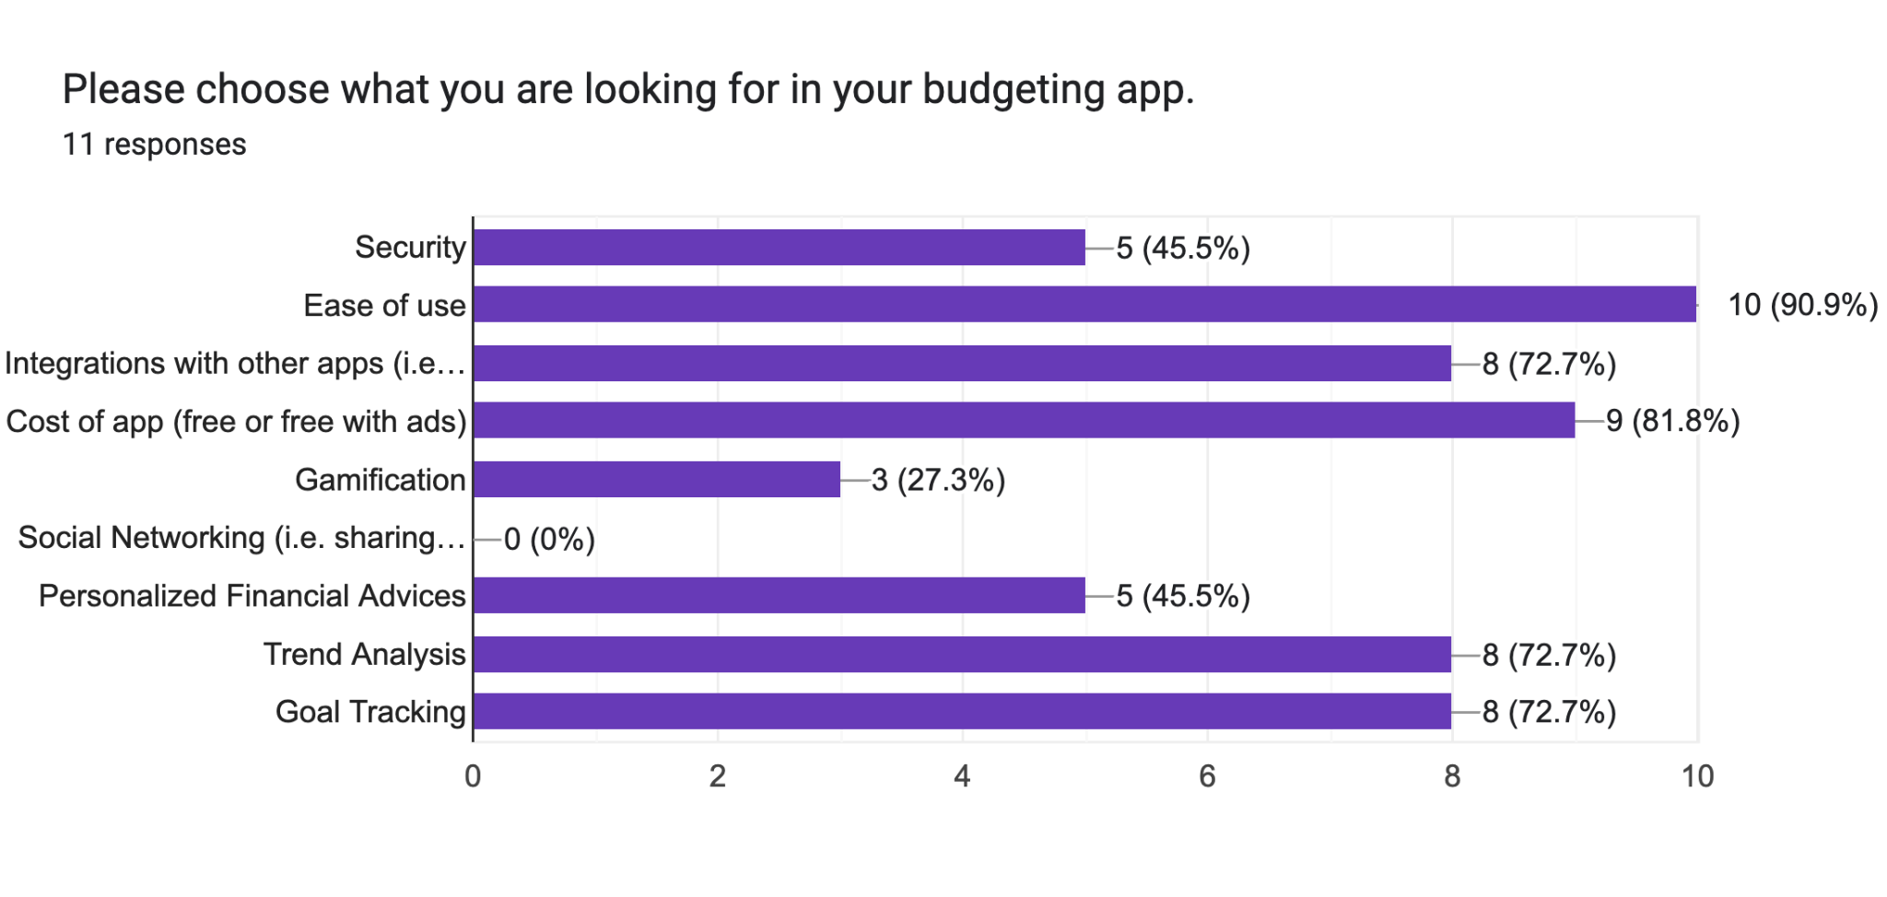
Management Plan
Objectives & Priorities:
User centric design
Expense tracking and budgeting categorization
Expense analysis
Data storage efficiency
User friendly registration and login
Expert tips integration
User Preferences
Ease of Use
Cost of App
Goal Tracking
Trend Analysis
Integration with Other Apps
Personalized Financial Advices
Security
Gamification

Slide 7
Quality Assurance - Metrics
The following Software Quality Assurance Metrics will be used to continuously monitor and improve the quality of PennyWise software.
Test Coverage: The percentage of code or functionalities covered by test cases.
Defect Density (KLOC): The number of defects per thousand lines of code.
Execution Rate: The number of test cases executed in a given time frame.
Test Case Effectiveness: The number of defects measured by test cases.
Test Case Pass Rate: The percentage of test cases passed by a testing cycle.
Defect Escape Rate: The number of defects found post-production compared to the number of defects identified by QA
Test Automation Coverage: The percentage of tests that have been automated
Notes:
For Quality Assurance, we decided to use the following metrics to assess the quality of PennyWise software. These metrics are commonly used metrics in the industry and will be used to monitor and improve the quality of our code. The metrics minly focus on test effectiveness, defect density, and code execution. We plan to use these metrics to identify problem areas in our code that should be addressed.
The QA leader will take the lead on monitoring these metrics for the team and provide updates for the team.

Slide 8
Quality Assurance - Code Management
Code Review
Team members will review each project iteration
Those working together will review each other’s code and provide feedback using the Code Review Summary Worksheet
It is encouraged for teammates to walk through each other’s code via Zoom
Coding Standard
Will be used as a guideline for best coding practices
Will follow Industry-Specific Standards for software development
Intent: to improve readability, compatibility, and code quality.
Testing Tools
JUnit
Maven
Defect Management Tool
Jira
Notes:
For code management, we will have all team members review each project iteration. It will be helpful for each team member to walk through the code before project submission so that everyone is contributing to the code review.
Since some team members will be working on project requirements together, we plan for them to review each other’s code when it is helpful to do so. We have a Code Review Summary Worksheet to facilitate this process, although it is encouraged for teammates to meet in live Zoom sessions when possible.
We will use a Coding Standard to improve the readability, compatibility, and quality of our code. The Coding Standard rules will align with Industry-Specific-Standards.
For Testing Tools, we will use JUnit and Maven. Each developer will unit test their code throughout the course of development. The QA leader will focus on integration testing and fill in any gaps in unit testing as needed.
For defect management, we will use Jira which is the software that we are using for project management. The Jira software makes it easy to track issues and progress in our code as a team.

Slide 9
Configuration Management Plan
Tools:
Version Control: GitHub
CI/CD: GitHub Actions (Automated pipeline)
Project Management: Jira
Containerization: Docker
Deployment: Ansible + Docker Compose or Kubernetes
Branching Strategy: GitFlow with Pull Requests
Code Quality: SonarQube for DAST*
Container Orchestration: Kubernetes
Deployment Platform: AWS*

Slide 10
Branch and Code Commitment
Branch Strategy
There are 2 fixed branches: main and dev
main branch serves as the single source of truth and is production branch.
dev branch serves as the integration branch where features branch will merge and tested here before committing to main branch.
Besides main and dev branches, there are also “story” branch. The branch name will be created and name after the story
Team members should only create “story” branch
Commit Strategy
Regular commit - For individual story branch. Commit should include a descriptive comment
Pull Request - Code should only commit to dev branch through Pull Request and reviewed by either team leader or Design & Implementation leader

Slide 11
Github Action/Pipeline
Pipeline is orchestrated using Github Action with the following stages
Retrieve Github Code
Linting
Code Scanning
Build
Unit Test
Create the supporting container(s) (Database) and label
Create App Container and label
Save the container image and upload the image

Slide 12
Containers
Docker container technology is used
The following containers should be created
Database with MariaDB
Application - PennyWise
OpenLDAP

Slide 13
Testing the App
Members can download the images and launch on local machine
Launching the same containers (set) can guarantee every team member is accessing exactly the same environment
Testing could be performed on local environment

