Slide 1
PennyWise - Personal Budgeting and Finance Application
Iteration 1 - Team #1: Brian Fenstermacher, Jisoo Lee, Sherif Zeyada, Mali Rivera, Clyde Yeung, Chaitanya Saraogi, Sean Rawson

Slide 2
Member Roles
Team leader: Brian Fenstermacher
Requirements leader: Jisoo Lee, Chaitanya Saraogi
Design and Implementation leader: Sherif Zeyada
QA leader: Mali Rivera
Configuration leader: Clyde Yeung
Security leader: Sean Rawson

Slide 3
Iteration 1 - Key tasks
Define Software architecture
Create Class diagram
Define Design patterns to be used
Create mockup of front-end
Implement API endpoints for adding users and expenses
Complete setup of MariaDB container and Github Actions pipeline

Slide 4
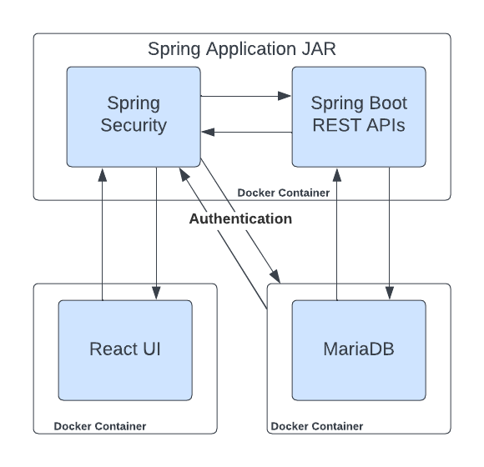
Software Architecture
Notes:
(Chaitanya)PennyWise is a robust application built on a client-server architecture with user-centric front-end and robust back-end. Our system is designed to be easily expanded and scalable. Each of our components will be within its container which reduces coupling and leads to future improvements. The Spring Boot back-end serves as a core in our application; it handles data processing and communication with the database. For the data integrity and persistence, we are using the MariaDB database instance. Data integrity and persistence is crucial for our application because we are managing income and expenditure data from the user. PennyWise application is containerized using Docker. This approach will streamline deployment and configuration management.

Slide 5
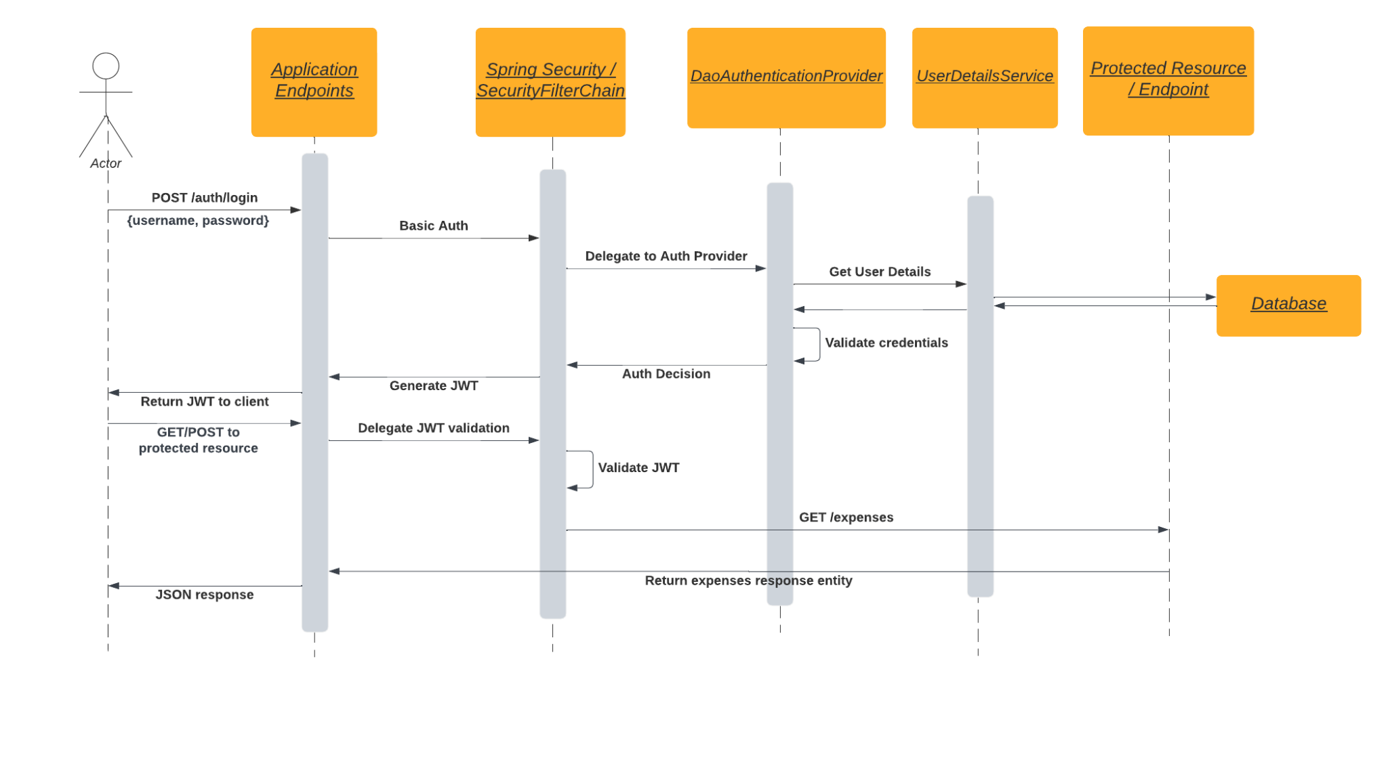
Software architecture
Notes:
Spring Security is responsible for authenticating and authorizing all requests. On initial authentication, user details are retrieved from the database. On successful authentication, a JWT is generated and can be used for subsequent requests without retrieving user details again. This diagram shows a typical flow when authentication is required for a protected resource (a REST endpoint in our case).
DaoAuthenticationProvider and UserDetailsService are both elements of Spring Security, and are involved in the actual retrieval and validation of user details against supplied credentials. Once credentials are validated, a JWT is returned to the user and can be supplied with all future requests (until token expiry). All validation of the JWT is done in the background by Spring Security for each request.
Once a (non-admin) user is authenticated, they can begin to actually use PennyWise for managing their budget. Both the front-end React UI and the Spring Boot portion of the back-end are heavily involved in these use cases.
we are also parallely exploring the implementation of google authentication within our design to improve user login experience.

Slide 6
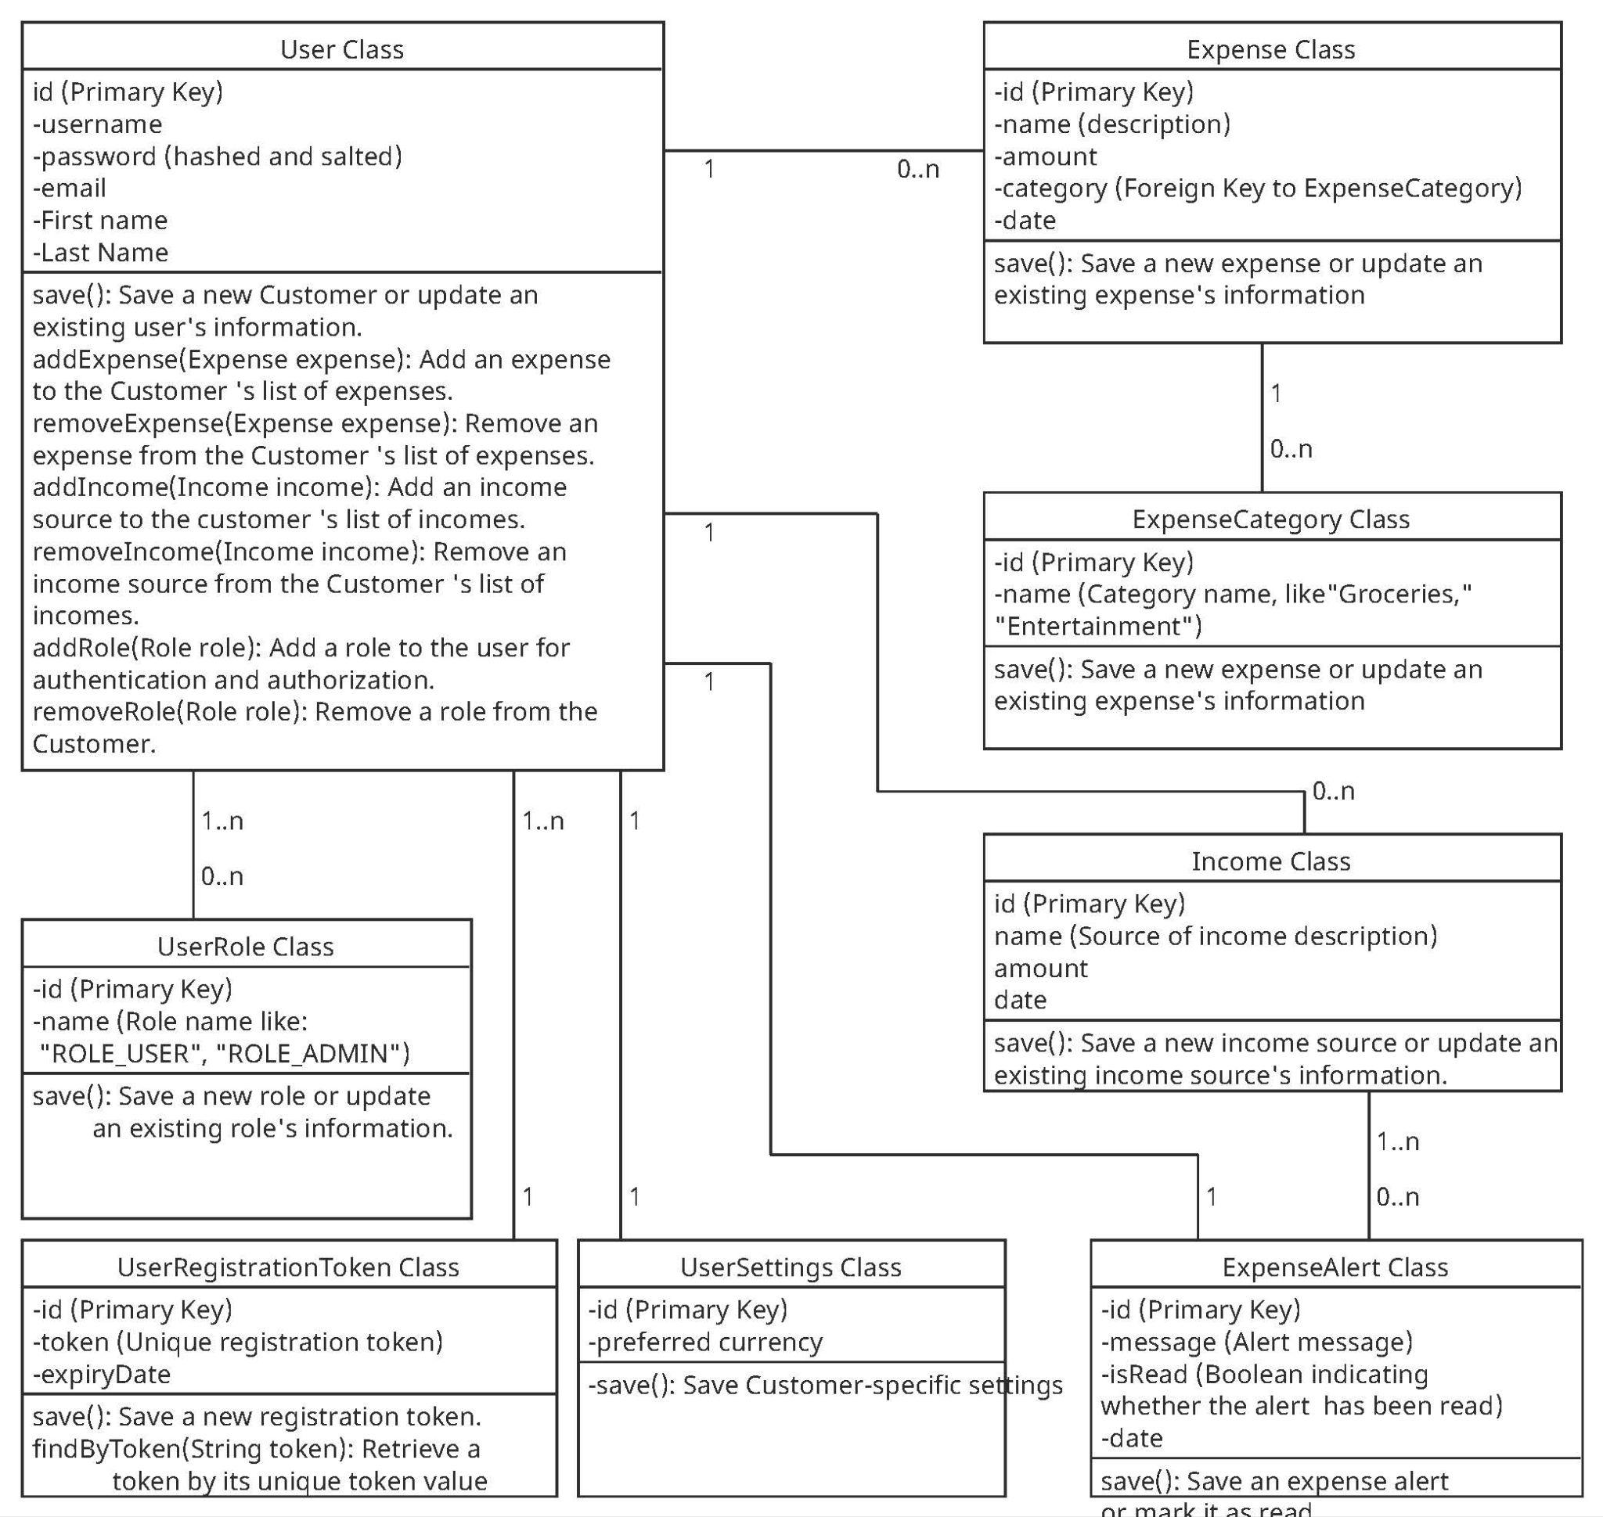
Class Diagram
Notes:
8 classes -
User,
UserRole -where we define if they have admin rights,
userRegistration Token,
User Sertings class,
Expense Class,
Expense category class,
Income Class,
Expense alert class

Slide 7
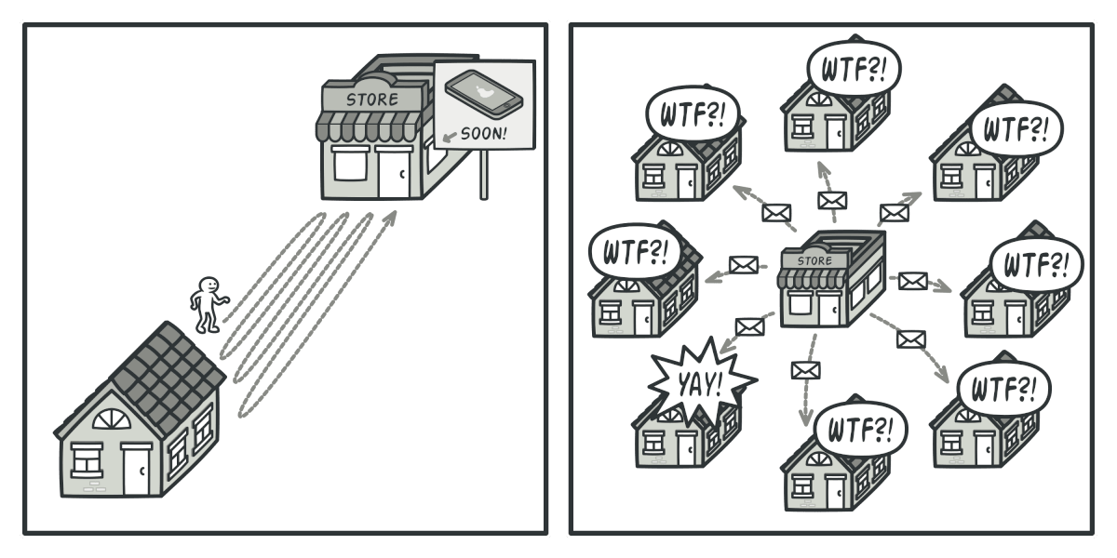
Design pattern
Observer Pattern
Subject: The category class
Concrete Observer: individual User instance
Update/Notify: The Category provides methods for Users to register themselves as Observers and notifies them whenever an expense is added or updated.
Notes:
Observer pattern : The Observer pattern enhances the flexibility and maintainability of PennyWise by decoupling the expense management logic from the user interface. It can also allows us to build in future functionality for multiple Users to stay synchronized with changes to their expenses in a household
.

Slide 8
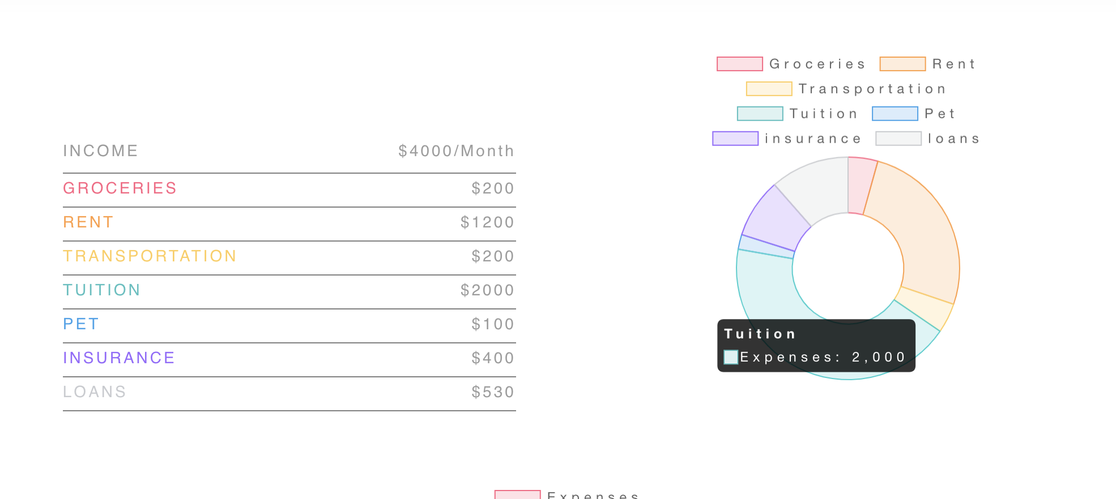
UI Design
Clean and intuitive user interface for users to track expenses
Simple login and sign up pages
Informative dashboard
Expense chart and expense table
Intuitive sidebar navigation
Clean color palette that relates to the product
Green logo - money
Tools
Chart.js
Notes:
For our UI design, we plan to create a clean and intuitive user interface to help users track their expenses. Users are first brought to a login page with the app logo. The user can then either sign in with a username and password or their google account. If they’re new users, they can navigate to the sign up page to easily create a new account. Once logged in, users are redirected to the main dashboard.
The dashboard presents a visual representation of the user’s expenses through a pie chart and table. The user can easily use the drop down menu on the dashboard to access expense data from different months.
We also will have an intuitive sidebar navigation for the user to navigate between the dashboard, login/signups and add expense pages. The add expense page allows users to enter individual expenses and specify the expense category so that this information is correctly saved in the DB. The front end will access this data to continuously update the user’s expense charts.

Slide 9
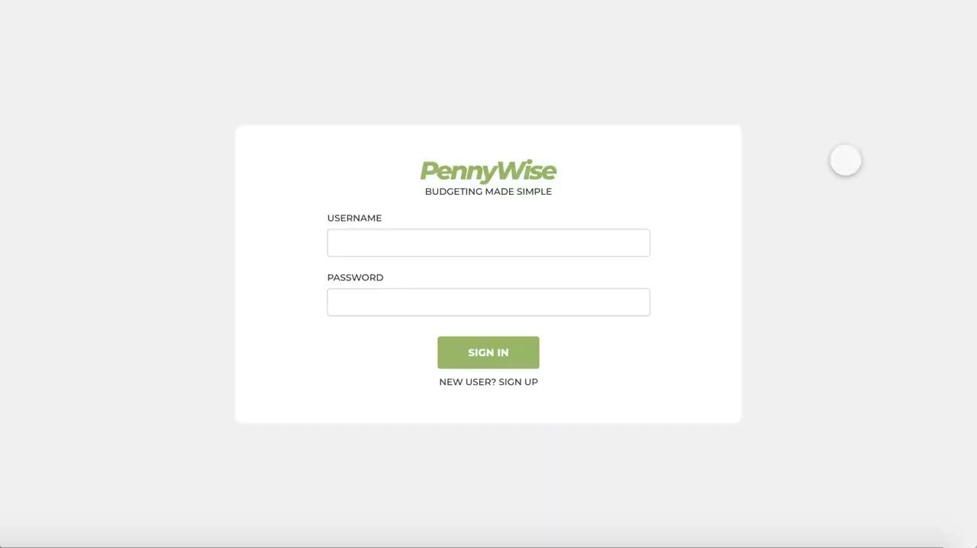
Front-End Demo

Slide 10
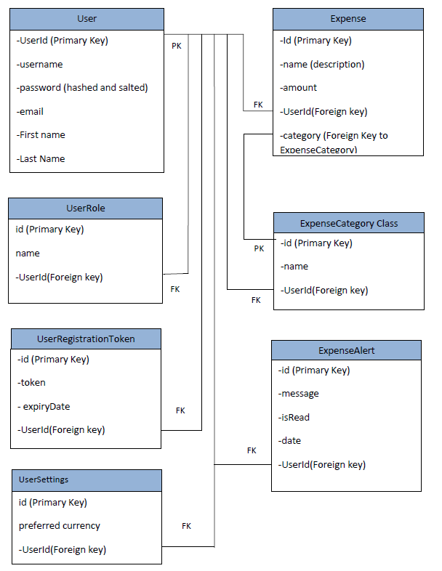
Database Design
User is central to the data model
All other tables except the expense category table have ‘user_id’ as a foreign key
Joins are less complicated

Slide 11
Security Design
Application Security
User login with OAuth2 via Google or basic authentication followed by JSON web tokens
For users who sign up with basic authentication, passwords are hashed using Spring’s BCryptPasswordEncoder
Spring Security handles all validation of tokens
Container Security
Application processes run as non-privileged users
Docker overlay network created with encryption flag to encrypt data traffic

Slide 12
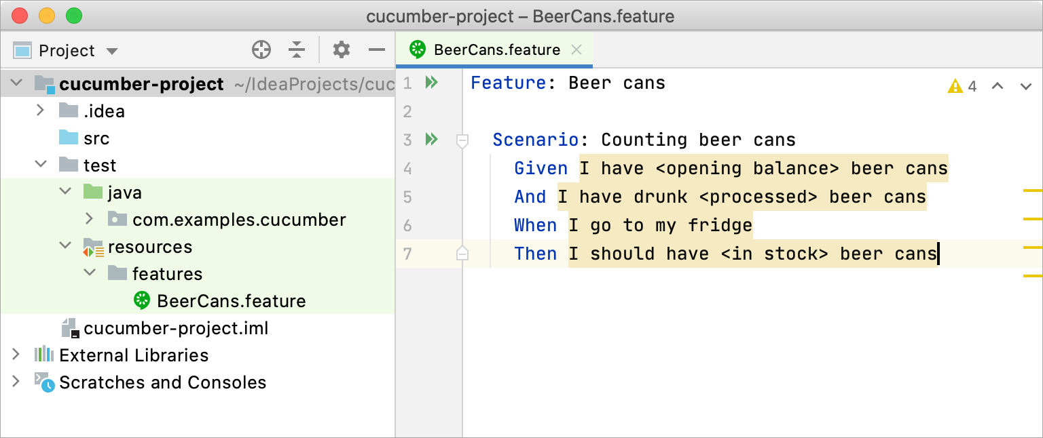
Testing Summary
Unit Tests
we will use JUnit5 and integrate Mockito
Mockito is a framework that is used to mock interfaces so that dummy functionality can be added to a mock interface for Unit Testing purposes
Integration Tests
We will use JUnit5 and MockMVC to test the web layer
Acceptance Tests
We will use Cucumber which is a behavior-driven development framework in JUint5

Slide 13
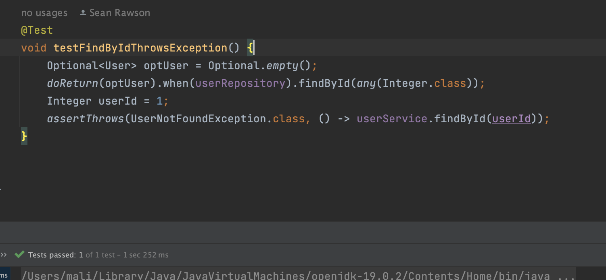
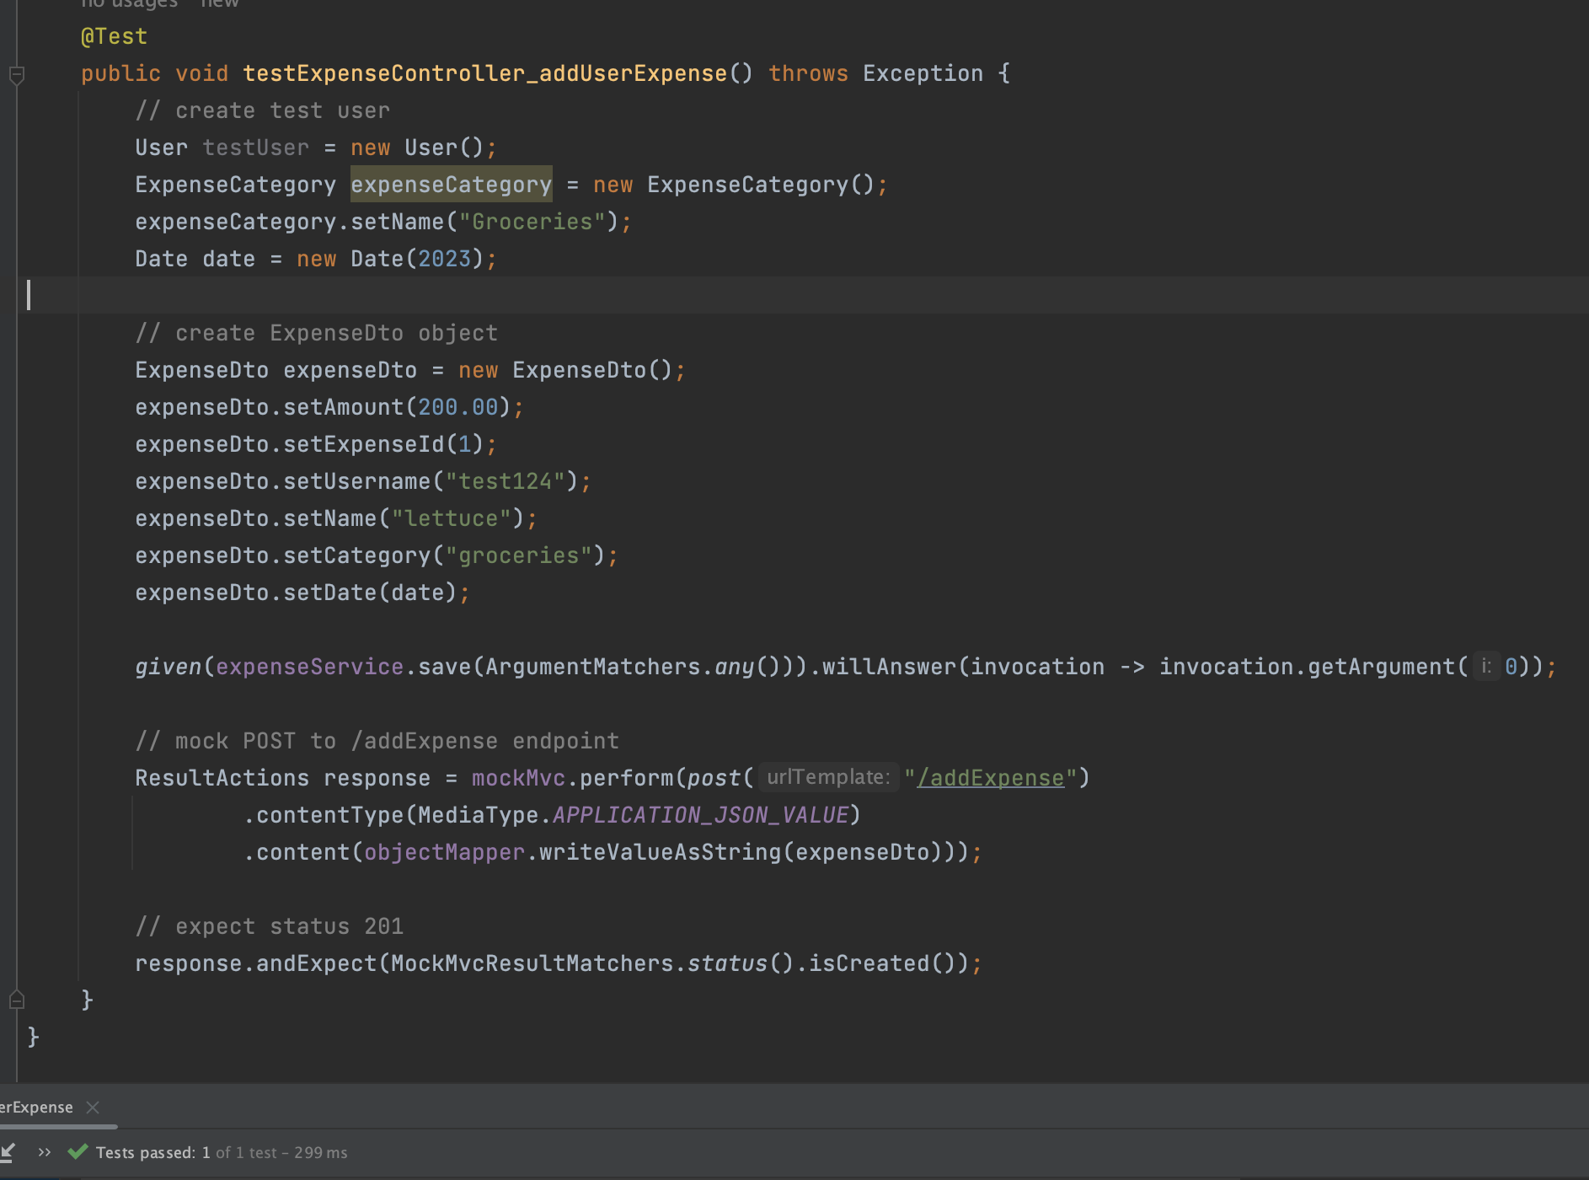
Testing Examples

Slide 14

Back-End Demo

