Slide 1

Solo Savings
Team Members:
Will Aftring, Maryam Hussein, Andrew Ouellette,
Christan Pratt, Whitney To, Hanwen Zhang, Xin Zhao

Slide 2
Project Introduction
SoloSavings is a web-based UI application revolutionizing financial management and expense budgeting.
The Application is designed to provide users with an intuitive interface for efficiently managing their finances.
Prioritizing the security and privacy of user data, implementing robust encryption and data protection measures to ensure the utmost confidentiality and peace of mind for our users.

Slide 3
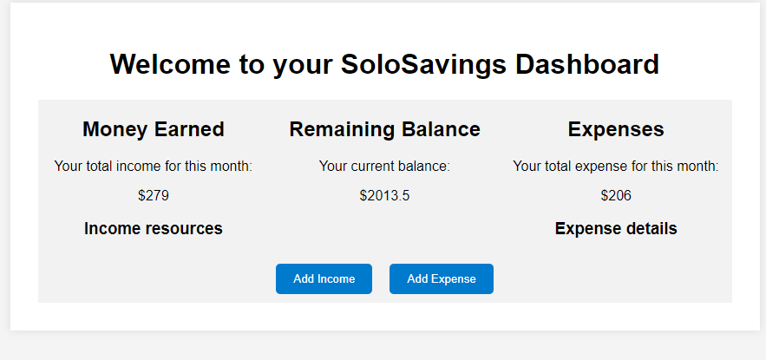
Previous Features
User Authentication :
Login
Register
Financial Transactions:
add income
add expense
view transactions

Slide 4
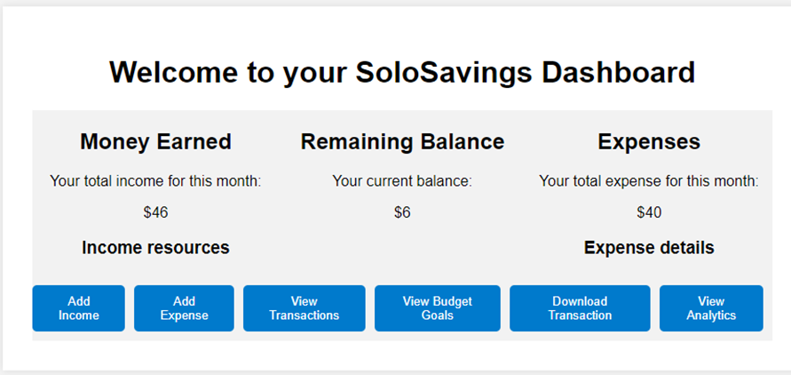
New Features
Implement JWT Security
Generate JWT Token
Registration and Login with JWT
Password Reset
Transactions Enhancements:
Transaction History
Delete Transactions
Export Transactions to CSV
Analytics
View transactions trends
Budget Goals:
Add Budget Goals for savings and spending limits
Comments (In Progress)
Add Comments for future reference to dashboard

Slide 5
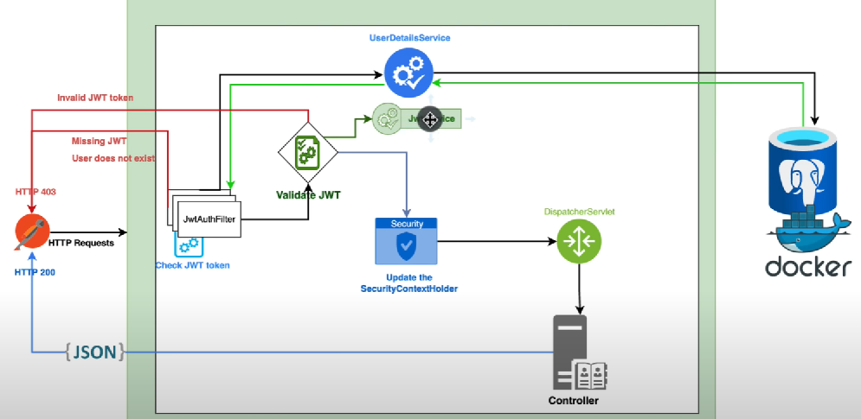
SoloSavings Security Architecture
SoloSavings leverages the Spring Boot security framework using JWT Authentication:
Spring Security:
Class to establish security rules and manage JWT
JWTUtil:
Class to generate and validate JWT Tokens
UserAuthenicationController:
Class to handle user registration and authentication
JWTFilter:
Class to handle JWT authentication and authorization for each request
SecurityContext:
Class to retrieve JWT Token details
Screenshot taken from Amigoscode

Slide 6
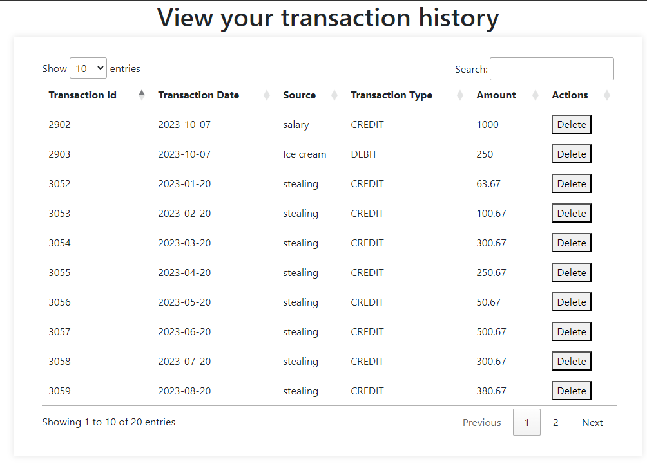
Transactions History:
1. Transaction History: Users can see their transactions in an organized table.
2. Delete Transaction: Users can delete their transactions from the transaction history table.
3. Search transaction: users can user search bar to search for transactions based on their name, date, type, etc.

Slide 7
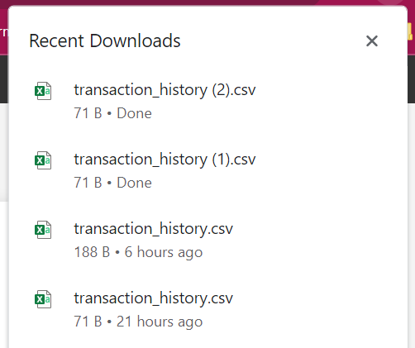
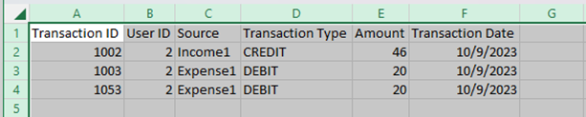
Transactions Enhancements:
1. Download transactions:
users are able to download their transactions in csv format.

Slide 8
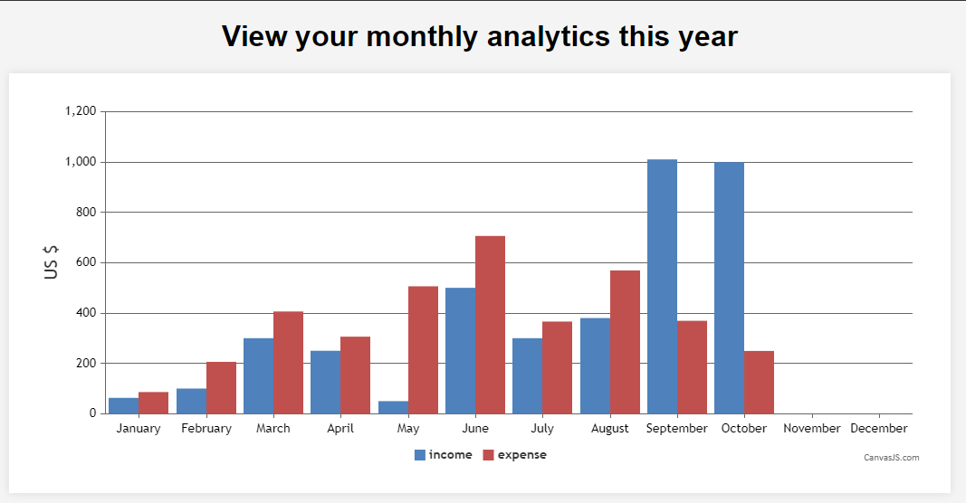
View Analytics feature:
View analytics:
Users can see their income/expense for each month in this year in a bar graph.

Slide 9
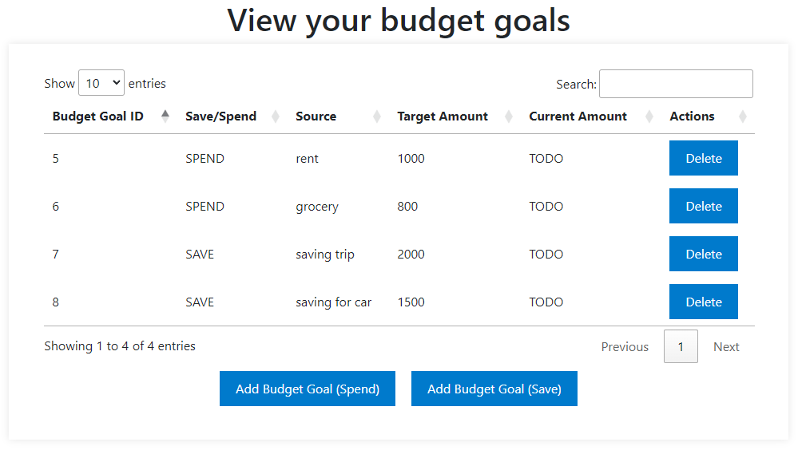
Budget Goal feature:
1. Dashboard: users can navigate from dashboard to budget goal page.
2. Budget Goals: Users can set budget goals for saving and spending limits.
3. Delete goal: users can delete their goals from the goal table.
4. Users can search for their goals either based on name, type, amount, etc.

Slide 10
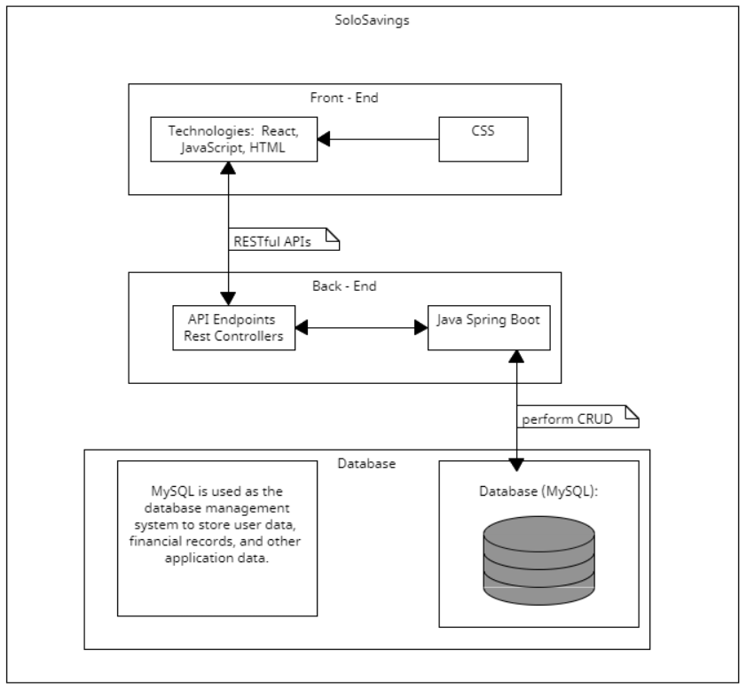
Architecture Overview
Description:
Layered architecture for modularity and maintainability.
Three key components: Frontend, Backend, Database.
Frontend (UI):
Responsible for the user interface and experience.
Technologies: JSP, JavaScript, HTML, CSS.
Communicates with the backend via RESTful APIs.
Backend (Java Spring Boot):
Handles business logic and data processing.
Technologies: Java Spring Boot, Spring Security.
Exposes RESTful APIs to the frontend.

Slide 11
Architecture Overview
Database (MySQL):
Stores user data, financial records, application data.
Backend interacts with MySQL for CRUD operations.
Frontend-Backend Communication:
Communication via RESTful APIs.
REST endpoints defined in the backend.
Dependency and Interaction:
Frontend makes HTTP API calls.
Spring Boot acts as middleware.
MySQL stores and retrieves data.
Framework:
Java Spring Boot serves as the primary backend framework.

Slide 12
SoloSavings Database Design
Users Table:
user_id (Primary Key)
username
password_hash
email
registration_date
Balance_amount
Last_updated
Transaction Table:
transaction_id (Primary Key)
user_id (Foreign Key)
source
Transaction_type
amount
transaction_date
Budget Goals Table:
id (Primary Key)
user_id (Foreign Key)
budget_goal_type
source
start_date
target_amount
Comments Table:
id (Primary Key)
user_id (Foreign Key)
content

Slide 13
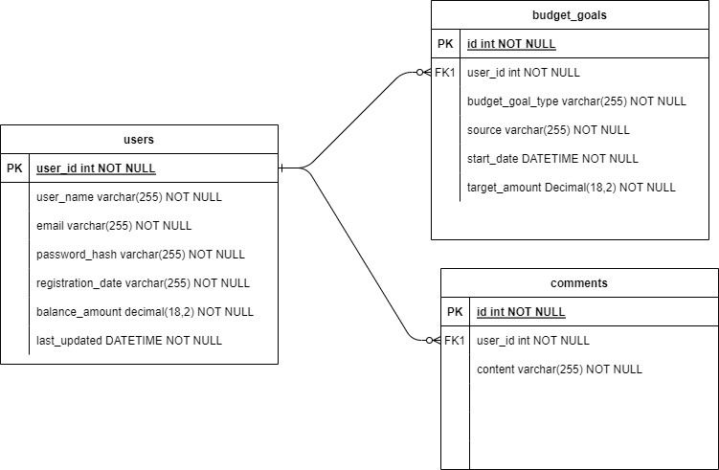
SoloSavings Database Design
Relationships:
Users can have multiple budget goals records (One-to-Many).
Users can have multiple comments records (One-to-Many)
Explanation:
Users table stores account information and balance
Budget Goals table stores savings and spending targets with relevant attributes.
Comments table stores content for future reference on the users account.

Slide 14
Project High Level Requirements - Non-Functional
Average monthly update 95%.
24/7/365 Availability outside of scheduled downtime
Transaction summary report within 2 seconds
Handle a throughput of 1000 transactions per minute
Strong password requirements
Encrypted data in motion
Encrypted data at rest
User isolation

Slide 15
Management Plan
1. Complete All Proposed Essential Features:
Ensure that all essential features outlined in the project scope are developed and implemented successfully. These features are fundamental to the core functionality of the budgeting web application.
2. Run the Software Successfully:
Achieve a successful running of the budgeting web application without any major issues. This involves proper installation, configuration, and user accessibility.
3. Ensure High Data Security:
Prioritize data security by implementing robust encryption mechanisms and access controls to protect sensitive financial information.
4. Maintain High Software Quality:
Uphold a high level of software quality by adhering to coding standards, conducting thorough testing, and ensuring that the software performs reliably without frequent errors or crashes.

Slide 16
Management Plan
Risk Management
Ongoing Design Reviews: Continue to conduct comprehensive design reviews to identify and rectify design-related issues promptly.
Usability Testing: Continue usability testing to ensure that the application remains user-friendly and addresses any usability concerns.
Task Tracking: Maintain a robust project management and task tracking system to prevent duplication of work and ensure proper task sequencing.
Security Measures: Continue to implement security measures, including encryption, access controls, and vulnerability assessments, to protect user data.

Slide 17
Configuration Management Plan
Code Commit Guidelines and Git Branching Strategy
GitHub Flow branching strategy.
Better support for CI/CD processes.
Team members can create their own branches and commit and push their work once finished.
Team will then be able to compare and review all changes to the current master branch.
Provides best protection for master branch.
CodeQL implementation as part of CI process ( In Progress )
This will help scanning code when code is merging to main
This will help prevent any breaking to the main branch
This will help ensure the running status of the main branch
Azure hosting for deployment (In progress)
Team is exploring the option for deployment for our application onto Azure
This will help keep the app running and receiving traffic 24/7, allow other users to access the application

Slide 18
Quality Assurance Plan
Metrics: including KLOC, # of files/classes/methods, # of test cases, test coverage, etc…
Coding Standard: best practices on naming conventions, code formatting, error handling, code reusability, version control, security practices and testing standards, performance optimization.
Code review process:
Pull requests on Github.
All team members will participate in code reviews also review each other's code.
A checklist will be used and reviewers will provide constructive feedback.

Slide 19
Quality Assurance Plan (cont.)
Testing:
Automated Unit Testing
Automated Integration Testing (APIs)
Manual Testing from postman
Manual Testing from frontend
Testing tools and framework:
JUnit, Mockito, Postman
Manual Testing: Conduct manual testing through web browsers.
Defect Management:
Use issues on Github as our defect management tool.
Actions: reporting defects, prioritizing defects, assignment, resolution, testing/verification, closure and communication.

Slide 20
Testing Summary
Unit Testing
Tested individual components (methods and classes) in isolation.
All team members contributed to unit testing.
Used JUnit and Mockito for test cases.
Detected and fixed code-level issues, improving code quality.
Manual Testing
Used Postman for API endpoint testing.
Conducted UI manual testing for frontend-backend connectivity.
Integration testing (API)
Testing endpoints without mocking
checking expected behavior and response from APIs

Slide 21
References
Baeldung. "Java Password Hashing." Link
Java Interview Point. "Java Salted Password Hashing." Link
OpenAI. "ChatGPT."
Head First Design Patterns (Book).
Investopedia. "Business Logic." Link
Integrify. "What Is Business Logic?" Link
"Design Patterns: Elements of Reusable Object-Oriented Software" by Erich Gamma, Richard Helm, Ralph Johnson, and John Vlissides.
"Pattern-Oriented Software Architecture: Patterns for Concurrent and Networked Objects" by Douglas C. Schmidt and Michael Stal.

Slide 22
Thank You!
Team 2

