Slide 1

Solo Savings
Team Members:
Will Aftring, Maryam Hussein, Andrew Ouellette,
Christan Pratt, Whitney To, Hanwen Zhang, Xin Zhao

Slide 2
Project Introduction
SoloSavings is a web-based UI application revolutionizing financial management and expense budgeting.
The Application is designed to provide users with an intuitive interface for efficiently managing their finances.
Prioritizing the security and privacy of user data, implementing robust encryption and data protection measures to ensure the utmost confidentiality and peace of mind for our users.

Slide 3
Project High Level Requirements - Functional
User Authentication:
1.Login: Users must be able to log in to their SoloSavings accounts securely.
2.Register: New users should be able to create accounts with unique credentials.

Slide 4
Project High Level Requirements - Functional
Financial Transactions:
  1. Add Income: Users can add income transactions, specifying the source and amount.
  2.Add Expenses: Users can add expense transactions, categorize them, and specify the amount.
  3.View Transaction History: Users should be able to view a history of their income and expenses.

Slide 5
Project High Level Requirements - Functional
  Budget and Balances:
  1. Dashboard: Users are provided with a dashboard that displays their current balance, income, and expenses.

Slide 6
Project High Level Requirements - Non-Functional
  Average monthly update 95%.
  24/7/365 Availability outside of scheduled downtime
  Transaction summary report within 2 seconds
  Handle a throughput of 1000 transactions per minute
  Strong password requirements
  Encrypted data in motion
  Encrypted data at rest
  User isolation

Slide 7
Management Plan
1. Complete All Proposed Essential Features:
Ensure that all essential features outlined in the project scope are developed and implemented successfully. These features are fundamental to the core functionality of the budgeting web application.
2. Run the Software Successfully:
Achieve a successful running of the budgeting web application without any major issues. This involves proper installation, configuration, and user accessibility.
3. Ensure High Data Security:
Prioritize data security by implementing robust encryption mechanisms and access controls to protect sensitive financial information.
4. Maintain High Software Quality:
Uphold a high level of software quality by adhering to coding standards, conducting thorough testing, and ensuring that the software performs reliably without frequent errors or crashes.

Slide 8
Management Plan
Risk Management
Ongoing Design Reviews: Continue to conduct comprehensive design reviews to identify and rectify design-related issues promptly.
Usability Testing: Continue usability testing to ensure that the application remains user-friendly and addresses any usability concerns.
Task Tracking: Maintain a robust project management and task tracking system to prevent duplication of work and ensure proper task sequencing.
Security Measures: Continue to implement security measures, including encryption, access controls, and vulnerability assessments, to protect user data.

Slide 9
Configuration Management Plan
Tools
Git
Eclipse/IntelliJ
Heroku/AWS
Java/Spring Boot
JSP
Jira
GitHub Flow
Docker
GitHub Actions
Postman
Code Commit Guidelines and Git Branching Strategy
GitHub Flow branching strategy.
  Better support for CI/CD processes.
  Team members can create their own branches and commit and push their work once finished.
  Team will then be able to compare and review all changes to the current master branch.
  Provides best protection for master branch.

Slide 10
Quality Assurance Plan
Scope: covers all phases of the development lifecycle. (analysis, design, development, testing and deployment)
Metrics: including KLOC, # of files/classes/methods, # of test cases, test coverage, etc…
Coding Standard: best practices on naming conventions, code formatting, error handling, code reusability, version control, security practices and testing standards, performance optimization.
Code review process:
  Code reviews will be conducted through pull requests on Github.
  The code review process will include the design and implementation leader and other team members reviewing code.
  All team members will participate in code reviews also review each other's code.
  A checklist will be used and reviewers will provide constructive feedback.

Slide 11
Quality Assurance Plan (cont.)
Planning for Testing:
  Types of testing and their objectives:
    Unit Testing Objectives: Verify that individual code components behave correctly. Integration Testing Objectives: Ensure different parts of the application integrate seamlessly, data flows correctly between components, and APIs function as expected.
    Manual Testing Objectives: Evaluate the user interface, usability, and overall functionality of the application. Identify any user experience issues and report defects.
Testing tools and framework:
  Unit Testing: Use testing frameworks like Jest for JavaScript, JUnit for Java, Mockito to mock objects.
  Integration Testing: Leverage Postman for API testing.
  Manual Testing: Conduct manual testing using web browsers.
Defect Management:
  Use issues on Jira as our defect management tool.
  Types of defects including: Bugs, Enhancements, Documentation Issues, UI-UX Issues, Performance Issues, Security Vulnerabilities.
  Actions: reporting defects, prioritizing defects, assignment, resolution, testing/verification, closure and communication.

Slide 12
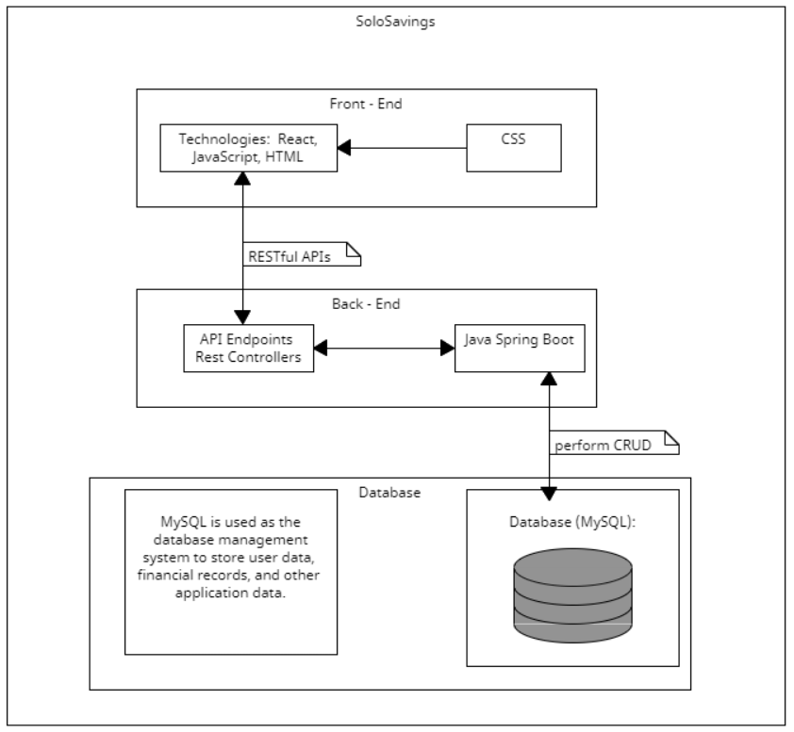
Architecture Overview
Description:
  Layered architecture for modularity and maintainability.
  Three key components: Frontend, Backend, Database.
  Frontend (UI):
    Responsible for the user interface and experience.
    Technologies: JSP, JavaScript, HTML, CSS.
    Communicates with the backend via RESTful APIs.
  Backend (Java Spring Boot):
    Handles business logic and data processing.
    Technologies: Java Spring Boot, Spring Security.
    Exposes RESTful APIs to the frontend.

Slide 13
Architecture Overview
Database (MySQL):
  Stores user data, financial records, application data.
  Backend interacts with MySQL for CRUD operations.
Frontend-Backend Communication:
  Communication via RESTful APIs.
  REST endpoints defined in the backend.
Dependency and Interaction:
  Frontend makes HTTP API calls.
  Spring Boot acts as middleware.
  MySQL stores and retrieves data.
Framework:
  Java Spring Boot serves as the primary backend framework.

Slide 14
SoloSavings Application Structure
Controller Package: Handles HTTP requests, interacts with services, and sends responses. Acts as a bridge between UI and business logic.
Service Package: Defines operation contracts for business logic components. Implemented by service classes.
Service Implementation Package: Contains the actual business logic, processes user data, and interacts with the repository.
Model Package: Defines data structures and entities. Includes attributes, relationships, and data manipulation methods.
Repository Package: Defines data access operations, simplifies database tasks using Spring Data JPA.
Exceptions Package: Manages custom exception classes for graceful error handling.
Main Package: Application's root package with the entry point (Application class).
Templates Directory: Stores HTML templates for rendering views.
Test Package: For unit testing controllers and services to ensure code correctness and reliability.

Slide 15
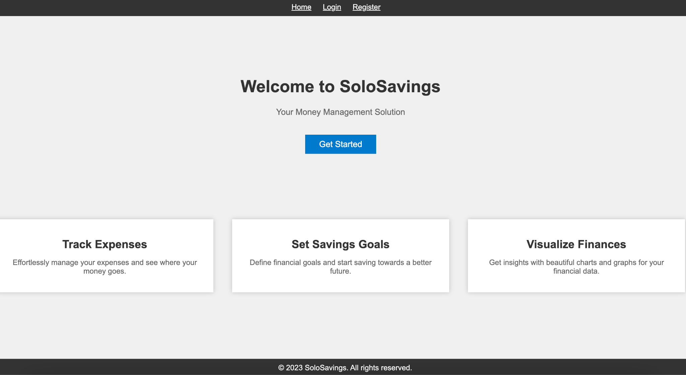
SoloSavings UI Design
Description:
Header: Navigation links for "Home," "Login," and "Register."
Home Page: Overview of SoloSavings with links to "Login" and "Register."
Register Page: Account creation with personal and account details.
Login Page: Login with username/email and password.

Slide 16
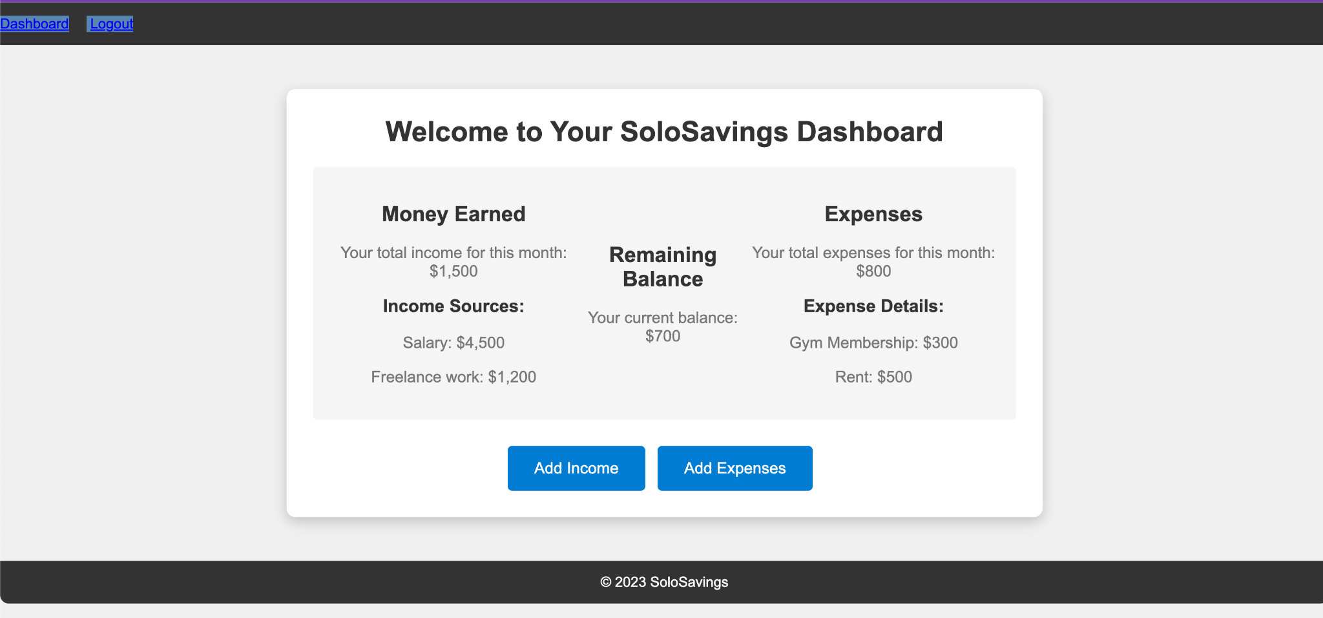
SoloSavings UI Design
Dashboard: After login, users are redirected to personalized dashboards with data fetched from the database.

Slide 17
SoloSavings Database Design
Description:
Users Table:
  user_id (Primary Key)
  username
  password_hash
  email
  registration_date
  Balance_amount
  Last_updated
Transaction Table:
  transaction_id (Primary Key)
  user_id (Foreign Key)
  source
  Transaction_type
  amount
  transaction_date

Slide 18
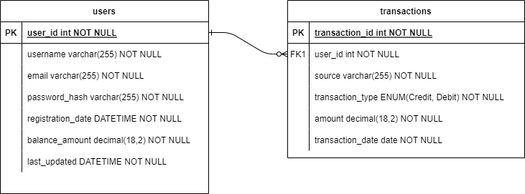
SoloSavings Database Design
Relationships:
  Users can have multiple transaction records (One-to-Many).
Explanation:
  Users table stores account information and balance.
  Transaction table stores income and expense data with relevant attributes.

Slide 19
SoloSavings Security Design
Description:
Secure Password Storage:
Strong Password Requirements
Password Regex Validation
Password Hashing
Salting for Added Security
HTTPS Encryption:
Secure Data Transmission
Protection for CRUD Operations
Cross-Origin Resource Sharing (CORS) Implementation

Slide 20
SoloSavings Database Design
  Input Validation:
    Prevention of Common Security Vulnerabilities
    Mitigating SQL Injection Risks
  Code Quality Assurance:
    GitHub Code Scanning Tools
    Dependency Research
  Error Handling and Logging:
    Error Logging into Database
    User Warning for Errors
    Suspicious Activity Monitoring

Slide 21
Business Logic for Transaction Entries
Income:
Ensure Valid Transaction:
  Flag zero or negative values for user review before saving.
Successful Income Entry:
  Store the income transaction.
  Increase the account balance.
Budget Goal Check:
  Verify if the budget goal is met.
  Notify the user if the goal is not reached.
  Calculate the remaining balance and display an encouraging message if the goal is met.

Slide 22
Business Logic for Transaction Entries
Expense:
Ensure Valid Transaction:
  Flag zero or negative values for user review before saving.
Successful Expense Entry:
  Store the expense transaction.
  Check if the expense can be covered and decrease the account balance.
Budget Goal Check:
  Verify if the budget goal is met.
  Notify the user if the goal is not reached.
  Calculate the remaining balance and display an encouraging message if the goal is met.

Slide 23
Design Pattern: MVC-R
(Model-View-Controller with Repository): Extends classic MVC pattern with a Repository layer to separate data access, promoting clean architecture.
Motivation: Decouples data access concerns from UI and business logic, enhancing maintainability and scalability.
Components:
  Model (M): Represents data and business rules.
  View (V): Manages presentation and user interface.
  Controller (C): Mediates between Model and View.
  Repository (R): Focuses on data access and storage, segregating database interactions.
Collaboration:
  View captures user input and displays data.
  Controller processes input, updates Model, and interacts with Repository.
  Repository manages data access, including database queries and updates.

Slide 24
Testing Summary
Unit Testing
  Tested individual components (methods and classes) in isolation.
  All team members contributed to unit testing.
  Used JUnit and Mockito for test cases.
  Detected and fixed code-level issues, improving code quality.
Manual Testing
  Used Postman for API endpoint testing.
  Conducted UI manual testing for frontend-backend connectivity.

Slide 25
References
Baeldung. "Java Password Hashing." Link
Java Interview Point. "Java Salted Password Hashing." Link
OpenAI. "ChatGPT."
Head First Design Patterns (Book).
Investopedia. "Business Logic." Link
Integrify. "What Is Business Logic?" Link
"Design Patterns: Elements of Reusable Object-Oriented Software" by Erich Gamma, Richard Helm, Ralph Johnson, and John Vlissides.
"Pattern-Oriented Software Architecture: Patterns for Concurrent and Networked Objects" by Douglas C. Schmidt and Michael Stal.

Slide 26
Thank You!
Team 2

