Slide 1
Spring-Security
By Team3
Zhiei Lin

Slide 2
How to use it ?
<dependency>
<groupId>org.springframework.boot</groupId>
<artifactId>spring-boot-starter-security</artifactId>
</dependency>

Slide 3
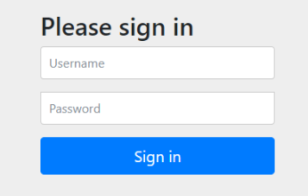
After you add it.
Spring Security provides many features by default to protect the entire program.Like
1. Require authenticated users to interact with the application
2. Create the default login form
3. Generate a random password with user name 'user' and print it on the console

Slide 4
Three core components in Spring Security
​ 1. Authentication：The authentication information is stored, representing the current logged-in user
Information included：
(1). Principal: User information, such as the user name without authentication. After authentication, the user object is stored.
(2). Credentials: User credentials, usually a password.
(3). Authorities: Control authority
​ 2. SeucirtyContext：Context object, used to get Authentication
​ 3. SecurityContextHolder: Context management object, used to get “SecurityContext” anywhere in the program

Slide 5
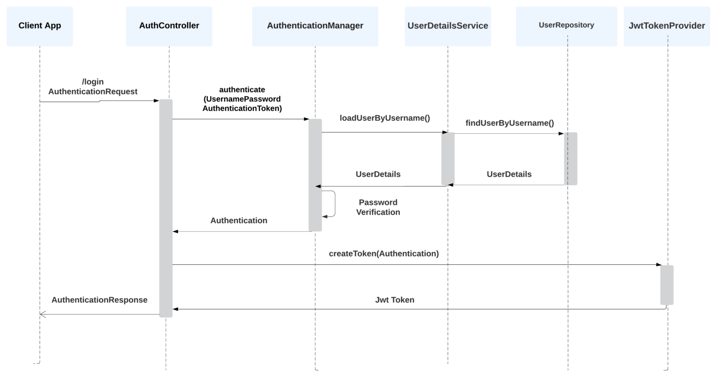
WorkFlow

Slide 6
Demo

