Slide 1
HRMasery — Iteration 1
An Employee Management System
Jingjing Tang
Yuxuan Wang

Slide 2
Outline
Role Assignments
Overview/purpose
Project plan
High Level requirements
Desirable and Optional Features
Management
Configuration
Quality Assurance Plan
Future plans

Slide 3
Role Assignments
Backend & database: Yuxuan Wang,JingJing Tang
Frontend React: Abigya Devkota, Jianle Xie

Slide 4
Project Overview/Purpose
We will create an Employee Management System using Java and Spring Boot to demonstrate CRUD (create, read, update, delete) operations.
It will help staff to create, read, update, and delete roles thru an user interface.
We have a basic underlying potential users, functionalities, and technology stack, but more may be added as we progress.

Slide 5
Project Plan
**Baseline view:**
Our application have a baseline home page and register page
User would be able to perform one or more CRUD operations
Add an stuff (register using ‘Name’, ‘Job title’, ‘Annual Salary’
View Employee
Edit Employee
Delete Employee
**Technology Stack**
Language:Java
Backend Framework: Springboot
Frontend(User interfaces) Framework: React

Slide 6
High level requirements
Essential features:
Create: As an employee, I want to create my employee information so that it can be stored in the database.
Estimation person hours: 24 hrs
Read: As an employee, I want to view all current employees so that we know how many employees are there.
Estimation person hours: 24 hrs
Update: As an employee I want to update my information so that everything is accurate.
Estimation person hours: 24 hrs
Delete: As an employee, I want to be able to delete records when i leave the company.
Estimation person hours: 24 hrs
***hours are based on all team member’s available schedule

Slide 7
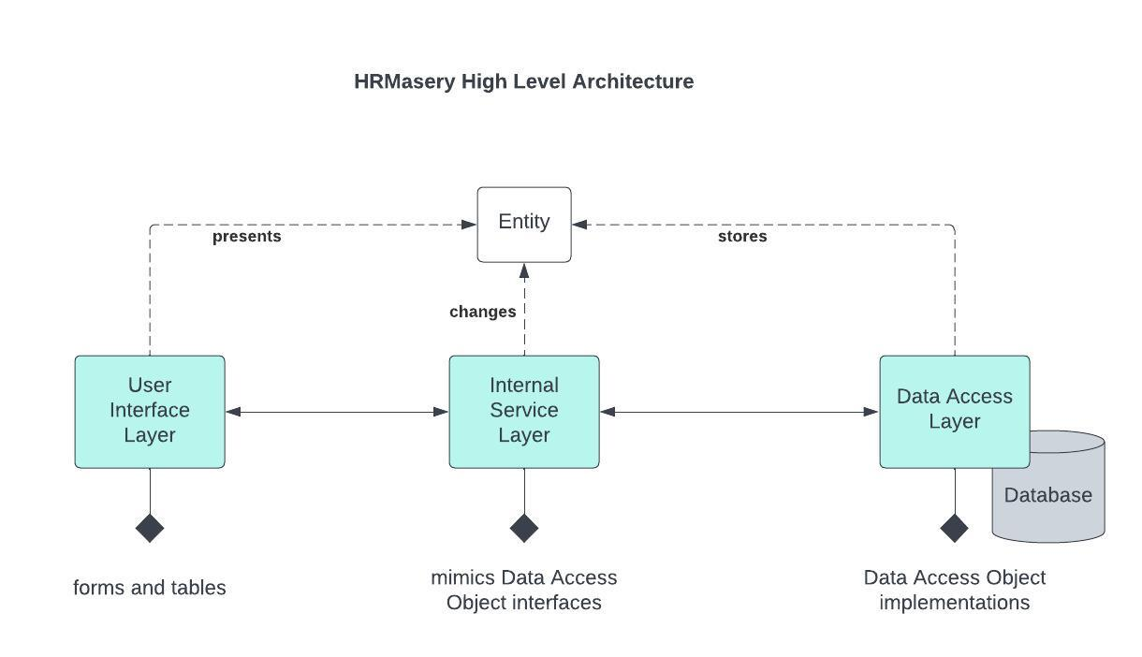

Slide 8
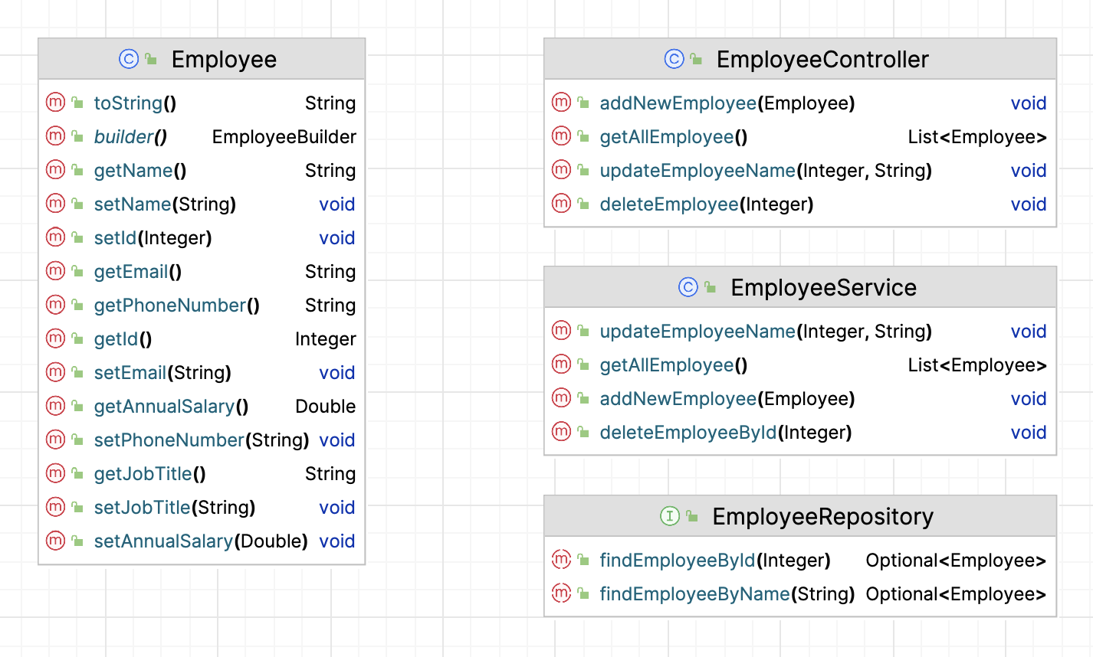

Slide 9
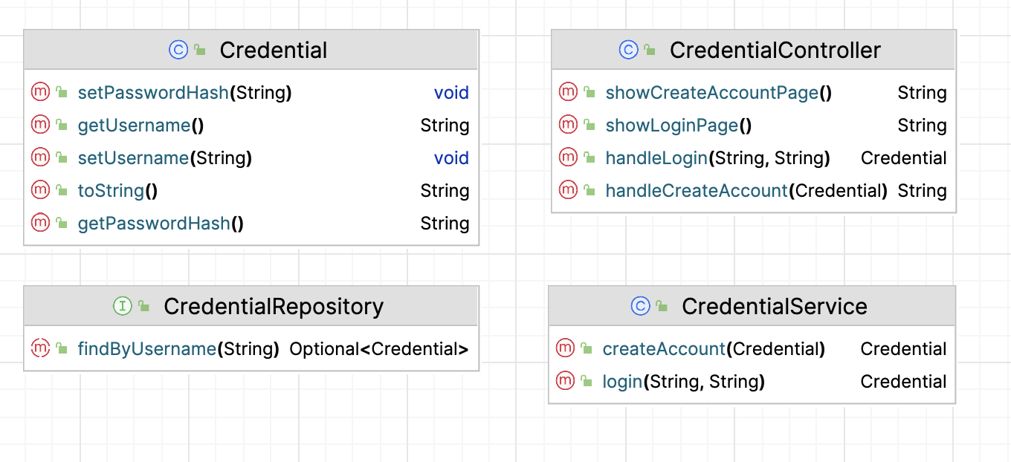

Slide 10
Configuration
Tools: Java SDK 17 or later, Maven, Intellij IDEA, Junit, Apache, React, Github
Code commit and Branching Strategy:
New branch is created for any change to be added
Changes are only merged to main after pull request review
Make sure no conflicts exist in branch before being merged to main
Deployment plan:
If time permits, application will be deployed

Slide 11
Quality Assurance
Use various metrics junit test coverage per class, method to maintain code quality
Use java best practices (e.g. camelCase method, class attributes are private, etc.)
Code is reviewed through pull request by team members before being merged to main
Unit testings
Use github issues to raise defects, prioritize defects based on needed functionality and time

Slide 12
Desirable and Optional Features
Desirable Features:
We would like to implement an employee management system homepage for users to perform basic CRUD(create, read, update, delete) operations
Optional Features:
Explore Spring Security for encryption

Slide 13
Future plans
Cover non functional requirements like assigning roles for employee and manager
Cover non functional requirements like vacation requests
Build a more robust user interface
Confirm security authentication part for project

